Slide 1
Ch 8. Latent Variables and State-Space Models
Amy Hurford
Memorial University

Slide 2
Latent variables
Latent variables: The variable of interest is unobserved or estimated with uncertainty
Dietz 2017. Ecological forecasting.

Slide 3
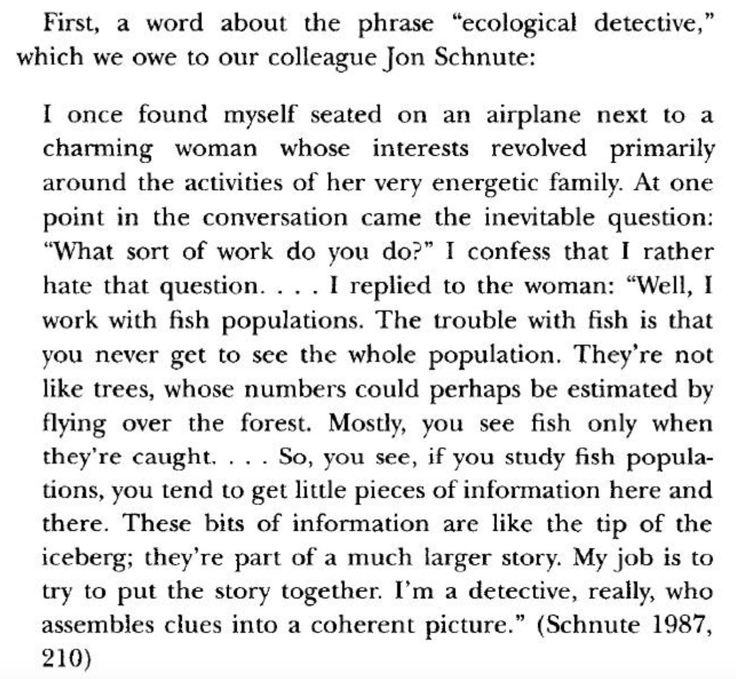
The ecological detective
Mangel, M. and C. Clark. 1997. The Ecological Detective: confronting models with data. Princeton Monographs.

Slide 4
Latent variables
Latent variables: The variable of interest is unobserved or estimated with uncertainty
Random and systematic observation errors
Proxy data
Missing data
Unobserved variables
Dietz 2017. Ecological forecasting.

Slide 5
Examples
Random & systematic: sensor drift
Proxy: Total Domain Reflectometry (TDR) – 2 electric probes that measures soil impedence estimate soil moisture
Proxy: NVDI - net primary production
Proxy: O¹⁸ in water – temperature, evaporation, and atmospheric cipitation
Unobserved: resource allocation to growth, fecundity, allometry
Dietz 2017. Ecological forecasting.

Slide 6
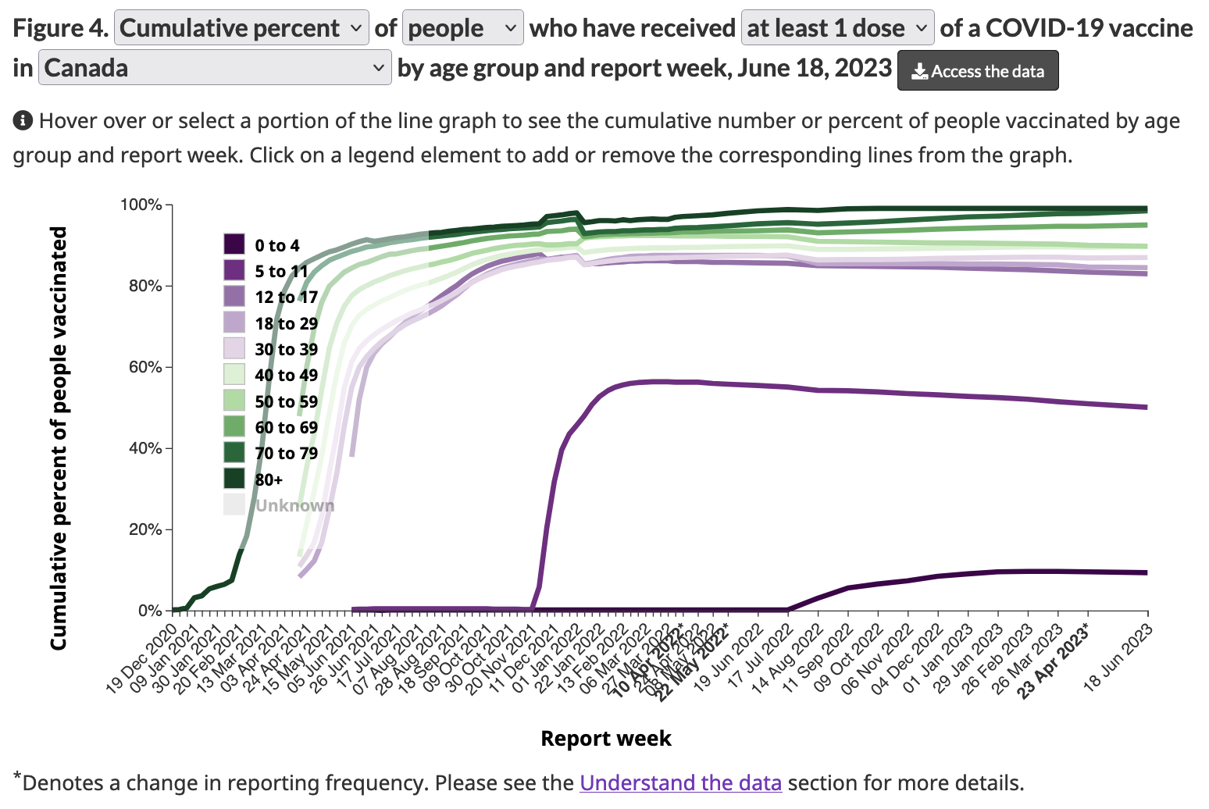
Canadian vaccination data
Government of Canada https://health-infobase.canada.ca/covid-19/vaccination-coverage/

Slide 7
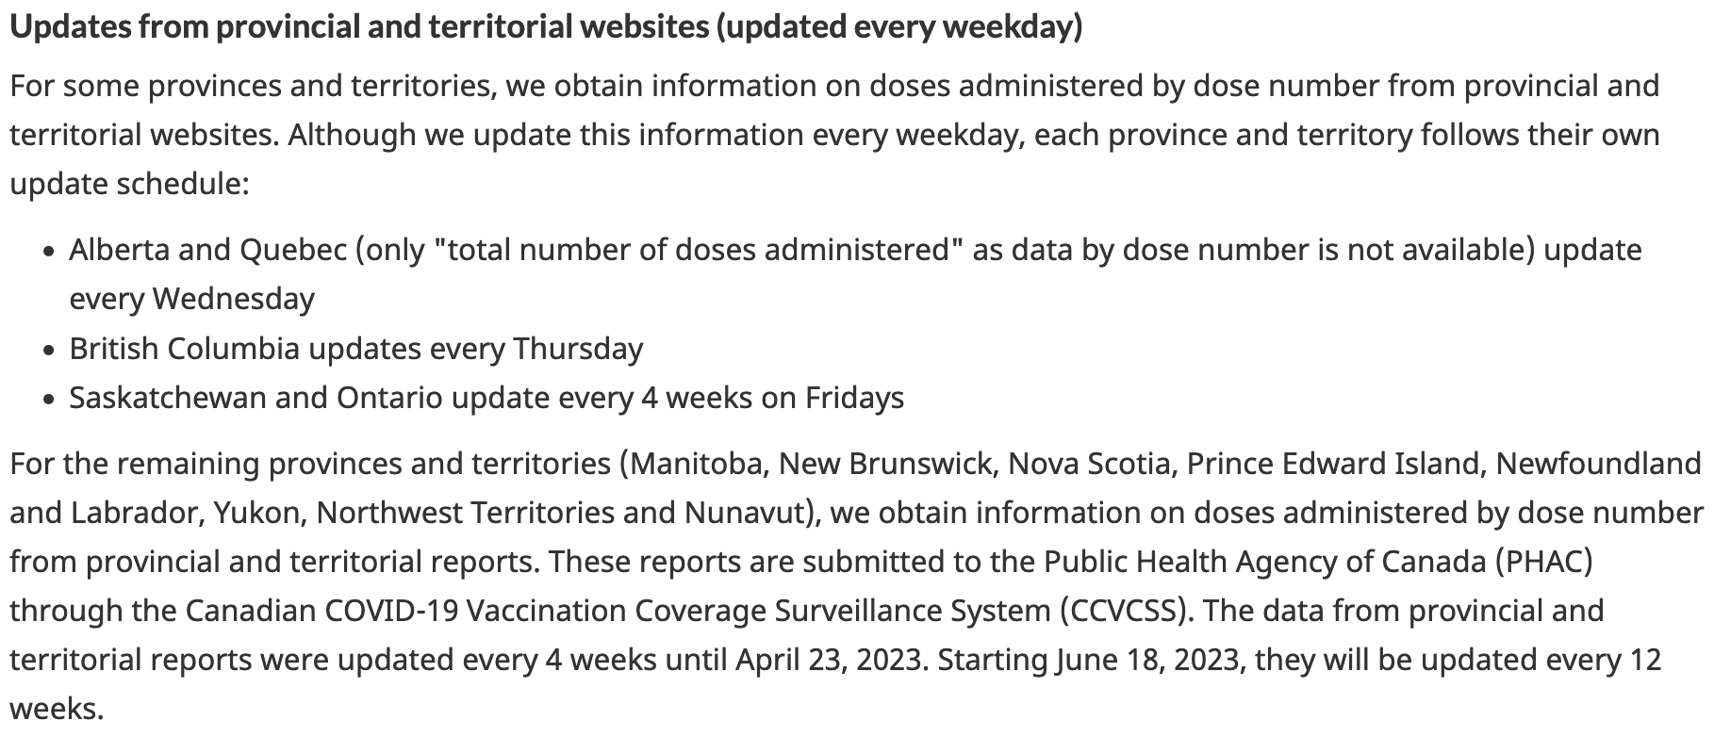
Reporting frequency (missing data)

Slide 8
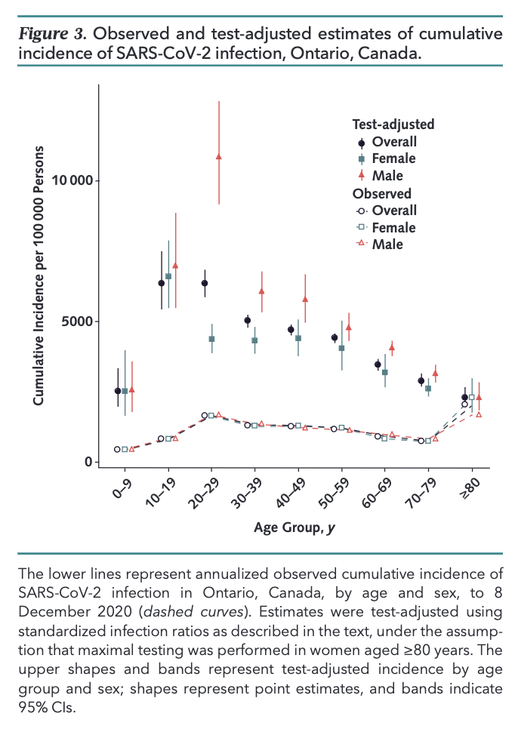
COVID-19 Case Age Distribution: Correction for Differential Testing by Age David N. Fisman, Amy L. Greer, et al. Annals of Internal Medicine

Slide 9
State space models
For time series analysis, also referred to as hidden Markov models
hidden => latent; Markov => next state depends only on current state
Dietz 2017. Ecological forecasting.

Slide 10
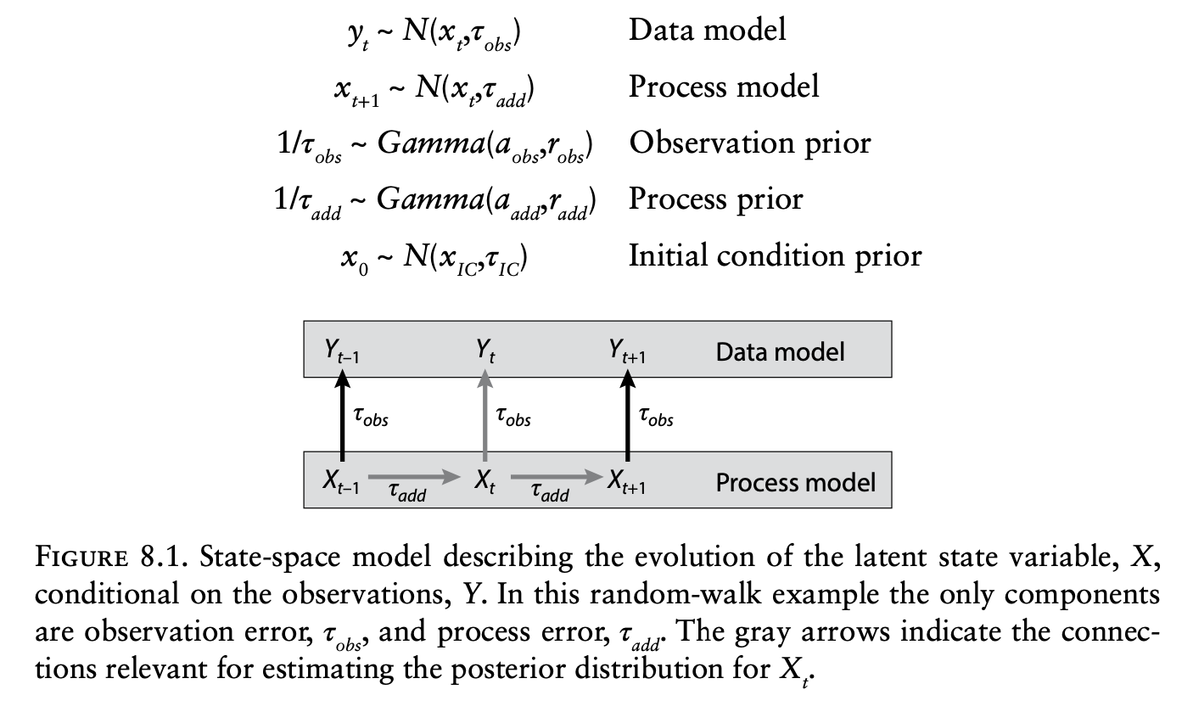
Dietz 2017. Ecological forecasting.

Slide 11
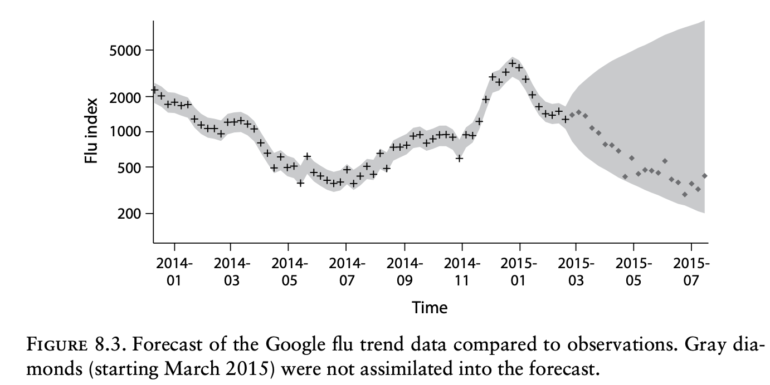
Dietz 2017. Ecological forecasting.

Slide 12
That process model was not SIR – that was a random walk…
…. much less epidemiological detail than McMasterPandemic
https://canmod.github.io/macpan-book/index.html#history-and-motivation

Slide 13
Key concepts
3. Because of their capacity to flexibly capture and partition a wide range of uncertainties and address the complexities of real data, Dietz recommends state space models as the basis of forecasting.
5. Missing data gaps and irregularly spaced data are handled automatically with uncertainties increasing with distance to the nearest observation.
Dietz 2017. Ecological forecasting.

Slide 14
Ch 9 Fusing Data Sources
“Balancing the information provided by different data sources remains among the most debated topics in ecological model-data fusion”
Dietz 2017. Ecological forecasting.

Slide 15
Fusing data sources
Fusing data involves more than joining data sources
Naïve interpolation or extrapolation can lead to biased and overconfident results
Covariances are critical to leverage complementary data types
Dietz 2017. Ecological forecasting.

Slide 16
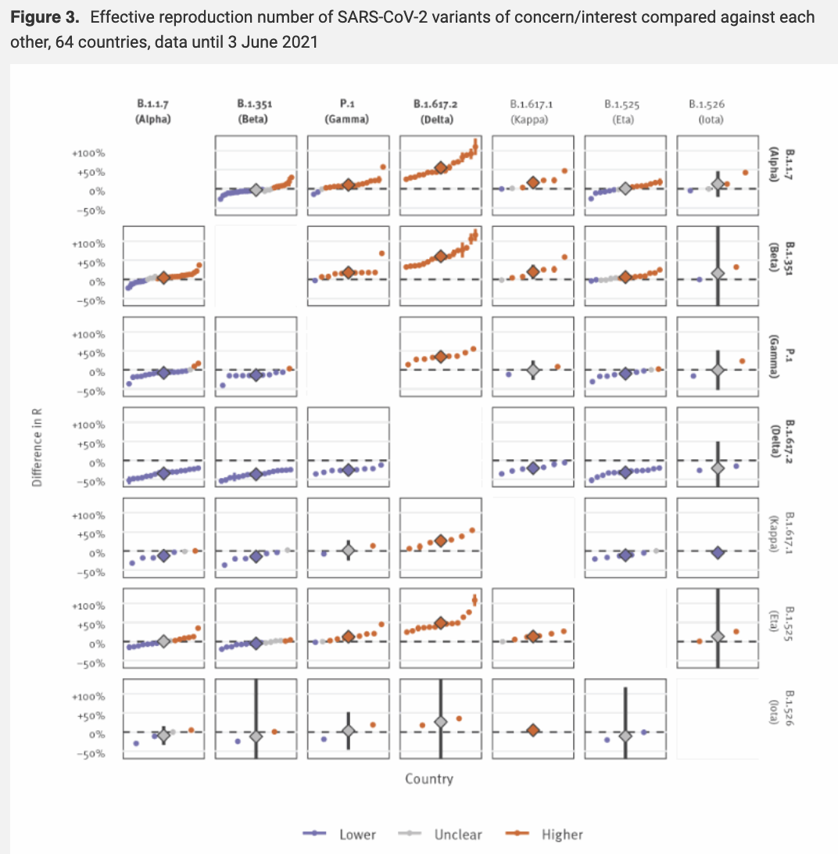
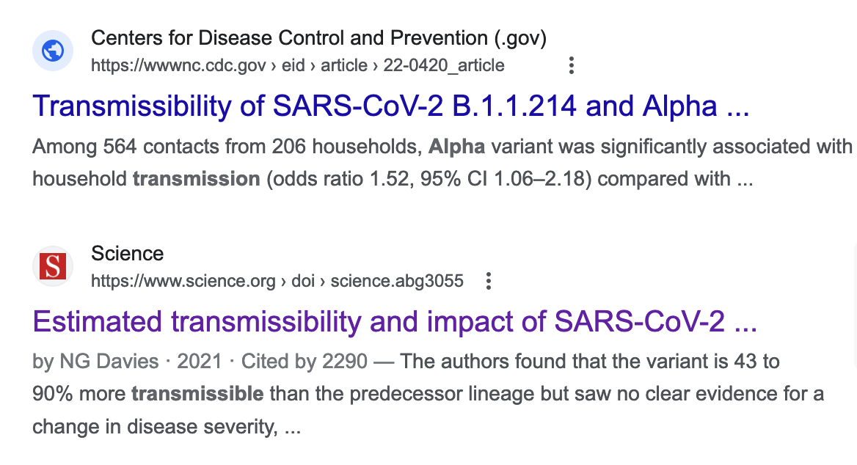
Fusing data sources
Increased transmissibility and global spread of SARS-CoV-2 variants of concern as at June 2021
Campbell et al. (2021), Eurosurveillence. https://doi.org/10.2807/1560-7917.ES.2021.26.24.2100509

Slide 17
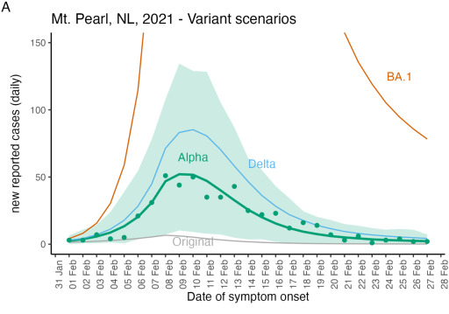
Fusing data sources - counterfactuals
Hurford et al. 2023. Pandemic modelling for regions implementing an elimination strategy

Slide 18
Meta-analysis
Meta-analyses combine information, usually in the form of summary statistics from independent studies
Reporting bias is a challenge for high quality meta-analyses; that is, that negative results are not reported
While less common, meta-analysis can also be used to directly estimate priors for parameters in a larger model (LeBauer et al. 2013)
Dietz 2017. Ecological forecasting.

Slide 19
Meta-analysis
Compared to parameterizing a model from a single study or site, a meta-analysis provides both greater constraint and the ability to account for the real ecological variability among multiple studies.
What distinguishes a meta-analytical model from other models is that the observations are typically summary statistics, and thus there is a need for different studies to have different weights based on their sample sizes and variability
Dietz 2017. Ecological forecasting.

Slide 20
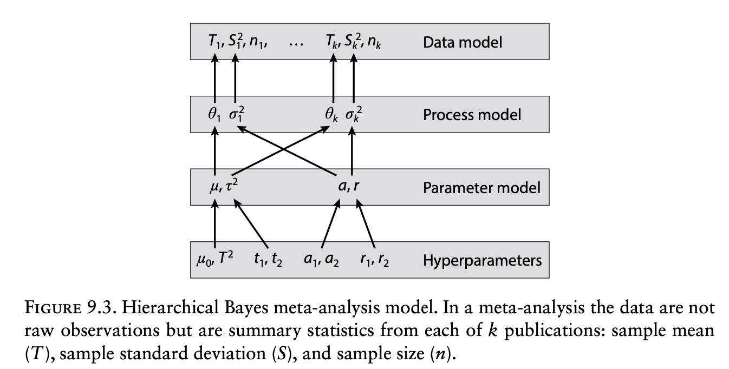
Meta-analysis
Reported summary statistics in study, i
True summary statistics in study, i
True across study mean
Dietz 2017. Ecological forecasting.

Slide 21
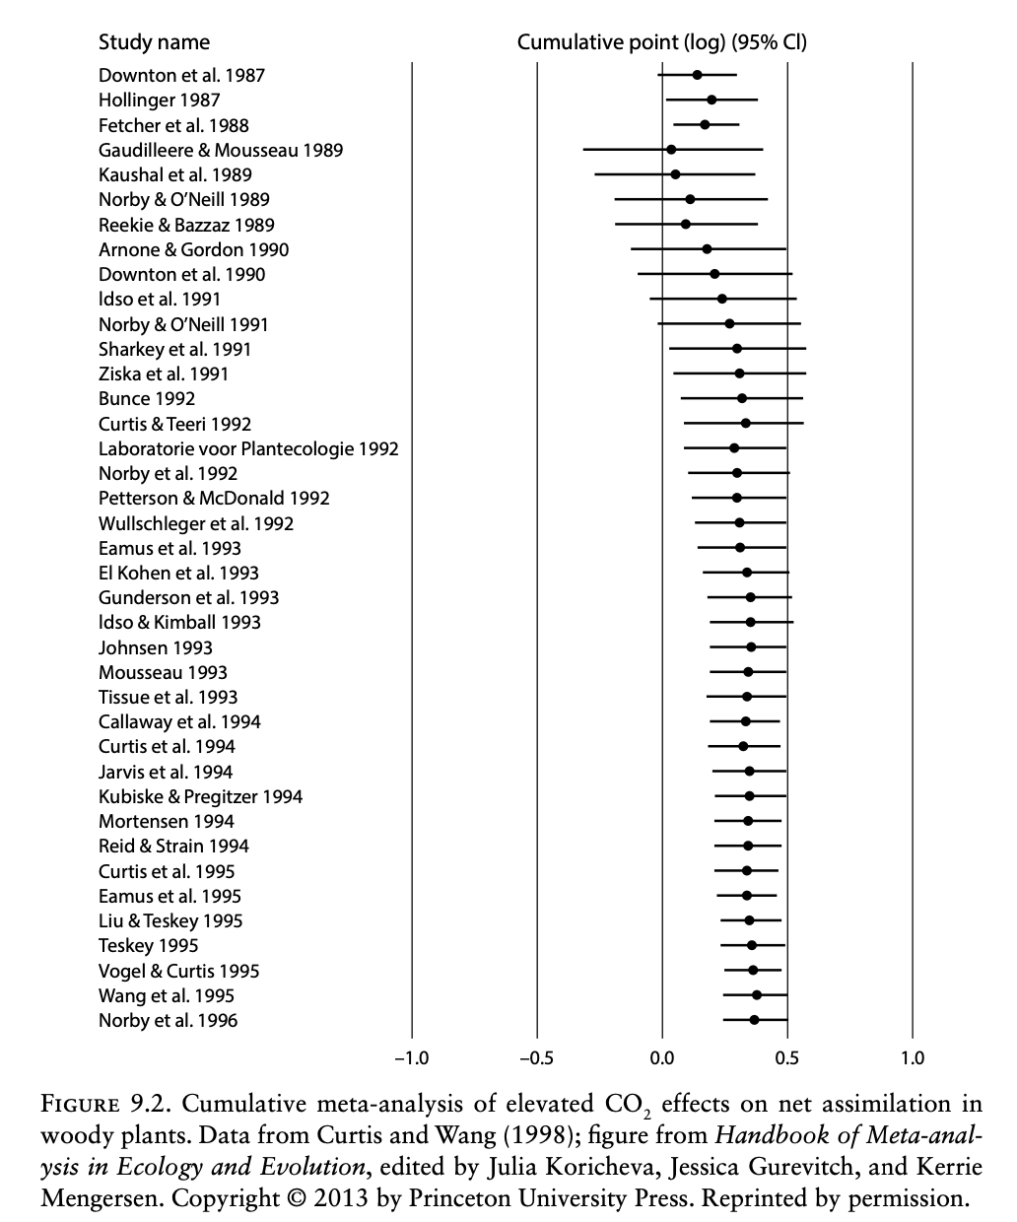
Dietz 2017. Ecological forecasting.

Slide 22
PHAC – Emerging Sciences Group
Parameter estimation tables
IFR, CFR, Incubation period, Latent period, Infectious period, Asymptomatic-Inf, Serial interval
Epi+Model Data Parameter Tables 2020-06-29.xls

Slide 23

Parameter estimates
https://canmod.github.io/macpan-book/index.html#history-and-motivation

Slide 24
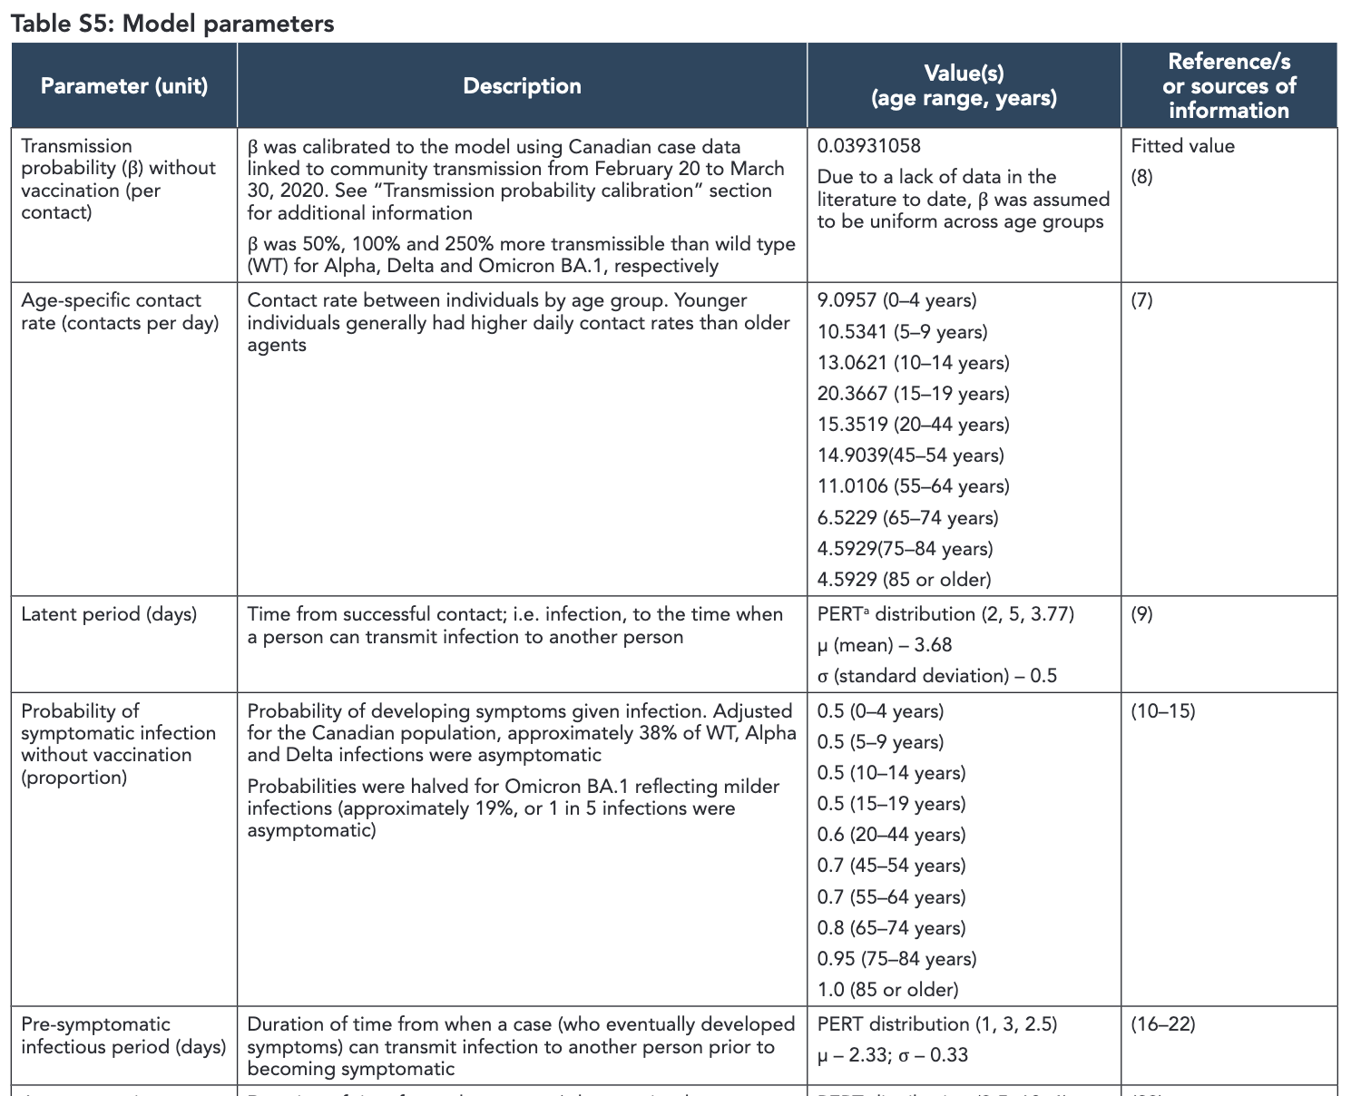

https://www.canada.ca/content/dam/phac-aspc/documents/services/reports-publications/canada-communicable-disease-report-ccdr/monthly-issue/2022-48/issue-7-8-july-august-2022/ccdrv48i78a01s-eng.pdf

Slide 25
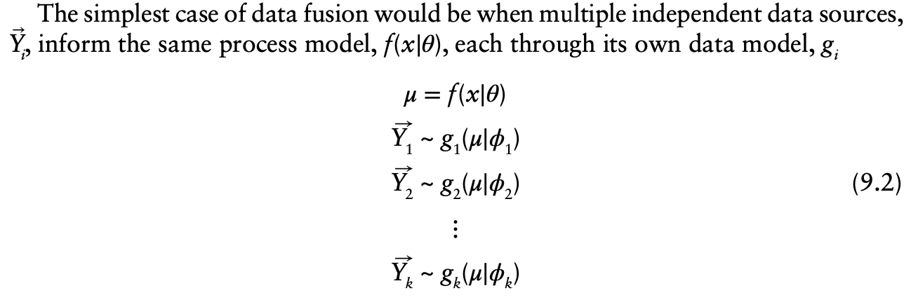
Combining data
Process model
Observation model for study, i=1
Observation model for study, i=k
Dietz 2017. Ecological forecasting.

Slide 26
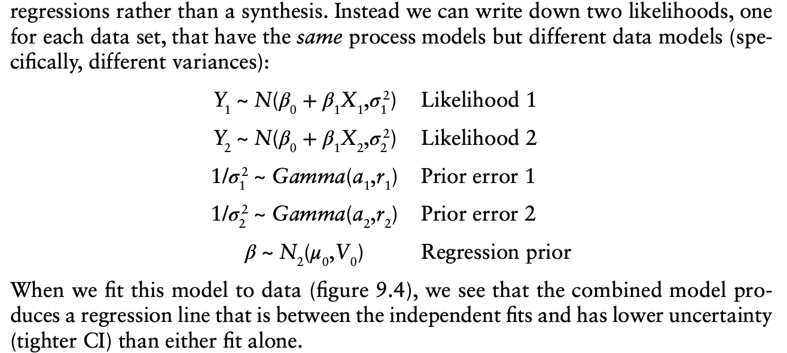
Combining data
Dietz 2017. Ecological forecasting.

Slide 27
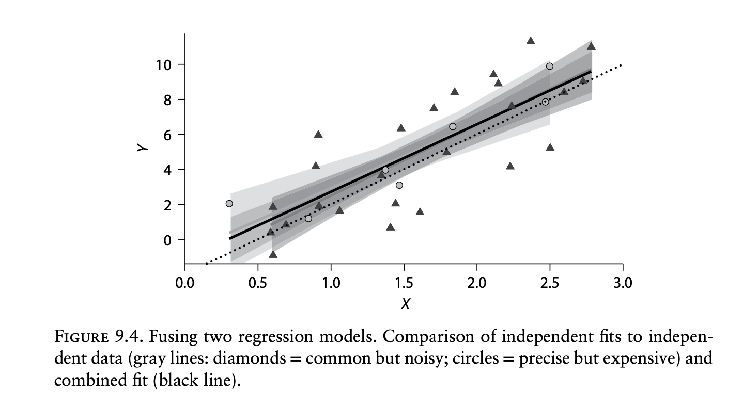
Combining data
Dietz 2017. Ecological forecasting.

Slide 28
Key concepts
3. Fusing data involves more than concatenating files. Considering uncertainty is essential.
7. When combining likelihoods avoid ad hoc weightings, instead use a model
9. State-space models can allow us to combine spatial and temporal information that operate at different scales, even if scales are misaligned.
Dietz 2017. Ecological forecasting.

