Slide 1
Ch 6. Characterizing uncertainty
Amy Hurford
Memorial University

Slide 2
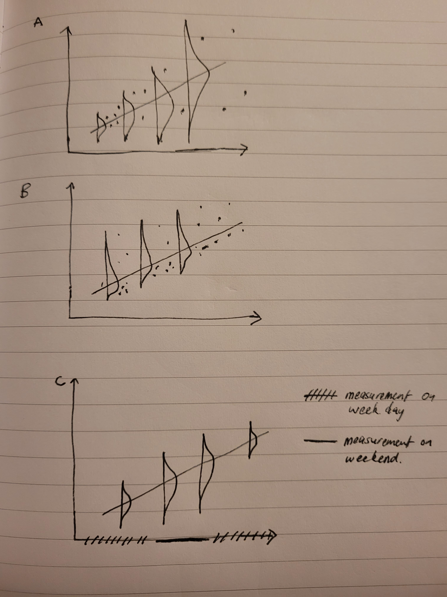
Traditional statistical assumptions

Slide 3
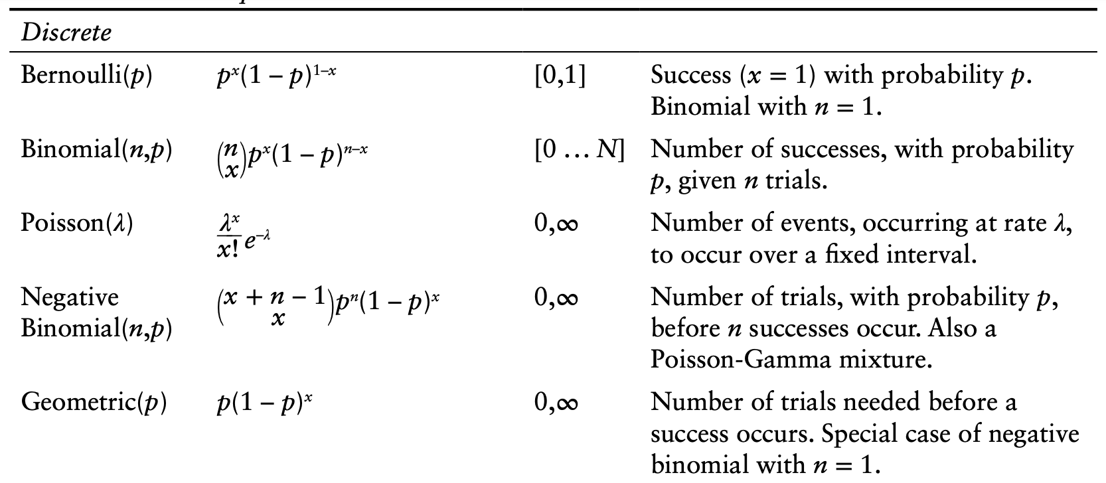
Probability distributions
Dietz 2017. Ecological forecasting.

Slide 4
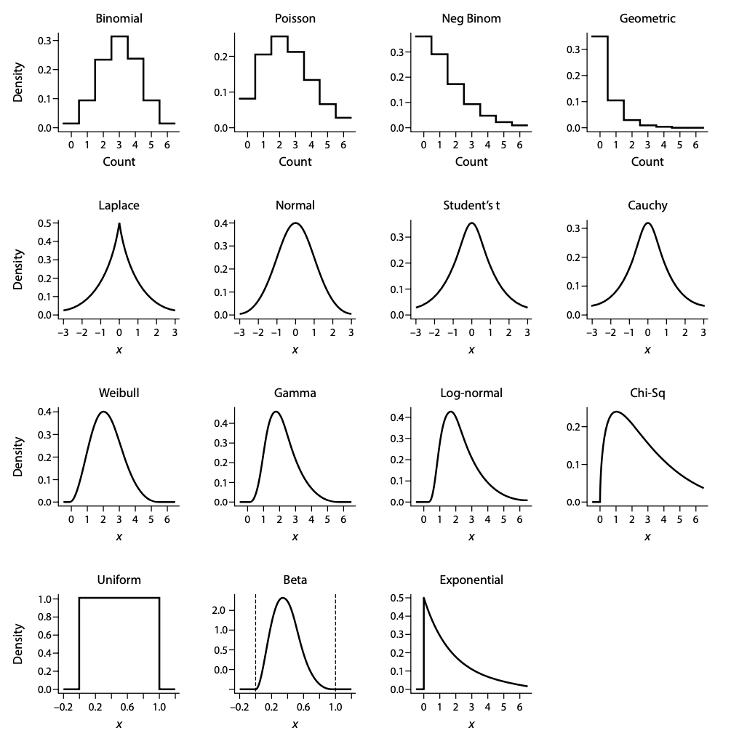
Probability distributions
Dietz 2017. Ecological forecasting.

Slide 5
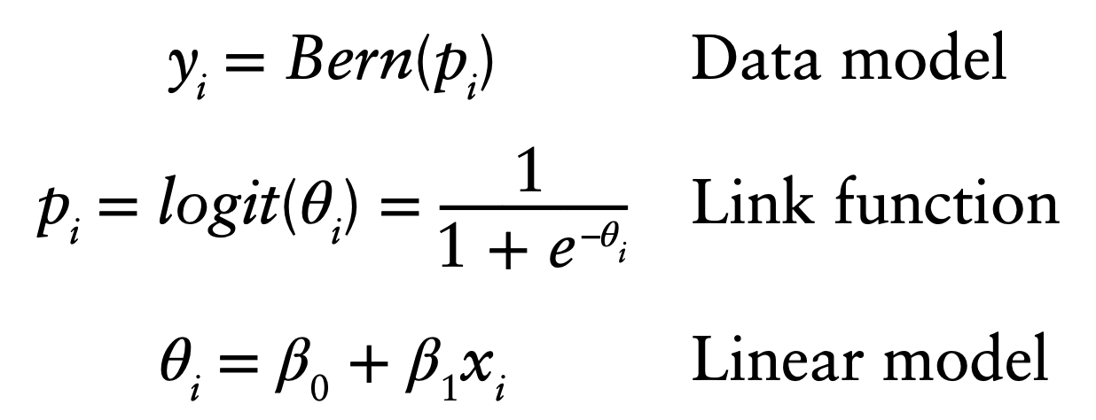
Generalized linear models
Logistic regression:
Boolean: TRUE/FALSE or 0/1
Converts real number to domain of the distributions mean
Dietz 2017. Ecological forecasting.

Slide 6
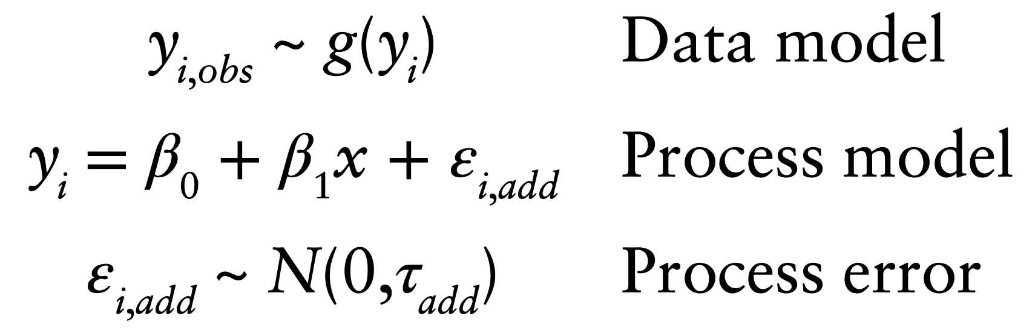
Observation error
A discussion on modeling observation error is straightforward if we believe that all of the observed residual error is measurement error and that there is no uncertainty in the model structure, covariates, or drivers.
Dietz 2017. Ecological forecasting.

Slide 7
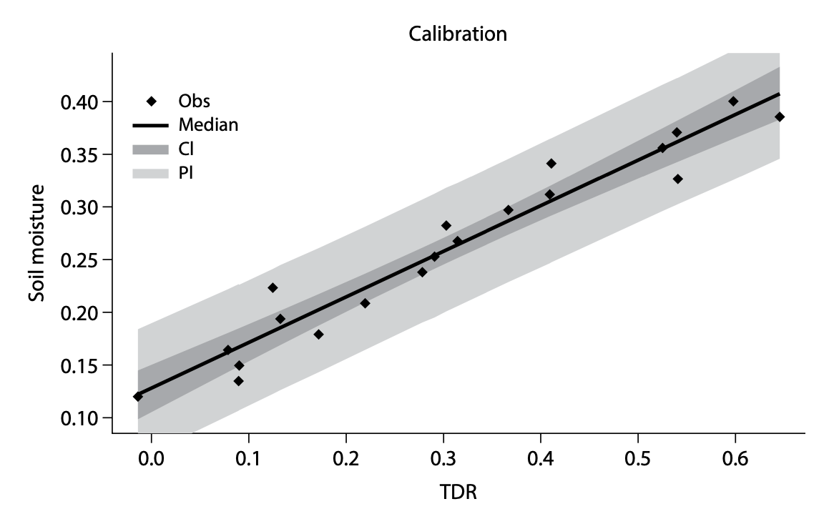
Observation error
Confidence interval: uncertainty in parameter estimates
Predictive interval: all sources of model uncertainty
Based on how these are constructed in Exercise05B_Regression.Rmd (EF_Activities)

Slide 8
Random effects
A fixed factor has categories, or levels, that we set to certain values in an experiment or levels that we choose in an observational study. We infer only to those levels.
A random factor has categories that we have not chosen, or that vary even after we make them as uniform as possible.
The same factor might be treated as fixed or random depending on the population of inference.
By Dave Scheinder

Slide 9
Fixed or random effect?
treated versus untreated (control) units
before versus after treatment of an experimental unit.
day versus night
habitat types
insect stages (larval, adult)
tanks in aquaculture
plots in agriculture
individual organisms
By Dave Scheinder

Slide 10
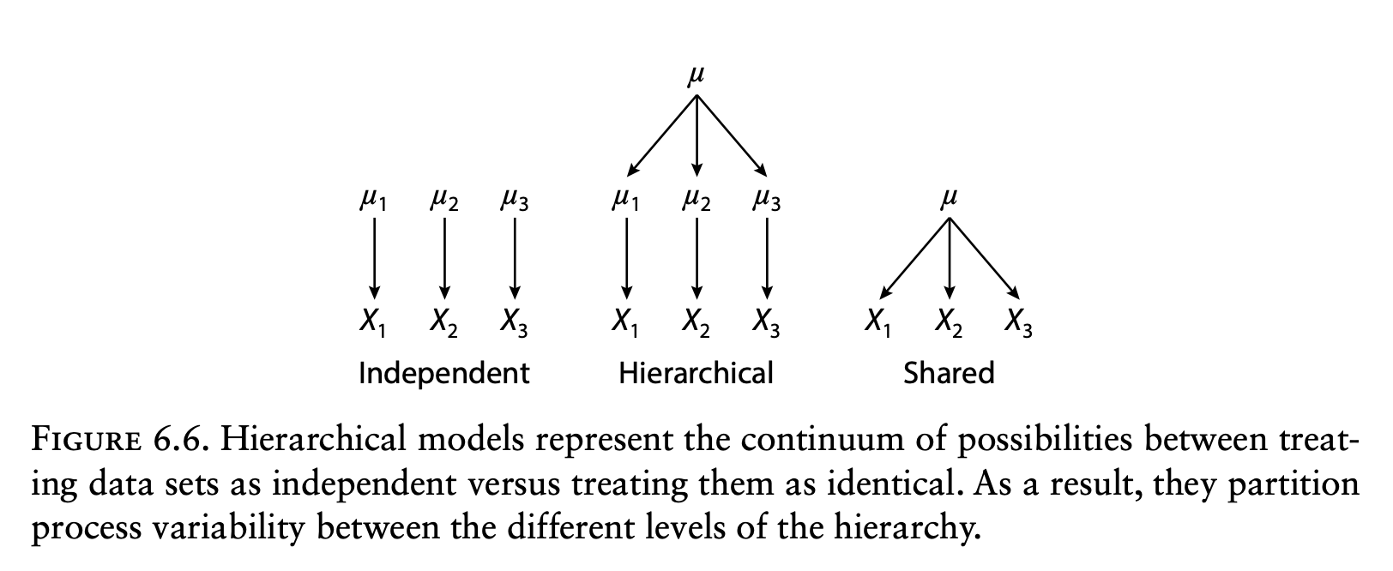
Hierarchical models
Dietz 2017. Ecological forecasting.

Slide 11
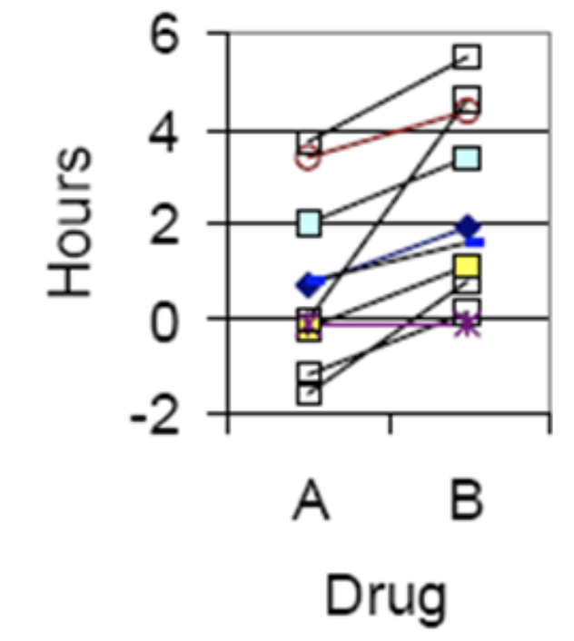
Hierarchical models
Account for variability in process or scale even if we cannot yet explain that variability in our process model
Dietz 2017. Ecological forecasting.
By Dave Schneider

Slide 12
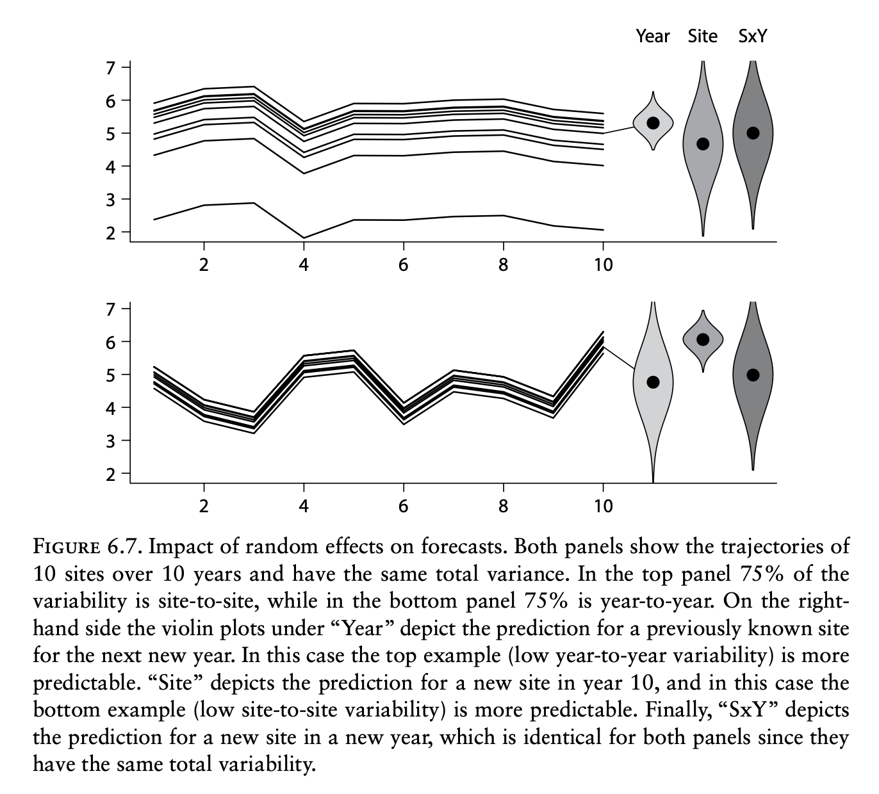
Hierarchical models are a powerful tool for estimating and partitioning process error
Dietz 2017. Ecological forecasting.

Slide 13
Conclusion
3. It is better to thoughtfully choose the appropriate data model than transform data to meet normality assumptions
6. Ignoring errors in variables (covariates, inputs) leads to falsely overconfident and potentially biased conclusions
7. Derived data products should be used with caution, especially if they lack a rigorous partitioning of uncertainties
11. Partitioning process errors improves forecasts because different errors do not propagate the same ways in space and time

