Slide 1
Why “ecological forecasting”?
Amy Hurford
Memorial University

Slide 2
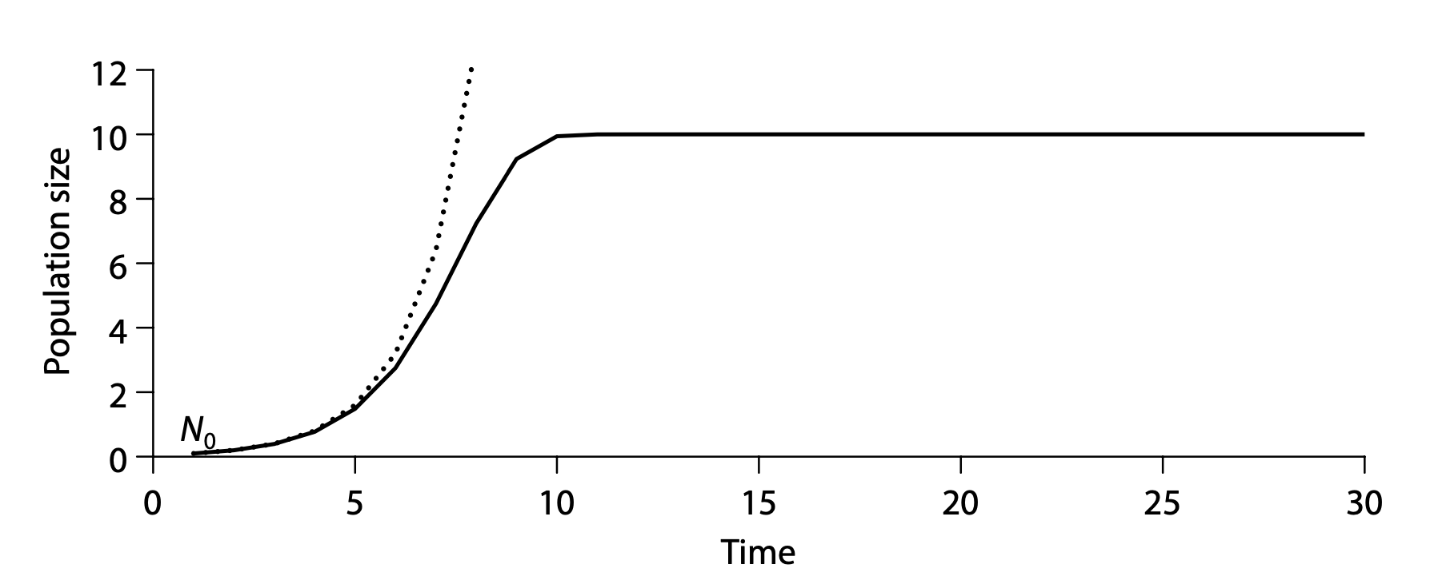
Population biology, deterministic dynamical systems, mechanistic models
Dietz 2017. Ecological forecasting. Ch 2.

Slide 3
Simple parameterization approach
r = b – d
b: births per individual per time step
d: fraction of the population that dies per time step

Slide 4
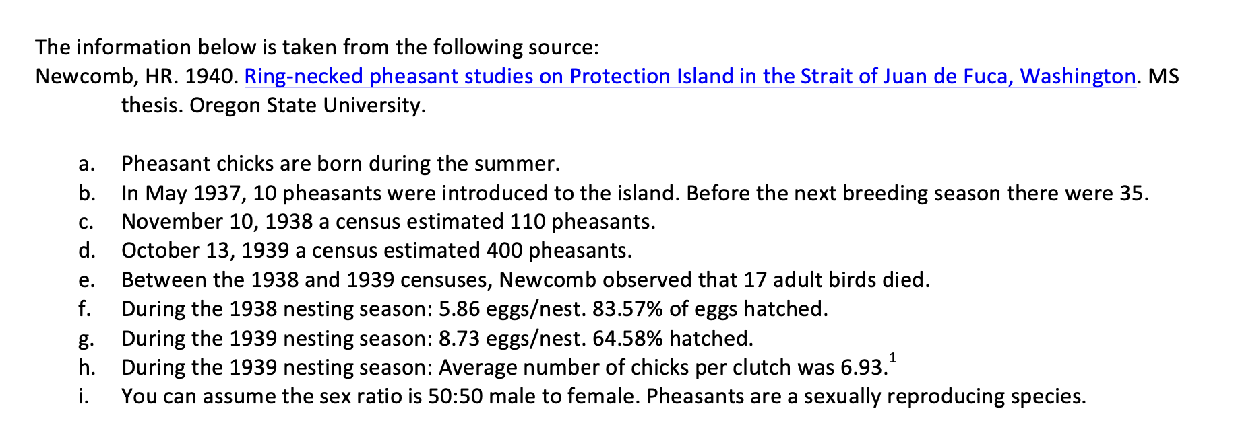
Simple parameterization approach

Slide 6
The simple approach
Search the literature for 1 value or average
Not rigorous
No or limited treatment of uncertainty in forecasts
Some error sources overlooked, falsely confident predictions
Does not fit data
Disconnected from statistics

Slide 7
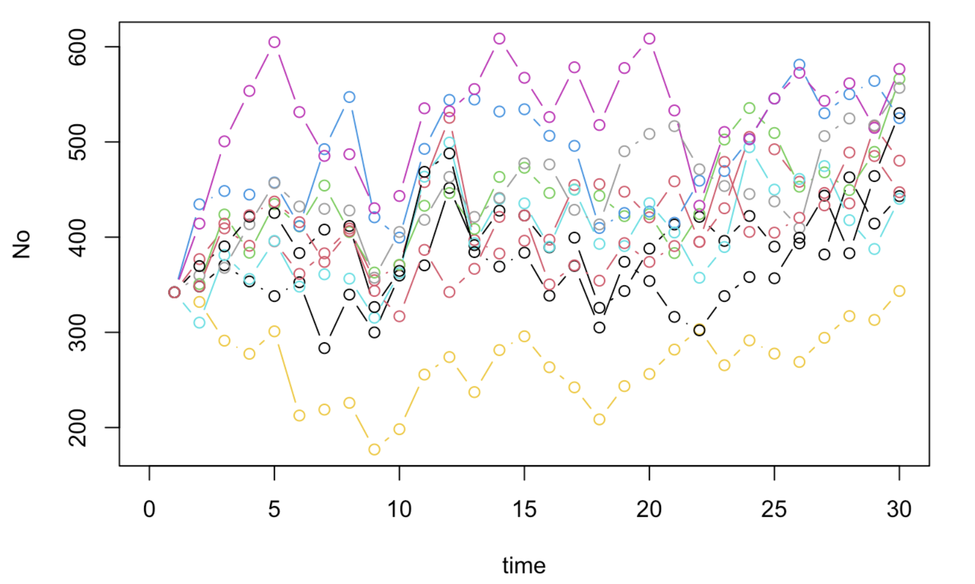
Ecological forecasting
Observed population size, No[s,t]
s: site
t: time
Dietz 2017. Ecological forecasting.
Ch17_Uncertainty_Analysis.Rmd

Slide 8
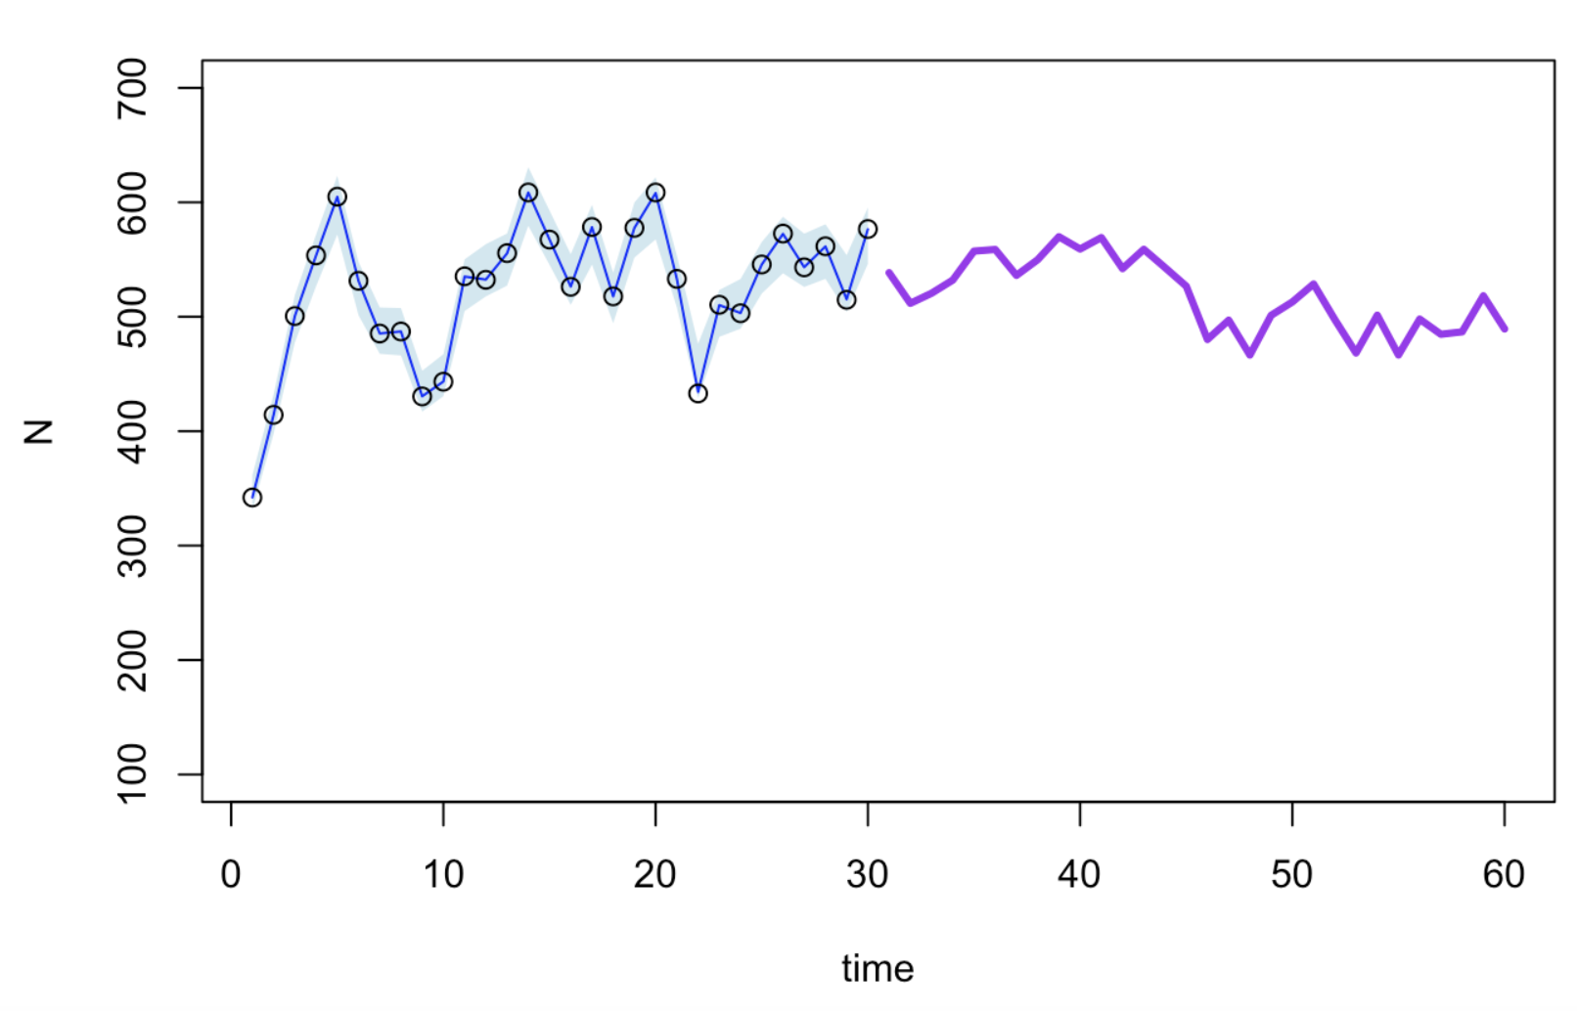
Deterministic forecast for site, s=6
Dietz 2017. Ecological forecasting.
Ch17_Uncertainty_Analysis.Rmd

Slide 9
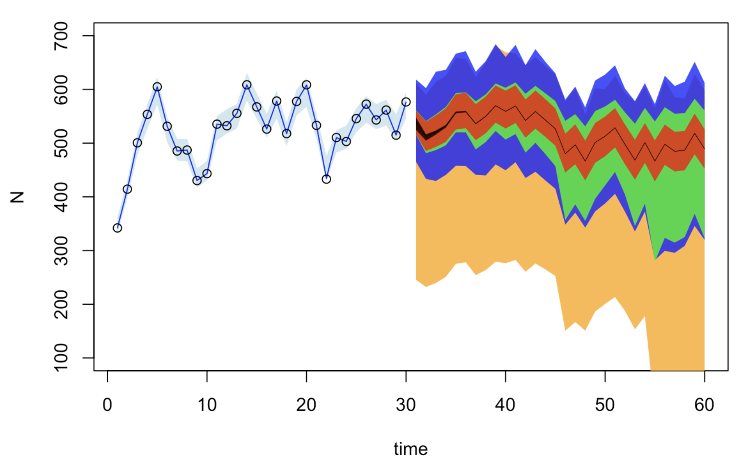
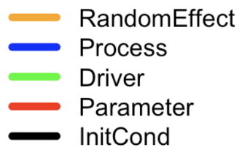
Sources of uncertainty
Dietz 2017. Ecological forecasting.
Ch17_Uncertainty_Analysis.Rmd

Slide 10
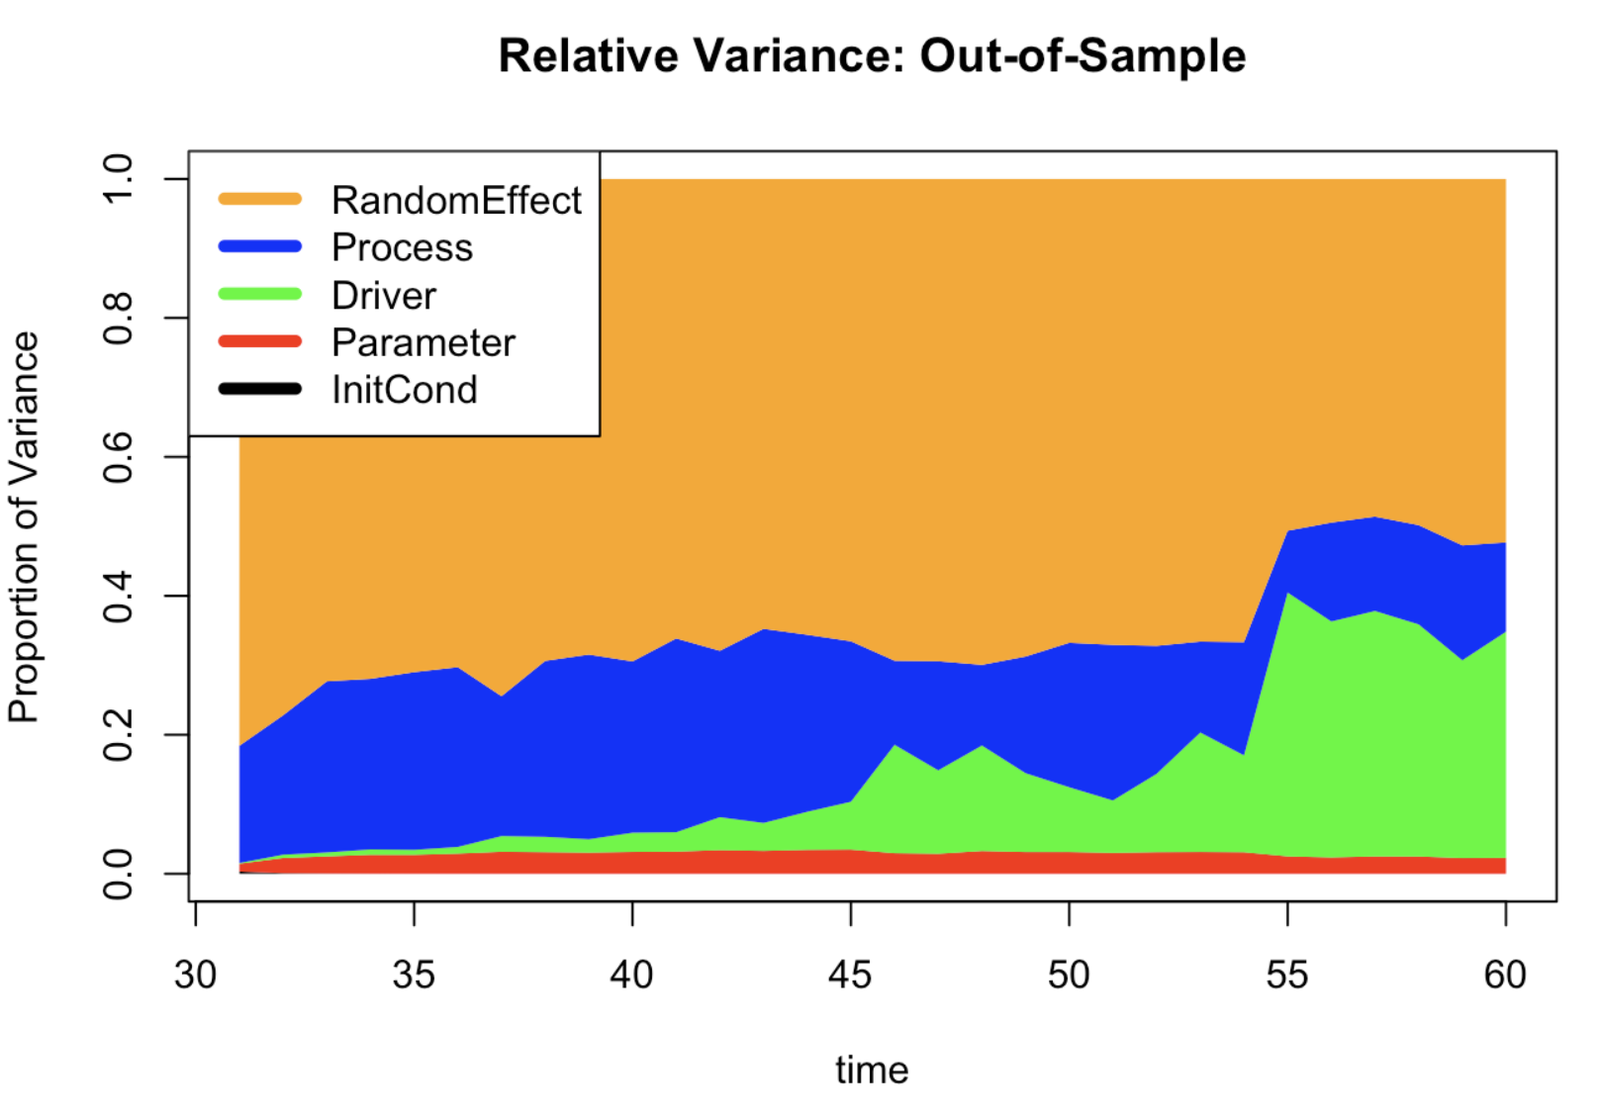
Sources of uncertainty
Dietz 2017. Ecological forecasting.
Ch17_Uncertainty_Analysis.Rmd

Slide 11
Schedule
Chapter 6: Characterizing uncertainty (Tuesday PM)
Chapter 8: Latent and state-space models (Wednesday PM)
Chapter 9: Fusing data sources (Wednesday PM)
Chapter 11: Propagating uncertainty (Thursday PM)

