Slide 1
Ch 6. Characterizing uncertainty
Amy Hurford
Memorial University

Slide 2
Traditional statistical assumptions
Figure

Slide 3
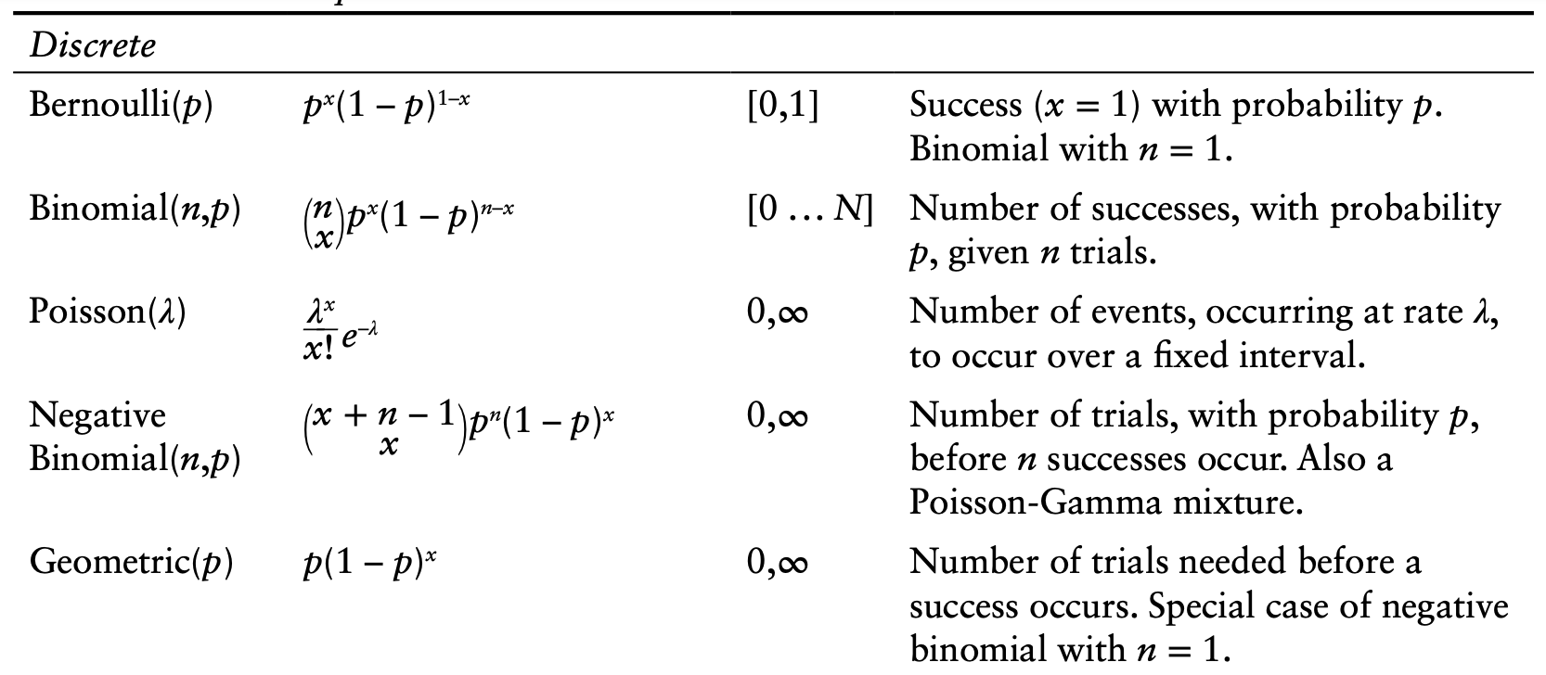
Probability distributions
Dietz 2017. Ecological forecasting.

Slide 4
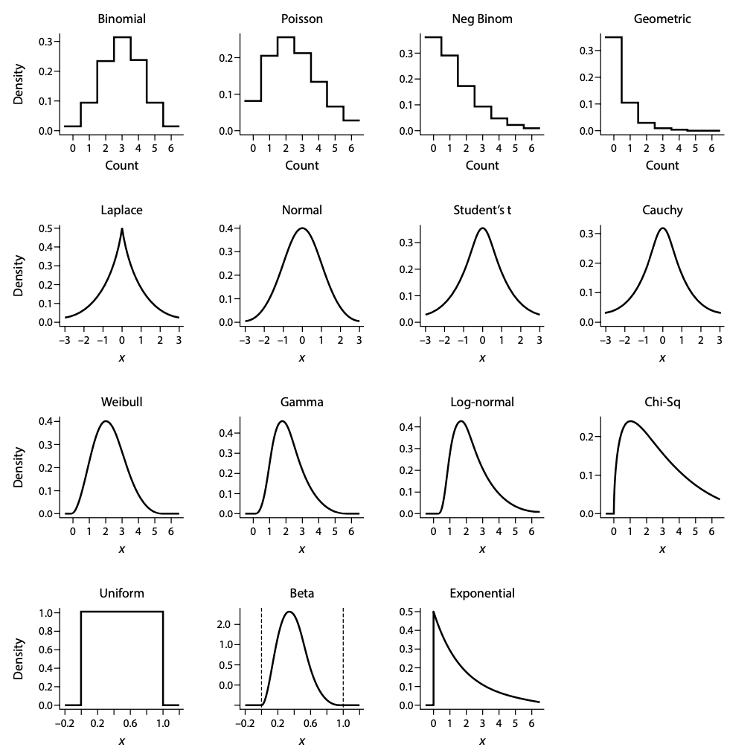
Probability distributions
Dietz 2017. Ecological forecasting.

Slide 5
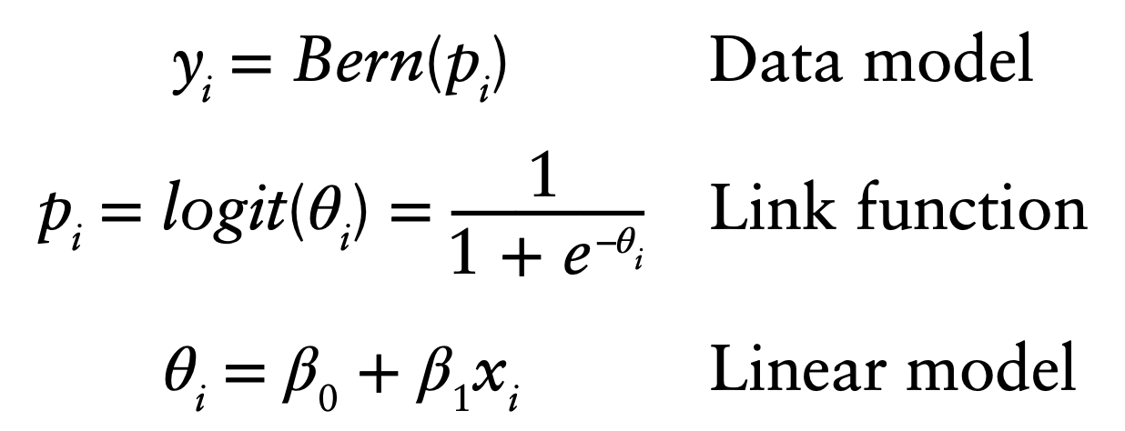
Generalized linear models
Logistic regression:
Boolean: TRUE/FALSE or 0/1
Converts real number to domain of the distributions mean
Dietz 2017. Ecological forecasting.

Slide 6
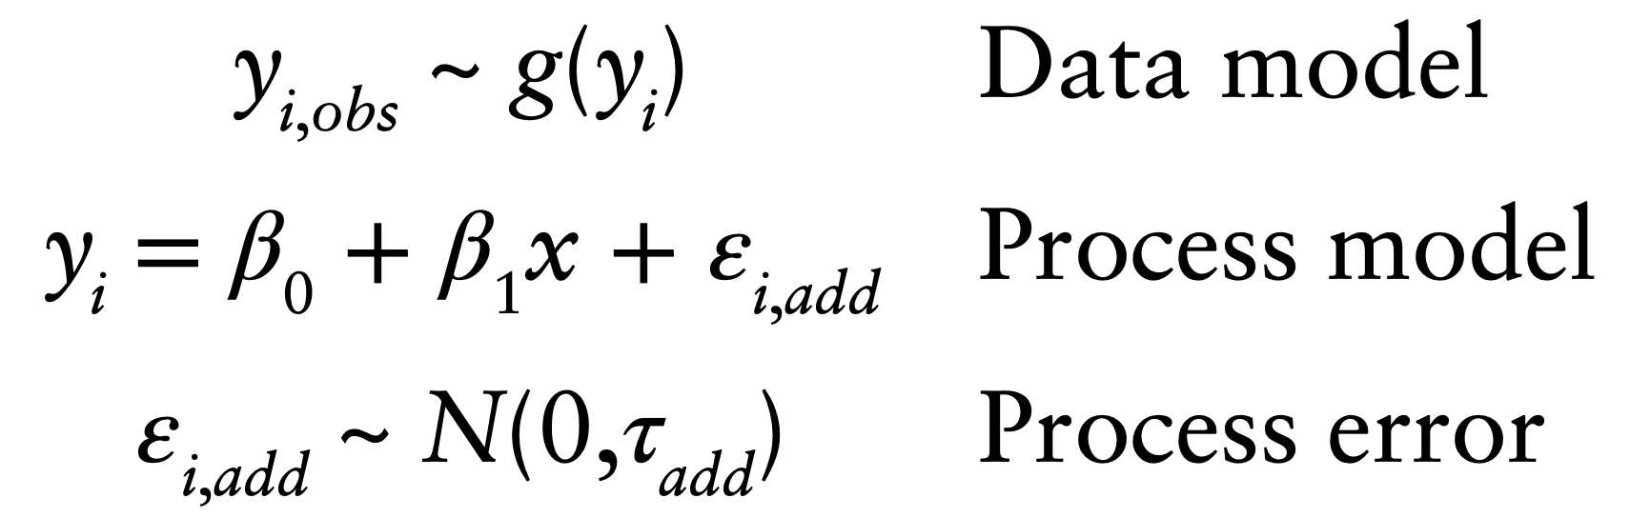
Observation error
A discussion on modeling observation error is straightforward if we believe that all of the observed residual error is measurement error and that there is no uncertainty in the model structure, covariates, or drivers.

Slide 7
Random effects
A fixed factor has categories, or levels, that we set to certain values in an experiment or levels that we choose in an observational study. We infer only to those levels.
A random factor has categories that we have not chosen, or that vary even after we make them as uniform as possible.
The same factor might be treated as fixed or random depending on the population of inference.

Slide 8
Fixed or random effect?
treated versus untreated (control) units
before versus after treatment of an experimental unit.
day versus night
habitat types
insect stages (larval, adult)
tanks in aquaculture
plots in agriculture
individual organisms

Slide 9
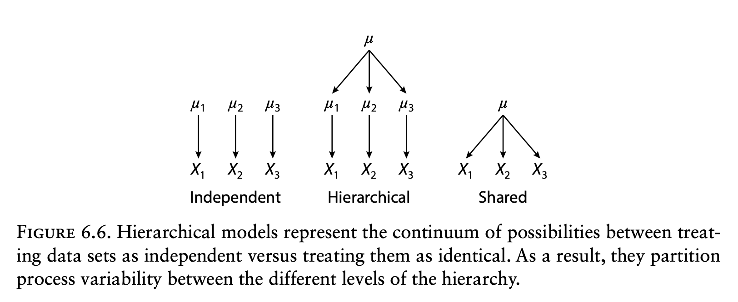
Hierarchical models
Powerful tool for estimating and partitioning process error

