Slide 1
Ch 17: Projection and Decision Support
Amy Hurford
Memorial University

Slide 2
Decision support
Decision support is, at its heart, a forecasting problem.
Decision making is ultimately not a technical question, but a question of values. Factual information resolves trade-offs.
A consequence table (Gregory et al. 2012) summarizes how different alternatives perform for different performance measures.

Slide 3
Definitions
Forecasting – future prediction and projection.
Prediction – “probabilistic statement that something will happen in the future based on what is known today” (MacCracken 2001).
Projection – “probabilistic statement that it is possible that something will happen in the future” (MacCracken 2001) conditioned on boundary condition scenarios (Dietze 2017, p222).

Slide 4
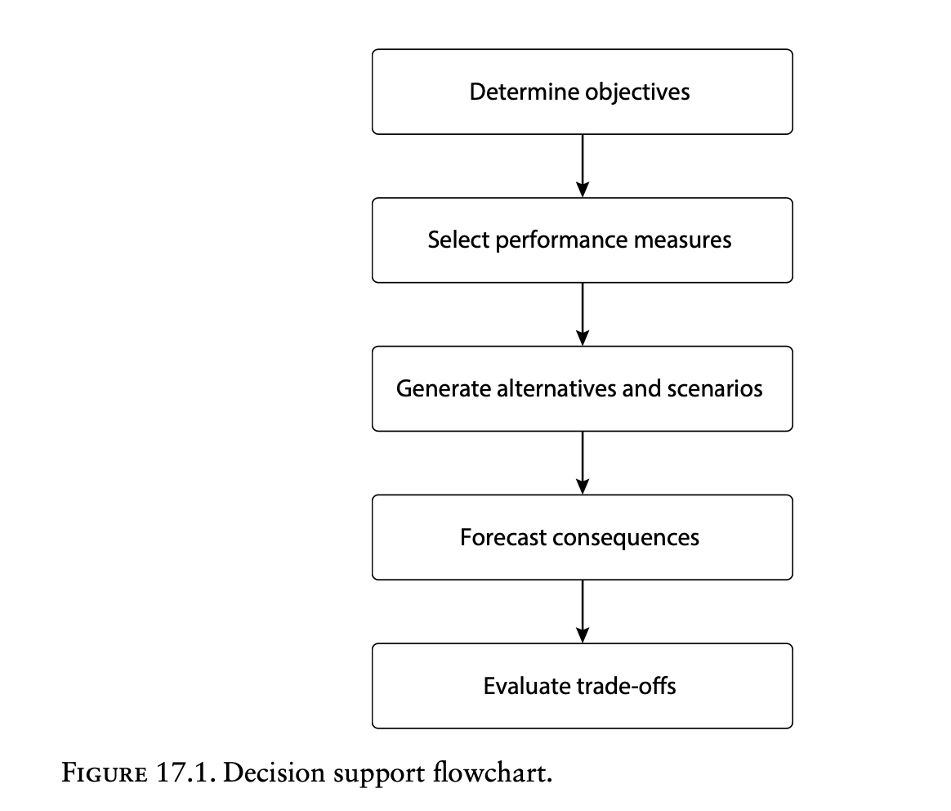
Consequence table

Slide 5
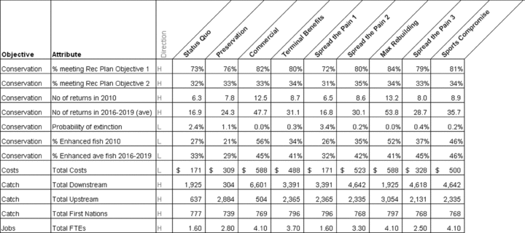
Consequence table showing initial objectives and alternatives developed by the consultative committee
Using Structured Decision Making to Help Implement a Precautionary Approach to Endangered Species Management Risk Analysis, Volume: 29, Issue: 4, Pages: 518-532, First published: 18 March 2009, DOI: (10.1111/j.1539-6924.2008.01182.x)
Notes:
Consequence table showing initial objectives and alternatives developed by the consultative committee.
IF THIS IMAGE HAS BEEN PROVIDED BY OR IS OWNED BY A THIRD PARTY, AS INDICATED IN THE CAPTION LINE, THEN FURTHER PERMISSION MAY BE NEEDED BEFORE ANY FURTHER USE. PLEASE CONTACT WILEY'S PERMISSIONS DEPARTMENT ON PERMISSIONS@WILEY.COM OR USE THE RIGHTSLINK SERVICE BY CLICKING ON THE 'REQUEST PERMISSIONS' LINK ACCOMPANYING THIS ARTICLE. WILEY OR AUTHOR OWNED IMAGES MAY BE USED FOR NON-COMMERCIAL PURPOSES, SUBJECT TO PROPER CITATION OF THE ARTICLE, AUTHOR, AND PUBLISHER.

Slide 6
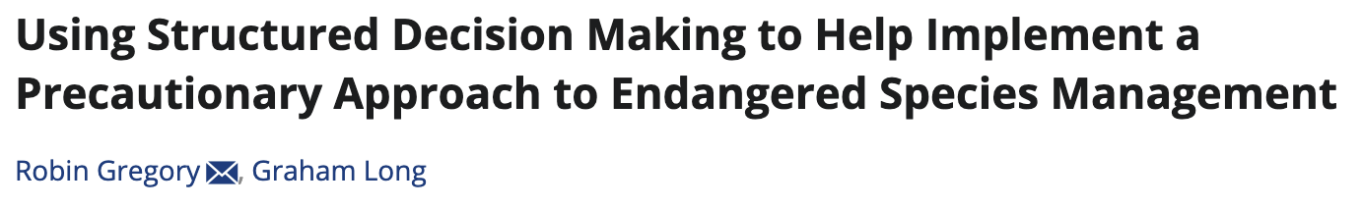
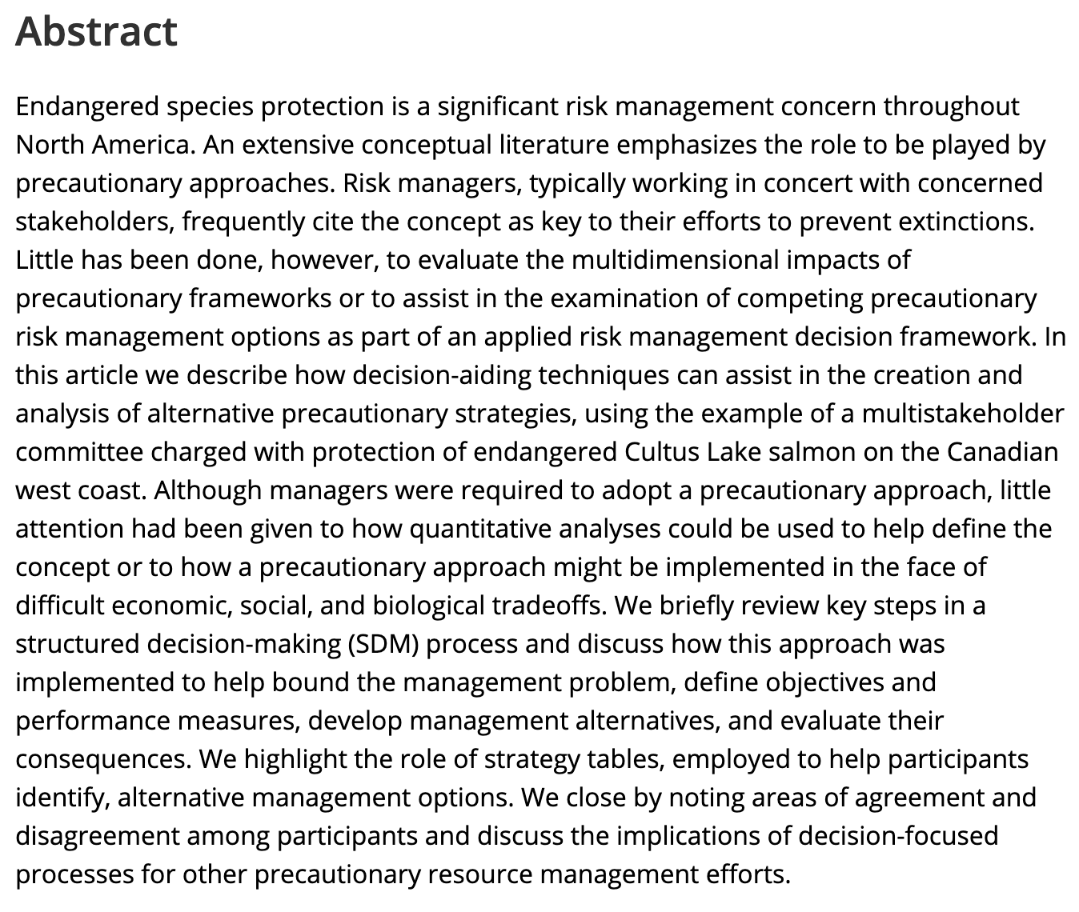

Slide 7
Objectives and performance measures
Objectives describe the desired direction of change, but do not prescribe targets.
Performance measures should not unnecessarily be monetarized.

Slide 8
Scenarios
Boundary condition = driver = scenario (treated as synonyms in Dietz 2017).
Representative “what-if” statements.
Not meant to be random samples from a set of plausible futures
=> Do not average, evaluate individually
Scenario can have different definitions in the literature. A scenario meets the definition of an “alternative” in decision support.
Can be used to evaluate rare low probability events with large impacts: “failures of imagination”, “unknown unknowns”.

Slide 9
Definitions - alternatives
Robust alternatives perform adequately over a wide range of uncertainties
Brittle alternatives are optimal but sensitive to deviations
Adaptive alternatives learn as they go, refining approaches as additional data is collected and uncertainties are reduced over time

Slide 10
Alternatives and scenario development
Scenarios are not to be random samples.
Any decision is only as good as the set of alternatives considered.
Once the bookends are established, consider a wide range of alternatives including minority viewpoints.

Slide 11
Alternatives and scenario development
The development of scenarios is subject to cognitive bias
Anchoring: value assigned to alternatives is relative to an initial impression (often the status quo)
FIX => Use bookends to focus on the range
Representative bias: stereotyping
Availability bias: giving more weight to recent examples
Sunk cost bias: protecting and justifying earlier choices
Groupthink: premature convergence to one viewpoint without sufficient analysis

Slide 12
Alternative and scenario development
Time, money, manpower and computation are practical limitations.
4-12 alternatives to be discussed by stakeholders, narrowed down to 3-4 to be presented to decision maker (Schwartz 2005)
“Paradox of choice”: when there are too many choices it is difficult to keep track of the differences between them.
Alternatives need to:
have neutral names, i.e. not “pro-business”
be complete, comparable and internally consistent. Also mutually exclusive.
enough detail to drive projections

Slide 13
Consequences and uncertainties
This is the forecasting/modelling component.
Linguistic uncertainties associated with vagueness, ambiguity, under-specificity (unwanted generality), context dependence, indeterminacy (change in meaning over time) should be minimized.
Epistemic uncertainties are those associated with knowledge and were the focus of much of the Ecological Forecasting book.
Further data collection should focus on aspects that affect the decision.

Slide 14
Careful thought should be given to how uncertainties are reported
The full PDF, or many summary statistics, are likely unhelpful
Most end-users that have not been trained in statistics will interpret all values in a confidence interval as equally likely
1 in 20 is easier to understand, but perceived as higher risk than 5%
Most people cannot visualize the difference between 1 in 1 million and 1 in 1 billion
It can be helpful to report relative to a baseline

Slide 15
Risk tolerance
Risk tolerance is how gains and losses are perceived
A 10% loss is perceived, on average, to be twice as bad a 10% increase (Berger 1985; Kahneman 2013)
Downside reporting and exceedance probability can help as risk perception (and consequences) are asymmetric (losses are worse than gains).
Downside reporting is reporting relative to a worst plausible case.

Slide 16
Risk tolerance
The worse plausible case: “plausible” is defined relative to a pre-defined probability.
Exceedance probability – probability of exceeding a pre-defined threshold.
Decision-makers may be less risk averse when decisions are repeated because consequences average out. As a decision becomes more routine, we progressively become more risk neutral.

Slide 17
Precautionary alternatives
Precautionary alternatives apply the precautionary principle embodied in the United Nations (1993) Rio Declaration on Environment and Development:
Lack of full scientific certainty should not be used as a reason for postponing cost-effective measures to prevent environmental degradation
Being precautionary involves trade-offs with other objectives and it may be useful to develop alternatives that explore different levels of precaution

Slide 18
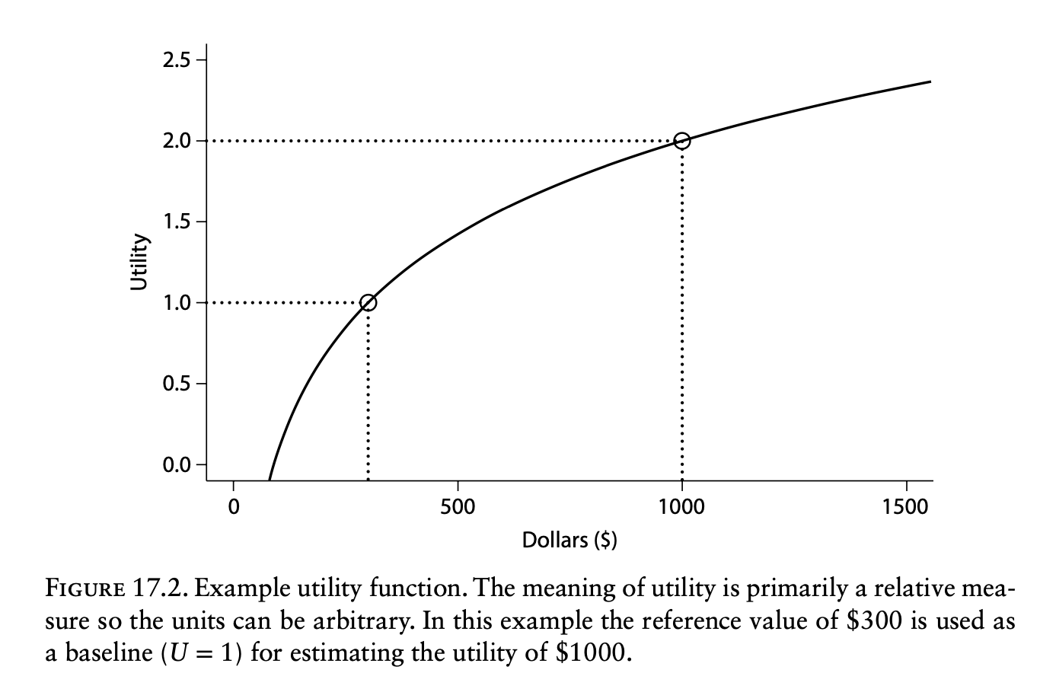
Utility: Value and risk tolerance
Utility is often logarithmic
Economists represent the concepts of value, preference, and risk tolerance as utility
Utility functions are used to compare performance measures:
U[a,y]
y
a is an action

Slide 19
Trade-offs: “winnowing of alternatives”
Deleting bad alternatives and insensitive performance measures
Refining our understanding of key tradeoffs
Adding new alternatives that address these trade-offs

Slide 20
Using Structured Decision Making to Help Implement a Precautionary Approach to Endangered Species Management Risk Analysis, Volume: 29, Issue: 4, Pages: 518-532, First published: 18 March 2009, DOI: (10.1111/j.1539-6924.2008.01182.x)

Slide 21
Dominated alternatives
Dominated alternatives: lose on all measures relative to another alternative.
“Practically” dominated alternative: there are tradeoffs, but they are judged to be negligible.

Slide 22
Pareto optimization
Used when there are many alternatives, such that manual consideration isn’t feasible
Seeks to clarify the trade-off front (termed ‘Pareto Front’)

Slide 23
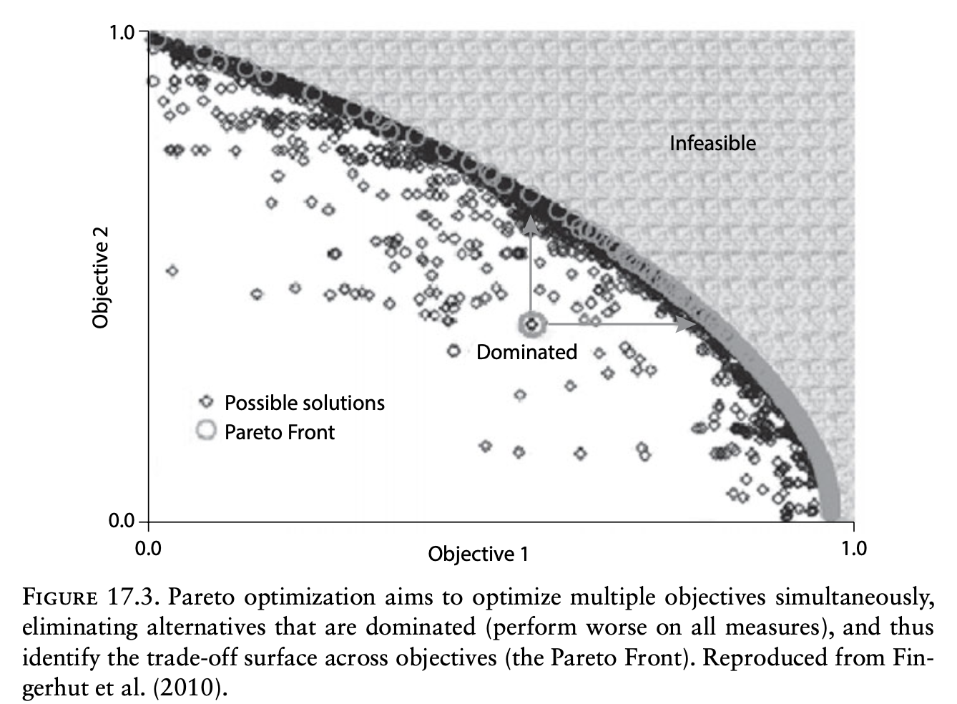

Slide 24
Have stakeholders evaluate the consequence table
Which alternatives do they enthusiastically support/are willing to accept/actively oppose?
Can any alternatives be eliminated due to lack of support?
Identify ‘no-regret’ actions – features that are common to all alternatives along the Pareto front that can be implemented immediately without disagreement

Slide 25
No-regret action: no disagreement and along Pareto front
Ex. implement volunteer community monitoring program
Better water quality
Low Cost

Slide 26
Swing weighting
Imagine an alternative that performs worst on all metrics
Consider, if you could improve one objective, which would be it?
Label this objective, i=1, and assign p₁ = 100.
Iteratively repeat 2, and assign appropriate p_{i}
When all objectives have been considered, calculate
Perform sensitivity analyses to determine if choices are robust to small changes in weights

Slide 27

Critical value analysis
Considers how much a performance measure would have to change to change the decision.
Calculates the probability of crossing this threshold.

Slide 28
Conclusions
Better than 50:50 is the only the only threshold for modelling to be useful for decision-making.
Decision support may end with a narrowed set of alternatives and a clear identification of the trade-offs between them.

Slide 29
Conclusions
The goal of decision support is not to reach consensus, but to inform decision makers about how different trade-offs are viewed.
Decision support must consider a wide suite of cognitive biases in how both alternatives and probabilities are generated and presented.
Precautionary, adaptive, and robust alternatives may guard against risk and uncertainty.

Slide 30
Conclusions
Within decision support, modelling occurs as estimating the consequences of decisions
The accurate quantification of uncertainty is essential to guard against decisions that are overconfident or excessively precautionary.
The only “bad” trade-offs are the ones we make unknowingly, or without fully appreciating their implications.

