Slide 1
Ch 8. Latent Variables and State-Space Models
Amy Hurford
Memorial University

Slide 2
Latent variables
Latent variables: The variable of interest is unobserved or estimated with uncertainty

Slide 3
Latent variables
Latent variables: The variable of interest is unobserved or estimated with uncertainty
Random and systematic observation errors
Proxy data
Missing data
Unobserved variables

Slide 4
Examples
Random & systematic: sensor drift
Proxy: Total Domain Reflectometry (TDR) – 2 electric probes that measures soil impedence estimate soil moisture
Proxy: NVDI - net primary production
Proxy: O¹⁸ in water – temperature, evaporation, and atmospheric cipitation
Unobserved: resource allocation to growth, fecundity, allometry

Slide 5
NL vaccination data

Slide 6
Ecological detective

Slide 7
State space models
For time series analysis, also referred to as hidden Markov models
hidden => latent; Markov => next state depends only on current state

Slide 8
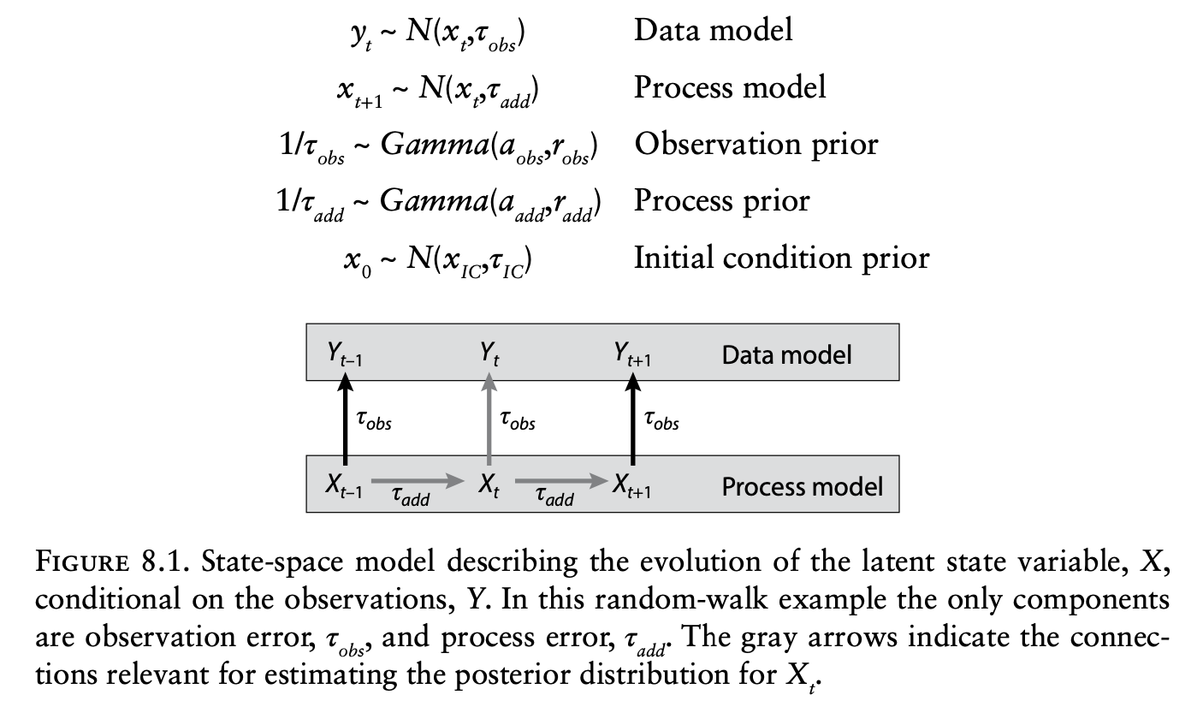

Slide 9
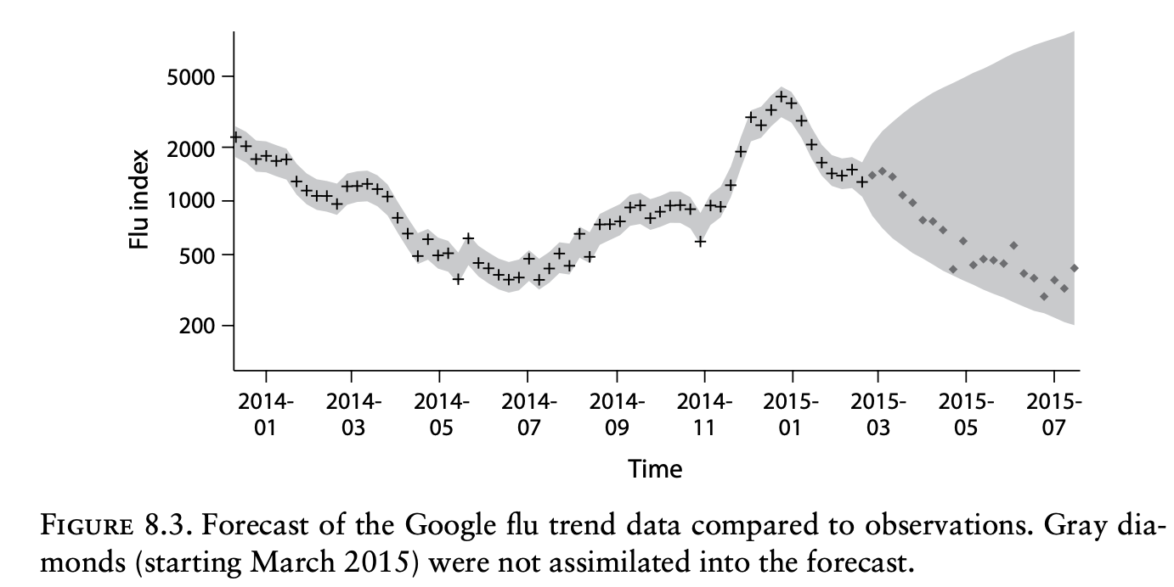

Slide 10
Key concepts
3. Because of their capacity to flexibly capture and partition a wide range of uncertainties and address the complexities of real data, Dietz recommends state space models as the basis of forecasting.
5. Missing data gaps and irregularly spaced data are handled automatically with uncertainties increasing with distance to the nearest observation.

Slide 11
Ch 9 Fusing Data Sources
“Balancing the information provided by different data sources remains among the most debated topics in ecological model-data fusion”

Slide 12
Fusing data sources
Fusing data involves more than joining data sources
Naïve interpolation or extrapolation can lead to biased and overconfident results
Covariances are critical to leverage complementary data types

Slide 13
Meta-analysis
Meta-analyses combine information, usually in the form of summary statistics from independent studies
Reporting bias is a challenge for high quality meta-analyses; that is that negative results are not reported

Slide 14
