Slide 1
macpan2 calibration
Amy Hurford
March 4, 2026

Slide 2
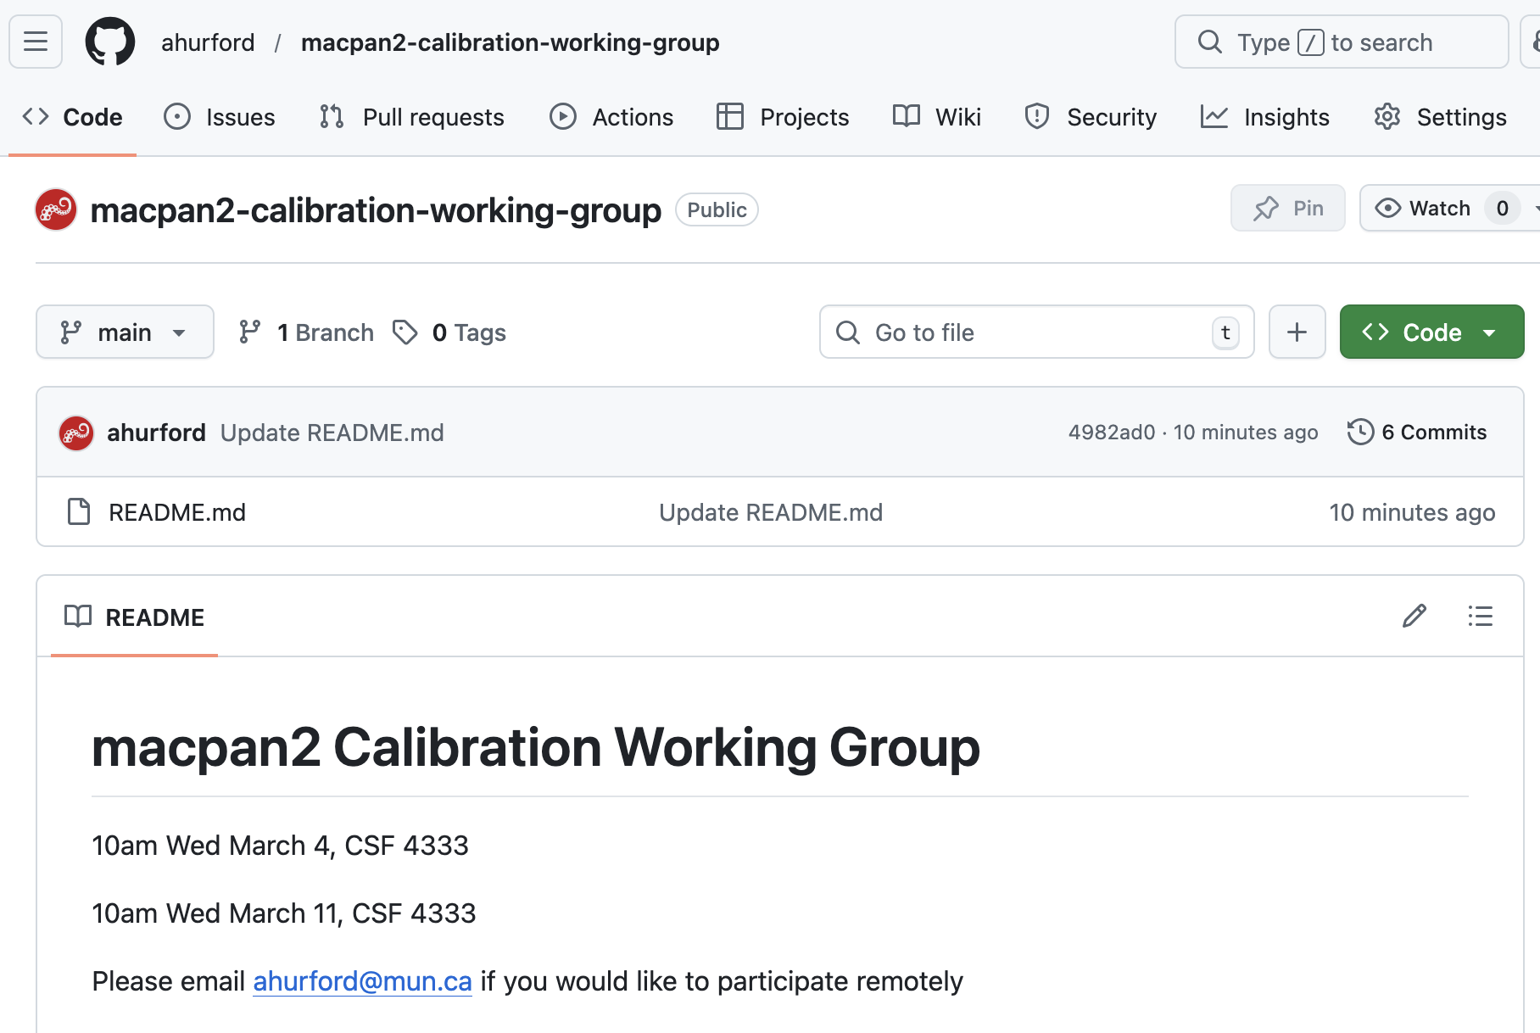
Working group repository
Link

Slide 3

Link
Link to “why macpan2?” video

Slide 4
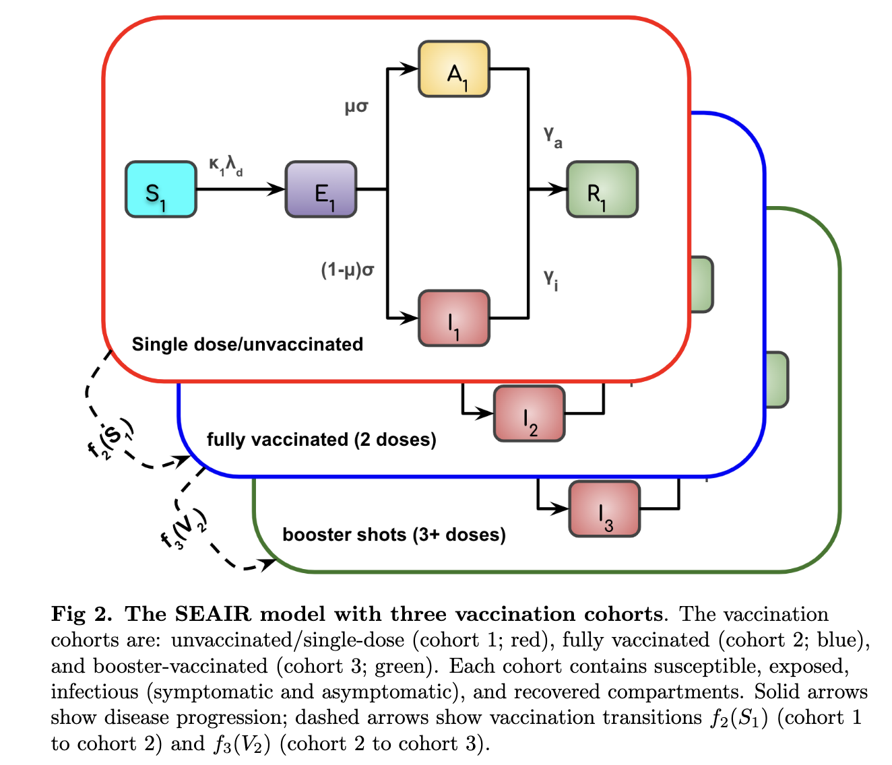
Goal: calibration of mechanistic models
Mechanistic models describe processes
Contrast with pattern matching approaches
Examples are from Anokye et al. MedRxiv. link

Slide 5
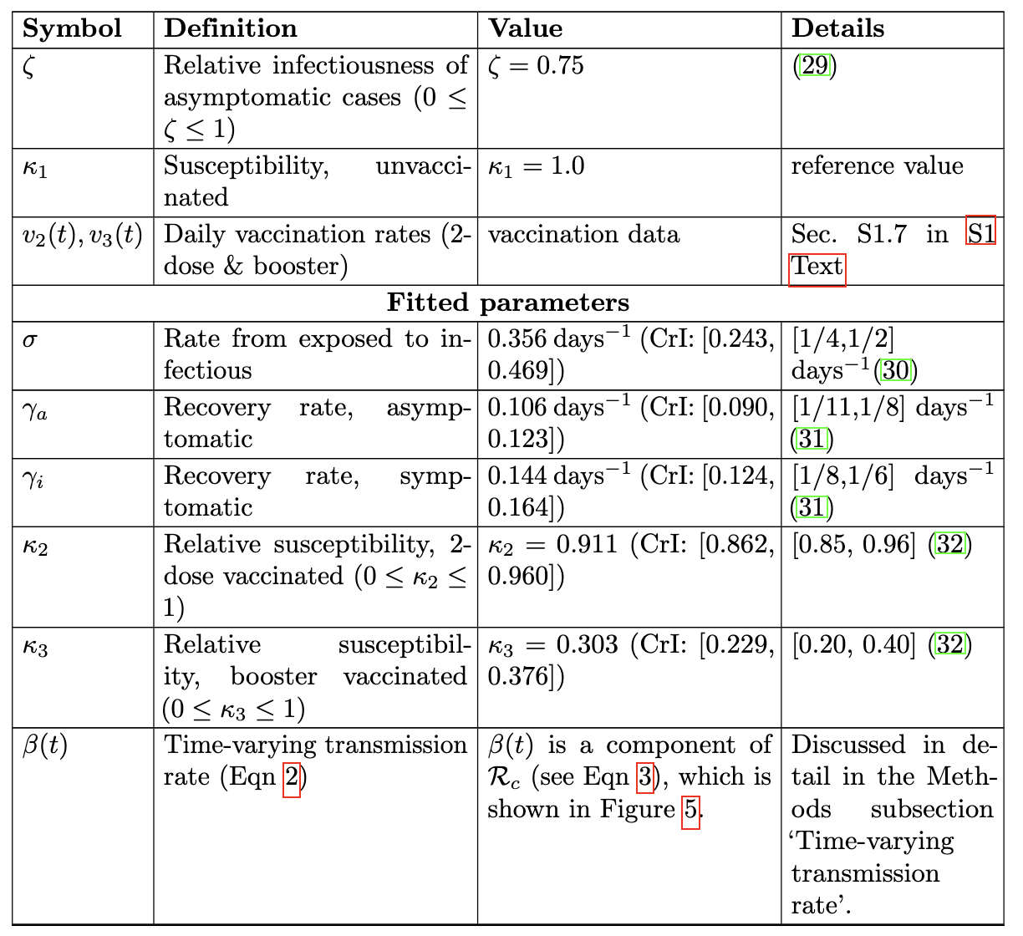
Parameter estimation for mechanistic models
Fixed parameters: a point estimate based on published values
Fitted parameters: assumed prior distributions based on published values. Estimated using MAP

Slide 6
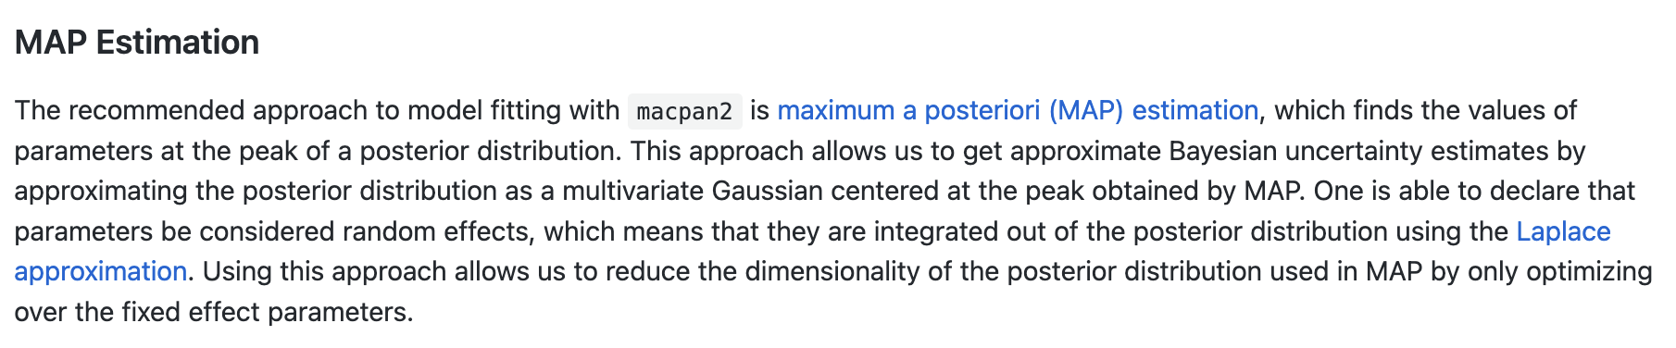
Maximum a posteriori (MAP) estimation
link
link about maximum a posteriori (MAP) estimation

Slide 7
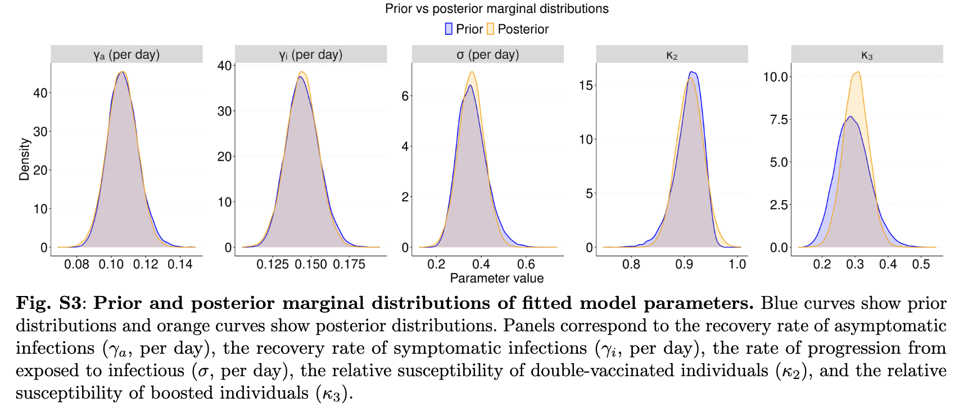
Prior and posterior distributions

Slide 8
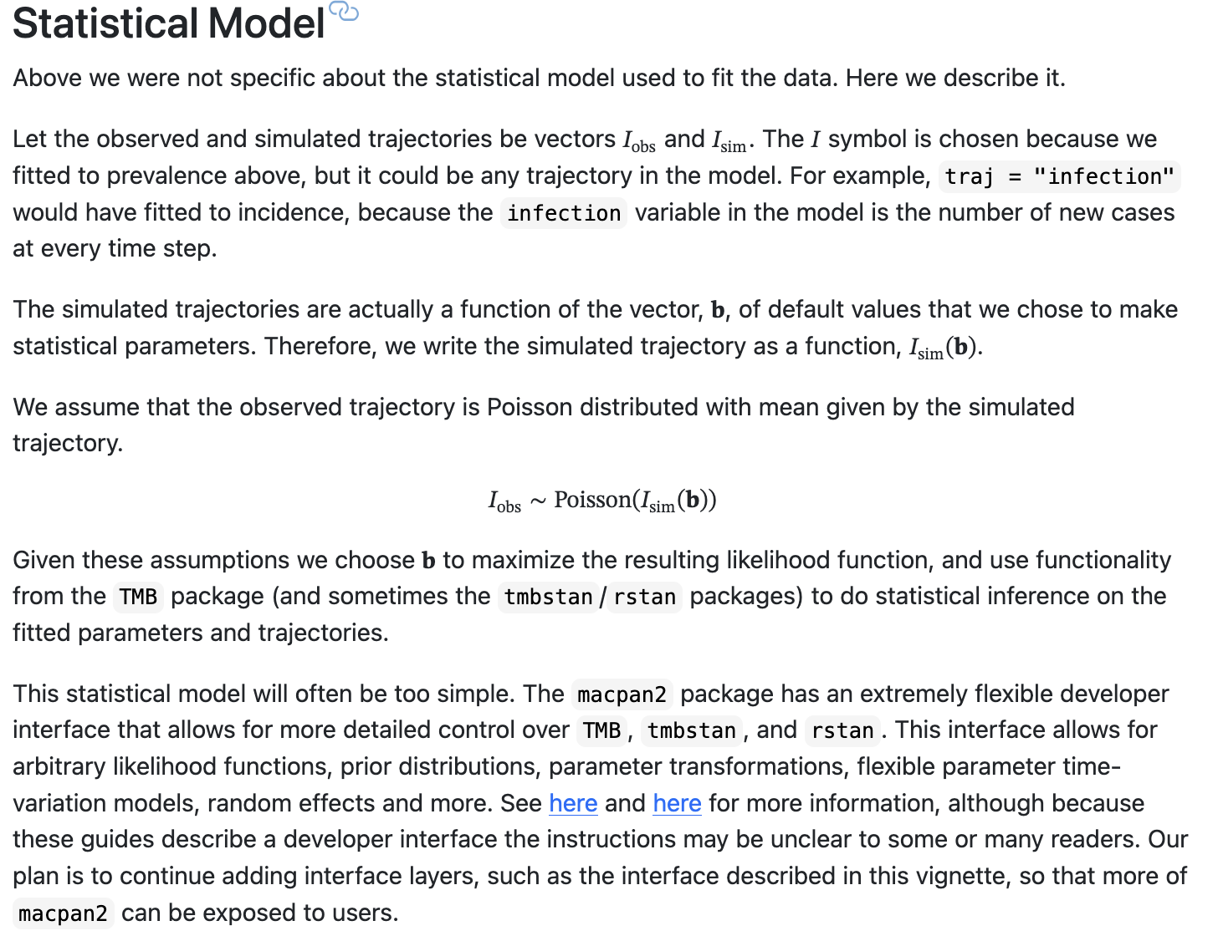
Statistical model
link

Slide 9
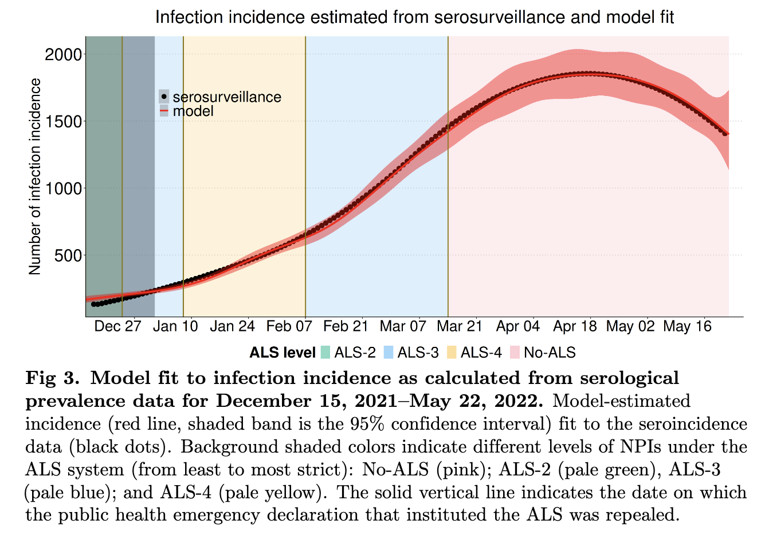
Statistical model
macpan2 uses template model builder (TMB) to calibrate models to data
Link about what latent variable models are

Slide 10
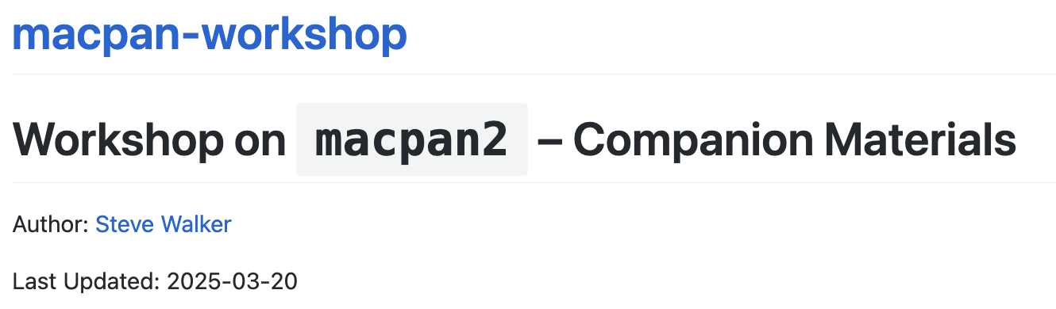
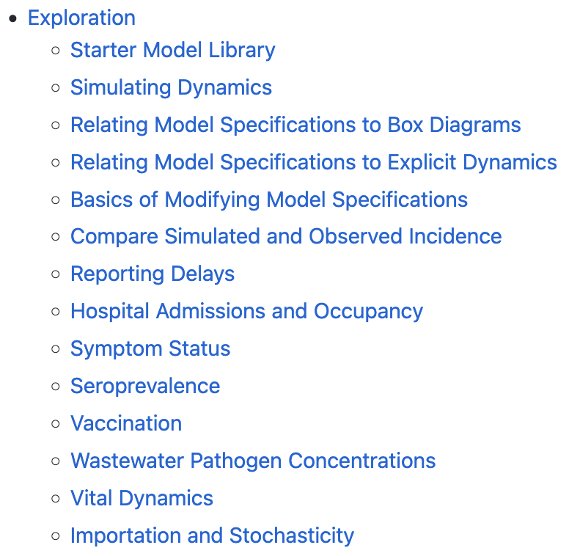
See also topics from workshop materials
Link to macpan2 workshop

Slide 11
To get started visit the working group repository
Link

