Slide 1
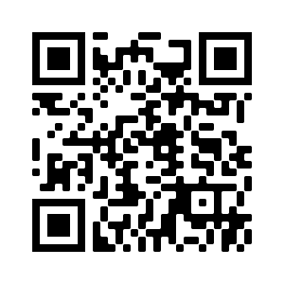


Are you interested in contributing your COVID-19 Rapid Antigen Test results from the K-12 school return on January 25 for a research project?
Study title: Return to school COVID-19 rapid antigen testing in Newfoundland and Labrador
Principal Investigator:
Dr. Amy Hurford
Interested? To ask questions contact:
Dr. Amy Hurford, Associate Professor
(709) 864-8301
ahurford@mun.ca
Deadline to participate: February 13, 2022
What is the study about?
The study asks parents and guardians of K-12 school students to report the results of COVID-19 Rapid Antigen Tests completed on January 22 and 25. The study will estimate the occurrence of COVID-19 infections in K-12 students on January 22 and 25, provide summary results back to Newfoundlanders and Labradorians, and inform mathematical modelling.
Who can participate?
Eligible participants are parents or guardians of K-12 students that completed at least one COVID-19 Rapid Antigen Test on January 22 and/or 25.
What’s involved?
You will be asked to complete a 5 minute web survey. Participate at:
www.mun.ca/science/school-test
If you have questions regarding your rights as a research participant please contact the Health Research Ethics Authority at (709) 777-6974 or info@hrea.ca.

