Slide 1
Independent Study Weekly Report (June 29 – July 3, 2020)
Ahuti Shrestha

Slide 2
Paper (Contd.): Representation Learning on Graphs: Methods and Applications - William L. Hamilton, Rex Ying, Jure Leskovec, Department of Computer Science, Stanford University, Stanford, CA
Generalized encoder-decoder architectures: They differ from the direct encoding methods as they use a more complex encoders, which depend more generally on the structure and attributes of the graph. Examples:
Neighborhood autoencoder methods such as Deep Neural Graph Representations (DNGR) and Structural Deep Network Embeddings (SDNE) which directly incorporate graph structure into the encoder algorithm;
Neighborhood aggregation and convolutional encoders that generate they generate embeddings for a node by aggregating information from its local neighborhood.
Extensions to multi-modal graphs:
In order to deal with different node and edge types, (i) use different encoders for nodes of different types and (ii) extend pairwise decoders with type-specific parameters.
In some cases graphs have multiple “layers” that contain copies of the same nodes In such cases it can be beneficial to share information across layers, so that a node’s embedding in one layer can be informed by its embedding in other layers.
Embedding structural roles: In many cases, it is important to learn representations that correspond to the structural roles of the nodes, independent of their global graph positions (e.g., in communication or transportation networks). This is addressed by node2vec approach as biasing the random walks allows their model to better capture structural roles. Similarly, GraphWave that relies on spectral graph wavelets and heat kernels can also be used to capture structural roles.
Embedding subgraphs:
Sets of node embeddings and convolutional approaches: The basic intuition behind these approaches is that they equate subgraphs with sets of node embeddings. They use the convolutional neighborhood aggregation idea to generate embeddings for nodes and then use additional modules to aggregate sets of node embeddings corresponding to subgraphs.
Graph neural networks: Here, instead of aggregating information from neighbors, the intuition behind GNNs is that subgraphs can be viewed as specifying a “compute graph”, i.e., a recipe for accumulating and passing information between nodes.

Slide 3
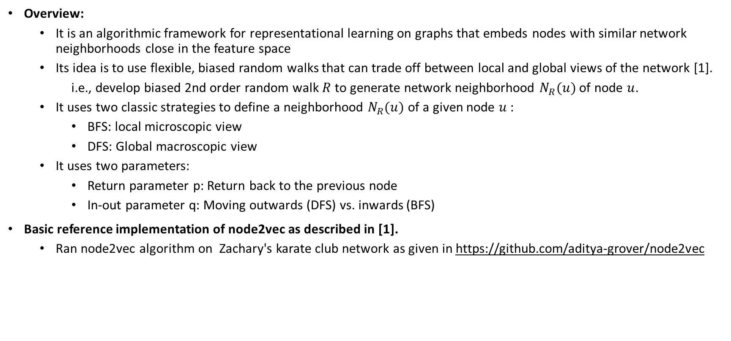
Node2vec node embedding
Overview:
It is an algorithmic framework for representational learning on graphs that embeds nodes with similar network neighborhoods close in the feature space
Its idea is to use flexible, biased random walks that can trade off between local and global views of the network [1].
i.e., develop biased 2nd order random walk $R$ to generate network neighborhood $N_{R}(u)$ of node $u$.
It uses two classic strategies to define a neighborhood $N_{R}(u)$ of a given node $u$:
BFS: local microscopic view
DFS: Global macroscopic view
It uses two parameters:
Return parameter p: Return back to the previous node
In-out parameter q: Moving outwards (DFS) vs. inwards (BFS)
Basic reference implementation of node2vec as described in [1].
Ran node2vec algorithm on Zachary's karate club network as given in https://github.com/aditya-grover/node2vec
[1]: node2vec: Scalable Feature Learning for Networks. A. Grover, J. Leskovec. ACM SIGKDD International Conference on Knowledge Discovery and Data Mining (KDD), 2016.

