Slide 1
Independent Study Weekly Report (July 27-31, 2020)
Ahuti Shrestha

Slide 2
Worked on Stack Overflow Data Set
Parsed the original Stack Overflow Data Set (Posts.xml) and extracted information as follows:
ques.py:
It takes input file Posts.xml and outputs ques.txt with fields: question id, question owner id and accepted answer id.
ans.py:
It takes input file Posts.xml and outputs ans.txt with fields: answer id and answer owner id.
java_tag.py:
It takes input file Posts.xml and outputs java_tag.txt with field: java question id.
join_javatag_ques.py:
It joins input files java_tag.txt and ques.txt based on java question id and question id from the respective files and outputs java_post.txt with fields: java question id, question owner id, accepted answer id, java question id.

Slide 3
Worked on Stack Overflow Data Set (Contd..)
join_ans_javapost.py:
It joins input files ans.txt and java_post.txt based on accepted answer ids of the respective files and outputs java_ques_ans.txt with fields: java question id, question owner id, accepted answer id, java question id, accepted answer id and answer owner id.
ques_ans_owners.py:
It takes input file java_ques_ans.txt and output ques_ans_owners.txt with fields: question owner id and answer owner id.
Input files, output files and codes can be found at “/media/Data/ahuti" in server.

Slide 4
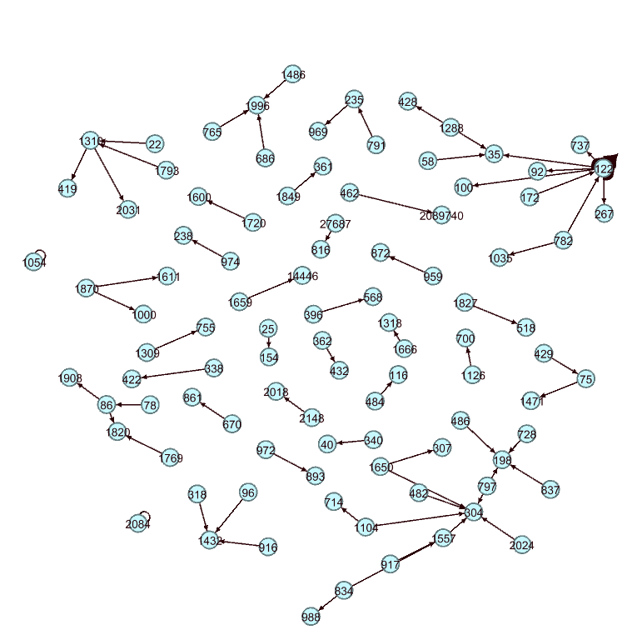
Worked on Stack Overflow Data Set (Contd..)
Used Gephi to visualize the network
Total number of nodes ≈390,000 Total number of edges ≈830,000
The network formed using all nodes was extremely dense to visualize. So, below is the network created using only the small portion of data (with ≈ 100 nodes).
Here,
nodes: User id
edges: Question owner pointing towards accepted answer owner

