Slide 1
Independent Study Weekly Report (July 6-10, 2020)
Ahuti Shrestha

Slide 2
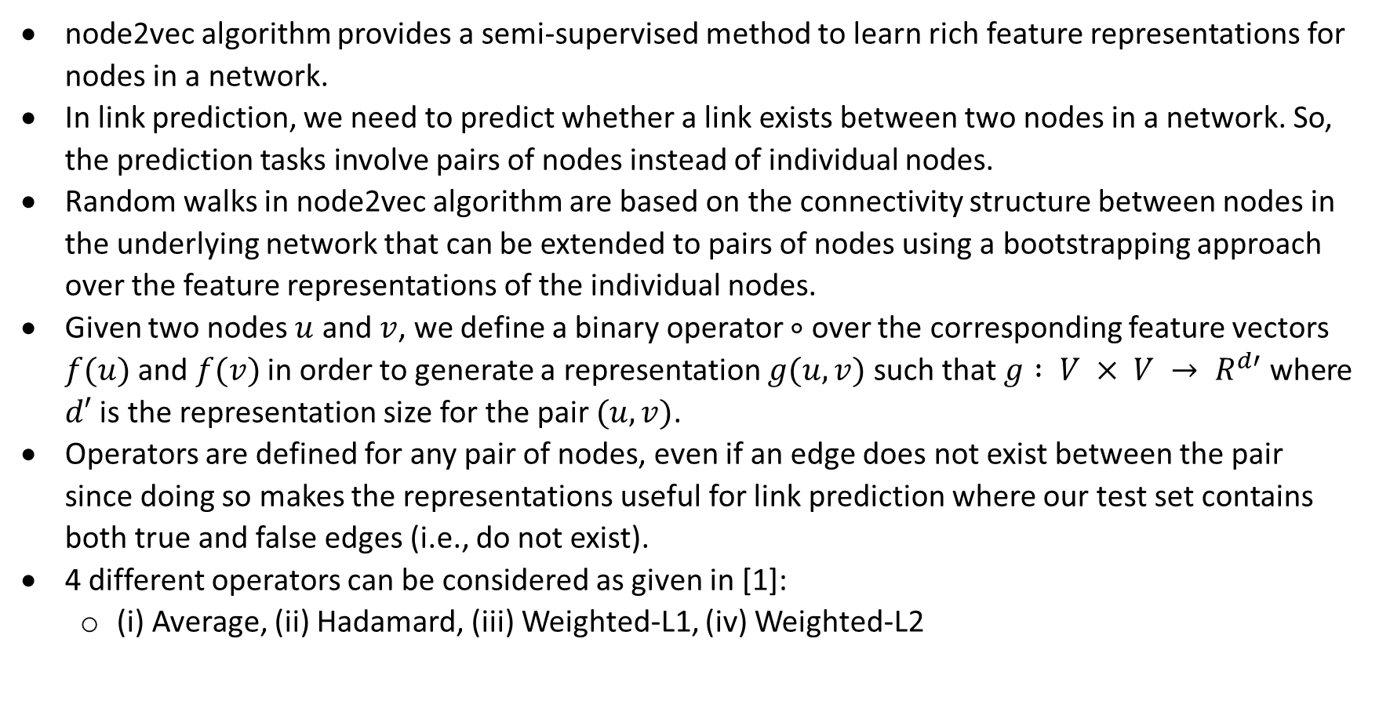
Node embedding and link prediction
node2vec algorithm provides a semi-supervised method to learn rich feature representations for nodes in a network.
In link prediction, we need to predict whether a link exists between two nodes in a network. So, the prediction tasks involve pairs of nodes instead of individual nodes.
Random walks in node2vec algorithm are based on the connectivity structure between nodes in the underlying network that can be extended to pairs of nodes using a bootstrapping approach over the feature representations of the individual nodes.
Given two nodes $u$ and $v$, we define a binary operator $∘$ over the corresponding feature vectors $f(u)$ and $f(v)$ in order to generate a representation $g(u, v)$ such that $g : V × V → R^{d′}$ where $d′$ is the representation size for the pair $(u, v)$.
Operators are defined for any pair of nodes, even if an edge does not exist between the pair since doing so makes the representations useful for link prediction where our test set contains both true and false edges (i.e., do not exist).
4 different operators can be considered as given in [1]:
(i) Average, (ii) Hadamard, (iii) Weighted-L1, (iv) Weighted-L2
[1]: node2vec: Scalable Feature Learning for Networks. A. Grover, J. Leskovec. ACM SIGKDD International Conference on Knowledge Discovery and Data Mining (KDD), 2016.

Slide 3
Other works
Downloaded Stack Overflow original data (zipped) but unable to extract the data due to huge size (≈82 GB) .
Tried graph visualization with Networkx.

