Slide 1
Independent Study Weekly Report (June 8 – 19, 2020)
Ahuti Shrestha

Slide 2
Covered the following topics from the course material from Stanford University: Overview of graph and network
Graphs describes topologies and networks are graphs with data on nodes and/or edges of the network that describe complex systems such as society, world economy, roads, etc.
Network contains objects as vertices, interactions as edges and system as a graph and can be represented as directed or undirected graphs, adjacency matrix, adjacency list, etc.
There are more types of graphs such as self-loop or multigraphs and the connectivity of the graphs can be strongly connected
Key network properties: degree distribution, path length, clustering coefficient, connected components
Different graph models:
Random graph model (G_{np}): Not correct when compared with real world networks but still helpful
Small-world model: Small average path lengths and high clustering (Watts Strogatz Model).
Kronecker Graph Model: Generating large realistic graphs.

Slide 3
Subgraphs
Network motifs:
Recurring, significant and patterns of interconnections
Helps to understand how networks work and predict operation and reaction of the network in a given situation.
Graphlets:
Connected non-isomorphic subgraphs
Counting subgraphs:
Network-centric approaches:
Enumerating all size-k connected subgraphs
Counting #(occurrences of each subgraph type) via graph isomorphisms test
Algorithms:
Exact subgraph enumeration (ESU)
Kavosh
Subgraph sampling
Roles vs Groups in Network
Roles: A group of nodes with similar structural properties
Communities/Groups: A group of nodes that are well-connected to each other
Roles and communities are complementary

Slide 4
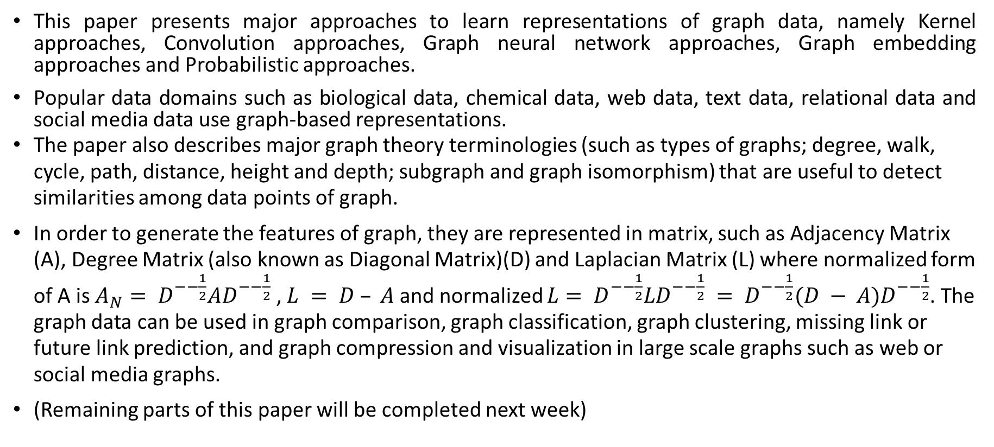
Paper: Learning Representations of Graph Data- A Survey - Mital Kinderkhedia, Department of Statistical Science, University College London, London, W1CE 6BT
This paper presents major approaches to learn representations of graph data, namely Kernel approaches, Convolution approaches, Graph neural network approaches, Graph embedding approaches and Probabilistic approaches.
Popular data domains such as biological data, chemical data, web data, text data, relational data and social media data use graph-based representations.
The paper also describes major graph theory terminologies (such as types of graphs; degree, walk, cycle, path, distance, height and depth; subgraph and graph isomorphism) that are useful to detect similarities among data points of graph.
In order to generate the features of graph, they are represented in matrix, such as Adjacency Matrix (A), Degree Matrix (also known as Diagonal Matrix)(D) and Laplacian Matrix (L) where normalized form of A is $A_{N}= D^{−−\frac{1}{2}}AD^{−−\frac{1}{2}}$ , $L = D – A$ and normalized $L= D^{−−\frac{1}{2}}LD^{−−\frac{1}{2}} = D^{−−\frac{1}{2}}(D − A)D^{−−\frac{1}{2}}$. The graph data can be used in graph comparison, graph classification, graph clustering, missing link or future link prediction, and graph compression and visualization in large scale graphs such as web or social media graphs.
(Remaining parts of this paper will be completed next week)

Slide 5
Stanford Network Analysis Platform (SNAP)
Open source software for network analysis and graph mining library used widely in studies of web and social media.
APIs are available in python (snap.py) and C++.
Efficiently manipulates large graphs, calculates structural properties, generates regular and random graphs, and supports attributes on nodes and edges.
Edges and attributes in a graph or a network can be changed dynamically during the computation.
Large collection of web and social network datasets
Graph types and network types in SNAP
TUNGraph: undirected graph (single edge between an unordered pair of nodes)
TNGraph: directed graph (single directed edge between an ordered pair of nodes)
TNEGraph: directed multi-graph
TNEANet: directed multigraph with attributes for nodes and edges

Slide 6
Worked on Snap.py Tutorial
Installed snap.py along with Gnuplot and Graphviz
Completed quick tutorial on:
Basic data types
Vectors, hash tables and pairs
Graph creation
Adding and traversing nodes and edges
Saving and loading graphs
Graph manipulation
Plotting and visualization

Slide 7
This week
Cover more on graphs and networks (Stanford course and papers)
SNAP Hands-on Exercise

