Slide 1
Independent Study Weekly Report (June 22 – 26, 2020)
Ahuti Shrestha

Slide 2
Paper (Contd.): Learning Representations of Graph Data- A Survey - Mital Kinderkhedia, Department of Statistical Science, University College London, London, W1CE 6BT
This paper presents the following approaches to graph representation based on the survey of various papers:
Kernel approaches:
They use kernel function which is the inner product of two vectors in feature space.
The feature representation for each kernel type is fixed using the Bag-of-Structure approach in which each data point is a derived vector representation for a given type of graph substructure and each dimension corresponds to a type of substructure.
Convolution approaches:
Convolutional neural networks (CNNs) can work with image, video and speech data.
CNNs learning involves convolution and pooling where localized convolutional filters learned from data identify similar features which are then fed into pooling layer to provide a compressed output.
Graph neural network:
It has two steps. i) parametric transition functions that shows the dependence between vertex, its label and its neighborhood, propagates the learned vertex representations. ii) the local output function maps vertex representations to respective graph labels. GNN learns in a recursive manner.
Graph embedding approaches:
They transform an input graph into its respective vector representation mapping it to a point in space with a function mapping. They focus on preserving the proximity such that vertices within the same neighborhood share nearby euclidean space.
The general idea of graph embedding is: the encoder ENC maps the vertices to vector embeddings and the decoder DEC accepts a set of embeddings and decodes the user-specified graph statistics from these embeddings. Examples: walk based approaches of graph embedding such as Deepwalk that uses truncated random walk to transform the sampled linear sequence vertices into a co-occurrence matrix; subgraph based embedding approaches, multimodal data graphs, inductive framework
Probabilistic Approach:
It encompasses a variety of neural generative models, gradient based optimization methods and neural inference techniques. It can use a variational auto-encoding approach to learn the graph representation, where a Graph Convolutional Network is used as and encoder and inner product as decoder.

Slide 3
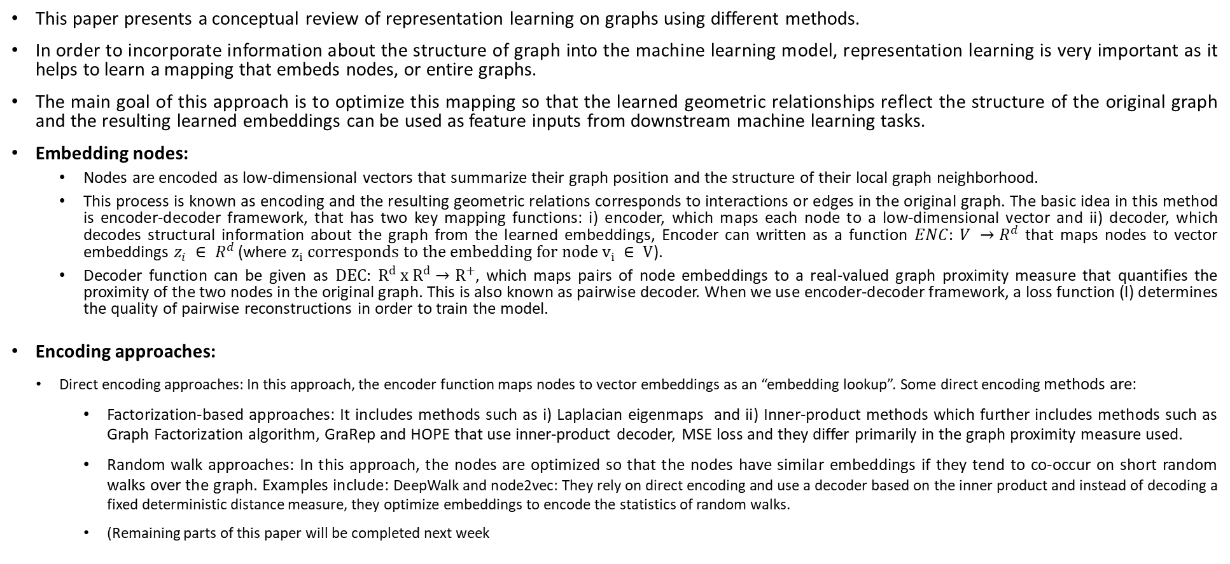
Paper: Representation Learning on Graphs: Methods and Applications - William L. Hamilton, Rex Ying, Jure Leskovec, Department of Computer Science, Stanford University, Stanford, CA
This paper presents a conceptual review of representation learning on graphs using different methods.
In order to incorporate information about the structure of graph into the machine learning model, representation learning is very important as it helps to learn a mapping that embeds nodes, or entire graphs.
The main goal of this approach is to optimize this mapping so that the learned geometric relationships reflect the structure of the original graph and the resulting learned embeddings can be used as feature inputs from downstream machine learning tasks.
Embedding nodes:
Nodes are encoded as low-dimensional vectors that summarize their graph position and the structure of their local graph neighborhood.
This process is known as encoding and the resulting geometric relations corresponds to interactions or edges in the original graph. The basic idea in this method is encoder-decoder framework, that has two key mapping functions: i) encoder, which maps each node to a low-dimensional vector and ii) decoder, which decodes structural information about the graph from the learned embeddings, Encoder can written as a function $ENC: V →R^{d}$ that maps nodes to vector embeddings $z_{i} ∈ R^{d}$(where $z_{i} corresponds to the embedding for node v_{i} ∈ V$).
Decoder function can be given as $DEC: R^{d} x R^{d}→R^{+}$, which maps pairs of node embeddings to a real-valued graph proximity measure that quantifies the proximity of the two nodes in the original graph. This is also known as pairwise decoder. When we use encoder-decoder framework, a loss function (l) determines the quality of pairwise reconstructions in order to train the model.
Encoding approaches:
Direct encoding approaches: In this approach, the encoder function maps nodes to vector embeddings as an “embedding lookup”. Some direct encoding methods are:
Factorization-based approaches: It includes methods such as i) Laplacian eigenmaps and ii) Inner-product methods which further includes methods such as Graph Factorization algorithm, GraRep and HOPE that use inner-product decoder, MSE loss and they differ primarily in the graph proximity measure used.
Random walk approaches: In this approach, the nodes are optimized so that the nodes have similar embeddings if they tend to co-occur on short random walks over the graph. Examples include: DeepWalk and node2vec: They rely on direct encoding and use a decoder based on the inner product and instead of decoding a fixed deterministic distance measure, they optimize embeddings to encode the statistics of random walks.
(Remaining parts of this paper will be completed next week

