Slide 1
MS Project
Weekly Report
Ahuti Shrestha
May 25, 2021

Slide 2
Features before normalization
Cluster-GCN
Features after normalization
Ans_ownid | Ans_score | Comt_ct | Ques_score | View_ct | Ans_ct | Time | Ans
5004157 | 1 | 0 | 0 | 81 | 1 | 4555.377 | 1
6815131 | 2.6 | 1.666667 | 0.466667 | 129.2 | 1.466667 | 501.3885 | 15
2988730 | 1.625 | 0.375 | 0.375 | 217.625 | 1.5 | 1189.677 | 8
34397 | 2.5 | 0 | 0.25 | 127.25 | 1.5 | 641.8108 | 4
5645656 | 0.6 | 1.8 | 0.5 | 109.9 | 2.2 | 2187.292 | 10
10116037 | 1 | 0 | 0 | 330 | 1 | 59305.07 | 1
992484 | 1.196429 | 1.678571 | 0.107143 | 77.5 | 1.401786 | 9951.699 | 112
7176382 | 0 | 0 | 1 | 45 | 2 | 1097.07 | 1
2830167 | 1.272727 | 0.181818 | 1 | 121.6364 | 0.636364 | 990.0587 | 11
1746118 | 2.984733 | 1.549618 | 2.400763 | 267.5916 | 1.851145 | 4927.297 | 262
2970947 | 2.016194 | 1.558704 | 0.259109 | 107.2794 | 1.708502 | 1351.869 | 247
20860 | 1.166667 | 0.166667 | 2 | 265.6667 | 1.166667 | 14459.27 | 6
6505250 | 1.944444 | 1.740741 | 0.907407 | 488.3519 | 1.222222 | 46595.77 | 54
1137174 | 1.8 | 1.2 | 0.8 | 113.8 | 1 | 41156.01 | 5
Ans_ownid | Ans_score | Comt_ct | Ques_score | View_ct | Ans_ct | Time | Ans
5004157 | 1.25 | 1 | 1.672414 | 1.010431 | 1.428571 | 1.001016 | 1
6815131 | 1.35 | 1.681818 | 1.696552 | 1.016638 | 1.628571 | 1.000112 | 1.211055
2988730 | 1.289063 | 1.153409 | 1.69181 | 1.028026 | 1.642857 | 1.000265 | 1.105528
34397 | 1.34375 | 1 | 1.685345 | 1.016387 | 1.642857 | 1.000143 | 1.045226
5645656 | 1.225 | 1.736364 | 1.698276 | 1.014153 | 1.942857 | 1.000488 | 1.135678
10116037 | 1.25 | 1 | 1.672414 | 1.042497 | 1.428571 | 1.013221 | 1
992484 | 1.262277 | 1.686688 | 1.677956 | 1.00998 | 1.600765 | 1.002218 | 2.673367
7176382 | 1.1875 | 1 | 1.724138 | 1.005795 | 1.857143 | 1.000245 | 1
2830167 | 1.267045 | 1.07438 | 1.724138 | 1.015664 | 1.272727 | 1.000221 | 1.150754
1746118 | 1.374046 | 1.633935 | 1.796591 | 1.03446 | 1.793348 | 1.001098 | 4.934673
2970947 | 1.313512 | 1.637652 | 1.685816 | 1.013815 | 1.732215 | 1.000301 | 4.708543
20860 | 1.260417 | 1.068182 | 1.775862 | 1.034212 | 1.5 | 1.003223 | 1.075377
6505250 | 1.309028 | 1.712121 | 1.719349 | 1.06289 | 1.52381 | 1.010387 | 1.798995
1137174 | 1.3 | 1.490909 | 1.713793 | 1.014655 | 1.428571 | 1.009175 | 1.060302

Slide 3
Input:
Ans_ownid | Ans_score | Comt_ct | Ques_score | View_ct | Ans_ct | Time | Ans | Label
5772882 | 1.332801 | 1.421035 | 1.719607 | 1.02165 | 1.730448 | 1.009742 | 5.115578 | 6
5221149 | 1.325146 | 1.612952 | 1.695422 | 1.017791 | 1.688724 | 1.0009 | 10 | 6
2711488 | 1.437 | 1.682364 | 1.822 | 1.031264 | 1.785143 | 1.099498 | 4.753769 | 6
10819573 | 1.240951 | 1.901106 | 1.686393 | 1.007475 | 1.858798 | 1.001112 | 8.79397 | 6
3788176 | 1.428797 | 1.66542 | 1.725938 | 1.012177 | 1.744575 | 1.002685 | 5.748744 | 6
5133585 | 1.331767 | 1.652085 | 1.723166 | 1.012585 | 1.765306 | 1.000404 | 4.994975 | 6
139985 | 1.328403 | 1.58501 | 1.706633 | 1.02298 | 1.675027 | 1.012134 | 6.909548 | 6
1221571 | 1.466539 | 1.727487 | 1.795991 | 1.024857 | 1.805593 | 1.000093 | 7.376884 | 6
1240763 | 1.262261 | 2.121575 | 1.704092 | 1.048826 | 1.504443 | 1.004506 | 4.135678 | 6
51591 | 1.270127 | 1.672573 | 1.742548 | 1.04265 | 1.62615 | 1.009902 | 5.432161 | 6

Slide 4
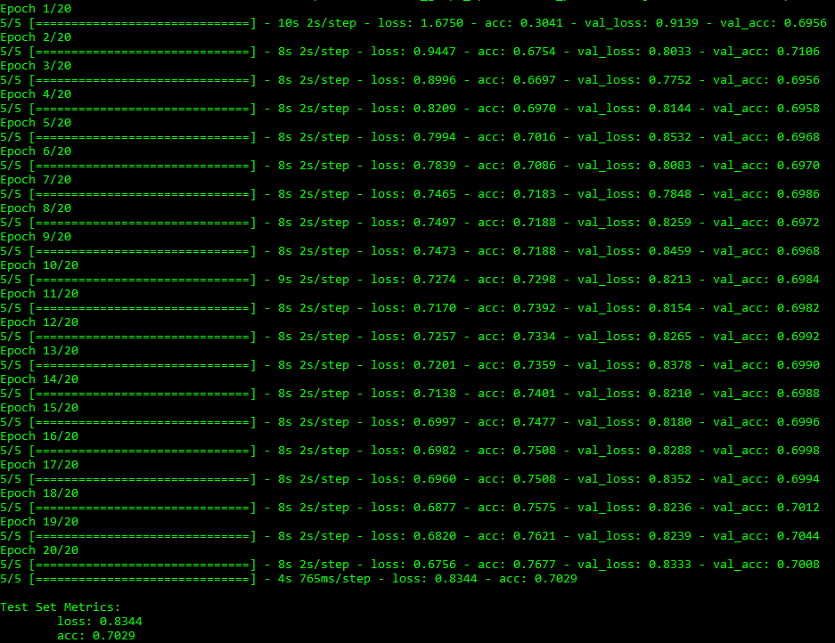
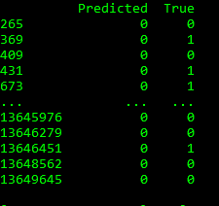
Output

