Slide 1
MS Project
Weekly Report (March 29 – April 2, 2021)
Ahuti Shrestha
April 5, 2021

Slide 2
Cluster-GCN: Running the code
Tried to run the codes, but could no install required packages
It requires following packages:
networkx==1.11
tqdm==4.28.1
numpy==1.15.4
pandas==0.23.4
texttable==1.5.0
scipy==1.1.0
argparse==1.1.0
torch==0.4.1
torch-geometric==0.3.1
metis==0.2a.4
scikit-learn==0.20
torch_spline_conv==1.0.4
torch_sparse==0.2.2
torch_scatter==1.0.4
torch_cluster==1.1.5
But when I am not able to install torch_spline_conv.

Slide 3
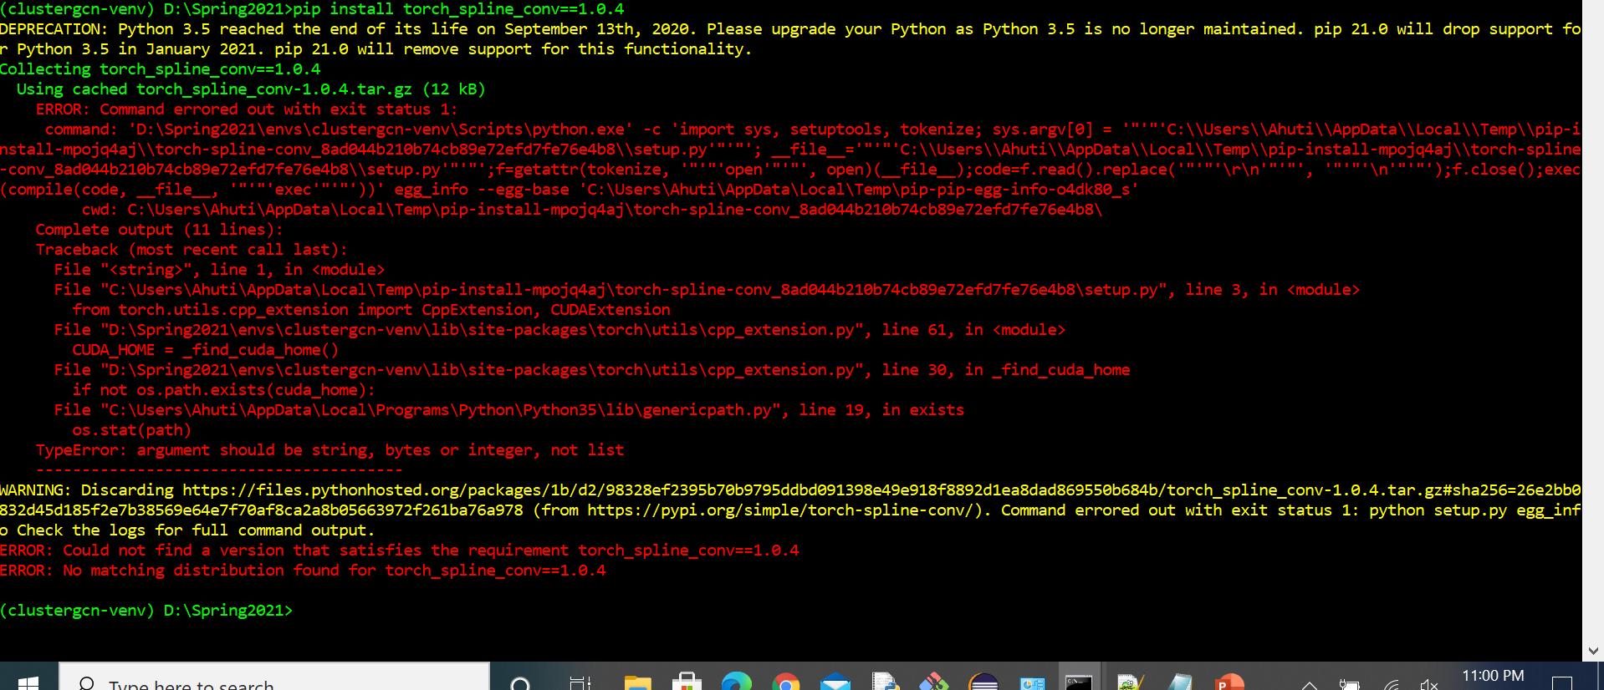

Slide 4
GraphSAGE
Working on the codes

