Slide 1
Predicting Housing Prices
Machine Learning with Python

Slide 2

Agenda
Goal & Approach
Feature Analysis & Engineering
Model: Selection & Optimization
Predictive
Model
Housing Prices

Slide 3
E.
Approach
D.
Model
Optimization
C.
Model
Selection
Feature Engineering
A.
B.
Exploratory
Data Analysis (EDA)
Feature
Analysis
Predictive
Model
Housing Prices

Slide 4
Exp
Data
Analysis
Overview: Dataset
Samples: Training set has 1460 samples &
test set has 1459 samples *
Features: Training set has 81 features and test set has 80 features *
One extra feature in the training set is SalePrice, which is the target to predict
* Missing Features and wrong d-types
Predictive
Model
Housing Prices

Slide 5
Exp
Data
Analysis
Overview: Missingness
There are many features with missing values in both training set and test set
Training set has missing values in 19 features
Test set has missing values in 32 features
Predictive
Model
Housing Prices

Slide 6
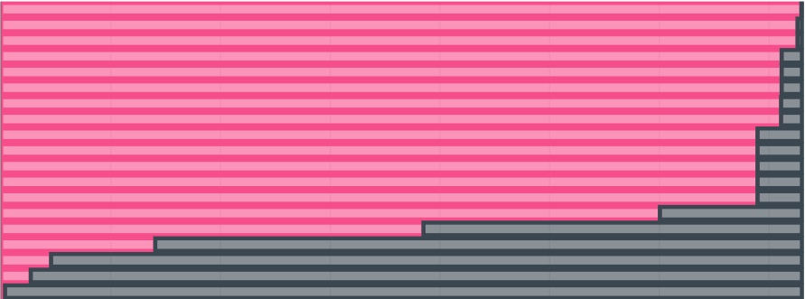
Exp
Data
Analysis
Overview: Missingness
Electrical
MasVnrType
MasVnrArea
BsmtQual
BsmtFinType2
GarageCond
GarageFinish
GarageType
LotFrontage
FirePlaceQu
Fence
Alley
Misc Feature
PoolQC
Predictive
Model
Housing Prices
NULL
Exist

Slide 7
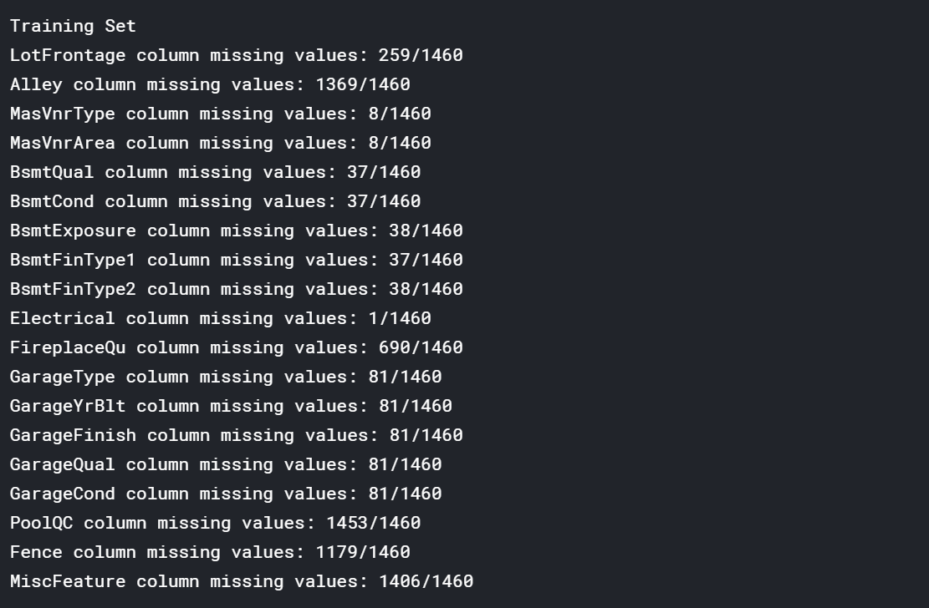
Exp
Data
Analysis
Overview: Missingness
Predictive
Model
Housing Prices

Slide 8
Exp
Data
Analysis
Overview: Missingness
There are two types of missing data
Systematically missing data
Randomly missing data.
Predictive
Model
Housing Prices
Electrical
MasVnrType
MasVnrArea
BsmtQual
BsmtFinType2
GarageCond
GarageFinish
GarageType
LotFrontage
FirePlaceQu
Fence
Alley
Misc Feature
PoolQC

Slide 9
Exp
Data
Analysis
Overview: Missingness
Examples of Systematic Missing Data :
MasVnrArea and MasVnrType are defined as masonry veneer area in square feet and masonry veneer type. Missing values in those features mean that there is no masonry veneer in those houses. Imputation : None
Other systematically missing categorical features are Alley, Fence, FireplaceQu, MiscFeature and PoolQC. There are missing data in them because those features doesn't exist in those houses. Imputation : None
GarageType, GarageYrBlt, GarageFinish, GarageQual and GarageCond are categorical Imputation : None
Predictive
Model
Housing Prices
Electrical
MasVnrType
MasVnrArea
BsmtQual
BsmtFinType2
GarageCond
GarageFinish
GarageType
LotFrontage
FirePlaceQu
Fence
Alley
Misc Feature
PoolQC

Slide 10
Exp
Data
Analysis
Overview: Missingness
Examples of Random Missing Data:
Garage Cars, BsmtFullBath, BsmtHalfBath column has very few nulls.
Imputation: Median
Electrical, Exterior1st, Exterior2nd, Functional, KitchenQual, MSZoning, SaleType and Utilities are categorical features with randomly missing data.
Imputation : Random Values Method
LotFrontage is the only randomly missing continuous feature.
Imputation: Median values of neighborhoods.
Predictive
Model
Housing Prices
Electrical
MasVnrType
MasVnrArea
BsmtQual
BsmtFinType2
GarageCond
GarageFinish
GarageType
LotFrontage
FirePlaceQu
Fence
Alley
Misc Feature
PoolQC

Slide 11
Exp
Data
Analysis
Target Variable : Distribution and Normality
The data is not normally distributed. Training set SalePrice skew is 1.88 which clearly shows that the target has high positive skew. The distribution is asymmetrical because of the extremely high outliers in Training dataset
SalePrice kurtosis is 6.53 which is an indicator of the tail extremity. Mean SalePrice is 180921.2, however, median is 163000. This huge gap between mean and median is also the effect of outliers
Probability plot clearly illustrates that outliers will strongly affect the regression models since a single outlier may result in all predictor coefficients being biased. The probability being a convex curve rather than a straight line is the result of the skewness.
Predictive
Model
Housing Prices

Slide 12
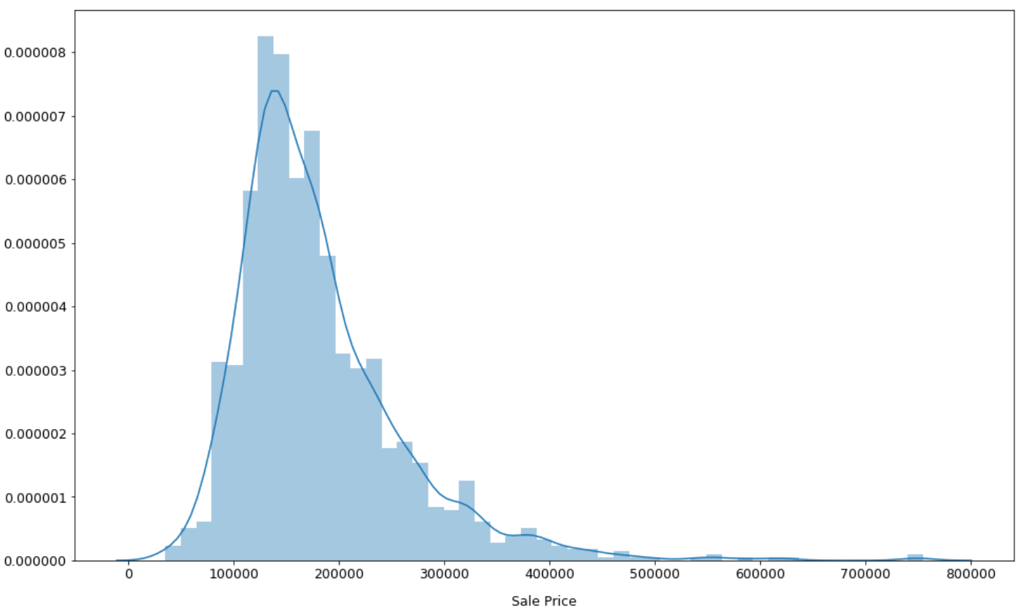
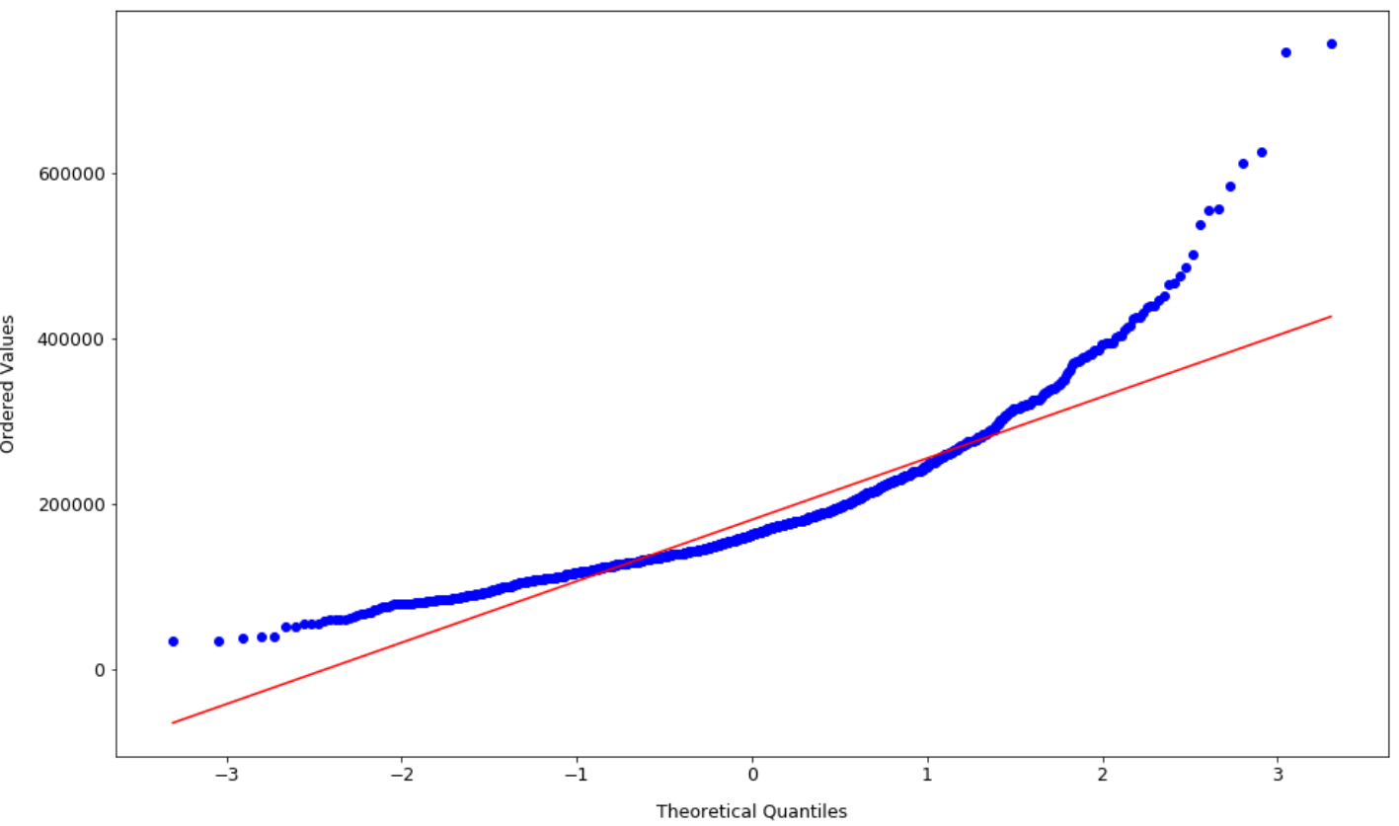
Feature
Analysis
Target Variable : Distribution and Normality
Predictive
Model
Housing Prices

Slide 13
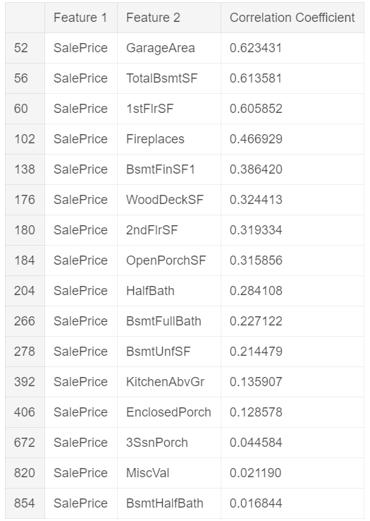
Feature
Analysis
Correlations Analysis
Features are strongly correlated with target
8 features have more than 0.3 correlation coefficient with SalePrice and 3 of them are higher than 0.6
Also, It looks like multicollinearity occurs in the dataset.
The other features are also strongly correlated with each other and dependent to each other
There are more than 25 correlations with at least 0.5 coefficient.
The highest among them is between GarageArea and GarageCars which is 0.88
Predictive
Model
Housing Prices

Slide 14
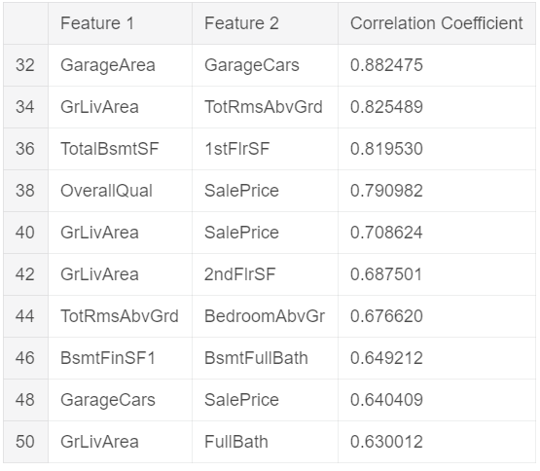
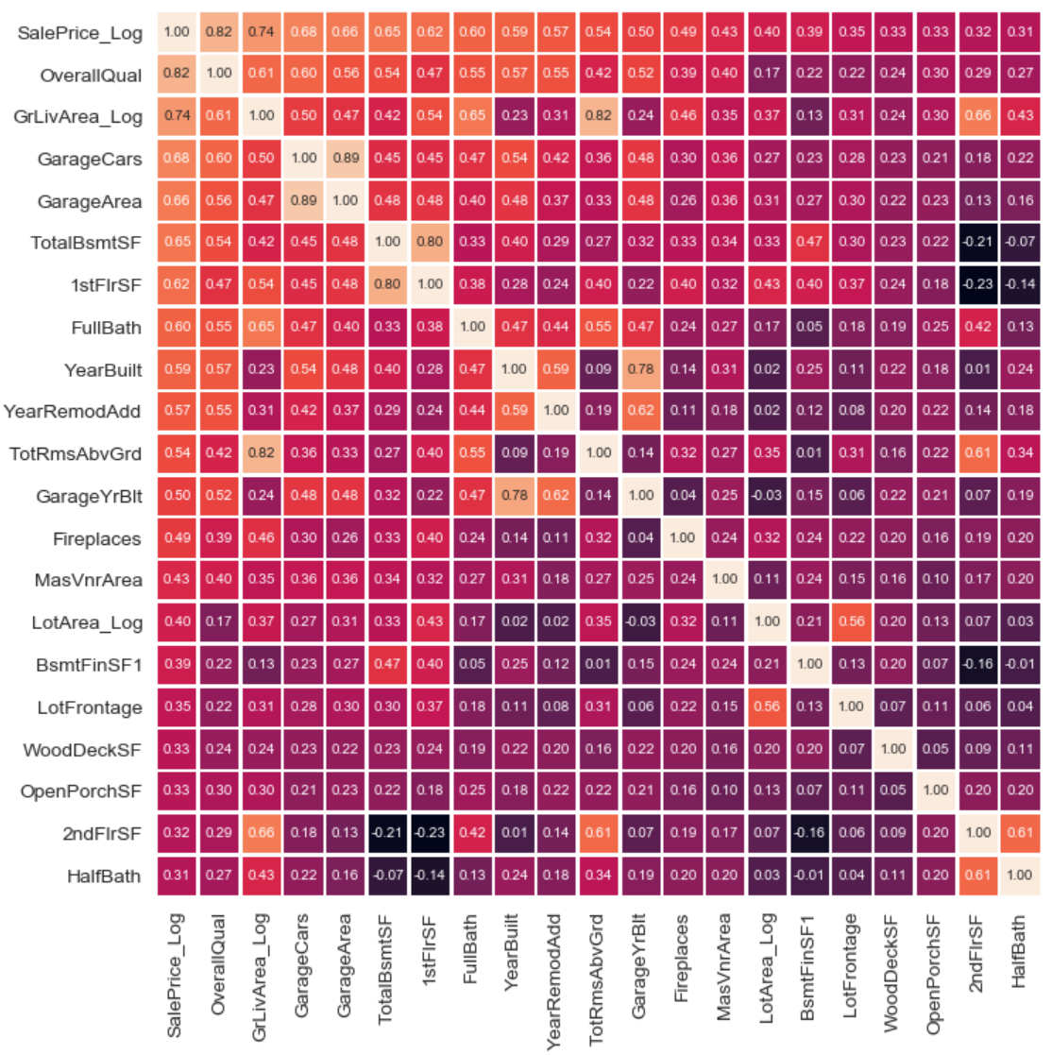
Feature
Analysis
Correlations Analysis
Predictive
Model
Housing Prices

Slide 15
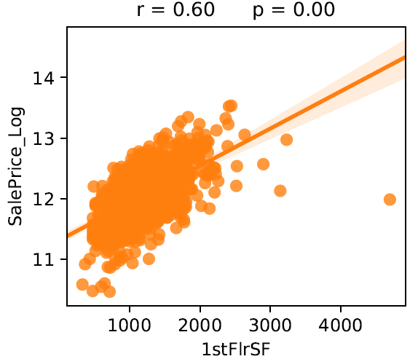
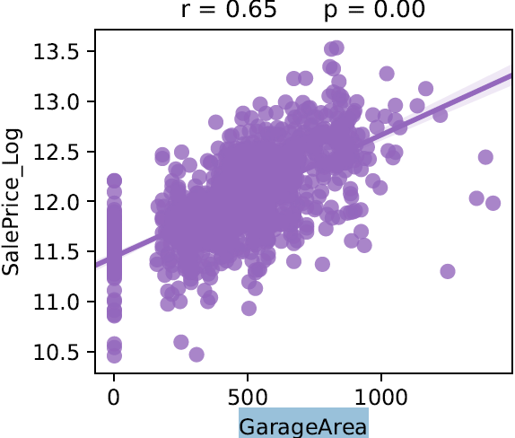
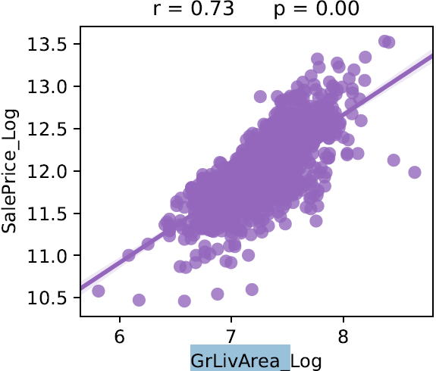
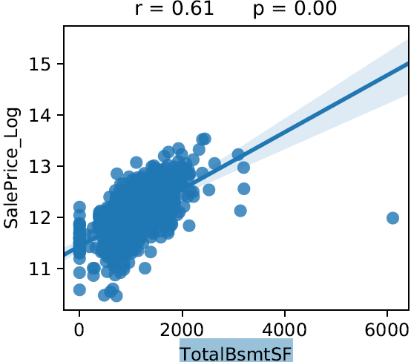
Feature
Analysis
Target vs. Features: Bi-variate analysis
Numeric Features
Data points of 1stFlrSF, BsmtUnfSF, GarageArea, GrLivArea, LotArea, LotFrontage and TotalBsmtSF features are not stacked at 0 as much as other numerical features. Those features exist in almost every single house.
Fitting the regression line is easier for those features.
In addition to that, outliers are very visible in those features.
Predictive
Model
Housing Prices

Slide 16
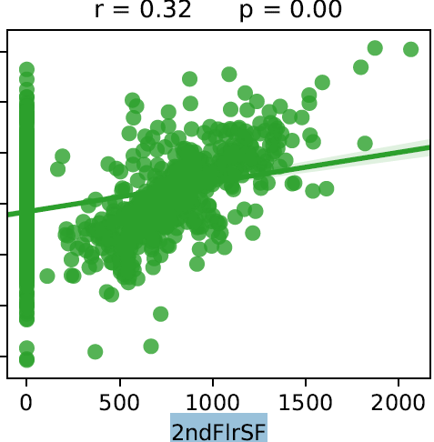
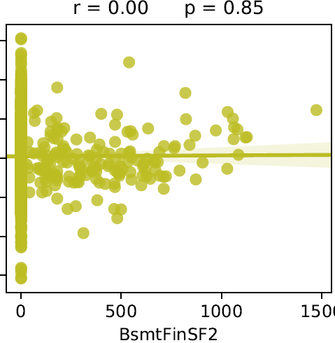
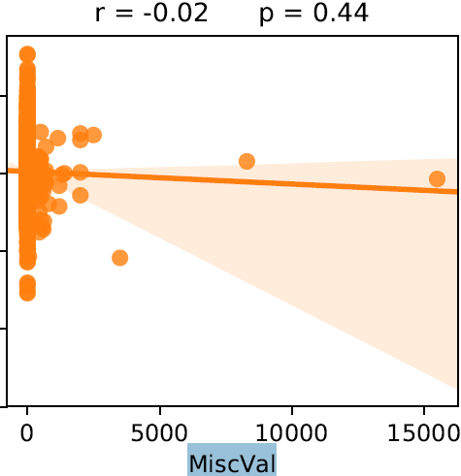
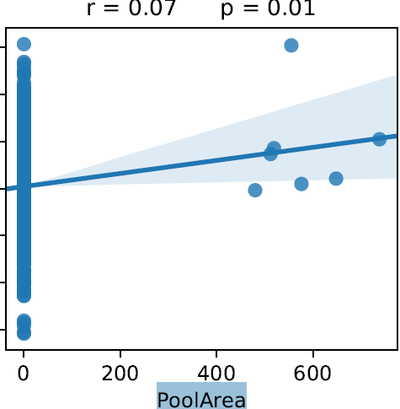
Feature
Analysis
Target vs. Features: Bi-variate analysis
Data points of 2ndFlrSF, 3SsnPorch, BsmtFinSF1, BsmtFinSF2, EnclosedPorch, LowQualFinSF, MasVnrArea, MiscVal, OpenPorchSF, PoolArea, ScreenPorch and WoodDeckSF features are heavily stacked at 0. Those features are rarer than the previous ones and they don't exist in every house, so they are sparse features. Those sparse features may not be reliable as the previous features when they are used as continuous features, because they are going to introduce bias to the regression function.
Predictive
Model
Housing Prices

Slide 17
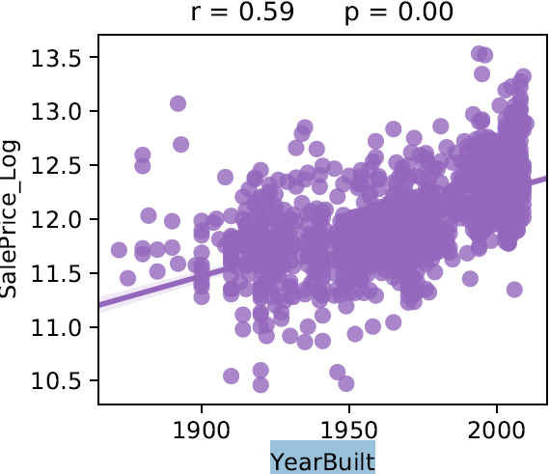
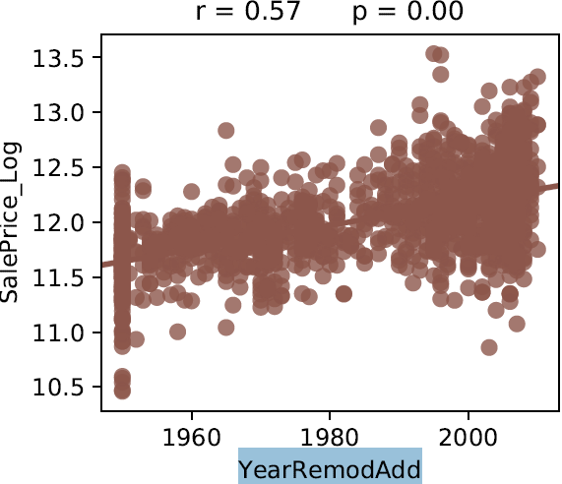
Feature
Analysis
Target vs. Features: Bi-variate analysis
GarageYrBlt, YearBuilt and YearRemodAdd are ordinal features, but a linear relationship can be seen from their plots. Houses with recent dates are more likely to be sold at higher prices
Predictive
Model
Housing Prices

Slide 18
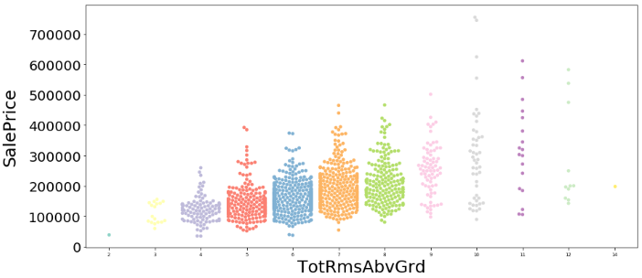
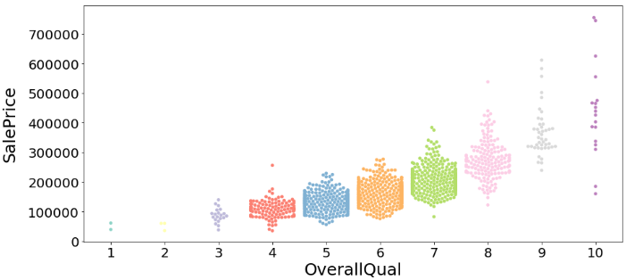
Feature
Analysis
Target vs. Features: Bi-variate analysis
Categorical features are not strongly correlated with SalePrice. There are only 2 categorical features that have significant correlation with SalePrice, and they are OverallQual and TotRmsAbvGrd. A linear relationship can easily be seen from their plots. When the number of OverallQual and TotRmsAbvGrd increases, SalePrice tends to increase as well.
Predictive
Model
Housing Prices

Slide 19
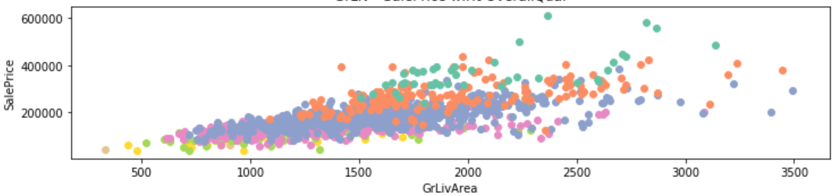

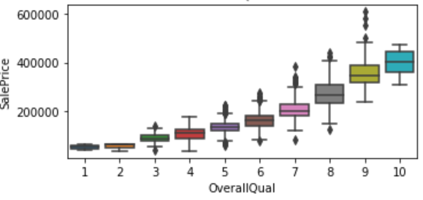
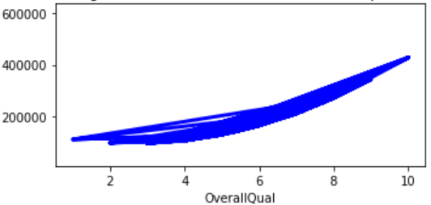
Feature
Analysis
Overall Effect Sale price
GrLiv to SalePrice (w.r.t OverallQual)
Boxplot Overall Qual & SalePrice
Linear Regression , SalePrice ~OverallQual
Predictive
Model
Housing Prices
OverallQual is the best variables among Ordinal Variables regard of explaining SalePrice
OverallQual causes different SalePrice where having same "GrLivArea". We have to put a strong attention!
OverallQual is proportional to SalePrice, and (1-2) almost identical.
Square of OverallQual was a good variables since linear regression (SalePrice ~ O.Q + O.Q^2) has good curve shape

Slide 20
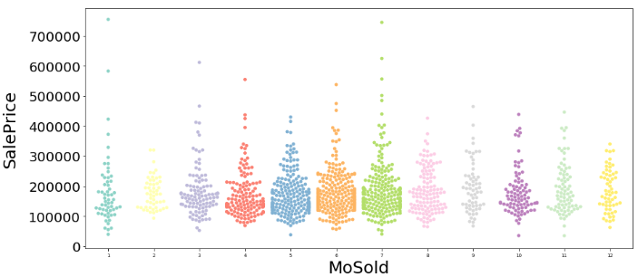
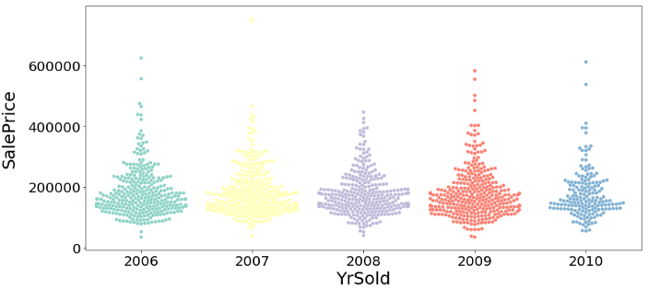
Feature
Analysis
Target vs. Features: Bi-variate analysis
Data points of MoSold and YrSold are uniformly distributed between classes. Those two features might have the least information about SalePrice among other categorical features
The other categorical features don't have significant correlation with SalePrice. However, values in some of those features have very distinct SalePrice maximums, minimums and interquartile ranges. Those features could be useful in tree based algorithms.
Predictive
Model
Housing Prices

Slide 21
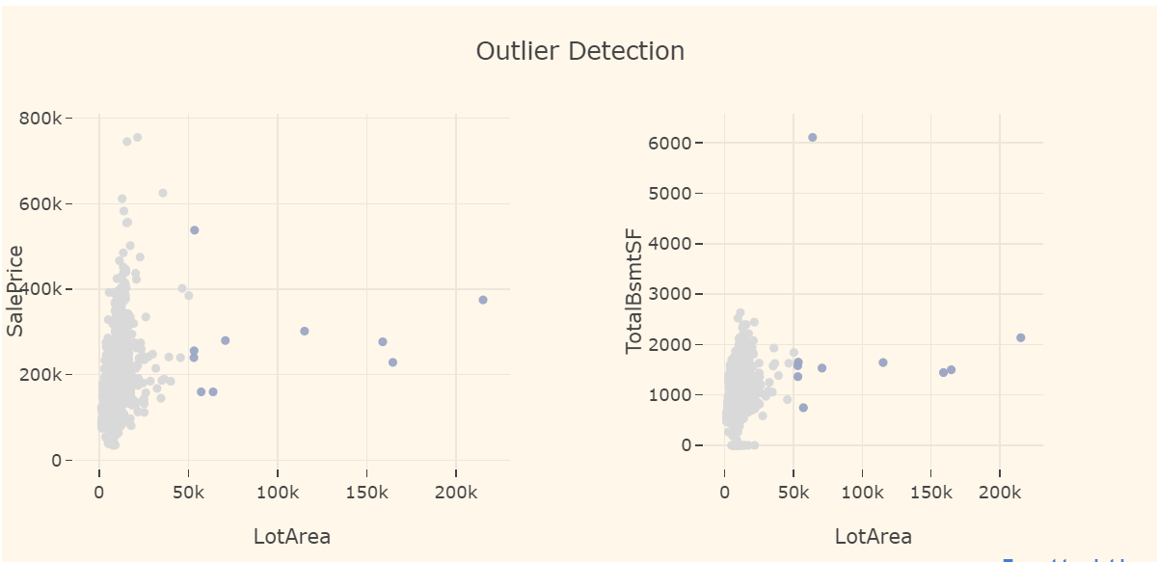
Feature
Analysis
Outlier Detection
Predictive
Model
Housing Prices

Slide 22
Feature
Analysis
EDA: Conclusions
There were 24 features with systematically missing data. Those features are filled with None and 0 depending on their types which made them sparse. Converting those features from multi class or continuous to binary, could give better results.
There are features with ambiguous types. GarageYrBlt, MoSold, YearBuilt, YearRemodAdd and YrSold are date features. Those are numerical features by default, and they imply linear relationship. It might be better to use some of them as categorical features.
Target (SalePrice) distribution is highly skewed and long tailed because of the outliers. It requires a transformation in order to perform better in models. Dealing with the outliers could also achieve better model performance.
Many features are strongly correlated with each other and target [Multi-collinearity]
12 continuous features are heavily stacked at 0. They are also sparse features.
Some categorical features are not informative for two reasons.
The feature is either too homogenous like Utilities feature
or in case of Garage X variables where one variable is an aggregation of other variables.
Predictive
Model
Housing Prices

Slide 23
Feature
Engineering
Philosophy & Approach
We combine some features to make a more useful variable:
Basement square footage
Living area square footage
Porch total square footage
Drop MiscVal as it contains no useful information
While attempting a Multiple Linear Regression model, we accounted for multicollinearity by removing features that are highly correlated with another.
We also removed features that had a low correlation with sale price.
Ridge, Lasso, and Random Forest removed the need to do this.
Predictive
Model
Housing Prices

Slide 24
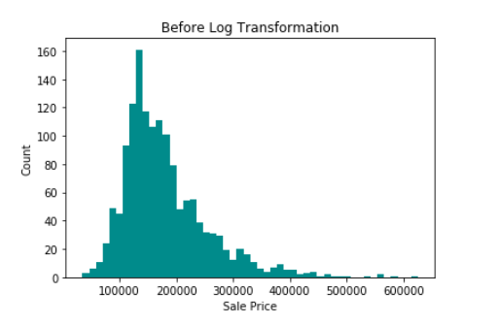
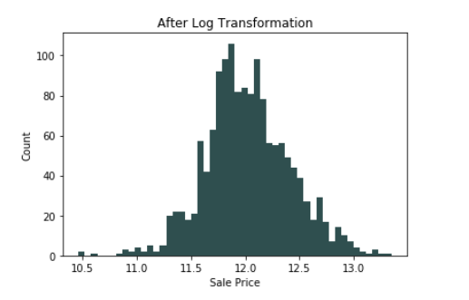
Feature
Engineering
Log Transformation
Upon inspection of the distribution of our features, we notice a right skewed distribution for sale price. We apply a log transformation to combat this, which results in a normally distributed feature.
We use this concept for some of our predictors as well:
GrLivArea, LotArea, LotFrontage
Predictive
Model
Housing Prices

Slide 25
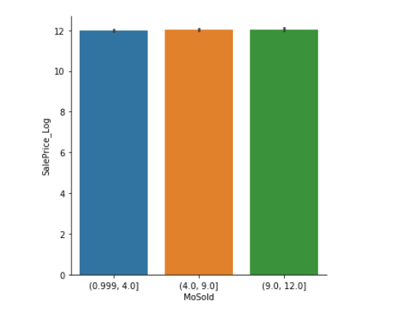
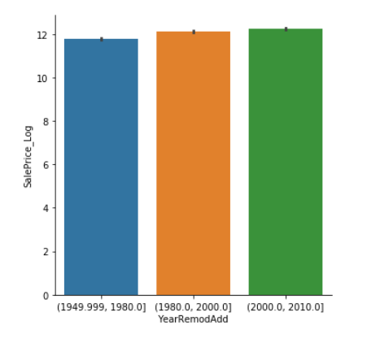
Feature
Engineering
Binning
We applied binning to MoSold, YearBuilt, YearRemodAdd, GarageYrBlt, PoolArea
As a result, we obtained a linear trend among these variables with sale price, and therefore gave us a relationship that was more useful.
Predictive
Model
Housing Prices

Slide 26
Feature
Engineering
Dummification of Categorical Variables
We dummify our categorical features and prepare to fit a model.
Before dummification, we had 45 categorical variables, 23 of which were ordinal. Different set of integers are mapped to those ordinal features depending on their values.
After dummification, we had a total of 321 features to help us predict our target variable.
There are also partial ordinal features that are not label encoded because all of their values are not ordered.
Predictive
Model
Housing Prices

Slide 27
Model Selection

Slide 28
Model
Selection
Models Employed
Multiple Linear Regression
RidgeCV
LassoCV
ElasticNetCV
Random Forest
XGBoost
Predictive
Model
Housing Prices

Slide 29
Model
Selection
RidgeCV
Hyperparameter search
Alpha range = linspace(0.01, 5, 200)
Cross-validation folds = [3, 5, 10, sqrt_n]
Normalization = [False, True]
Intercept = [False, True]
200 alpha X 4 CV X 2 Norm X 2 Intercept =
3200 config
Predictive
Model
Housing Prices

Slide 30
Model
Selection
RidgeCV
CV | Norm Type | Intercept Type | Alpha | R2 Training | R2 Test | MSE | Avg. CV Score
CV_3 | TRUE | TRUE | 0.34 | 0.94307 | 0.86306 | 0.01809 | 0.90146
CV_3 | TRUE | FALSE | 0.39 | 0.94784 | 0.89691 | 0.02134 | 0.85406
CV_3 | FALSE | TRUE | 5 | 0.94958 | 0.86306 | 0.01611 | 0.90035
CV_3 | FALSE | FALSE | 0.39 | 0.94784 | 0.88388 | 0.02134 | 0.85406
CV_5 | TRUE | TRUE | 0.21 | 0.94769 | 0.86303 | 0.01805 | 0.90681
CV_5 | TRUE | FALSE | 0.29 | 0.95005 | 0.89718 | 0.02135 | 0.86948
CV_5 | FALSE | TRUE | 4.17 | 0.9507 | 0.86303 | 0.01607 | 0.91139
CV_5 | FALSE | FALSE | 0.29 | 0.95005 | 0.88419 | 0.02135 | 0.86948
CV_10 | TRUE | TRUE | 0.16 | 0.94968 | 0.86299 | 0.01808 | 0.90625
CV_10 | TRUE | FALSE | 0.41 | 0.94736 | 0.89738 | 0.02135 | 0.86789
CV_10 | FALSE | TRUE | 3.27 | 0.95204 | 0.86299 | 0.01604 | 0.91051
CV_10 | FALSE | FALSE | 0.41 | 0.94736 | 0.88408 | 0.02135 | 0.86789
CV_31 | TRUE | TRUE | 0.16 | 0.94968 | 0.86299 | 0.01808 | 0.90048
CV_31 | TRUE | FALSE | 0.41 | 0.94736 | 0.89736 | 0.02135 | 0.8682
CV_31 | FALSE | TRUE | 3.5 | 0.95169 | 0.86299 | 0.01604 | 0.90696
CV_31 | FALSE | FALSE | 0.41 | 0.94736 | 0.88408 | 0.02135 | 0.8682
Predictive
Model
Housing Prices
Strategy: Choose model with max. R² for test dataset

Slide 31
Model
Selection
LassoCV
Hyperparameter search
Alpha range = linspace(0.01, 5, 200)
Cross-validation folds = [3, 5, 10, sqrt_n]
Normalization = [False, True]
Intercept = [False, True]
200 alpha X 4 CV X 2 Norm X 2 Intercept =
3200 config
Predictive
Model
Housing Prices

Slide 32
Model
Selection
LassoCV
CV | Norm Type | Intercept Type | Alpha | R2 Training | R2 Test | MSE | Avg. CV Score
CV_3 | FALSE | FALSE | 0.01 | 0.73466 | 0.64765 | 0.05505 | 0.70116
CV_3 | FALSE | TRUE | 0.01 | 0.83404 | 0.80719 | 0.03012 | 0.82056
CV_3 | TRUE | FALSE | 0.01 | 0.73466 | 0.64765 | 0.05505 | 0.70116
CV_3 | TRUE | TRUE | 0.01 | 0 | -0.01689 | 0.15887 | 0.11887
CV_5 | FALSE | FALSE | 0.01 | 0.73466 | 0.64765 | 0.05505 | 0.70861
CV_5 | FALSE | TRUE | 0.01 | 0.83404 | 0.80719 | 0.03012 | 0.8237
CV_5 | TRUE | FALSE | 0.01 | 0.73466 | 0.64765 | 0.05505 | 0.70861
CV_5 | TRUE | TRUE | 0.01 | 0 | -0.01689 | 0.15887 | 0.03997
CV_10 | FALSE | FALSE | 0.01 | 0.73466 | 0.64765 | 0.05505 | 0.69927
CV_10 | FALSE | TRUE | 0.01 | 0.83404 | 0.80719 | 0.03012 | 0.81986
CV_10 | TRUE | FALSE | 0.01 | 0.73466 | 0.64765 | 0.05505 | 0.69927
CV_10 | TRUE | TRUE | 0.01 | 0 | -0.01689 | 0.15887 | -0.01202
CV_31 | FALSE | FALSE | 0.01 | 0.73466 | 0.64765 | 0.05505 | 0.68557
CV_31 | FALSE | TRUE | 0.01 | 0.83404 | 0.80719 | 0.03012 | 0.80619
CV_31 | TRUE | FALSE | 0.01 | 0.73466 | 0.64765 | 0.05505 | 0.68557
CV_31 | TRUE | TRUE | 5 | 0 | -0.01689 | 0.15887 | -0.04973
Predictive
Model
Housing Prices

Slide 33
Model
Selection
ElasticNetCV
Hyperparameter search
Alpha range = np.linspace(0.1, 10, 100)
Rho range = np.linspace(0.01, 1, 100)
Cross-validation folds = [3, 5, 10, sqrt_n]
Normalization = [False, True]
Intercept = [False, True]
P.S. Set max_iter = 10,000 to solve convergence problem
100 Alpha X 100 Rho X 4 CV X 2 Norm X 2 Inter =
160K config
Predictive
Model
Housing Prices

Slide 34
Model
Selection
ElasticNetCV
CV | Norm Type | Intercept Type | Alpha | Rho | R2 Training | R2 Test | MSE | Avg. CV Score
CV_3 | FALSE | FALSE | 0.01 | 0.01 | 0.9028 | 0.83444 | 0.02587 | 0.83211
CV_3 | FALSE | TRUE | 0.01 | 0.03 | 0.93788 | 0.8959 | 0.01626 | 0.90279
CV_3 | TRUE | FALSE | 0.01 | 0.01 | 0.9028 | 0.83444 | 0.02587 | 0.83211
CV_3 | TRUE | TRUE | 0.01 | 0.01 | 0.71525 | 0.69664 | 0.0474 | 0.76227
CV_5 | FALSE | FALSE | 0.01 | 0.01 | 0.9028 | 0.83444 | 0.02587 | 0.84312
CV_5 | FALSE | TRUE | 0.01 | 0.01 | 0.94213 | 0.89555 | 0.01632 | 0.91096
CV_5 | TRUE | FALSE | 0.01 | 0.01 | 0.9028 | 0.83444 | 0.02587 | 0.84312
CV_5 | TRUE | TRUE | 0.01 | 0.01 | 0.71525 | 0.69664 | 0.0474 | 0.73666
CV_10 | FALSE | FALSE | 0.01 | 0.01 | 0.9028 | 0.83444 | 0.02587 | 0.84113
CV_10 | FALSE | TRUE | 0.01 | 0.01 | 0.94213 | 0.89555 | 0.01632 | 0.90933
CV_10 | TRUE | FALSE | 0.01 | 0.01 | 0.9028 | 0.83444 | 0.02587 | 0.84113
CV_10 | TRUE | TRUE | 0.01 | 0.01 | 0.71525 | 0.69664 | 0.0474 | 0.71598
CV_31 | FALSE | FALSE | 0.01 | 0.01 | 0.9028 | 0.83444 | 0.02587 | 0.83764
CV_31 | FALSE | TRUE | 0.01 | 0.01 | 0.94213 | 0.89555 | 0.01632 | 0.90506
CV_31 | TRUE | FALSE | 0.01 | 0.01 | 0.9028 | 0.83444 | 0.02587 | 0.83764
CV_31 | TRUE | TRUE | 0.01 | 0.01 | 0.71525 | 0.69664 | 0.0474 | 0.6946
Predictive
Model
Housing Prices

Slide 35
Model
Selection
Random Forest
Randomly select samples
bootstrap = [True, False]
Max. # of levels in tree
max_depth = [10, 20, 30, 40, 50, 60, 70, 80, 90, 100, 110, None]
Max. # of features to consider at each split
max_features = ['auto', 'sqrt’]
Min. # of samples required to split node
min_samples_leaf = [1, 2, 4]
Min. # of samples required to split node
min_samples_split = [2, 5, 10]
# of Trees
n_estimators = [200, 400, 600, 800, 1000, 1200, 1400, 1600, 1800, 2000]
2 BS X 12 Levels X 2 Feat X 3 Leafs X 3 Samples X 10 Estimators =
4320 config
Predictive
Model
Housing Prices

Slide 36
Model
Selection
Random Forest
CV | R2 Training | R2 Test | Avg CV Score | MSE
CV_3 | 0.94598 | 0.7622 | 0.723 | 0.03715
CV_5 | 0.946 | 0.76201 | 0.74271 | 0.03718
CV_10 | 0.94571 | 0.76276 | 0.72345 | 0.03706
CV_31 | 0.94582 | 0.76377 | 0.70945 | 0.03691
Predictive
Model
P.S. Omit all dummified columns
Scores are very close for each cross-validation
We choose CV = 5 and CV = 31
Housing Prices

Slide 37
Model
Selection
Model Comparison
Predictive
Model
Housing Prices

Slide 38
Model
Selection
Best Prediction Performances
SubmissionNo | Model | Parameters | Score
16 | Ridge | CV=10, Norm=T, Int=F, alpha=0.41 | 0.12757
19 | ElasticNet | CV=10, Norm=T, Int=F, alpha=0.01, rho=0.01 | 0.12866
11 | Lasso | CV=5, Norm=T, Int=F, alpha=0.01 | 0.12946
15 | RandomForest | CV=5, trees=1000 | 0.14313
Predictive
Model
Housing Prices
Ranking:
1775/4749 -> ~ Top 37%

Slide 39
Thank You for listening
Yours truly,
Team
Maximum Likelihoodlums

Slide 40

Q & A

