Slide 1
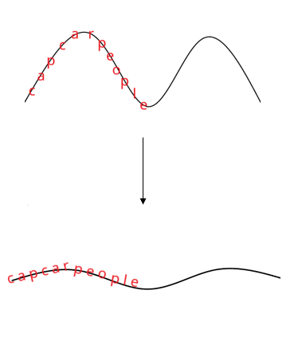
The Concept
Text, split into individual words/letters moving in the form of a sin wave. The sin wave’s amplitude and freciency can be changed with movment of the mouse.
Letter()
Variables
Main()
Variables
Setup();
Draw();
keyPressed();
UFO
Load ufo image
Display()
Animation
Variables
S
Display()
Card
Display()
textDisplay()

