Slide 1
How to build a brain from scratch
Lecture 4:
Computation and memory systems

Slide 2

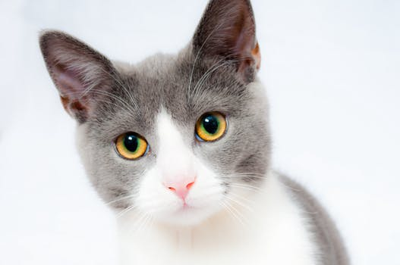
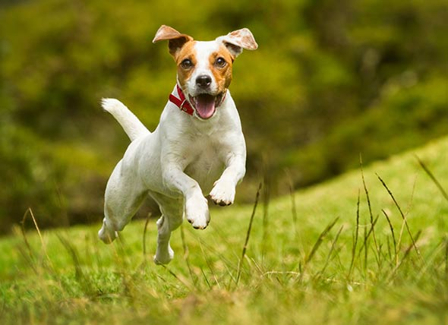
Same/different task
training set (n=2)
same
different
different
same
different
A feedforward neural network would perform at chance at this simple task, because it has no means to remember what occurred on the last timestep

Slide 3
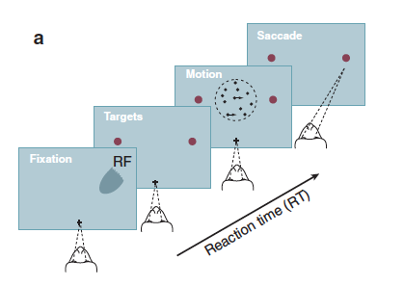
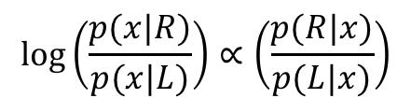
Optimal perceptual decisions & the SPRT
In a standard psychophysical task, observers judge the motion direction in a stream of randomly moving dots
solution is to compute the (log) likelihood ratio:
$$log\left(\frac{p(x|R)}{p(x|L)}\right)∝\left(\frac{p(R|x)}{p(L|x)}\right)$$
From Bayes’ rule, posterior is proportional to likelihood
Sequential probability ratio test (SPRT)
$log⁡\left(\frac{p\left(x_{1→n} | R\right)}{p\left(x_{1→n} | L\right)}\right)=$ $log⁡\left(\frac{p\left(x_{1} | R\right)}{p\left(x_{1} | L\right)}\right)$+ $\log\left(\frac{p\left(x_{2} | R\right)}{p\left(x_{2} | L\right)}\right)…+log⁡\left(\frac{p\left(x_{n} | R\right)}{p\left(x_{n} | L\right)}\right)$
likelihood ratio after n samples
likelihood ratio for sample 1
likelihood ratio for sample 2
likelihood ratio for sample n
Wald & Wolfwitz, 1946; Bogacz 2006

Slide 4
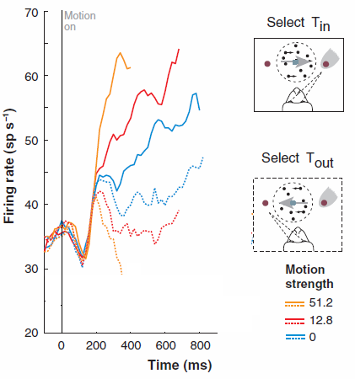
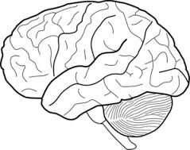
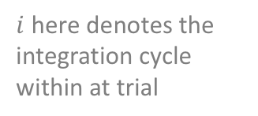

Temporal integration in cortical neurons
Neurons in the lateral parietal and prefrontal cortex act as integrators during perceptual choice tasks
$V_{i}$ $=V_{i−1}+δ+𝒩(0,σ)$
$i$ here denotes the integration cycle within at trial
cumulative DV
drift rate
noise
average firing rates and behaviour can be predicted by sequential sampling models such as the DDM, which approximates SPRT
During decisions about a dot motion stimulus, firing rates increase in proportion to the signal-to-noise ratio (motion coherence)
Gold & Shadlen 2007; Hanks & Summerfield 2017

Slide 5
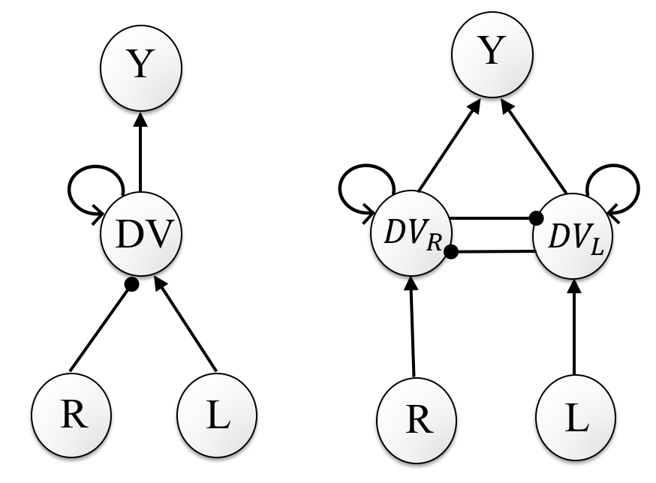
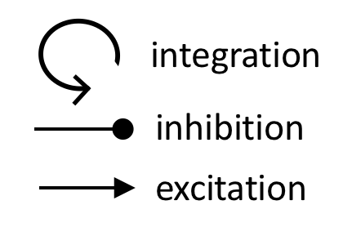
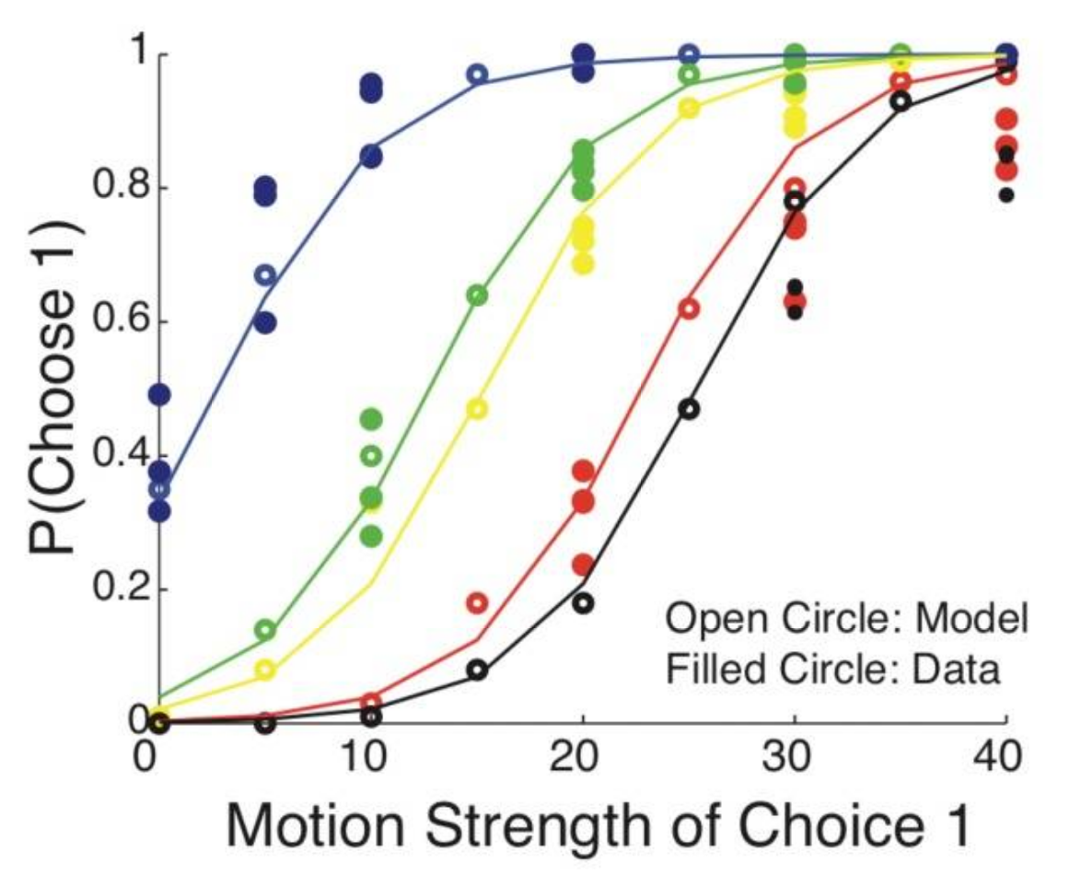
Recurrent models for perceptual decisions
drift-diffusion model (linear)
Wang model (nonlinear)
the Wang model accounts for nonlinear dynamics in integration
Elaborations of the sequential sampling framework include recurrent inhibition between integrators
Wang, 2012

Slide 6
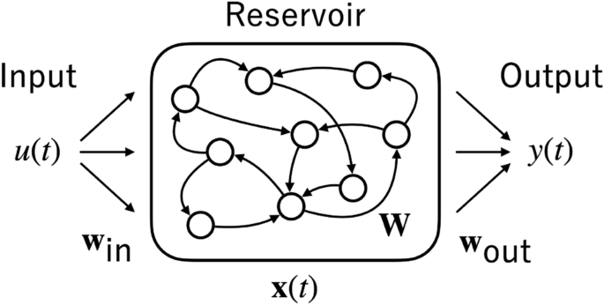

Echo state network
$$h(t)$$
An echo state network is an RNN in which the hidden weights are fixed (not trainable)
$$h(t)=f(W_{res}∙​h(t−1)+W_{in}​∙x(t))$$

Slide 7
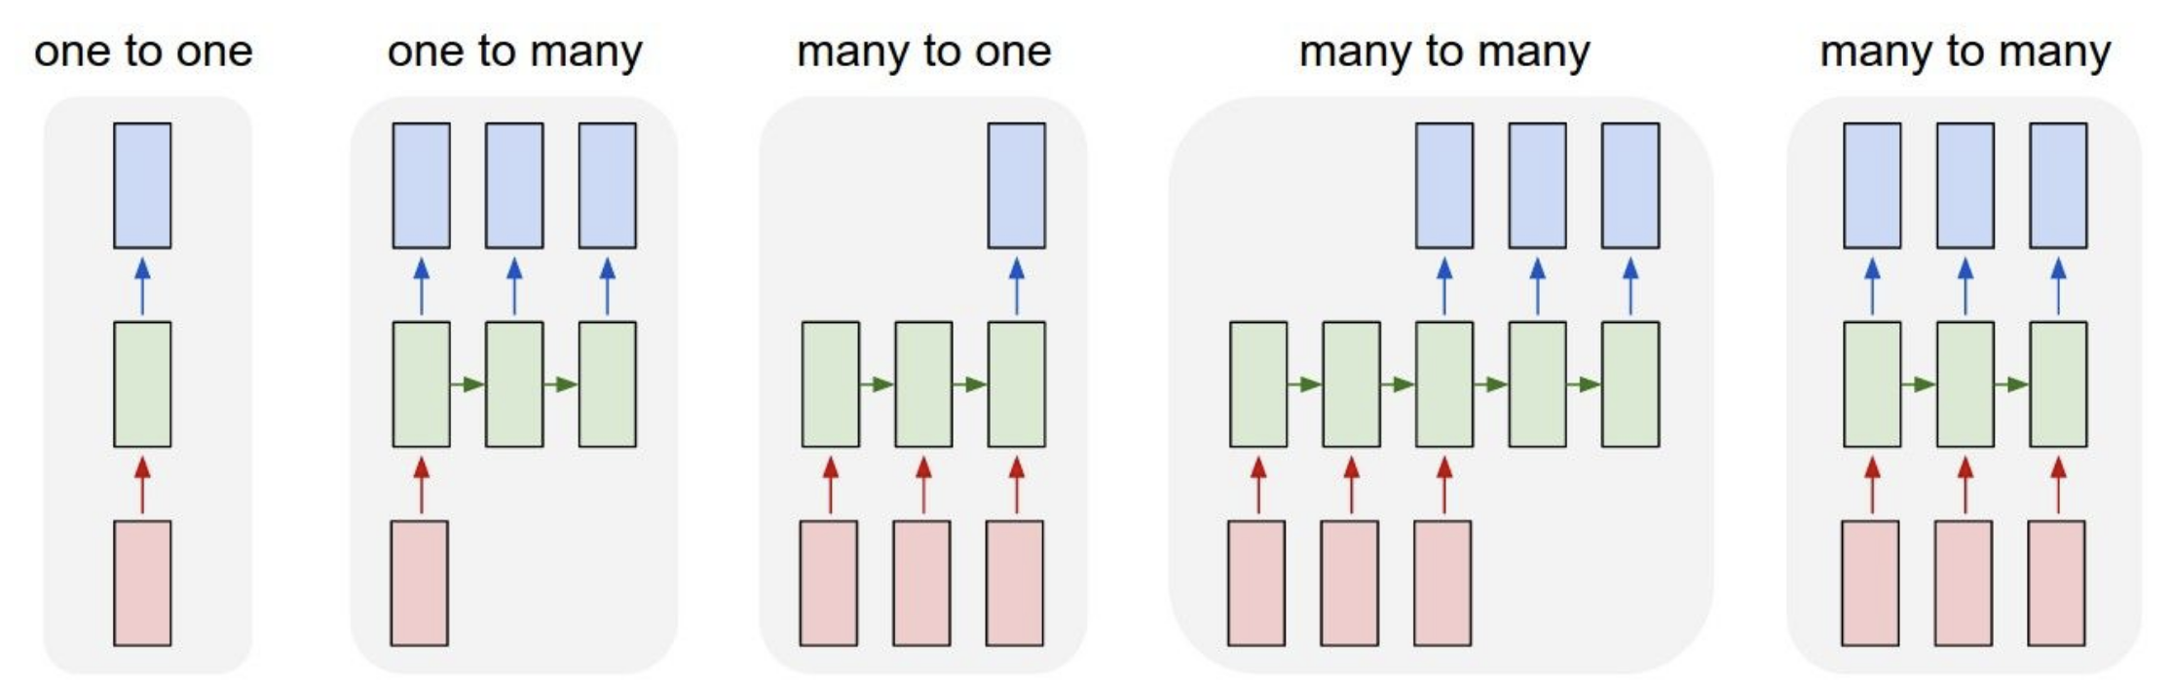
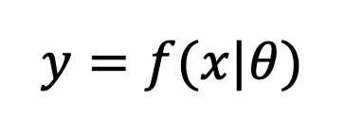
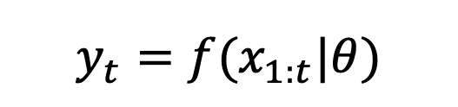
Recurrent neural network
time
time
time
time
$$y=f(x|θ)$$
$$y_{t}=f(x_{1:t}|θ)$$
RNNS are neural networks that process sequences

Slide 8







Recurrent neural network
$$Y$$
$$H_{t}=f(W_{in}∙X_{t}+{W_{rec}∙H}_{t−1})$$
$$W_{res}$$
$$W_{out}$$
$$H$$
current input
“memory” weight matrix
previous hidden unit activations
this allows the network to make sequential predictions based on past information
$$W_{in}$$
$$X$$
In a basic RNN, information flows forward through the network as in an MLP
However, the hidden units receive an additional input from themselves in the previous timestep

Slide 9
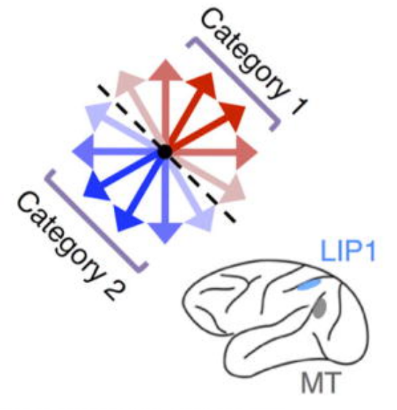
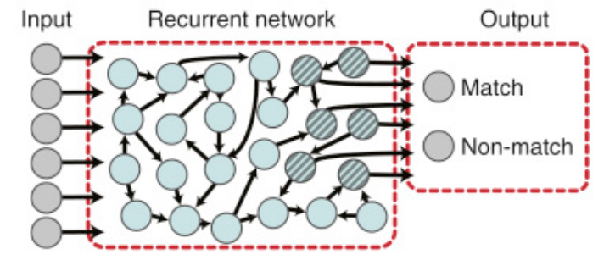
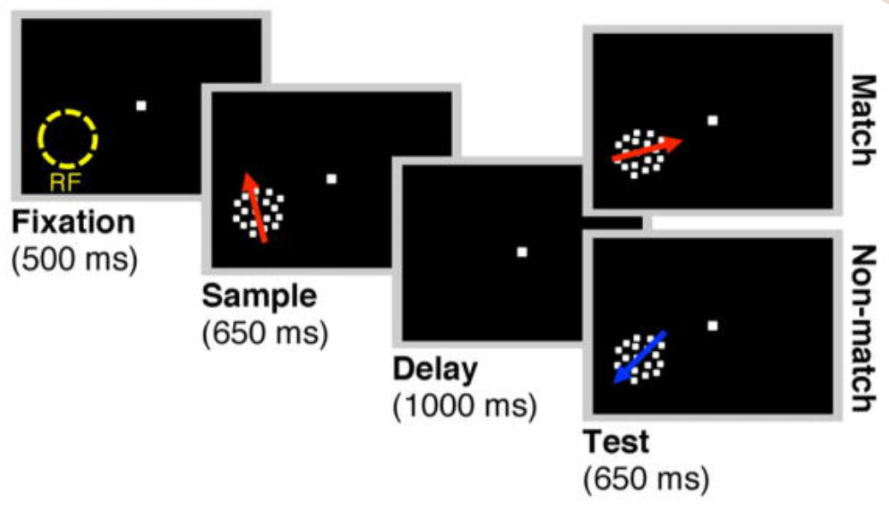
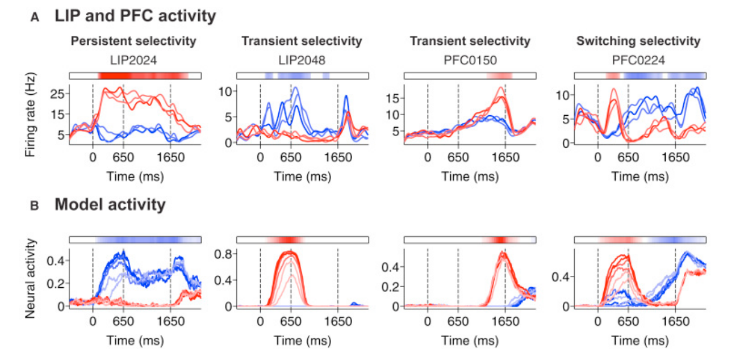
Neural evidence for recurrent dynamics
Monkeys judged whether two motion directions came from the same category (match to sample task). RNN trained to recreate neural outputs
RNN recreates the heterogenous selectivity during the delay period
Chaisangmongkon et al 2017

Slide 10
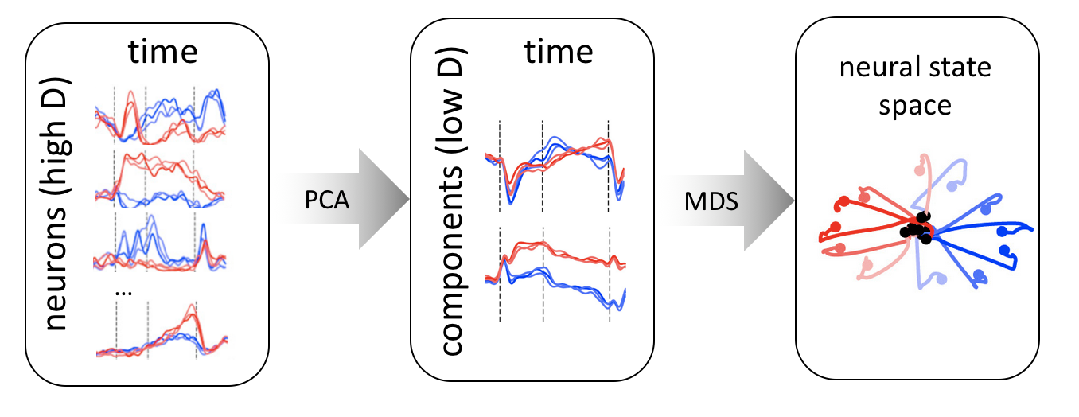
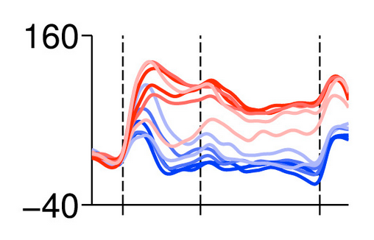
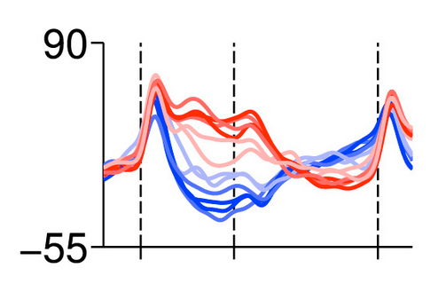
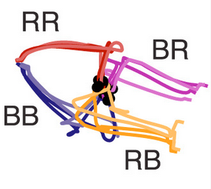
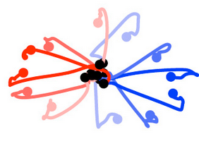
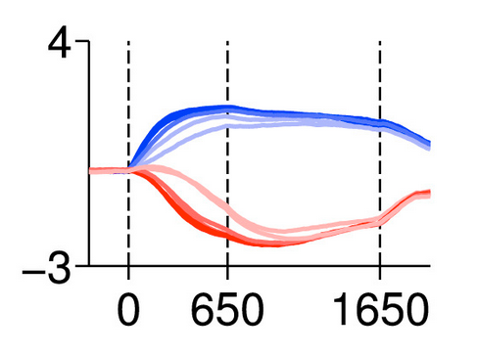
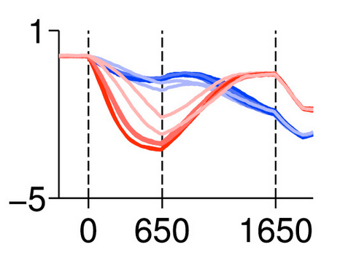
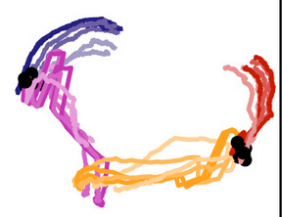
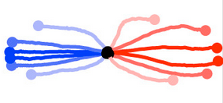
State space analysis
Neural state space analysis visualizes multivariate trajectories in a low dimensional space
LIP
comp.1
comp.2
activity rate
model
sample
time
test

Slide 11
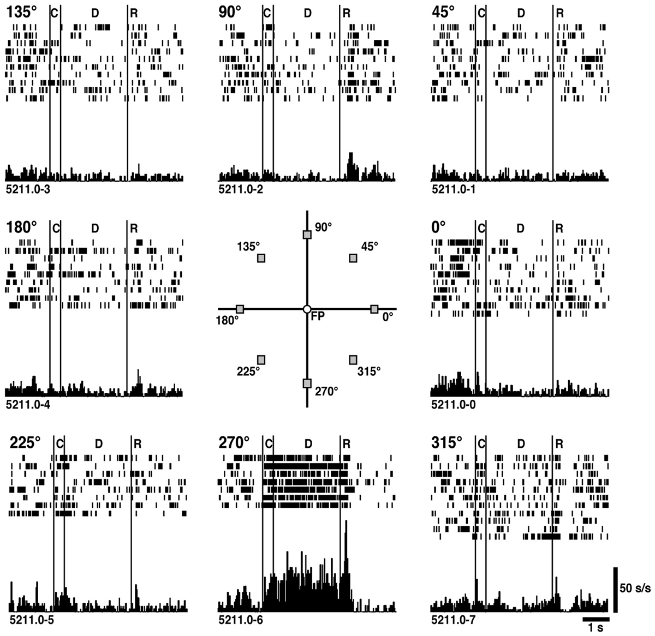
Persistent delay-period activity
prefrontal cortex
parietal cortex
Neurons in lateral parietal and prefrontal cortex display persistent, content-specific activity in working memory tasks
e.g. Goldman-Rakic, Fuster

Slide 12
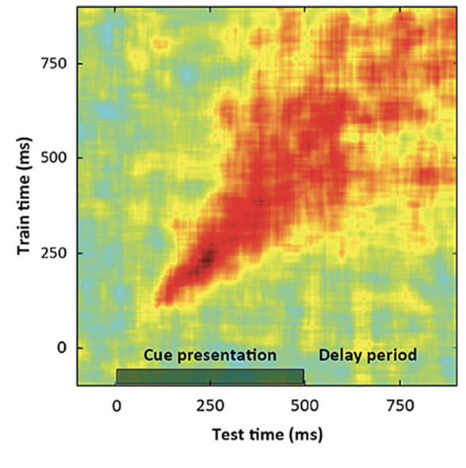
Attractors
Working memory often displays persistent activity, in which patterns are fixed over time
We can think of an RNN as a discrete time dynamical systems, and persistent activity indicates a fixed point
Cross-time decoding
(red = higher accuracy)

Slide 13
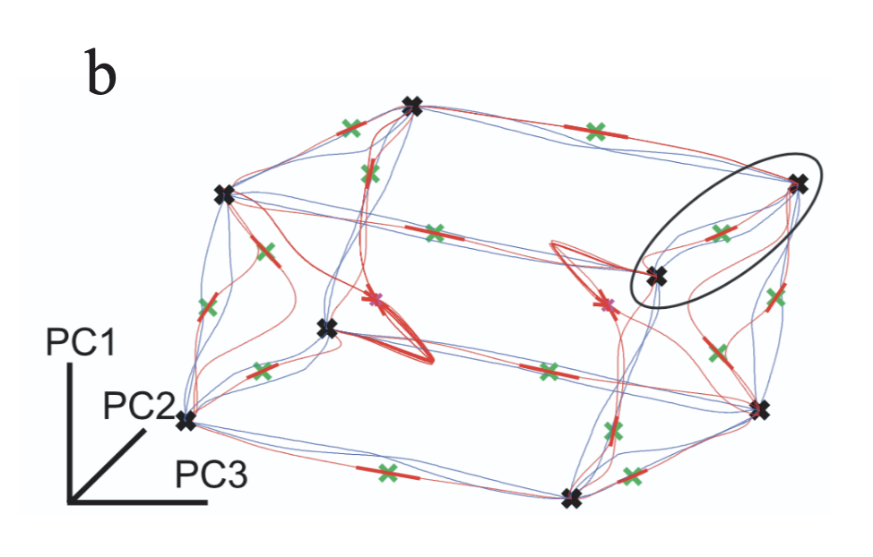




Attractors
fixed points
1
-1
1
$$W_{res}$$
$$W_{out}$$
$$H$$
$$W_{in}$$
1
0
0
0 0 0
Neurons remain in fixed points (or attractors) to maintain information over time
0 0 0
0 -1 0
0 0 0
0 0 1

Slide 14
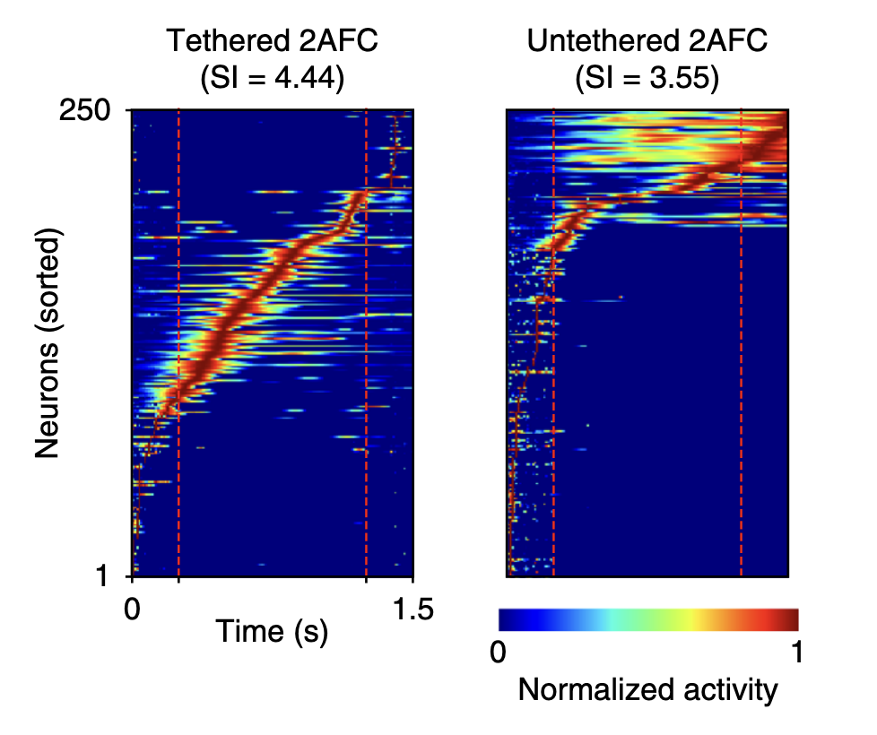
Attractors
Tethered task – fixed delay duration
Untethered task – unknown delay duration

Slide 15
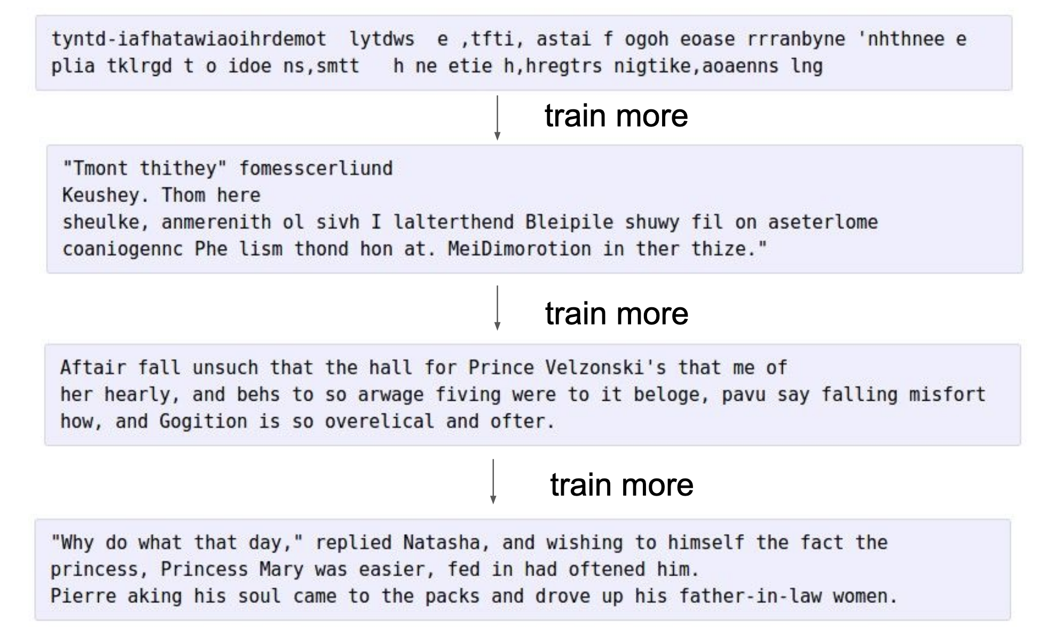
The power of RNNs

Slide 16
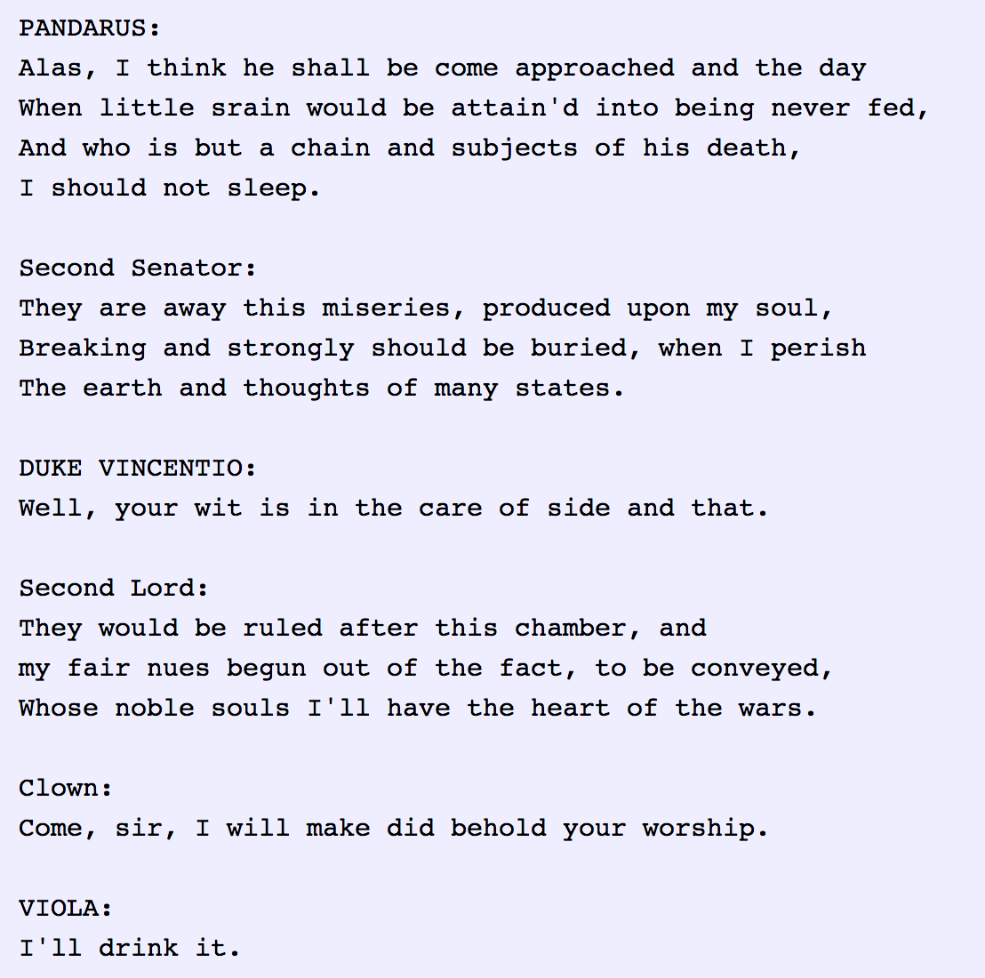
The power of RNNs
And here is an RNN trained on the complete works of Shakespeare]
For obvious reasons, RNNs have widespread applications in machine translation

Slide 17
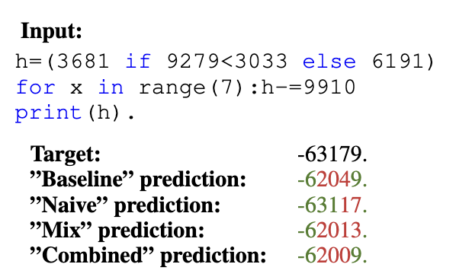
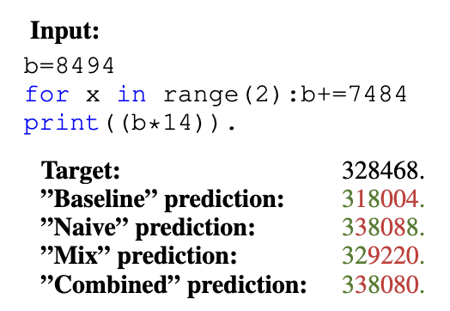
The power of RNNs
RNN trained on Python scripts, can predict variable states for new code snippets!! Early version of in-context learning
Zaremba 2017

Slide 18
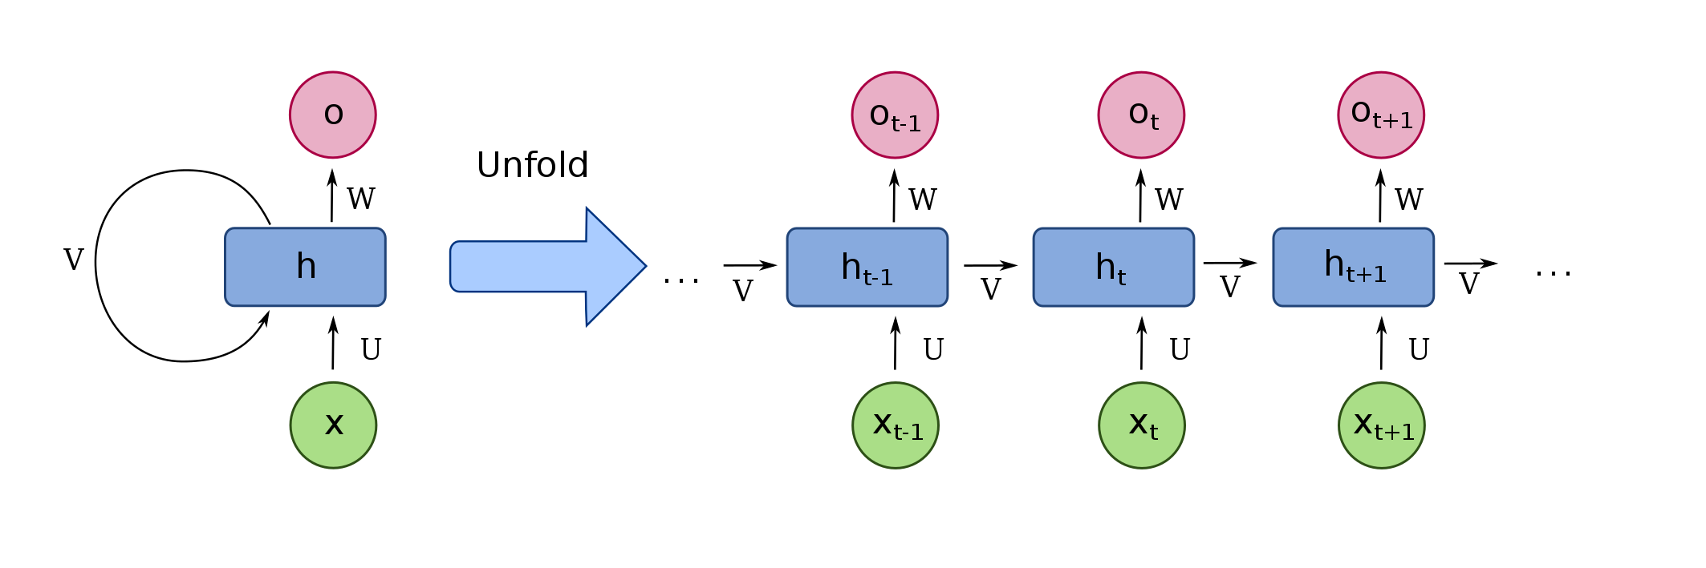
Backpropagation through time (BPTT)
To train the network, the gradients need to be computed with respect to the past information.

Slide 19
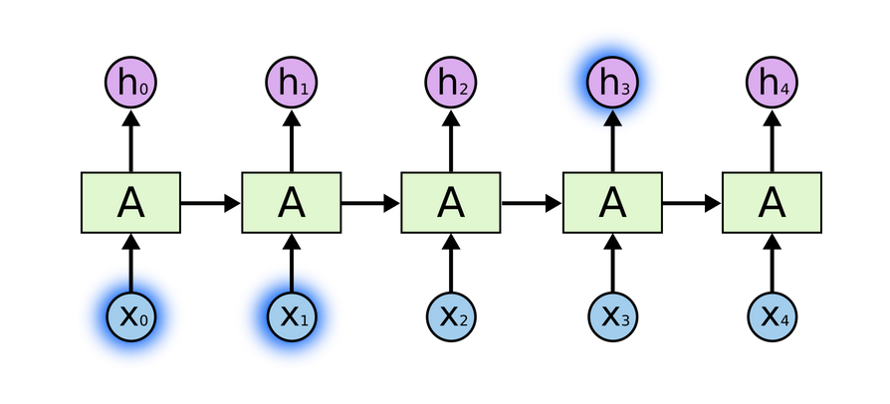
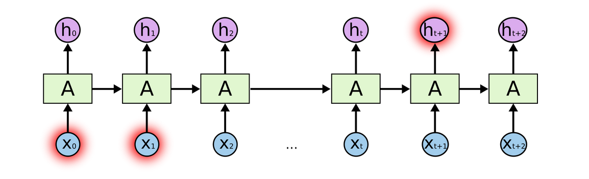
Problems with BPTT
”The clouds are in the…[sky]”
”I grew up in France…I can speak…[French]”
The network needs to be “unrolled” in time, updates applied, and then “rolled back up”.
This leads to the problems of vanishing and exploding gradients, especially over long timescales

Slide 20
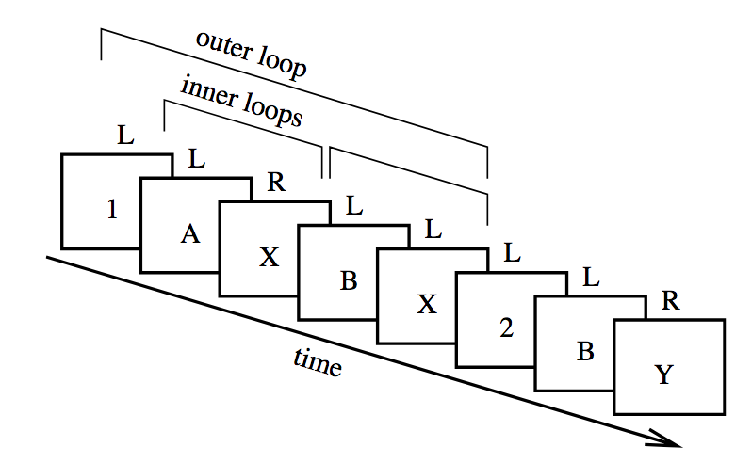
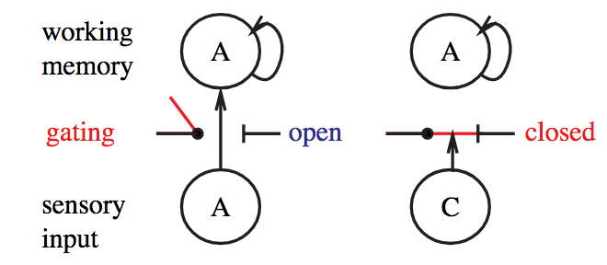
PBWM model
AX-CPT
If the last number was 1, press for AX
If the last number was 2, press for BY
Frank proposes that one outcome of striatal inputs to PFC is to gate an activity state in working memory circuits
This allows the circuit to solve the temporal credit assignment problem, i.e. knowing which events caused an outcome
Frank et al 2001; Hazy et al 2006

Slide 21
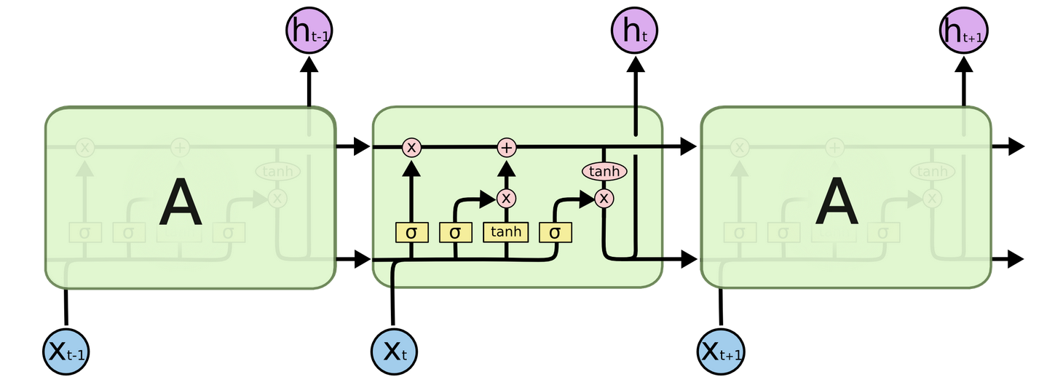
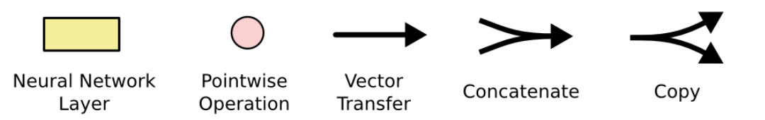
Long short-term memory network (LSTM)
cell state
The full LSTM architecture involves distinct gates that switch states in or out of the hidden units
However, the principle is still the same, in that the hidden state is passed between cycles
Hochreiter & Schmidthuber 1997

Slide 22
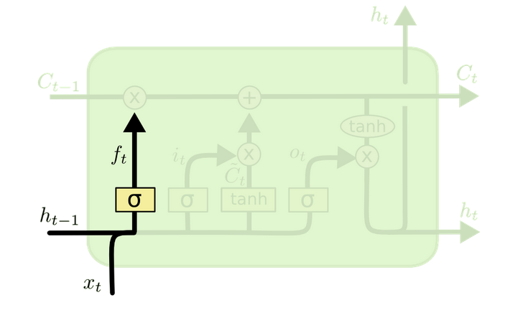
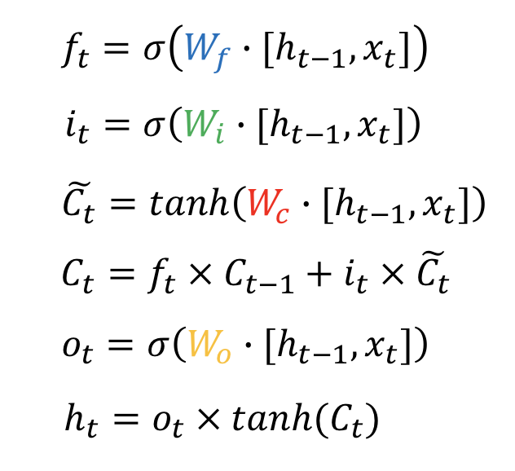
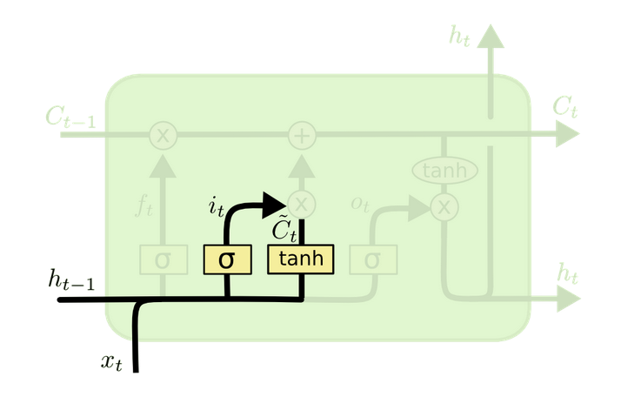
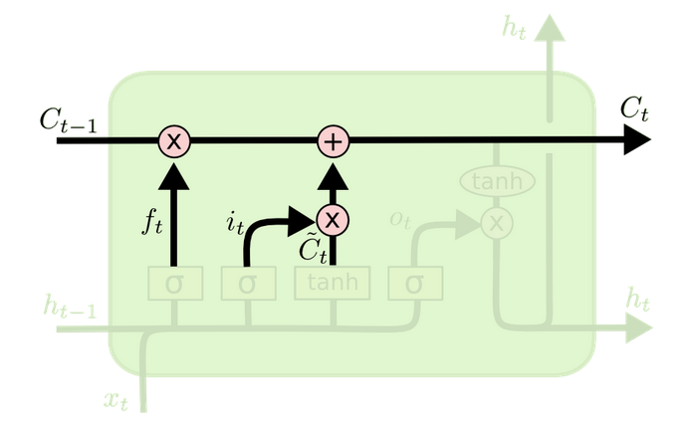
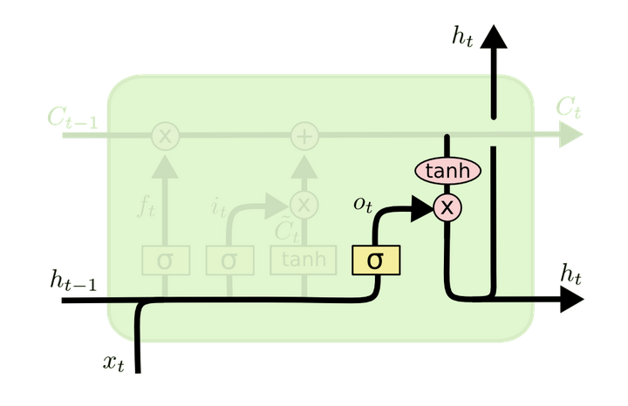
LSTMs
Four distinct set of trainable weights control what is switched in or out on each timestep
Sigmoid nonlinearities determine how ”open” the switches are in range [0,1].
Hochreiter & Schmidthuber 1997

Slide 23
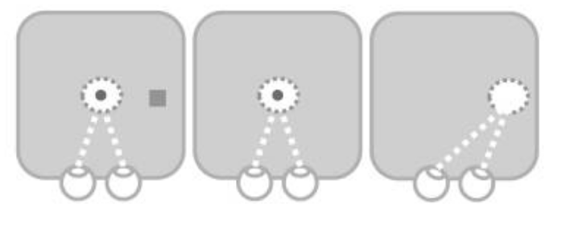
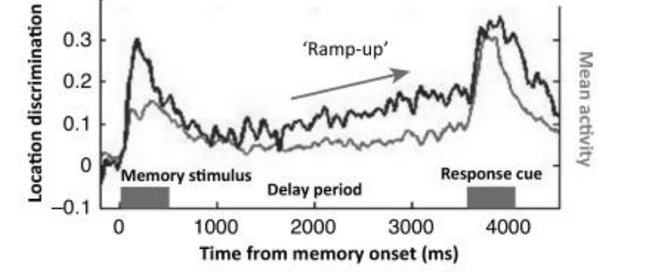
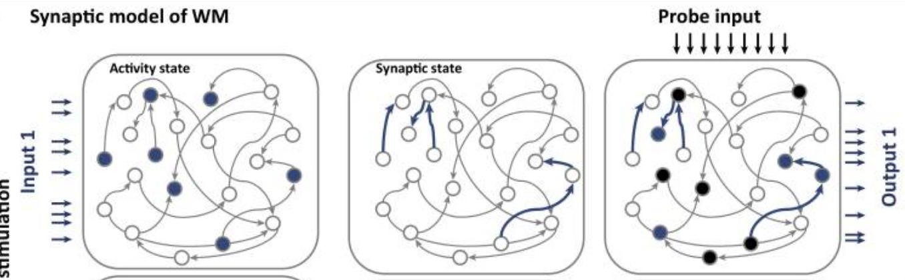
Synaptic memory model
In BA 46 (DLPFC)
In the synaptic memory model, the activity is maintained in fast plastic connections (or gates) rather than persistent activity states
Predicts that random input to the system should re-elicit neural code for WM stimulus
Stokes et al 2015

Slide 24




“pinging” working memory
During a working memory task, the sensory stimulus can initially be decoded but the neural code gradually fades
however, the WM stimulus can be re-evoked by a strong sensory input, because this “opens the gate”
Wolff et al 2017

Slide 25
Parietal and prefrontal cortices
The prefrontal cortex may be responsible for selecting outputs over multiple (longer) timescales, e.g. during language production and complex motor control
prefrontal cortex
parietal cortex
The parietal cortex is involved in integration of information over short timescales for rapid sensorimotor decisions

