Slide 1
ALGORITHM RESEARCH · GROUP 4
Selection Sort
Understanding the logic through flowcharts and pseudocode
“If you had to sort cards by always picking the smallest one left, how would you do it?”
Rothana · Dara · Deth · Lyheng · Samnang
Programming Fundamentals · August 2026
Notes:
Team introduces themselves. Read the hook question aloud and pause for 5 seconds to let the audience think about how they would answer it.

Slide 2
The everyday problem of sorting
“
A natural human strategy
Imagine a hand of playing cards in random order. To sort them, you might scan the whole hand, find the smallest card, and place it at the front.
Then repeat the process for the remaining cards until every card is in place.
This is exactly what Selection Sort does — a computer version of a natural human sorting strategy.
Sorting matters because searching, reporting, and decision-making all become faster on ordered data.
If you had to sort cards by always picking the smallest one left, how would you do it?
— The hook question
Notes:
Introduce the everyday problem. Emphasize that we sort all the time in daily life — cards, contacts, prices, scores — and computers do the same, but need a clear procedure to follow.

Slide 3
What is Selection Sort?
Definition. A comparison-based sorting algorithm that arranges a list in order by repeatedly finding the smallest remaining element and placing it at the beginning of the unsorted portion.
01
02
03
04
Works in rounds
One minimum per round
At most one swap
Two portions
One element becomes sorted after each pass.
Each pass performs one full scan of the unsorted portion.
Each pass performs at most one swap, unlike Bubble Sort.
A sorted left side that grows, and an unsorted right side that shrinks.
Notes:
Read the definition aloud. Then walk through each of the four key properties — these are the anchors your audience needs to remember.

Slide 4
Step-by-step trace
Sorting the list [64, 25, 12, 22, 11]
Pass | Unsorted portion | Minimum found | List after this pass
1 | [64, 25, 12, 22, 11] | 11 | [11, 25, 12, 22, 64]
2 | [25, 12, 22, 64] | 12 | [11, 12, 25, 22, 64]
3 | [25, 22, 64] | 22 | [11, 12, 22, 25, 64]
4 | [25, 64] | 25 (no swap) | [11, 12, 22, 25, 64]
Key insight. After four passes the list is fully sorted. Notice that at most one swap occurred per pass — this is what distinguishes Selection Sort from Bubble Sort.
Notes:
Walk through each pass slowly. Emphasize what the algorithm 'sees' at each step. Ask the audience to verify the last pass — pass 4 has no swap because 25 is already the smallest in its position.

Slide 5
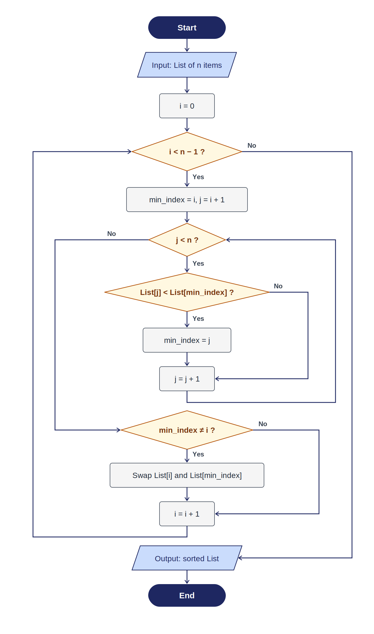
The full logic as a flowchart
Symbol key
How to read it
Start / End
Outer loop
Moves position i from 0 to n − 1, marking where the next-smallest element must go.
Inner loop
Scans from j = i + 1 to n − 1 and tracks the smallest value found.
Swap step
Only performed if the smallest is not already at position i.
Return arrows
Bring control back to the loop condition to check whether to continue.
Input / Output
Process (assignment, swap)
Decision (if / condition)
Notes:
Walk through the flowchart. Follow the arrows: Start → Input → i = 0 → outer loop check → inner setup → inner loop → swap check → back to outer. Point out the two return arrows on the sides. Emphasize the shapes and what they represent.

Slide 6
The same logic as pseudocode
Plain structured English — no programming language syntax.
ALGORITHM: SelectionSort
INPUT: A list called List with n items (index 0 .. n − 1)
BEGIN
FOR i FROM 0 TO n − 2 DO
SET min_index = i
// Find the smallest in the unsorted portion
FOR j FROM i + 1 TO n − 1 DO
IF List[j] < List[min_index] THEN
SET min_index = j
END IF
END FOR
// Place the smallest at position i
IF min_index ≠ i THEN
SWAP List[i] WITH List[min_index]
END IF
END FOR
OUTPUT: List, now sorted in ascending order
END
Two loops, one swap
Outer FOR
Advances the sorted boundary one step at a time.
Inner FOR
Only looks — never swaps. It tracks where the smallest lives.
Single SWAP
Happens once per outer pass — the whole point of the algorithm.
Notes:
Read the pseudocode aloud line by line. Tie each block back to the flowchart from the previous slide: outer FOR = outer loop diamond, inner FOR = inner loop diamond, SWAP = the swap process box.

Slide 7
Selection Sort vs Bubble Sort
Same comparison count. Very different swap count.
Selection Sort
Bubble Sort
Our topic
For comparison
Scans the unsorted portion to find the smallest, then swaps once at the end of the pass.
At most n − 1 swaps in total, no matter how the data is ordered.
Comparisons: always O(n²) — always looks at every remaining element.
Best when moving data is expensive (large records, flash memory, physical items).
Repeatedly compares neighboring pairs and swaps them whenever they are out of order.
Up to n(n − 1)/2 swaps in the worst case — many more writes per pass.
Comparisons: also O(n²) — no advantage on comparison count.
Useful for teaching pairwise comparison, but rarely the right choice in practice.
Notes:
Emphasize that the number of comparisons is the same — both are O(n²). The real difference is the number of swaps. This connects directly to the next slide about where fewer swaps matter.

Slide 8
Where fewer swaps really matter
Selection Sort earns its keep whenever moving data costs something.
📦
Warehouse sorting
💾
Flash memory & SSD
Moving heavy boxes or pallets costs labor and time. Fewer swaps means less physical handling by workers or forklifts.
Every write slowly wears out memory cells. Algorithms that write less extend the useful life of the storage device.
🗃️
Large database records
🤖
Robotic sorting arms
When each record contains many fields, swapping two rows moves a large amount of data. Fewer swaps means less I/O cost.
Every pick-and-place operation takes time and mechanical wear. A predictable cap of n − 1 moves is valuable in production.
Notes:
Give one concrete example for each card. Warehouse: think of a distribution center. Flash memory: SSDs have limited write cycles. Databases: big rows, many fields. Robotics: automated pick-and-place systems in factories.

Slide 9
Complexity summary
Predictable performance regardless of the input order.
Case | Comparisons | Swaps | Description
Best | O(n²) | 0 | Already sorted, but scanning still happens
Average | O(n²) | O(n) | Typical random input
Worst | O(n²) | n − 1 | Never exceeds n − 1 swaps
In conclusion
Selection Sort captures a very natural human sorting strategy: find the smallest, put it aside, repeat. It is not the fastest algorithm for large data, but it is easy to explain, always predictable, and genuinely useful whenever the cost of moving data matters more than the cost of comparing.
Thank you · Questions?
Notes:
Summarize the complexity table quickly. Deliver the conclusion with conviction. Thank the audience and open the floor for questions.

