Slide 1
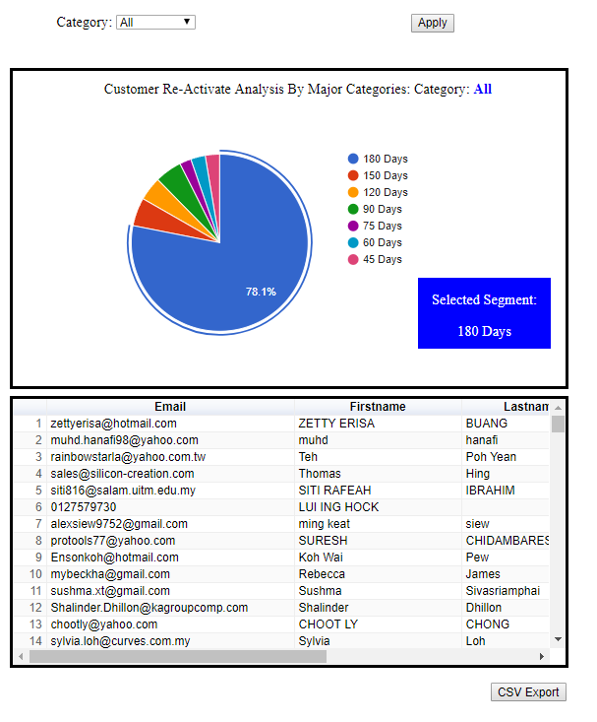
Default Chart
By default, the page will show All Categories Dashboard.
By default, the selected pie chart segment will be 180 days, same as the table data below.

Slide 2
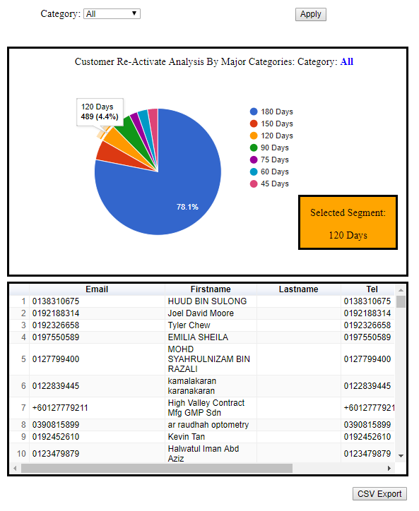
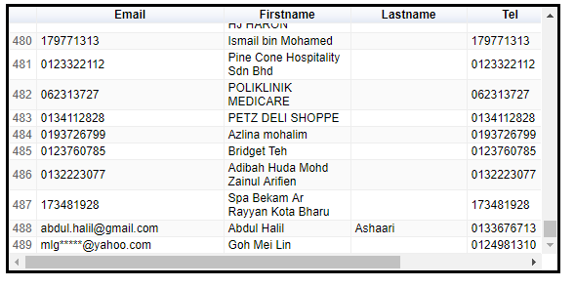
View data from selected segment.
Click on the pie chart segment base on colour, and retrieve the segment’s data in table form below.
Take note the you will found the total row number of table and pie chart tooltip are same

Slide 3
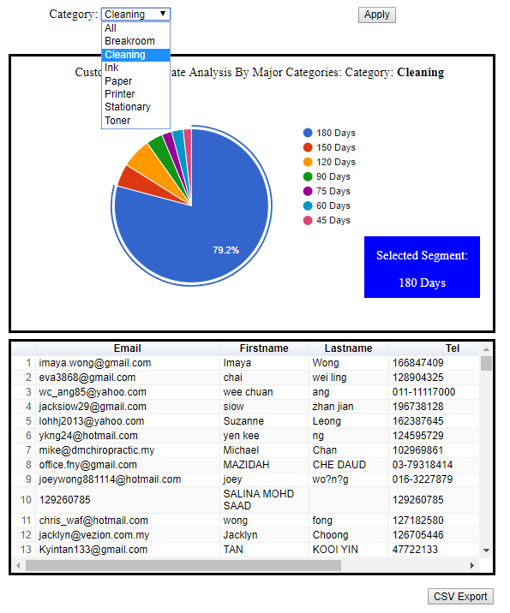
View Other Category Chart
Click on the category selector at the above and choose a category, then click Apply to generate new chart base on selected category.
For each time a different category chart is generated, the default pie chart segment will be 180 days, same for the table data below.

Slide 4
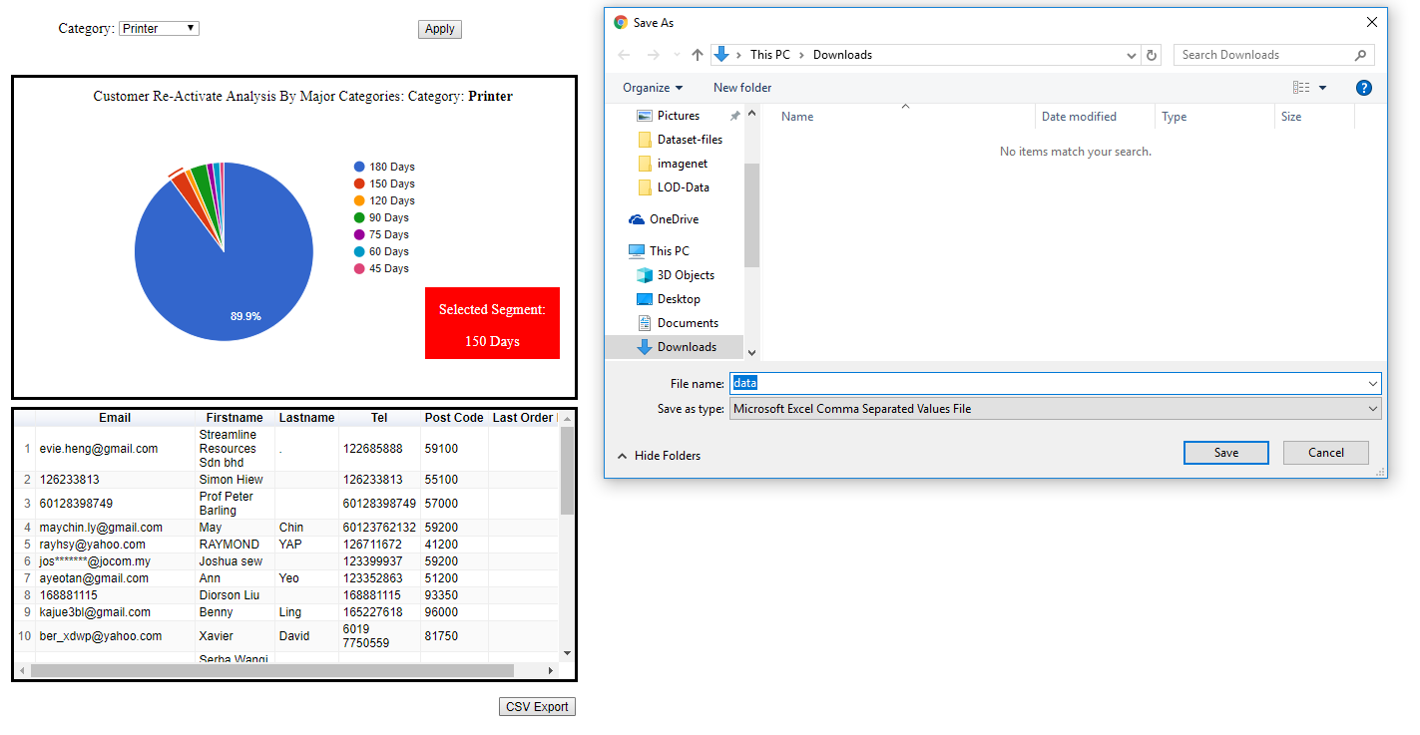
Export Data in CSV file format
To save and download the selected category/ segment data, click the CSV Export below and enter the name for it. Then click Save button.

