Slide 1
Solution Architecture of BI Automation + Sales Execution Plan
Ver 3.2

Slide 2
Tasks List
Implement script to produce Cross-sale dashboard data.
Implement script to produce Up-sale dashboard data.
Pass down Cross-sale dashboard development.
Pass down Up-sale dashboard development.
Complete Cross-sale dashboard development.
Complete Up-sale dashboard development.
Consolidate all dashboards code and DB connection.
Setup customer production folders @ server.
Setup customer website folders @ server.
Pointing correct URL to webpage.
Establish web reports to DB.
Setup customer DB and connection.
Research on Python code to DB connection.
Implement production code to have DB connection.
Implement scripts for 1 source, create all dashboard data.
End to end testing process. Source data to dashboard.
Implement MBA product list output.
Research on MBA – R script autorun scripts.
Implement MBA – R script taking same source and produce webpage.
Documentation in setting up all DB links, folders, remote server connection.
Presentation to explain overall prediction, cross, up MBA details.

Slide 3
Personal Tasks List Details
Tested Python basic function running in remote server.

Slide 4
Major Packages + Deliveries - BRP2 – BI @ JUL-2018 – SEP-2018
Done
D
Overall Prediction
predict.py
P
Prediction
Forecast + Potential
Dashboard
Done
R
P
P
Forecast
Time-Gap Analysis
a
Done
Done
Customer DB
P
Time-Gap Analysis
Dashboard
Manual
Marketing
Actions
Auto
Remarkety
Auto
Social + SMS
Manual
Done
Cross-Sale
Potential
D
D
P
Cross-Sale Analysis
Dashboard
Manual
Marketing
Actions
Auto
Remarkety
Auto
Social + SMS
D
D
Standard DB
Up-Sale
Potential
D
Done
P
Up-Sale Analysis
Dashboard
Manual
Marketing
Actions
Auto
Remarkety
Auto
Social + SMS
Done
Done
D
Re-Activate
Potential
Re-Activate
Dashboard
Manual
Marketing
Actions
Auto
Remarkety
Auto
Social + SMS
P
Done
Done
D
Market Basket Analysis
Market Basket Analysis
Dashboards
Manual
Marketing
Actions
P
R
Researching
Automation
D
Developing
Setup
Configure
Execute
P
Pending

Slide 5
Major Packages + Deliveries - BRP2 – BI @ FEB-2018
Done
D
Overall Prediction
Prediction
Forecast + Potential
Dashboard
Done
R
P
P
Forecast
Time-Gap Analysis
Done
Done
Customer DB
Time-Gap Analysis
Dashboard
Manual
Marketing
Actions
Auto
Remarkety
Auto
Social + SMS
Manual
Done
Cross-Sale
Potential
D
D
Cross-Sale Analysis
Dashboard
Manual
Marketing
Actions
Auto
Remarkety
Auto
Social + SMS
D
D
Standard DB
Done
Up-Sale
Potential
D
Up-Sale Analysis
Dashboard
Manual
Marketing
Actions
Auto
Remarkety
Auto
Social + SMS
Done
Done
D
Re-Activate
Potential
Re-Activate
Dashboard
Manual
Marketing
Actions
Auto
Remarkety
Auto
Social + SMS
Done
Done
D
Market Basket Analysis
Market Basket Analysis
Dashboards
Manual
Marketing
Actions
R
Researching
Setup
Configure
Execute
D
Developing
P
Pending

Slide 6
Major Packages + Deliveries - BRP2 – BI @ DEC-2017
Done
D
Overall Prediction
Prediction
Forecast + Potential
Dashboard
Done
R
P
P
Forecast
Time-Gap Analysis
Done
Done
Customer DB
Time-Gap Analysis
Dashboard
Manual
Marketing
Actions
Auto
Remarkety
Auto
Social + SMS
Manual
D
Cross-Sale
Potential
P
D
Cross-Sale Analysis
Dashboard
Manual
Marketing
Actions
Auto
Remarkety
Auto
Social + SMS
D
D
Standard DB
Done
Up-Sale
Potential
P
Up-Sale Analysis
Dashboard
Manual
Marketing
Actions
Auto
Remarkety
Auto
Social + SMS
Done
D
D
Re-Activate
Potential
Re-Activate
Dashboard
Manual
Marketing
Actions
Auto
Remarkety
Auto
Social + SMS
Done
Done
D
Market Basket Analysis
Market Basket Analysis
Dashboards
Manual
Marketing
Actions
R
Researching
Setup
Configure
Execute
D
Developing
P
Pending

Slide 7
Working on “R” – Auto Remarkety + Auto Social & SMS
Done
D
Overall Prediction
Prediction
Forecast + Potential
Dashboard
Done
R
P
P
Forecast
Time-Gap Analysis
Done
Done
Customer DB
Time-Gap Analysis
Dashboard
Manual
Marketing
Actions
Auto
Remarkety
Auto
Social + SMS
Manual
D
Cross-Sale
Potential
P
D
Cross-Sale Analysis
Dashboard
Manual
Marketing
Actions
Auto
Remarkety
Auto
Social + SMS
D
D
Standard DB
Done
Up-Sale
Potential
P
Up-Sale Analysis
Dashboard
Manual
Marketing
Actions
Auto
Remarkety
Auto
Social + SMS
Done
D
D
Re-Activate
Potential
Re-Activate
Dashboard
Manual
Marketing
Actions
Auto
Remarkety
Auto
Social + SMS
Done
Done
D
Market Basket Analysis
Market Basket Analysis
Dashboards
Manual
Marketing
Actions
R
Researching
Setup
Configure
Execute
D
Developing
P
Pending

Slide 8
BRP2 – E.Marketing Analysis Platform As A Service - Strategy Analysis
Data Source
Analysis Automation
Visualization
Marketing Automation
TopGen Strengths
TopGen Strengths
TopGen Strengths
TopGen Strengths
Analysis
Mapping to useable data source
Knowing on data
Ready tools for data cleaning
Integrated
Customizable code
Incorporated Machine Learning (ML) techniques
Fixed components
Integrated
Further enhance with :
Data Sense
Data Validation
Forecast Validation
Integrated
Tightly couple with Analysis and Marketing purpose.
Future enhancement required.
Continuous improvement enhanced on same product.
Open to existing / open-source / freely visualization tool
No further licensing cost.
Integrated
Domain knowledge in support and execution
Equipped with Manual and Automated actions.
Automated actions includes:
Email
Social
SMS
BI Vendor Strengths
BI Vendor Strengths
BI Vendor Strengths
BI Vendor Strengths
N/A
Easier to cross industries
Contain templates for industries
A lot of ready made ML tools to be used.
Better interactive
Ready made reports – fast
N/A
BI Vendor Weakness
BI Vendor Weakness
BI Vendor Weakness
BI Vendor Weakness
Lack of domain knowledge
Consume time
Charge
Resource required
Not in-depth analysis
Not in-depth of retail domain
Lack of research in ML suitable to retail domain
Not integrated.
Not integrated.
Lack of domain knowledge
Consume time
Charge
Resource required

Slide 9

BI - IT SOP Building + Execution
Setup a new customer database.
Auto API
Standard Database
2
Create a new LF for new customer.
Dump data over LF.
Prepare a analyzable processing format of data source.
1
External / BRP
Data
Source
Manual
Landing Folder (LF)
3
Duplicate a DC + Processing Folder (Code included) for a new customer.
Execute analysis jobs.
BRP Customer – Sync to Standard DB.
External Customer – SFTP to LF.
6
Data Cleaning +
Processing Folder
7
Duplicate a Customer Analysis Database
Emails
Facebook
SMS
Market-Places
4
Duplicate Marketing Excel Sheets for new customer.
Configure Zapier.
Configure Remarkety.
Customer
Analysis
Database
Duplicate a Customer Web Folder (Code included).
Configure DB access.
Operational
Dashboards
Customer
Web Folders
5
Virtual Machine @ Cloud
n
Operational Steps

Slide 10
Marketing Slides
v1.0

Slide 11





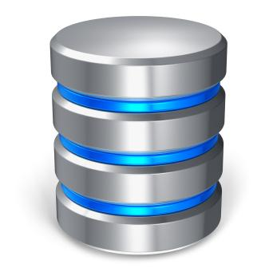
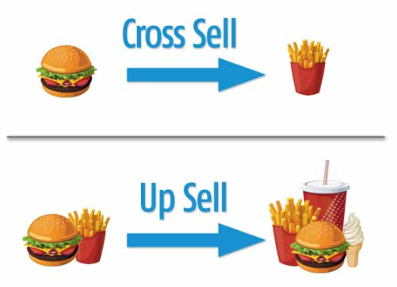





Business Analytic & Marketing Systems
Business Potential
Marketing Actions
Prediction
Automated Email Marketing
Automated Social Media Marketing
Automated
SMS
Historical
Sales Records
Re-Activate
Business Analytic
Marketing Systems

Slide 12
Market Basket Analysis (MBA) Dashboard of All Major Categories

Slide 13
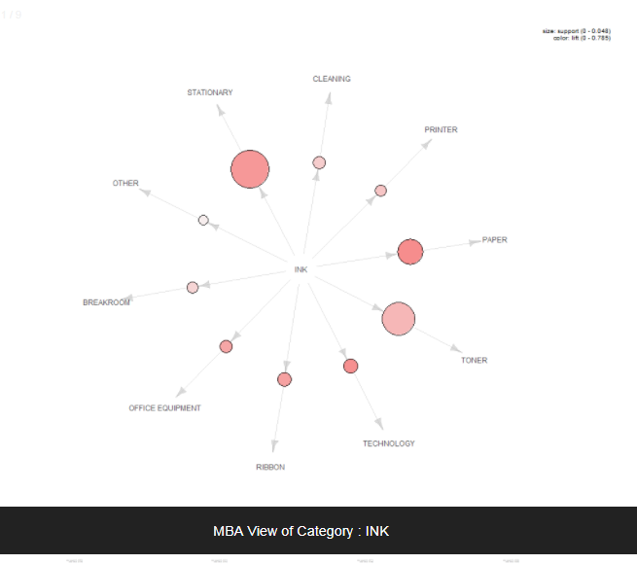
Market Basket Analysis of Main Categories for ViewNet Computer System
Monitor
Monitor
Sound Card
Other
Speaker
Desktop
Display Card
Software
Router
Mouse
Keyboard
Desktop

Slide 14


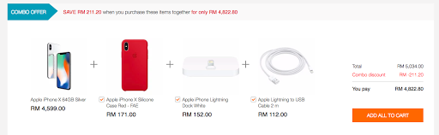
Usages of MBA Dashboard
Understand / Discover
the Selling Relationship between
Different Products and Different Major Categories
Better Product Bundle
Better Cross-Sales
Effective Promotion

Slide 15






User Operations in Business Analytic & Marketing Systems
1
Prediction
Automated Email Marketing
3
Automated Social Media Marketing
2
Automated
SMS
Re-Activate
Business User
Business Potential
Business Analytic
Marketing Systems
Step 1
User upload history Sales Transaction or Order Records.
Step 2
User obtains quarterly Business Prediction & Potential related reports.
Step 3
Backend automated execution of Marketing Systems.

Slide 16
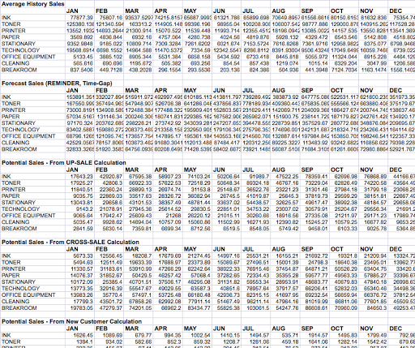
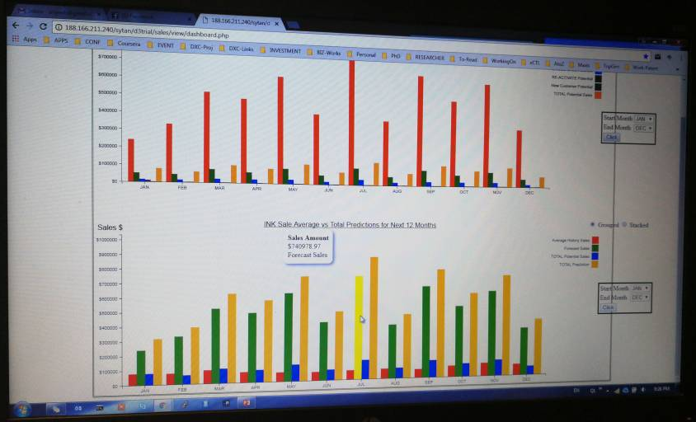
Business Opportunities and Potential
Example:
Category : INK
Sales
Sale
Potential
RM 350 K
Sale
Opportunities
RM 275 K
RM 205 K
Actual
Predict
Potential

Slide 17
Marketing Slides
End

Slide 18
Solution Architecture of BI Automation + Sales Execution Plan
System Flow Process
Andrew
Kang
Outsource Developer
Manual Operation Process
SY
Kelvin
Outsource
Web Designer
Data Source
Analysis Automation
Reports
Development
Marketing
Actions
Solution Package Sales
Production
Internal Data Source
Standard
Standard
Standard
Standard
Standard
Manual
Customized Tables
Automate
Scripts
PHP
Code
Web Designer
Emails
Facebook
SMS
Market-Places
External
Data
Source
API
Results
Automate
SQL
Pre-Calculate
Tables
Dashboard
API
Standard
Tables
Sale Packages
Reports
Manual Action
Plans
Developer
Developer
Developer
Development & Research
Software Design Spec
Software Design Spec
Software Design Spec
Marketing
Sales
Excel Reports
Dashboard
Develop
Action
Plans
Package
Discussion
Stage
Research
Customized Tables
Export
Manual
Scripts
Pre-Calculate
Tables
Third Party Report Tools
Reports
Defined
Standard
Tables
SQL
Testing on Results
OS
Dev
Copyright © Topgen Series Sdn. Bhd.

Slide 19
Technical Aspects of Production Capabilities
Data Source
Analysis Automation
Reports
Development
Production
Internal Data Source
Standard
Standard
Standard
Manual
Customized Tables
Automate
Scripts
PHP
Code
Web Designer
External
Data
Source
API
Automate
SQL
Pre-Calculate
Tables
Dashboard
API
Standard
Tables
Reports
High-level Works :
Defining standard tables structure.
Standardizing cron-jobs to flow data into standard tables.
Prepare Dev. Env. for working process.
Access to Pro & Dev for review and support.
Define pre-calculate tables structure.
Working space for Dev. & Pro. Env.
Automate Scripts & Cron-SQL
Working space for Dev. Env.
Working space for Pro. Env.
Web development and production environment setup for Webserver, Php Code space, Dashboard & Reports.
Working space for Dev. & Pro. Env.
Copyright © Topgen Series Sdn. Bhd.

Slide 20
Required Resources
Resources | Role | Monthly Engagement | Activities
Andrew | Technical Lead | Once a week On-going | Discuss & Synchronize Technical Design Database tables / Fields / Data quality / API Sync / etc Define Server Access, Development and Deployment Env Define Cron-jobs execution for Dev and Prod
SY | Technical Lead | Once a week On-going | Draft + Provide Technical Design Database tables / Fields / Data quality / API Sync / etc Test + Using Development and Deployment Env Research & Development activities
Developer | Developer | 1 week / month On-going | Implementation of Cron-jobs for SQL + Scripts Implementation of Dashboard Php Code + Reports Syncing Outsource code vs Production code + documentation
Outsource Developer x 2 | Developer Part time | Part time 3 months cycle | Implementation of Customer Behavior dashboard Additional analysis script / programs
Designer | Web Designer | When necessary | Design template for dashboard and reports Design template for google charts / organization color theme and etc.
Copyright © Topgen Series Sdn. Bhd.

Slide 21
Required Resources
Resources | Role | Monthly Engagement | Activities
Kang | Marketing Lead | On-going | Define & Requirements gathering Marketing action plan design & standardization
Kelvin | Sale Lead | On-going | Solution package Market needs feedbacks
Copyright © Topgen Series Sdn. Bhd.

Slide 22
Solution Architecture of BI Automation + Sales Execution Plan
System Flow Process
Andrew
Kang
Outsource Developer
Manual Operation Process
SY
Kelvin
Outsource
Web Designer
Data Source
Analysis Automation
Reports
Development
Marketing
Actions
Solution Package Sales
Production
Internal Data Source
Standard
Standard
Standard
Standard
Standard
Manual
Customized Tables
Automate
Scripts
PHP
Code
Web Designer
Emails
Facebook
SMS
Market-Places
External
Data
Source
API
Results
Automate
SQL
Pre-Calculate
Tables
Dashboard
API
Standard
Tables
Sale Packages
Reports
Manual Action
Plans
Developer
Developer
Developer
Development & Research
Software Design Spec
Software Design Spec
Software Design Spec
Marketing
Sales
On-going …
Excel Reports
Dashboard
Develop
Action
Plans
Package
Discussion
Stage
Research
Customized Tables
Export
Manual
Scripts
Pre-Calculate
Tables
Third Party Report Tools
Reports
Defined
Standard
Tables
SQL
Testing on Results
OS
Dev
Copyright © Topgen Series Sdn. Bhd.

Slide 23
Solution Architecture of BI Automation + Sales Execution Plan
System Flow Process
Andrew
Kang
Outsource Developer
Manual Operation Process
SY
Kelvin
Outsource
Web Designer
Data Source
Analysis Automation
Reports
Development
Marketing
Actions
Solution Package Sales
Production
Internal Data Source
Standard
Standard
Standard
Working…
Working…
Working…
Standard
Standard
Manual
Customized Tables
Automate
Scripts
PHP
Code
Web Designer
Emails
Facebook
SMS
Market-Places
External
Data
Source
API
Results
Automate
SQL
Pre-Calculate
Tables
Dashboard
API
Standard
Tables
Sale Packages
Reports
Manual Action
Plans
Developer
Developer
Developer
Development & Research
Software Design Spec
Software Design Spec
Software Design Spec
Marketing
Sales
On-going …
Excel Reports
Dashboard
Develop
Action
Plans
Package
Discussion
Stage
Research
Customized Tables
Export
Manual
Scripts
Pre-Calculate
Tables
Third Party Report Tools
Reports
Defined
Standard
Tables
SQL
Testing on Results
OS
Dev
Copyright © Topgen Series Sdn. Bhd.

Slide 24
Solution Architecture of BI Automation + Sales Execution Plan
System Flow Process
Andrew
Kang
Outsource Developer
Manual Operation Process
SY
Kelvin
Outsource
Web Designer
Data Source
Analysis Automation
Reports
Development
Marketing
Actions
Solution Package Sales
Production
Internal Data Source
Standard
Standard
Standard
On-going …
On-going…
Standard
Standard
On-going …
Working…
Manual
Customized Tables
Automate
Scripts
PHP
Code
Web Designer
Emails
Facebook
SMS
Market-Places
External
Data
Source
API
Results
Automate
SQL
Pre-Calculate
Tables
Dashboard
API
Standard
Tables
Sale Packages
Reports
Manual Action
Plans
Developer
Developer
Developer
Development & Research
Software Design Spec
Software Design Spec
Software Design Spec
Marketing
Sales
On-going …
Excel Reports
Dashboard
Develop
Action
Plans
Package
Discussion
Stage
Research
Customized Tables
Export
Manual
Scripts
Pre-Calculate
Tables
Third Party Report Tools
Reports
Defined
Standard
Tables
SQL
Testing on Results
OS
Dev
Copyright © Topgen Series Sdn. Bhd.

Slide 25
Solution Architecture of BI Automation + Sales Execution Plan
System Flow Process
Andrew
Kang
Outsource Developer
Manual Operation Process
SY
Kelvin
Outsource
Web Designer
Data Source
Analysis Automation
Reports
Development
Marketing
Actions
Solution Package Sales
Production
Internal Data Source
Standard
Standard
Standard
On-going …
On-going…
Standard
Standard
On-going …
On-going…
Manual
Customized Tables
Automate
Scripts
PHP
Code
Web Designer
Emails
Facebook
SMS
Market-Places
External
Data
Source
API
Results
Automate
SQL
Pre-Calculate
Tables
Dashboard
API
Standard
Tables
Sale Packages
Reports
Manual Action
Plans
Developer
Developer
Developer
Development & Research
Software Design Spec
Software Design Spec
Software Design Spec
Marketing
Sales
On-going …
Excel Reports
Dashboard
Develop
Action
Plans
Package
Discussion
Stage
Research
Customized Tables
Export
Manual
Scripts
Pre-Calculate
Tables
Third Party Report Tools
Reports
Defined
Standard
Tables
SQL
Testing on Results
OS
Dev
Copyright © Topgen Series Sdn. Bhd.

Slide 26
Solution Architecture of BI Automation + Sales Execution Plan
System Flow Process
Andrew
Kang
Outsource Developer
Manual Operation Process
SY
Kelvin
Outsource
Web Designer
Data Source
Analysis Automation
Reports
Development
Marketing
Actions
Solution Package Sales
Production
Operational Components … + Selling …
Internal Data Source
Standard
Standard
Standard
Standard
Standard
Manual
Customized Tables
Automate
Scripts
PHP
Code
Web Designer
Emails
Facebook
SMS
Market-Places
External
Data
Source
API
Results
Automate
SQL
Pre-Calculate
Tables
Dashboard
API
Standard
Tables
Sale Packages
Reports
Manual Action
Plans
Developer
Developer
Developer
Development & Research
Software Design Spec
Software Design Spec
Software Design Spec
Marketing
Sales
Excel Reports
Dashboard
Develop
Action
Plans
Package
Discussion
Stage
Research
Customized Tables
Export
Manual
Scripts
Pre-Calculate
Tables
Third Party Report Tools
Reports
Defined
Standard
Tables
SQL
Testing on Results
OS
Dev
Copyright © Topgen Series Sdn. Bhd.

Slide 27
Potential + Predictive of Customers
Purchasing Category
Average Spending
Cycle of Purchase
Cross Category
&
Market Basket Analysis
BI MODELs

Slide 28
Customer Behaviour Dashboards + Designs
Customer Purchasing Gap Analysis
AREA A
AREA I
Title
Title
Graph Area
Graph Area
AREA T
AREA P
Title
Title
Graph Area
Graph Area
AREA PA
AREA S
Title
Title
Graph Area
Graph Area
AREA C
AREA B
Title
Title
Graph Area
Graph Area

