Slide 1

Price Engine for Bababos
Design Choice, Architecture, and Implementation Details

Slide 2
Introduction
Price Engine System.
Design choice, architecture, implementation details

Slide 3
Design Choices
Modularity
Scalability
Security
Performance

Slide 4
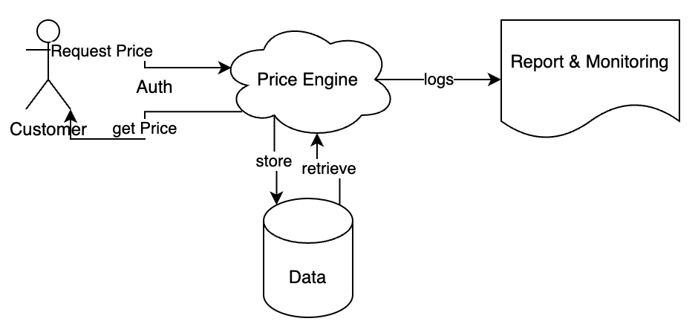
Architecture Overview
Web Application
Pricing Engine Service
Database
Authentication Service
External Integrations

Slide 5
Web Application
Backend for Price Engine System
Technologies: Python, Flask, RESTful API
Function: Handling incoming request, processing data, and returning pricing recommendations

Slide 6
Pricing Engine Service
Core logic for determining pricing strategies
Algorithm: Cost-based pricing
Functionality: Calculating optimal price prices based on various factor

Slide 7
Database
Store historical sales data, COGS data
RDBMS: PostgreSQL
Schema Design: Overview of tables and relationships

Slide 8
Authentication Service
Handle user authentication and authorization
Technologies: JWT token, bcrypt for password hashing
Function: Verify user credentials, issue access token, enforce access control policies.

Slide 9
External Integrations
Collect relevant data for pricing analysis (supplier price list, competitor pricing APIs, market research database)
Technologies: APIs, data scraping

Slide 10
Implentation Details
RESTful for data exchange
Pricing Algorithm: Cost-based pricing
Security Measures: Input Validation, authentication, encryption
Performance: Database optimization, caching, asynchronous processing

Slide 11
Conclusion
Simple and customizable algorithm
Machine Learning for next features

Slide 12
Thank You
Any questions ???

