Slide 1
INTRODUCTION
CacheWise replication
and KV cache recovery
Replicating CacheWise and evaluating host-DRAM recovery
CENTRAL QUESTION
How can coding agents reuse previous computation
when GPU memory is limited?
Six-page report, abstract and §1
01/12
Notes:
Slide 1: CacheWise replication and KV cache recovery
Time: 0:00–0:15 (15 seconds)
This project studies KV reuse for coding agents under limited GPU memory. We first examine CacheWise and its replication, then motivate and describe host-cache recovery.
Evidence: Six-page report, abstract and §1

Slide 2
PART 1 · CODING-AGENT TRACES
What do the CacheWise traces contain?
CATraces: real coding sessions
Reuse across turns
Claude Code interaction logs
Model requests + tool calls
Timing + prompt / output lengths
Growing, shared prompt prefixes
Long inputs with short outputs
Tool waits between requests
Released content is redacted; replay
preserves lengths and prefix growth.
Requests arrive in sessions,
with repeated opportunities for reuse.
Why prefix-aware scheduling can help
Reuse a resident prefix → less new prefill → fewer additional KV blocks.
A smaller active working set can reduce eviction pressure.
CacheWise v1 §§3–5; released-trace replay: report §3.1
02/12
Notes:
Slide 2: What do the CacheWise traces contain?
Time: 0:15–0:40 (25 seconds)
CATraces records real Claude Code sessions: model requests, tool calls, timings, and token usage. The released content is redacted, so our replay preserves lengths and prefix growth with synthetic tokens. The next two slides use the original paper’s graphs to show why this workload needs special cache management.
Evidence: CacheWise v1 §§3–5; released-trace replay: report §3.1

Slide 3
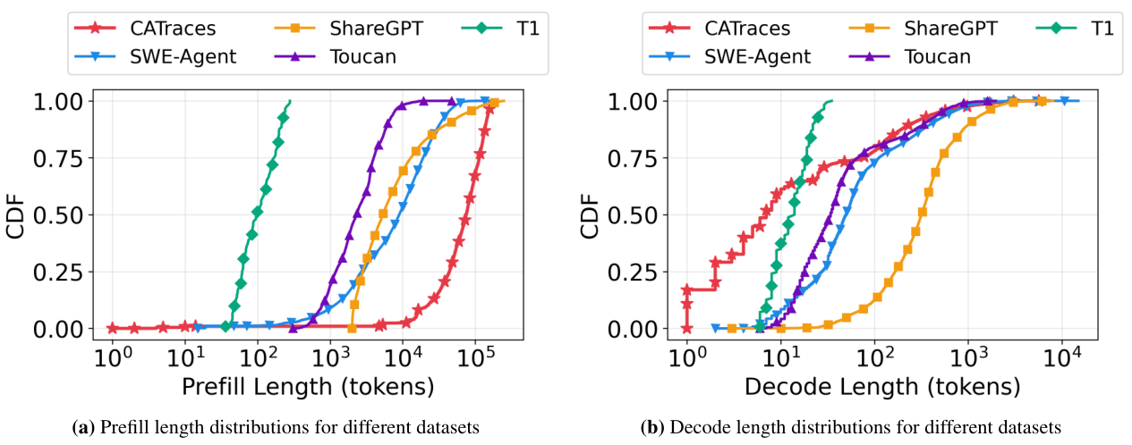
PART 1 · ORIGINAL PAPER: WORKLOAD SHAPE
CATraces: long inputs, short outputs
CATraces (red) vs. ShareGPT chat (orange): longer prefill, shorter decode.
CDF = fraction of requests at or below the token length. Published results, not our replay.
Cropped from Tiwari et al., CacheWise v1, Fig. 2 (PDF p. 4); CC BY 4.0
03/12
Notes:
Slide 3: CATraces: long inputs, short outputs
Time: 0:40–1:25 (45 seconds)
These are the original paper’s published prefill and decode distributions. A CDF shows the fraction of requests at or below a token length. Compare CATraces in red with the ShareGPT chat baseline in orange. The prefill curve is much farther right: agent prompts are much longer. The decode curve is farther left: outputs tend to be shorter. Reprocessing a large shared prefix can therefore be expensive even when little new text is generated. These are original-paper results, separate from our replay measurements.
Evidence: Cropped from Tiwari et al., CacheWise v1, Fig. 2 (PDF p. 4); CC BY 4.0

Slide 4
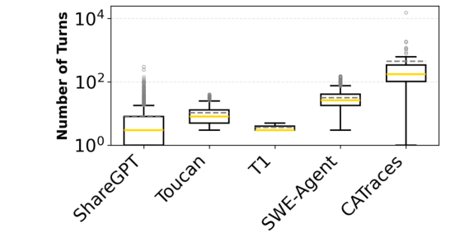
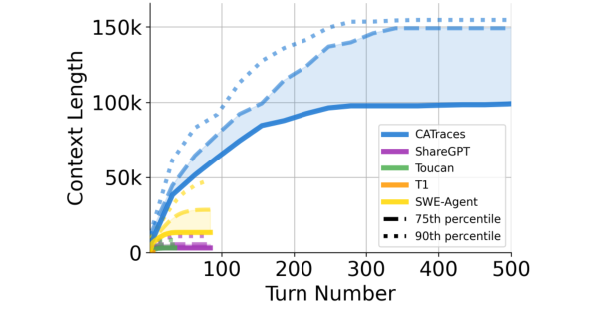
PART 1 · ORIGINAL PAPER: SESSIONS AND CONTEXT
CATraces differ from traditional chat
More turns per session (Fig. 3)
Growing context across turns (Fig. 6)
One task drives many model/tool turns; growing KV prefixes compete for memory.
Session completion matters alongside individual request latency.
Cropped from Tiwari et al., CacheWise v1, Figs. 3 and 6 (PDF p. 4); CC BY 4.0
04/12
Notes:
Slide 4: CATraces differ from traditional chat
Time: 1:25–2:00 (35 seconds)
ShareGPT is the chat baseline here. CATraces has many more turns in the left plot. On the right, follow blue CATraces versus purple ShareGPT: agent contexts grow much larger. One user task drives repeated model and tool calls, so KV must survive between requests and session completion matters alongside individual response latency.
Evidence: Cropped from Tiwari et al., CacheWise v1, Figs. 3 and 6 (PDF p. 4); CC BY 4.0

Slide 5
PART 1 · SCHEDULING AND TOOL-DURATION PREDICTION
CacheWise predicts when a session returns
Schedule requests
Predict duration → order evictions
Additional KV blocks
= required − resident
Tool name +
arguments
TF–IDF → trained KMeans
Historical duration samples
Serve the smallest
additional-block cost first.
Condition on the tool still running:
r = E[D − e | D > e]
Uses current GPU
prefix overlap.
Evict unreferenced KV with largest r;
refresh predictions as time passes.
D = total duration; e = elapsed time. Replication: tool names only (arguments redacted).
Algorithm adapted from CacheWise v1 §§5.1–5.3; original-paper argument-aware predictor
05/12
Notes:
Slide 5: CacheWise predicts when a session returns
Time: 2:00–3:05 (65 seconds)
The scheduler serves the request with the fewest additional KV blocks: required state minus resident state. For eviction, CacheWise predicts tool-call duration from historical calls. The original paper embeds arguments with TF–IDF and clusters similar calls with KMeans, giving a duration distribution for each group. For a tool still running after elapsed time e, estimate the remaining time as E of D minus e, conditioned on D being greater than e. This accounts for the time already spent waiting. Evict unreferenced KV whose predicted reuse is farthest away, and refresh estimates as time passes. Our replication uses tool names only because arguments are redacted.
Evidence: Algorithm adapted from CacheWise v1 §§5.1–5.3; original-paper argument-aware predictor

Slide 6
PART 1 · REPLICATION METHODOLOGY
CacheWise combines scheduling and eviction
Scheduler × eviction policy
Coverage study
LRU
Predictive
5 settings × 3 repeats
60 runs · 6,384 requests
FCFS
Baseline
FCFS + LRU
Eviction only
FCFS + predictive
14B model · BF16
287,696 KV token slots
512-token prefill chunks
Prefix-aware
Scheduling only
Prefix + LRU
CacheWise (both)
Prefix + predictive
Bottom-right: adapted CacheWise uses both components.
Primary metric: mean session serving time, excluding tool waits.
Evidence: four-policy replication; report Tables 1–3 and §3
06/12
Notes:
Slide 6: CacheWise combines scheduling and eviction
Time: 3:05–3:50 (45 seconds)
The bottom-right cell is adapted CacheWise: prefix-aware scheduling plus predictive eviction. The top-left cell is the FCFS/LRU baseline. The other two cells isolate one component: scheduling only uses prefix/LRU, while eviction only uses FCFS/predictive. We compare all four on the same configuration and inputs, using a 14B Qwen coding model on one Blackwell GPU. Three nested loads and two additional held-out workloads give five settings. With three repeats per policy, that is sixty runs and 6,384 request executions. The metric sums model-request latency per session, excluding tool waits.
Evidence: four-policy replication; report Tables 1–3 and §3

Slide 7
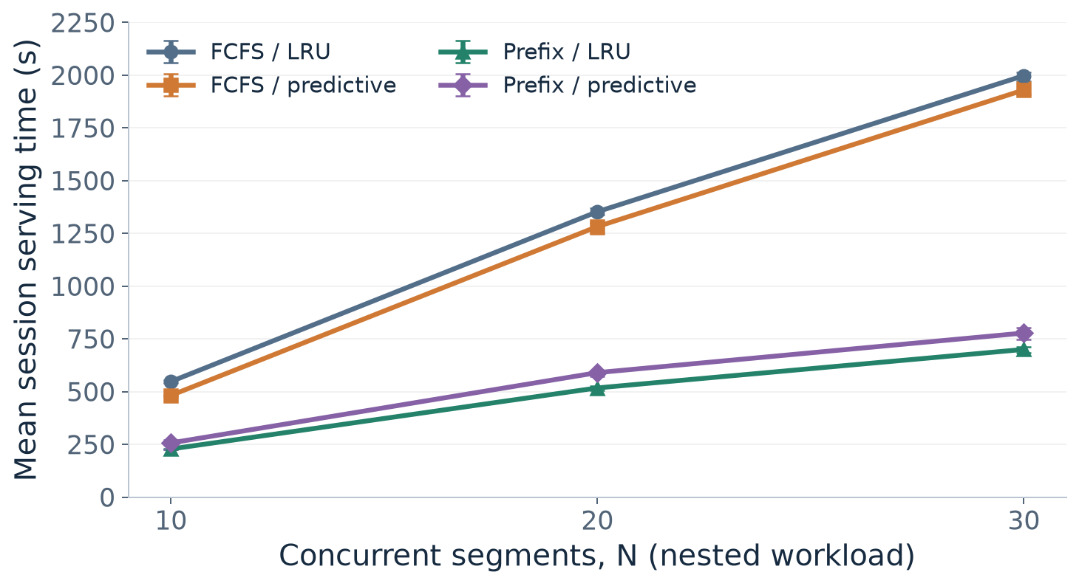
PART 1 · MAIN RESULT
Prefix / LRU has the lowest mean
5 / 5
settings favor
prefix / LRU
58–65% lower
mean vs. FCFS / LRU
in the load sweep
Three repeats per cell. Ranges are observed minima/maxima; lower is better.
Evidence: frozen 60-run coverage study; report Table 3 and Figure 1a
07/12
Notes:
Slide 7: Prefix / LRU has the lowest mean
Time: 3:50–5:00 (70 seconds)
The green prefix/LRU line is the scheduling-only ablation and has the lowest mean at all three tested loads. Adapted CacheWise is the purple prefix/predictive line. Compared with FCFS/LRU, the reduction is about 58, 62, and 65 percent as N rises. It also has the lowest mean in two additional held-out workloads, making five settings out of five. Ranges show observed minima and maxima from three repeats, not confidence intervals. The load sweep adds segments, so concurrency and composition both change. These are our adapted replay results, separate from the preceding published workload graphs.
Evidence: frozen 60-run coverage study; report Table 3 and Figure 1a

Slide 8
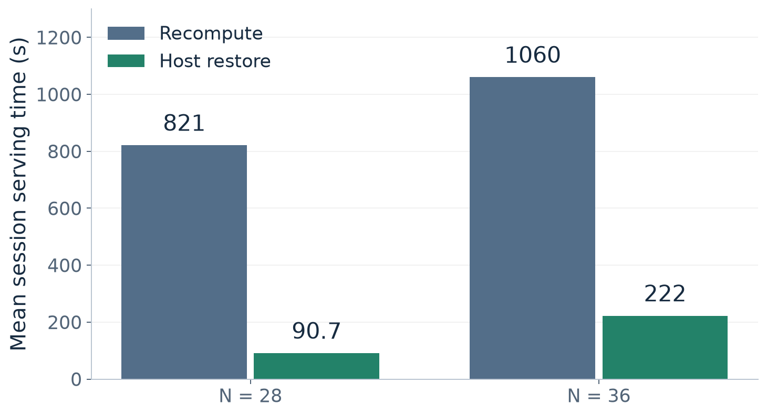
PART 2 · MOTIVATION FOR KV OFFLOADING
Host restoration reduces session time
Recovery tradeoff: save + restore + management < recomputation
9.1× / 4.8×
reported time ratios
at N = 28 / 36
+36 GiB host KV
24 GiB GPU KV
fixed
One observation
per bar
Separate Mini-SGLang study. Added-capacity comparison; lower is better.
Evidence: host-dram-reported-results.json; report Figure 3a and §6
08/12
Notes:
Slide 8: Host restoration reduces session time
Time: 5:00–6:15 (75 seconds)
After the CacheWise replication, we turn to recovery after eviction. Scheduling can limit churn, but useful state may still leave the GPU. Saving it in host memory allows restoration instead of repeating prefill. A simple cost test is whether saving, restoring, and managing the copy costs less than recomputation. Here we keep LRU and FCFS fixed and compare recomputation with on-demand host restoration. At twenty-eight concurrent episodes, reported mean session time falls from 821 to 90.7 seconds, a baseline-to-restoration ratio of about 9.1. At thirty-six it falls from 1,060 to 222 seconds, about 4.8. The reported prior-prefix deficit also drops sharply, supporting the interpretation that more reusable state survives. Two qualifications matter. First, restoration adds thirty-six GiB of host KV capacity to the common twenty-four-GiB GPU pool, so this is not an equal-total-memory algorithm comparison. Second, each bar is one reported run. This study also uses a different engine, smaller GPU pool, larger prefill chunks, and transformed replay inputs. We therefore keep it separate from the vLLM replication. The result demonstrates a favorable host-DRAM operating regime, not a measured SSD break-even curve.
Evidence: host-dram-reported-results.json; report Figure 3a and §6

Slide 9
PART 3 · HOST-CACHE DESIGN
Preserve evicted KV in host DRAM
Request queue + radix prefix index
Track GPU / host residency; select the next request
Save dirty KV
GPU KV cache
Pinned host KV cache
24 GiB · 16-token pages
Restore / fetch
36 GiB · inclusive clean copies
On demand
Prefetch
Fallback
Restore before prefill.
Overlap predicted reuse.
Recompute on a miss.
Implementation: Mini-SGLangs 3f9aee7; report Figure 2 and §5
09/12
Notes:
Slide 9: Preserve evicted KV in host DRAM
Time: 6:15–7:15 (60 seconds)
These recovery observations motivate offloading. Here is how the Mini-SGLang host cache implements the save-and-restore path. One radix index records which prefix pages reside on the GPU and which have host copies. When memory is needed, dirty GPU pages are copied to pinned host DRAM. Clean inclusive copies can remain there, so a later GPU eviction does not require another save. When a request returns, a compatible host suffix is restored before prefill; if no copy survives, the engine recomputes. The implementation uses sixteen-token pages, locks and events to protect transfers, and predictive prefetch with a bounded per-step budget. In the recovery study the GPU pool holds twenty-four GiB of KV payload and the host tier adds thirty-six GiB. These are nominal cache payloads, excluding weights and other memory. No SSD path is implemented.
Evidence: Implementation: Mini-SGLangs 3f9aee7; report Figure 2 and §5

Slide 10
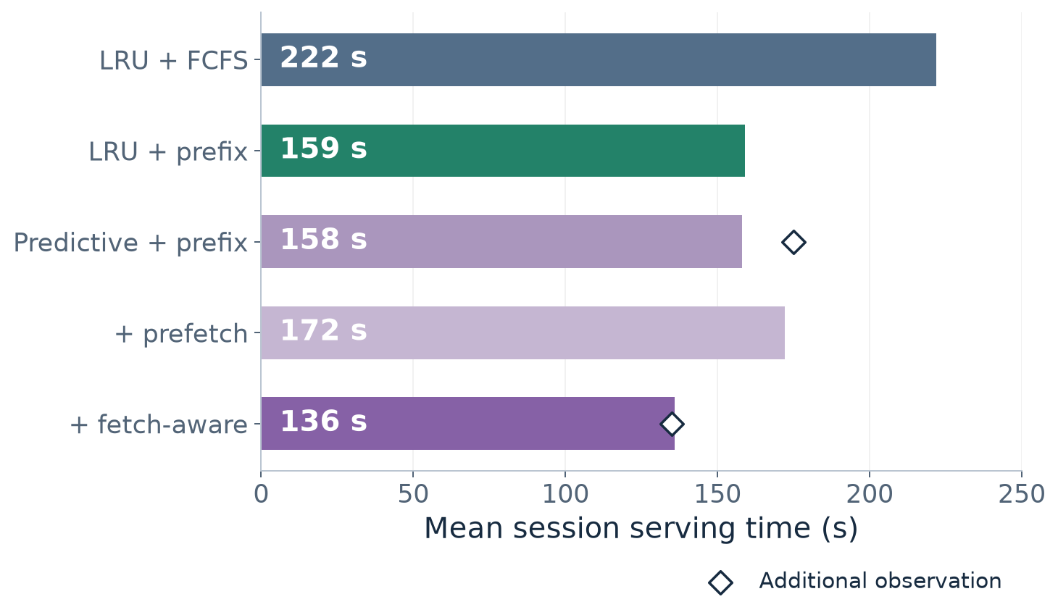
PART 3 · SCHEDULING EXTENSION
Fetch-aware ordering discounts host hits
Priority cost
new prefill tokens
+ 0.05 × host
tokens
Mean of 2
observations
166.5 s → 135.5 s
Sparse repetitions;
no confidence interval.
Bars: first observations. Diamonds: additional observations, not matched blocks.
Evidence: Mini-SGLangs 3f9aee7; report Figure 3b and Eq. (3)
10/12
Notes:
Slide 10: Fetch-aware ordering discounts host hits
Time: 7:15–8:35 (80 seconds)
Ordinary prefix-aware ordering considers the GPU prefix. Fetch-aware ordering also recognizes that a host-resident prefix can be cheaper than recomputing a complete miss. The priority is new prefill tokens plus alpha times the additional host tokens, with alpha fixed to 0.05. Lower-cost requests go first. This is a heuristic, not a calibrated latency predictor. On the left are the reported N-equals-thirty-six host ablations at fixed tier capacities. LRU plus prefix scheduling takes 159 seconds, predictive plus prefix takes 158, adding prefetch alone takes 172, and the full fetch-aware combination takes 136. The diamonds show the additional observations: 175 seconds for predictive-prefix and 135 for the full combination. The two descriptive means are 166.5 and 135.5 seconds. These sparse, not verified matched observations favor the full combination, but do not isolate every component or establish statistical significance. Prefetch alone is not enough in this example.
Evidence: Mini-SGLangs 3f9aee7; report Figure 3b and Eq. (3)

Slide 11
SCOPE AND LIMITATIONS
Keep the conclusions within the evidence
Replication
Host results
SSD extension
Synthetic replay and
selected segments.
One retained preemption;
extra prefill work
unmeasured.
Separate engine and
replay.
Added host capacity; most
configurations run once.
Not implemented or
measured.
Needs full I/O, staging,
metadata and recovery.
Interpret both studies separately; retain the declared protocol deviation.
Limitations: report §§3.2, 6.1 and 7
11/12
Notes:
Slide 11: Keep the conclusions within the evidence
Time: 8:35–9:20 (45 seconds)
There are three boundaries to keep in mind. The replication uses synthetic content and runtime-bounded selected segments; increasing the load also changes the workload. One real preemption violated the original zero-preemption rule. It remains in the results under a disclosed post hoc audit amendment, and its extra computation is unmeasured. The host study is a separate replay with added backing capacity and mostly single-run observations. We reproduce its rounded reported values rather than claim an independent request-level audit. Finally, the implemented recovery tier is pinned host DRAM. SSD support would need complete storage writes and reads, bounded staging, compatibility metadata, and failure handling. We cannot infer an SSD speedup from these DRAM results.
Evidence: Limitations: report §§3.2, 6.1 and 7

Slide 12
CONCLUSION · QUESTIONS
Three takeaways
01
Scheduling and eviction interact.
Prefix / LRU has the lowest mean in all five replication settings.
02
Host copies can avoid costly recovery.
Large reported gains include the added 36 GiB backing tier.
03
Order requests by recovery cost.
Fetch-aware results are promising; SSD evaluation remains future work.
Full results and qualifications: six-page report; archived evidence in repository
12/12
Notes:
Slide 12: Three takeaways
Time: 9:20–10:00 (40 seconds)
The first takeaway is that scheduling dominates the mean improvement in our adapted replication: prefix-aware LRU wins all five settings, while predictive eviction changes direction with the scheduler. The second is that retaining KV in host memory can avoid substantial recovery work for long prefixes, with large reported improvements when host capacity is added. The third is that host residency should inform request ordering. Fetch-aware scheduling is promising here, but the policy evidence is much smaller than the replication study. The completed scope is replication and host-DRAM recovery. SSD performance remains future work. Thank you; I am happy to take questions.
Evidence: Full results and qualifications: six-page report; archived evidence in repository

