Slide 1


Final Year Presentation on
Application Named “Thieves Beware”
Department of Computer Science and Engineering
7th December, 2017

Slide 2
HELLO!
Our Supervisor is
Jannatul Fardous
ID: 2013-2-60-028
Nawab Yousuf Ali
Associate Professor
Dept. of Computer Science and Engineering
East West University
Ahmad Hussain Zamee
ID: 2013-2-60-024

Slide 3
Abstract
The aim of this project is to implement anti-theft application for android based mobile phones. We implemented this by using different services and sensors like front camera, SMS, location, proximity sensor, accelerometer sensor and so on. We focused on how we can protect our mobile from theft and how we can recover our mobile after theft

Slide 4
Outline
Motivation
Objectives
Features
Design & Analysis
Project Demo
Unique Features
Future works
Conclusion

Slide 5
Motivation
Mobile theft is become a major problem now a days. People feel so sad when they lost their favorite smart phone
During Travelling on a busy bus/ train/ etc.
While walking in a busy street.
From surface where you put your mobile for any purpose.
What You Think????
Your Mobile is safe!!!
Bag
Car
Pocket
Bed

Slide 6

Motivation
There are also some other different situations where you may lost your mobile.
Keeping above situations in our mind we came up with our idea to built a Mobile Application in android platform which is named “THIEVES BEWARE”

Slide 7
Objective
Explain how the application is designed.
Explain how the application is built.
Explain how this application is able to secure your mobile from thief.
Explain how user can recover his/her mobile from intruder.

Slide 8
Features
Pocket Security
Before Theft
After Theft
Phone Moved Security
Thieves Beware
Send Email
Hardware Lock
Send SMS

Slide 9
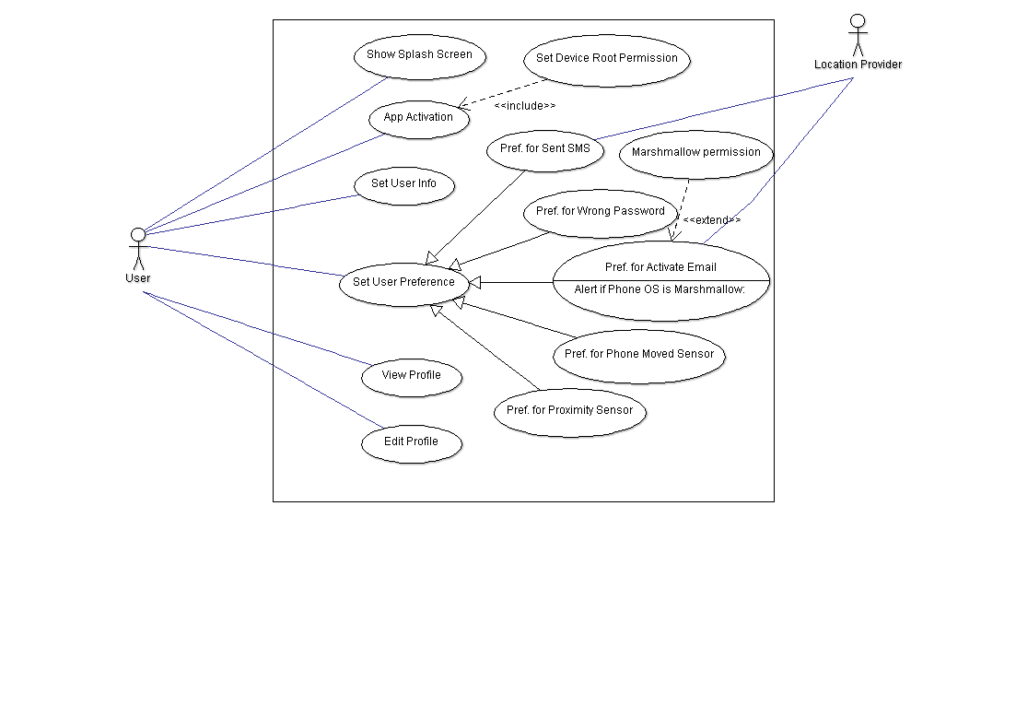
Design & Analysis
Use Case Diagram

Slide 10
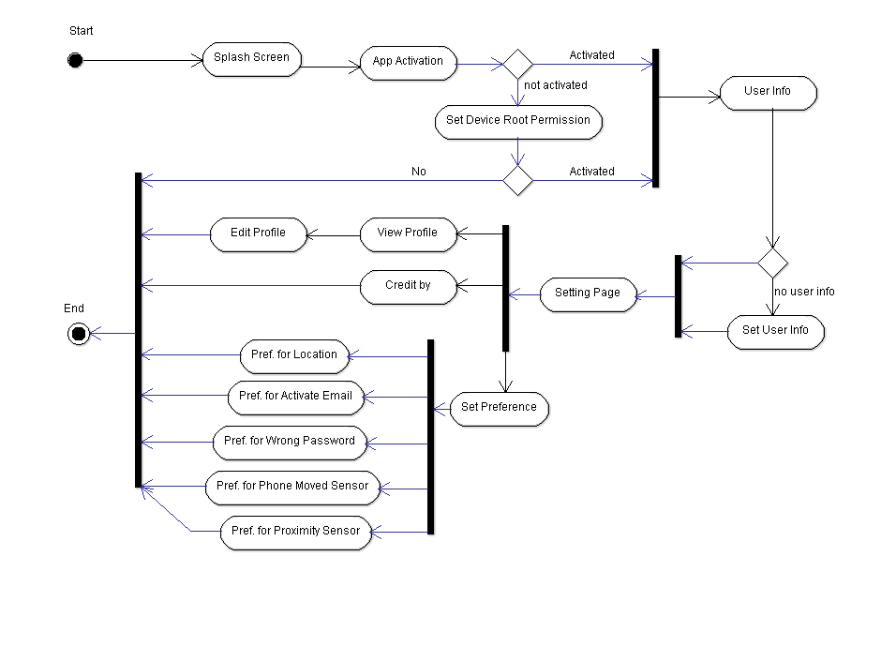
Design & Analysis
Activity Diagram

Slide 11
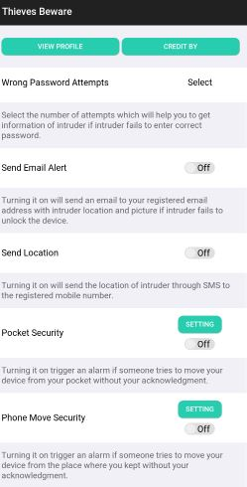
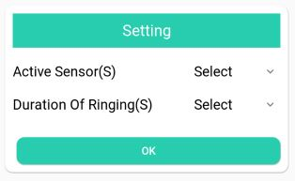
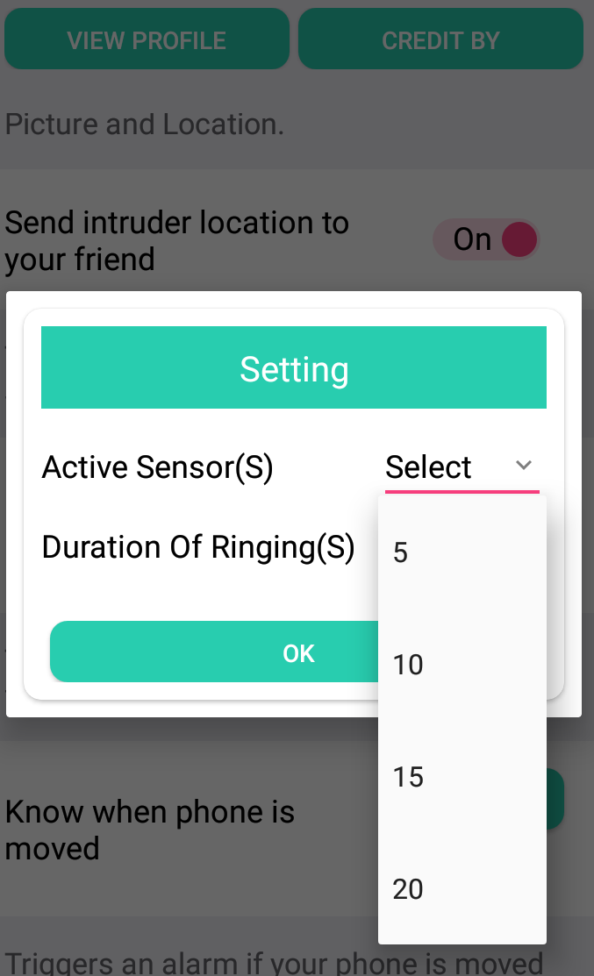
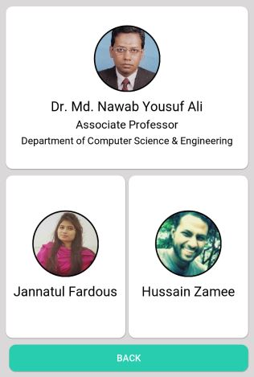
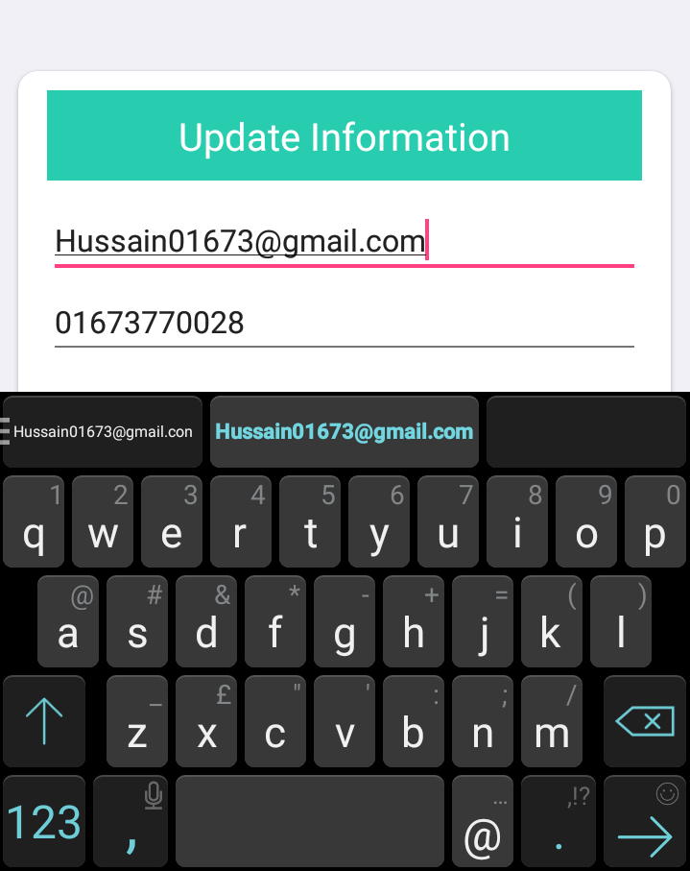
Project Demo

Slide 12
Unique Features
Access hardware lock and watch failed password attempts
No Internet connection. Start service to send email when internet available.
send email if the device started or device is restarted.
Alarm if mobile is removed from pocket

Slide 13
Future Plans
Select Option for user for how many images will be taken to send email
Sent image by MMS.
SIM card change, than notify the owner with new SIM card number by SMS.
Wipe all the data if any SMS with body contains specific word like “wipe data” came.
Make a backup of all the contact information and send email to the provided email if any SMS with body contains specific word like “sent contact information” came.

Slide 14
Conclusion
After all of this description of our project, we feel satisfy to successfully conclude this project. Throughout the development of this project we’ve learnt a lot. After a lots of R&D we can come up some of our unique features and merge them together where now the application is working very well. We also did a lots of testing to check our application performance and it works very well.

Slide 15
References
[1] GitHub. (2017). binjar/prefs-droid. [online] Available at: https://github.com/binjar/prefs-droid [Accessed 10 Sep. 2017].
[2] GitHub. (2017). jituijiaqiezi/compress-Compressor. [online] Available at: https://github.com/jituijiaqiezi/compress-Compressor [Accessed 14 Sep. 2017].
[3] GitHub. (2017). square/okhttp. [online] Available at: https://github.com/square/okhttp [Accessed 14 Oct. 2017].
[4] GitHub. (2017). square/retrofit. [online] Available at: https://github.com/square/retrofit/tree/master/retrofit-converters/gson [Accessed 17 Sep. 2017].
[5] GitHub. (2017). square/retrofit. [online] Available at: https://github.com/square/retrofit/tree/master/retrofit-converters/gson [Accessed 17 Sep. 2017].
[6] GitHub. (2017). square/okhttp. [online] Available at: https://github.com/square/okhttp/tree/master/okhttp-logging-interceptor [Accessed 10 Nov. 2017].
[7] GitHub. (2017). kyleduo/SwitchButton. [online] Available at: https://github.com/kyleduo/SwitchButton [Accessed 14 Sep. 2017].
[8] GitHub. (2017). kevalpatel2106/android-hidden-camera. [online] Available at: https://github.com/kevalpatel2106/android-hidden-camera [Accessed 11 Oct. 2017].
[9] GitHub. (2017). Tapadoo/Alerter. [online] Available at: https://github.com/Tapadoo/Alerter [Accessed 10 Oct. 2017].
[10] Administration, D. (2017). Device Administration | Android Developers. [online] Developer.android.com. Available at: https://developer.android.com/guide/topics/admin/device-admin.html [Accessed 15 Oct. 2017].
[11] Khan, B. (2017). Android Email App Using Javamail API in Android Studio. [online] Simplified Coding. Available at: https://www.simplifiedcoding.net/android-email-app-using-javamail-api-in-android-studio/ [Accessed 22 Oct. 2017].
[12] GMailSender?, S. (2017). Sending email with attachment through GMailSender?. [online] Stackoverflow.com. Available at: http://stackoverflow.com/questions/6005983/sending-email-with-attachment-through-gmailsender [Accessed 20 Oct. 2017].

Slide 16
Demonstrate Project
Here we are going show our whole project and its functionality through
“Vysor“

Slide 17
Q & A
Thank You For Staying With Us

