Slide 1
FTIR · EC CALIBRATION · ADDIS ABABA · ANN 1:1 · 12 AUG 2026
What changed —
and what needs your call.
Three committed results on the intercept · one open question resolved this morning · six decisions before tomorrow's 10:00 with Satoshi.
Every number traces to a committed, executed notebook (ftir_11–27) except where a slide says otherwise. Focus: FTIR, HIPS, TOR and the IMPROVE network.
Notes:
Three things landed since you last saw this, and I need six decisions before tomorrow morning. The deck for Satoshi is built and it has not gone anywhere. Nothing here has been said out loud outside this room.

Slide 2
STATUS AT A GLANCE
Since you saw it — and what needs you today.
Since you saw it
Needs you today
Audit: the random-cohort claim corrected in deck, summary and email
pushed
Approve the Satoshi deck — five parts, six asks, two tone calls
sign off
Intercept restated as a MAC-invariant ~21 Mm⁻¹ absorption target (ftir_25)
committed
What does SPARTAN mean by HIPS_Uncertainty / HIPS_MDL?
semantics
“The offset lives in x” survives its sharpest cheap test (AIRSpec gain)
committed
ftir_24 — build today, or after tomorrow?
go / no-go
IMPROVE HIPS reads ≈ 0 at EC = 0 — not a generic HIPS zero (ftir_26)
committed
Who owns each of tomorrow's asks in the room?
assign
Both ChemSpec carbon columns circular — no independent EC reference in hand (ftir_27)
committed
Quartz-TOR one-pager — hand to Satoshi tomorrow?
go / no-go
HIPS wavelength resolved: He–Ne 632.8 ≈ 633 nm, MAC 10 at 633
resolved today
Hossein outcome — it gates the co-author email
blocked on you
ftir_24 (dry vs non-dry) is buildable today — the 43-undated worry is retired
ready
Notes:
Let her read the scorecard while you give the opening line. Do not walk it row by row. Everything green is committed and pushed; the gold column is the decision list for this meeting.

Slide 3
01 · THE AUDIT — CAUGHT BEFORE SATOSHI, NOT AFTER
The random-cohort claim was wrong on all three counts — and never comparable anyway.
The claim said “beats ten size-matched random cohorts, 3.4 vs 4.4–7.3”. The committed numbers: five cohorts, range 3.10–5.00 — and random #3 beats OCEC-800.
Worse: each cohort was scored on its own disjoint-site split (n_test 114–194), so the comparison was never valid — the chart exists to show why it left the deck.
What replaces it is like-for-like and stronger:
same 190 filters, RMSE 1.16 vs 1.48–2.24
held-out TOR R² 0.911 vs 0.594–0.775
fix pushed 53c332e
held-out TOR RMSE (µg/filter) — run_ftir_11, committed
Also corrected: VIP ρ = 0.74/0.12 uncorroborated · −1.61 → −1.62 · ETBI vs Dry median 43.2 · “91% baseline” = one filter.
Notes:
SAY: Before anything else — the audit found a wrong claim in the deck and it is fixed. We had been saying the low-OC/EC cohort beats ten random cohorts on the held-out TOR test. There were five, not ten. The range was 3.1 to 5.0, not 4.4 to 7.3. And one of the five actually beat ours — you can see it in red. Worse than any of that, the comparison was structurally meaningless: each cohort was scored on its own disjoint-site split, so those RMSEs were never comparable in the first place. The conclusion survives on the like-for-like evidence — same 190 Addis filters, RMSE 1.16 against 1.48 to 2.24; held-out TOR R-squared 0.911 against 0.594 to 0.775. That is what the deck, the summary and the email now say. Fixed and pushed this morning. IF SHE PUSHES on how it got in: the number came in through the summary and propagated outward. No executed notebook ever produced it — that is the signature to watch for: a claim with no cell behind it. Frame the whole slide as the check working, not as damage.

Slide 4
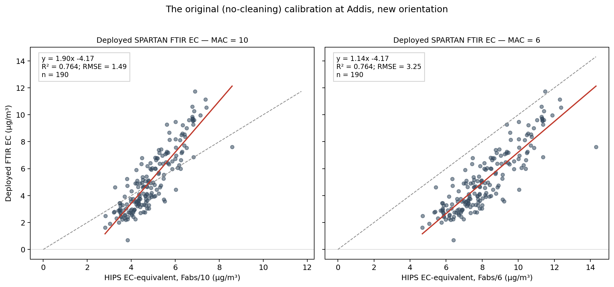
02 · WHERE THIS STARTED
The deployed calibration reads y = 1.90x − 4.17 at Addis.
Nothing at Addis has negative EC — the offset is the model, not the air.
At MAC 6 the slope pivots to 1.14 but the intercept stays at −4.17: the intercept column is MAC-proof (proved on slide 12).
MAC 10 1.90x − 4.17
MAC 6 1.14x − 4.17
ftir_17 · deployed_alldata_crossplot Fixed 190-filter cohort; deployed predictions exist only for these
Notes:
Thirty seconds — she knows this plot. It is here so the new results have their reference point on screen.

Slide 5
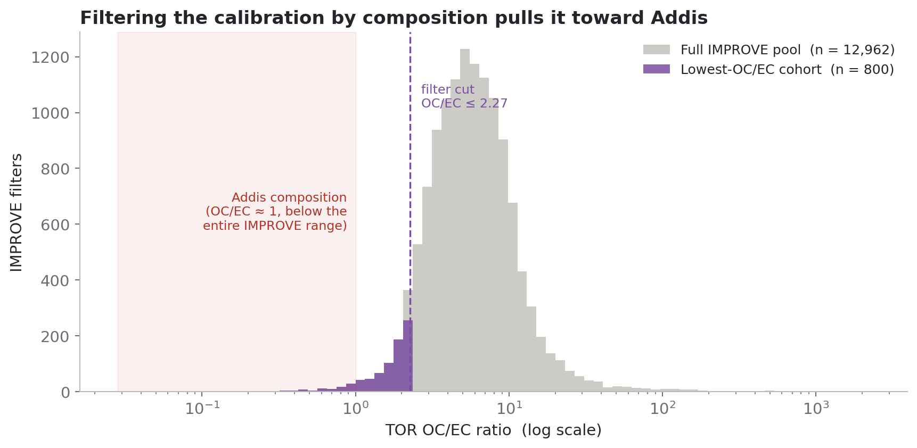
03 · ANN'S COHORT
Addis-like composition is the extreme tail of IMPROVE — 800 of 13,010 filters.
Your low-OC/EC idea remains the best locked calibration — and cohort engineering beyond it breaks the held-out TOR test, so OCEC-800 (+ AIRSpec) is the terminal IMPROVE-only candidate.
cutoff OC/EC ≤ 2.27
held-out TOR RMSE 3.4 µg/filter
deck · filtering_by_ocec Cutoff OC/EC ≤ 2.27; pool median 5.54; Addis ≈ 1, below the whole range
Notes:
Quick — context for the setup matrix. The random-cohort correction does not change this ranking; the like-for-like tests do the work now.

Slide 6
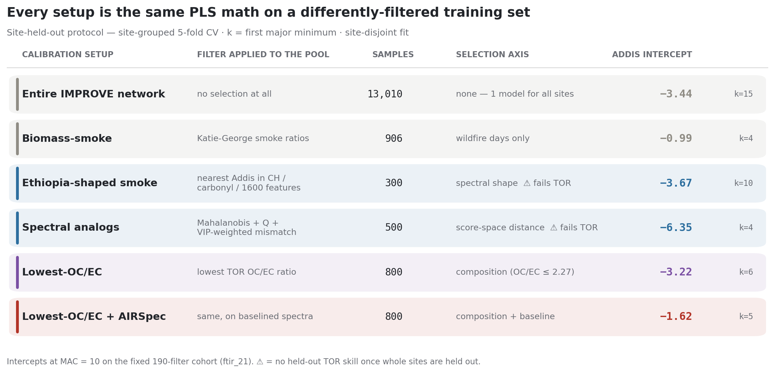
04 · EVERY TRAINING CHOICE, ONE TABLE
Lowest-OC/EC + AIRSpec ends at −1.62 — and is protocol-robust.
The intercept ladder: −4.17 → −3.22 → −1.62.
The corrected setup barely moves between protocols (−1.65 / −1.62) and passes the disjoint-site TOR test (slope 1.01, R² 0.90).
Tone call for tomorrow: the deck says MAC 10 is where it “lands closest” — deliberately not “self-consistent”, since 0.86 fails ftir_19's |slope−1| ≤ 0.1 bar.
intercept −1.62
protocol-robust −1.65 / −1.62
by_protocol/site_held_out · calibration_setup_matrix Row 1 is the whole IMPROVE network — ETAD spectra are evaluation-only
Notes:
This is what she is approving for tomorrow, structurally. The two tone calls live here and on the component-selection slide of the Satoshi deck: the Calibration-app framing (“different question, not wrong tool”) and how hard to push MAC 10.

Slide 7
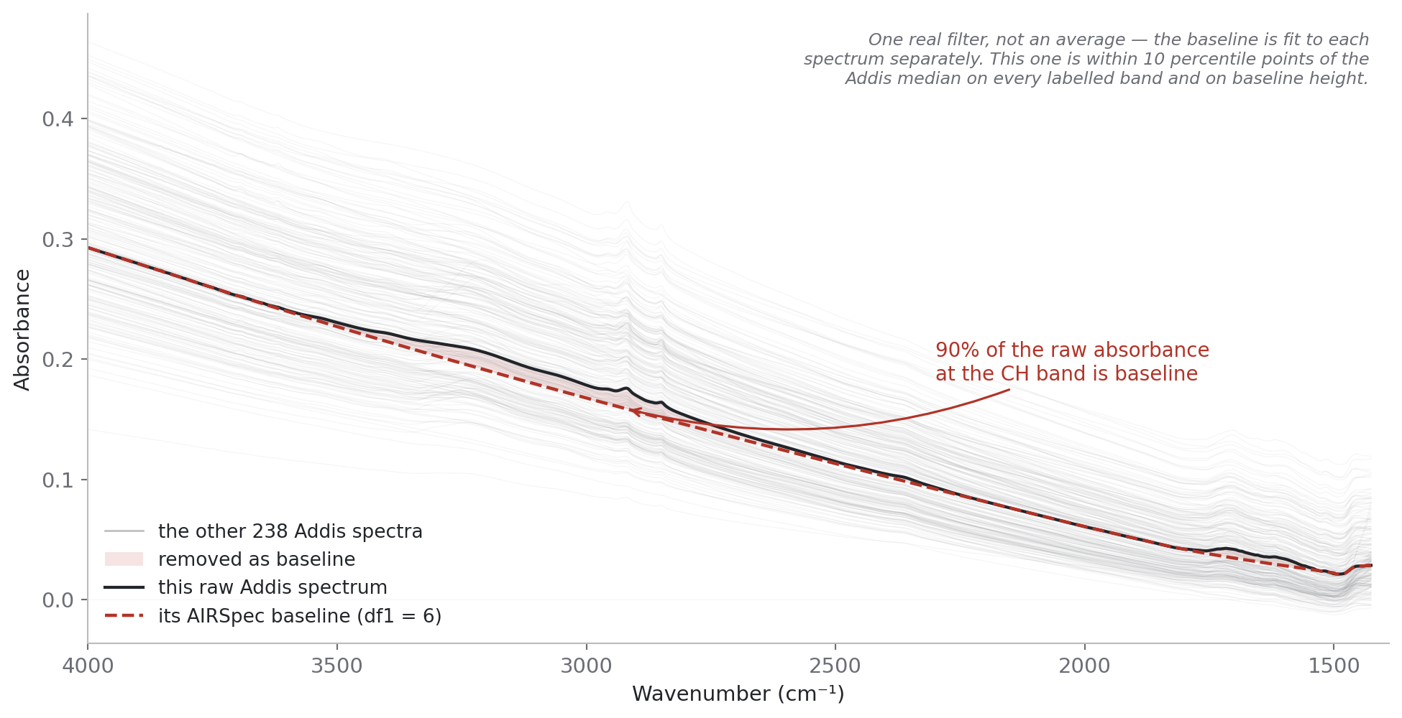
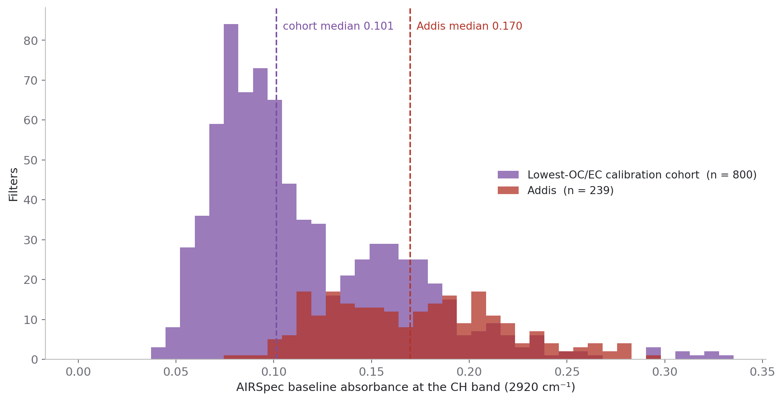
05 · WHY BASELINING MOVES THE ANSWER
~91% of a raw Addis spectrum at the CH band is background — and Addis rides a higher background than its cohort.
deck · airspec_1_baseline One real filter (median-like); grey = all 239 Addis spectra
deck · airspec_3_background_gap Baseline at 2920 cm⁻¹ per filter: cohort 0.101 vs Addis 0.170
baseline share @ CH ~91% (one filter)
Addis vs cohort baseline 0.170 vs 0.101
intercept −3.22 → −1.62
Notes:
She has seen these; keep to the mechanism sentence: a raw-spectra model is free to regress on background, Addis rides a higher background than anything it was trained on, and that error lands as an offset. Honest cost: corrected R² 0.66 vs 0.77 raw and RMSE 2.41 vs 1.16 — we prefer it for its residual structure, not its fit.

Slide 8
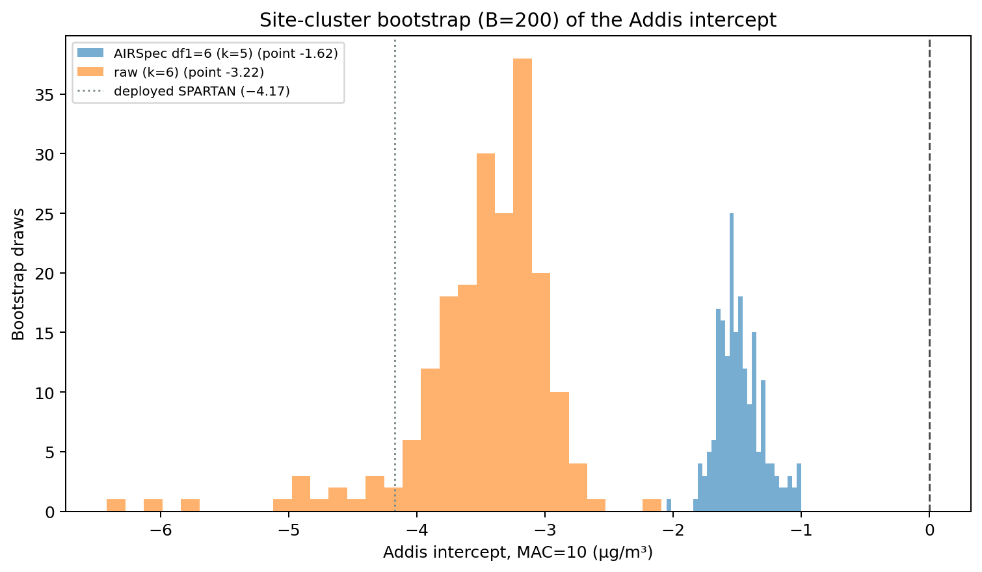
06 · RESURFACED — JULY SLIDE 15, NEVER PRESENTED
The AIRSpec improvement is real — and so is what remains.
Skipped in July's jump from the cohort sweep to seasonality.
The raw and corrected distributions are fully disjoint — the improvement is not a lucky draw — and the corrected interval still excludes zero: the remaining offset is not noise.
corrected 95% CI [−1.78, −1.06]
raw 95% CI [−4.88, −2.81]
overlap none
ftir_15 · bootstrap_intercepts Site-cluster bootstrap, B = 200; deployed −4.17 dotted
Notes:
This is the uncertainty evidence the July meeting never saw — the statistical backbone under the intercept work, and the bridge into restating that remainder as a physical target on slide 08.

Slide 9
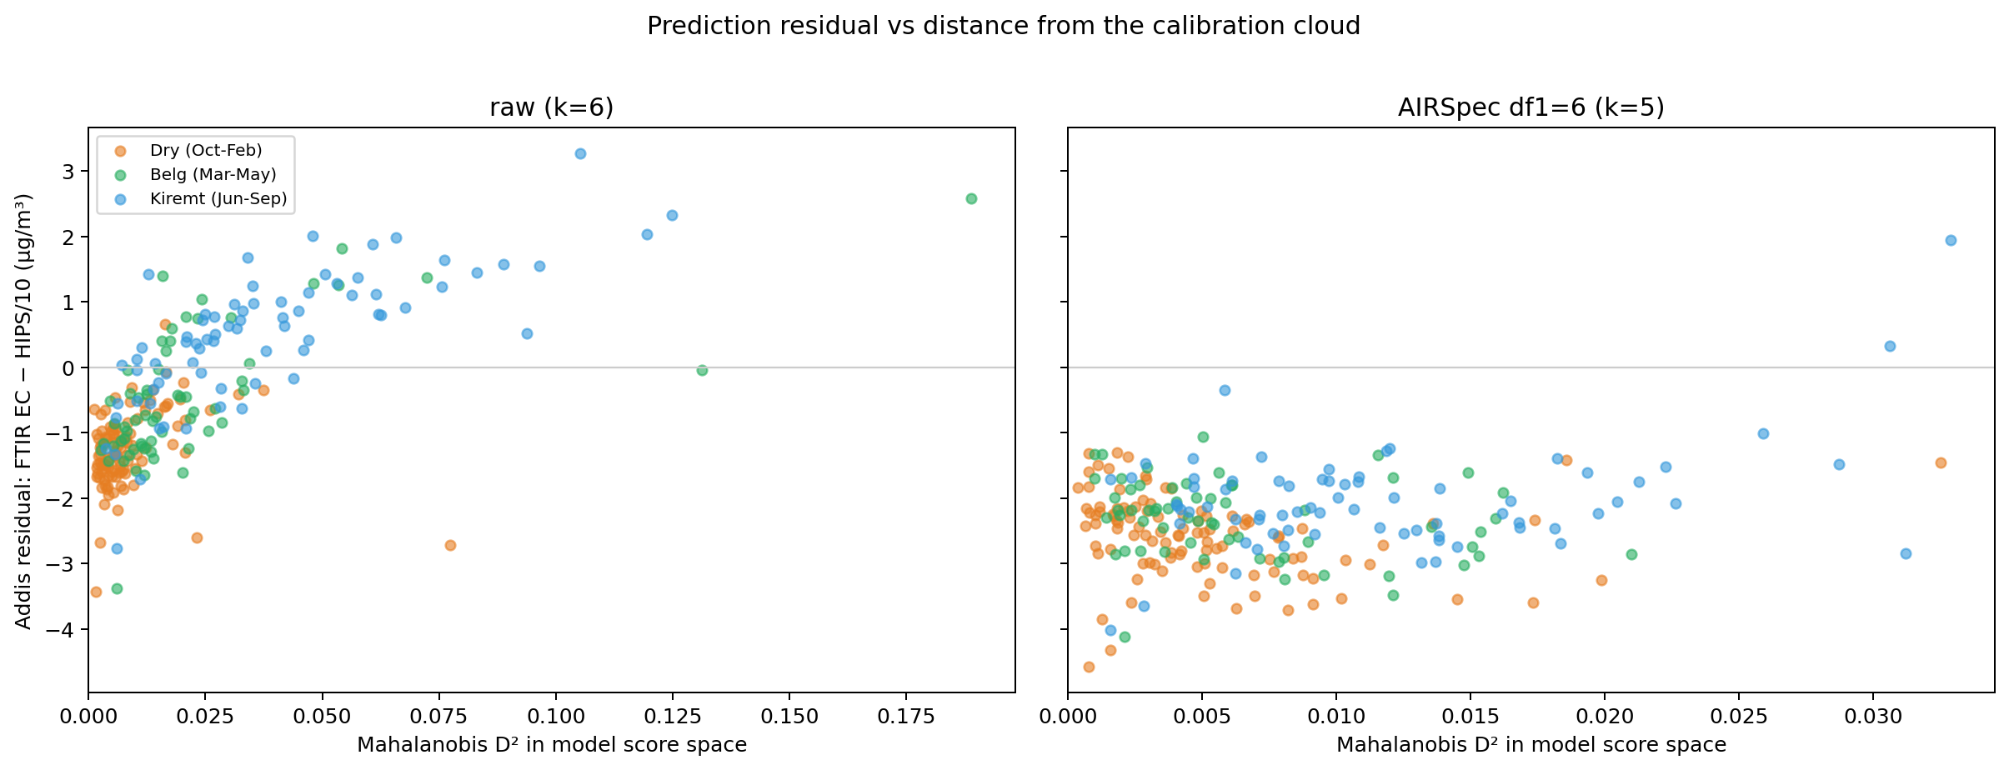
07 · RESURFACED — JULY SLIDE 16, NEVER PRESENTED
The corrected model misses by a flat constant — and Dry was already separating.
Raw model: error tracks extrapolation distance and flips sign by season.
Corrected model: D²-independent, a season-stable −2.0 to −2.6 µg/m³ — and in both panels the Dry points sit lowest.
The season structure slide 15 quantifies was visible here first.
raw: resid ~ D² r = 0.71
corrected offset −2.0 … −2.6
Dry lowest in both
ftir_15 · residual_vs_D2_by_season Residual vs Mahalanobis D² in score space, colored by Naveed's seasons
Notes:
Ironically the slide that most directly answered her July “I'm confused” moment. A constant offset that does not grow with extrapolation distance is not a domain failure — it behaves like something additive sitting in the x-axis data.

Slide 10
08 · RESULT — THE INTERCEPT, RESTATED (FTIR_25, COMMITTED)
~21 Mm⁻¹ of absorption with no FTIR-EC behind it — and no modelling choice moves it.
Calibration setup | intercept | slope @10 | C (Mm⁻¹)
Whole IMPROVE network (deployed) | −4.17 | 1.90 | 21.9
Biomass-smoke (906) | −6.91 | 2.65 | 26.1
Ethiopia-shaped smoke (300) | −3.69 | 1.75 | 21.1
Spectral analogs (500) | −6.43 | 2.91 | 22.1
Lowest-OC/EC (800) | −3.22 | 1.59 | 20.3
Lowest-OC/EC + AIRSpec | −1.62 | 0.86 | 18.8
21.5
Mm⁻¹ median — 46% of a typical Addis filter's Fabs. Slopes span 3.4× across these six setups; C spans 1.4×. Exactly MAC-invariant, so the target survives the MAC fork.
Sharpest cheap test, passed: AIRSpec touches only the spectra (y-side) yet halves slope and intercept in proportion — under y = a(x − c), c stays put: 2.03 → 1.88 (−7.3% where a and b each move ~50%). The offset behaves as if it lives in the Fabs axis.
Stated caveat: C is invariant to any rescaling of the EC axis, so cross-setup stability is partly structural. The claim is “robust to every scaling choice” — not “six independent routes agree”.
Notes:
SAY: This is the answer to your July question — why is the intercept negative when nothing at Addis is. Set predicted EC to zero and the intercept becomes a quantity you could go and look for: about 21 inverse megametres at the HIPS wavelength with no FTIR-EC behind it — 46 percent of a typical Addis filter. IF SHE PUSHES on what it licenses: nothing about the cause on its own — brown carbon, dust, a HIPS artifact and curve geometry are all still live on this slide alone; the next two slides start eliminating them. IF SHE PUSHES on the −7.3%: it is systematic — c runs 1.885–2.608 across setups, best setup lowest; a shared c costs only 1.6% in RSS but is confounded by the same gain-invariance.

Slide 11
09 · RESULT — IS IT A GENERIC HIPS ZERO? (FTIR_26, COMMITTED)
No. IMPROVE HIPS runs through the origin — which leaves two explanations that are not an absorber.
≤ 1.3 Mm⁻¹
+0.12 Mm⁻¹
0.010%
pooled intercept, hard upper bound
median Fabs at EC ≤ 0 (n = 4,247)
IMPROVE filters reaching Addis's 47.1
So the offset is Addis-specific: ≤ 6% of C is instrument-generic — and OLS is the maximum over all errors-in-variables fits, so the bound is hard. Two non-absorber explanations survive — hear them today, not tomorrow:
① Curve geometry
② Loading-dependent HIPS artifact
Fabs is concave in EC across IMPROVE (≈ EC^0.796, through zero) — a straight line through a concave cloud manufactures a negative intercept with no offset present. Per-site intercepts: median 35% of site mean Fabs; Addis is 46%, and ~a third of sites sit at or above that in data whose true offset is ~0. Caveat: the exponent is an upper bound on concavity (Fabs-binned it comes out faintly convex), so this may be smaller than it looks.
IMPROVE median Fabs 1.3 vs Addis 47 — a 37× gap that rules out an additive loading-independent offset, but not one growing with loading: per-site intercept grows with loading (r = 0.69), extrapolating to 16.2 Mm⁻¹ ≈ 75% of C. That extrapolation is 6× beyond IMPROVE's largest site — it cannot be closed from IMPROVE data.
Notes:
Give this the most air — it is both the strongest support and the sharpest caveat. SAY: Tier-1 item one came back. The question was whether HIPS generically reads a few inverse megametres at zero EC. It does not — the intercept is at most 1.3 pooled, 0.1 in the Addis-like subset, the median at zero EC is +0.12 with a quarter of filters negative: zero at zero with symmetric noise. And only 0.01 percent of IMPROVE filters carry as much total absorption as Addis's median — a generic 21-megametre offset cannot exist in that dataset. Then give the two survivors, slowly. IF SHE ASKS about testing curvature at Addis directly: it needs an EC reference derived from neither Fabs nor FTIR — after ftir_27 there is none in hand; it waits on quartz TOR. IF SHE ASKS about the 170/176 significant sites: n-power, not magnitude — no site reaches 5 Mm⁻¹.

Slide 12
10 · RESULT — NO INDEPENDENT EC REFERENCE EXISTS IN HAND (FTIR_27, COMMITTED)
Both ChemSpec carbon columns are circular — BC with Fabs, EC with our own FTIR-EC.
ChemSpec_BC = round(Fabs/10, 2)
ChemSpec_EC = EC_ftir, rounded
bit-for-bit on 163/188 ETAD filters; 23 of 25 SPARTAN sites give a BC slope within 1% of 10. Circular with the x-axis.
r² = 0.9997, ratio median 1.0000, median |Δ| = 0.0030 µg/m³ — exactly the 2-dp rounding half-width; exact on 164/175. Circular with the y-axis.
I briefly wrote ChemSpec_EC up as the independent reference; the audit standard caught it within hours — the tell was that its R² against Fabs matches FTIR-EC's own, because it is FTIR-EC. Corrected and pushed.
Consequence: nothing in the committed data can arbitrate between the surviving explanations — or the MAC fork. Every EC reference we hold is circular with one axis or the other. That is what promotes quartz TOR from one ask to the ask.
independent EC references in hand 0
what separates the survivors quartz TOR
Notes:
Get ahead of it: if she read ftir_25 yesterday, she saw the wrong version — say plainly that the correction standard caught your own error the same way it caught the audit items. ChemSpec_OC is circular too. Three proofs: the bit-for-bit rounding lattice, the shared per-filter volume-revision ratio across BC/EC/OC, and the network-wide slope of 10.

Slide 13
11 · RESOLVED THIS MORNING
HIPS is the He–Ne line: 632.8 ≈ 633 nm — and MAC 10 belongs to 633.
Sources, both SPARTAN-side: the Instruments page (HeNe laser, 632 nm — and it names your group as running the HIPS analysis) and the 2025 SPARTAN methods paper (He–Ne at 633 nm; MAC 10 at 633). IMPROVE literature reports 633. The 632/633 spread is rounding of the same laser line.
Consequences: the AERONET dust null was aimed at the right wavelength after all — and dust absorbs less at 633 than 405, so it strengthens and narrows “real non-EC absorption” toward brown carbon. Classic BrC absorbs weakly at 633, so the non-absorber explanations gain weight correspondingly. The headline ask is untouched: quartz TOR separates the survivors at any wavelength.
Remaining question — semantics, not existence: HIPS_Uncertainty exists as its own parameter row (190/190, median 2.91 Mm⁻¹ = 6.2% of Fabs → Deming λ* ≈ 3; λ = 1 overstates the EIV intercept correction by ~55%). Is that field counting statistics, repeatability, or propagated calibration uncertainty?
633
nm — He–Ne 632.8, rounded.
MAC = 10 m²/g at 633.
Corrected in this commit: the 405 nm premise in RESEARCH_PROGRESS · both OPEN cells in the optics reference · the one-pager's hedges.
λ 632.8 ≈ 633 nm
MAC 10 @ 633
HIPS_Uncertainty 190/190
λ* ≈ 2.96
Notes:
If she asks who confirmed it: Ahmad, this morning, from SPARTAN's public Instruments page and the 2025 methods paper — SPARTAN-side sources, exactly what the optics reference said was missing. If she cannot answer the semantics question today, assign the ask: who emails SPARTAN, before or after tomorrow.

Slide 14
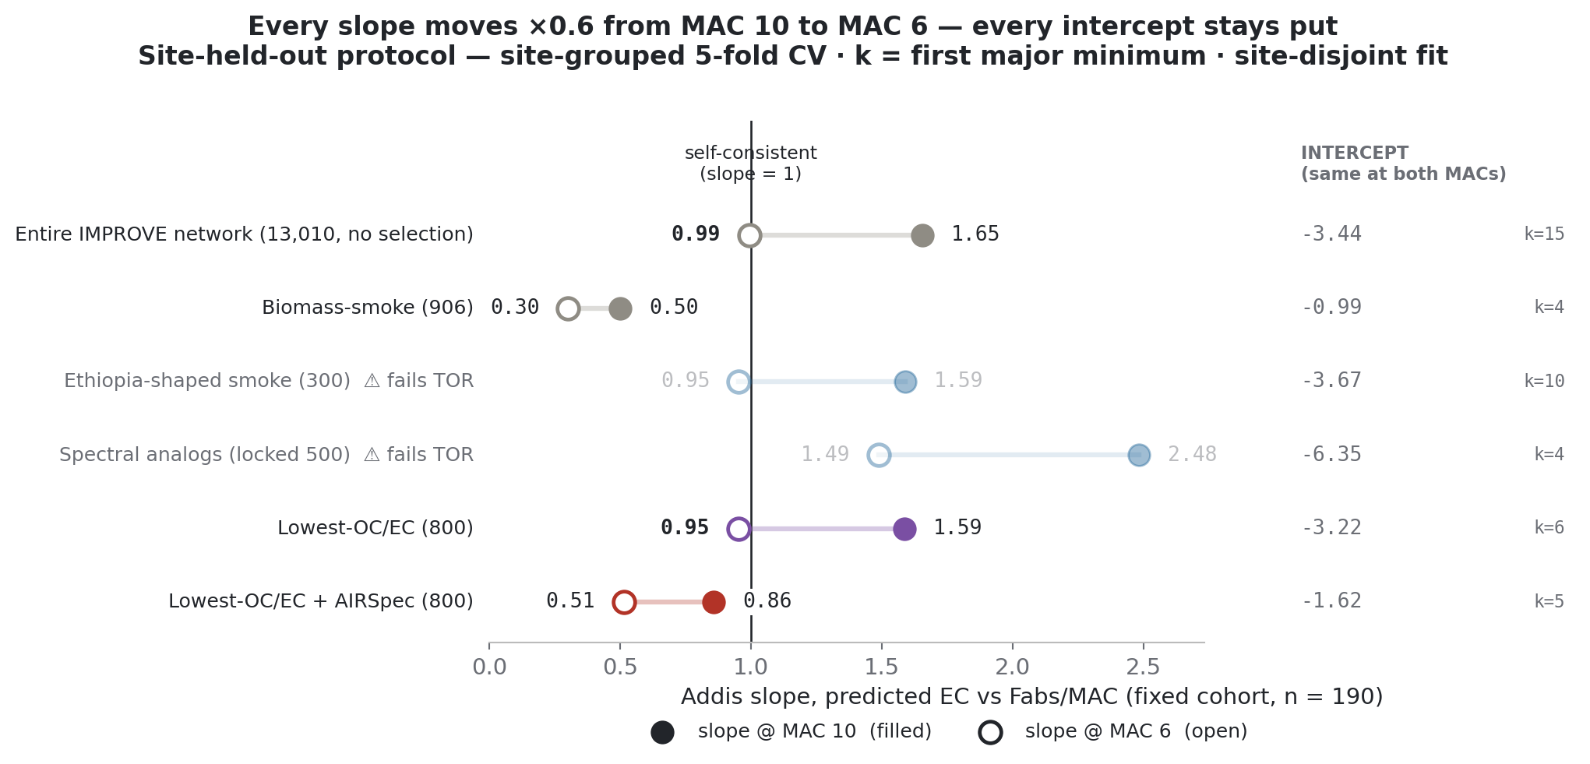
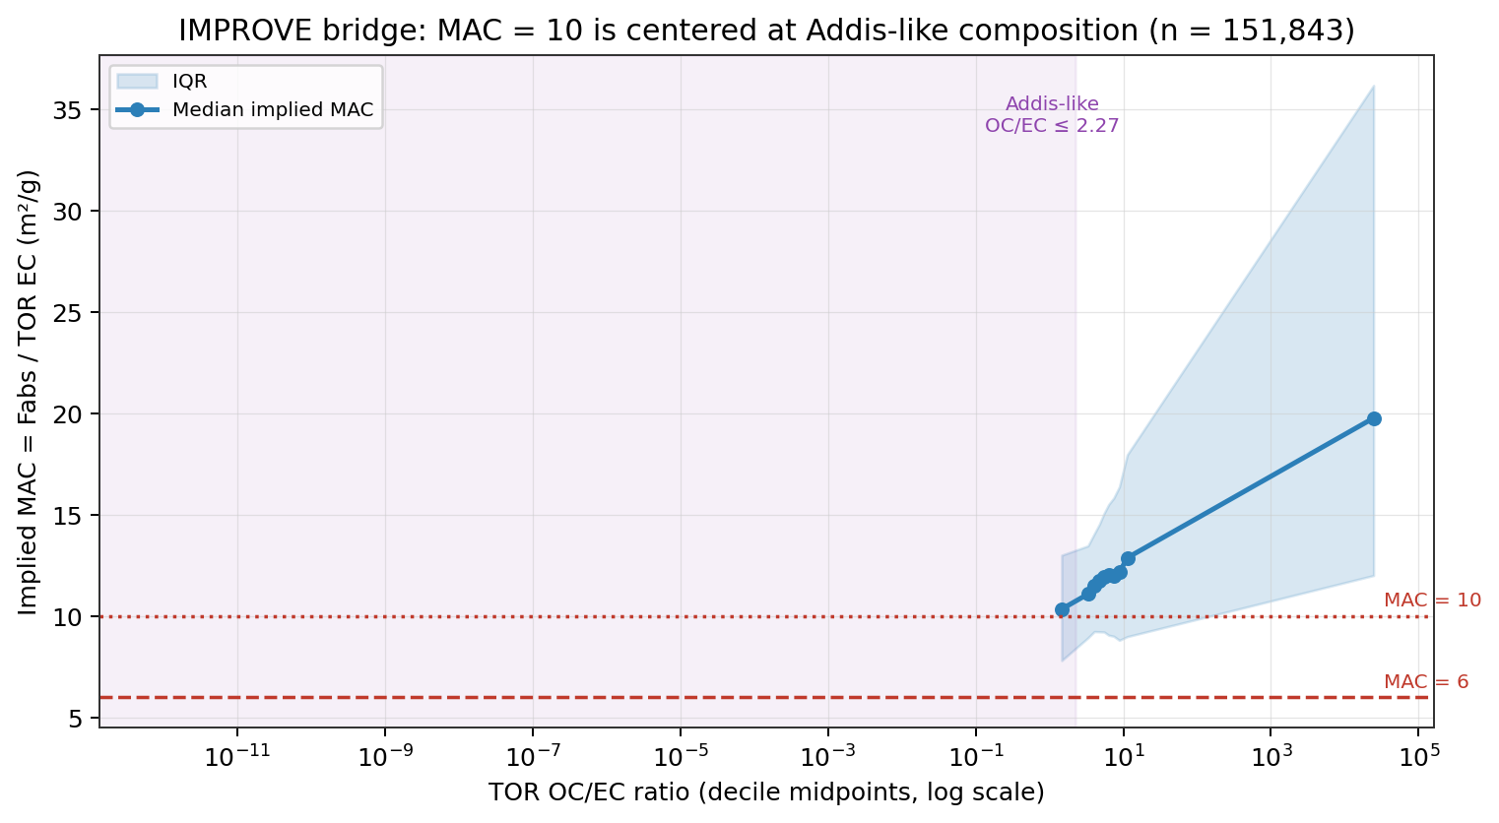
12 · THE MAC FORK, IN TWO FIGURES
MAC cannot move any intercept — and the IMPROVE bridge puts MAC ≈ 10 at Addis-like composition.
by_protocol/site_held_out · mac_slope_pivot x = Fabs/MAC: intercept and R² exact, slope ×0.6 going 10 → 6
ftir_16 · improve_implied_mac_curve Implied MAC = Fabs / TOR-EC, 151,843 matched filters
Addis-like subset (n = 6,503) MAC 10.05
pool median 11.96
high-OC/EC tail 19.8
Notes:
Left: the fork is a slope contest — the intercept column is algebra-proof. Right: quote 10.05 only with its qualifier — the Addis-like OC/EC ≤ 2.27 subset, 6,503 filters; the pool median is 11.96. The inflated high-OC/EC tail independently shows Fabs carries organic-scaling non-EC absorption.

Slide 15
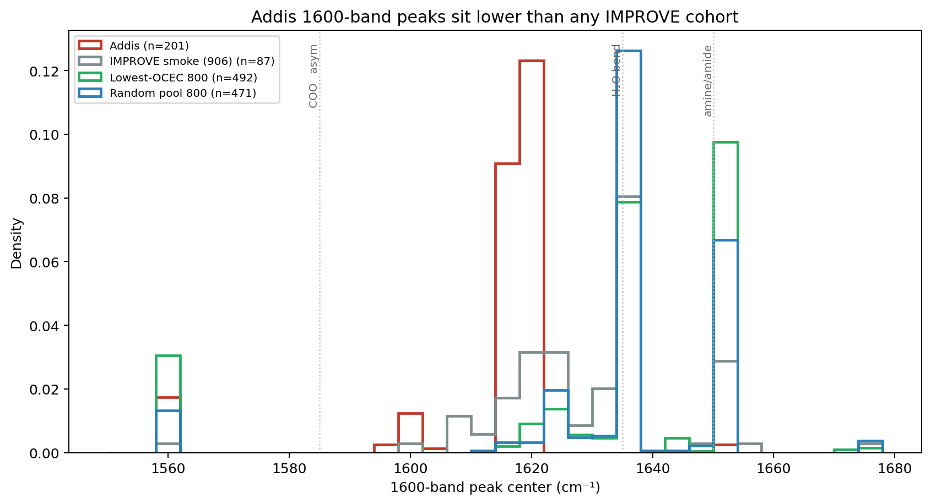
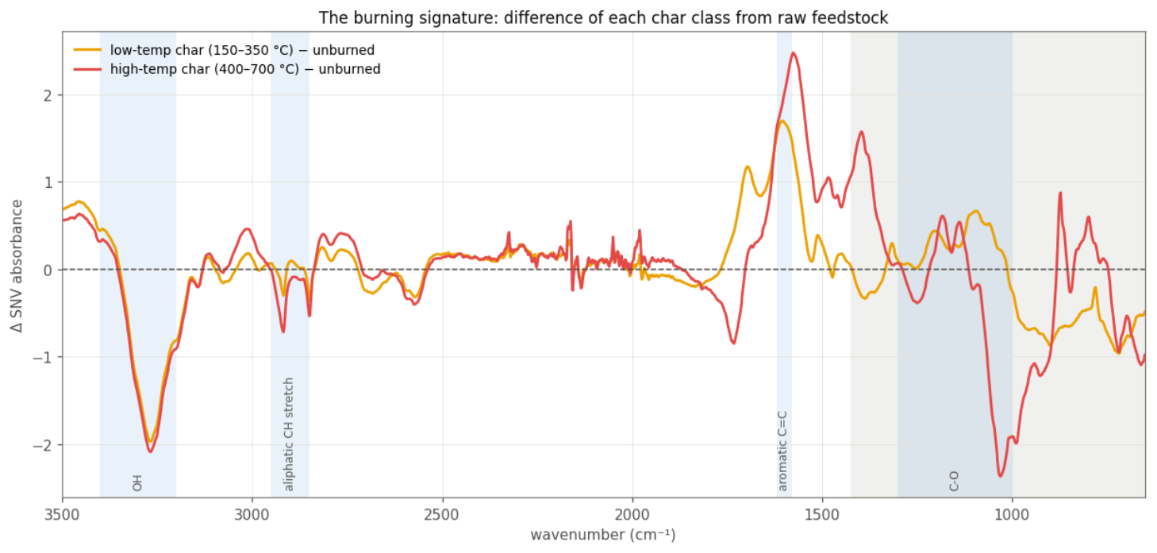
13 · THE 1600 BAND — WITH JULY'S BURNING SIGNATURE, RESURFACED
Charring grows aromatic C=C at ~1600 — a process argument, not just a correlation.
ftir_12 · peak_center_1600_by_group Addis 1617–1619 cm⁻¹ in every season; IMPROVE ≥ 1633
July-17 deck · slide 23 (McCall) Δ from raw feedstock: O–H and aliphatic C–H destroyed, aromatic C=C grown
Addis center 1617–1619
char peak ~1590–1600
amine rejected (ftir_12)
Notes:
The burning-signature panel was never walked through in July. Honesty note for the room: char peaks near 1590–1600, Addis at 1617–1619 — charcoal-consistent, not charcoal-matched. Carboxylate vs aromatic C=C still cannot be separated on Teflon below 1425 — that is the sub-1500 model ask to Satoshi tomorrow.

Slide 16
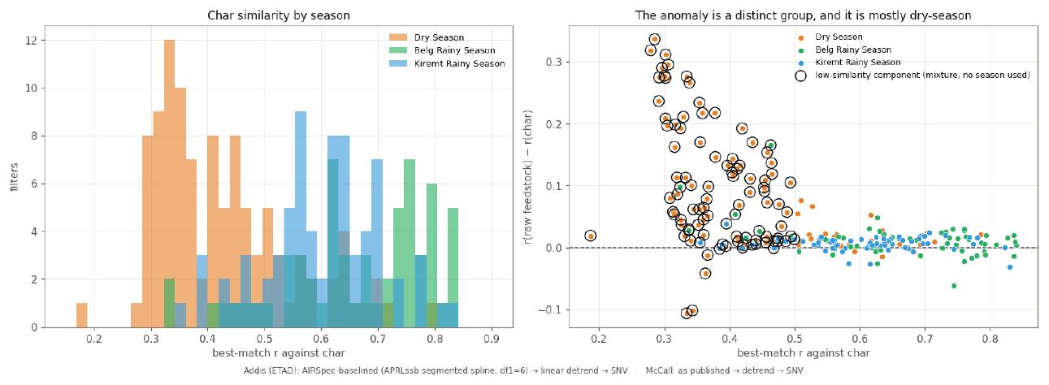
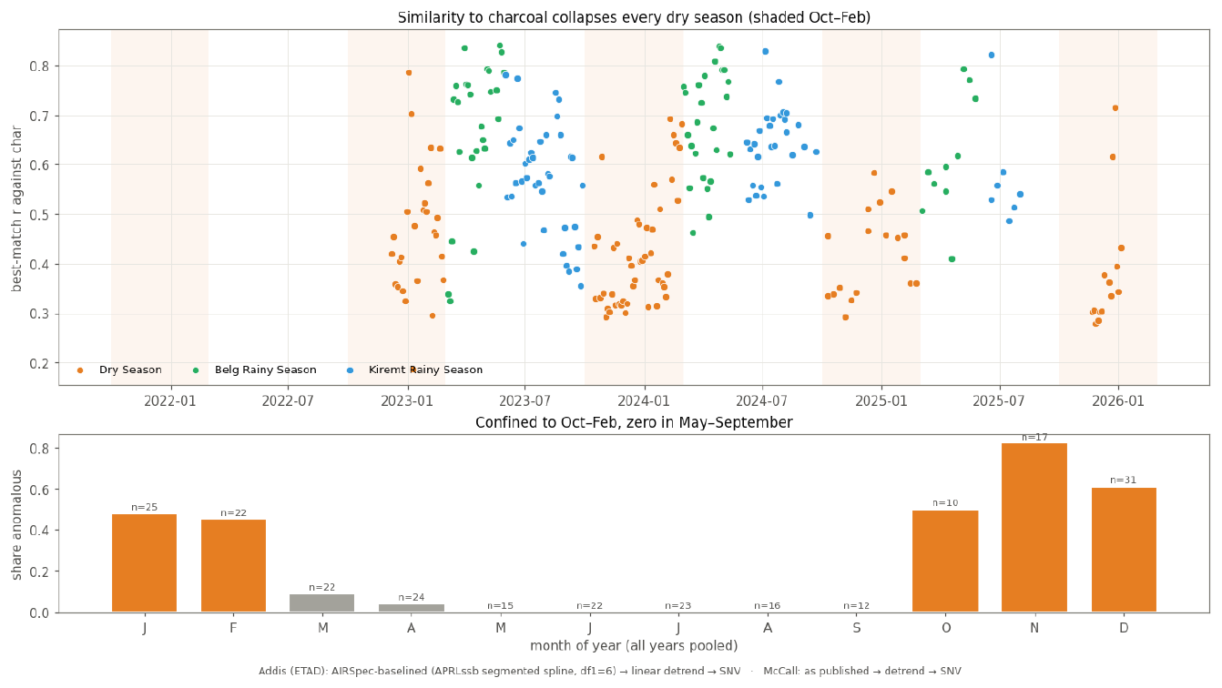
14 · THE JUSTIFICATION YOU ASKED FOR — JULY SLIDES 30 & 27, SAID OUT LOUD
A mixture component found with no season labels isolates the anomaly — and it is Oct–Feb.
July-17 deck · slide 30 Low-similarity component fitted season-blind (circled) — almost entirely Dry
July-17 deck · slide 27 Share anomalous by month: Nov 0.82, Dec 0.61 — ≈ 0 May–Sep
Nov 0.82 anomalous
May–Sep ≈ 0
season labels used none
Notes:
This replaces the analog R-values you rightly called hand-wavy. A season-blind statistical structure that recovers the seasons on its own is a categorically stronger argument. With the residual panel (slide 07) and the band ratios, three independent views isolate the same Oct–Feb anomaly.

Slide 17
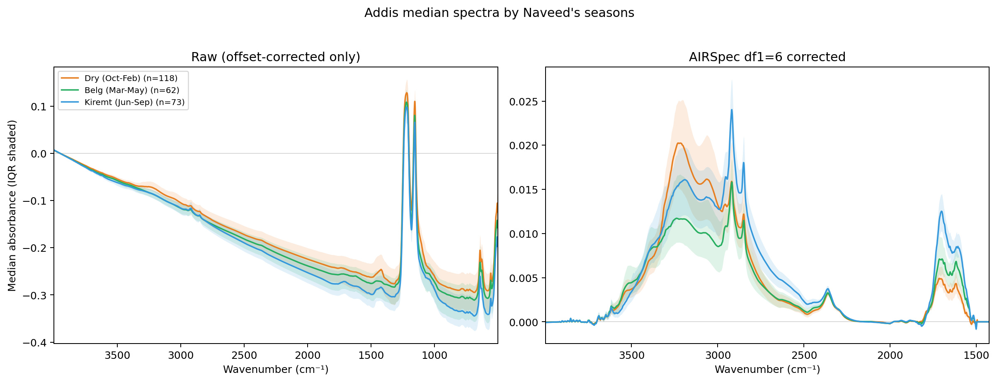
15 · FTIR_24 — YOUR HYPOTHESIS, TESTED AGAINST COMMITTED NUMBERS
“Dry is right, wet breaks” comes out inverted — and only for the raw model.
Raw-model residuals by season: Dry −1.25 (worst), Belg −0.47, Kiremt +0.49 (best). Corrected: season-stable −2.0…−2.6. Season sensitivity is a raw-model phenomenon.
Design constraint: Dry spans only ~55% of the wet x-range, so naive per-season slopes attenuate mechanically. It must be a pooled fit with a season × x interaction, not three crossplots.
Feasibility: buildable today (~1 GB pull, ~5 min regen); all 43 undated spectra fall outside the 239-filter evaluation set (105 / 61 / 73).
Decision: build today, or after tomorrow?
ftir_17 · addis_spectra_by_season Dry Oct–Feb / Belg / Kiremt; season moves loading, not shape
Notes:
If she wants it in tomorrow's deck: doable only with the go-ahead now — and say plainly that a result built this afternoon has had no audit pass; the last unaudited number that reached a deck is slide 01's correction. February moves 22 of 239 filters between conventions (dry_feb headline, belg_feb sensitivity) — name the calendar on every seasonal number.

Slide 18
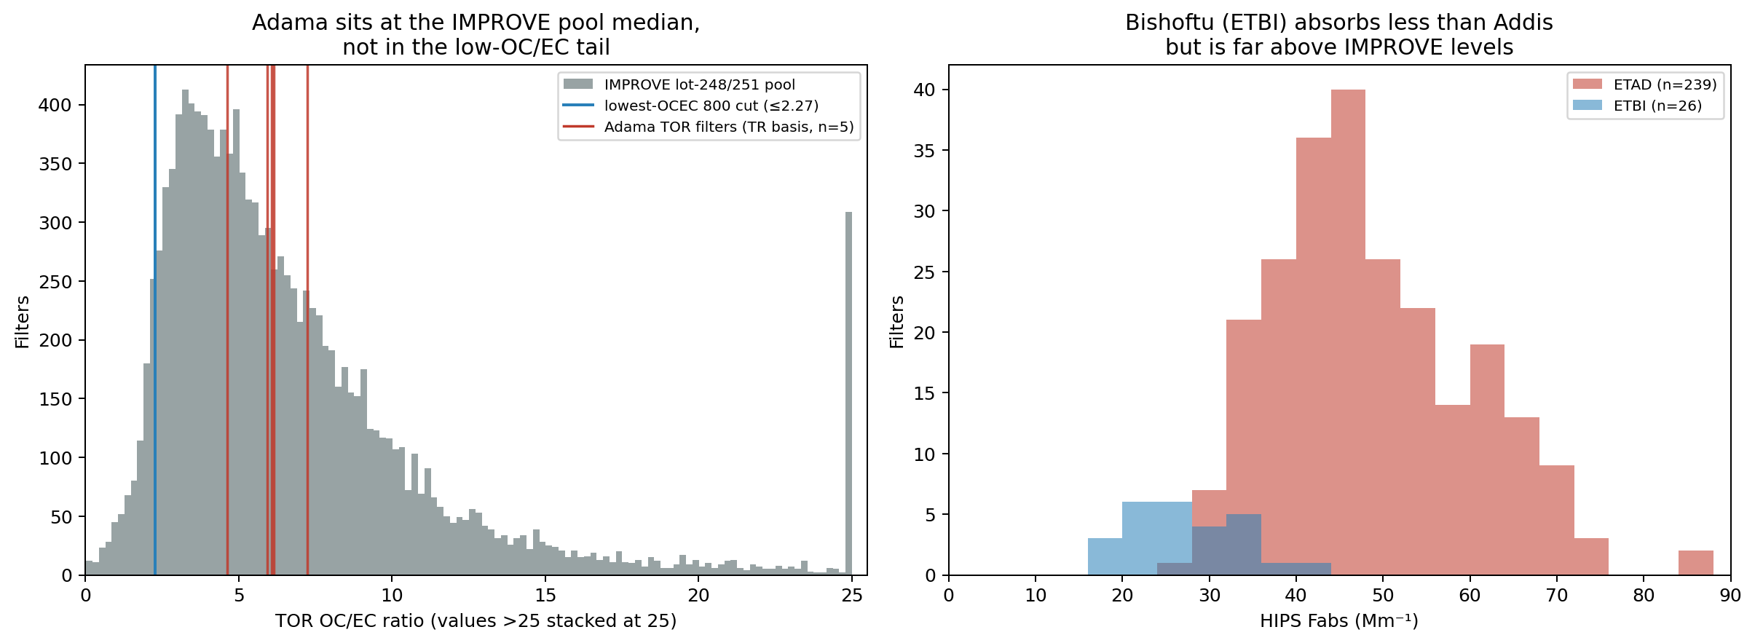
16 · THE ASK THAT SEPARATES THE SURVIVORS
Quartz TOR is now the ask — every EC reference we hold is circular with one axis or the other.
Four-direction narrowing: not a generic HIPS zero (ftir_26) · not the FTIR zero (slide 07's flat, D²-independent structure) · no in-hand reference can discriminate (ftir_27) · and the survivors — loading artifact, curve geometry, real absorption — all yield to a co-located quartz-TOR campaign.
Spec (ftir_16, committed): ~3σ/day separation of MAC 6 vs 10 → 11–13 days per season, ~36 filters in total (12 + 13 + 11). TOR needs quartz; archived Teflon cannot substitute; Adama Batch-54 proves the chain works.
Pre-registered: if the ~21 Mm⁻¹ were a persistent background, ETBI (median 26.9 Mm⁻¹) would be mostly background — its FTIR-EC should come out very low the day its spectra arrive.
days per season 11–13
context · adama_etbi_context Adama TOR sits at the IMPROVE median; Bishoftu (ETBI) unused, 26 HIPS filters
filters TOTAL ~36
Notes:
Say “thirty-six filters total” — never per season; getting it wrong triples the ask. The one-pager is written and committed; the decision is whether it goes to Satoshi tomorrow.

Slide 19
TODAY'S DECISIONS
Six calls, then tomorrow is mechanical.
① Approve the Satoshi deck
② HIPS_Uncertainty semantics
Five parts, six asks — two tone calls: the Calibration-app framing, and how hard to push MAC ≈ 10.
Counting statistics, repeatability, or propagated calibration uncertainty? If unknown — assign who emails SPARTAN.
③ ftir_24 — today or after?
④ Ask owners for tomorrow
Buildable this afternoon with the season × x design; unaudited if it goes straight to a deck.
Quartz TOR (headline) · Emily Lee's charcoal spectra · sub-1500 model · INDH/CHTS/ETBI pull · ATR go/no-go · baselining trade-off.
⑤ Quartz-TOR one-pager
⑥ Hossein outcome
Committed and ready — does it go to Satoshi tomorrow?
Gates the co-author email; nothing else can unblock it.
Standing rule: nothing reaches Satoshi or the co-authors until you have approved it. That is what today is for.
Notes:
Walk the six cards and get a yes/no or an owner on each. The two that cannot slip: the deck approval and Hossein. Then the evening pass folds today's results into the Satoshi deck — mechanical once this content is approved.

