Slide 1
FTIR · EC CALIBRATION · ADDIS ABABA · BRIEFING FOR SATOSHI & NAVEED · 13 AUG 2026
Phase 3, end to end —
and what we need from you.
Your baselining suggestion implemented and validated · Ann's low-OC/EC cohort locked as the best calibration · the MAC question reduced to a two-branch fork · the residual offset restated as a measurable target · and the asks that would unblock the rest.
Notebooks ftir_11–27 · fixed 190-filter Addis cohort for crossplots · intercepts in µg/m³ · MAC = 10 headline · site-disjoint splits (seed 20260717) · every number traces to a committed table.
Notes:
Naveed is joining too — he had the SPARTAN EC thread before the handoff, so the recap slides are for him as much as Satoshi. Roughly 30 minutes of content; parts B and C are where Satoshi's input matters most.

Slide 2
STATUS AT A GLANCE
Settled since we last talked — and open, mostly needing you.
Settled since we last talked
Open — mostly needs you
AIRSpec baseline correction ported to Python, validated to ~10⁻⁷ vs the R output
done
Emily Lee's charcoal spectra (print-only in the paper)
ask
EDF 6 vs 8: indistinguishable — not a sensitive parameter
done
Sub-1500 cm⁻¹ model — status? (unblocks the band identity)
ask
Lowest-OC/EC (800) + baseline correction locked as the terminal IMPROVE-only candidate
done
Why does baselining help if baseline carries EC signal?
discuss
~1600 cm⁻¹ band: amine rejected; carboxylate / aromatic C=C remain
done
How many PLS components — and must it match across models?
discuss
MAC choice provably cannot move any intercept — it is a slope contest
done
INDH / CHTS / ETBI spectra export (same shape as the ETAD pull)
blocked · data
HIPS wavelength confirmed: He–Ne 632.8 ≈ 633 nm, MAC 10 at 633
resolved
Charcoal ATR: worth it, given grinding stops at 10–40 µm?
advise
Intercept restated as a MAC-invariant ~21 Mm⁻¹ absorption target
committed
Notes:
Let him read while you frame it: everything left is committed and reproducible; everything right is why this meeting exists. The component-count question is new on the list — it came out of yesterday's meeting with Ann.

Slide 3
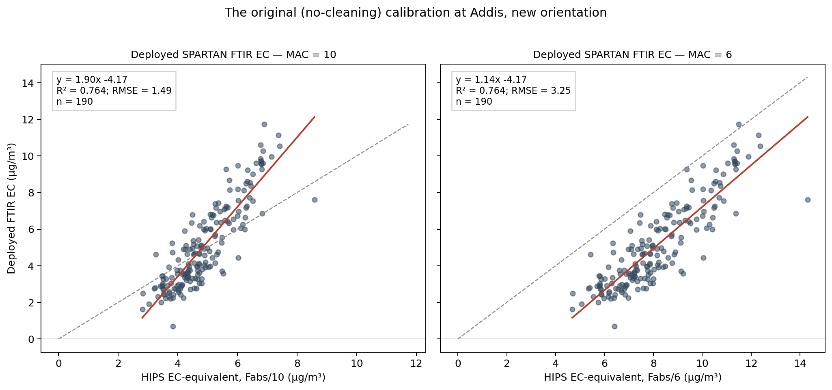
A·01 · THE PROBLEM — DEPLOYED CALIBRATION AT ADDIS
The deployed calibration reads y = 1.90x − 4.17 at MAC = 10.
The network calibration, carried to Addis, is steep with a deep negative y-intercept (µg/m³).
At MAC 6 it pivots to slope 1.14 but the intercept stays at −4.17 — dividing x by a constant cannot move where the line crosses y. Proved for every setup in part D.
Nothing at Addis has negative EC; the offset is the model, not the air.
MAC 10 1.90x − 4.17
MAC 6 1.14x − 4.17
implied “native” MAC ≈ 5.3
ftir_17 · deployed_alldata_crossplot FTIR EC (y, µg/m³) vs HIPS Fabs/MAC (x); deployed predictions exist only for the fixed 190
Notes:
SAY: The network calibration carried to Addis is steep with a deep negative intercept — and nothing at Addis has negative EC, so the offset is the model, not the air. One framing from yesterday: with no MAC applied at all, the deployed fit implies a native MAC of about 10 over 1.90, roughly 5.3 — but that trusts FTIR-EC, which is the same circularity that rules out ChemSpec as a reference. The non-circular version of that idea is the implied-MAC bridge in part D.

Slide 4
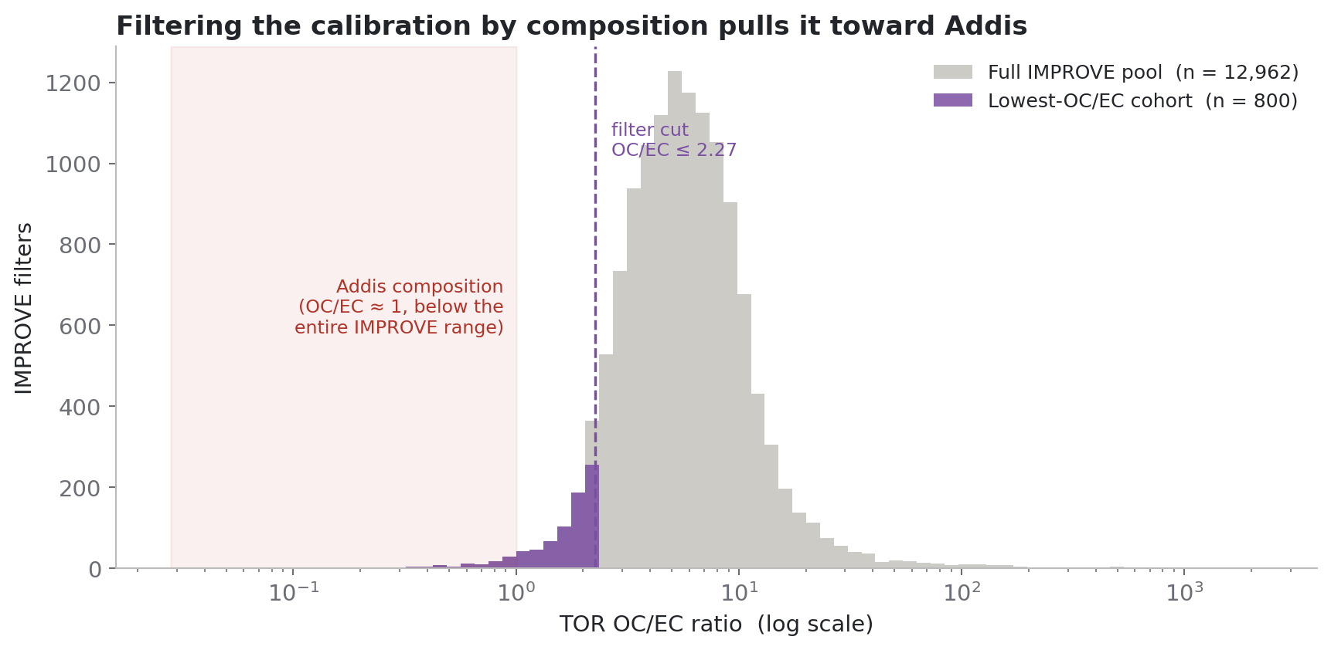
A·02 · ANN'S COHORT — WHAT “LOWEST OC/EC” MEANS
Addis-like composition is the extreme tail of IMPROVE — 800 filters out of 13,010.
The Addis offset implies OC/EC far below anything IMPROVE routinely sees. The 800 lowest-OC/EC filters (≤ 2.27 vs pool median 5.54) are the closest IMPROVE gets to Addis composition.
Like-for-like, that cohort wins: same 190 Addis filters, RMSE 1.16 vs 1.48–2.24 µg/m³; held-out TOR R² 0.911 vs 0.594–0.775.
New since yesterday: the Ethiopia-shaped-300 and lowest-OC/EC-800 cohorts share 1 filter. Shape-similarity and composition-similarity select disjoint filters.
cutoff OC/EC ≤ 2.27
eth-300 ∩ ocec-800 1 filter
deck · filtering_by_ocec Cutoff OC/EC ≤ 2.27; IMPROVE pool median 5.54
Notes:
SAY: Ann asked yesterday whether the shape-selected and composition-selected cohorts overlap — in theory shape should reflect the OC/EC ratio. From the committed membership tables: one filter of three hundred. They are disjoint selections, which is consistent with their opposite behaviour — the shape-selected cohort fails the held-out TOR test while this one passes. QUESTION FOR SATOSHI: why does spectral-shape similarity fail to track composition here — is that a baseline effect too?

Slide 5
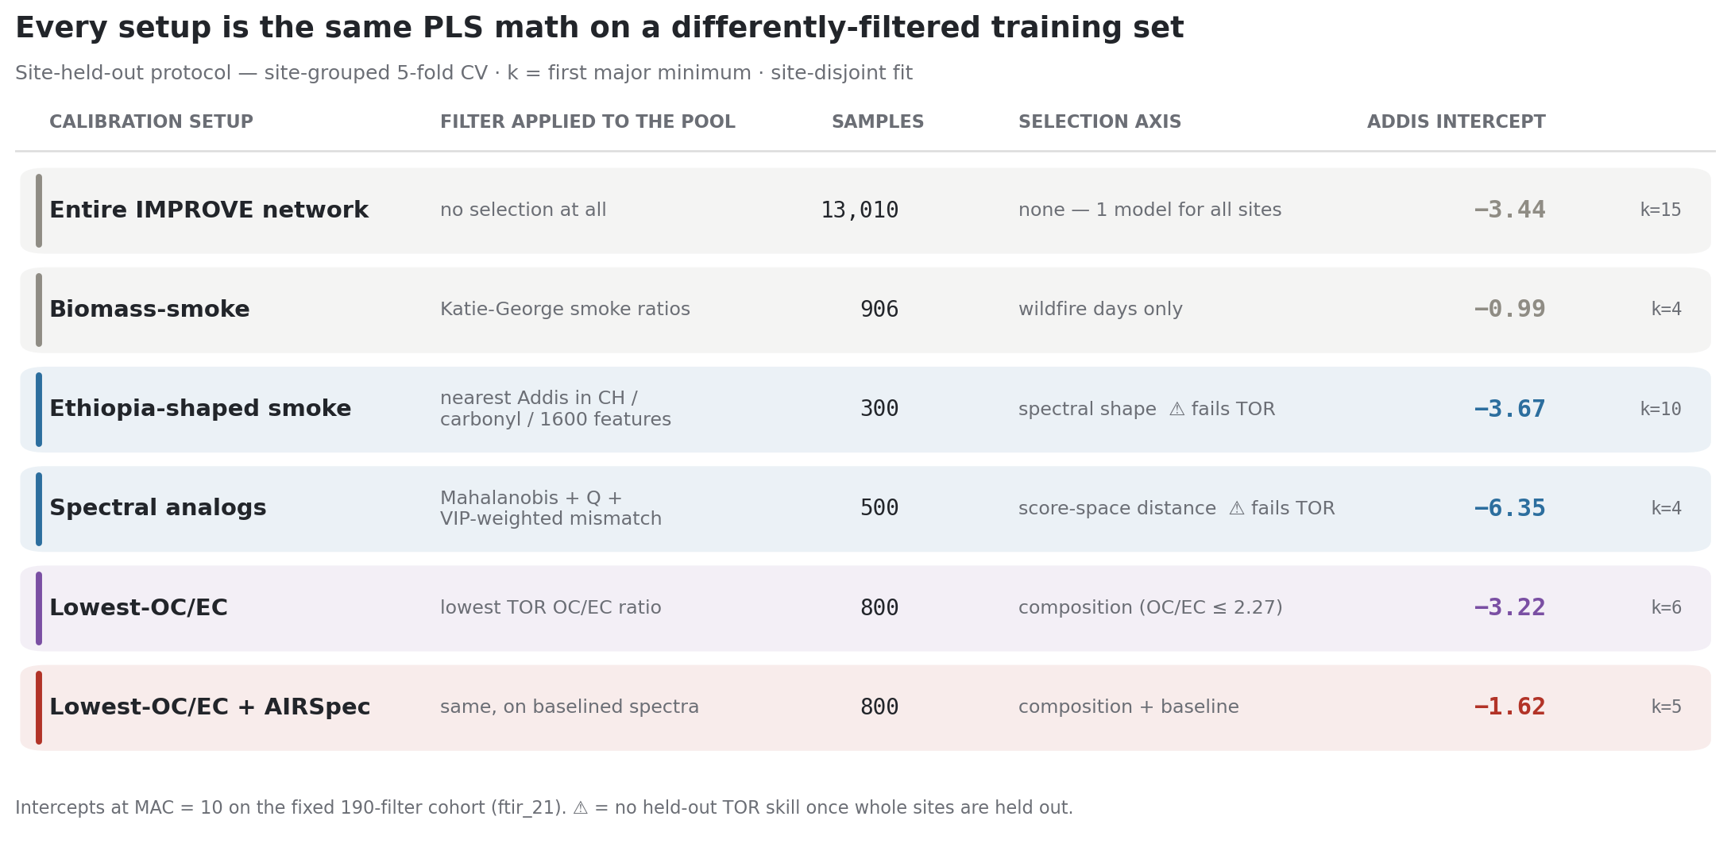
A·03 · EVERY TRAINING CHOICE, ONE TABLE — SITE-HELD-OUT PROTOCOL, INTERCEPTS IN ΜG/M³
Lowest-OC/EC + baseline correction ends at −1.62 — and is the only setup robust to who processes it.
The intercept ladder: −4.17 (deployed) → −3.22 (lowest-OC/EC raw) → −1.62 (+ baseline correction).
Protocol matters more than MAC: the same smoke-906 filters give −0.99 here (k = 4) but −6.91 under the Calibration-app protocol (k = 19). The corrected setup is the one that barely moves: −1.65 vs −1.62.
It also passes the disjoint-site TOR test cleanly (slope 1.01, R² 0.90).
corrected intercept −1.62 µg/m³
protocol-robust −1.65 / −1.62
smoke by protocol −0.99 vs −6.91
by_protocol/site_held_out · calibration_setup_matrix All intercepts µg/m³, site-grouped 5-fold CV, first-major-minimum k. Row 1 = whole IMPROVE network; ETAD spectra are evaluation-only
Notes:
SAY: One thing that confused us yesterday and is worth stating plainly: the biomass-smoke intercept is −0.99 on this table and −6.91 on older slides — both are right; they are two protocols, k = 4 versus k = 19 on the same filters. That swing is itself a finding: the component choice moves the Addis answer more than the MAC fork can. The corrected setup is the one whose answer does not depend on who processed it. All intercepts on this slide are micrograms per cubic metre.

Slide 6
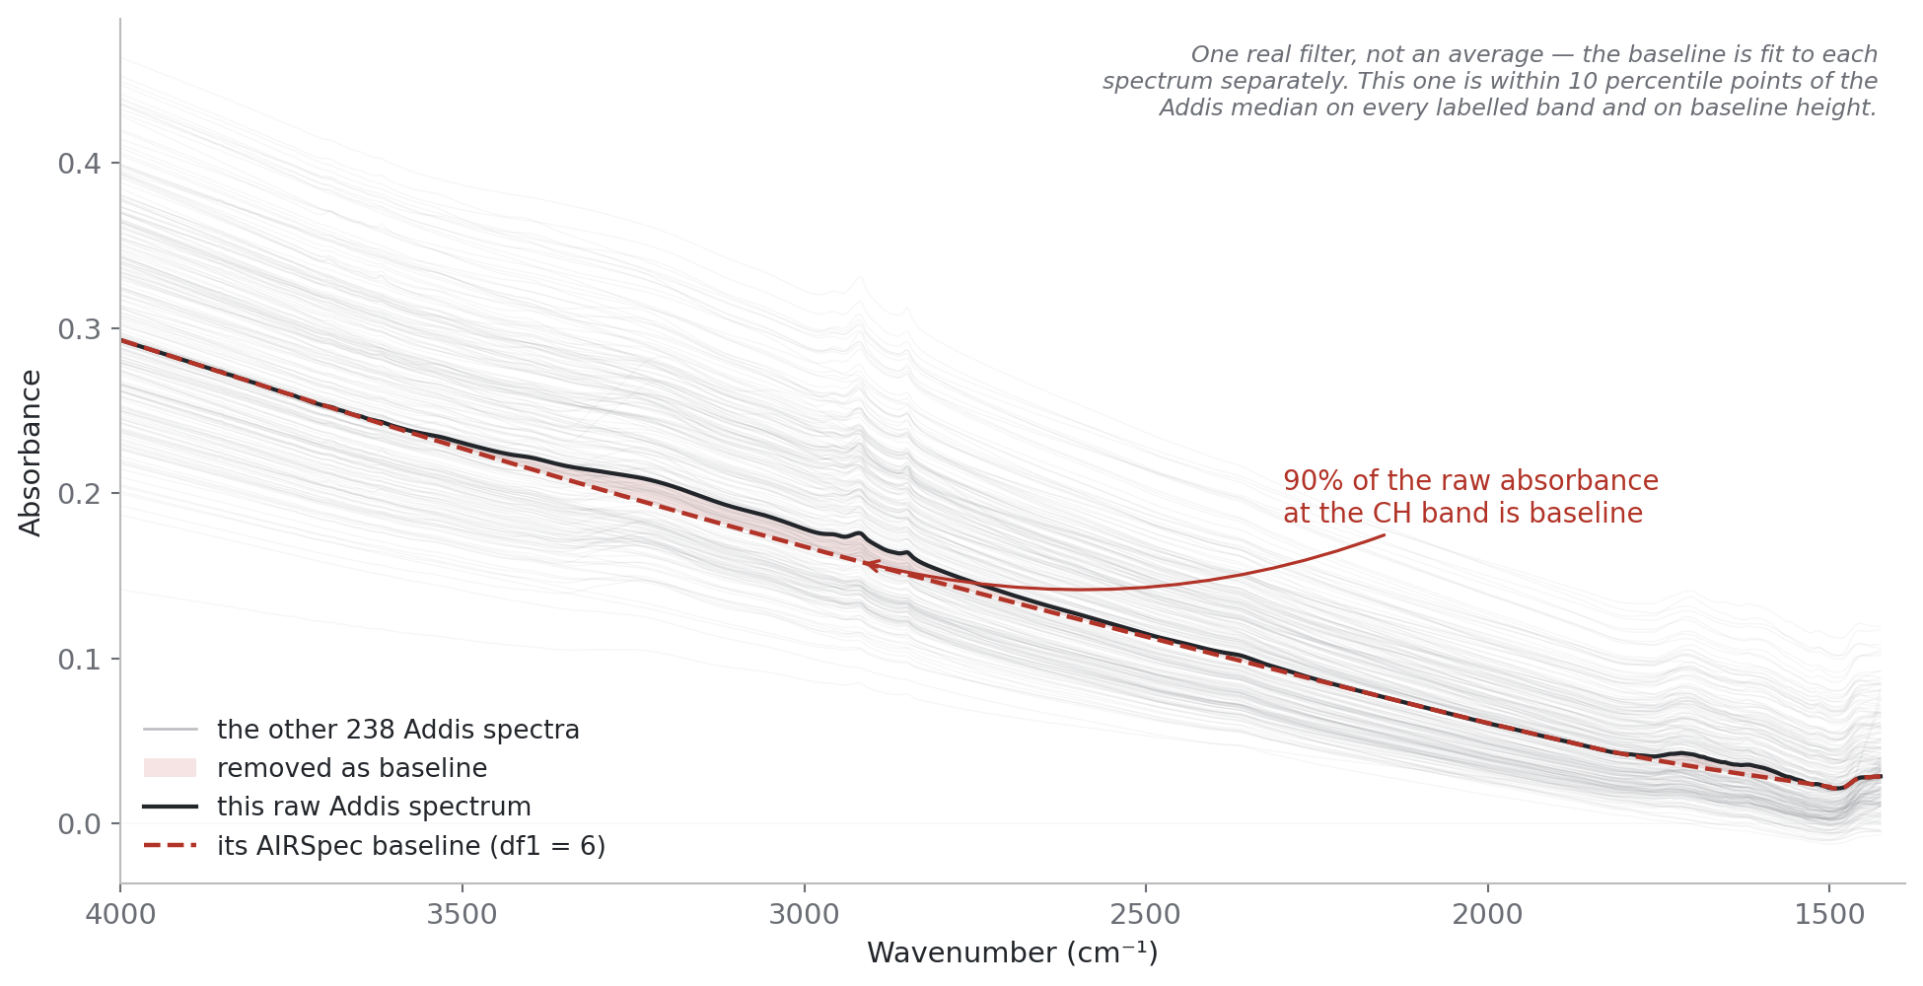
B·04 · YOUR BASELINING SUGGESTION, IMPLEMENTED — 1 OF 3
At the CH band, ~91% of a raw Addis spectrum is background, not chemistry.
“Baseline-corrected (AIRSpec)” throughout = the APRLssb segmented-spline correction only — we use that one component of the package.
The black line is a single real filter; the red dash is the baseline fitted underneath it, per spectrum. The shaded sliver is all that is actually bands.
Port note: reimplemented in Python and validated against your group's R output on the ETAD scans to ≤ 6×10⁻⁷ absorbance. EDF 6 vs 8: indistinguishable (Δslope < 0.01).
CH-band baseline share ~91%
port vs R ≤ 6×10⁻⁷
EDF 6 vs 8 Δslope < 0.01
deck · airspec_1_baseline One real filter (median-like on all four bands and baseline height); grey = all 239. Not an average.
Notes:
SAY: A PLS model on raw spectra is handed a predictor that is mostly background, and is free to lean on it. The port is validated against your R output — this is your algorithm, not an approximation. And your EDF question has an answer: six versus eight makes no practical difference.

Slide 7
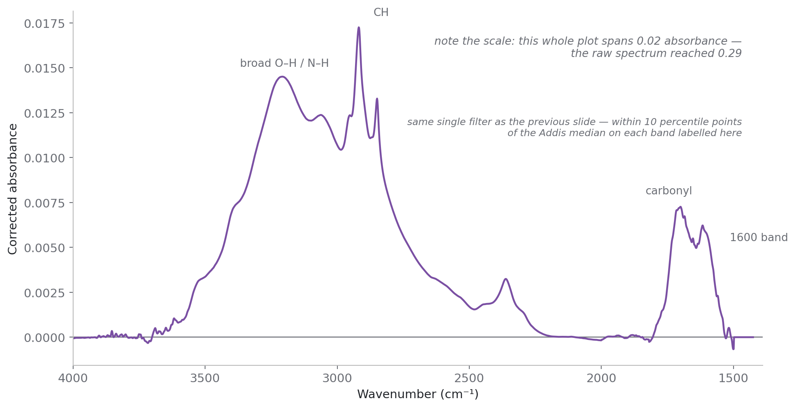
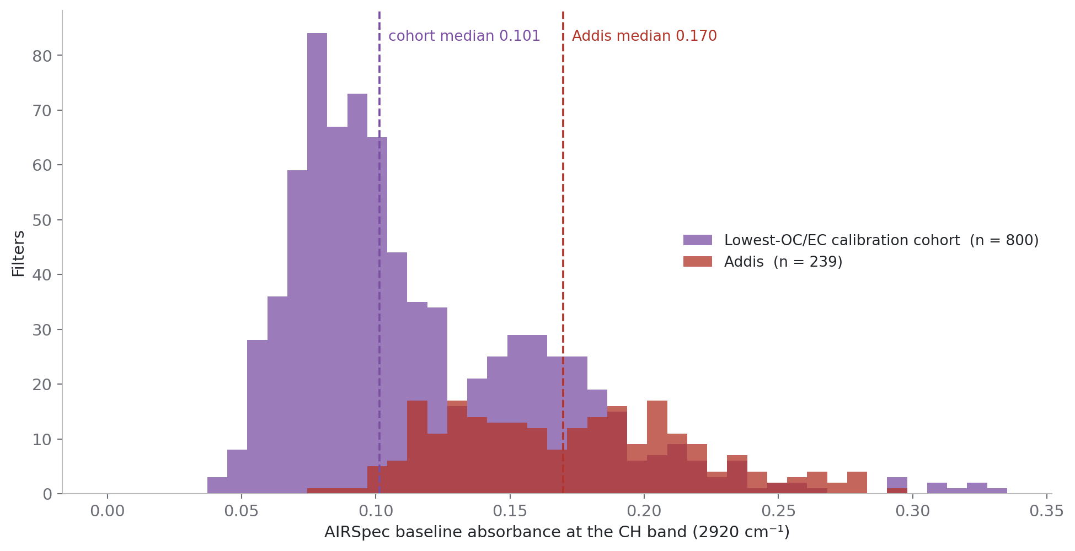
B·05 · YOUR BASELINING SUGGESTION, IMPLEMENTED — 2 & 3 OF 3
What is left is a thin skin — and Addis rides a higher background than its calibration cohort.
deck · airspec_2_corrected Same filter, baseline removed — the panel spans 0.03 AU against a raw spectrum of 0.34
deck · airspec_3_background_gap Baseline at 2920 cm⁻¹ per filter: 800-cohort 0.101 vs Addis 0.170
Addis baseline 0.170
cohort baseline 0.101
intercept −3.22 → −1.62 µg/m³
slope 1.59 → 0.86
Notes:
SAY: Whatever a raw-spectra model learned about background does not transfer, and that error lands as an offset. Baselining both sides and retraining takes the Addis intercept from −3.22 to −1.62 — the single biggest improvement of phase 3. Honest cost: Addis R² drops 0.77 to 0.66 and RMSE 1.16 to 2.41; we prefer it for its residual structure, not its fit.

Slide 8
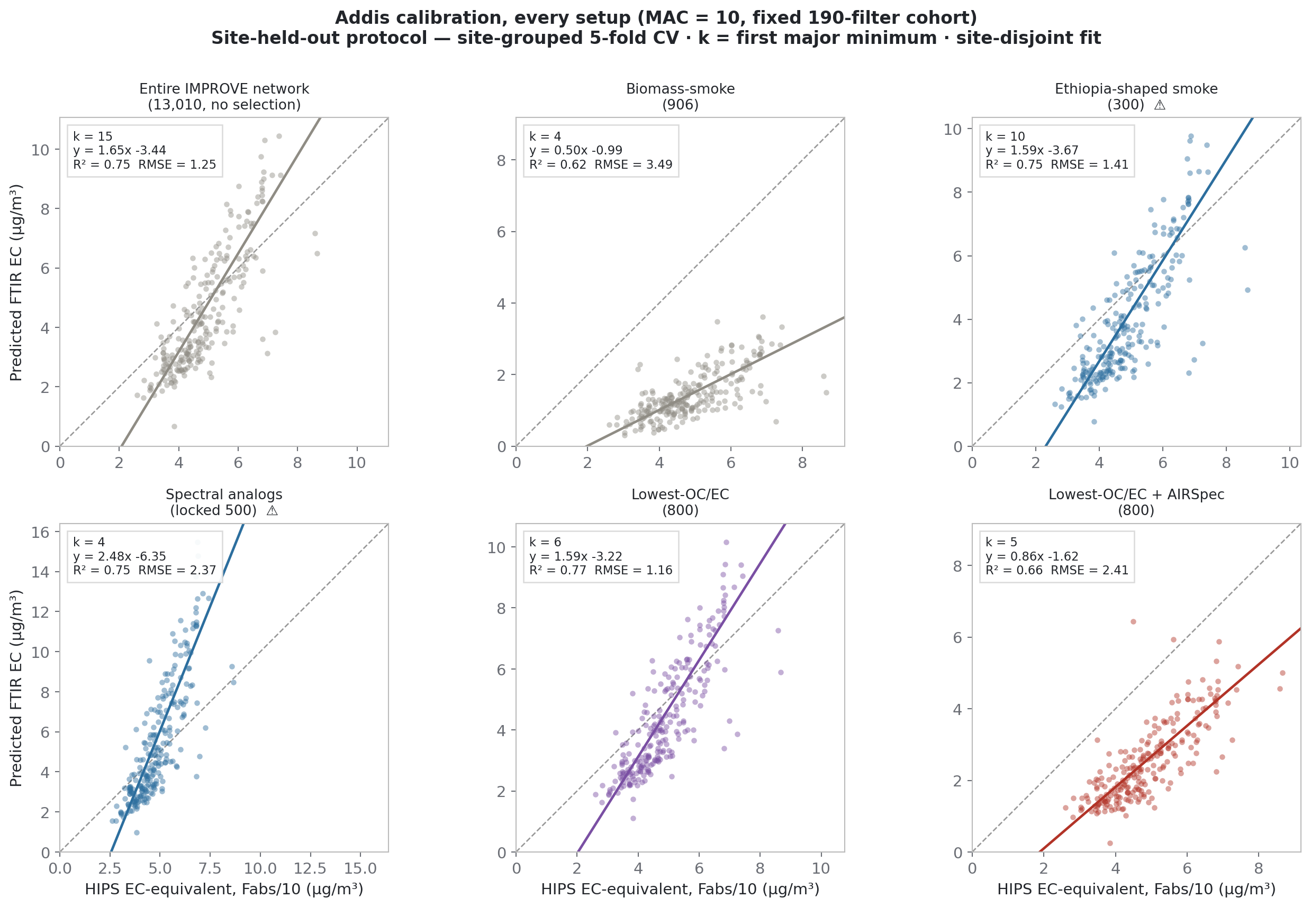
B·06 · ANN'S QUESTION — DOESN'T THE BASELINE CARRY EC?
The smoke calibration collapses on corrected spectra — its Addis response was mostly baseline.
Ann's standing objection: EC's sloping absorption lives partly in the baseline, so baselining an EC calibration should lose signal.
Our evidence so far: the 906-smoke model falls from slope 2.65 to 0.37 when both sides are baselined — much of its raw response was memorised background — and the ftir_08 HIPS-transfer failure survives baselining, so what breaks at Addis is compositional.
The open question for you: how much genuine EC signal does the correction discard, and is a middle path — or your group's newer baselining work — worth testing?
smoke-906 corrected slope 0.37
HIPS transfer post-correction still fails
by_protocol/site_held_out · crossplots_all_setups All six setups, identical per-panel square axes, fixed 190-filter cohort, MAC = 10
Notes:
SAY: Ann's objection deserves a direct answer, and this is our evidence: the smoke model collapses on corrected spectra, and the HIPS-transfer failure survives baselining — so what breaks at Addis is compositional, not a baseline artifact. The question we cannot answer alone: how much genuine EC signal does full baseline removal discard, and is a partial-retention middle path worth trying?

Slide 9
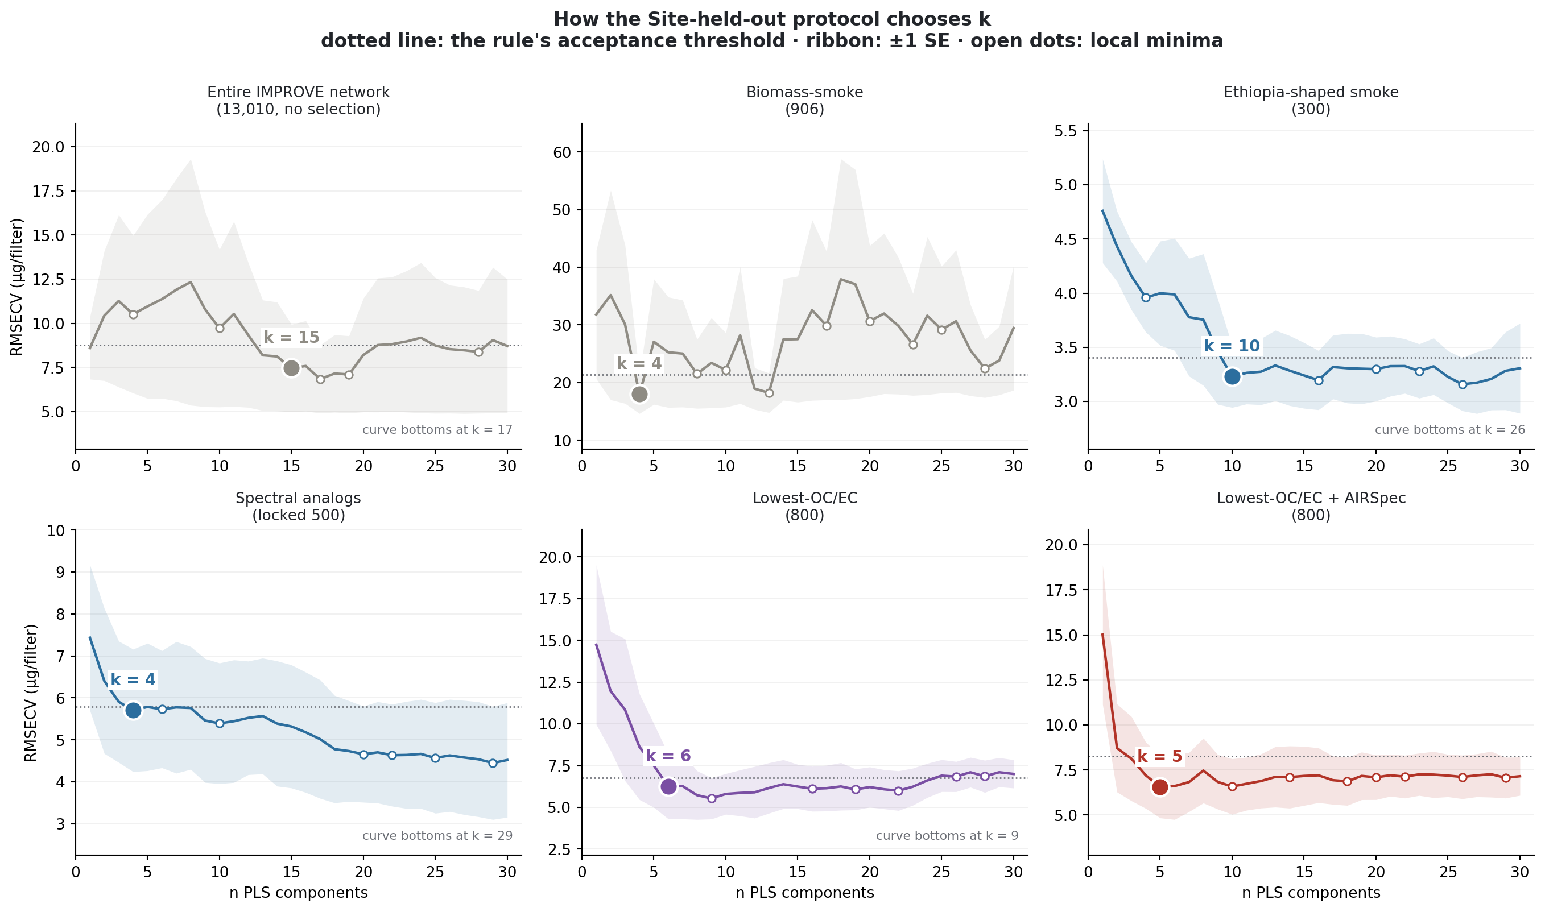
C·07 · HOW K WAS CHOSEN — ONE RULE, APPLIED TO EVERY SETUP
Site-grouped 5-fold CV, first major minimum — the curve each rule actually ran on.
One selection rule everywhere: site-grouped 5-fold CV, first major minimum. It picks k = 4–15 where the app protocol (interleaved 10-fold, within-5%) picks 17–27.
Two subtleties Ann surfaced yesterday, answered here: the chosen k is selected on the training split, so it need not sit on a full-cohort curve's minimum; and small k is not a red flag on corrected spectra — the baseline components the big-k models spend factors on are already gone.
Where curves bottom early the protocols agree (smoke 4/4, corrected 5/5); the disagreement is long flat tails.
site-held-out k 4–15
app-protocol k 17–27
ftir_23 · selection_curves_site_heldout Each cohort's CV curve with the rule's machinery drawn: ±1 SE ribbon, every local minimum, chosen k marked
Notes:
SAY: Every headline number uses one rule — site-grouped five-fold, first major minimum. QUESTION FOR SATOSHI: is four or five components defensibly enough, especially on corrected spectra? And does comparing across models require matching the component count, or is per-model selection under one rule the right discipline? Ann flags that four or five factors on raw spectra can still be mostly Teflon. Also have ready: the ±SE ribbons on the network and smoke panels are huge — the interleaved curve only looks decisive because pooling discards that spread.

Slide 10
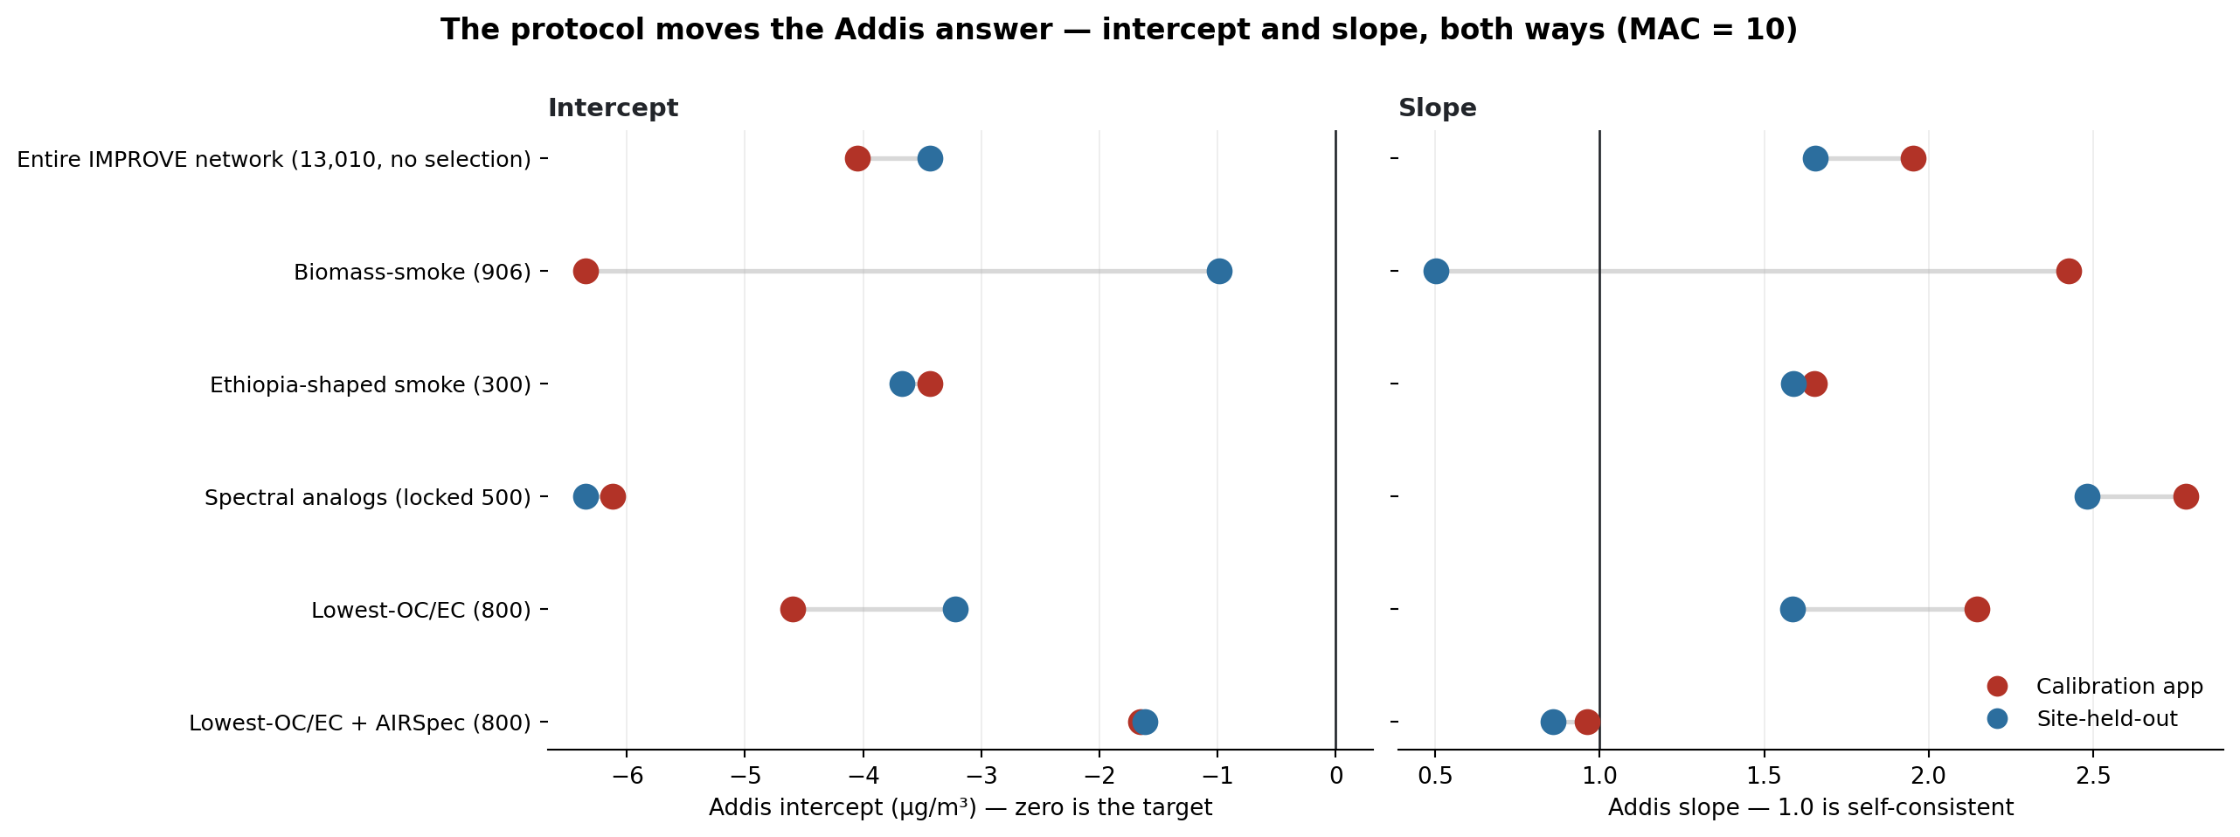
C·07B · THE SAME SIX SETUPS UNDER BOTH PROTOCOLS — ANN'S REQUEST
The component protocol moves the Addis answer more than the MAC fork can.
Same filters, two protocols: smoke-906 swings −6.91 → −0.99; OCEC-800 swings −4.59 → −3.22. The corrected setup moves −1.65 → −1.62.
And the app protocol is not reproducible: interleaved CV is row-order dependent — the same 800 filters give k = 15, 18 or 19 on reorderings; site-grouped gives 5 every time.
The app also yields no site-disjoint test by construction — only the site-held-out protocol produces the TOR test that picks 800 as the cohort size.
smoke by protocol −6.91 → −0.99
corrected −1.65 → −1.62
ftir_21 · intercept_slope_by_mode Calibration-app protocol vs site-held-out, per setup; intercepts µg/m³
Notes:
SAY: This is the slide Ann asked for yesterday — everything twice, one protocol per side. Two takeaways: robustness to protocol is itself a model-selection criterion, and only one setup has it; and the order-dependence result means the app's k is not a reproducible quantity. Framing discipline: this is not a criticism of the app as a tool — interleaved CV answers a different question than transfer to an unseen site.

Slide 11
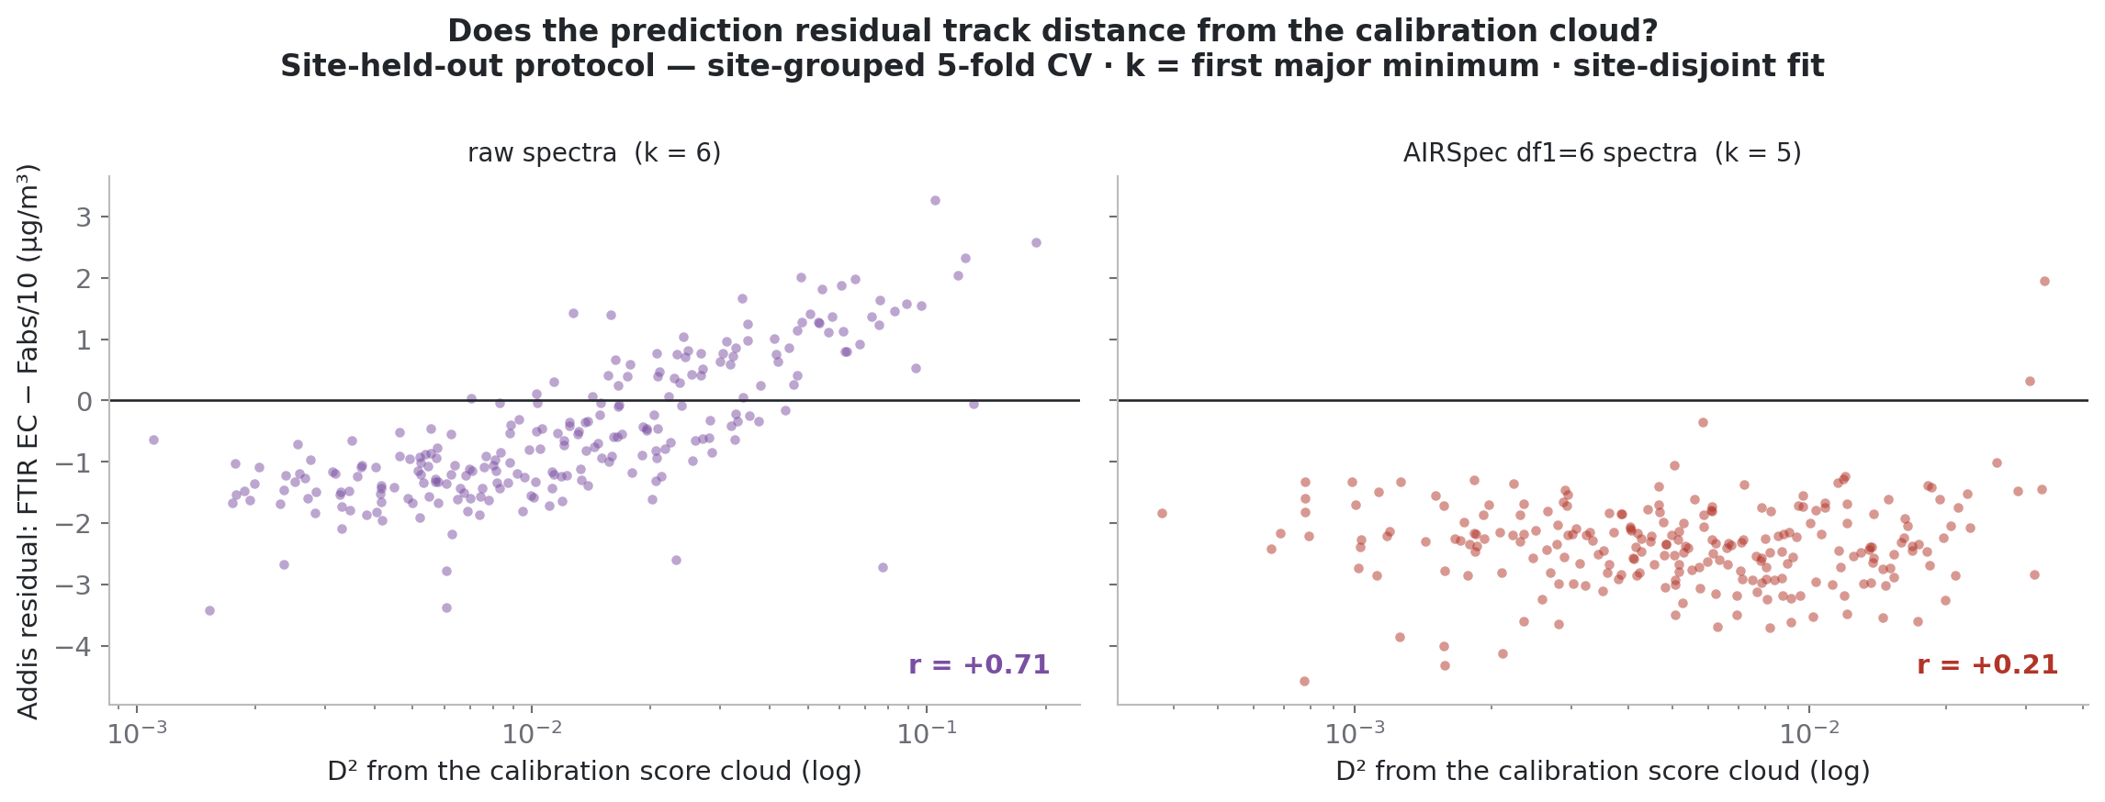
C·08 · RESIDUAL STRUCTURE — RAW VS CORRECTED
The corrected model misses by a season-stable constant: −2.0 to −2.6 µg/m³.
The raw model's Addis error tracks extrapolation distance (r = 0.71) and flips sign by season — it fails by being out of domain.
The corrected model's error is D²-independent and flat in every season. Bootstrap: corrected intercept 95% CI [−1.78, −1.06] — excludes zero, disjoint from raw's [−4.88, −2.81].
Estimator check (Ann's ask): headline fits are OLS; Deming with measured σ_x (HIPS_Uncertainty, λ* ≈ 2.96) moves the corrected intercept to −2.09 — errors-in-variables makes the offset larger, so OLS is the conservative bound.
raw: resid ~ D² r = 0.71
corrected CI [−1.78, −1.06]
Deming λ* −1.62 → −2.09
ftir_15/22 · residual_vs_d2 Residual vs Mahalanobis D² in score space; site-cluster bootstrap B = 200
Notes:
SAY: The raw model fails by extrapolation; the corrected model misses by a flat constant that no cohort choice removes. Restated as absorption, that constant is C = |intercept| × MAC / slope — about 21 inverse megametres, 46% of a typical Addis filter's Fabs, and exactly MAC-invariant. Three explanations survive: a loading-dependent HIPS artifact, curve geometry in the Fabs–EC relation, and real non-EC absorption. Nothing in hand separates them — that is the quartz ask. On Ann's estimator point: we now have a real sigma-x from HIPS_Uncertainty, and Deming moves the intercept to −2.09, so the OLS number understates the offset if anything.

Slide 12
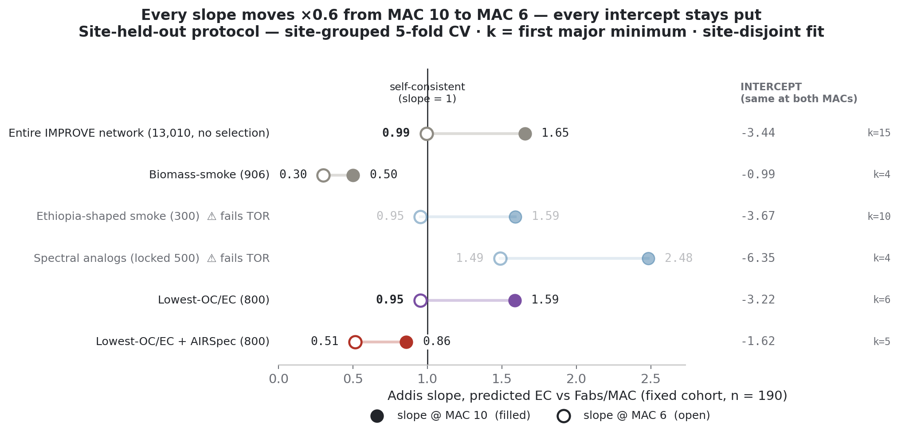
D·09 · ALGEBRA FIRST — WHAT MAC CAN AND CANNOT MOVE
MAC cannot move any intercept — every calibration pivots; the fork is a slope contest.
Since x = Fabs/MAC, switching MAC rescales x by a constant: every setup keeps its y-intercept and R² exactly, and its slope scales by exactly 0.6.
So the fork reduces to: MAC 6 makes the raw models self-consistent (lowest-OC/EC 0.95, Ethiopia-shaped 1.05, deployed 1.14); MAC 10 is where the corrected model lands closest (0.86). Fit statistics cannot choose between the branches.
“Let the slope define MAC” (native MAC ≈ 5.3 for the deployed fit) is circular while FTIR-EC itself is in question — the non-circular route is the next slide.
slope scaling ×0.6 exact
raw @ MAC 6 0.95
ftir_19 · mac_slope_pivot x = Fabs/MAC: intercept and R² exact, slope ×0.6 going 10 → 6
corrected @ MAC 10 0.86
Notes:
SAY: The intercept ladder is MAC-proof and R² cannot arbitrate MAC — the fork is purely a slope contest between two self-consistent branches. Deliberate phrasing: the corrected model “lands closest” at MAC 10 — 0.86 does not clear the |slope−1| ≤ 0.1 bar the raw models clear at MAC 6. Yesterday's discussion of letting the slope define MAC is on the slide with its circularity caveat, so it is pre-answered if Naveed raises it.

Slide 13
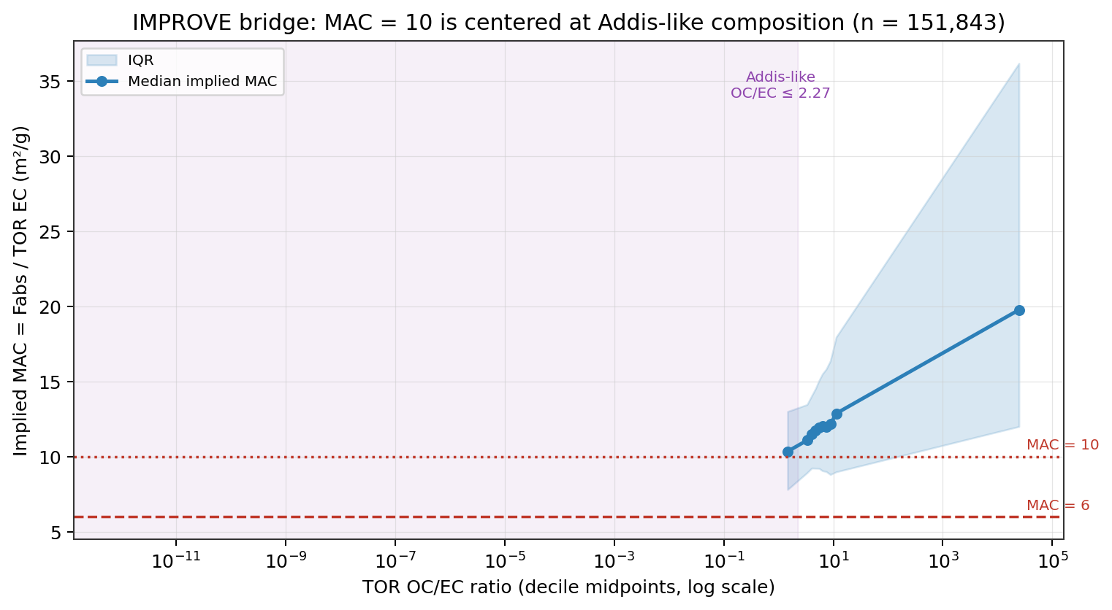
D·10 · THE BRIDGE — 151,843 IMPROVE FILTERS
At Addis-like composition, IMPROVE's implied MAC is 10.05 — at the confirmed 633 nm.
Where IMPROVE has both HIPS and TOR: implied MAC median 11.96 overall — and 10.05 in the Addis-like OC/EC ≤ 2.27 subset (n = 6,503). MAC 10 is centred at Addis-like composition; MAC 6 sits in the lower tail.
This is the non-circular version of “let the data set MAC” — TOR EC, not FTIR-EC, on the denominator.
The high-OC/EC tail's inflated implied MAC (median 19.8) independently shows Fabs carries organic-scaling non-EC absorption. Wavelength: HIPS is confirmed He–Ne 632.8 ≈ 633 nm, MAC 10 defined at 633 — bridge and convention on the same wavelength.
Addis-like subset MAC 10.05
pool median 11.96
ftir_16 · improve_implied_mac_curve Implied MAC = HIPS Fabs / TOR EC, 151,843 matched filters, binned by OC/EC
high-OC/EC tail 19.8
Notes:
SAY: The net phase-3 read is MAC ≈ 10, the corrected model, and a genuine additive component at Addis whose owner is not yet identified. We would like your judgment on this chain, and whether an independent HIPS MAC or protocol bridge exists that could test it without new sampling. Quote 10.05 only with its qualifier: the Addis-like subset, 6,503 filters.

Slide 14
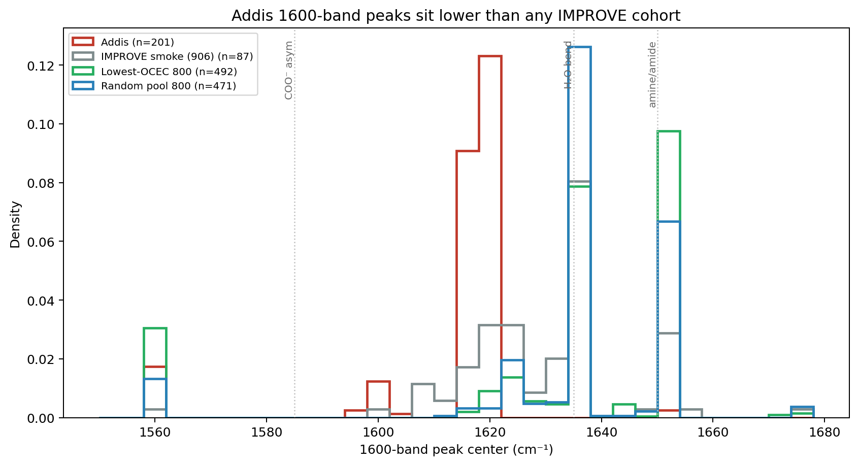
E·11 · THE ~1600 CM⁻¹ BAND
Not amine. Carboxylate and/or aromatic C=C — stuck below 1425 cm⁻¹ without your sub-1500 model.
Addis peaks at 1617–1619 cm⁻¹ (IQR 1616–1620) in every season; every IMPROVE cohort sits ≥ 1633 with essentially no overlap.
Within Addis the band co-varies with CH (ρ = 0.88) and carbonyl (0.93) but not with the 3100–3400 N–H/O–H window (0.17) — an N–H bend without its stretch is implausible, so amine is out.
The remaining candidates — carboxylate COO⁻ and aromatic C=C — are both charcoal-consistent and cannot be separated on Teflon: the ~1400 symmetric partner is below the trusted range.
Addis center 1617–1619
IMPROVE ≥ 1633
ftir_12 · peak_center_1600_by_group Peak centers under the edge-corrected window; unchanged on baseline-corrected spectra
ρ(1600, N–H) 0.17
Notes:
SAY: Two asks live on this slide. Where does the sub-1500 model stand — it is the unblocking tool for carboxylate versus aromatic C=C. And can we get Emily Lee's charcoal spectra as data — the paper versions are print-only, and burning chemistry (O–H and aliphatic C–H destroyed, aromatic C=C grown, stronger with temperature) is the process argument for the aromatic reading.

Slide 15
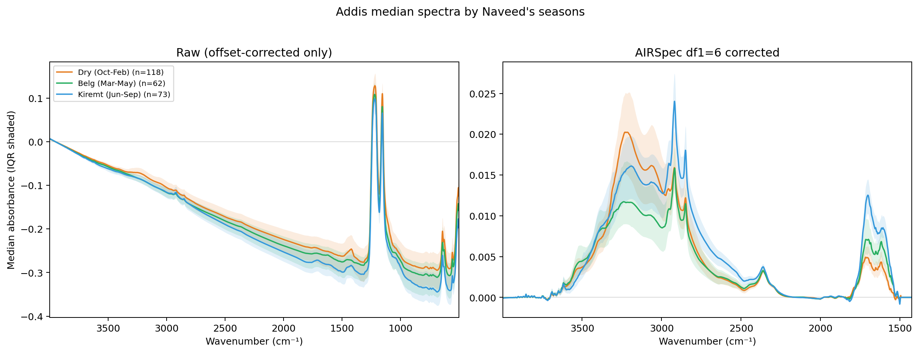
E·12 · NAVEED'S SEASONS — AND THE NEXT NOTEBOOK
Season changes loading, not shape — ftir_24 predicts dry and wet separately.
All bands, deployed EC (3.3 → 7.2 µg/m³) and Fabs (43 → 56 Mm⁻¹) peak in Kiremt, while the 1600-band centre never moves; the one shape effect is relatively more broad O–H in the Dry season.
The committed residuals already show the season structure is a raw-model phenomenon (Dry −1.25 → Kiremt +0.49; corrected season-stable). ftir_24 will put per-season crossplots under the locked models with a season × x interaction design.
EC by season 3.3 → 7.2
band centre fixed 1617–1619
eval split 105 / 61 / 73
ftir_17 · addis_spectra_by_season Dry Oct–Feb / Belg Mar–May / Kiremt Jun–Sep
Notes:
SAY: Season moves loading, not shape — and a season-blind mixture component isolates the same Oct–Feb anomaly the residuals show, so three independent views agree. ftir_24 quantifies it with a pooled season-by-x design to avoid the mechanical slope attenuation from Dry's shorter x-range.

Slide 16
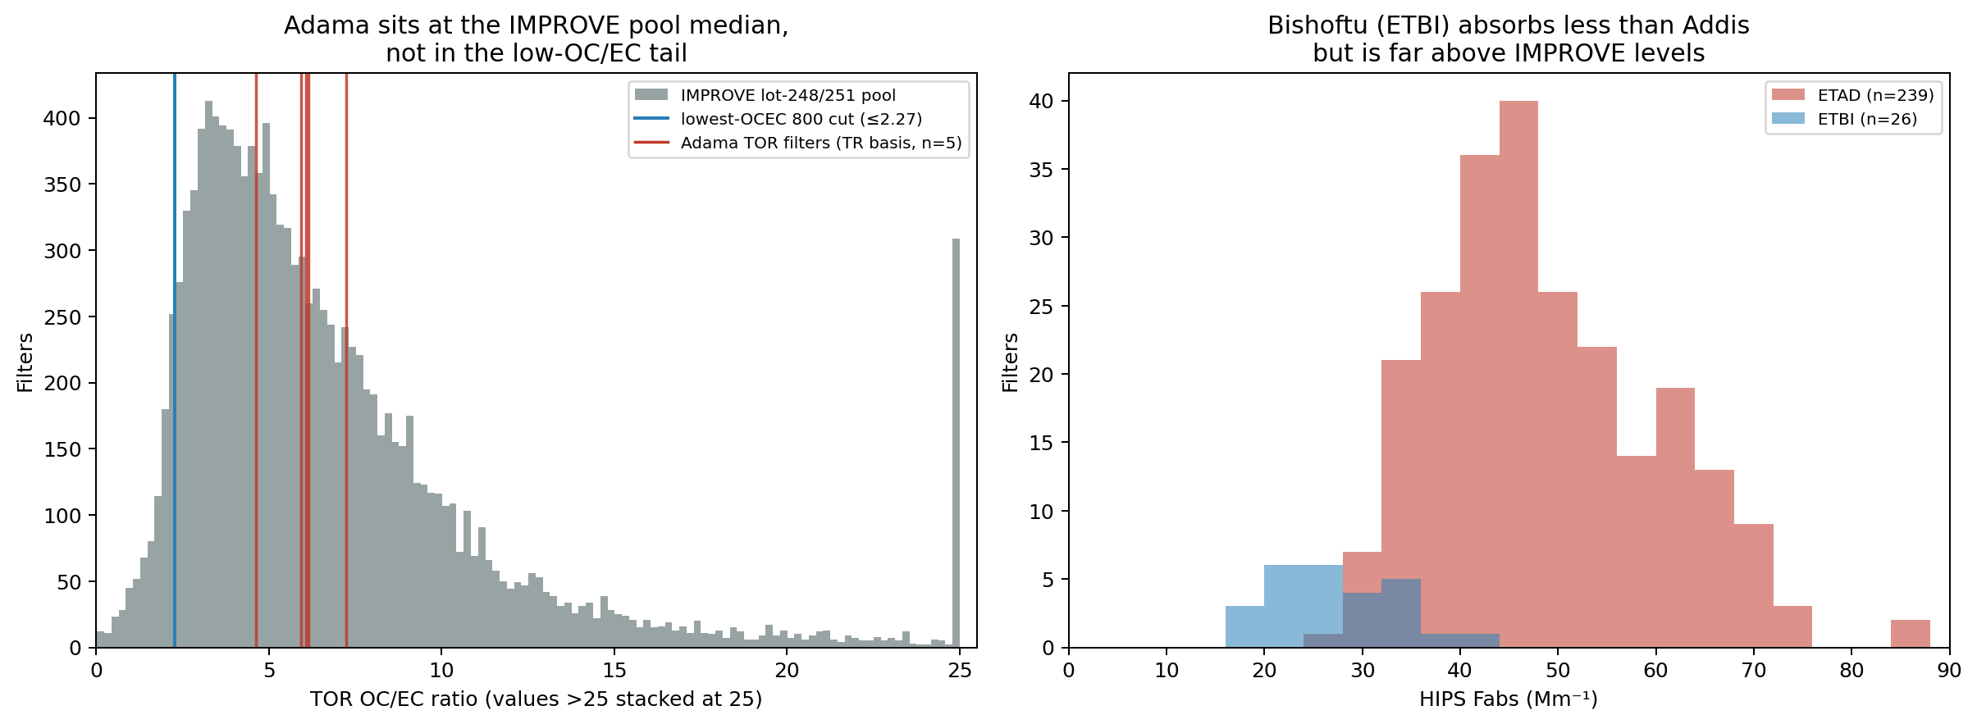
E·13 · ADAMA & BISHOFTU — THE UNCOMFORTABLE CHECK AND THE FREE TEST SET
The one same-corridor TOR we have looks ordinary — and a second Ethiopian site sits unused.
Adama TOR gives OC/EC 4.6–7.2 — right at the IMPROVE median, not the extreme tail the Addis offset implies regionally. Reconciling Addis HIPS with FTIR OC at Adama-like composition would need MAC ≈ 47 m²/g — unphysical — so something has to give.
ETBI (Bishoftu, median Fabs 26.9 Mm⁻¹ vs Addis Dry-season 43.2) is an untouched in-country test set for every conclusion here — if its spectra come through in the same pull as INDH/CHTS.
Adama OC/EC 4.6–7.2
bridge MAC ≈ 47 m²/g
ETBI HIPS filters 26, unused
context · adama_etbi_context Adama Batch-54: 5 quartz filters, July 2024 · ETBI: 32 filters Oct–Dec 2025, 26 with HIPS
Notes:
SAY: Since Addis's extreme ranking is computed from the very FTIR/HIPS values under suspicion, we cannot currently tell how much of the extremity is the artifact. The spectra pull that would include ETBI is the cheapest unblocking step on the list — and we have pre-registered the prediction: if the ~21 Mm⁻¹ were a persistent background, ETBI's FTIR-EC should come out very low.

Slide 17
THE ASKS
One headline ask, five supporting.
Quartz-TOR campaign at ETAD or Bishoftu — the instrument that separates what is left. Every EC reference we hold is circular with one axis or the other; the three surviving explanations for the ~21 Mm⁻¹ offset all yield to co-located quartz TOR. Spec: ~3σ/day separation of MAC 6 vs 10 → 11–13 days per season, ~36 filters total; Adama Batch-54 proves the chain. One-pager in hand.
Emily Lee's charcoal spectra
Sub-1500 cm⁻¹ model status
Print-only in the paper. As data, they replace our failed KBr-pellet attempt and benchmark any ATR run.
The 1600-band identity is stuck at the 1425 cm⁻¹ trusted-range edge. Your model is the unblocking tool.
Baselining & components
INDH / CHTS / ETBI spectra export
How much real EC signal does baseline removal discard? And is k = 4–5 defensible on corrected spectra — must k match across models?
Same shape as the ETAD pull. Unblocks Delhi/Beijing score-space checks and turns Bishoftu into a live test set.
Charcoal ATR — go / no-go
MAC / protocol bridge
Grinding stops at 10–40 µm; ambient soot is sub-micron. Is ATR on ground charcoal informative at all?
Does the implied-MAC chain hold up — and is there an independent HIPS bridge that tests MAC ≈ 10 without new sampling?
Sources: research/ftir_ec_phase3 (ftir_11–27) · every figure is executed notebook output · every number traces to a committed table · intercepts in µg/m³ throughout.
Notes:
The ask order changed this week: quartz TOR is the headline because ftir_26/27 closed every in-hand route to an independent EC reference. Hand over the one-pager here — Ann has seen it. The components question is folded into the baselining card since they are both his-methods territory.

