Slide 1
Follow up meeting
FTIR EC at Addis Ababa · 13 Aug 2026 · every figure regenerated in ftir_31
Staged: the component-selection discussion comes first — then we jump into the results under whichever selection we agree on (both sections are in here).
Notes:
SAY: Thanks both — Naveed, good to have you back on this thread. The plan: shared ground first, then the component-selection question, which is genuinely open and where we want your call, Satoshi. The deck is staged: once we settle how components should be chosen, we jump into that section's results — both variants are fully built, so whichever way the discussion goes, the numbers are one click away.

Slide 2
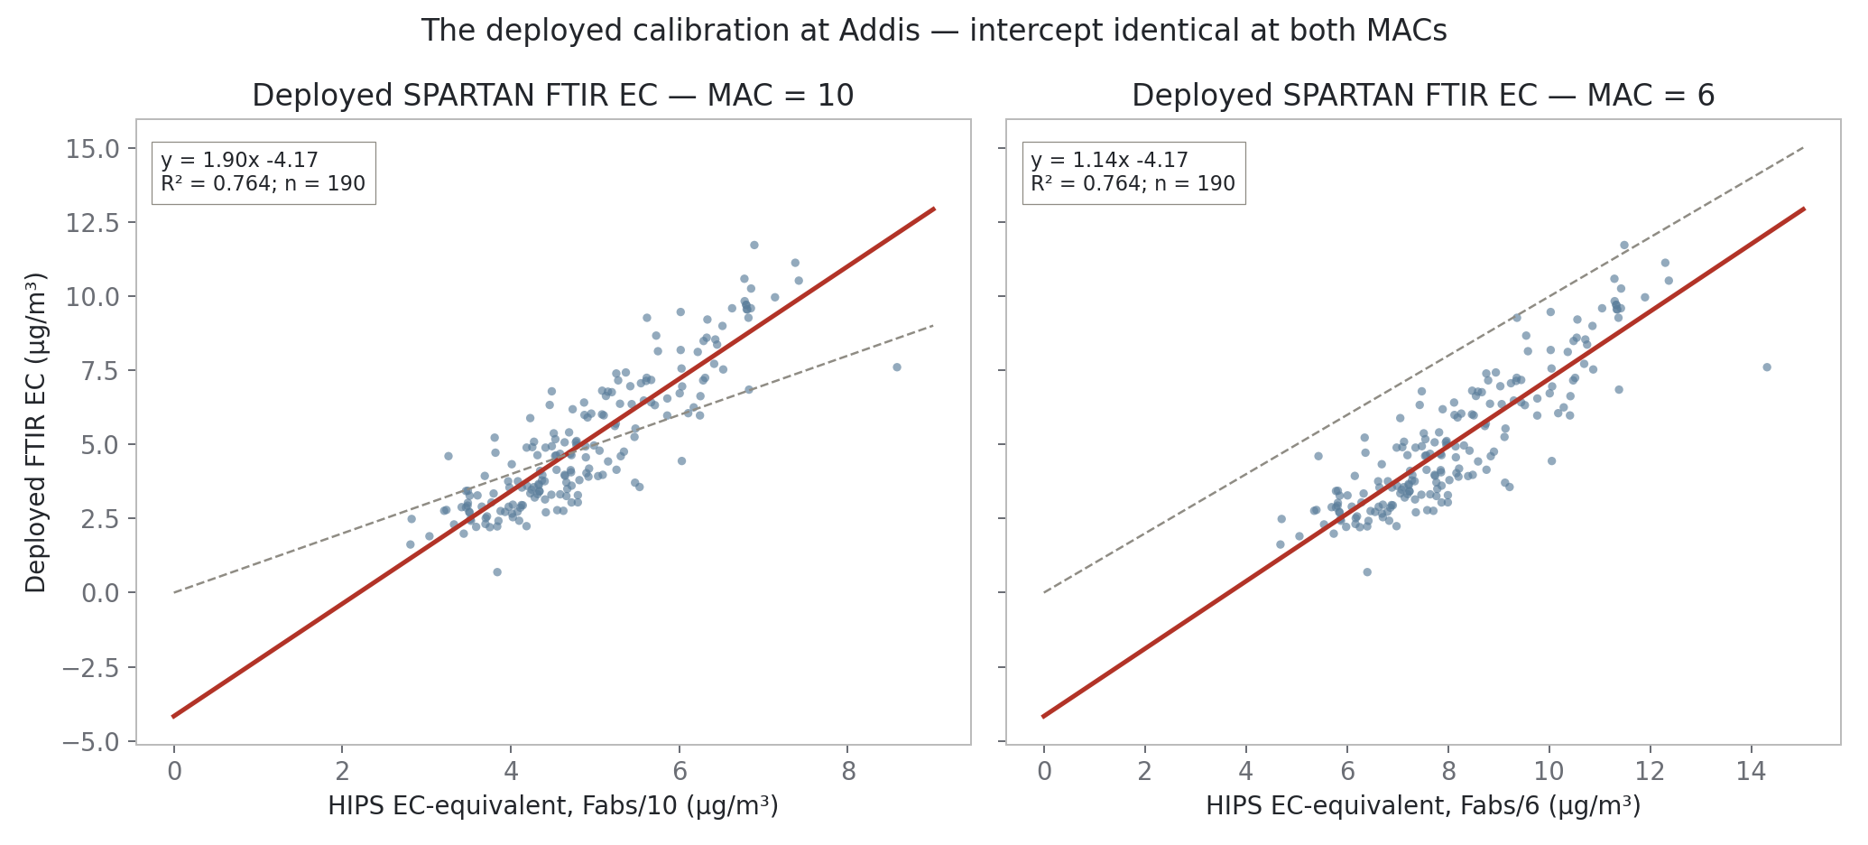
The problem: the deployed calibration reads y = 1.90x − 4.17 at Addis.
Nothing at Addis has negative EC — the offset is the model, not the air.
At MAC 6 the slope pivots to 1.14 but the intercept stays at −4.17. All intercepts today are µg/m³.
MAC 10 1.90x − 4.17
MAC 6 1.14x − 4.17
ftir_31 §4 Fixed 190-filter cohort; fits asserted against committed values in-notebook
Notes:
SAY: The anchor plot. The network calibration carried to Addis is steep with a deep negative intercept — and nothing at Addis has negative EC, so the offset is the model, not the air. Note the right panel: at MAC six the slope pivots to one-point-one-four but the intercept stays at exactly minus four-point-one-seven — that invariance is proved later and it kills a whole family of would-be fixes. Intercepts are micrograms per cubic metre everywhere today.

Slide 3
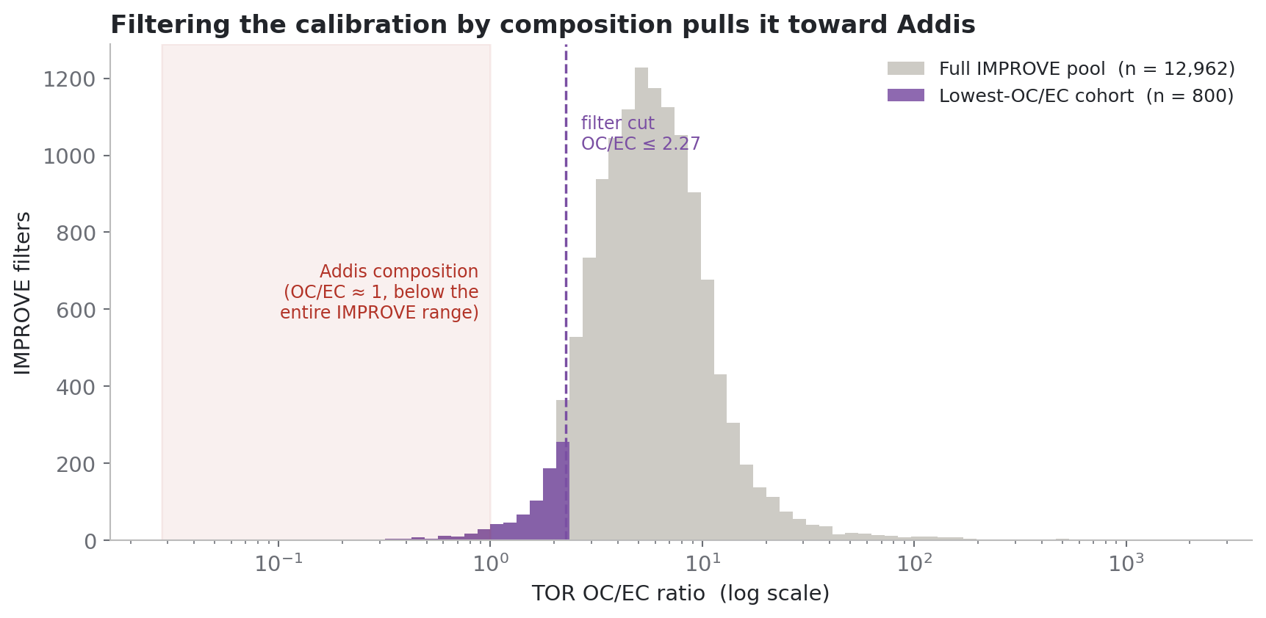
Addis-like composition is the extreme tail of IMPROVE — 800 of 13,010 filters.
The 800 lowest-OC/EC filters (≤ 2.27 vs pool median 5.54) are the closest IMPROVE gets to Addis. Like-for-like they win: same-190 RMSE 1.16 vs 1.48–2.24; held-out TOR R² 0.911 vs 0.59–0.78.
New: Ethiopia-shaped-300 ∩ lowest-OC/EC-800 = 1 filter. Shape and composition select disjoint filters.
cutoff OC/EC ≤ 2.27
300 ∩ 800 overlap 1 filter
held-out TOR R² 0.911 vs 0.59–0.78
ftir_31 §2.1 n = 12,962 with TOR pairs (48 of 13,010 lack them)
Notes:
SAY: Ann's cohort idea: the 800 lowest-OC/EC filters, the closest IMPROVE gets to Addis composition. Like-for-like it wins — same 190 Addis filters, RMSE one-point-one-six against one-point-five to two-point-two, held-out TOR R-squared point-nine-one against point-six to point-eight. New since yesterday, answering Ann's question: the Ethiopia-shaped-300 and this 800 share exactly ONE filter — shape-similarity and composition-similarity select disjoint filters, which fits their opposite behaviour since the shape-selected cohort fails the held-out TOR test. QUESTION FOR SATOSHI: why would spectral-shape similarity fail to track composition here — is the baseline swamping the shape metric too? IF ASKED about the histogram n: 12,962 is the pool with TOR pairs; 48 of the 13,010 lack them.

Slide 4
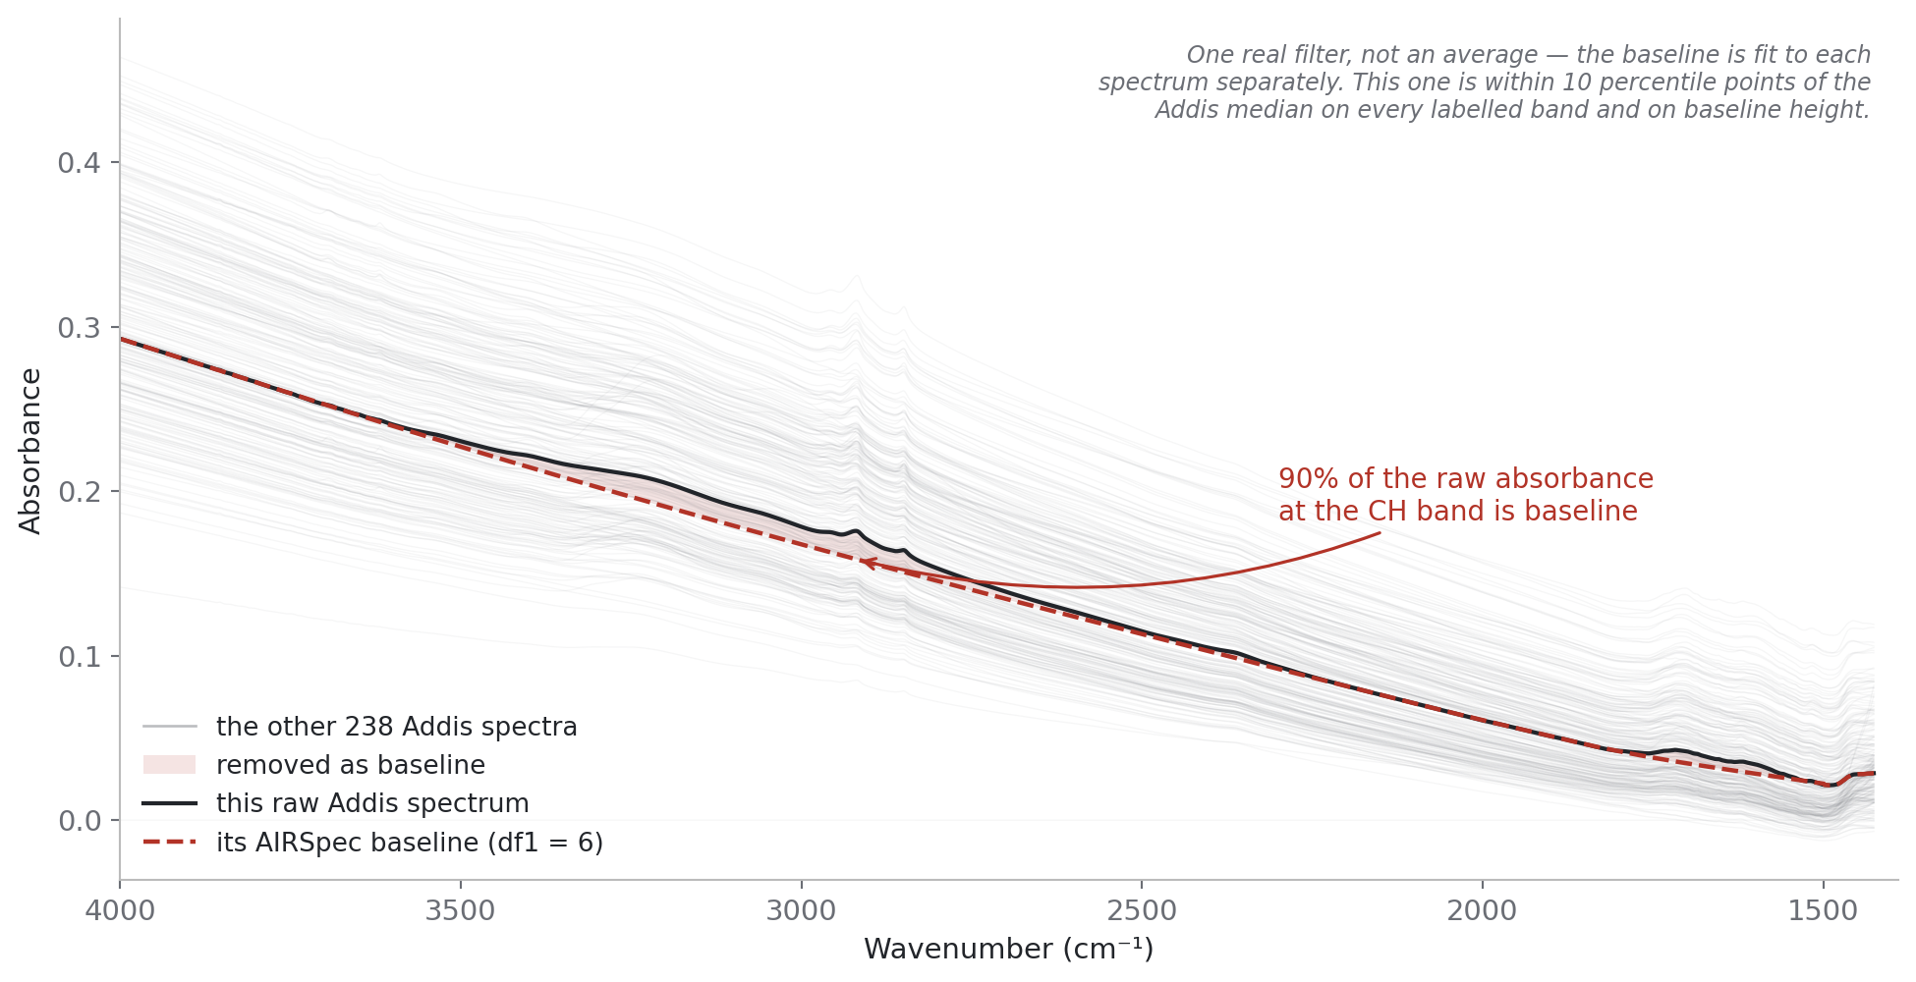
At the CH band, ~91% of a raw Addis spectrum is background.
One real filter; the red dash is the baseline AIRSpec fits under it, per spectrum. The shaded sliver is the bands.
Python port validated against the group's R output to ≤ 6×10⁻⁷ absorbance. EDF 6 vs 8: indistinguishable.
baseline share @ CH ~91% (this filter)
port vs R ≤ 6×10⁻⁷
EDF 6 vs 8 Δslope < 0.01
ftir_31 §2.3 One real filter (median-like); grey = all 239 Addis spectra
Notes:
SAY: Your baselining suggestion, implemented. Black line is one real filter — not an average; the red dash is the APRLssb segmented-spline baseline fitted under it, per spectrum. The shaded sliver is all that is actually bands. Two things for you specifically: the port is your algorithm — validated against your group's R output on the ETAD scans to six times ten-to-the-minus-seven absorbance. And your EDF question has an answer: six versus eight is indistinguishable, delta-slope under one hundredth.

Slide 5
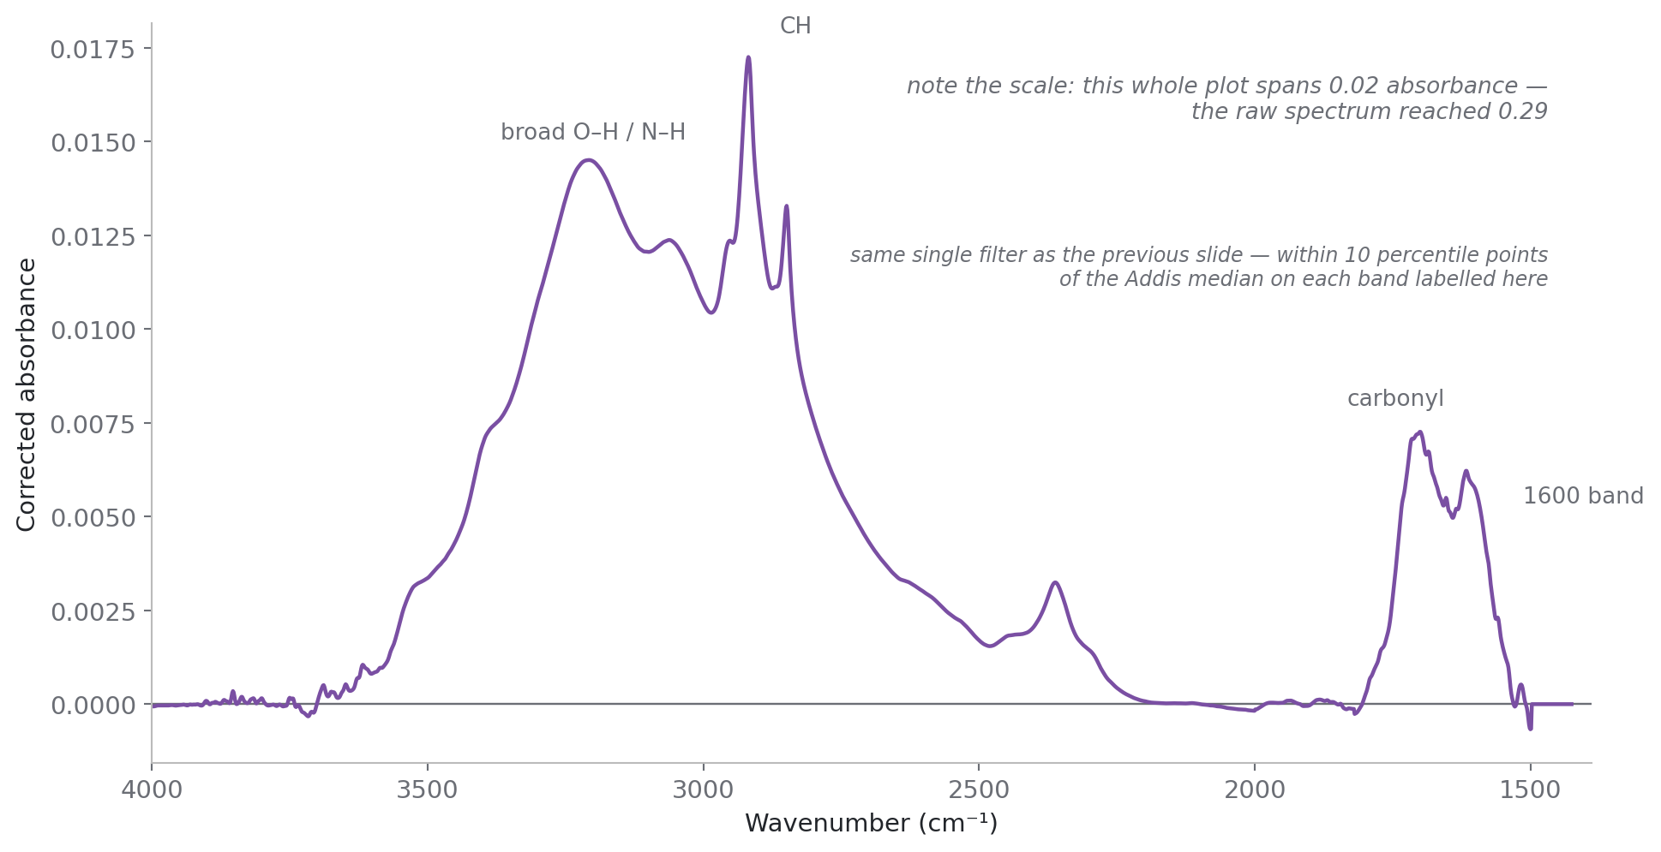
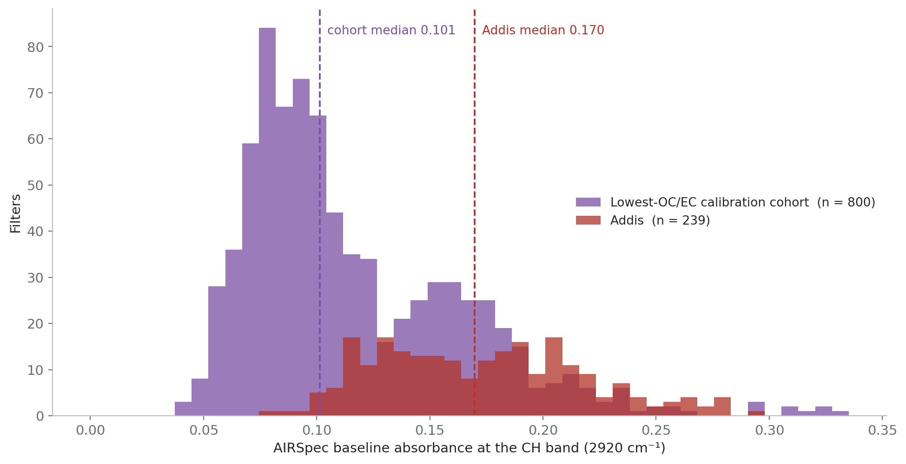
Addis rides a higher background than its calibration cohort.
Baseline height at 2920 cm⁻¹ per filter: cohort 0.101 vs Addis 0.170. Background structure does not transfer — and lands as an offset.
Baselining both sides: intercept −3.22 → −1.62, slope 1.59 → 0.86. Cost: R² 0.77 → 0.66, RMSE 1.16 → 2.41.
Addis vs cohort baseline 0.170 vs 0.101
intercept −3.22 → −1.62
ftir_31 §2.4 same filter, corrected
ftir_31 §2.5 baseline at 2920 cm⁻¹ per filter
Notes:
SAY: Left: the same filter after subtracting its own baseline — the whole panel spans three hundredths of an absorbance unit against a raw spectrum of point-three-four. Right: baseline height at the CH band, one value per filter — cohort median point-one-oh-one, Addis point-one-seven-oh. Whatever a raw-spectra model learns about background does not transfer, and that error lands as an offset. Baselining both sides takes the intercept from minus three-point-two to minus one-point-six — the biggest single improvement of the project. Honest cost: R-squared point-seven-seven to point-six-six, RMSE one-point-two to two-point-four. We prefer it for its residual structure, coming up in the results sections.

Slide 6
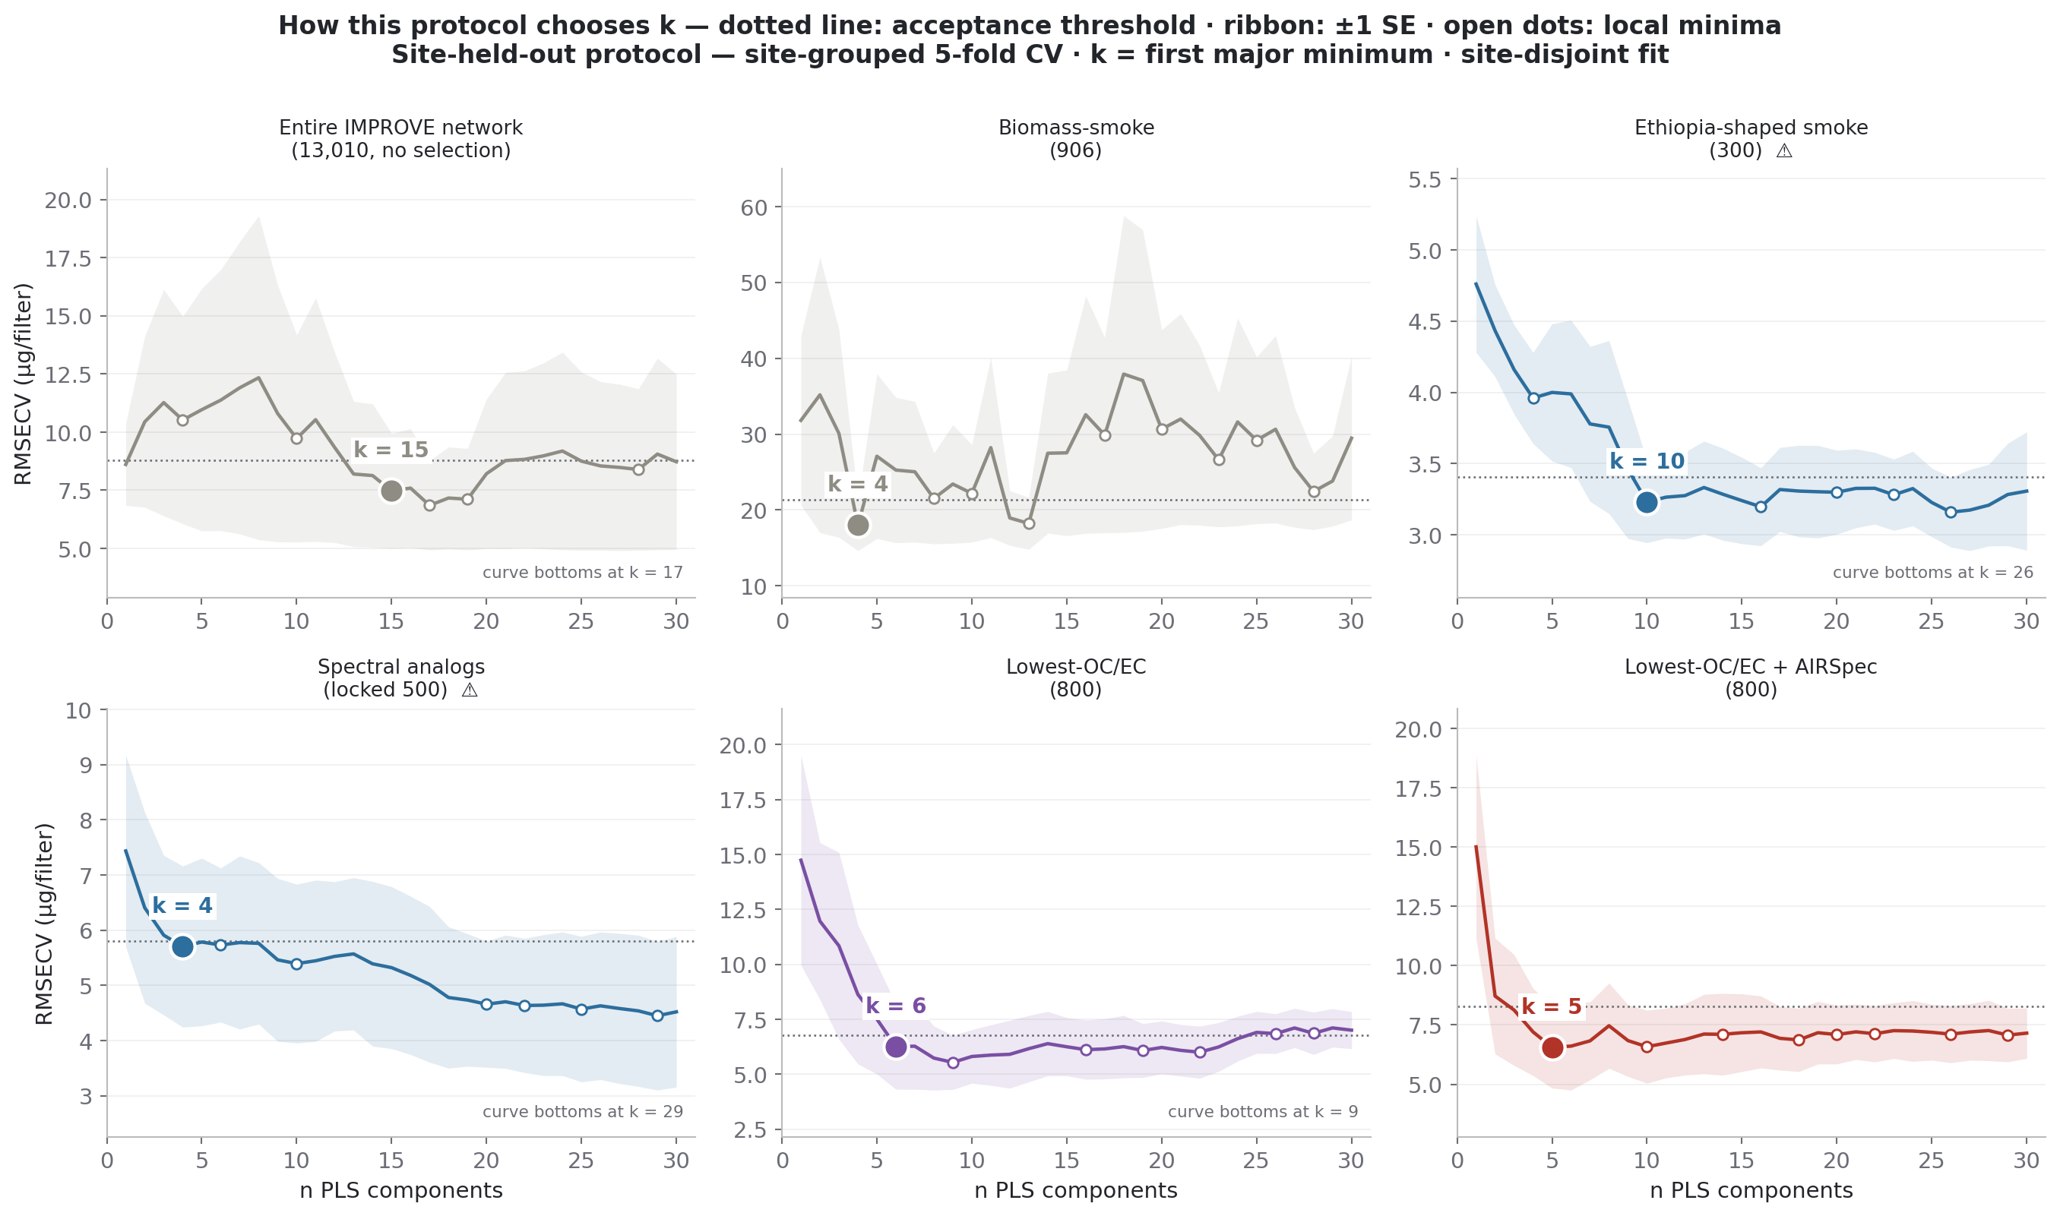
Choosing components, option A: site-grouped 5-fold CV, first major minimum.
Hold whole sites out (5 folds), take the first major minimum, ±1 SE ribbon drawn. Picks k = 4–15.
Verified: biomass-smoke's k = 4 IS this curve's global minimum. And site-grouped CV is row-order stable — the same k every time.
For: Addis is an unseen site; this is the rehearsal. Against (Ann): the first few factors on raw spectra can be mostly Teflon.
picks k = 4–15
smoke k = 4 global minimum
ftir_31 §1.5 Site-grouped curves with the rule's machinery and chosen k drawn
Notes:
SAY: Now the open question — how many PLS components. Option A holds whole SITES out, five folds, and takes the first major minimum, with the standard-error ribbon drawn. It picks small k — four to fifteen. Two verified facts: for biomass-smoke, k equals four IS the global minimum of this curve — the earlier confusion came from a different overlaid figure — and this scheme returns the same k on any row ordering of the data. The case FOR it: Addis is a site nobody has seen, and holding sites out is the rehearsal for that. The worry Ann raised: on raw spectra, the first four or five factors can be mostly Teflon.

Slide 7
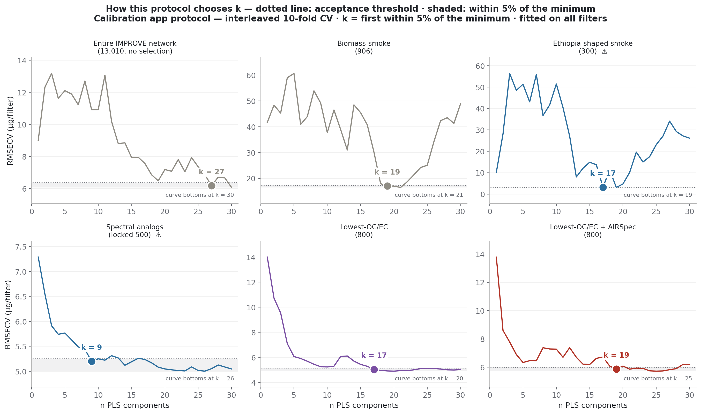
Choosing components, option B: interleaved 10-fold CV, within 5% of minimum.
Every 10th filter held out (10 folds), first k within 5% of the minimum. Picks k = 17–27 — the group's standard, matching the deployed models.
Caveats: the pooled curve has no fold spread, so no error band exists; and it is row-order dependent (k = 15/18/19 on reorderings of the same 800).
For Satoshi: which scheme carries the headline — and must k match across models? (Control option: 5-for-all vs 20-for-all.)
picks k = 17–27
row-order k = 15/18/19
ftir_31 §1.5 Interleaved curves with the within-5% band and chosen k drawn
Notes:
SAY: Option B is the group's standard — the Calibration app's scheme. Every tenth FILTER held out, ten folds, take the first k within five percent of the minimum. It picks large k — seventeen to twenty-seven, about twenty for smoke, which matches how the deployed models were built. Two caveats we can show: the pooled curve carries no fold-to-fold spread, so it cannot draw an error band — it looks decisive partly because it discards that information — and it is row-order dependent: the same 800 filters give k of fifteen, eighteen or nineteen depending on row order. THE DECISION QUESTION FOR SATOSHI: which scheme should carry the headline — and must k match across models when we compare them? Ann's suggestion if unresolved: run five-for-all and twenty-for-all as a control.

Slide 8
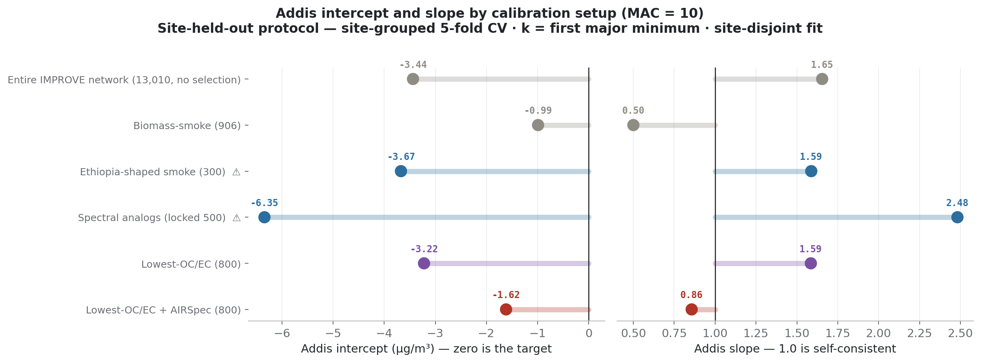
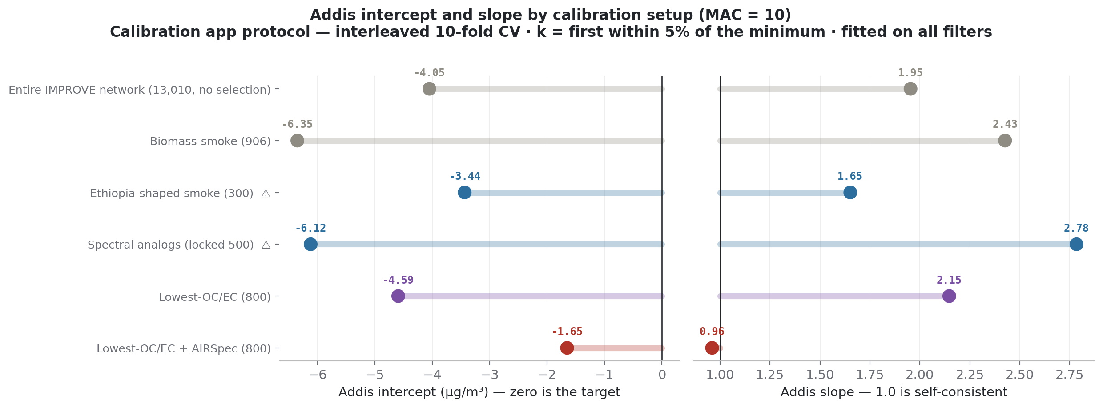
Decide — then jump. Both sections are fully built.
The consequences, side by side: smoke-906 swings −6.35 ↔ −0.99 on the component scheme alone; the corrected setup moves −1.65 ↔ −1.62.
Whichever we pick, the corrected setup's answer is the same — the headline is protocol-robust.
▶ Section A — 5-fold site-grouped results
▶ Section B — 10-fold interleaved results
▶ Skip both — shared results
ftir_31 §1.6 site-grouped 5-fold
ftir_31 §1.6 interleaved 10-fold
Notes:
SAY: Here is the same six-setup ladder under both schemes, side by side, so the decision has its consequences in view: biomass-smoke swings from minus six-point-nine to minus one on the component choice alone — bigger than anything MAC can do — while the corrected setup moves from minus one-point-six-five to minus one-point-six-two. That last point is the safety net: OUR headline conclusion is protocol-robust, so if the room cannot decide today, the corrected setup's answer does not hang on it. Then jump: pick a scheme and I go to that section — same four slides in each: matrix, crossplots, residuals, MAC pivot. If we truly cannot pick, I present section A and hand section B out as the parallel copy.

Slide 9
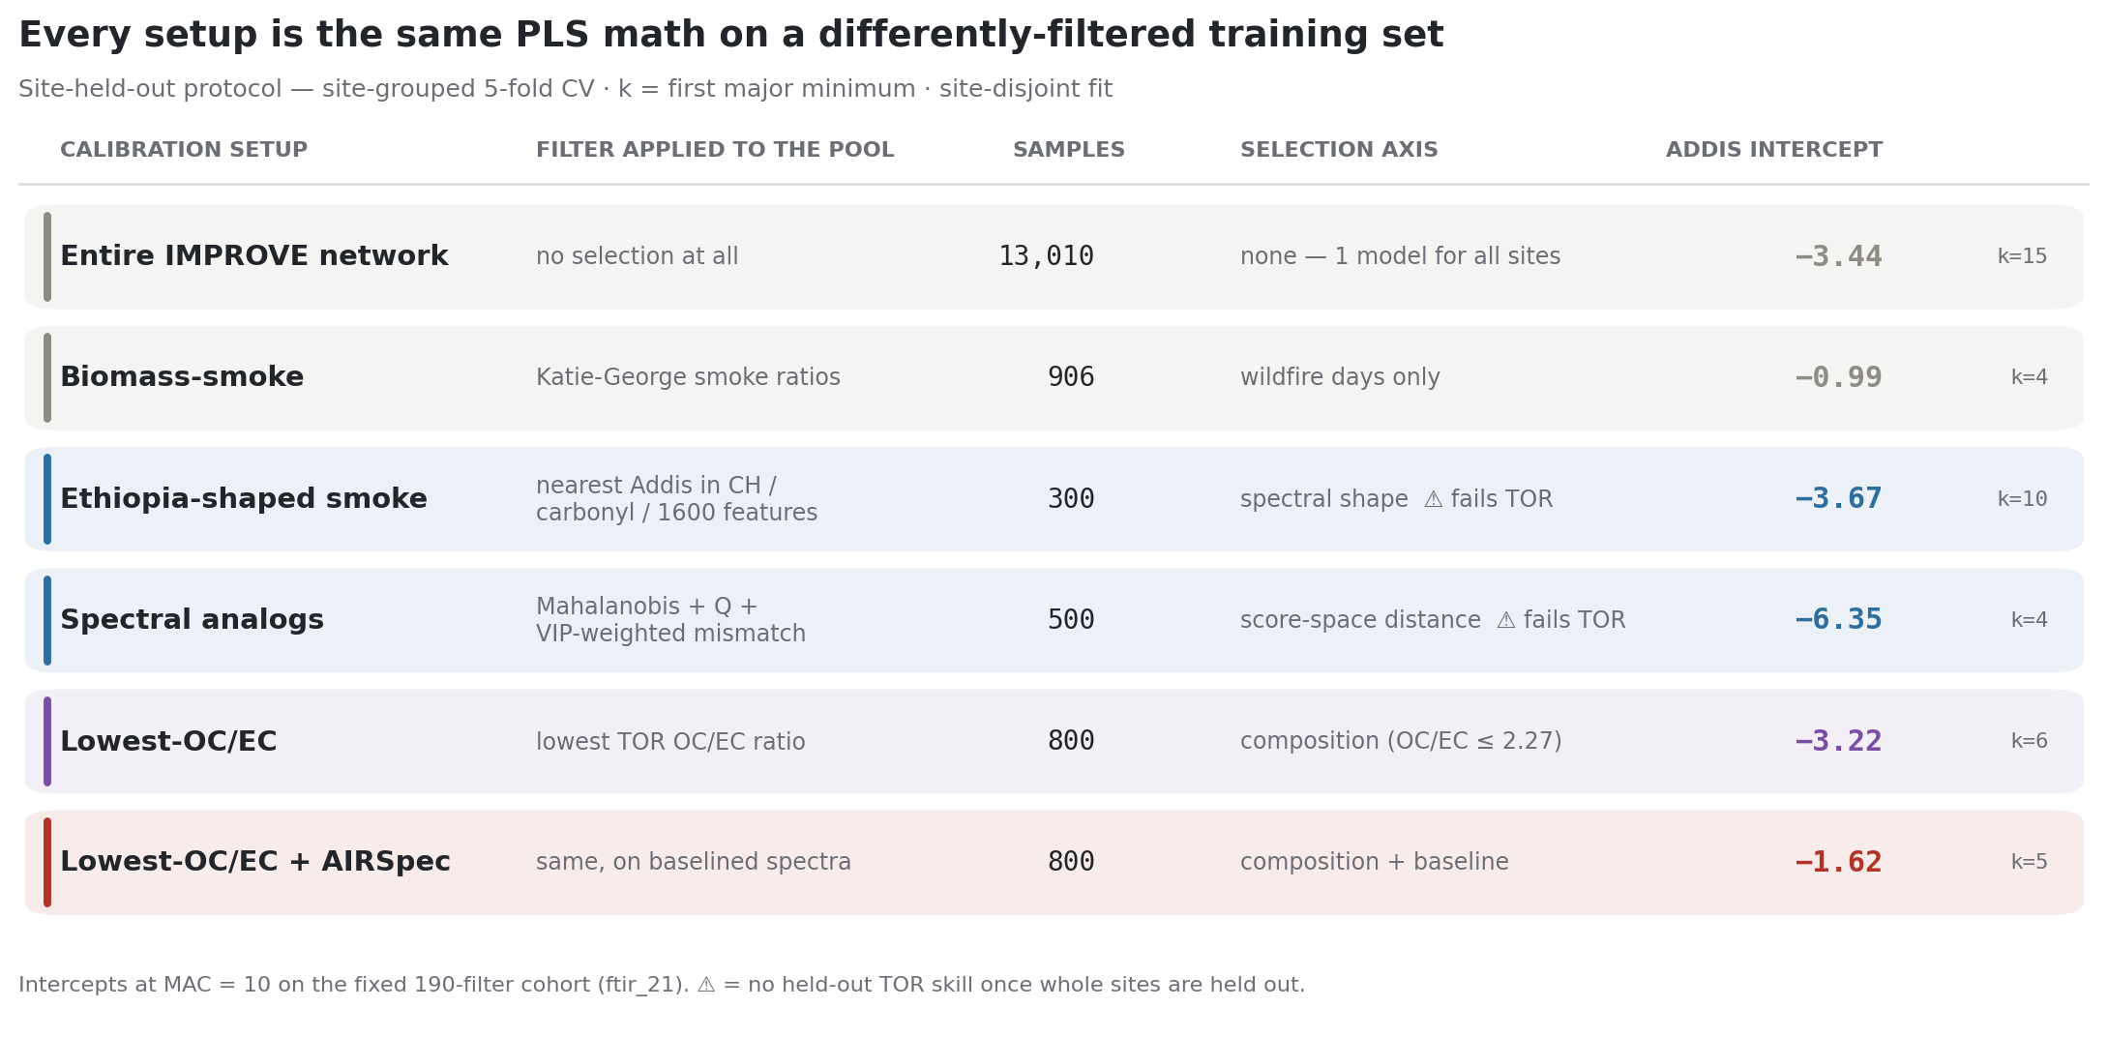
A1 · Every training choice, one table — k = 4–15.
A · 5-FOLD SITE-GROUPED
The intercept ladder: −4.17 (deployed) → −3.22 (lowest-OC/EC raw) → −1.62 (+ baseline correction).
The corrected setup passes the disjoint-site TOR test (slope 1.01, R² 0.90); engineering beyond it breaks that test.
corrected intercept −1.62 µg/m³
held-out TOR 1.01x · R² 0.90
ftir_31 §1.1 Site-grouped 5-fold · first major minimum · intercepts µg/m³
Notes:
SAY (Section A): the setup matrix under site-grouped selection, intercepts in micrograms per cubic metre. The ladder runs minus four-point-two, minus three-point-two, minus one-point-six. Two rows carry warnings — no held-out TOR skill. The corrected setup passes the disjoint-site TOR test cleanly, slope one-point-oh-one — and cohort engineering beyond it breaks that test: this is the terminal IMPROVE-only candidate.

Slide 10
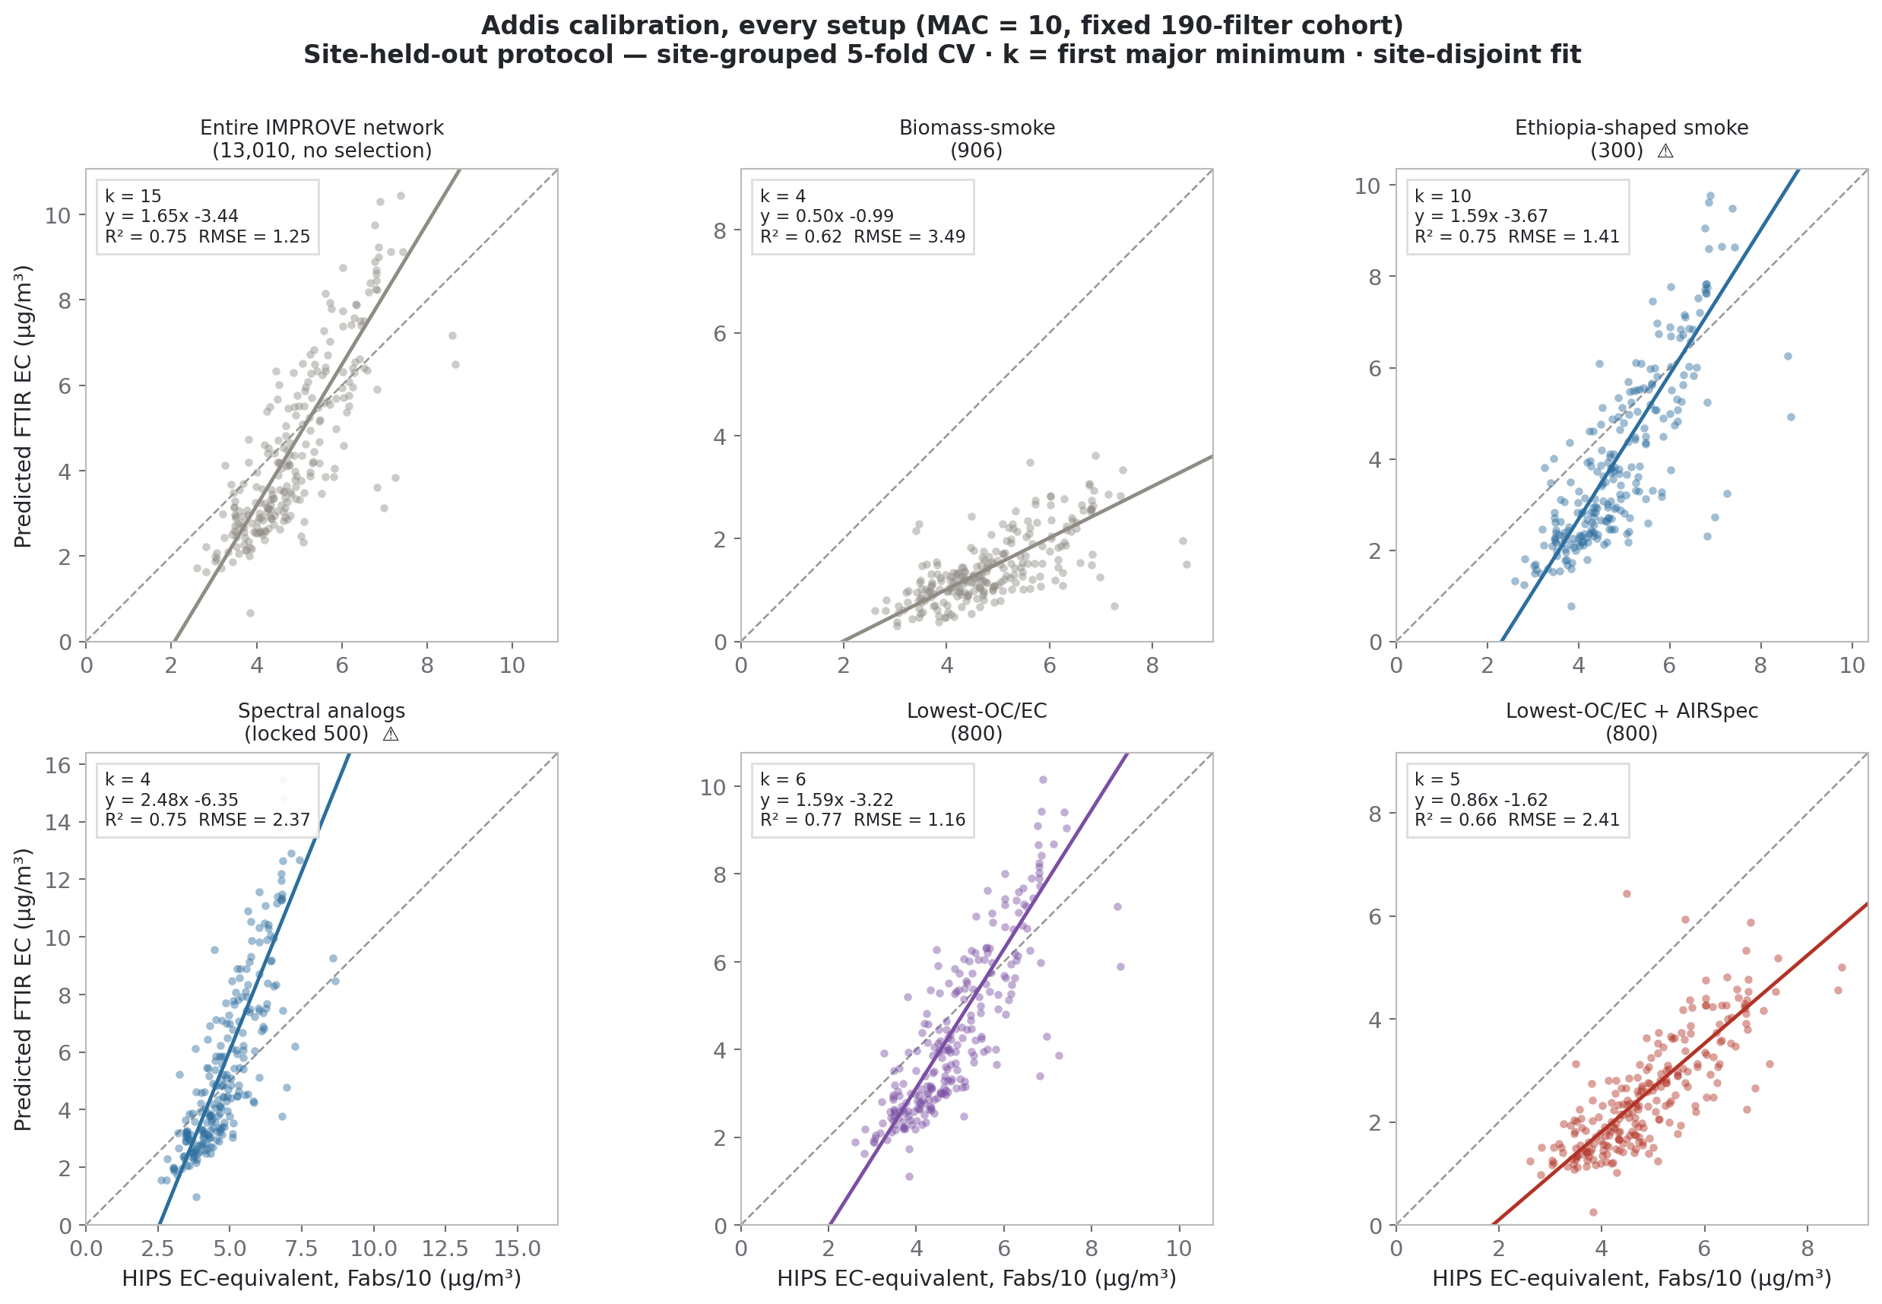
A2 · The smoke calibration collapses on corrected spectra.
A · 5-FOLD SITE-GROUPED
Ann's objection: EC's sloping absorption lives partly in the baseline, so baselining should lose signal.
Evidence it was mostly not EC: smoke-906 falls 2.65 → 0.37 on corrected spectra; the HIPS-transfer failure survives baselining.
For Satoshi: how much real EC does the correction discard — is a middle path worth testing?
smoke-906 corrected slope 0.37
HIPS transfer still fails
ftir_31 §1.2 Fixed 190-filter cohort, MAC = 10
Notes:
SAY: All six setups, identical axes, fixed cohort, MAC ten. Ann's standing objection deserves saying out loud: EC's sloping absorption lives partly in the baseline, so baselining an EC calibration should LOSE signal. Our evidence that what we removed was mostly not EC: smoke-906 falls from slope two-point-six-five to point-three-seven when both sides are baselined, and the HIPS-transfer failure survives baselining — the break at Addis is compositional. THE BIG QUESTION FOR SATOSHI: how much genuine EC signal does full baseline removal discard? Is a middle path worth testing — and where does your group's newer baselining work stand?

Slide 11
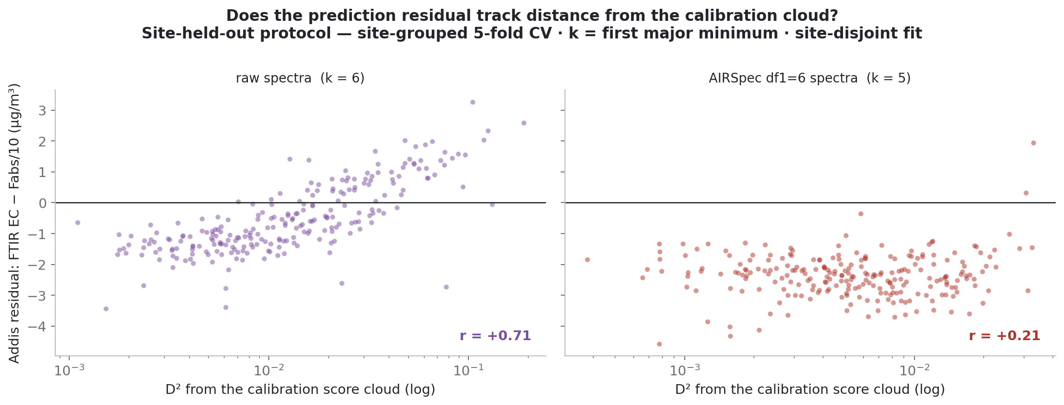
A3 · The corrected model misses by a season-stable constant: −2.0 to −2.6 µg/m³.
A · 5-FOLD SITE-GROUPED
Raw: error tracks D² (r = 0.71) and flips sign by season. Corrected: flat, season-stable −2.0…−2.6; bootstrap CI [−1.78, −1.06] excludes zero.
Restated: ~21 Mm⁻¹ of absorption with no FTIR-EC behind it — MAC-invariant. Deming (measured σ_x): −1.62 → −2.09; OLS is the conservative bound.
raw: resid ~ D² r = 0.71
corrected CI [−1.78, −1.06]
Deming λ* −1.62 → −2.09
ftir_31 §1.3 Residual vs Mahalanobis D²; site-cluster bootstrap B = 200
Notes:
SAY: Residual against distance from the calibration cloud. Raw model: error tracks extrapolation, r point-seven-one, flips sign by season — out-of-domain failure. Corrected model: flat, distance-independent, season-stable minus two to minus two-point-six. Bootstrap CI excludes zero. Restated as absorption: about twenty-one inverse megametres with no FTIR-EC behind it, forty-six percent of a typical Addis filter, exactly MAC-invariant. IF THE ESTIMATOR comes up: with measured HIPS uncertainty, Deming moves the corrected intercept to minus two-point-one — errors-in-variables makes the offset LARGER, so OLS is the conservative bound. Backup slides at the end.

Slide 12
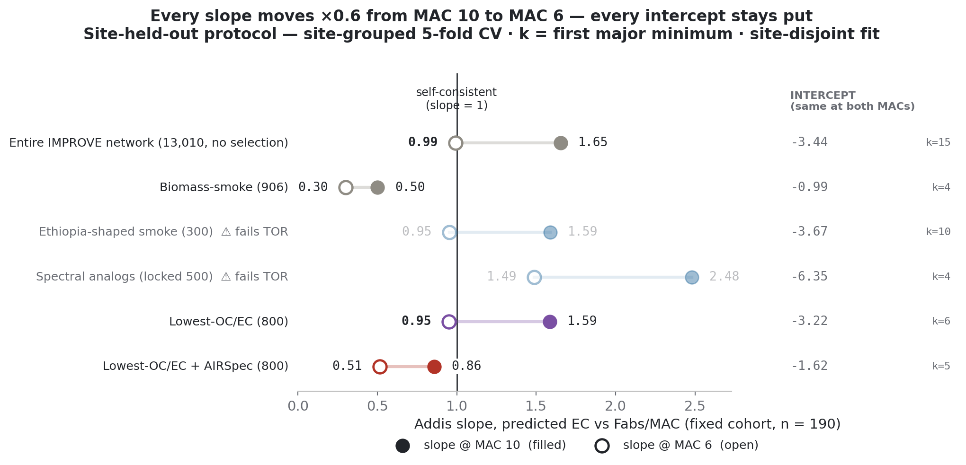
A4 · MAC cannot move any intercept — the fork is a slope contest.
A · 5-FOLD SITE-GROUPED
x = Fabs/MAC: intercepts and R² exact under any MAC; slopes ×0.6 going 10 → 6.
MAC 6 → raw self-consistent (0.95). MAC 10 → corrected lands closest (0.86). Fit statistics cannot choose.
slope scaling ×0.6 exact
raw @ MAC 6 0.95
corrected @ MAC 10 0.86
▶ Continue — shared results
ftir_31 §1.4 Intercepts identical at both MACs; slope ×0.6 exactly
Notes:
SAY: The promised algebra. x is Fabs over MAC, so changing MAC rescales x by a constant — every setup keeps its intercept and R-squared exactly; slopes scale by exactly point-six. MAC six makes the raw models self-consistent — lowest-OC/EC point-nine-five — while MAC ten is where the corrected model lands closest at point-eight-six. Deliberately “lands closest”, not “self-consistent”. Estimator-independent too: the pivot survives Deming exactly — backup slide. Then click through to the shared results.

Slide 13

B1 · Every training choice, one table — k = 17–27.
B · 10-FOLD INTERLEAVED
Same six setups, interleaved 10-fold, within-5% rule (k = 17–27), fits on all cohort filters.
The corrected setup reads −1.65 — same answer as section A. Raw setups deepen: smoke-906 −6.35 (k = 19).
No site-disjoint TOR test exists under this scheme, by construction.
corrected intercept −1.65 µg/m³
smoke-906 −6.35 (k = 19)
ftir_31 §1.1 Interleaved 10-fold · within 5% of minimum · intercepts µg/m³
Notes:
SAY (Section B): the same matrix under the group's interleaved scheme with its large k. The corrected setup reads minus one-point-six-five here — essentially unchanged from section A — while the raw setups deepen: smoke-906 sits at minus six-point-three-five at k nineteen. One structural caveat to state: under this scheme the fit uses all cohort filters, so there is no site-disjoint TOR test by construction — the TOR column that defends cohort choices only exists under site-held-out.

Slide 14
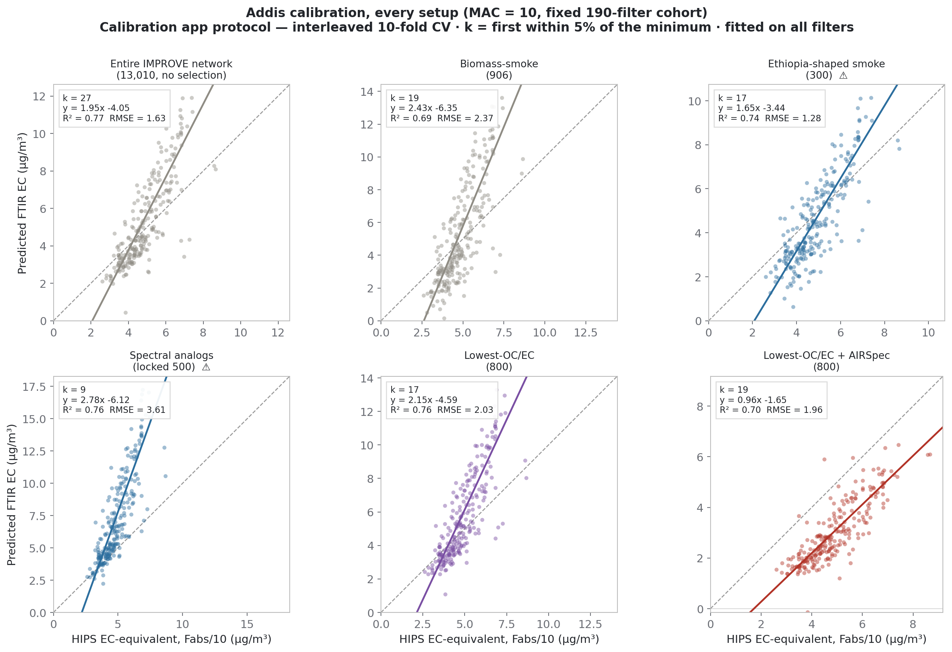
B2 · The six setups on Addis — interleaved-selection models.
B · 10-FOLD INTERLEAVED
Same six setups, large-k models. Every transfer is roughly linear with wrong gain/offset; the corrected setup is nearest 1:1.
The steeper, deeper smoke/analog fits show what the extra components bought: fit at familiar sites, not transfer.
corrected ≈ same as A
smoke/analogs steeper, deeper
ftir_31 §1.2 Fixed 190-filter cohort, MAC = 10, interleaved-selection models
Notes:
SAY: The same six crossplots with the large-k models. The reading is unchanged in kind: every setup is roughly linear at Addis with the wrong gain and offset, and the corrected setup is the closest to one-to-one. The smoke and analog fits are steeper and deeper here — the extra components bought fit at their own sites, not transfer. Ann's baselining question stands identically in this branch: how much genuine EC does the correction discard?

Slide 15
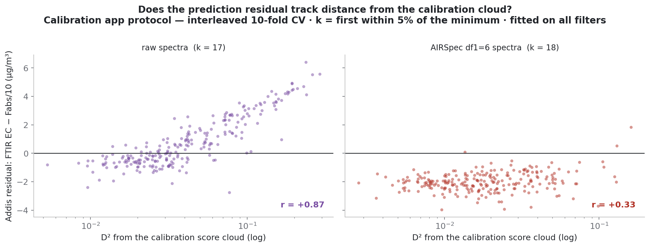
B3 · Residual structure — the raw/corrected contrast survives the scheme.
B · 10-FOLD INTERLEAVED
Raw: residual tracks D² at r = 0.87 under this scheme. Corrected: flat, distance-independent.
The diagnosis is scheme-independent: raw fails by extrapolation; corrected misses by an additive constant.
raw: resid ~ D² r = 0.87
corrected flat
ftir_31 §1.3 Interleaved-selection models; bootstrap CIs overlap section A's
Notes:
SAY: The residual story under the interleaved models: the raw model's error still tracks extrapolation distance — even more strongly here, r point-eight-seven — and the corrected model's error is still a flat constant. So the central diagnosis does not depend on the component scheme: raw models fail by extrapolation, the corrected model misses by something additive.

Slide 16
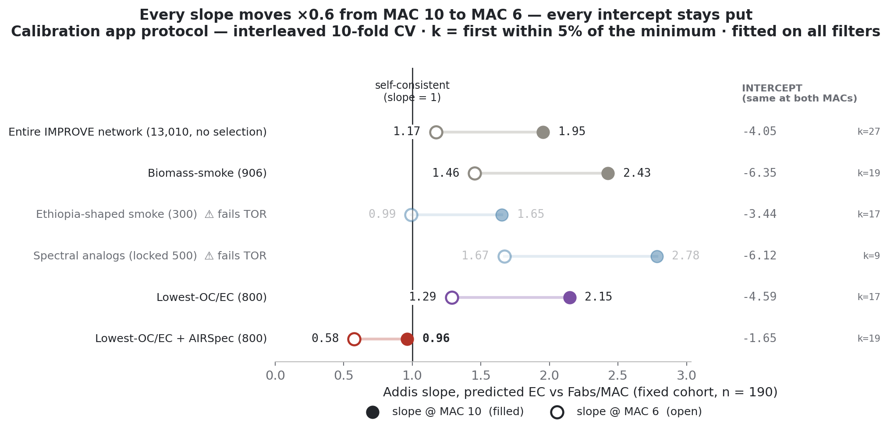
B4 · MAC cannot move any intercept here either.
B · 10-FOLD INTERLEAVED
Intercepts identical at both MACs; slopes ×0.6 exactly — the MAC-proof result is scheme-independent.
slope scaling ×0.6 exact
intercepts MAC-proof
▶ Continue — shared results
ftir_31 §1.4 Interleaved-selection models
Notes:
SAY: Same algebra, this branch's models: every intercept is identical at both MACs and every slope scales by exactly point-six. The fork stays a slope contest whichever way components are chosen. Then click through to the shared results.

Slide 17
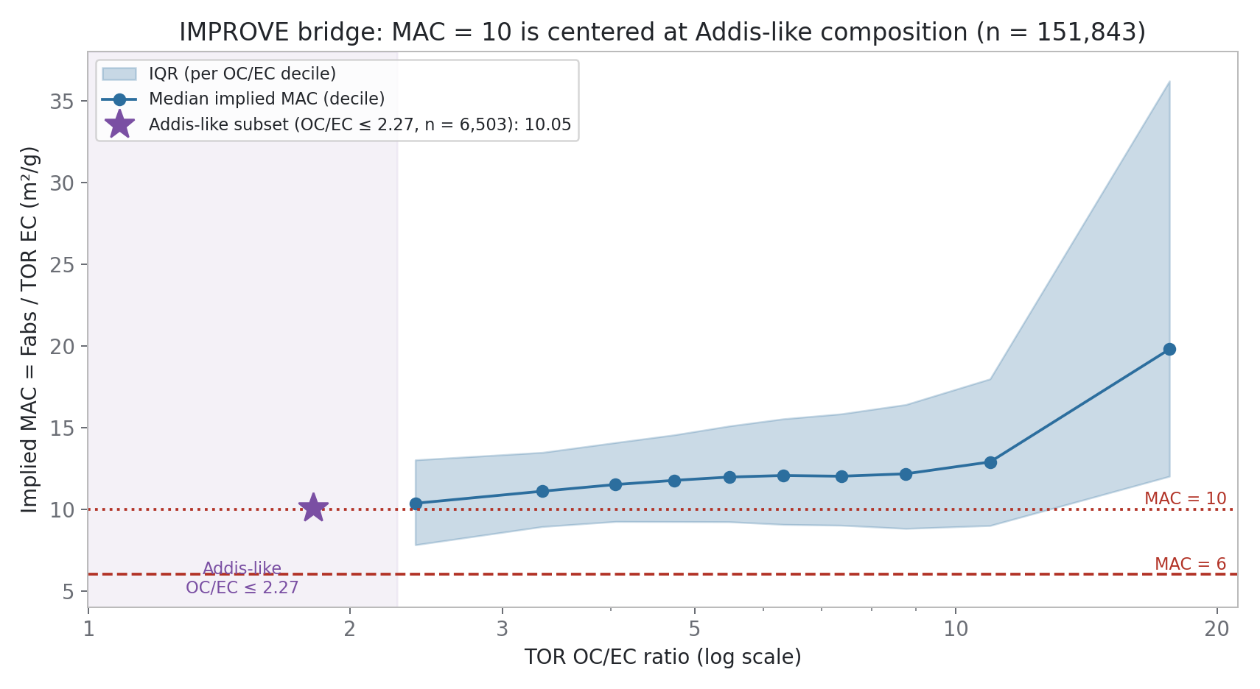
At Addis-like composition, IMPROVE's implied MAC is 10.05 — at the confirmed 633 nm.
Implied MAC = Fabs / TOR-EC across 151,843 matched filters. Pool median 11.96; the Addis-like OC/EC ≤ 2.27 subset (star, n = 6,503) sits at 10.05.
HIPS wavelength confirmed: He–Ne 632.8 ≈ 633 nm, MAC 10 defined at 633.
Addis-like subset MAC 10.05
pool median 11.96
high-OC/EC tail 19.8
ftir_31 §3 Rebuilt from the committed 151,843-filter table; numbers asserted in-notebook
Notes:
SAY: Back on shared ground — nothing from here depends on the component scheme. The non-circular way to let data set MAC: where IMPROVE has both HIPS and TOR — one hundred fifty-two thousand filters — implied MAC is Fabs over TOR-EC. Pool median twelve; the Addis-like subset, the purple star, ten-point-oh-five. MAC ten is centred at Addis-like composition. And the high-OC/EC tail inflating to twenty shows Fabs carries organic-scaling non-EC absorption. Resolved fact: HIPS is confirmed helium-neon, six-thirty-three nanometres, MAC ten defined at six-thirty-three — SPARTAN's own sources. QUESTION FOR SATOSHI: does this chain hold — and is there an independent HIPS MAC or protocol bridge that tests MAC-ten-at-Addis without new sampling?

Slide 18
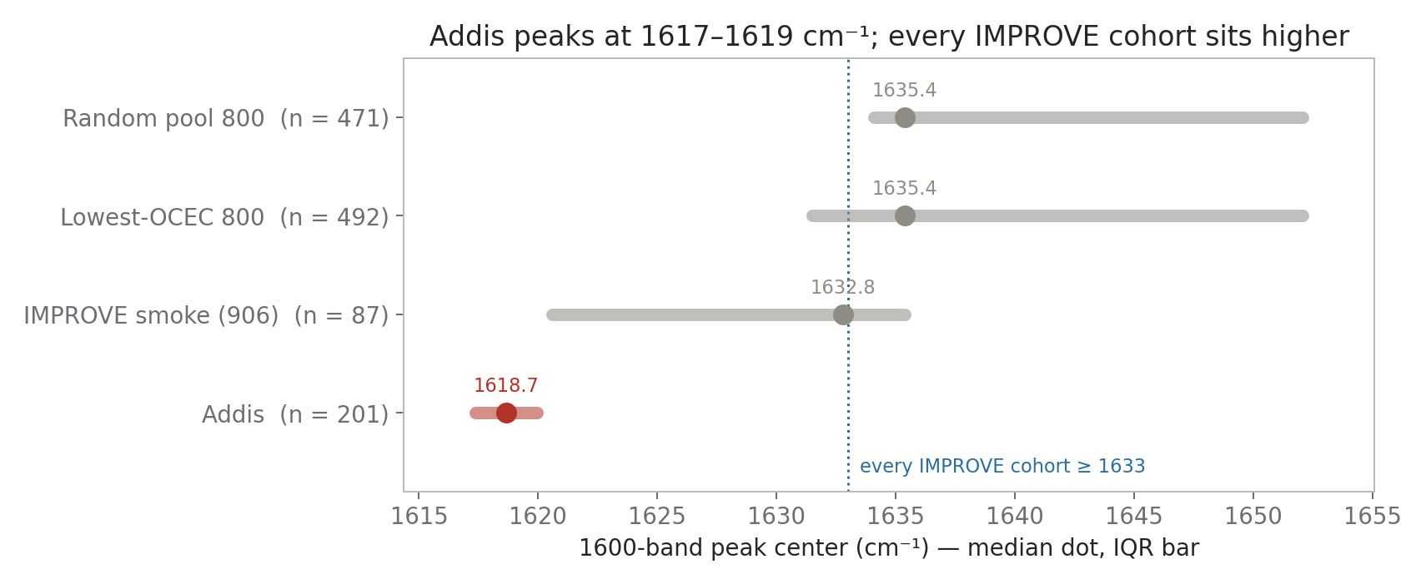
The 1600 band is not amine — stuck below 1425 cm⁻¹ without your sub-1500 model.
Addis: 1617–1619 cm⁻¹, every season. IMPROVE cohorts: ≥ 1633. Co-varies with CH (ρ 0.88), carbonyl (0.93); not N–H/O–H (0.17) — amine rejected.
Carboxylate vs aromatic C=C needs the region below 1425 cm⁻¹: your sub-1500 model, or charcoal spectra as data.
Addis center 1617–1619
IMPROVE ≥ 1633
ρ(1600, N–H) 0.17
ftir_31 §6 Group medians and IQRs from the committed ftir_12 stats table
Notes:
SAY: Addis peaks at sixteen-seventeen to sixteen-nineteen in every season; every IMPROVE cohort sits at sixteen-thirty-three or higher. The band co-varies with CH and carbonyl but NOT with the N-H/O-H window — an N-H bend without its stretch is implausible, so amine is out. Carboxylate versus aromatic C=C cannot be separated on Teflon because the symmetric partner near fourteen-hundred is below the trusted range. TWO ASKS: the sub-1500 model status — it is the unblocking tool — and Emily Lee's charcoal spectra as data; the burning-chemistry argument is the process case for the aromatic reading.

Slide 19
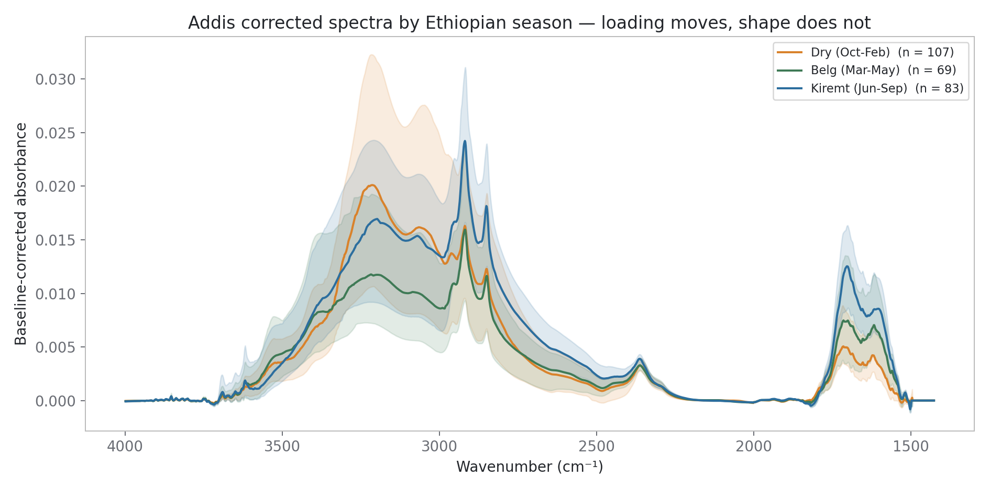
Season changes loading, not shape — ftir_24 predicts dry and wet separately.
All bands, deployed EC (3.3 → 7.2 µg/m³) and Fabs peak in Kiremt; the 1600-band centre never moves; Dry has relatively more broad O–H.
Raw-model residuals: Dry −1.25 (worst) → Kiremt +0.49 (best); corrected season-stable. ftir_24: pooled season × x design.
EC by season 3.3 → 7.2
raw residuals Dry −1.25 → Kiremt +0.49
eval split 105 / 61 / 73
ftir_31 §5 Corrected spectra, median ± 10–90 % per season
Notes:
SAY: Naveed's seasons on the corrected spectra: everything peaks in Kiremt — deployed EC three-point-three to seven-point-two — while the 1600-band centre never moves; the one shape effect is more broad O-H in the Dry season. The committed residuals show season sensitivity is a raw-model phenomenon, and inverted from our guess: Dry is the WORST season for the raw model, Kiremt the best; the corrected model is season-stable. ftir_24 is queued with a pooled season-by-x design, because Dry spans only about half the wet x-range and naive per-season slopes attenuate mechanically.

Slide 20
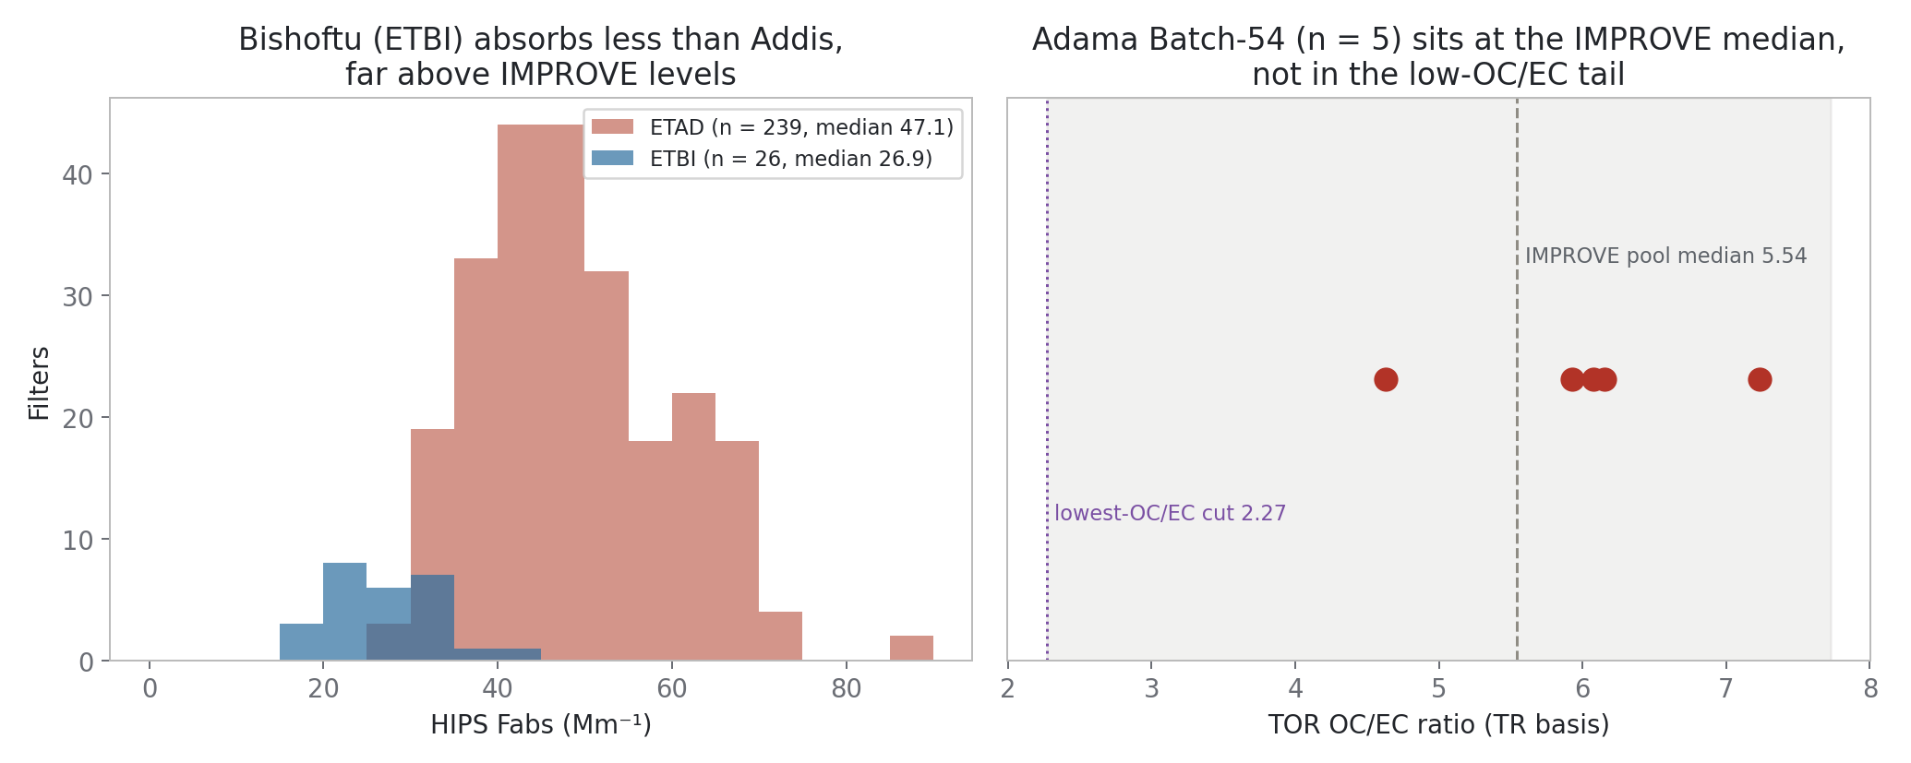
The one same-corridor TOR looks ordinary — and a second Ethiopian site sits unused.
Adama TOR: OC/EC 4.6–7.2 — the IMPROVE median. Reconciling Addis HIPS with FTIR OC at that composition needs MAC ≈ 47 m²/g — unphysical.
ETBI (Bishoftu): 26 HIPS filters, median 26.9 Mm⁻¹ — a free in-country test set, blocked only on the spectra pull.
Adama OC/EC 4.6–7.2
bridge MAC ≈ 47 m²/g
ETBI 26 filters, unused
ftir_31 §7 Rebuilt from the SPARTAN HIPS export + committed Adama TOR; medians asserted
Notes:
SAY: The uncomfortable check: Adama's five quartz TOR filters give OC/EC four-point-six to seven-point-two — the IMPROVE median, not the extreme tail the Addis offset implies regionally. Reconciling Addis HIPS with FTIR OC at that composition needs a MAC around forty-seven — unphysical — so something has to give. And Bishoftu, ETBI, is an untouched in-country test set — twenty-six HIPS filters, median twenty-seven against Addis's dry-season forty-three — IF its spectra come through. THE ASK: the INDH-CHTS spectra export with ETBI added, same shape as the ETAD pull — the cheapest unblocking step on the list. Pre-registered: if the twenty-one megametres were a persistent background, ETBI's FTIR-EC should come out very low.

Slide 21
What we need from you.
The headline: a co-located quartz-TOR campaign at ETAD or Bishoftu. Every EC reference we hold is circular with one axis or the other, and the surviving explanations for the ~21 Mm⁻¹ offset all yield to it. Spec: 11–13 days per season, ~36 filters total; Adama Batch-54 proves the chain. One-pager in hand.
Components — the decision from today
Baselining trade-off
Which CV scheme carries the headline, and must k match across models? Control option: 5-for-all vs 20-for-all.
How much real EC does full baseline removal discard? Middle path / your newer method — worth testing vs AIRSpec?
Sub-1500 cm⁻¹ model
Emily Lee's charcoal spectra
Status? It is the unblocking tool for carboxylate vs aromatic C=C at 1600.
As data — the paper versions are print-only; replaces our failed KBr attempt.
INDH / CHTS / ETBI spectra export
MAC / protocol bridge
Same shape as the ETAD pull; turns Bishoftu into a live in-country test set.
Does the implied-MAC chain hold — any independent test of MAC ≈ 10 without new sampling?
Notes:
SAY: Six things, one headline. Quartz TOR moved to the top this week because we closed every in-hand route to an independent EC reference — both ChemSpec carbon columns turned out circular, BC with Fabs and EC with our own FTIR-EC. Spec: eleven to thirteen days per season, about thirty-six filters TOTAL — not per season — and Adama Batch-54 proves the chain. Hand over the one-pager here. The first card is today's decision, written down so it leaves the room with an owner: which CV scheme carries the headline, and whether k must match across models.

Slide 22
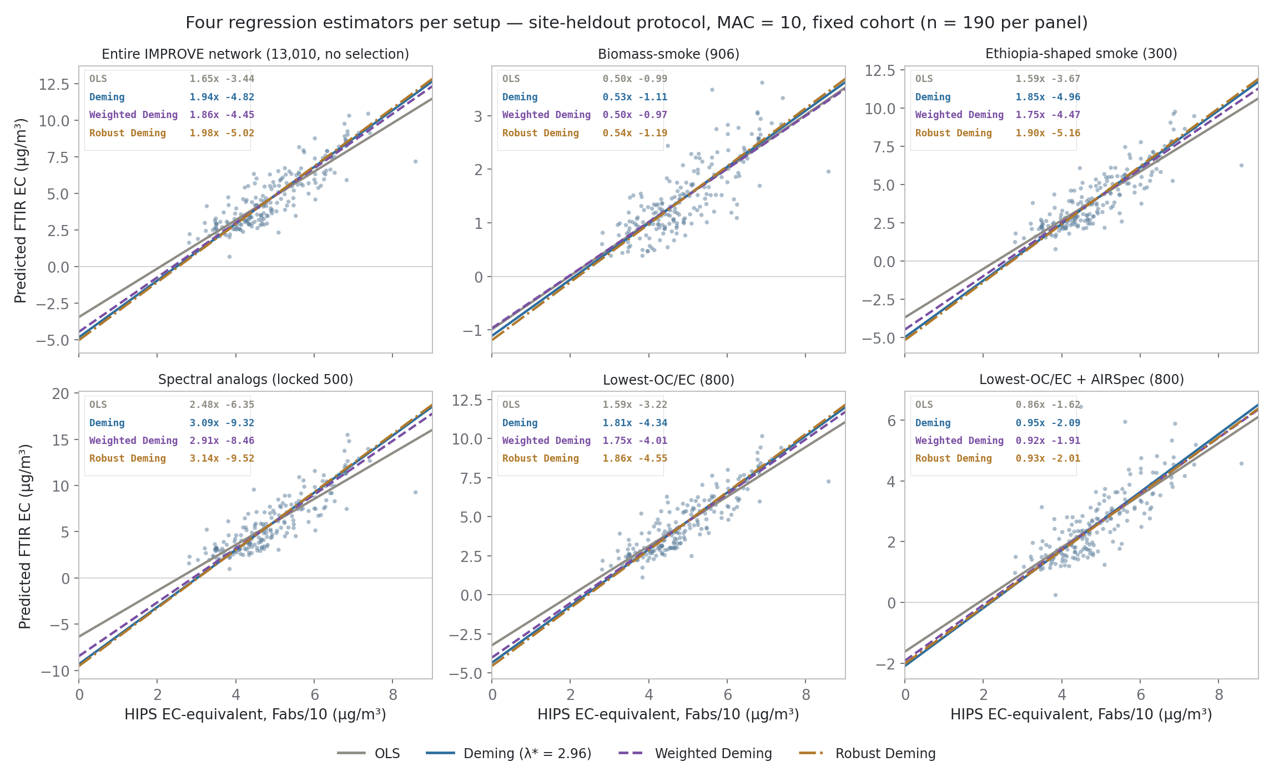
BACKUP — Four regression estimators per setup: OLS is the conservative bound.
Same fixed cohort, four fits per setup: OLS, Deming (measured λ* = 2.96), constant-CV weighted Deming, Huber-robust Deming.
Every errors-in-variables treatment deepens the intercept — OLS is the conservative bound. Corrected setup moves least (−1.62 → −2.09).
λ* 2.96 (measured)
corrected, Deming 0.95x − 2.09
ftir_31 §1.10 OLS rows asserted against the committed setup matrix
Notes:
SAY (if the estimator question opens): every crossplot today used OLS, which assumes all error in y. Refit with errors in both axes — Deming at the measured error ratio, a constant-CV weighted variant, and a Huber-robust variant — every slope steepens and every intercept goes MORE negative. So the slide numbers are the conservative bound on the offset. The corrected setup moves least: minus one-point-six-two to minus two-point-one across all four. OLS rows asserted against the committed matrix in-notebook.

Slide 23
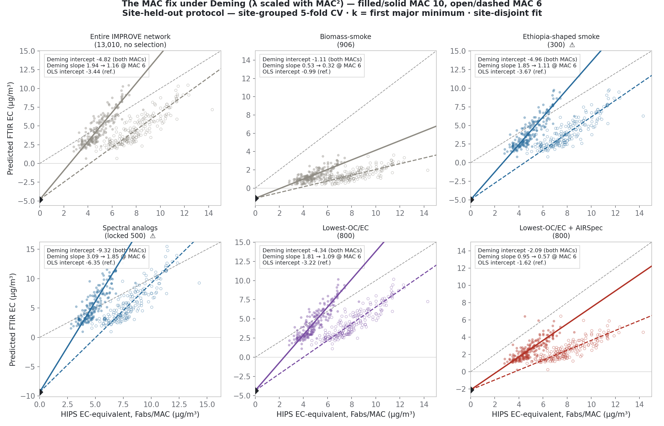
BACKUP — The MAC pivot survives Deming exactly.
Filled/solid = MAC 10, open/dashed = MAC 6, diamond = the shared intercept. All fits Deming, λ scaled with MAC².
Asserted per setup: intercept identical at both MACs (10⁻⁹); slope ×0.6 exactly — estimator-independent.
λ @ MAC 10 / 6 2.96 / 1.07
pivot exact under Deming
ftir_31 §1.11 Every fit Deming; OLS intercepts quoted per panel for reference
Notes:
SAY (if asked whether MAC-proof depends on OLS): no. Redone under Deming with the error-variance ratio scaled with MAC squared — the correct error model when rescaling x — the intercept is identical at both MACs to ten-to-the-minus-nine and the slope scales by exactly point-six, asserted per setup in the notebook. Deming deepens every intercept relative to OLS, but MAC still cannot move any of them.

