Slide 1





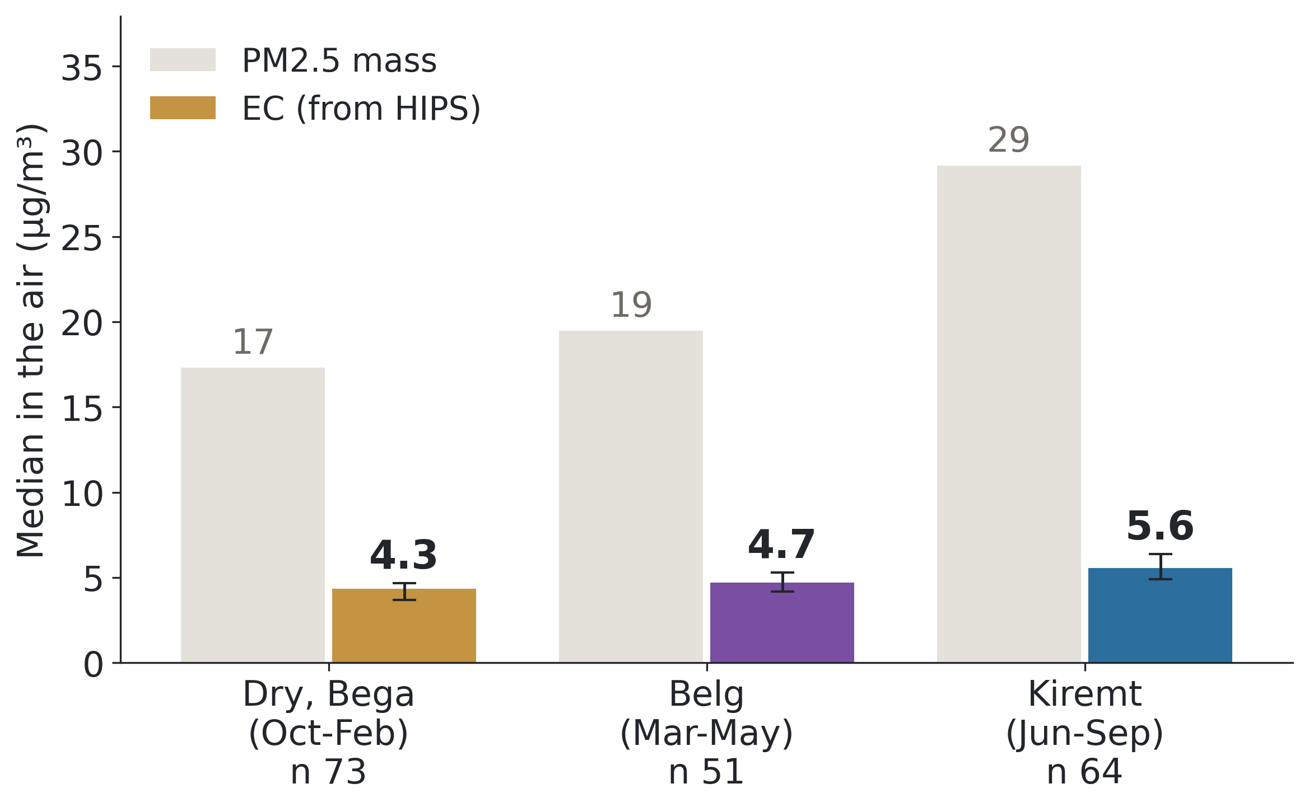
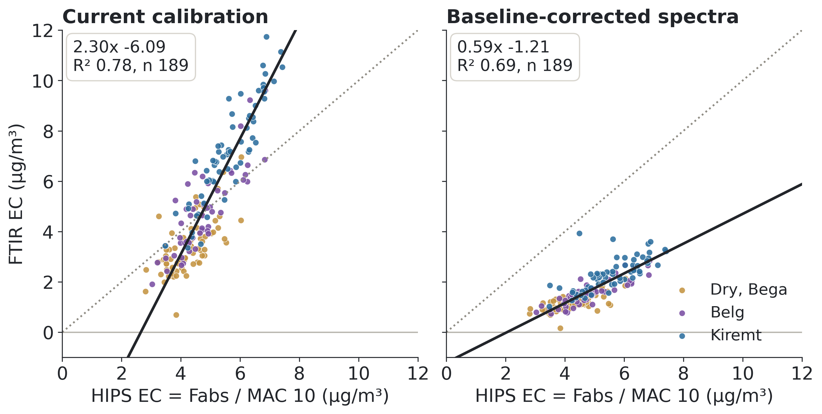
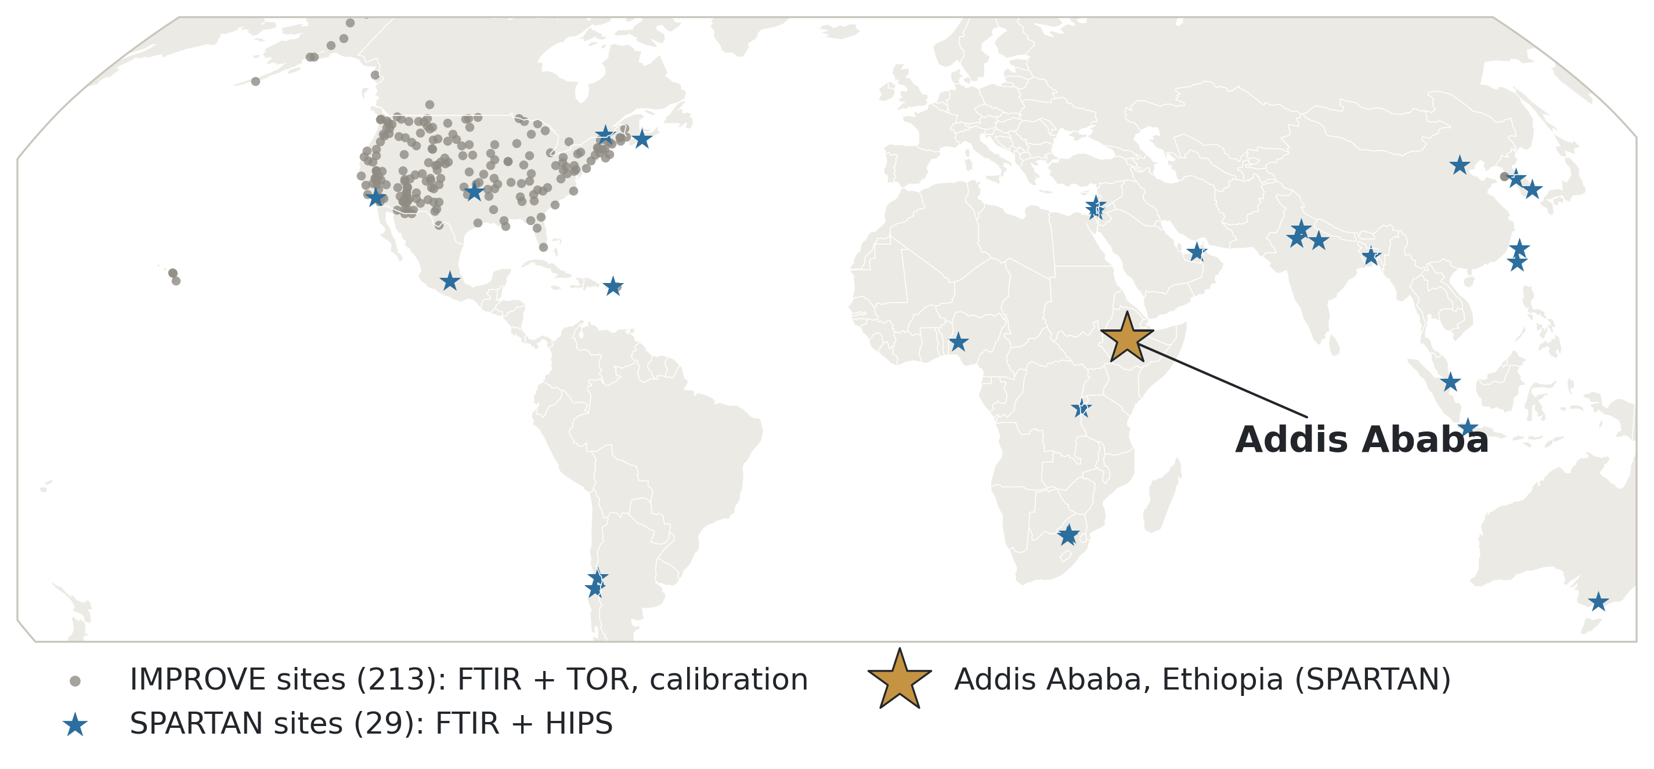
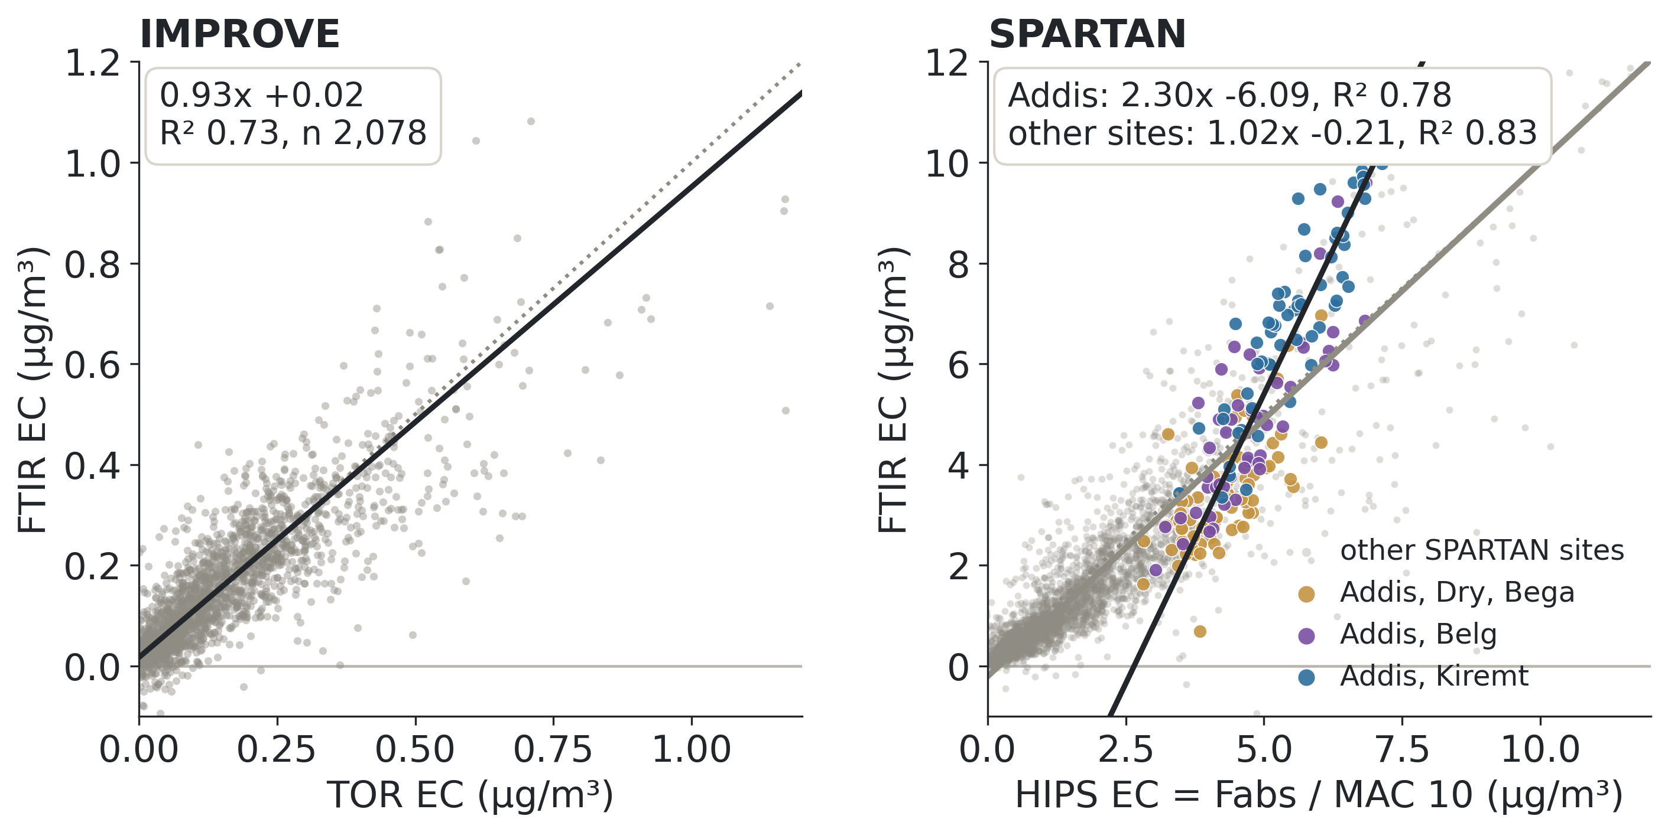
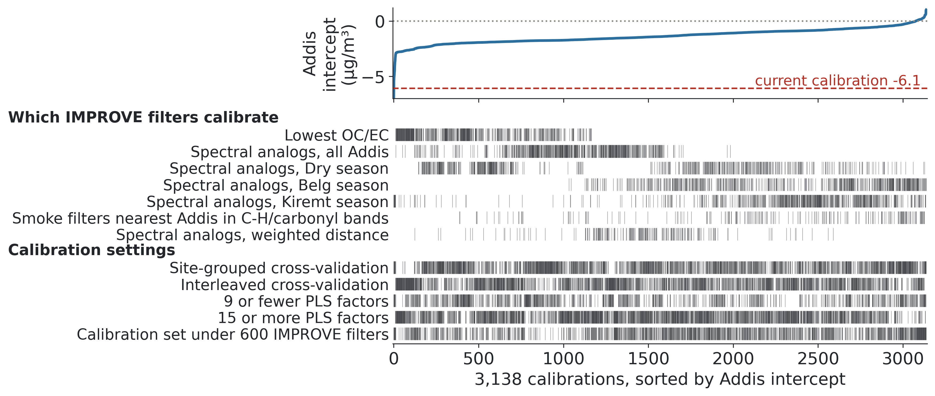
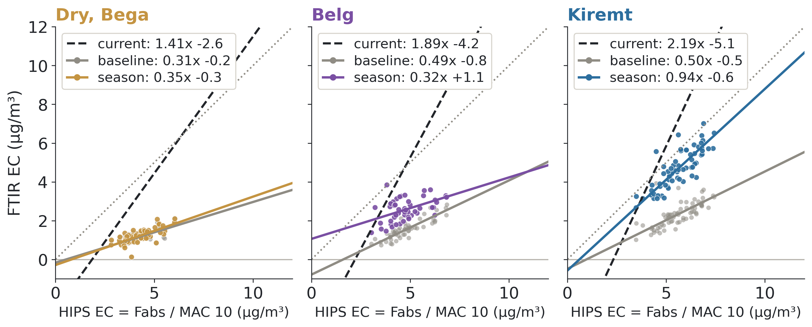
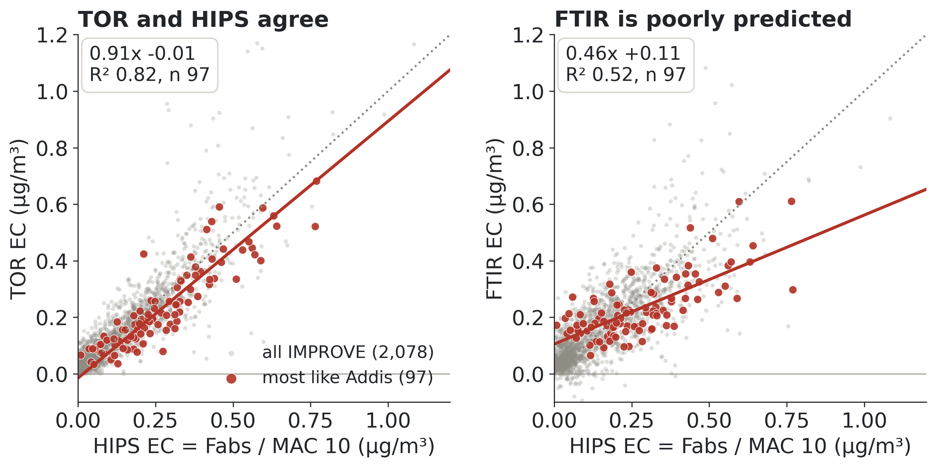
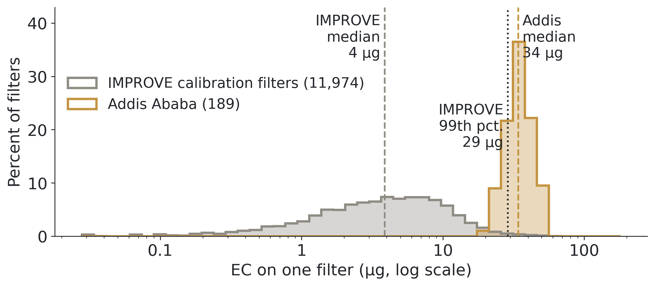
Challenges of using rural U.S. IMPROVE FTIR elemental carbon (EC) measurements to calibrate FTIR EC in Addis Ababa, Ethiopia
Ahmad Jalil¹˒⁴, Sina Hasheminassab², Kyan Shlipak⁵˒², Tesfaye Mamo Mekonnen³, Araya Asfaw³, Hossein Kazemian¹, Ann M. Dillner⁴
¹ MATTER lab, University of Northern British Columbia, Prince George, BC, Canada · ² NASA Jet Propulsion Laboratory, Pasadena, CA, USA · ³ Addis Ababa University, Addis Ababa, Ethiopia · ⁴ Air Quality Research Center, University of California Davis, Davis, CA, USA · ⁵ Northwestern University, Evanston, IL, USA
Why elemental carbon in Addis Ababa?
Addis Ababa EC is high, and so is its share of PM2.5
Toward a better calibration (work in progress)
Elemental carbon (EC) is the black, soot-like carbon from burning. It warms the climate and harms health.
SPARTAN (Surface PARTiculate mAtter Network, www.spartan-network.org, Fig 1) samples particles onto filters in cities around the world, mostly in the Global South. It measures EC by FTIR (below).
FTIR EC compares well to absorption measurements (Fabs) at most SPARTAN sites, but not in Addis Ababa.
Addis Ababa, capital of Ethiopia (about 2,400 m elevation, about 5 million people), has some of the highest EC in SPARTAN. Households cook and heat with wood and charcoal.
We use 189 Addis filters (Dec 2022 to Sep 2024) across three seasons: Dry (Bega, Oct to Feb), Belg short rains (Mar to May) and Kiremt long rains (Jun to Sep).
Step 1. Baseline correction of the spectra, the biggest gain so far.
Figure 3. Addis medians by season (bars on EC: interquartile range). EC is 4.3 to 5.6 µg/m³ and 19 to 25% of PM2.5 in every season, against about 4% for a typical IMPROVE filter.
The problem: FTIR EC is poorly predicted but well correlated
Figure 7. Same Addis filters, same axes as Figure 4. Correcting the baseline moves the intercept from -6.1 to -1.2 µg/m³, but the slope drops to 0.59.
Step 2. Test thousands of calibrations with an interactive app we built, changing which IMPROVE filters are in the calibration set and how it is built.
Figure 1. Where the filters come from. Grey: IMPROVE sites (US), which provide the calibration. Blue stars: SPARTAN sites, where the calibration is applied.
How FTIR measures EC: a calibration
FTIR (Fourier-transform infrared spectroscopy) passes infrared light through a Teflon filter and records absorption across the wavenumbers. That curve is the filter's spectrum. FTIR is fast, cheap and does not destroy the filter, but a spectrum does not give EC directly: it has to be calibrated against a reference.
Most methods are calibrated with laboratory standards. FTIR EC is calibrated with ambient samples (Dillner and Takahama, 2015): IMPROVE filters on which the same air was collected on a Teflon filter (FTIR spectrum) and on a quartz filter (EC measured by TOR, the reference method) (Figs 1 and 2).
Figure 4. Each point is one filter; dotted line: 1:1. IMPROVE: 2,078 filters, FTIR against TOR EC: slope near 1, intercept near 0. SPARTAN: FTIR against HIPS EC. The other SPARTAN sites together are predicted reasonably (grey data points and grey line); Addis alone is well correlated with the wrong slope and intercept (2.3x -6.1). Every season is off (slopes 1.4 to 2.2).
Figure 8. Each column is one calibration (3,138, all on baseline-corrected spectra), sorted by its Addis intercept (top). Tick marks show which choices it used. 254 put the intercept within ±0.5 µg/m³ of zero; 20 of those also have a slope between 0.8 and 1.25. Next: find out why those work, or whether it is chance.
IMPROVE spectra that look like Addis spectra fail too
Step 3. One calibration per season, built from the IMPROVE filters whose spectra most resemble that season's Addis spectra.
IMPROVE
ambient samples
(US national
parks, rural)
Teflon filter
→ FTIR spectrum
PLS calibration
learns which
spectral features
predict TOR EC
From the IMPROVE filters we picked the 97 whose spectra most resemble the Addis spectra. Many are smoke-affected.
Quartz filter
→ TOR EC
Applied to SPARTAN spectra (Addis Ababa): FTIR EC, QC checks against HIPS light absorption (Fig 4b; no TOR at Addis)
Figure 2. The calibration behind every SPARTAN FTIR EC value.
Figure 9. Dashed: current calibration; grey: baseline-corrected (Step 1); colour: season-specific. Kiremt improves (slope 0.50 to 0.94); Dry and Belg do not yet.
Why calibrate with IMPROVE filters? Because it is the only data set that exists: no other large library of matched Teflon (FTIR) and quartz (TOR) ambient filters exists, and there are no quartz filters from Addis Ababa. CSN (the US urban network) filters are bigger and thicker and sample at a lower flow, so FTIR calibrations built on CSN filters predict less well.
Conclusions and next steps
Figure 5. Grey: all IMPROVE filters; red: the 97 most like Addis. TOR and HIPS agree on them, but the same FTIR calibration predicts them poorly, at IMPROVE concentrations. Same calibration; only the samples changed.
FTIR EC calibrated on ambient IMPROVE filters predicts IMPROVE, and the SPARTAN network as a whole, reasonably, but not Addis Ababa.
Concentration is not the whole story: IMPROVE filters with Addis-like spectra are poorly predicted at IMPROVE concentrations. Addis burns different fuels (wood, charcoal) from rural US sites, so its EC may differ in composition.
Next: find out why the Dry and Belg seasons are poorly predicted (compare IMPROVE and Addis spectra by season); try choosing calibration filters by OC/EC ratio; check TOR on the heaviest smoke-affected IMPROVE filters; longer term, collect collocated Teflon and quartz filters in Addis Ababa, at least some to check calibrations.
Key terms
Addis filters carry far more EC than IMPROVE filters
IMPROVE: Interagency Monitoring of PROtected Visual Environments, the US network sampling in national parks and rural areas (vista.cira.colostate.edu/Improve).
TOR: thermal-optical reflectance. Heats a quartz filter and measures the carbon that evolves; the standard reference for EC.
HIPS: hybrid integrating plate/sphere. Measures how much red light (633 nm) a Teflon filter absorbs, called Fabs.
MAC: mass absorption cross-section, the light absorbed per gram of EC (m²/g). Fabs / MAC is a good estimate of EC. We use MAC = 10 m²/g, a common default; the true value varies with sources. Changing MAC changes the slope in Figure 4, not the intercept, so MAC alone cannot fix Addis' poor intercept.
Calibration set: the IMPROVE filters (with TOR EC) that a calibration is built from.
PLS: partial least squares regression, which turns a whole spectrum into one number (EC).
Baseline correction of the spectra: removing the smooth background from the Teflon filter and light scattering, so only particle absorption remains.
Deming regression: a straight-line fit that allows for error in both measurements. Agreement means slope 1, intercept 0.
References
Chow, J. C., et al. (2007). The IMPROVE_A temperature protocol for thermal/optical carbon analysis. J. Air Waste Manag. Assoc., 57, 1014-1023.
Dillner, A. M., & Takahama, S. (2015). Predicting ambient aerosol thermal-optical reflectance measurements from infrared spectra: elemental carbon. Atmos. Meas. Tech., 8, 4013-4023.
Kuzmiakova, A., Dillner, A. M., & Takahama, S. (2016). An automated baseline correction protocol for infrared spectra of atmospheric aerosols collected on polytetrafluoroethylene (Teflon) filters. Atmos. Meas. Tech., 9, 2615-2631.
Malm, W. C., et al. (1994). Spatial and seasonal trends in particle concentration and optical extinction in the United States. J. Geophys. Res., 99, 1347-1370.
Snider, G., et al. (2015). SPARTAN: a global network to evaluate and enhance satellite-based estimates of ground-level particulate matter for global health applications. Atmos. Meas. Tech., 8, 505-521.
White, W. H., et al. (2016). A critical review of filter transmittance measurements for aerosol light absorption, and de novo calibration for a decade of monitoring on PTFE membranes. Aerosol Sci. Technol., 50, 984-1002.
Data: SPARTAN public release v3.1.4 (www.spartan-network.org/data); IMPROVE data from the Federal Land Manager Environmental Database (FED, views.cira.colostate.edu/fed).
Figure 6. EC on one filter, from each filter's own volume of air (flow × sampling time). The typical Addis filter carries about 9× the EC of a typical IMPROVE calibration filter, and 79% are above the IMPROVE 99th percentile.
Acknowledgments: supported by the NASA MAIA mission. Thanks to the SPARTAN team and the UC Davis FTIR group.

