Slide 1
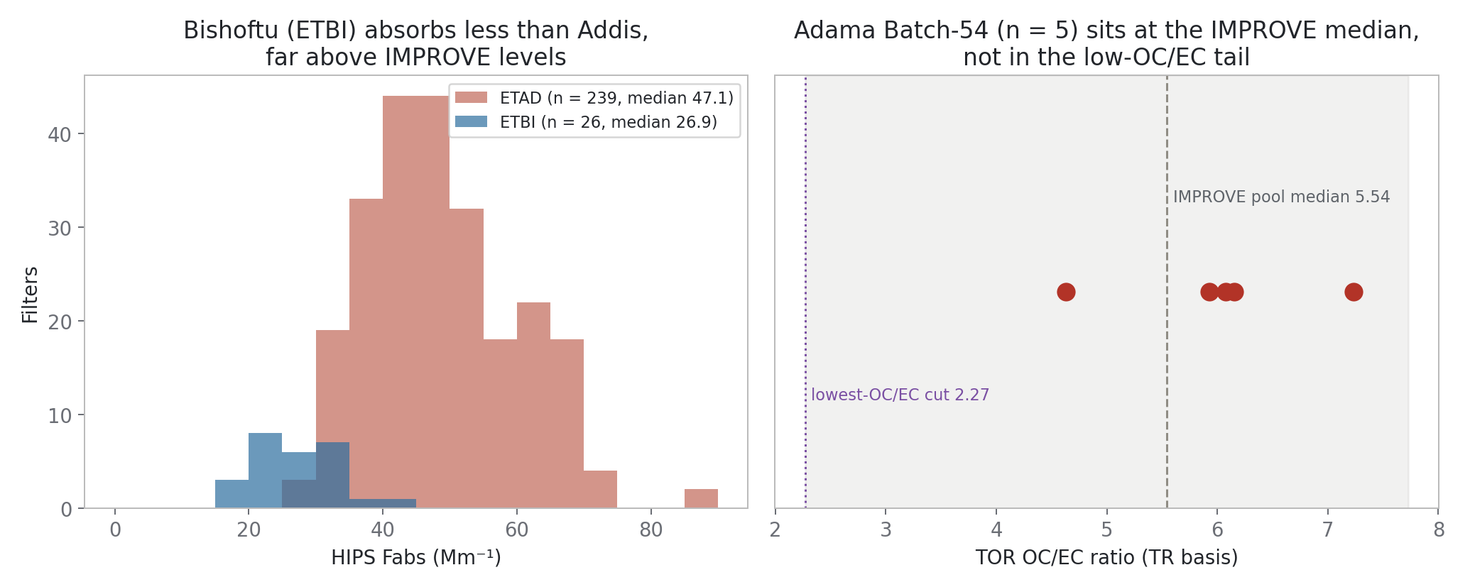
Adama is not Addis: OC/EC sits at the IMPROVE median, and regional absorption is half of Addis

Slide 2
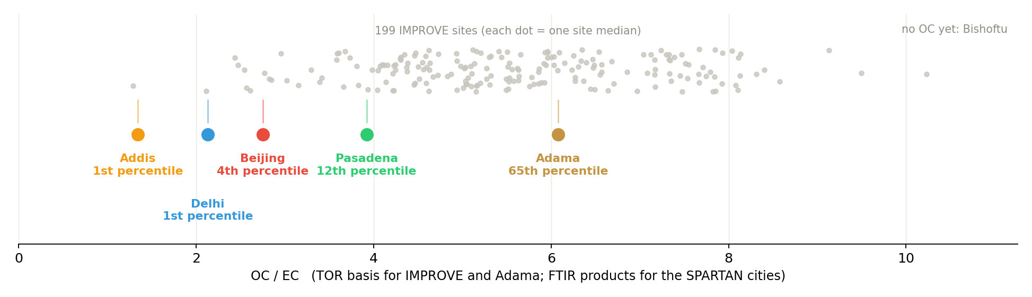
OC / EC across 199 IMPROVE sites: Addis is the lowest anywhere; Adama sits at the median

Slide 3
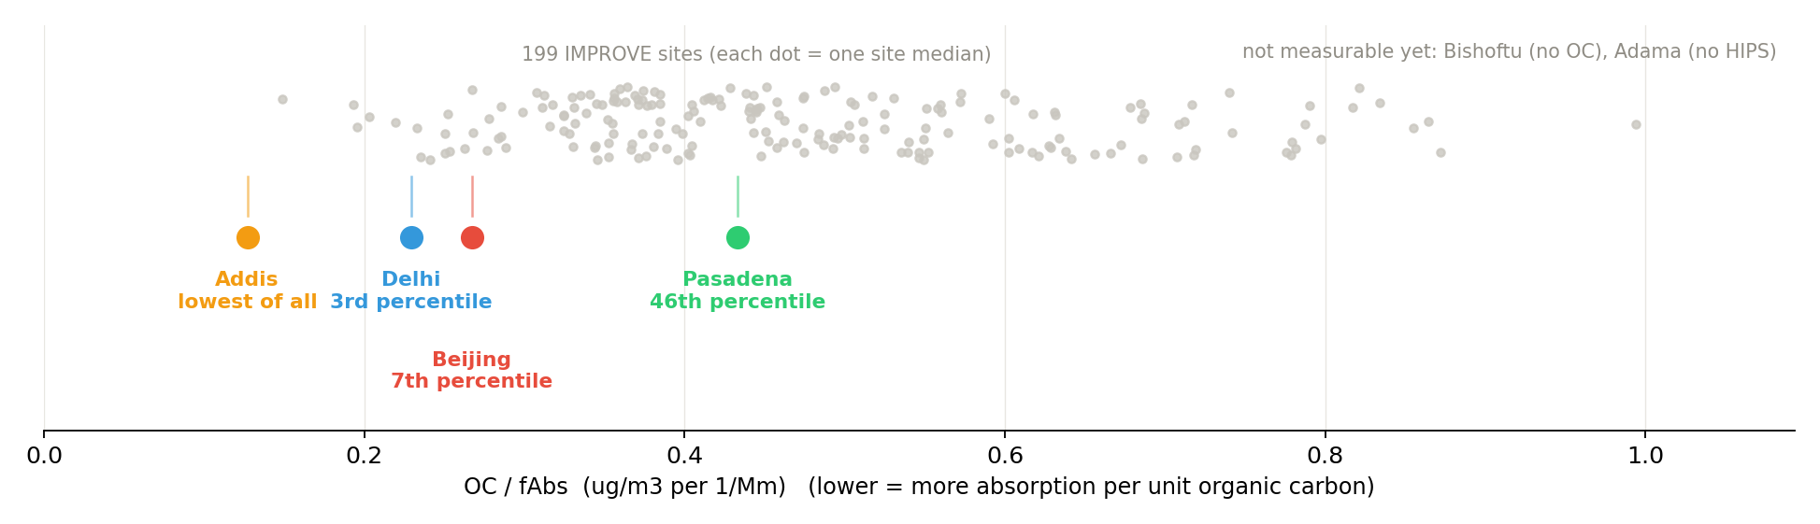
OC / fAbs: Addis has the least organic carbon per unit absorption of any site in either network

Slide 4
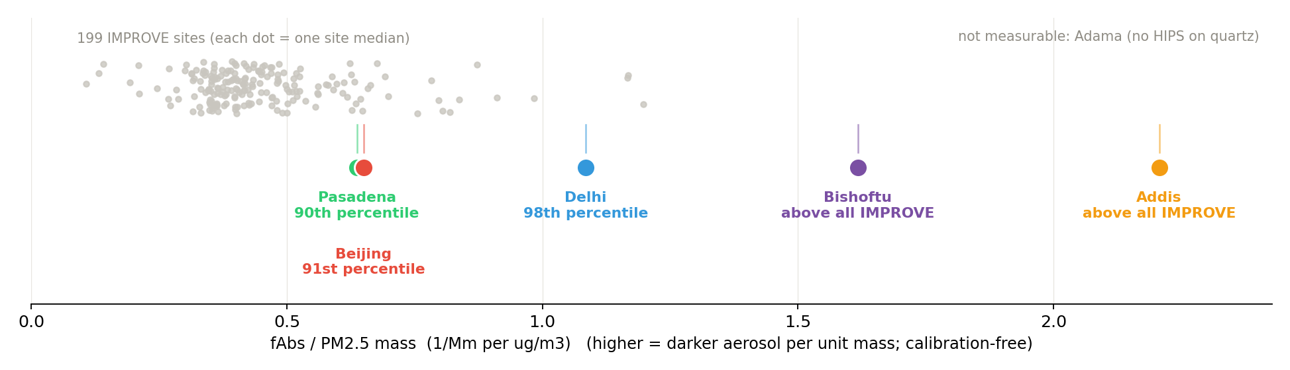
Absorption per unit mass: both Ethiopian sites exceed every IMPROVE site, yet only Addis has the offset

Slide 5
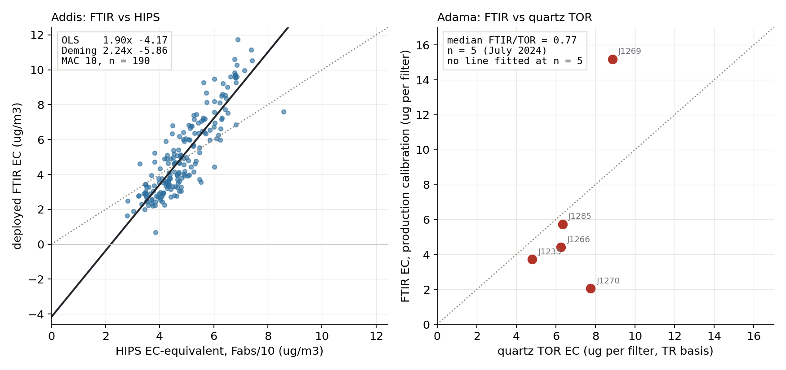
Side by side: the Addis crossplot is a systematic line; the Adama one scatters around 1:1

Slide 6
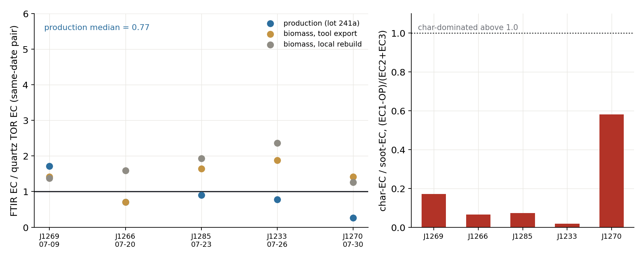
At Adama, FTIR EC agrees with quartz TOR; the Addis-style gap is absent

