Slide 1
Your lot hypothesis was right — and baselining already fixes it
Ann 1:1 — 25 Aug 2026 — the week of 19–25 August
Notes:
SAY: Roadmap. Slide 2 is your August list. Slide 3 is the week in order. Slide 4, the locked numbers still reproduce. Then the measurement block — the York re-fit and the five-site ladder under three blank lines. Then the HIPS decode, which is the big one: we took the instrument math apart and Pasadena's anomaly dissolved into it. Then your lot question, answered on slide 9 — you were right. Then the grid and the slope trap, the AERONET witness, the filters we recovered, what the app bought us, what didn't survive, and Adama. Backup block at the end has six more.
NOTES: This is the Ann 1:1, distinct from the 27 Aug FTIR-group deck (deliverables/ann_update_2026-08-25/). Shared figures, different framing: this one follows her August asks and the week's arc.

Slide 2
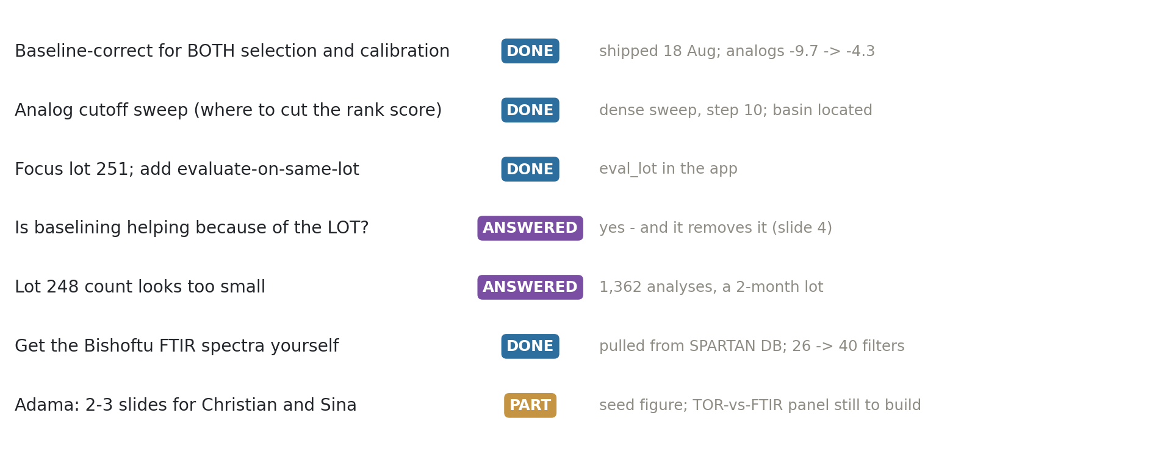
Every item from 12 August is closed or answered — except Adama
Notes:
SAY: Top to bottom: baseline both selection and calibration, shipped on the 18th. Cutoff sweep done. Evaluate-on-same-lot is in the app. Your two questions — is baselining helping because of the lot, and why does 248 look so small — both answered later in the deck. Bishoftu spectra pulled. Adama is the one still open.
NOTES: 'ANSWERED' is used where you asked a question rather than assigned a task. Adama is PART: the seed figure exists but the TOR-vs-FTIR OC/EC comparison you named is not built.

Slide 3
The week in order
19–20 Aug — your meeting actions became app features; server-side batches; the dense cutoff sweep found an ocec 440–490 × AIRSpec basin beating the locked 800.
22 Aug — direct SQL to the SPARTAN database; spectra for Bishoftu, Beijing, Delhi, Pasadena. The pre-registered Bishoftu test: the offset largely vanishes.
23 Aug — adjudication. York re-fit with real HIPS uncertainties; the HIPS math decoded from the batch export; the 1617-band story corrected twice; the 9,555-job grid.
24–25 Aug — validation layer (winner takes only 62.5% of bootstraps); LOCAL per-filter calibration; the lot question answered.
Notes:
SAY: One slide of context before the results. The shape of the week: it went from a one-city mystery to a five-city, multi-instrument adjudication. The turning point was the 22nd, when SQL access let me pull four more sites' spectra myself — which is the thing you told me to do. Everything after that is comparative.
NOTES: Three concurrent Claude sessions worked the repo this week, which is why some findings were produced in parallel and had to be reconciled (OFFSET_ADJUDICATION_2026-08-23.md exists because three docs reached different conclusions within 24 hours).

Slide 4
Before anything new: the locked numbers still reproduce
Lowest-OC/EC 800, Option A, raw → k = 6, OLS 1.5854x − 3.2215, held-out TOR R² 0.9107
Lowest-OC/EC 800, Option A, +AIRSpec → k = 5, OLS 0.857x − 1.615, Deming 0.9539x − 2.089
Option A = site-grouped 5-fold CV, first major minimum, site-disjoint 80/20 fit
Every number in this deck was pulled from the explorer today.
Notes:
SAY: Both locked anchors reproduce exactly against the live app, so everything after this is on the same footing as August. Option A is the site-grouped protocol — the only one that gives a held-out TOR test, so I quote that R² wherever I use it.
NOTES: Deming is primary for the intercept (lambda* = 2.96 at MAC 10, scaled by MAC^2); OLS alongside. The Deming intercept is MAC-invariant. Anchors validated before any figure in this deck was generated — and that validation caught a real error, slide 18.

Slide 5
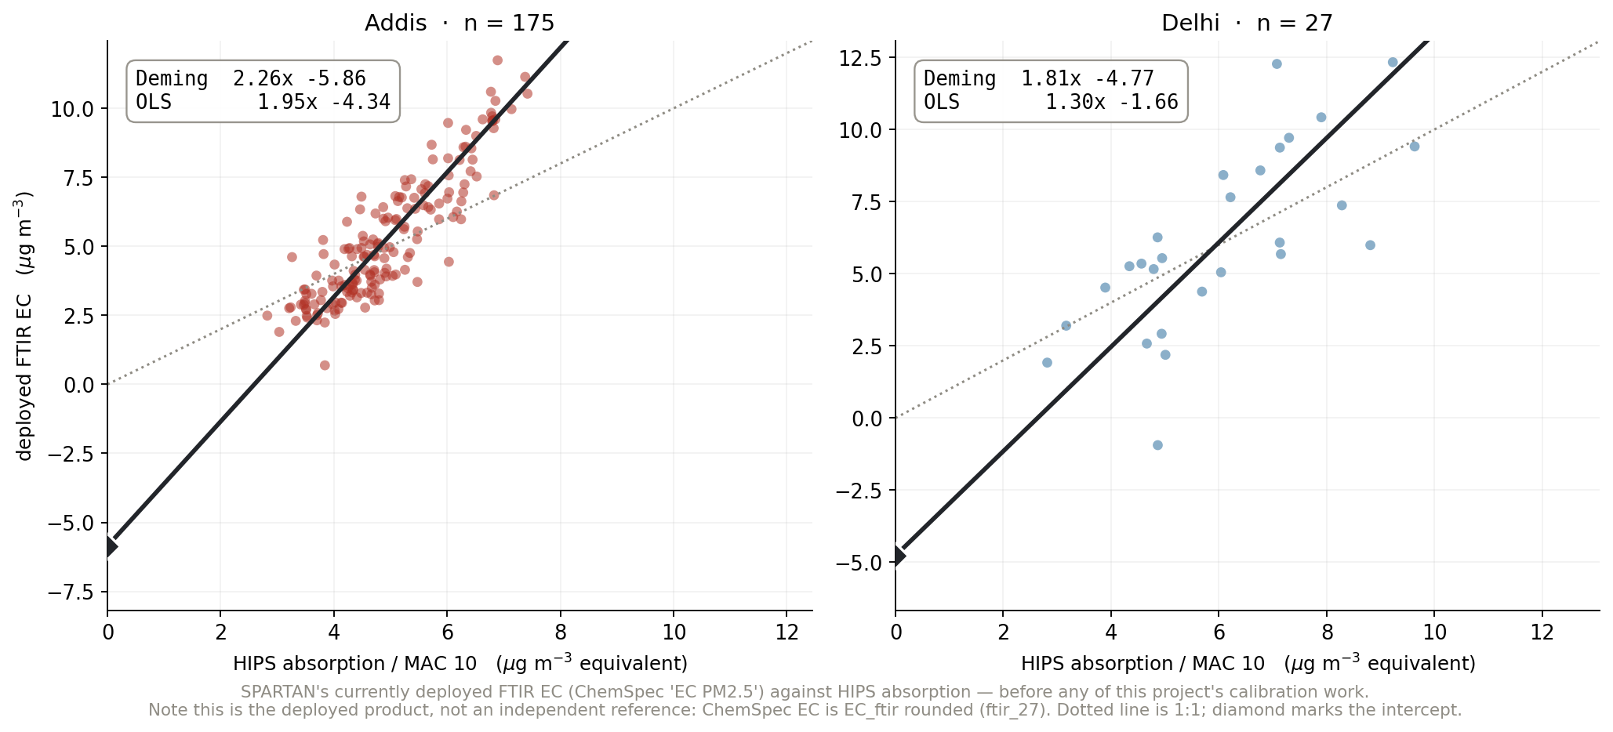
Where we started: what the network ships today
Notes:
SAY: One slide of before, so the rest has a baseline. This is SPARTAN's currently deployed FTIR EC plotted against HIPS absorption — no work of ours in it. Addis: slope 2.26 and an intercept of minus 5.9 micrograms. Delhi: 1.81 and minus 4.8. Both sit well off the one-to-one line, and both have large negative intercepts. For scale, the corrected calibration we will get to brings the Addis intercept from minus 5.9 to about minus 1.4 — roughly a four-fold reduction. So the offset we are chasing is what is left after the calibration work, not the whole gap.
NOTES: ChemSpec 'EC PM2.5' IS the deployed EC_ftir (ftir_27 showed ChemSpec_EC = round(EC_ftir, 2) at r2 = 0.9997), so this is the deployed product, NOT an independent reference. That is the right thing to plot here — the question is what the network currently produces. Addis n = 175, Delhi n = 27 (Delhi's ChemSpec coverage is thin). Deming lambda* = 2.96 at MAC 10; OLS shown alongside and is markedly flatter, which is the estimator point again. Do not read Delhi's -4.77 as comparable to the York table's Delhi number — different estimator, different n, deployed vs our calibration.

Slide 6
The measurement
Notes:
SAY: Divider: The measurement.
NOTES: Section break.

Slide 7
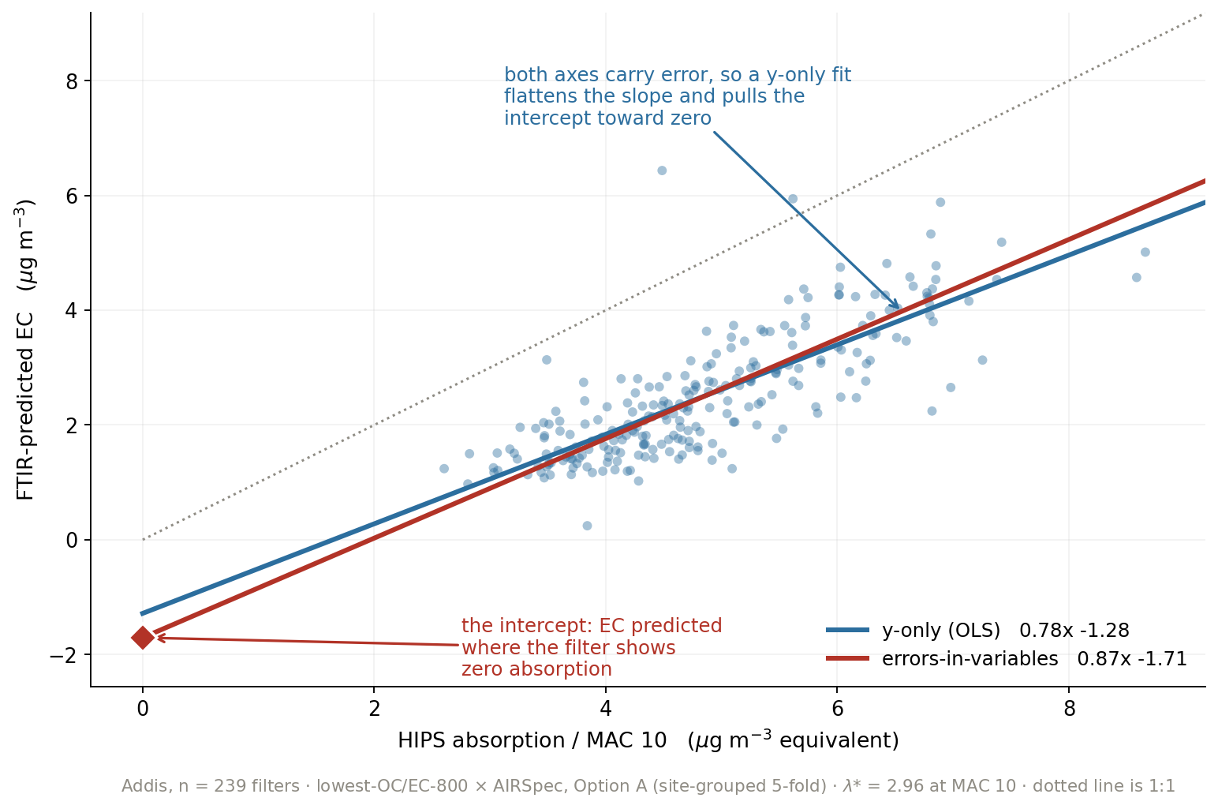
Why the estimator matters: a y-only fit hides part of the intercept
Notes:
SAY: Before the result, one slide on how it's fitted, because the choice moves the number. Blue is an ordinary fit that assumes the x-axis is exact. But the x-axis is HIPS absorption, which carries its own measurement error — so a y-only fit flattens the slope and drags the intercept toward zero. Red treats both axes as uncertain. On the same filters the intercept goes from minus 1.28 to minus 1.71. The red diamond on the left is the quantity we care about: the EC the model predicts where the filter shows no absorption at all.
NOTES: Addis, n = 239, lowest-OC/EC-800 x AIRSpec, Option A. lambda* = 2.96 at MAC 10. This is why the deck quotes Deming/York rather than OLS for the intercept — OLS understates it. Both are shown on every crossplot elsewhere. The full weighted treatment (York with per-filter HIPS uncertainties) is the next slide; this one is the intuition.

Slide 8
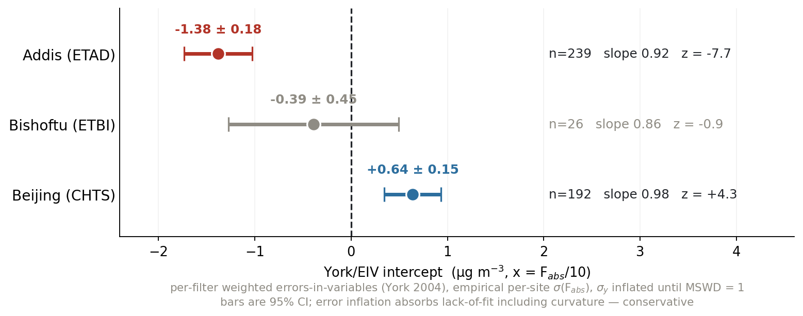
Weighted per-filter fitting leaves Addis as the only certain intercept
Notes:
SAY: This replaces the Deming table I showed you before. Per-filter weighted errors-in-variables, using each site's real HIPS uncertainties, with the errors inflated until the fit is consistent — so any lack of fit, including curvature, is absorbed into the bars rather than into the intercept. Addis sits at minus 1.38 with a z of nearly eight. Bishoftu, same country, same instrument, same lot, is indistinguishable from zero. Beijing is positive.
NOTES: York (2004) per-filter weighting; empirical per-site sigma(Fabs) from unified_filter_dataset; sigma_y inflated until MSWD = 1 — conservative, because it hands curvature to the error bars. Bars are 95% CI. This supersedes the pooled-lambda Deming table. Beijing was never anomalous: its unweighted slope of 1.48 was leverage from a few points and falls to 0.98 under weighting.

Slide 9
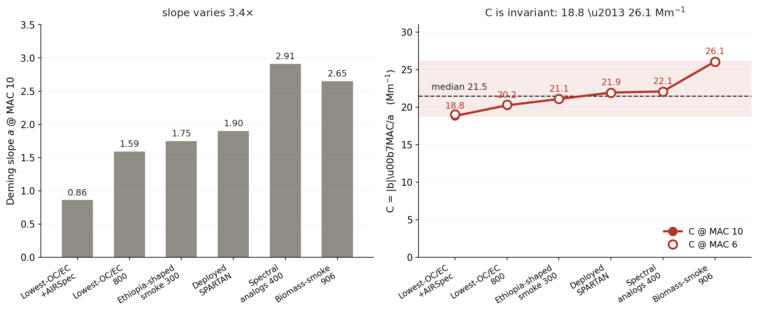
The offset is a property of the data, not of the MAC we assume
Notes:
SAY: A fair objection is that the intercept just reflects the mass absorption cross-section we picked. It doesn't. The quantity on the right — intercept times MAC over slope — is algebraically invariant to MAC, and empirically it barely moves: 18.8 to 26.1 across six setups whose slopes span a factor of three and a half. Median 21.5 inverse megametres, about 46 percent of the median Addis absorption.
NOTES: ftir_25_intercept_invariant.md — pure algebra on committed constants, hence markdown not a notebook. Open circles are MAC 6, filled are MAC 10; they coincide by construction. This is why the offset survives every reframing: it isn't a modelling artifact.

Slide 10
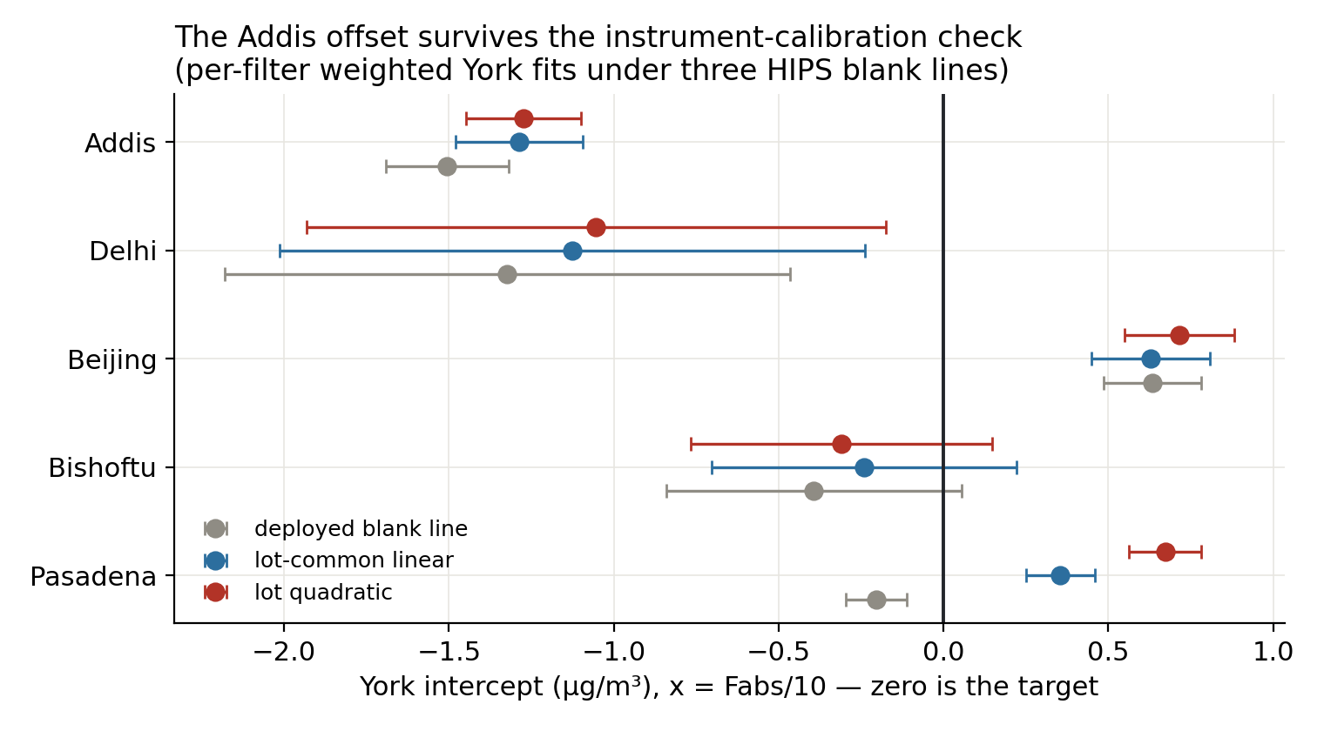
Addis holds its intercept under every HIPS blank-line variant
Notes:
SAY: We recomputed every filter's absorption under three different forms of the HIPS calibration line — the deployed one, a lot-common linear one, and a quadratic. Addis holds between minus 1.3 and minus 1.5 under all three. Delhi's bar reaches zero, so Delhi's intercept is uncertain. The others bracket them.
NOTES: The three variants are re-derivations of tau from raw T1/R1 with different blank-line fits, not re-weightings of the same Fabs. Harshest variant for Addis is -1.27 ± 0.17, z ~ -7. This is the figure that moved the story from 'Addis and Delhi' to 'Addis certain, Delhi uncertain'.

Slide 11
The HIPS calibration, decoded
what the instrument is actually doing
Notes:
SAY: Divider: The HIPS calibration, decoded.
NOTES: what the instrument is actually doing

Slide 12
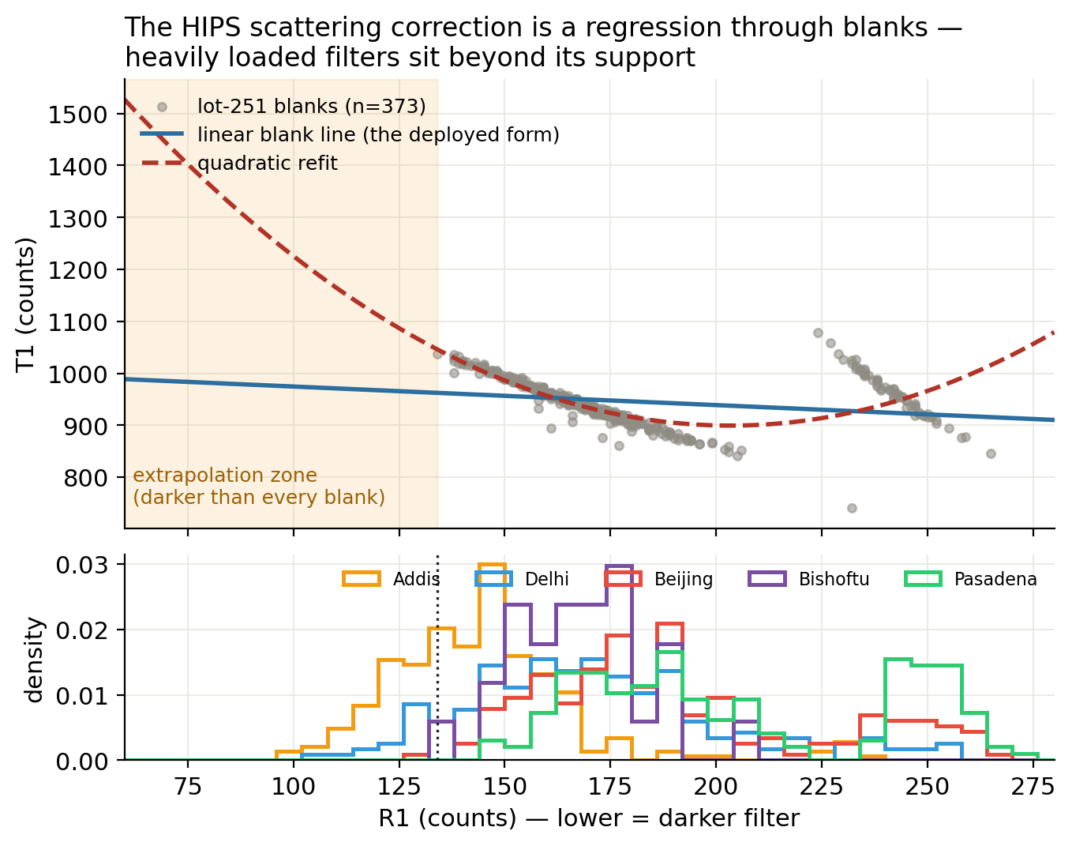
The scattering correction is a regression through field blanks — and 36% of Addis sits past its end
Notes:
SAY: This is the piece I didn't understand before this week. The HIPS scattering correction isn't a physical model — it's a straight line fitted through the field blanks of that filter lot. Tau is the log ratio of that line's prediction to the measured transmittance. The shaded region is where a filter is darker than every blank that defines its own calibration. Thirty-six percent of Addis filters live there, so their absorption rests on an extrapolated line.
NOTES: tau = ln((Intercept + Slope*R1)/T1), decoded from the SPARTAN batch export and confirmed against the database: the formula reproduces shipped tau for 100% of filters to within 1e-4. The PTFE zero itself is clean: +0.32 ± 0.46 Mm-1 from 575 blanks, so the extrapolation is the issue, not the origin.

Slide 13
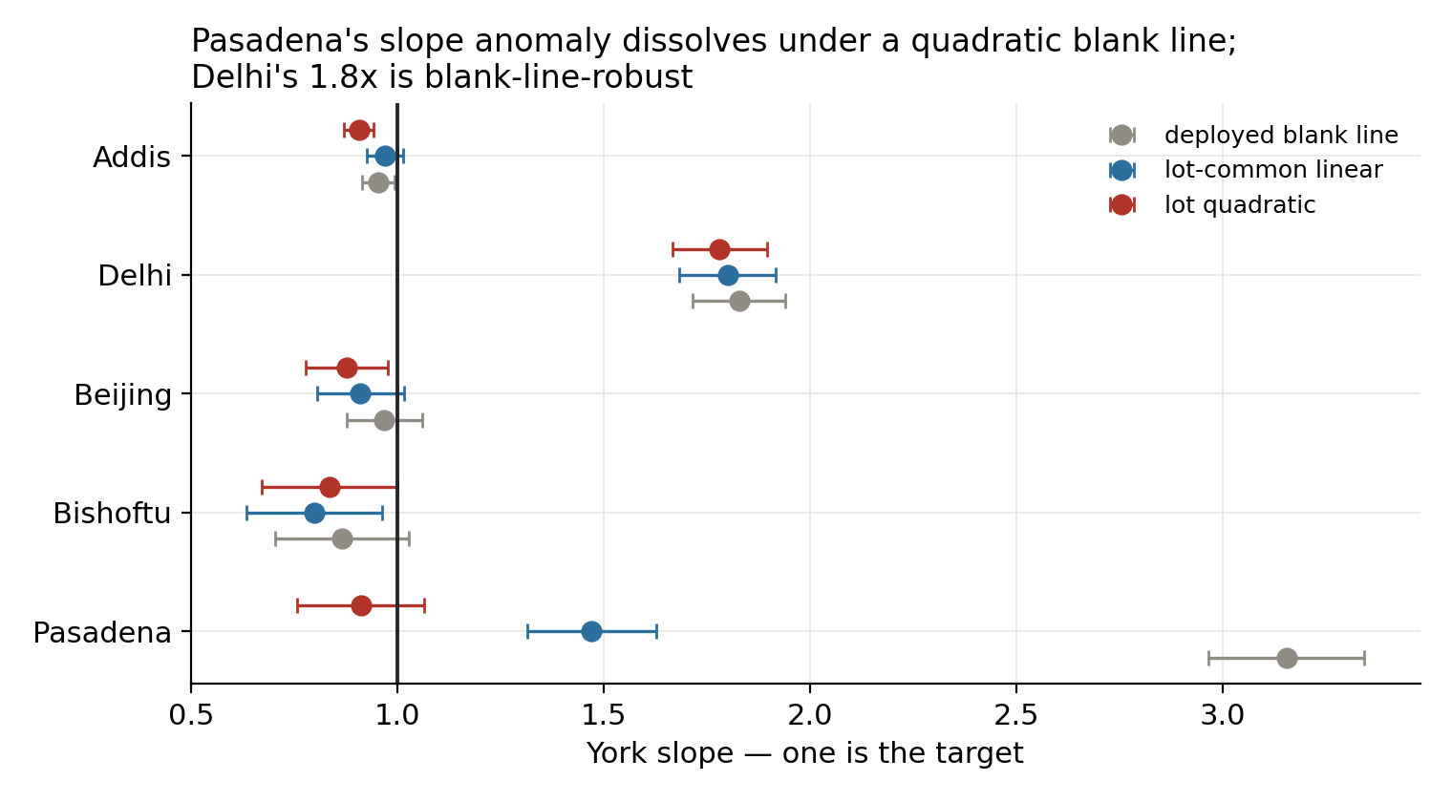
Pasadena's anomaly was the blank line; Delhi's slope is real
Notes:
SAY: And this is what that bought us. Pasadena looked wildly wrong — slope 3.15. Recompute it under a lot-common line and it falls to 1.47; under a quadratic, 0.91. Its anomaly was blank-line shape error at very low loading, not aerosol. Delhi's 1.8 barely moves across all three, so Delhi's slope is a real, unexplained result.
NOTES: Pasadena has sub-detection filters with up to 442% relative uncertainty — exactly where a mis-shaped blank line does the most damage. Delhi's stability across variants is what promoted it from 'probably the same story as Addis' to its own open question. Candidate explanations for Delhi: low true MAC, or FTIR organic interference — the four-site MA350 anchor would split them.

Slide 14
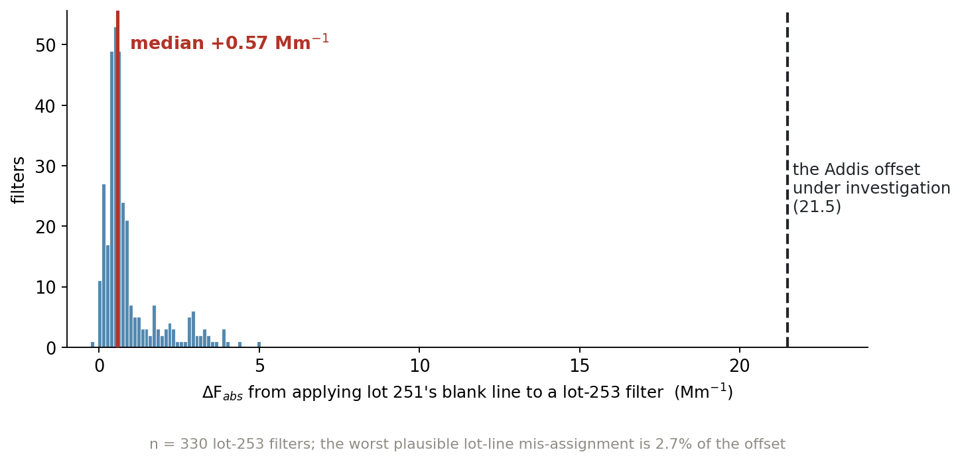
Mis-assigning a lot's blank line costs 2.6% of the offset
Notes:
SAY: The natural follow-up: if the blank line is lot-specific, how much damage does using the wrong lot's line do? I applied lot 251's line to every lot-253 filter. Median shift is 0.57 inverse megametres — the dashed line on the right is the offset we're chasing. It's about two and a half percent of it. So lot-line bookkeeping is a nuisance, not the explanation.
NOTES: n = 330 lot-253 filters. Blank lines by lot: 248 (1383.2, -2.544), 251 (1416.2, -2.783), 253 (1375.1, -2.608). Lot 253's line is built from 33 lab blanks vs lot 248's 10, so it is the better-determined one — I initially guessed the opposite and the database corrected me.

Slide 15
Your lot question
answered
Notes:
SAY: Divider: Your lot question.
NOTES: answered

Slide 16
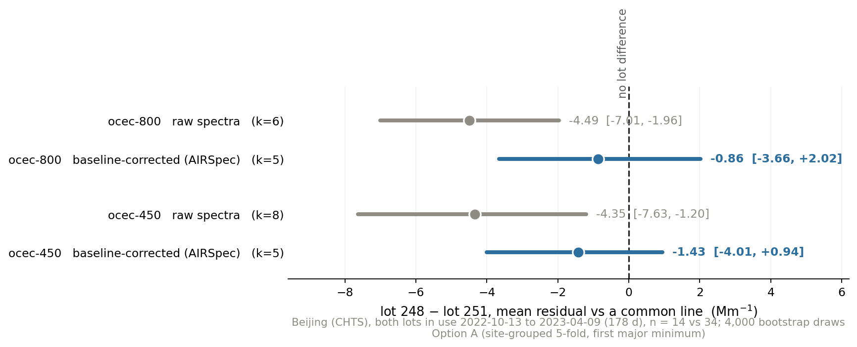
Baseline correction removes the lot-to-lot difference — the mechanism you predicted
Notes:
SAY: In August you said baselining might be helping because it minimises the difference between lot 248 and lot 251. This is that, measured. Beijing, because it's the one site that ran both lots at the same time — 178 days of overlap, so season and period are held fixed. Grey is raw spectra: the lots differ by about four and a half and the interval never touches zero, at either cohort size. Blue is the same comparison on baseline-corrected spectra: it collapses to about one and straddles zero. Baselining isn't just removing Teflon background in general — it's specifically absorbing the between-lot substrate difference.
NOTES: ocec-450 raw -4.35 [-7.63,-1.20], AIRSpec -1.43 [-4.01,+0.94]; ocec-800 raw -4.49 [-7.01,-1.96], AIRSpec -0.86 [-3.66,+2.02]. At MAC 10 that is -0.45 vs -0.09 ug/m3. Bootstrapped mean residual vs a common line, 4,000 draws — does not depend on a per-lot slope from small n. CAVEATS: n = 14 vs 34; within-window dates not matched further; loading differs slightly (median predicted EC 1.18 vs 1.66 at ocec-800 AIRSpec). It does NOT explain the Addis offset: ETBI is 100% lot 251 and ETAD 80%, so Addis-vs-Bishoftu is a within-lot-251 contrast, and the residual lot term after baselining is ~5% of 21.5 Mm-1.

Slide 17
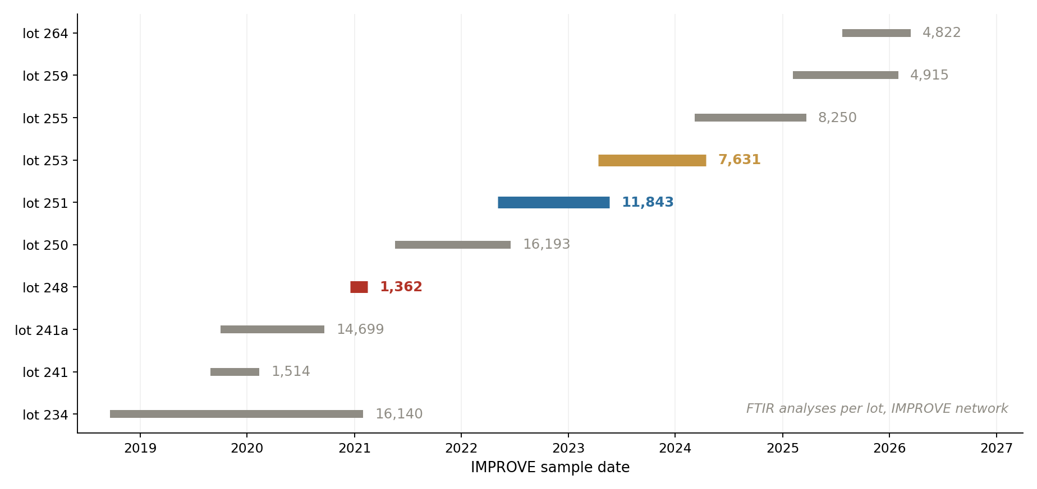
Lot 248 isn't a partial download — it's a two-month lot
Notes:
SAY: You flagged that my 248 pool looked too small — about 1,300 when 251 had eleven thousand. It's not a bad pull. Lot 248 ran for two months, mid-December 2020 to mid-February 2021, and produced 1,362 analyses network-wide. My 1,299 was essentially the whole lot. 251 ran a full year.
NOTES: IMPROVE ftir_catalog: 169,566 analyses, 182 sites. Bar labels are analysis counts. This also reframes the lot picture: IMPROVE runs roughly two years ahead of SPARTAN on the same lot numbering, so IMPROVE already holds the lots SPARTAN will use next.

Slide 18
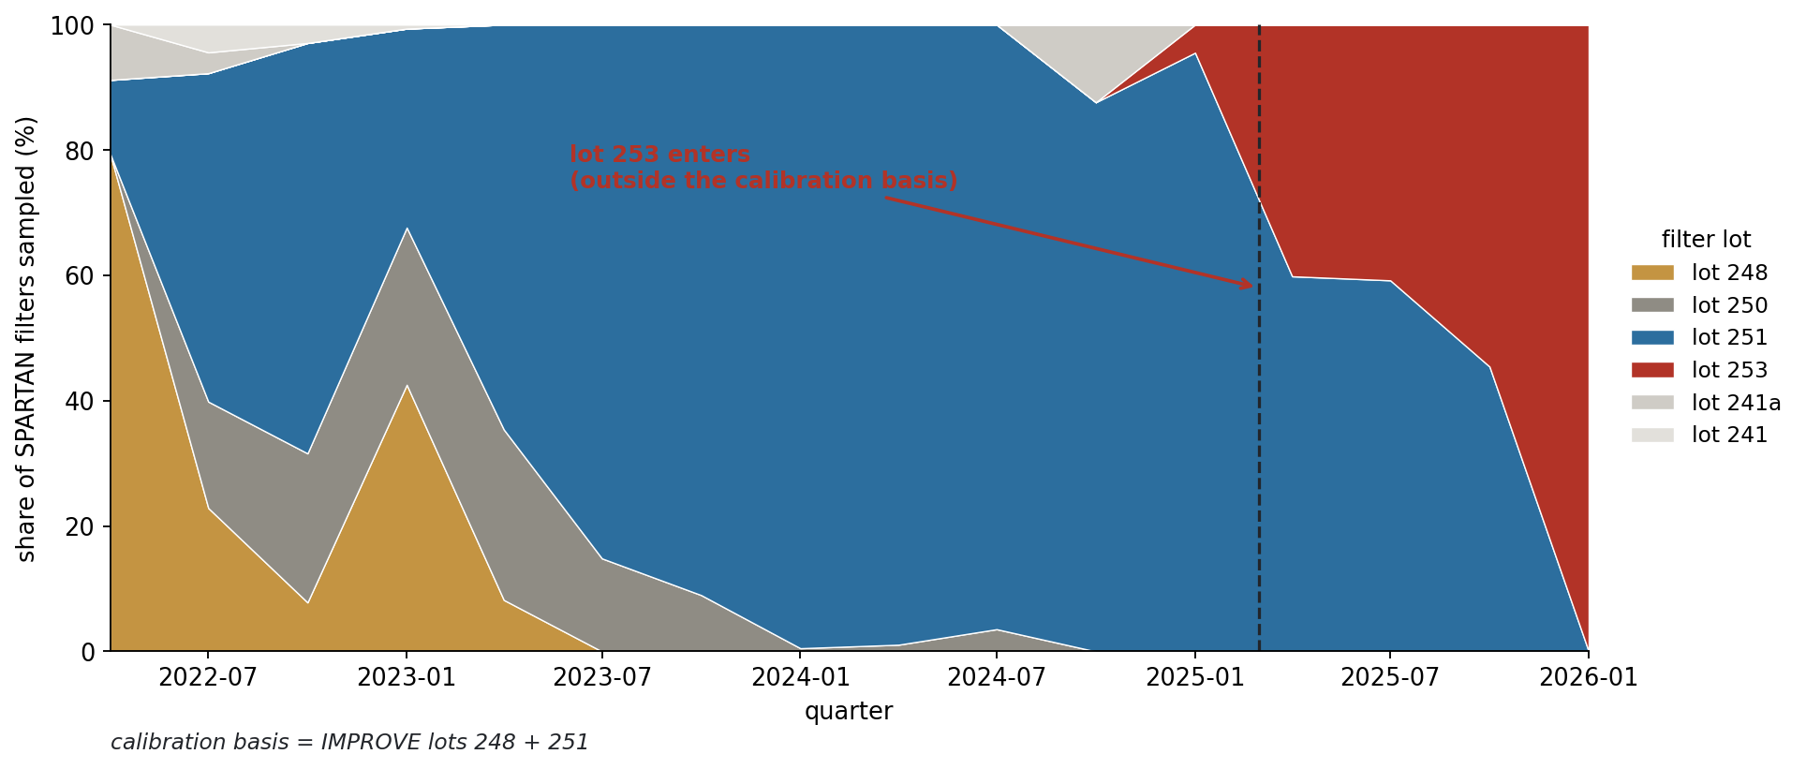
The lot that matters now is 253 — and the calibration has never seen it
Notes:
SAY: The forward-looking version of your lot question. Lot 253 entered SPARTAN in March 2025 and is now 58 percent of everything sampled since September, including the newest Addis filters. Our basis is IMPROVE lots 248 and 251 only. The good news: IMPROVE has already been through 253 — five thousand filters with matched TOR EC, and the pull manifest is written.
NOTES: 433 lot-253 SPARTAN filters, 13 sites; 340 carry a SampleDate and the stackplot uses that subset. IMPROVE lot 253: 7,631 analyses, 5,050 with matched TOR EC, 83 sites, 2023-04 to 2024-04. Lot 255 deliberately sealed for replication. The obvious Delhi lot-253 test is NOT identifiable: 4x more loaded, seasonally disjoint, 6 filters in the overlap, CI [-53, +304].

Slide 19
The exhaustive search
Notes:
SAY: Divider: The exhaustive search.
NOTES: Section break.

Slide 20
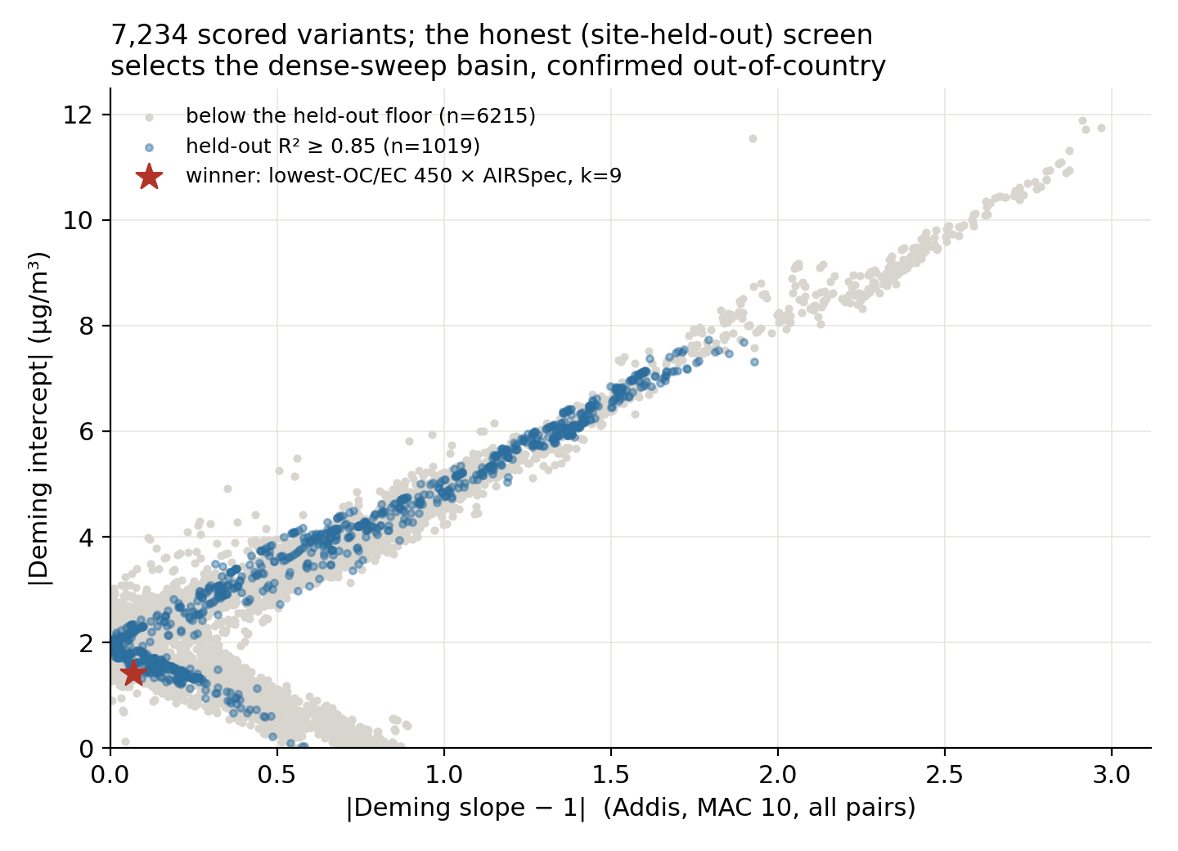
The Addis basin held when the search got 4–7× wider and ~28× denser
Notes:
SAY: Every Addis variant we can identify, scored the same way. One dot per configuration: cohort size across, the Addis intercept up. Grey fails the held-out floor, blue passes it, and the star is the winner. The point is the shape — there is a basin, and it stayed put when we widened the cutoff ranges four to seven times and sampled them roughly twenty-eight times more finely. Nine and a half thousand jobs, seventy-one thousand scored rows, zero errors. So the Addis answer is not sitting on a knife edge of cohort size; it is a broad, stable region.
NOTES: 7,234 honest-protocol (Option A) variants at Addis shown. Search widened from the original ladders — eth_shaped 200-400, analogs 400-600, ocec 600-1000, five cutoffs each — to eth_shaped 100-900, analogs 100-1500, ocec 100-2000 in steps of 10, so 15 cutoff values became 413. IMPORTANT CAVEAT to state if asked: these screening numbers are DESCRIPTIVE only. Every configuration here was scored on filters that informed the selection, so the cloud shows structure, not skill. Anything quoted as a result comes from the held-out TOR test or an out-of-country site. The methods lesson lives on its own slide later: |intercept| + w|slope-1| is gamed by flat slopes, so every ranking is slope-boxed to 0.85-1.18. The two-city question is the NEXT slide — this figure is Addis only and cannot speak to Delhi.

Slide 21
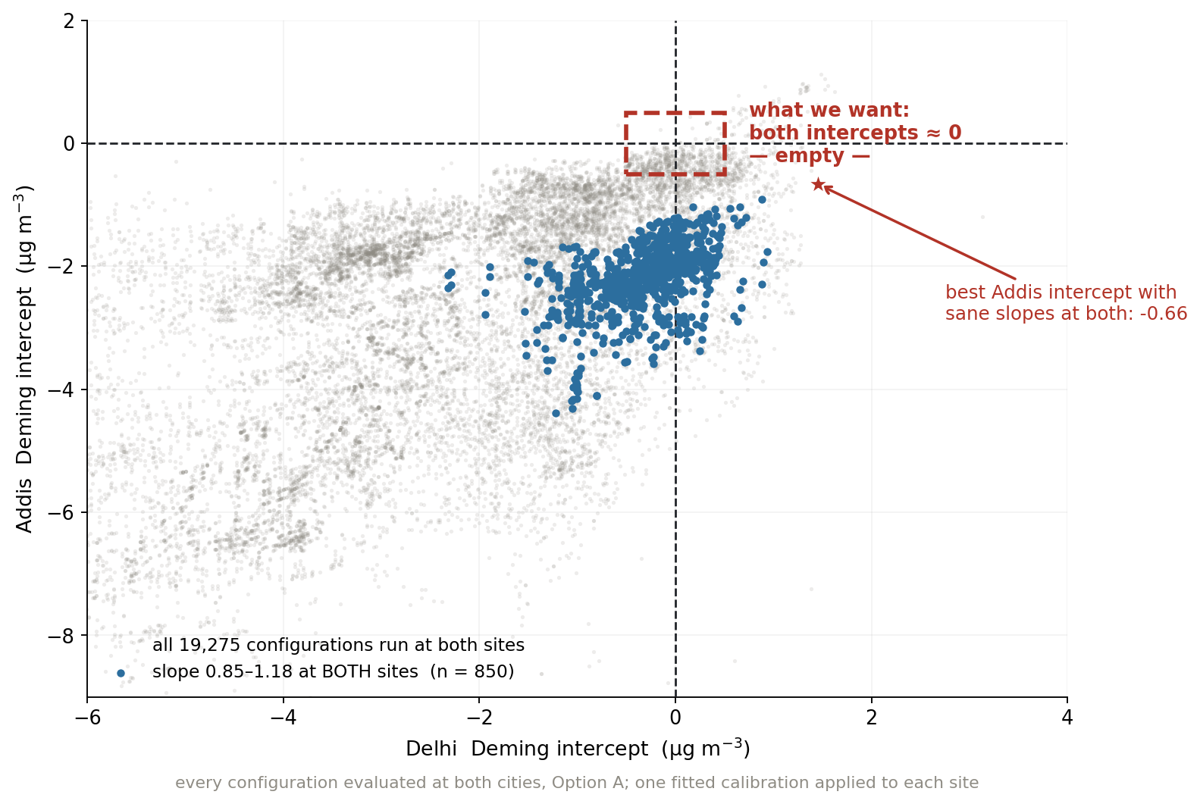
Across 19,275 configurations, the region we actually want is empty
Notes:
SAY: Here is the same search drawn as one picture. Every configuration is a point: its Delhi intercept across, its Addis intercept up. The dashed box top-centre is what we want — both intercepts near zero. It is empty. The blue points are the 850 configurations that hold a sane slope at both cities, and the best Addis intercept among them is minus 0.66. So the two cities cannot be reconciled by choosing a cohort, a baseline or a component count.
NOTES: 19,275 configurations run at both sites, Option A; one fitted calibration applied to each site. Slope box 0.85-1.18 at BOTH sites gives n = 850. The grey cloud's diagonal streaks are cohort families. This is the single strongest statement that the offset is not a tuning artifact — and it is descriptive, so quoted results still come from held-out sets.

Slide 22
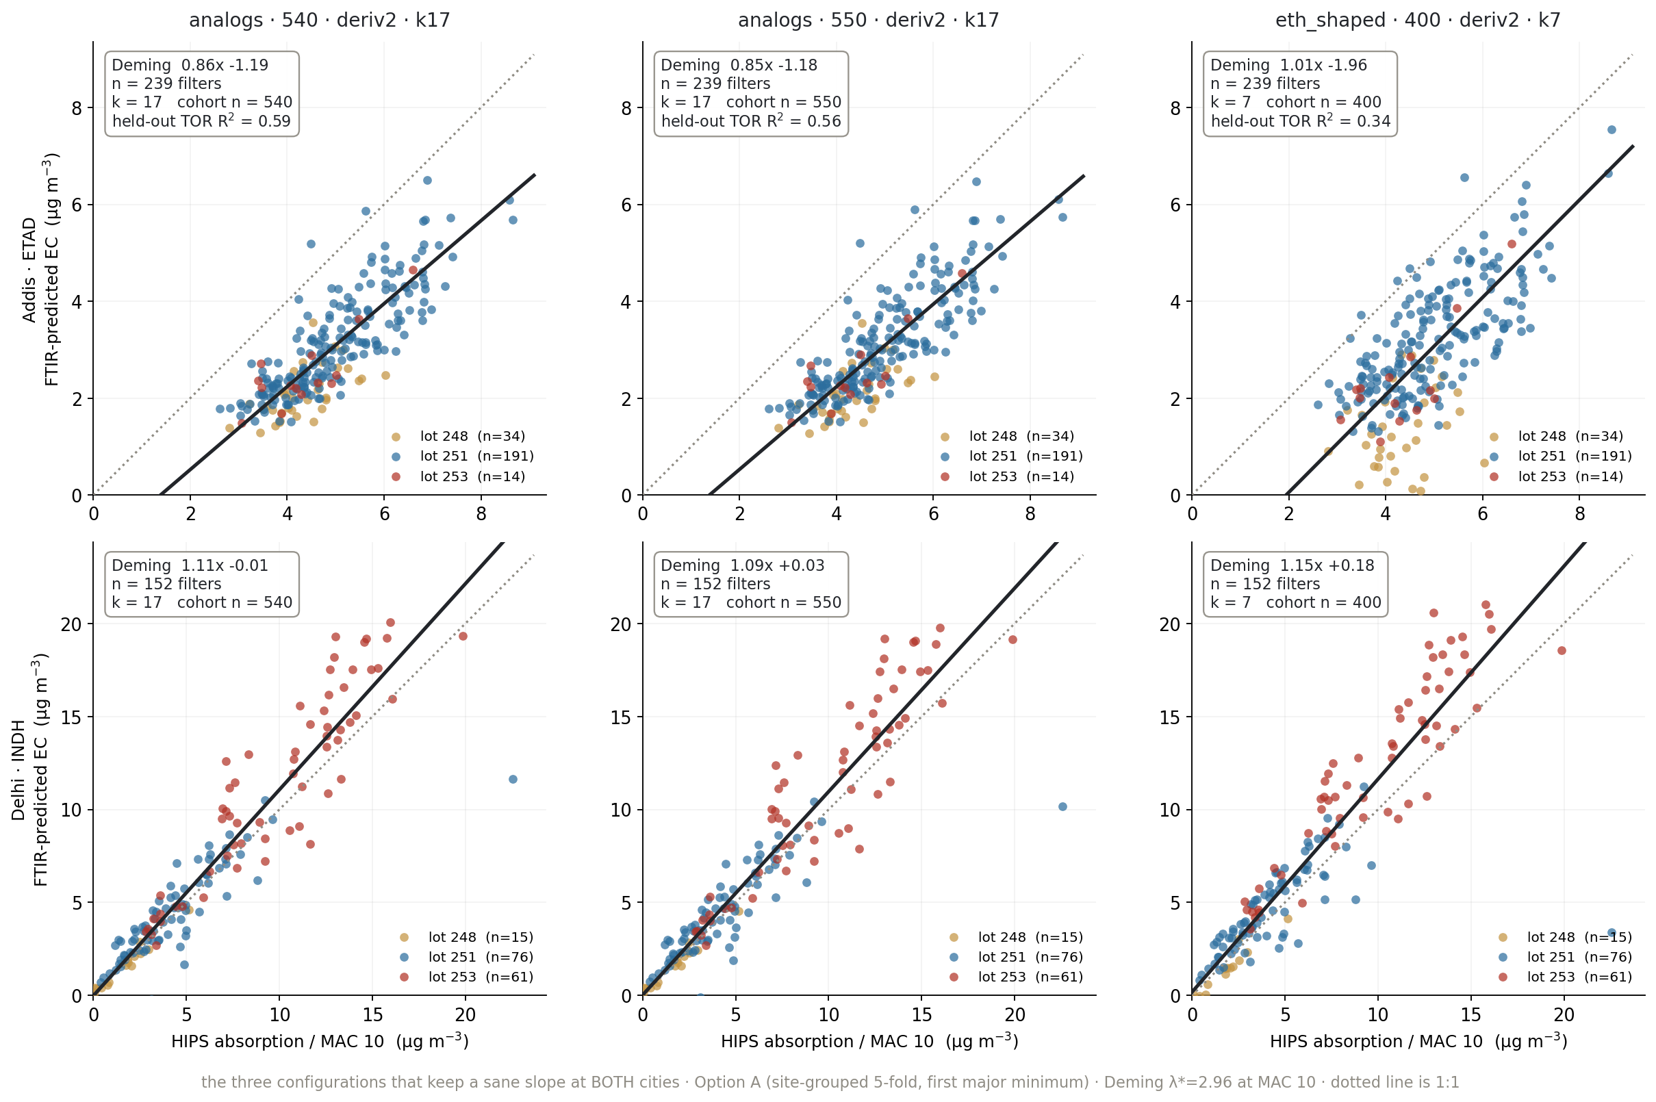
Three configurations do hold a sane slope at both cities — and they are the analogs
Notes:
SAY: These are the three. Top row Addis, bottom row Delhi, coloured by filter lot. Delhi sits on the one-to-one line across the whole range, and lot 253 — the red points, the new lot — lies on the same line as lot 251, which is a real cross-lot result. Addis is the tight band sitting parallel to and below the line: that shape is an additive offset, not noise and not a slope error. And note what they are: the spectral analog cohorts you pushed me toward in August.
NOTES: analogs-540 x deriv2 k17: Addis 0.86x-1.19, Delhi 1.11x-0.01, held-out TOR R2 0.59. analogs-550 x deriv2 k17: 0.85x-1.18 / 1.09x+0.03, R2 0.56. eth_shaped-400 x deriv2 k7: 1.01x-1.96 / 1.15x+0.18, R2 0.34 — best Addis slope but worst intercept and half the held-out skill, a case where slope alone flatters a weaker model. Samples: Addis 239 (lot 248:34, 251:191, 253:14), Delhi 152 (248:15, 251:76, 253:61). Addis lots recovered by joining the evaluation date field to ETAD metadata — validated against the HIPS-side counts, which match exactly.

Slide 23
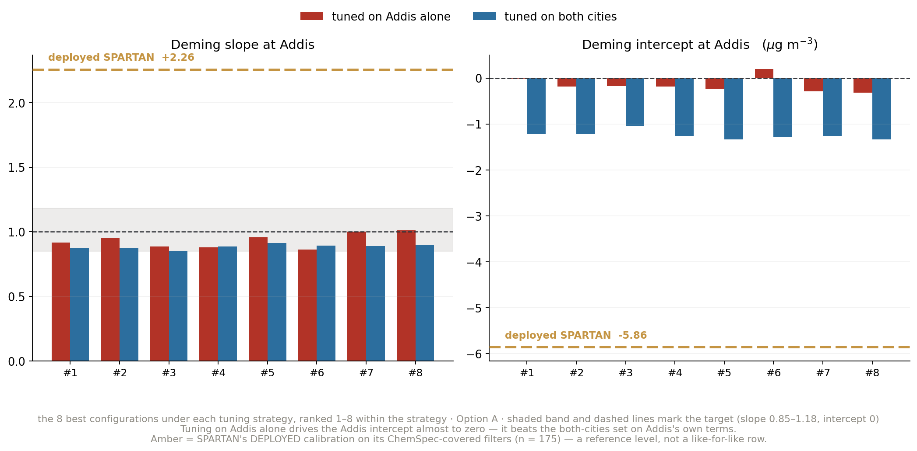
At Addis, tuning on Addis alone genuinely wins — that is the trap
Notes:
SAY: Now the counterpart, in three parts. First, Addis on its own terms. Red is tuned on Addis alone, blue on both cities, and the amber line is what SPARTAN ships today. Both tuned sets sit in the slope band on the left; the deployed calibration is up at 2.26, well outside it. But look at the intercept on the right: the red bars are almost exactly zero, and the blue ones are down at minus 1.2. On Addis's own scorecard, tuning on Addis wins outright. If this were the only slide, you would pick red.
NOTES: Top-8 under each strategy, Option A. Addis-tuned = best |intercept| + 0.5|slope-1| with the Addis slope boxed to 0.85-1.18; both-cities = the same score summed over Addis and Delhi with both slopes boxed. This slide is deliberately the case FOR the wrong answer — the next two are why it is wrong. The amber deployed line (Deming 2.26x -5.86, n = 175) is a REFERENCE LEVEL, not a like-for-like row: it is fitted on the ChemSpec-covered filters, a different and smaller set than our 239-filter evaluation, and ChemSpec EC is EC_ftir rounded (ftir_27).

Slide 24
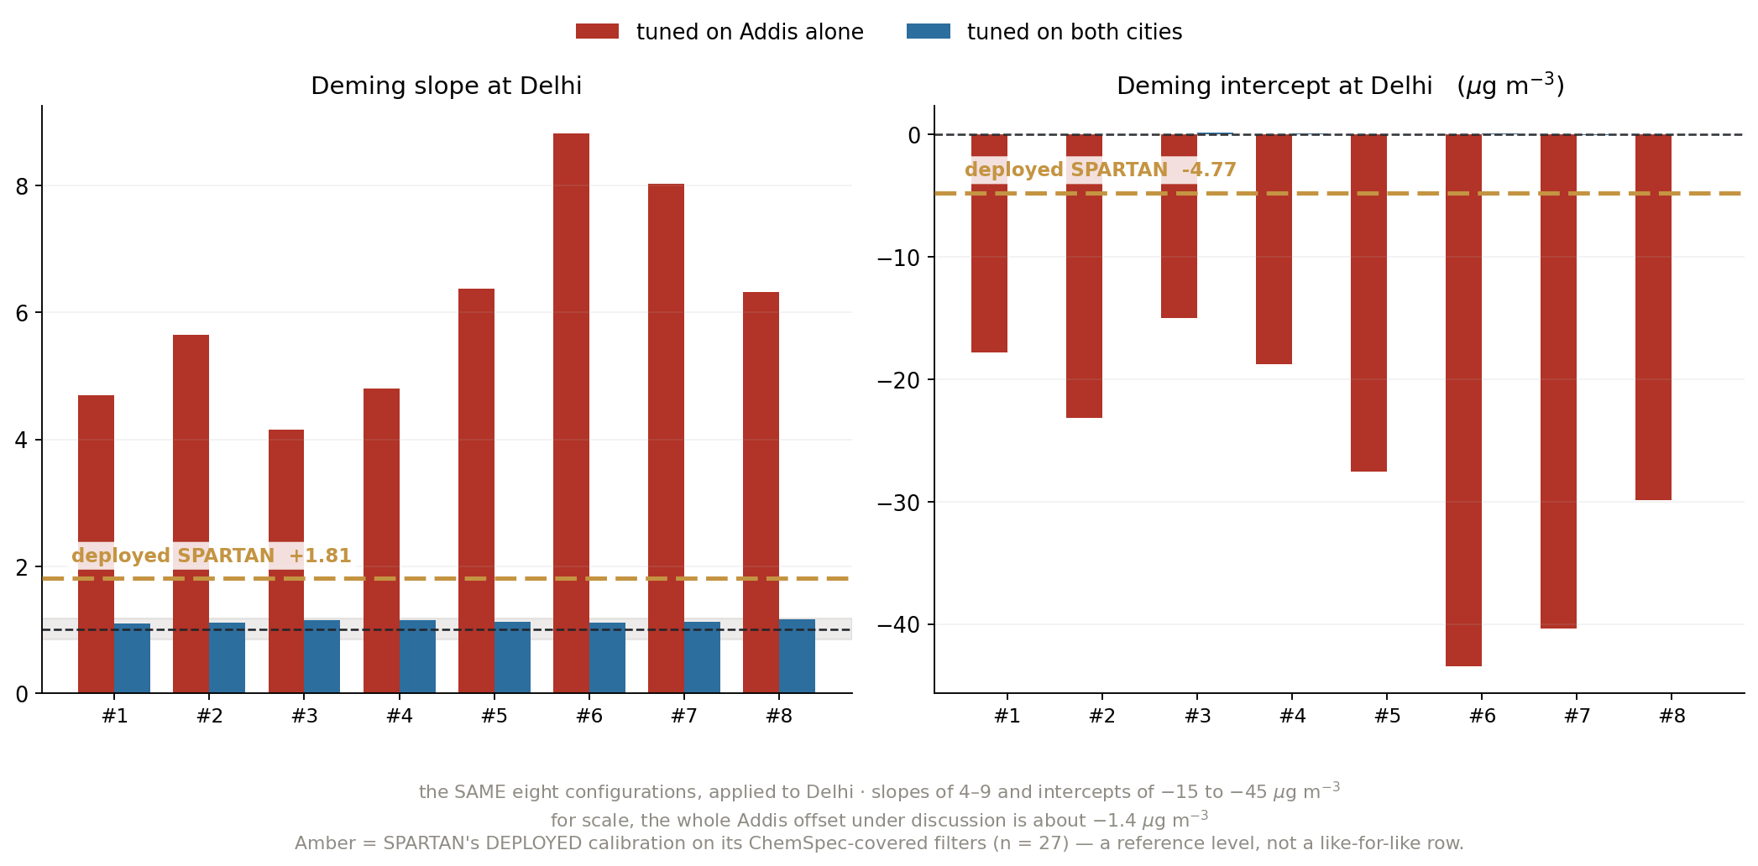
The same eight configurations collapse at Delhi
Notes:
SAY: Same eight configurations, now applied to Delhi. Slopes of four to nine, and intercepts of minus fifteen to minus forty-five micrograms. For scale, the entire Addis offset we have been chasing all deck is about minus one point four, and even the deployed calibration — the amber line, which nobody defends — only reaches minus 4.8. The Addis-tuned set is three to nine times worse than the thing we are trying to improve on. The blue set sits on the line at both cities. So the near-zero Addis intercept on the previous slide was bought by breaking the model everywhere else.
NOTES: Delhi n = 152. The magnitude of the intercept collapse is the point: this is not a mild degradation, it is a different model. Same failure the validation layer caught for Delhi's own grid winner (analogs-530 x deriv2: 96.1% of Delhi filters beyond the training domain). Deployed reference at Delhi: Deming 1.81x -4.77 on n = 27 ChemSpec-covered filters — thin coverage, so treat it as a level, not a precise value.

Slide 25
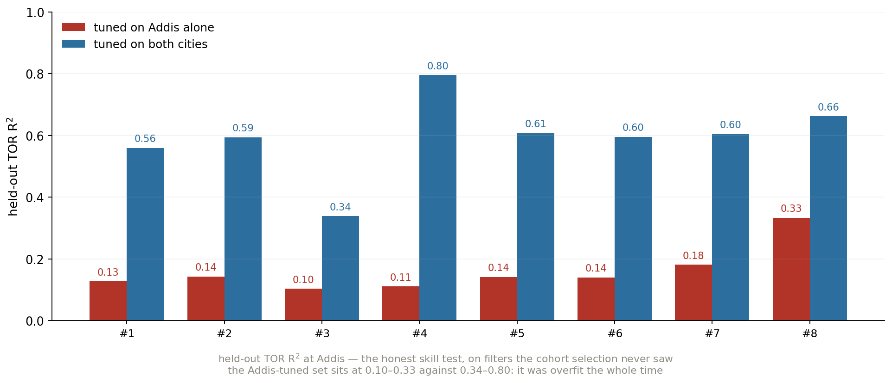
And they had almost no held-out skill to begin with
Notes:
SAY: And the honest skill test, on filters the cohort selection never saw. The Addis-tuned set sits between 0.10 and 0.33. The both-cities set is 0.34 to 0.80. So they were overfit the whole time — it was visible without ever looking at Delhi, if you check held-out skill rather than the fit you optimised. That is the argument for freezing lot 253 as a validation set nothing is screened on.
NOTES: Held-out TOR R2 under Option A — site-disjoint 80/20, so the test sites are not in the fit at all. This is the cleanest statement of the slope trap in the deck: a near-zero intercept at one site is cheap to buy and worth nothing on its own. Screening is not evaluation — VALIDATION_LAYER_2026-08-24.md.

Slide 26
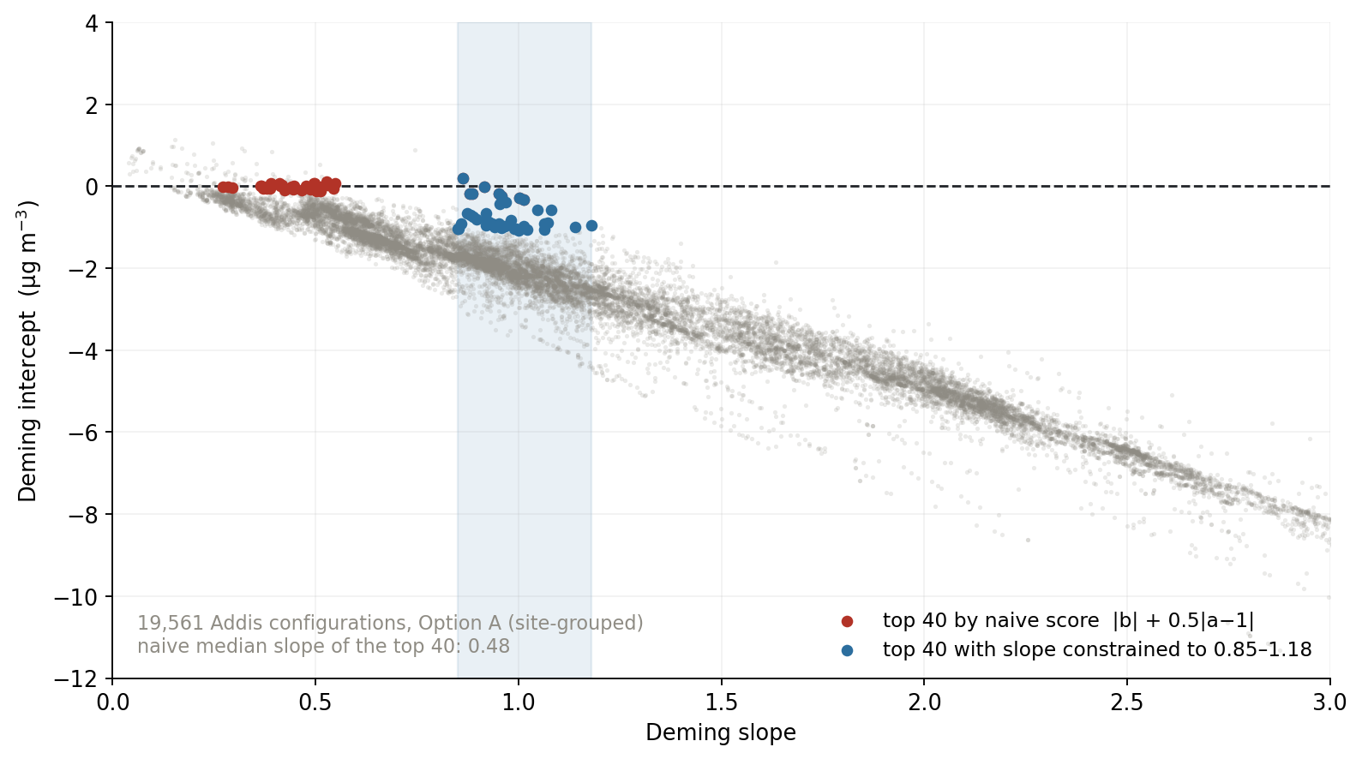
A flat enough line always has a small intercept — rankings need a slope box
Notes:
SAY: The methods lesson from running the grid at scale, and it's the kind of thing you only see with twenty thousand configurations. If you rank naively on intercept plus half the slope error, the winners are the red points — median slope 0.48. They have small intercepts because they're nearly flat, not because they're good. The blue points are the same ranking with slope constrained to a sane band. Every ranking in this deck uses the box.
NOTES: 19,561 Addis configurations, Option A. The score is |intercept| + 0.5|slope-1|. This is ftir_17's full-scale slope trap reappearing at grid scale. The Optimize tab's score alone is gameable — the app now ships with the slope box in the leaderboard.

Slide 27
Independent witnesses
Notes:
SAY: Divider: Independent witnesses.
NOTES: Section break.

Slide 28
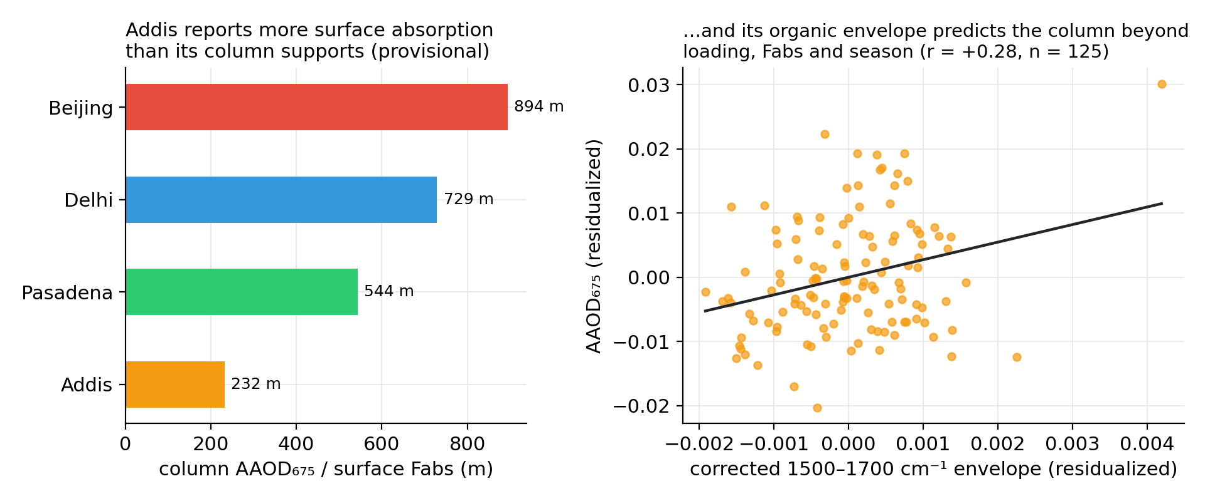
Addis reports more absorption than its own column can account for
Notes:
SAY: AERONET looking down at the same air. The ratio of column absorption to our surface Fabs gives an effective scale height. Delhi, Beijing and Pasadena cluster between 544 and 894 metres. Addis sits at 232. The sharpest contrast is Delhi: 1.6 times our surface absorption but 4.3 times the column. Delhi's column scales with its surface; Addis's doesn't.
NOTES: H = AAOD675/Fabs is NOT a physical boundary-layer height — meaningful only compared across sites measured the same way. Level 1.5; AERONET inversion products are formally reliable only above AOD440 ~ 0.4. Gurgaon is ~30 km from the Delhi SPARTAN site. Separately and more strongly: the corrected 1500-1700 cm-1 organic envelope at Addis predicts column absorption beyond loading, Fabs and month (r = +0.28, p = 0.002) — no filter artifact can produce that.

Slide 29
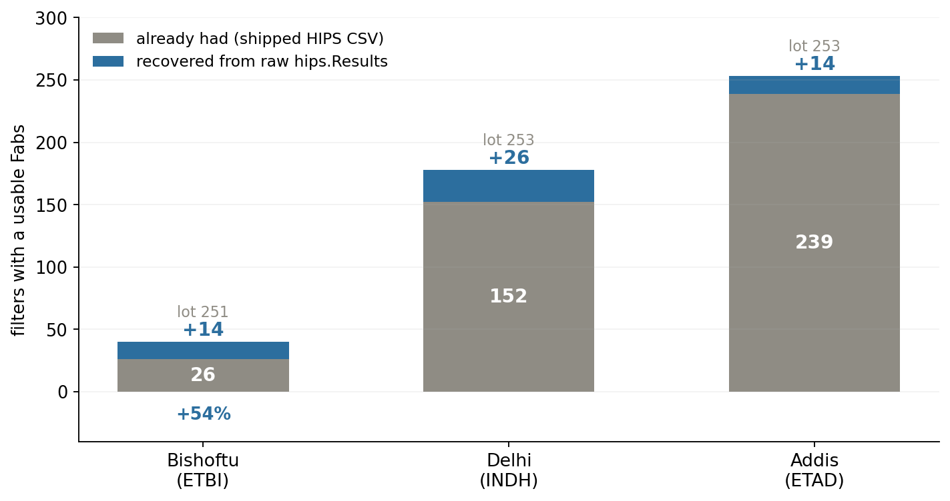
Bishoftu grew from 26 to 40 filters — recovered from raw instrument data
Notes:
SAY: You told me to get the Bishoftu spectra myself, and that turned into more than spectra. The database holds raw transmittance and reflectance for 256 filters that never reached the shipped file. Because the raw values are bit-identical to the shipped ones and the tau formula reproduces shipped tau exactly, I can recompute absorption for them. Bishoftu gains fourteen — a 54 percent increase on the site carrying our whole Addis-is-specific argument.
NOTES: Validation: raw T/R identical to shipped T1/R1 on 3,859 filters (max |diff| = 0); tau formula reproduces shipped tau for 100% within 1e-4. Recovered medians land on each site's shipped median. 42 of the 256 come out at tau < 0.05 with no volume — the field-blank signature. CAVEAT: RECONSTRUCTED, not official. Production QC (MDL, uncertainty, comment-based rejection) not replicated; DepositArea is the site median. Report headlines with and without them.

Slide 30
The tool, and what it taught us
Notes:
SAY: Divider: The tool, and what it taught us.
NOTES: Section break.

Slide 31
The app stopped being a viewer and became the experiment
Your actions became features: evaluate-on-same-lot masking, selection on corrected spectra, the cutoff slider you asked for.
Server-side batch optimizer — survives the browser tab, runs multi-site sweeps unattended; targets are the inner loop so one fit is reused across five cities.
New tabs this week: Sites (cross-site + extrapolation diagnostic), HIPS lab (York × blank-line variants, blank ledger), Analogs, Optimize with slope-boxed leaderboards.
Validation layer: Q-residual and score-distance guardrails; LOCAL per-filter endpoints.
Notes:
SAY: You asked in August how I'd keep track once I could make a million crossplots. This is the answer. The app went from something I click through to the thing that runs the experiment — I describe a grid, it runs overnight, and the leaderboard is scored the same way the interactive readout is. The HIPS lab is the piece that made this week's decode possible: it recomputes every filter under alternative blank lines.
NOTES: Flask on :5058 under anaconda python (the uv venv lacks flask). Caches are keyed and SHA-256-manifested. Curve caches from the 08-20 dense sweeps carried most of the 9,555-job grid's cost, which is why it finished same-day.

Slide 32
Three things we only learned because the search was exhaustive
The slope trap. Only visible with ~20,000 configurations — naive scoring picks flat lines.
The winner is not stable. Bootstrap the filters and the top configuration wins only 62.5% of draws — so 'the best cohort' is a range, not a point.
Screening is not evaluation. Delhi's grid winner had 96.1% of its filters outside the training domain and died on fresh filters — which is why lot 253 is now frozen as an untouched validation set.
Your August worry — that selection becomes 'Ahmad liked this one' — is exactly what these three guard against.
Notes:
SAY: This is the answer to the concern you raised in August, that picking configurations by hand would come down to taste. Running everything doesn't remove judgement, but it makes the judgement auditable: I can show you the whole cloud, the winner's stability, and whether a result held on filters nothing was screened on.
NOTES: Winner stability from the validation layer's bootstrap (VALIDATION_LAYER_2026-08-24.md). Lot 253 is the first untouched spectral-lot challenge; lot 255 stays sealed for replication. Nested selection lives in ftir_36; it validates the selection algorithm on source sites, which is NOT the same as turning the repeatedly-inspected Addis readout into an independent estimate (Varma & Simon 2006).

Slide 33
Corrections, and what's owed
Notes:
SAY: Divider: Corrections, and what's owed.
NOTES: Section break.

Slide 34
What didn't survive — and why that's the point
The 1617 cm⁻¹ band: retracted twice. Delhi matched Addis (wrong metric — it was reading a carbonyl flank); then Bishoftu had the band without the offset. Three baselines gave three answers.
'The offset is Addis-specific' → 'a two-city signature' → 'Addis certain, Delhi is a slope story'. Each doc carries a banner pointing forward.
Closed branches: dust/Fe (7% of Addis), PTFE zero (+0.3 Mm⁻¹), MA350 wavelength spread, ChemSpec columns (both circular), shape-based cohorts, pooled-λ Deming.
Method rule now standing: any claim about a band under 1520–1600 cm⁻¹ needs two independent baselines, because AIRSpec anchors its spline there.
Notes:
SAY: I want to show the failures as prominently as the results, because most of this week was killing my own findings. The band story is the clearest case: I wrote it up as a five-site result, then found the metric was measuring the wrong thing at Delhi, then found Bishoftu has the band and no offset. It's an Ethiopian regional marker, not the offset's carrier.
NOTES: Every superseded doc is retained with a banner rather than rewritten — BAND1617_LEAD has the full reversal trail. The AIRSpec spline anchor at 1520-1600 is a structural property of the method (find_min_pos with interval (1600,1520)), not a tuning choice.

Slide 35
The mistake you flagged in August was still live in my code
In August you caught me selecting on baseline-corrected spectra but calibrating on raw.
The app takes spectra = "airspec" / "neutral" / "deriv2" — anything else falls through to raw, silently.
I had been passing "corrected" — the filename convention. It ran on raw and looked fine.
Caught by an anchor refusing to reproduce. Both anchors now match; the lot result on slide 11 is the re-run.
Notes:
SAY: I want to flag this rather than bury it. The exact error you caught in August was still in my API calls, because the token I was passing isn't valid and the app falls back to raw without complaining. It was caught because the locked anchor wouldn't reproduce, which is why I validate them before building anything. The first version of the lot result showed a big lot effect that was really a raw-spectra effect.
NOTES: The dispatch in app.py is an if/elif chain with a bare else returning raw, so an unrecognised spectra token is indistinguishable from asking for raw. Recorded in SPARTAN_LOT_INVENTORY_2026-08-23.md and in the group deck's talking points.

Slide 36
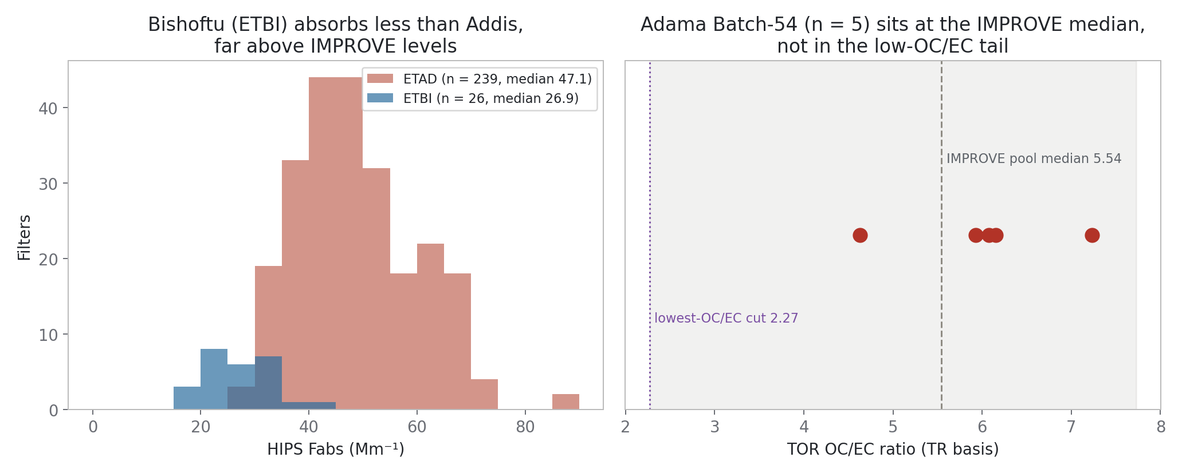
Adama: this is a seed, not yet the case you asked for
Notes:
SAY: The one I owe you. You asked for two or three slides making the case to Christian and Sina that Adama is unlike Addis, so they stop putting effort into collecting more. What I have is context — Adama sits at the IMPROVE median rather than the Addis extreme. What I don't have is the comparison you named: TOR OC and EC against FTIR OC and EC on the same filters. That's the panel that makes the argument, and it's next.
NOTES: Her exact ask (12 Aug): communicate to Christian and Sina that this site is very different from Addis — no HIPS-EC difference, different OC/EC ratios. Timeline: two-to-three weeks. Context in hand: Adama TOR OC/EC 4.6-7.2, about the pool median, which challenges the OC/EC-extreme premise. Blocked on nothing.

Slide 37
What I need from other people
Quartz TOR on collocated Addis filters — three independent lines now terminate there.
Kirchstetter solvent extraction + HIPS re-measurement — cheap, uses archived filters, and decisive between organic absorption and an instrument artifact. This is the ask for Davis.
IMPROVE lot-253 spectra — pull script written, needs a Windows/VPN session.
Adama TOR-vs-FTIR panel is mine to build; blocked on nothing.
Notes:
SAY: Three asks, and the second is new and cheap. If you extract the organics off an archived Addis filter with solvent and re-measure it on HIPS, an organic absorber shows up as a drop and an instrument artifact doesn't. That uses filters we already have. The quartz TOR campaign is still the primary, because it's the only thing that separates an additive offset from high-loading curvature — they're degenerate on the axes we have.
NOTES: Degeneracy: a per-site Fabs = alpha*EC^beta explains ~100% of the Addis and Beijing offsets as well as an additive constant does, and no rearrangement of FTIR-EC data separates them because the x-axis is the quantity in question. One-pager: quartz_tor_campaign_onepager.md.

Slide 38
Logistics
Committee meeting — 2 Sept, 3 pm. [FILL IN: invite resent? who has confirmed?]
FTIR group talk — 27 Aug. Deck built.
AAAR — poster Thursday, session 9, 1–3 pm. [FILL IN: forwarded to Ann?]
[FILL IN: funding / anything else she asked about]
Notes:
SAY: Quick logistics. Committee meeting is the 2nd at three. Group talk on the 27th, deck is built. AAAR poster Thursday session nine.
NOTES: From 12 Aug: she asked to be forwarded the AAAR acceptance and the committee invite, and flagged that nobody appeared to have received the committee email. Fill the bracketed items before presenting.

Slide 39
Backup
asked-for detail, and the threads that are still moving
Notes:
SAY: Divider: Backup.
NOTES: asked-for detail, and the threads that are still moving

Slide 40
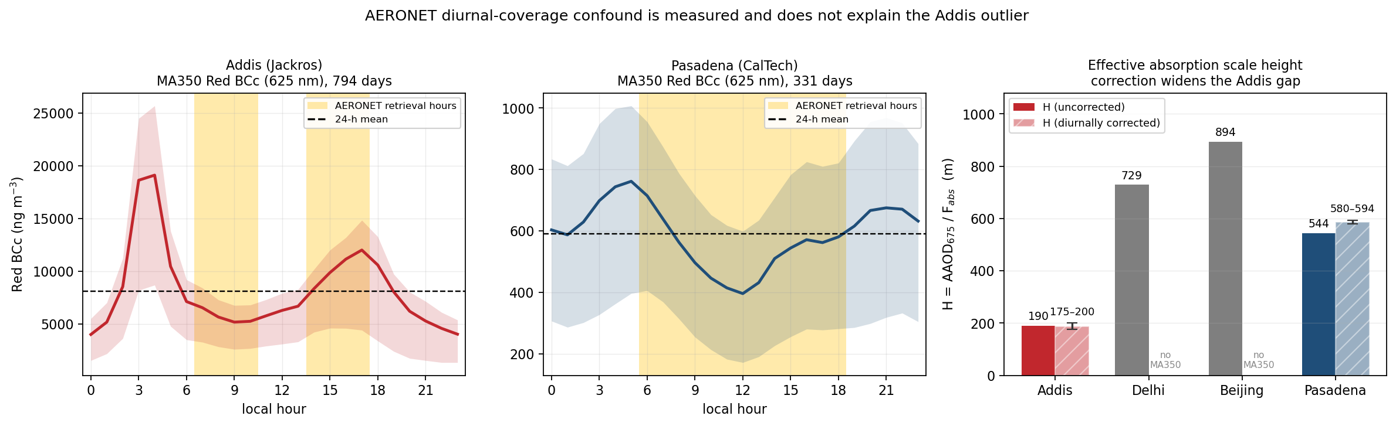
Backup — correcting for daytime-only sampling widens the Addis gap, not closes it
Notes:
SAY: The obvious objection to the column check is that the photometer only sees daylight, and Addis has a nearly five-fold day-night swing. Addis's two retrieval windows straddle the cycle and cancel; Pasadena's single midday window sits in its own minimum. Correcting pushes the sites further apart.
NOTES: Ratios are medians of per-day 24h/AERONET-hours values: Addis 0.92-1.05, Pasadena 1.07-1.09. Separation 2.9x -> 3.0-3.3x. Red BCc is 625 nm, effectively the HIPS wavelength. Assumes the column tracks the surface in relative diurnal shape. Delhi and Beijing have no co-located MA350. Uses the RAW 1-min files; the 9am-resampled pickles are daily and cannot answer this.

Slide 41
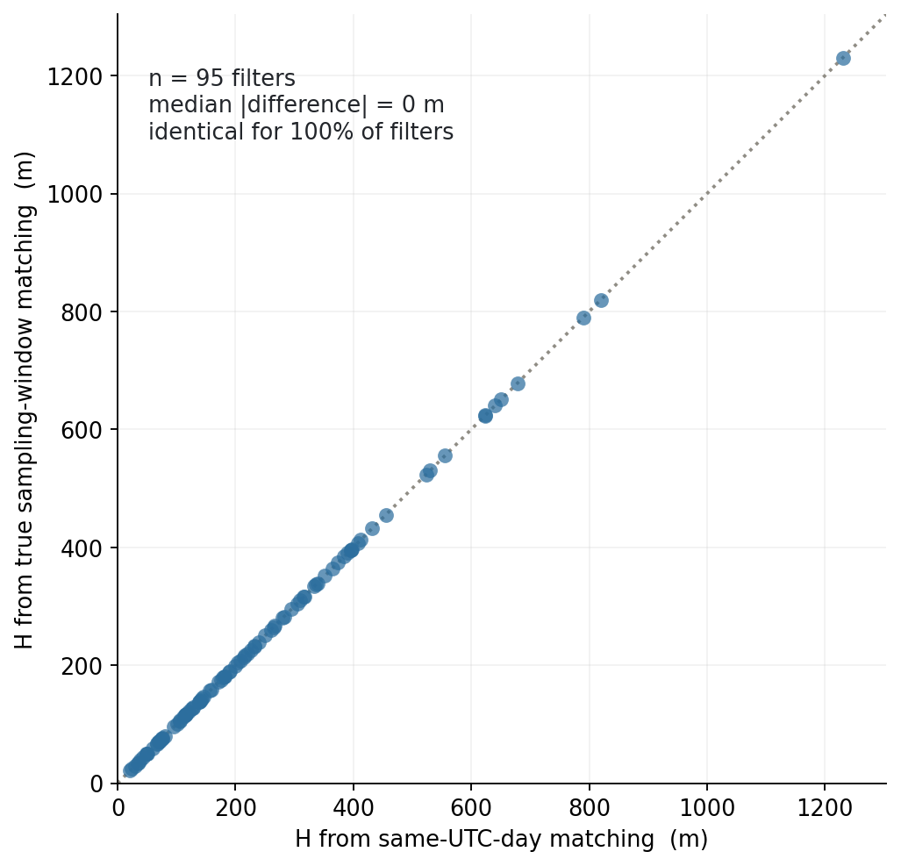
Backup — the AERONET pairing was right all along
Notes:
SAY: A literature reading said SPARTAN filters are eight staggered three-hour windows over nine days, which would have invalidated the whole column comparison. The metadata says otherwise: every clean Addis filter is exactly 24 hours, local midnight to midnight. I rebuilt the match on true windows anyway and it is identical — every point on the one-to-one line.
NOTES: 95 filters; median |difference| 0 m; 0.0% relative. Identical because every almucantar retrieval is daytime and therefore always lands on the same UTC calendar day as the local filter day — the timezone edge never bites at these longitudes. My 'correction' was the error; the original pairing was sound.

Slide 42
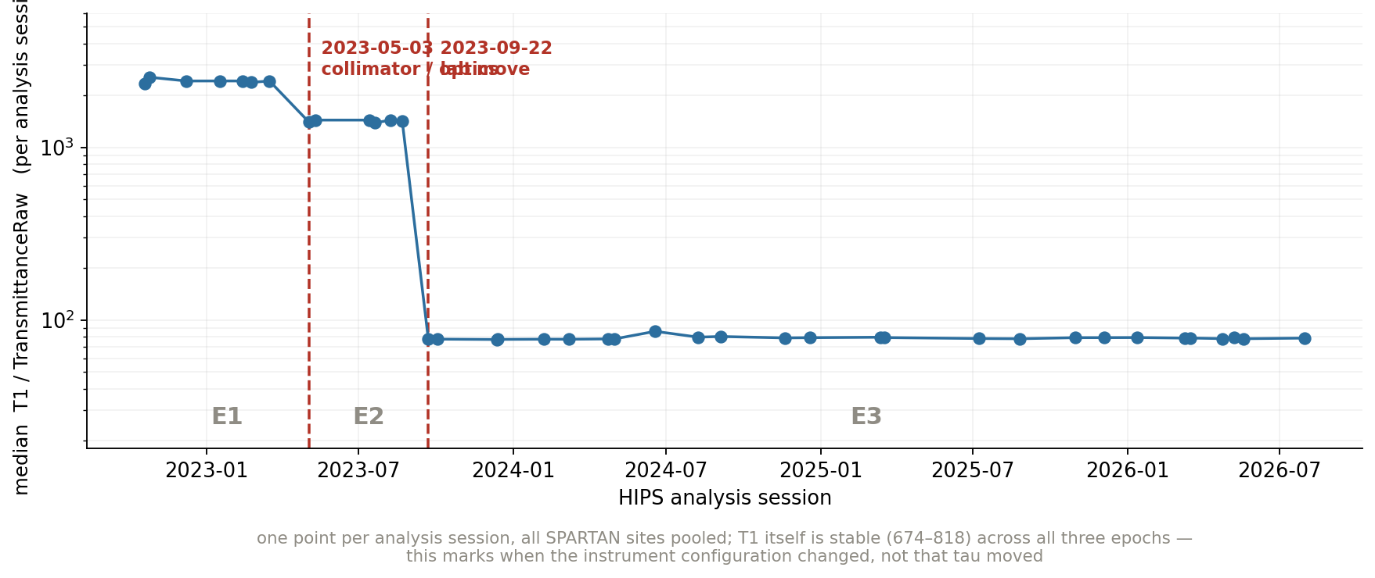
Backup — the HIPS instrument has three configuration epochs, and Addis straddles all of them
Notes:
SAY: The lab documented two unexplained re-calibrations. The database's instrument telemetry columns are entirely empty, but the ratio of shipped transmittance to its normalised twin recovers the epoch structure anyway — two sharp network-wide breaks, then stable for three years. Addis has filters in all three epochs, so the offset can be re-fitted per epoch.
NOTES: Breaks at 2023-05-03 and 2023-09-22, matching hips.CalibrationSets events (collimator replacement, lab move). IMPORTANT: T1 itself is stable (674-818) across all three, and T1 is what enters tau — so this marks when the configuration changed, NOT that Fabs moved. ETAD: 8 filters in E1, 48 in E2, 240 in E3. Flat across the boundary kills the instrument-shift hypothesis; a step is a measurement-side account of the intercept. Untested.

Slide 43
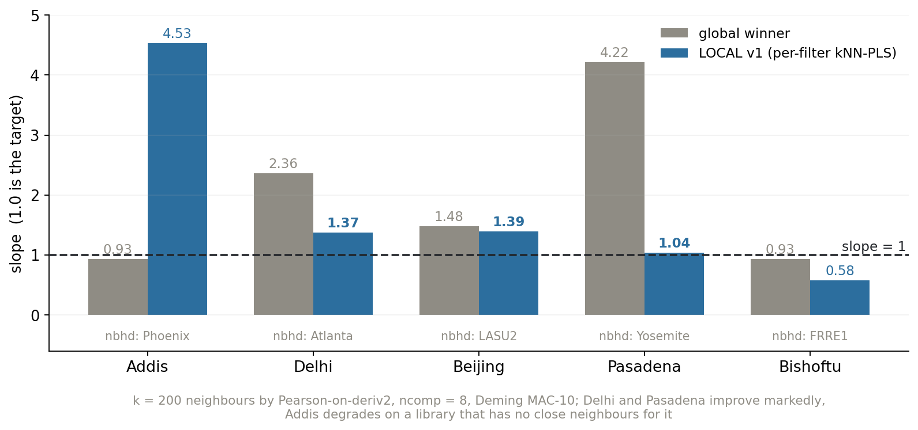
Backup — per-filter local calibration helps where the library has neighbours, and fails where it doesn't
Notes:
SAY: First pass at per-filter calibration: for each target filter, find its nearest library spectra and fit a small local model. Delhi and Pasadena improve markedly. Addis gets worse — its neighbourhood is Phoenix-dominated, which tells you something in itself about how unlike the library Addis is. Version two needs score-space similarity and a refuse-to-predict gate.
NOTES: k = 200 by Pearson-on-deriv2, ncomp = 8, Deming MAC-10. The textbook off-manifold failure: local is not the same as in-domain. A methods survey found no per-sample kNN-PLS prior art in the FTIR-aerosol literature — the template comes from soil and feed NIR (Shenk & Westerhaus 1997; Ramirez-Lopez 2013). TRANSFER_METHODS_2026-08-24.md.

Slide 44
Backup — baselining relocates seasonality rather than removing it
raw all-year 2.35x−6.08 Dry 1.27x−1.80 Belg 2.21x−5.15 Kiremt 2.25x−5.06
AIRSpec all-year 0.93x−1.42 Dry 0.60x−0.22 Belg 0.84x−0.91 Kiremt 0.86x−0.73
deriv2 all-year 1.61x−3.45 Dry 1.44x−2.86 Belg 1.36x−2.04 Kiremt 1.71x−3.93
Raw fails in the wet seasons; AIRSpec cleans them but leaves a dry-season slope deficit.
Notes:
SAY: One more thing the baseline does that we didn't expect. Raw spectra fail in the wet seasons. AIRSpec fixes the wet seasons but opens a dry-season slope deficit — 0.60. So baselining doesn't remove the seasonal structure, it moves it. The corrected model's anomaly is the charcoal-heavy dry regime.
NOTES: Consistent with the char_06 dry-season spectral anomaly. This is the seed of ftir_24, the dry/wet deliverable still owed. Also relevant: the seasonal pattern in the predicted EC series itself is stable across every calibration choice — which she called 'hugely important' in August, because a seasonal signal that flipped with the calibration would be uninterpretable.

