Slide 1
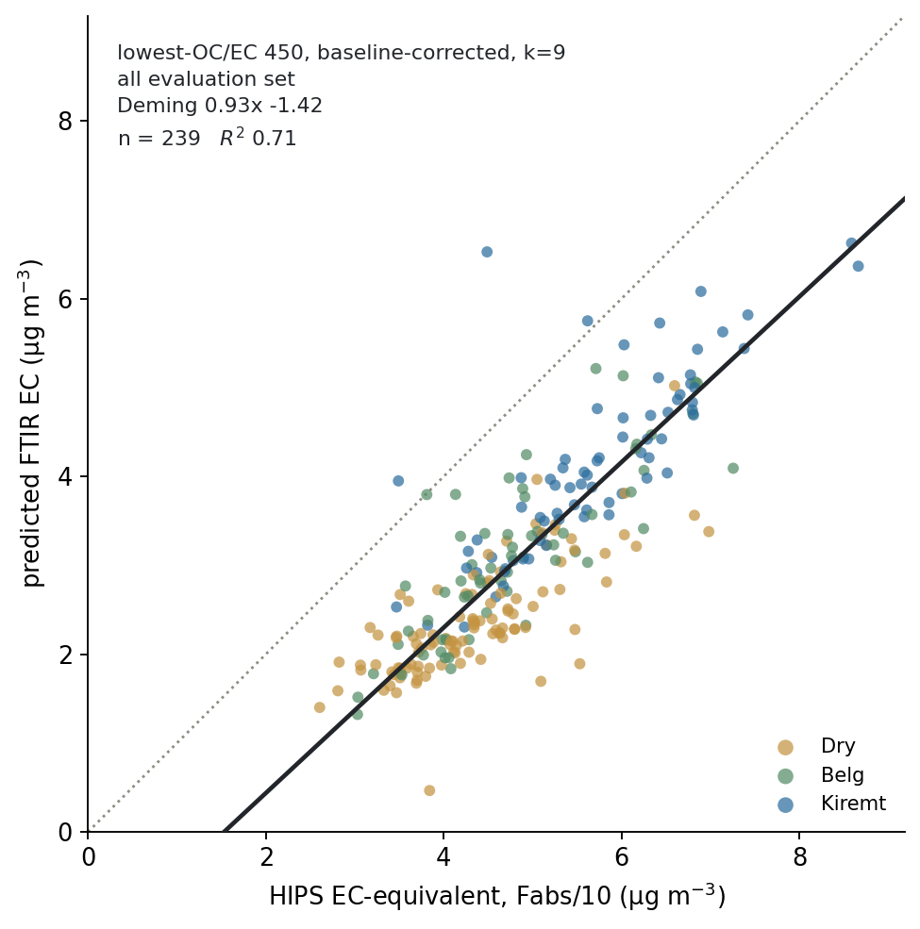
The result
lowest-OC/EC 450, AIRSpec, k=9, all 239 pairs: Deming 0.93x −1.42, R² 0.71. Reproduces the group deck's winner slide, with season colouring added.

Slide 2
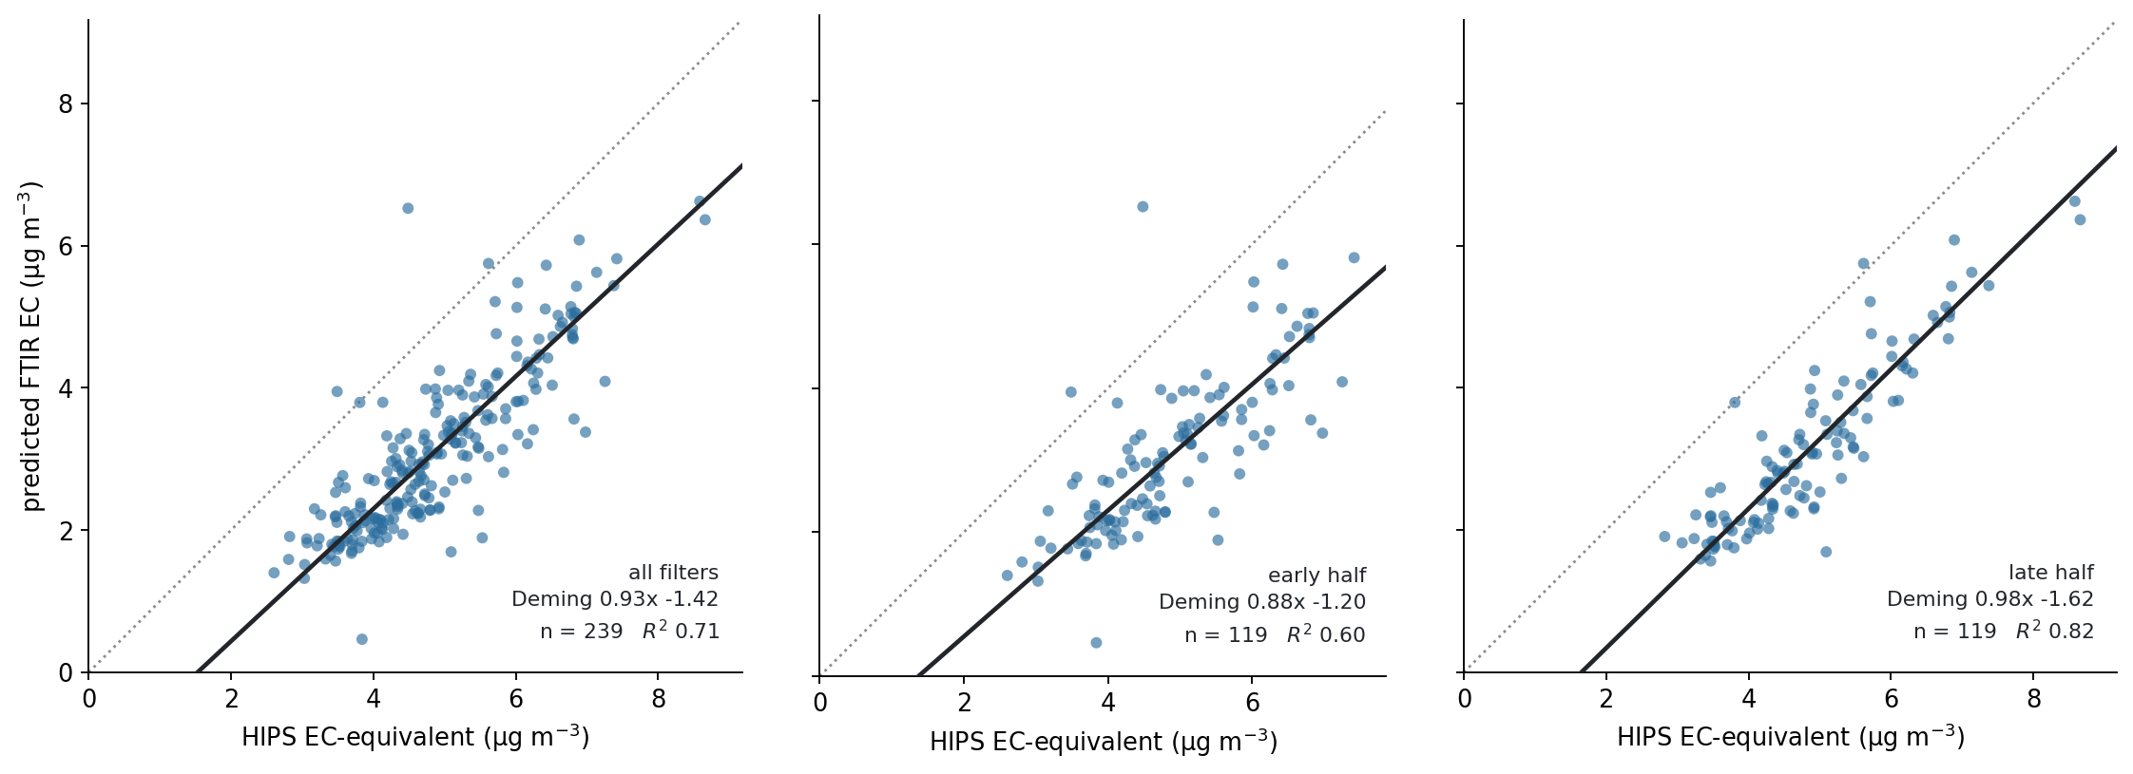
The same fit on each blind half
Early 0.88x −1.20 (R² 0.60) against late 0.98x −1.62 (R² 0.82). Both below the 1:1 line; the offset is not a property of which half you look at.

Slide 3
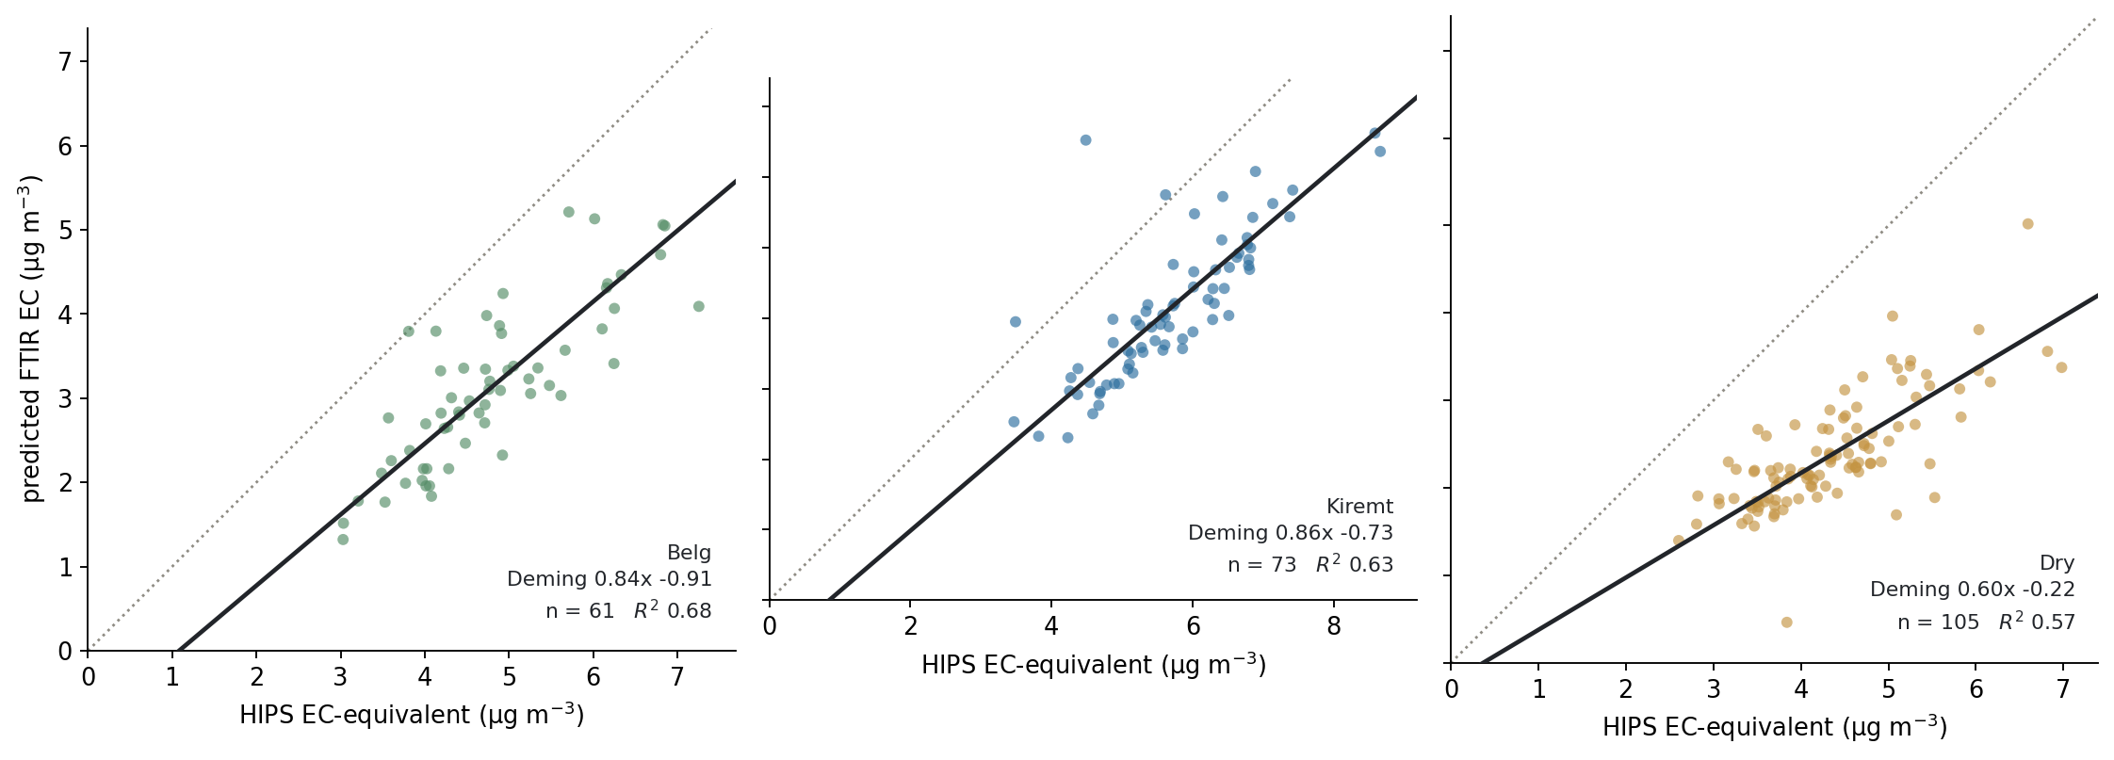
The same fit by season
Belg, Kiremt and Dry read out separately from one fitted model.

Slide 4
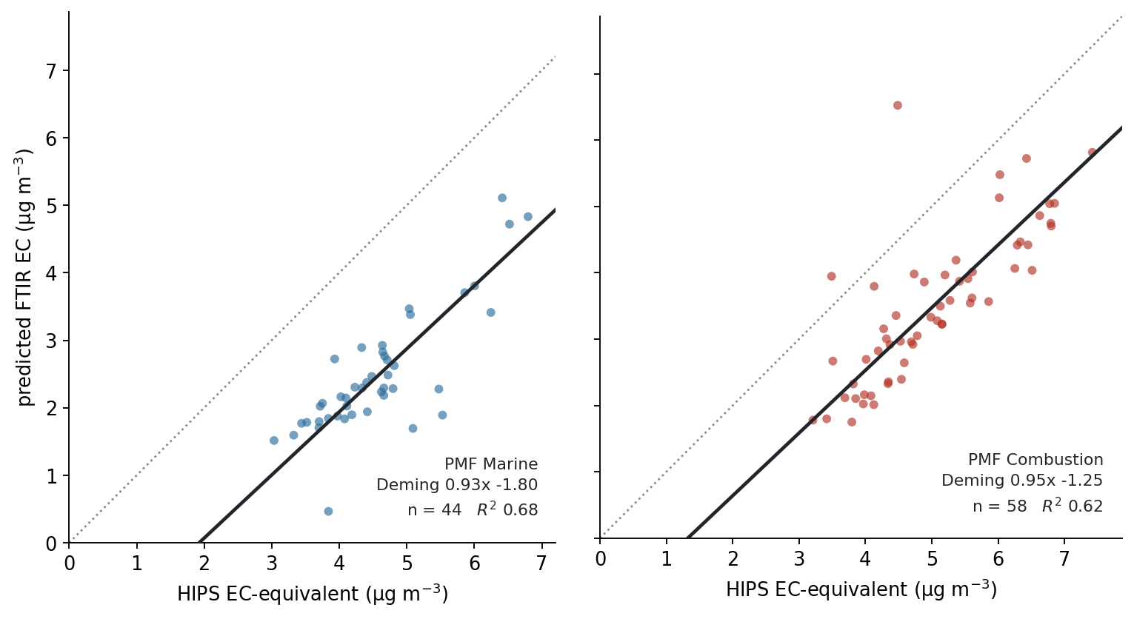
The same fit by PMF source class
Marine (n=44) against Combustion (n=58) from Navid's apportionment.

Slide 5
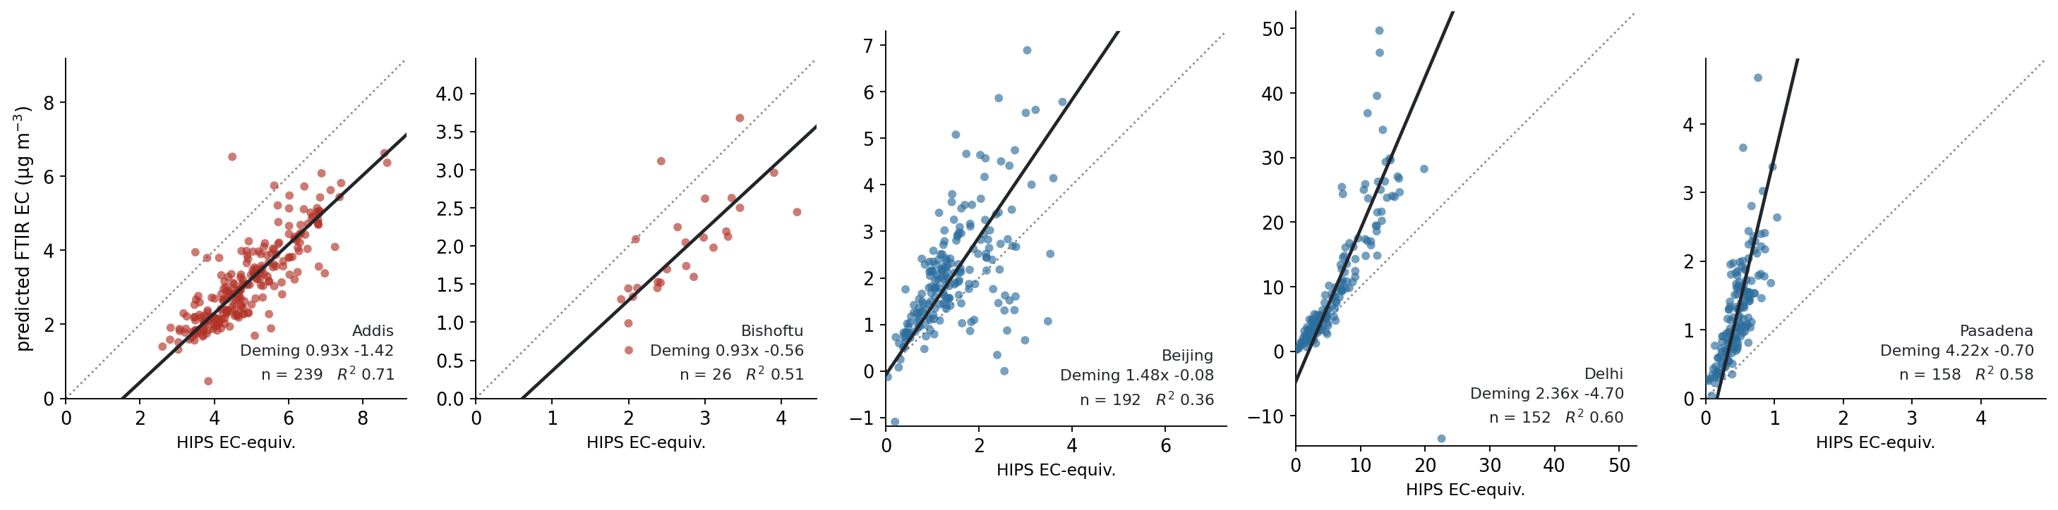
One calibration, every site
Addis and Bishoftu sit below the 1:1 line; Beijing, Delhi and Pasadena above it. Each panel keeps its own scale because site loadings differ 50×.

Slide 6
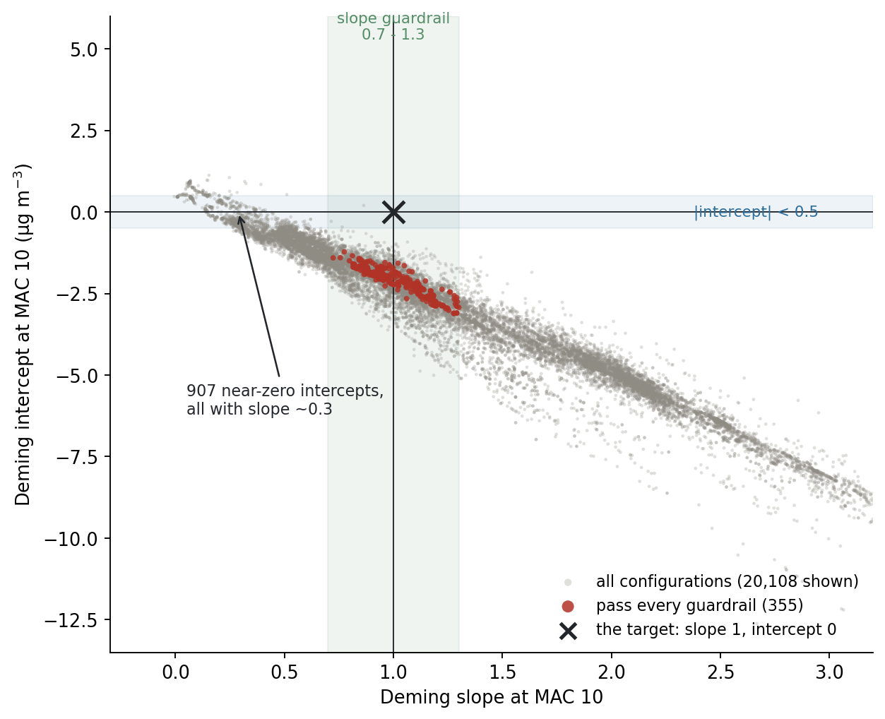
The feasible region does not contain the target
All 20,869 configurations in the (slope, intercept) plane fall on one diagonal band. The target (1, 0) is off it. The 907 near-zero intercepts are all bought with a slope near 0.3.

Slide 7
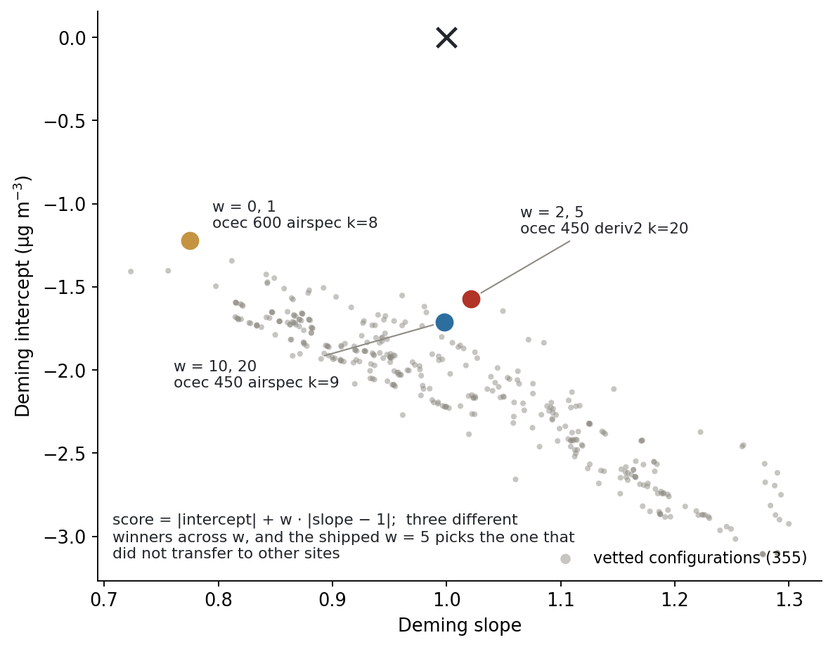
Three winners, depending on an unjustified weight
score = |intercept| + w·|slope − 1|. The shipped w = 5 picks deriv2 k=20, the family that did not transfer to other sites; w ≥ 10 picks AIRSpec.

Slide 8
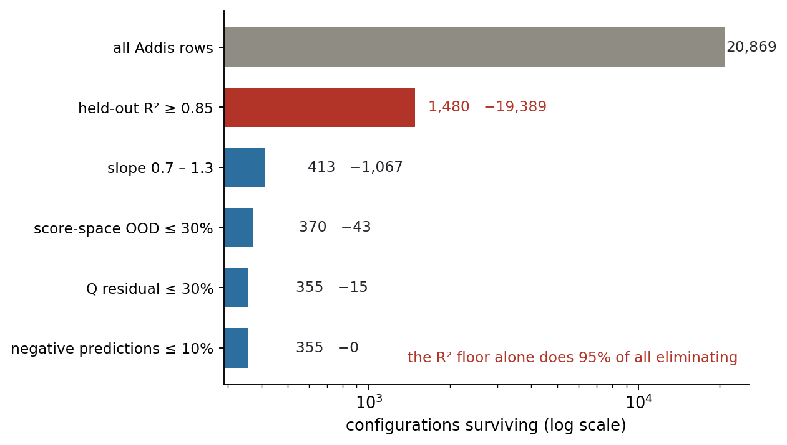
One guardrail does 95% of the eliminating
The held-out R² floor removes 19,389 of 20,514 eliminated rows, and it acts on the least stable quantity in the system.

Slide 9
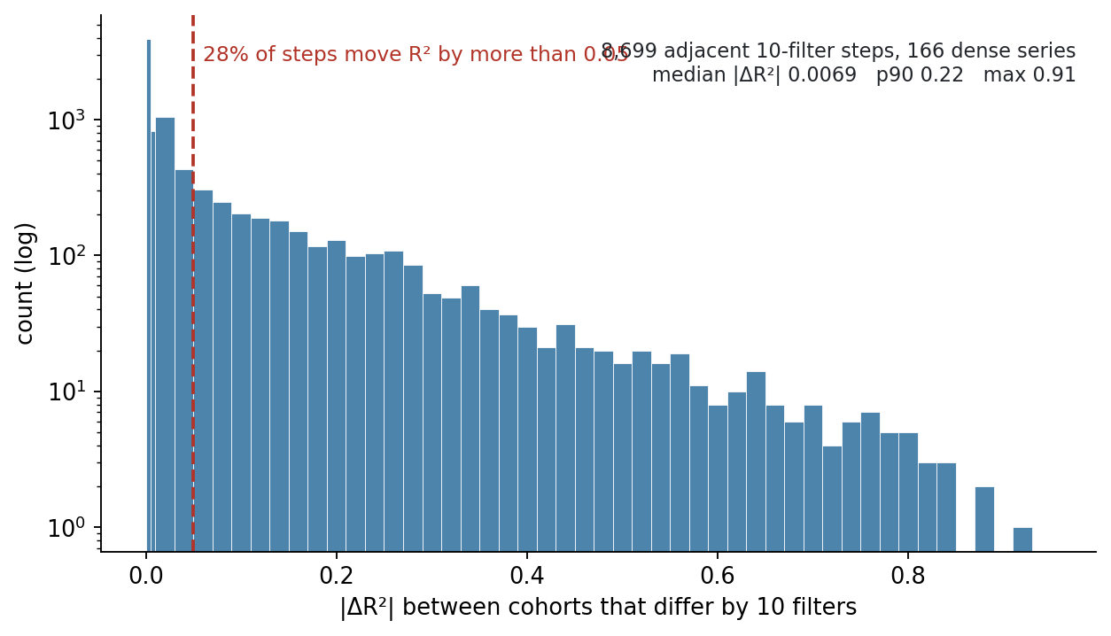
How far held-out R² moves per 10-filter cohort step
8,699 adjacent steps across the dense series: median 0.007, but 28% move by more than 0.05 and the p90 is 0.22. Plateaus are rare; the earlier 'plateaus of three' claim was one window, not the system.

Slide 10
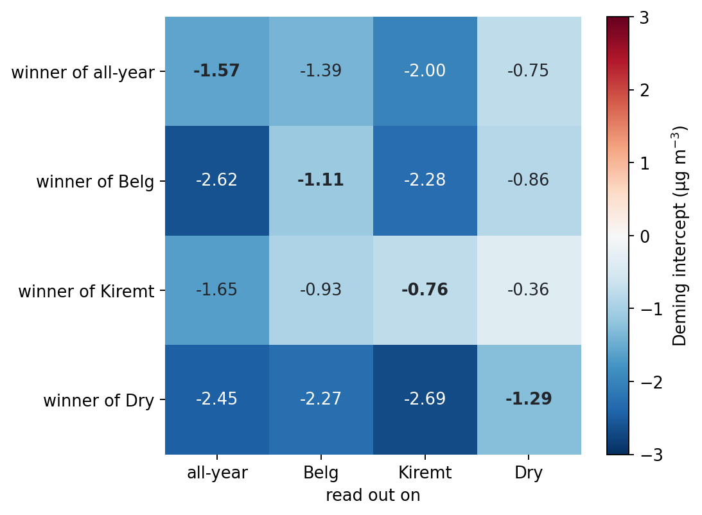
Season winners read out on every season
The all-year winner ranks #318 of 345 on Kiremt. The Kiremt winner beats it on three of four readouts, so optimising on the wet season generalises better than optimising on everything.

Slide 11
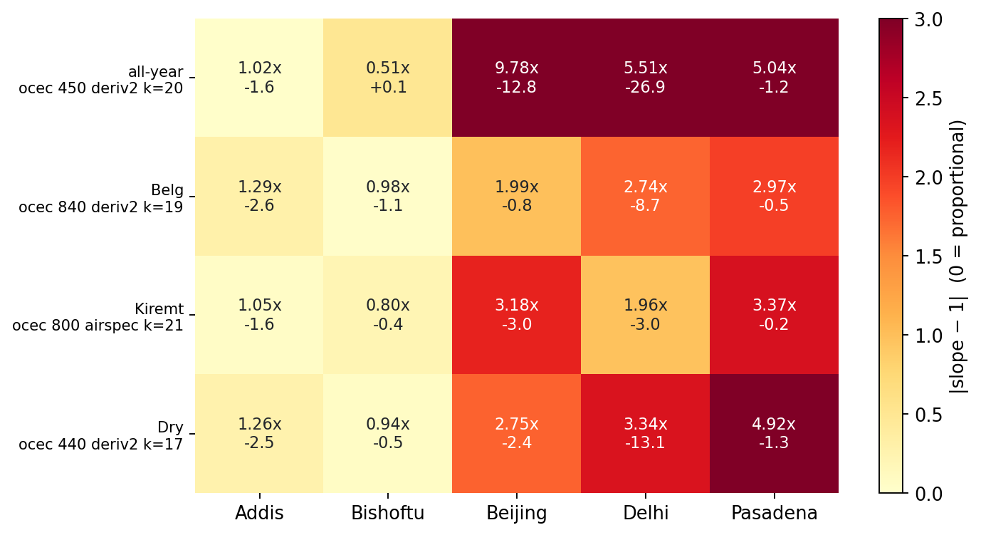
Each season's winner at every site
Colour is |slope − 1|. The all-year winner (deriv2 k=20) gives Beijing 9.78x and Delhi −26.9; the Kiremt winner (ocec 800 AIRSpec k=21) transfers, and is the repo's own terminal candidate rediscovered.

Slide 12
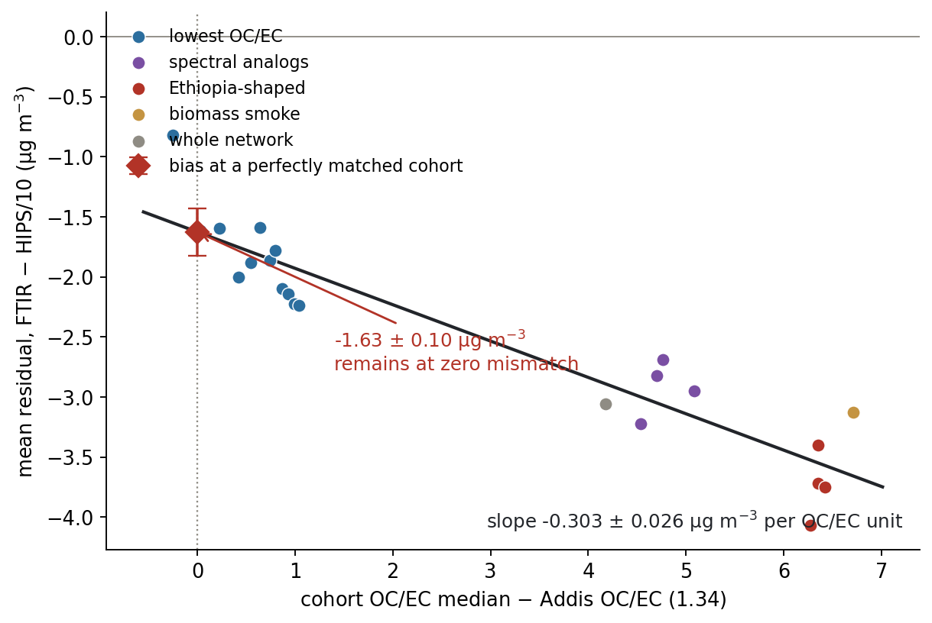
The OC/EC mismatch law
FTIR under-predicts by 0.303 ± 0.026 µg/m³ per unit of cohort-to-target OC/EC mismatch. At a perfectly matched cohort, −1.63 ± 0.10 remains.

Slide 13
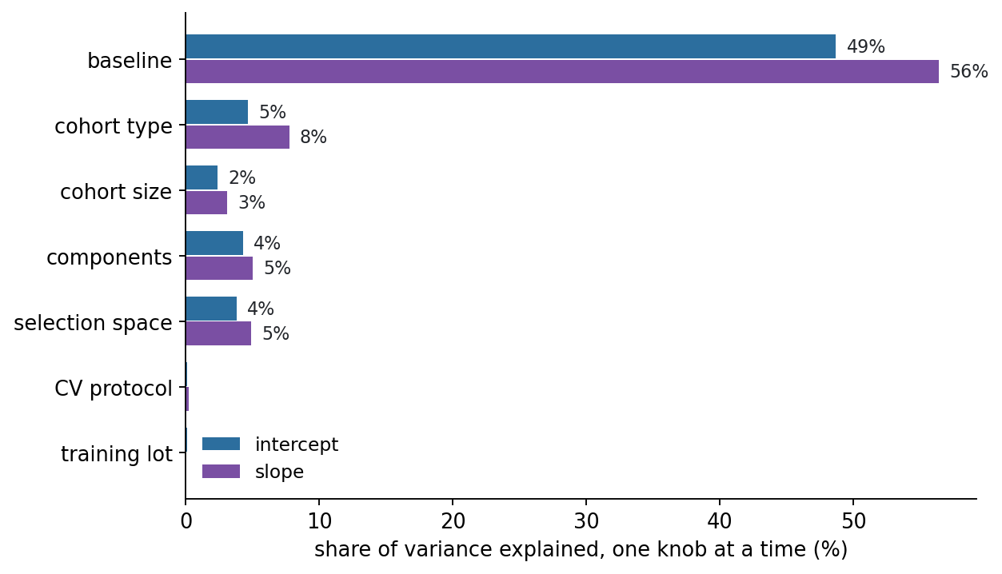
One knob matters, six are decoys
Baselining is 49% of intercept variance and 56% of slope variance. CV protocol and training lot are 0.1% each.

Slide 14
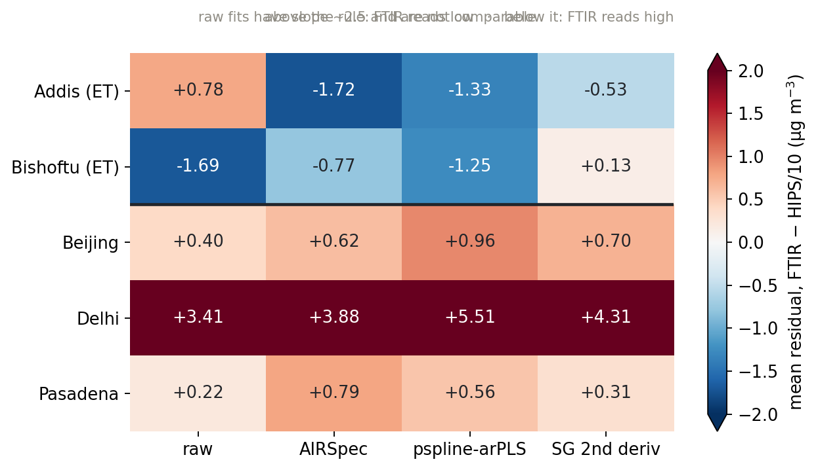
The regional sign flip
Both Ethiopian sites read low under every spectral representation; the other three read high under all four. Scale clipped at ±2 so Delhi saturates rather than flattening the contrast.

Slide 15
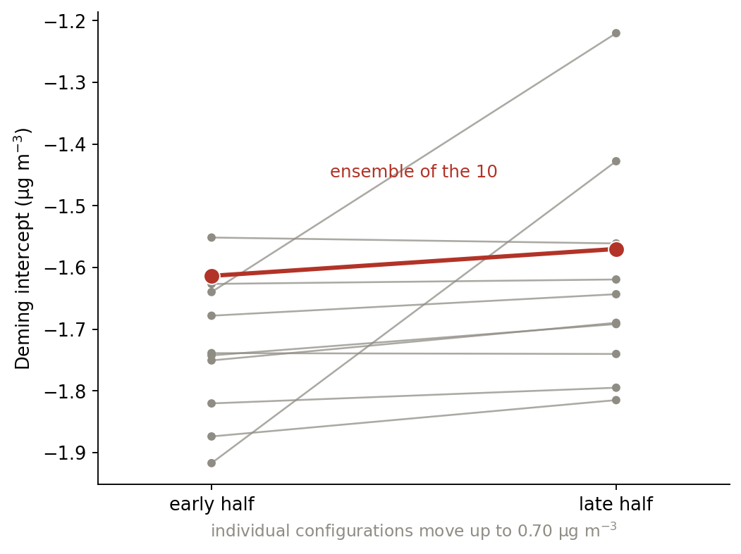
Ensembling buys reproducibility, not score
Ten individual configurations fan out by 0.70 µg/m³ between blind halves; their ensemble moves 0.04.

Slide 16
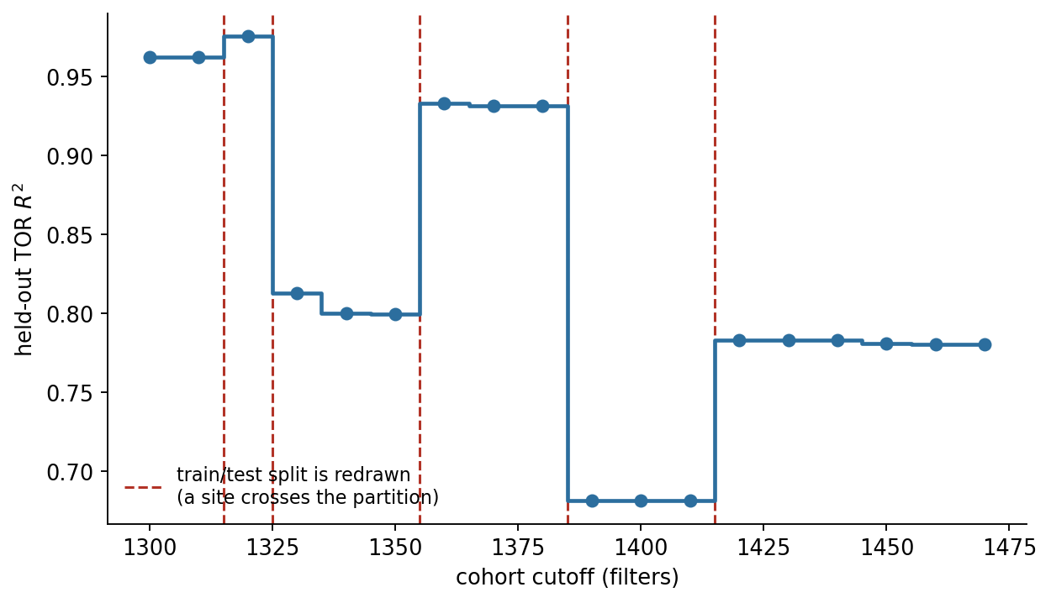
The held-out R² step function is an artifact
Every discontinuity coincides with the train/test split being redrawn, because the site-grouped folds are recomputed from whichever sites the cohort happens to contain.

Slide 17
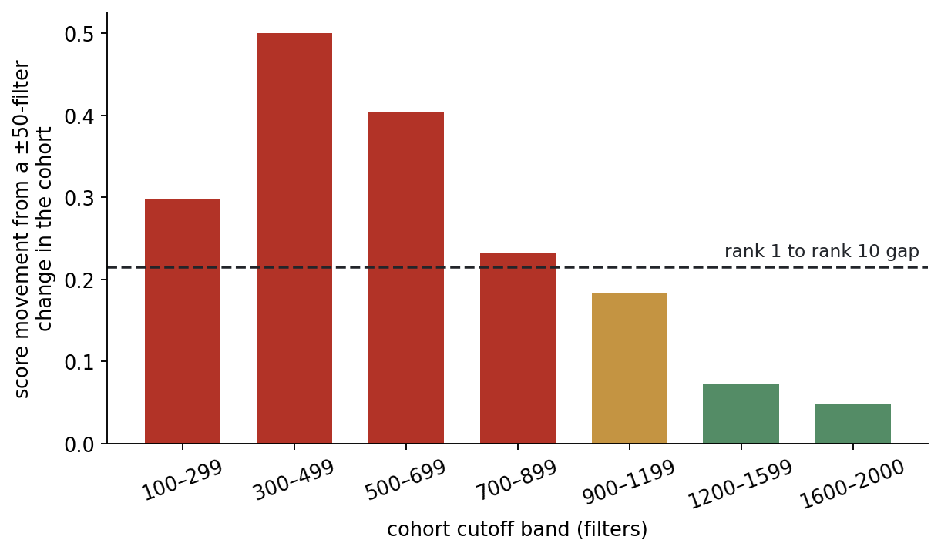
Cohort choice swamps the ranking
Below ~900 filters a ±50-filter change moves the objective further than the whole distance from rank 1 to rank 10.

Slide 18
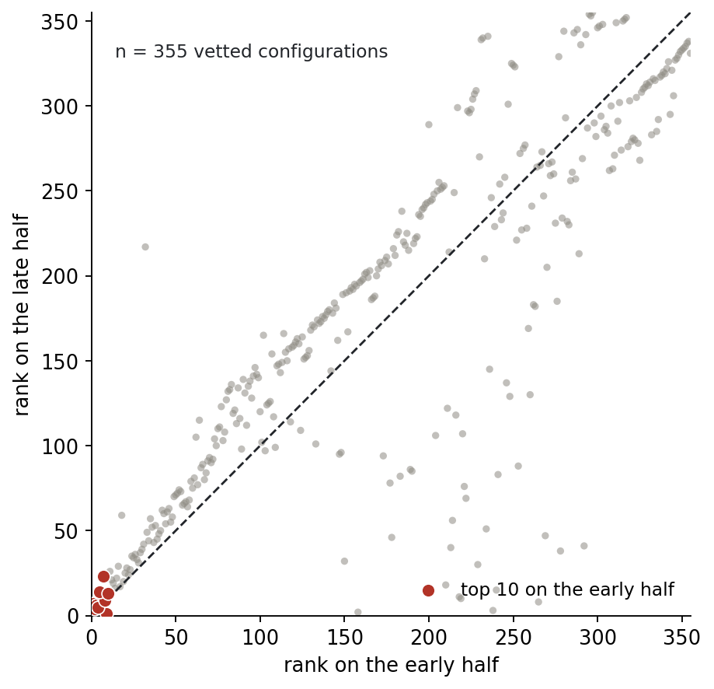
The vetted winner survives
Top ten on the early half cluster in the corner on the late half. This corrects the earlier claim that the leaderboard top was noise.

Slide 19
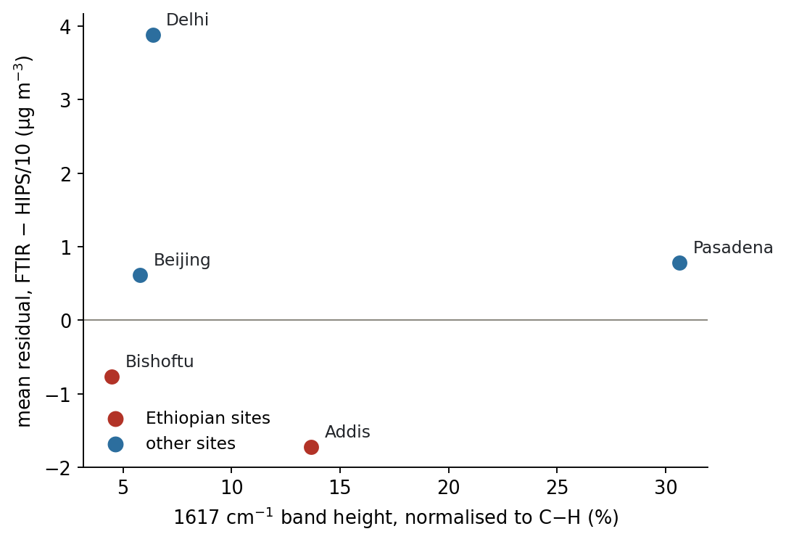
The 1617 cm⁻¹ band does not track the offset
Pasadena has the strongest normalised band of any site and a positive offset; Bishoftu the weakest and a negative one.

Slide 20
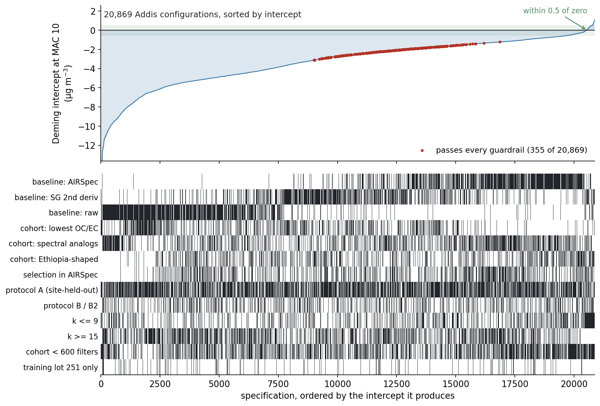
Every Addis iteration, all 20,869 of them
Each specification's intercept, sorted, with the analytic choices that produced it marked beneath. Raw baselines block the bad end and AIRSpec fills the good end, which is the visual form of baselining being 49% of the variance. 355 clear every guardrail and none reaches zero.

Slide 21
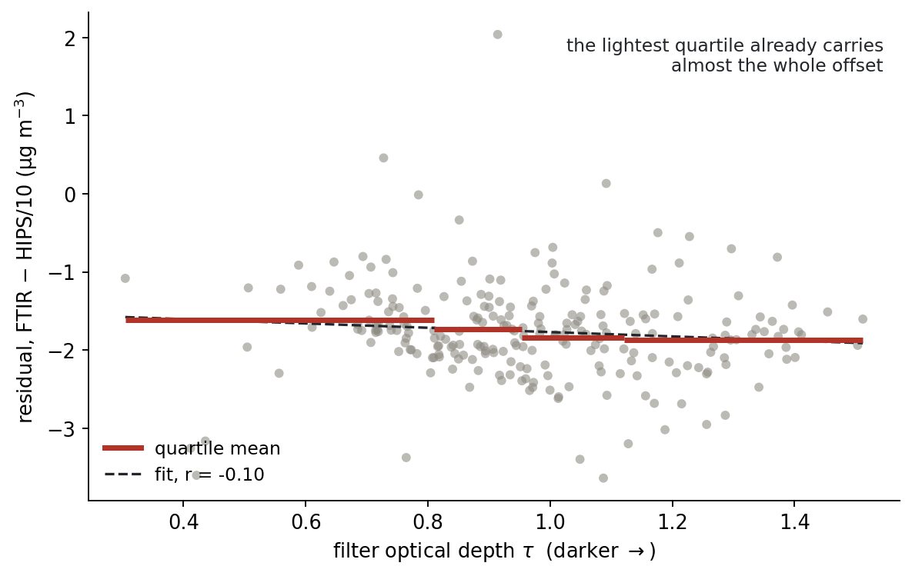
Loading is not the mechanism
Within Addis, r = −0.10 against filter darkness, and the lightest quartile already carries −1.61 of the −1.7.

Slide 22
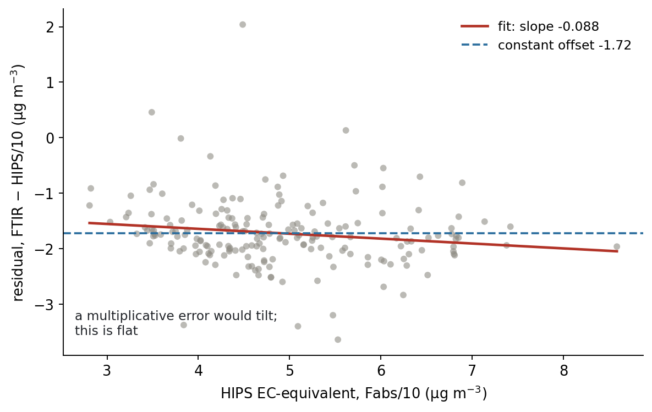
The offset is additive
Residual against concentration is flat, slope −0.088. A wrong MAC or any proportional error would tilt this line.

Slide 23
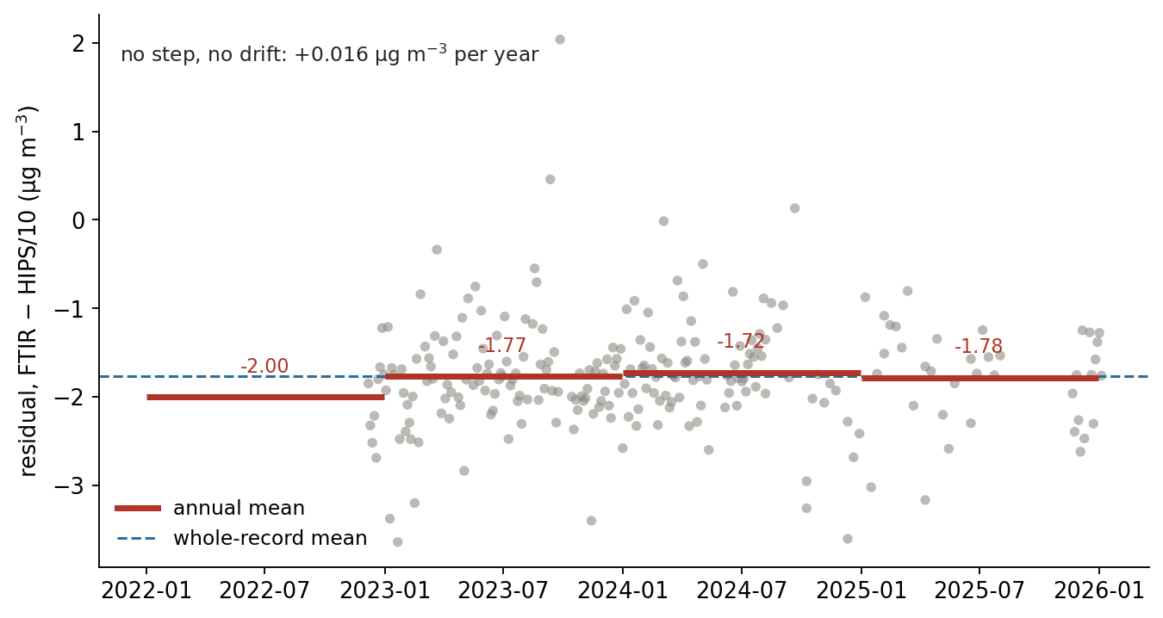
No drift, no processing step
+0.016 µg/m³ per year across three years and multiple analysis batches.

Slide 24
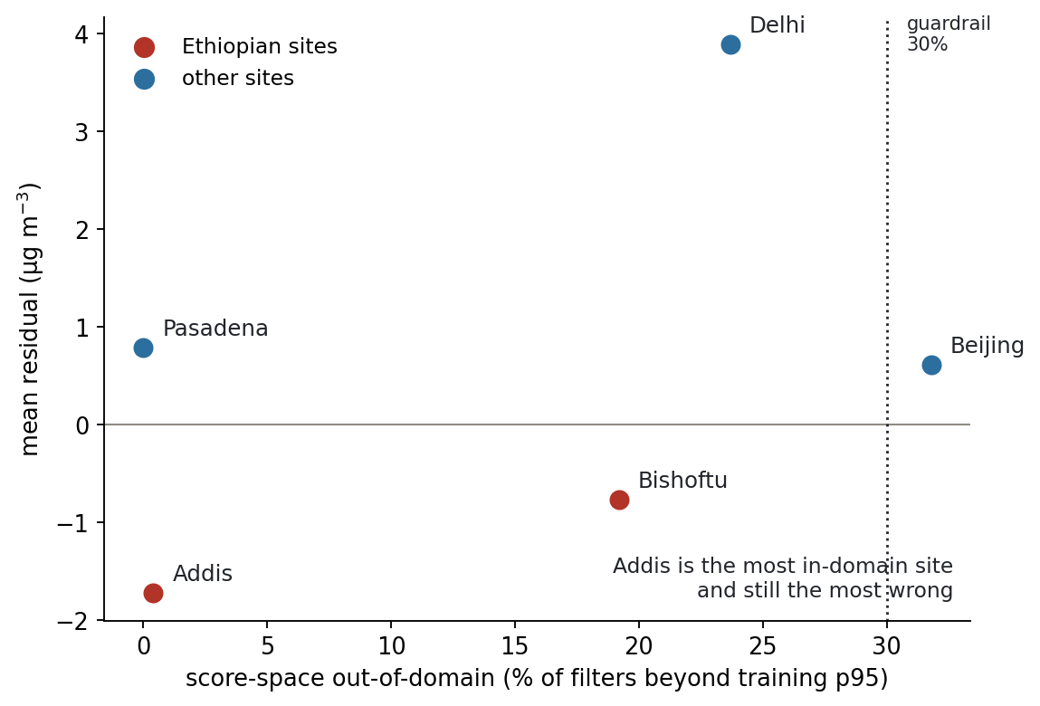
Addis is in-domain and still wrong
Weakley's diagnostic puts Addis at 0.4% out-of-domain, the lowest of the five sites. Beijing flags at 32% and reads high.

Slide 25
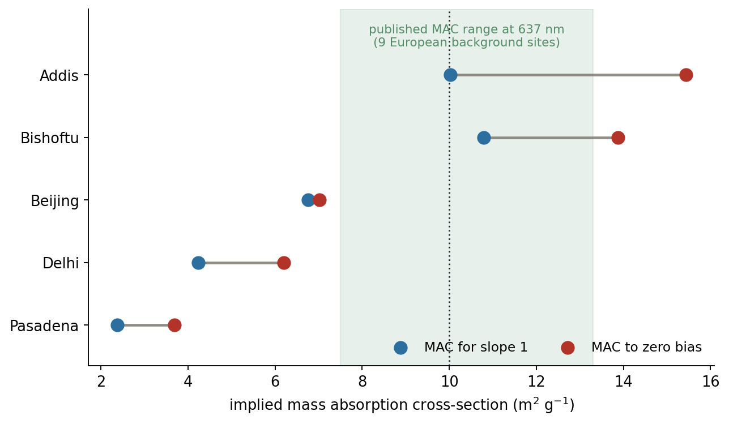
No single MAC reconciles Addis
Bar length is the gap between the MAC that would zero the bias and the MAC that would make the slope 1. Beijing is consistent at ~6.9; Addis needs 15.4 and 10.0 at once.

Slide 26
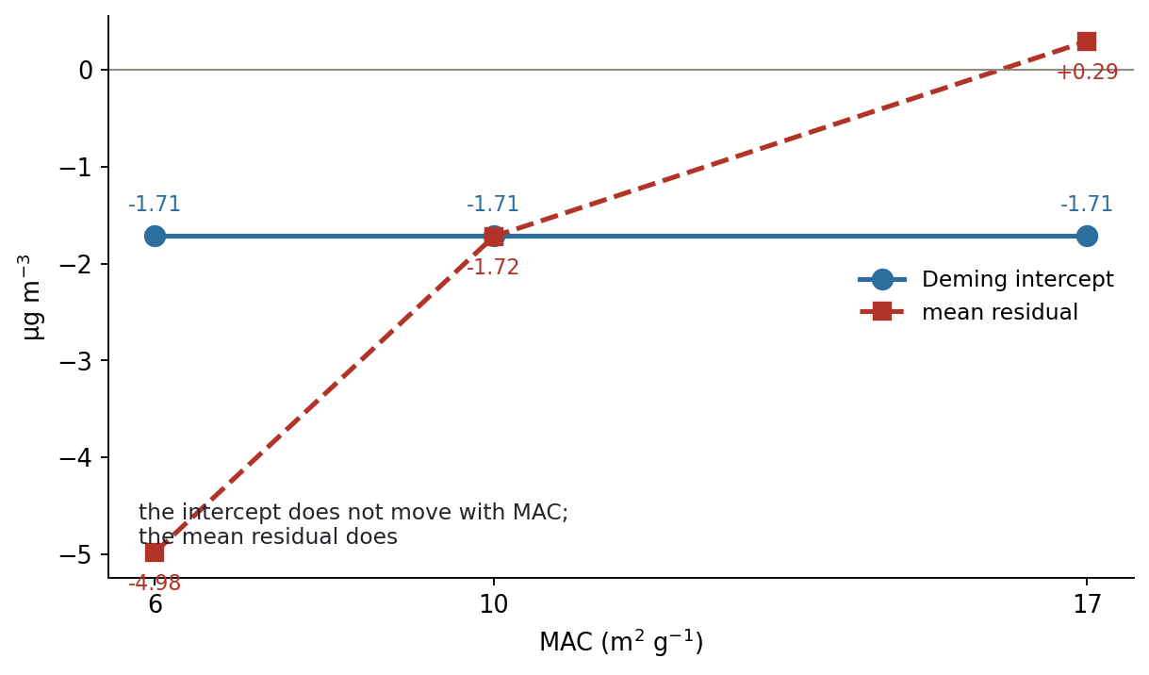
What MAC moves, and what it does not
The Deming intercept is identical at MAC 6, 10 and 17. The mean residual swings from −4.98 to +0.29.

Slide 27
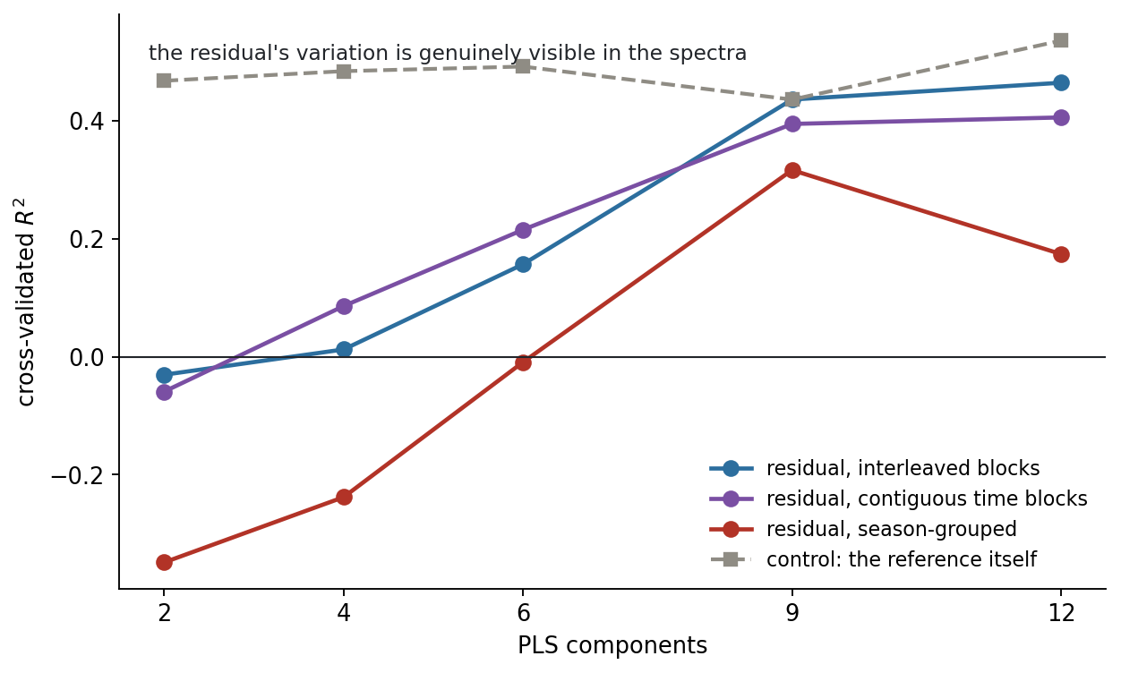
The residual's variation is spectrally visible
A model predicts the FTIR−HIPS residual from the spectra at CV R² 0.32–0.40 under strict schemes, about two thirds the predictability of the reference itself.

Slide 28
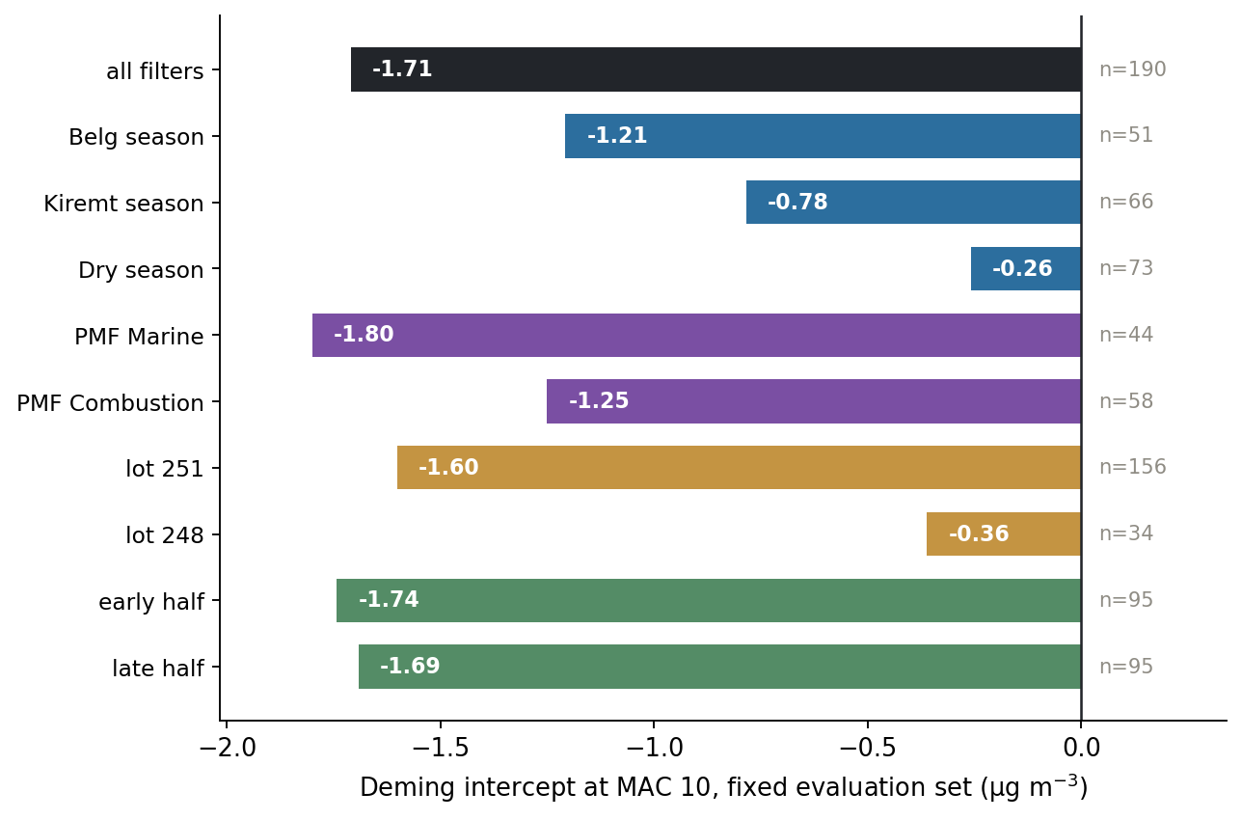
Negative under every slice
Season, PMF source class, filter lot and blind half. The dry season at −0.26 is the shallowest and matches the committed seasonal table.

