Slide 1



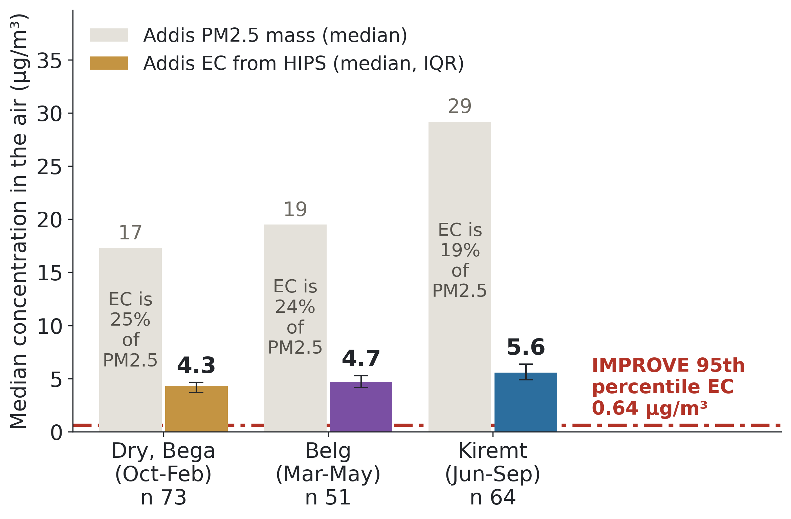
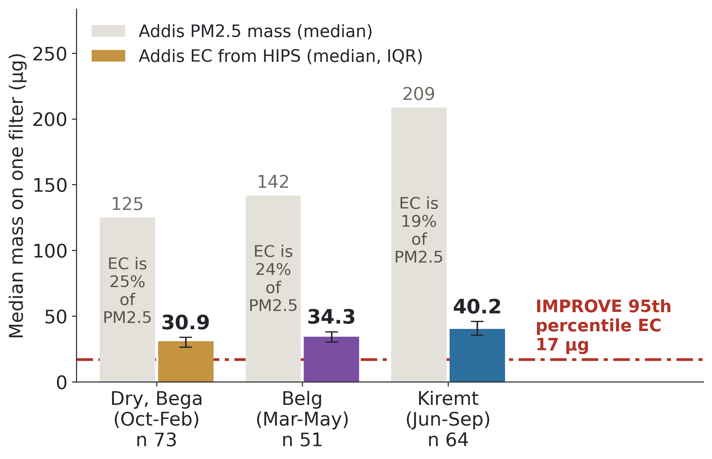
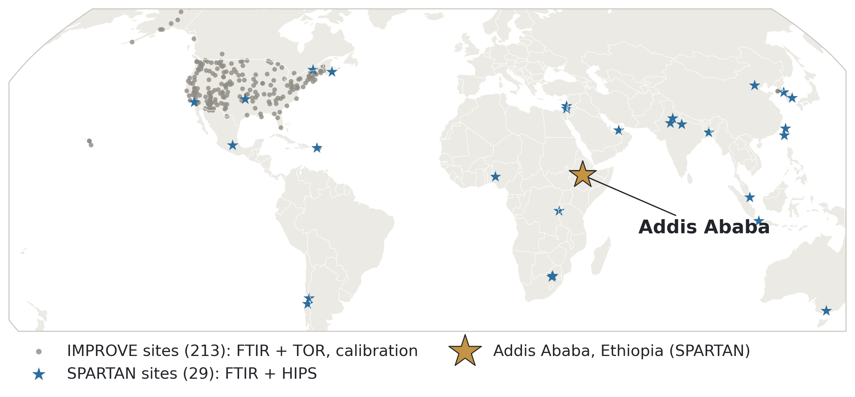
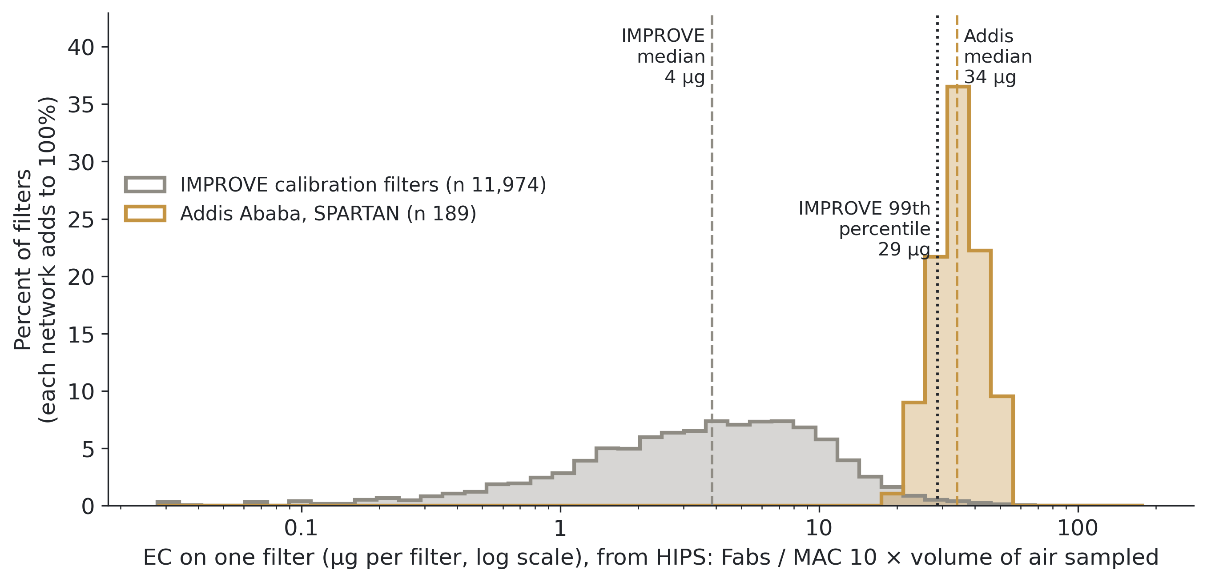
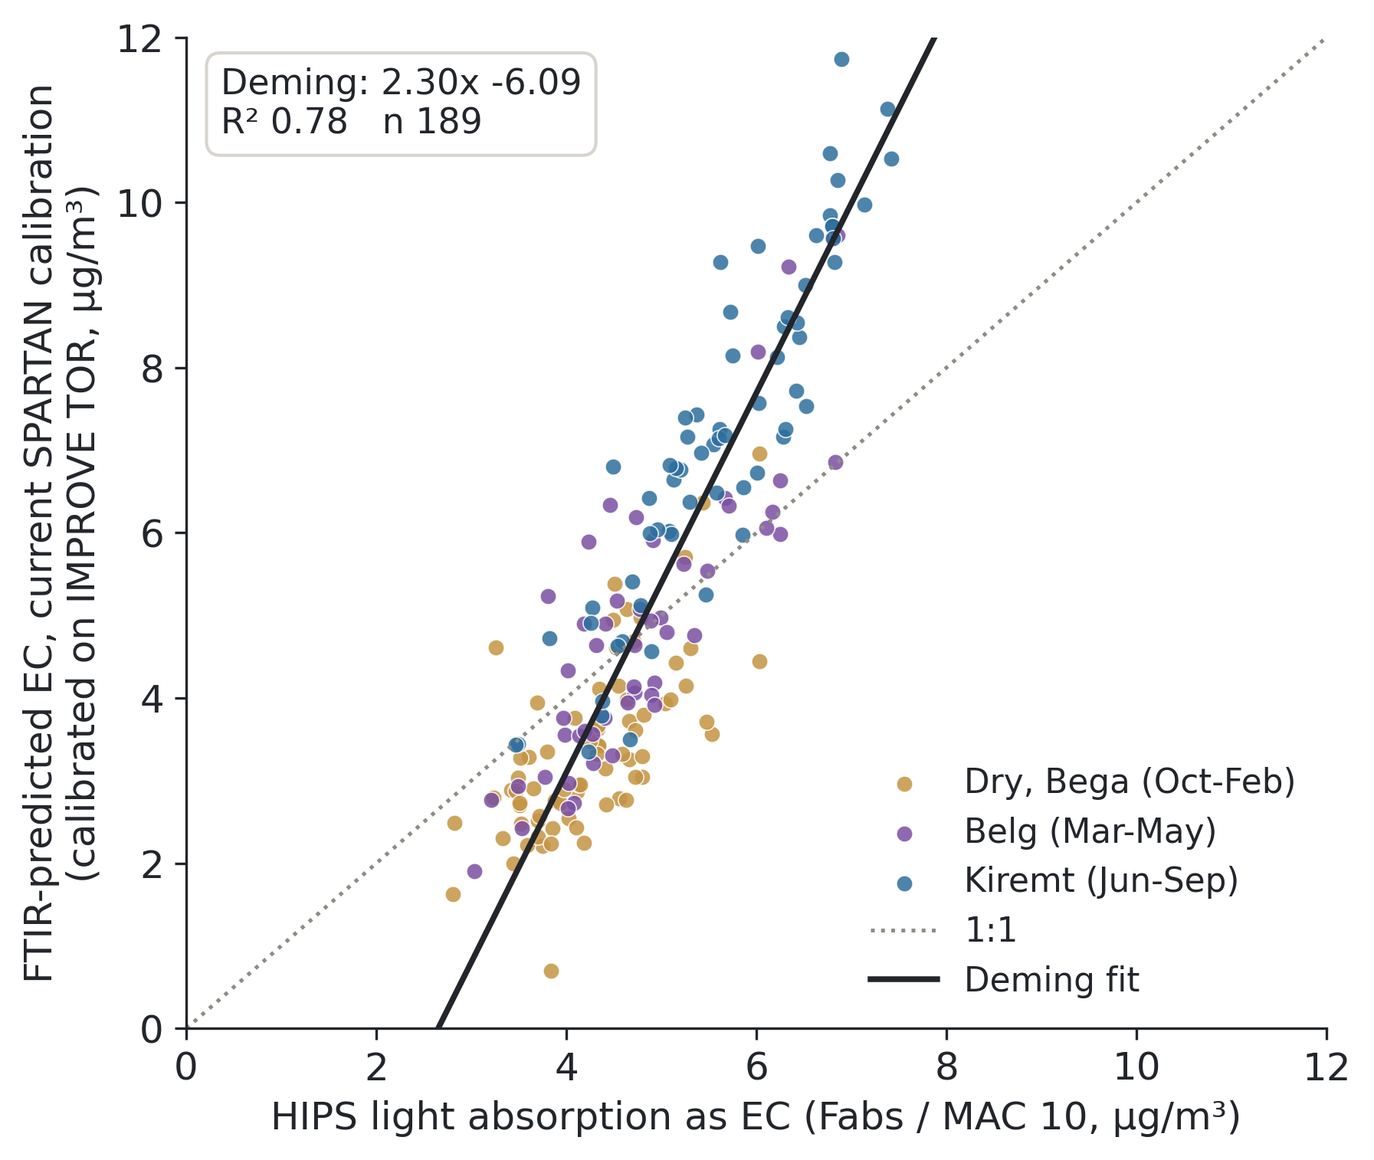
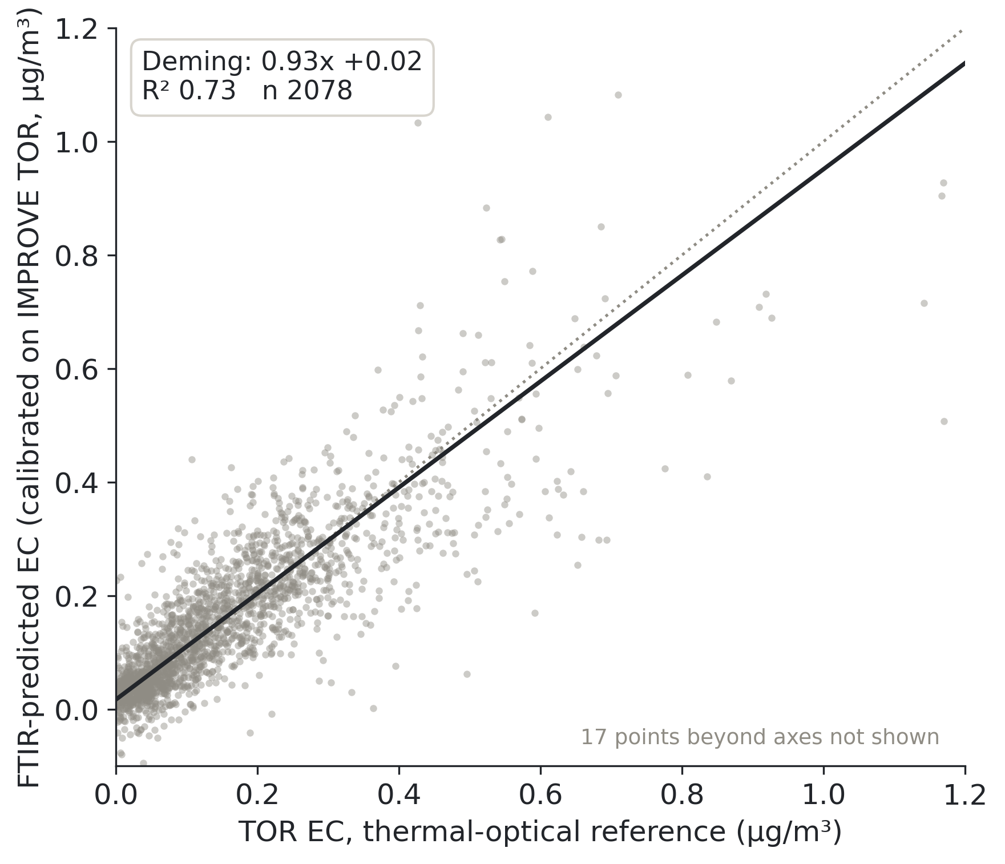
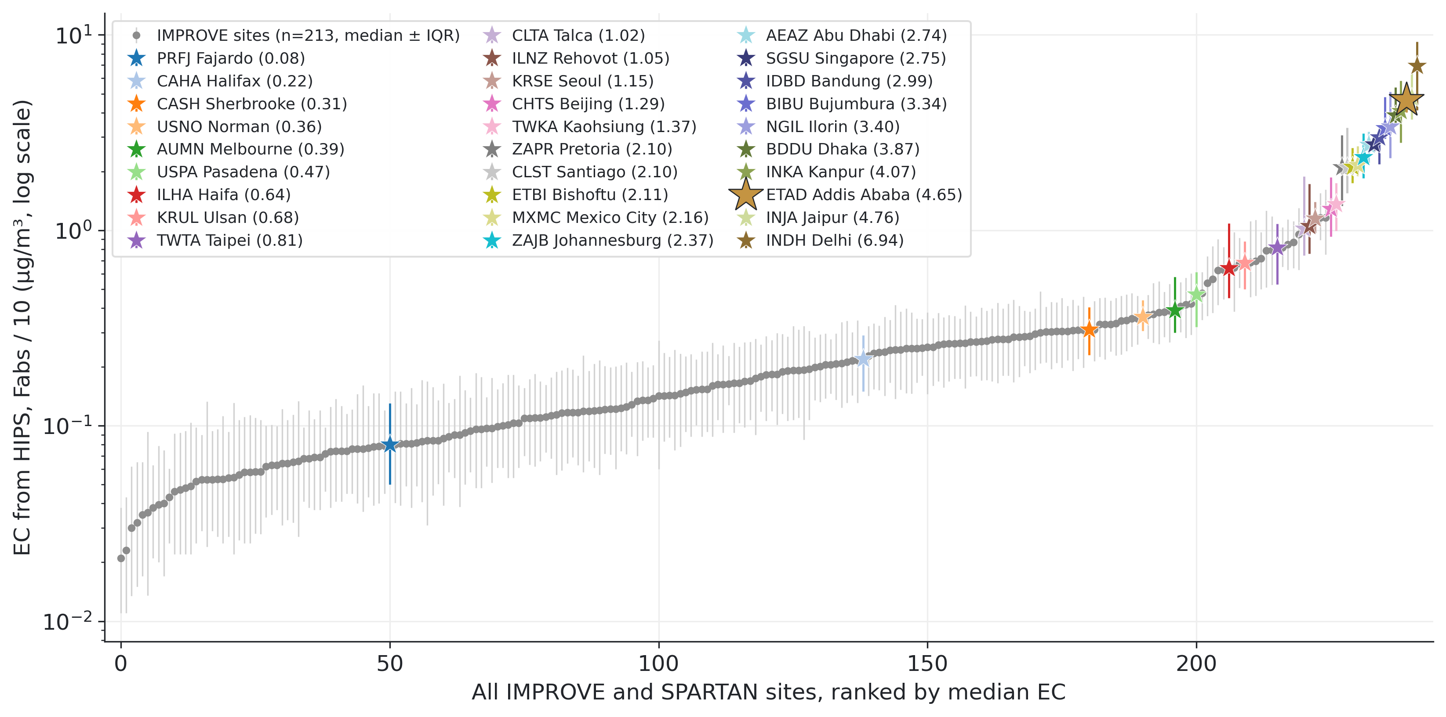
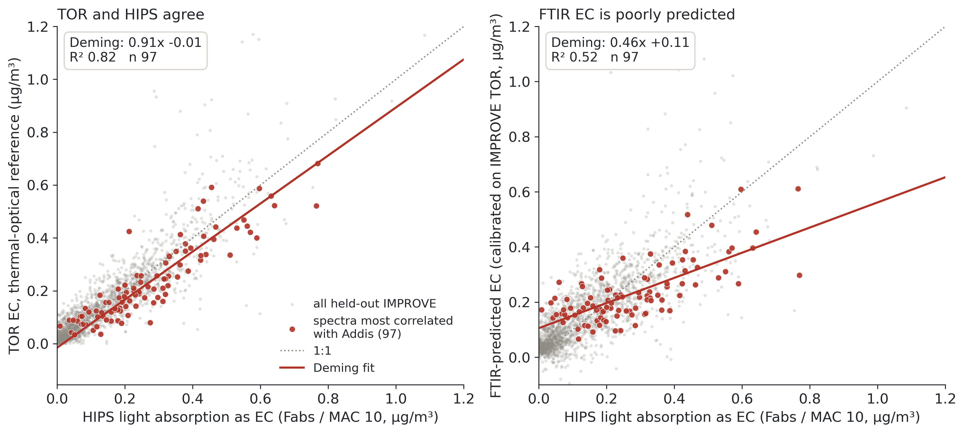
Comparison of FTIR elemental carbon (EC) measurements in Addis Ababa, Ethiopia with rural U.S. IMPROVE EC measurements
MAIA logo
Ahmad Jalil¹˒⁴, Sina Hasheminassab², Kyan Shlipak⁵˒², Tesfaye Mamo Mekonnen³, Araya Asfaw³, Hossein Kazemian¹, Ann M. Dillner⁴
¹ MATTER lab, University of Northern British Columbia, Prince George, BC, Canada · ² NASA Jet Propulsion Laboratory, Pasadena, CA, USA · ³ Addis Ababa University, Addis Ababa, Ethiopia · ⁴ Air Quality Research Center, University of California Davis, Davis, CA, USA · ⁵ Northwestern University, Evanston, IL, USA
Why elemental carbon in Addis Ababa?
Addis Ababa EC is higher than IMPROVE levels
Why: Addis filters are outside the calibration
Elemental carbon (EC) is the black, soot-like carbon from burning. It warms the climate and harms health.
SPARTAN (Surface PARTiculate mAtter Network) samples particles onto filters in cities around the world, mostly in the Global South. It measures EC by FTIR (below).
Addis Ababa, capital of Ethiopia (East Africa, about 2,400 m elevation, about 5 million people) is a SPARTAN site with some of the highest EC in the network. Households cook and heat with wood and charcoal.
We use 189 Addis filters (Dec 2022 to Sep 2024) across three seasons: Dry (Bega, Oct to Feb), Belg short rains (Mar to May) and Kiremt long rains (Jun to Sep).
Figure 3. Addis medians by season: grey bars PM2.5, coloured bars EC (line: interquartile range). Red line: the IMPROVE 95th percentile of EC (95% of IMPROVE filters are below it). Addis EC is 4.3 to 5.6 µg/m³ in every season, about 7× even that IMPROVE filter, and EC is 19 to 25% of PM2.5 (about 4% at a typical IMPROVE site).
Figure 6. The same Addis filters as µg of EC on one filter, which is what FTIR sees. IMPROVE samples about 4× more air per filter (about 22 vs 5 L/min), so the gap is smaller than in the air, but typical Addis EC is still about 2× the IMPROVE 95th percentile.
The problem: FTIR EC is poorly predicted but well correlated
Figure 1. Where the filters come from. Grey: IMPROVE sites (US), which provide the calibration. Blue stars: SPARTAN sites, where the calibration is applied.
How FTIR measures EC: a calibration
FTIR (Fourier-transform infrared spectroscopy) passes infrared light through a Teflon filter and records how much is absorbed at each wavenumber. That curve is the filter's spectrum. FTIR is fast, cheap and does not destroy the filter, but a spectrum does not give EC directly: it has to be calibrated against a reference.
Most methods are calibrated with laboratory standards. FTIR EC is calibrated with ambient samples: real IMPROVE filters on which the same air was collected on a Teflon filter (FTIR spectrum) and on a quartz filter (EC measured by TOR, the reference method).
Figure 7. Across: µg of EC on one filter (log scale, each tick is 10×). Up: percent of filters. The typical Addis filter carries about 9× the EC of a typical IMPROVE calibration filter, and 79% of Addis filters are above IMPROVE's 99th percentile: the calibration has seen almost nothing like them.
Figure 4. How to read: each point is one filter; the dotted line is 1:1 (perfect agreement). Left, Addis Ababa: across, HIPS light absorption converted to EC (Fabs / MAC 10); up, FTIR EC from the current SPARTAN calibration. R² is high (0.78), so the two are related, but slope 2.30 and intercept -6.1 µg/m³ are not physically sensible. Right, IMPROVE: 2,078 held-out filters, FTIR EC against TOR EC: slope 0.93, intercept +0.02 µg/m³, R² 0.73. The method works on typical IMPROVE filters.
IMPROVE
ambient samples
(US national
parks, rural)
Teflon filter
→ FTIR spectrum
PLS calibration
learns which
spectral features
predict TOR EC
Is it MAC? Changing MAC only stretches the HIPS axis: it changes the slope but leaves the intercept at -6.1. So something in the FTIR prediction must change too.
Quartz filter
→ TOR EC
IMPROVE filters that look like Addis fail too
Applied to SPARTAN spectra (Addis Ababa): FTIR EC, checked against HIPS light absorption (no TOR at Addis)
From the IMPROVE filters we picked the 97 whose spectra most resemble the Addis spectra. Many are smoke-affected.
Figure 2. The calibration chain. Every FTIR EC value in SPARTAN comes from a calibration built on IMPROVE filters.
Figure 8. Every IMPROVE (grey) and SPARTAN (stars) site ranked by median EC from HIPS. Addis is above all 213 IMPROVE sites, and 28 of 29 SPARTAN sites are above the typical IMPROVE site (17 above the highest). So this is not only an Addis problem.
Key terms
Conclusions and next steps
IMPROVE: Interagency Monitoring of PROtected Visual Environments, the US network sampling in national parks and rural areas.
TOR: thermal-optical reflectance. Heats a punch of a quartz filter and measures the carbon released; the standard reference for EC.
HIPS: hybrid integrating plate/sphere. Measures how much red light (633 nm) a Teflon filter absorbs, called Fabs.
MAC: mass absorption cross-section, the light absorbed per gram of EC (m²/g). EC = Fabs / MAC. We use MAC = 10 m²/g, a common default; the true value varies with sources.
Calibration set: the IMPROVE filters (with TOR EC) that one calibration is built from.
PLS: partial least squares regression, which turns a whole spectrum into one number (EC).
Baseline correction of the spectra: removing the smooth background from the Teflon filter and light scattering, so only particle absorption remains.
Held-out filters: IMPROVE filters from sites not used to build the calibration (a fair test).
Deming regression: a straight-line fit that allows for error in both measurements. Agreement means slope 1, intercept 0.
FTIR EC calibrated on ambient IMPROVE filters works for typical IMPROVE filters, but not for heavily loaded filters like Addis, nor for the IMPROVE filters whose spectra resemble Addis.
Calibrations built on clean, lightly loaded filters transfer poorly to polluted cities; testing on the whole network hides this.
Next: pick calibration filters by EC-to-PM2.5 ratio; check TOR on the heaviest, smoke-affected IMPROVE filters; collocated Teflon and quartz filters from Addis Ababa are planned.
Figure 5. Across: HIPS EC (Fabs / MAC 10). Grey: all held-out IMPROVE filters; red: the 97 most like Addis. Left: the two reference methods agree on them (TOR vs HIPS slope 0.91, R² 0.82). Right: the same FTIR calibration predicts them poorly (slope 0.46, R² 0.52): too high at low EC, too low at high EC. Same calibration, same method; only the samples changed.
References
Chow, J. C., et al. (2007). The IMPROVE_A temperature protocol for thermal/optical carbon analysis. J. Air Waste Manag. Assoc., 57, 1014-1023.
Dillner, A. M., & Takahama, S. (2015). Predicting ambient aerosol thermal-optical reflectance measurements from infrared spectra: elemental carbon. Atmos. Meas. Tech., 8, 4013-4023.
Kuzmiakova, A., Dillner, A. M., & Takahama, S. (2016). An automated baseline correction protocol for infrared spectra of atmospheric aerosols collected on polytetrafluoroethylene (Teflon) filters. Atmos. Meas. Tech., 9, 2615-2631.
Malm, W. C., et al. (1994). Spatial and seasonal trends in particle concentration and optical extinction in the United States. J. Geophys. Res., 99, 1347-1370.
Snider, G., et al. (2015). SPARTAN: a global network to evaluate and enhance satellite-based estimates of ground-level particulate matter for global health applications. Atmos. Meas. Tech., 8, 505-521.
White, W. H., et al. (2016). A critical review of filter transmittance measurements for aerosol light absorption, and de novo calibration for a decade of monitoring on PTFE membranes. Aerosol Sci. Technol., 50, 984-1002.
Data: SPARTAN public release v3.1.4; IMPROVE data from the Federal Land Manager Environmental Database (FED).
So why calibrate with IMPROVE filters at all? Because it is the only data set that exists. IMPROVE's library of matched Teflon (FTIR) and quartz (TOR) ambient filters is the only one anywhere in the world. There is no equivalent from Addis Ababa or any other city: CSN (the US urban network) filters are bigger and thicker and sample at a lower flow. Predication quality lower….
Acknowledgments: supported by the NASA MAIA mission. Thanks to the SPARTAN team and the UC Davis FTIR group.

