Slide 1
SPARTAN EC — update
August 18, 2026
Notes:
SAY: Quick shape of today: first, the Thursday list — every item on it has an answer, and I'll walk the four that changed the picture. Then two context results — the filter-lot check and a Mie-theory grounding for the MAC 6-vs-10 question — then where Bishoftu stands, and I saved time at the end for the committee-meeting and funding items from your email.
NOTES: If Ann joins late, slides 2-3 stand alone as the summary; resume from wherever she lands. Everything numeric today is Deming at MAC 10 on the fixed 190-filter cohort, in µg/m³, protocol named on every figure.

Slide 2
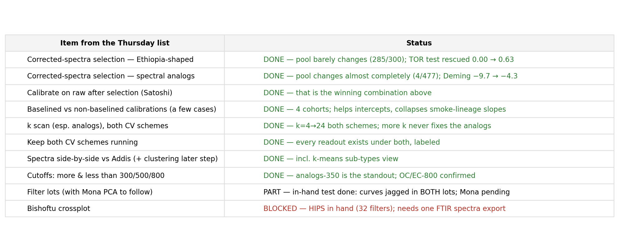
Thursday's list: every item has an answer
Notes:
SAY: This is the list I sent Thursday, item by item. Everything testable is done; the two open ones are open for external reasons — Mona's PCA plots for the lot question, and one data export for Bishoftu. The four rows that actually changed the picture are the corrected-spectra selections, the k scan, and the cutoffs — that's the next four slides.
NOTES: 'DONE' here means run end-to-end under the site-held-out protocol with the held-out TOR test, and cross-checked under the calibration-app protocol. All of it is reproducible on demand — the whole grid reruns in seconds from the calibration explorer.

Slide 3
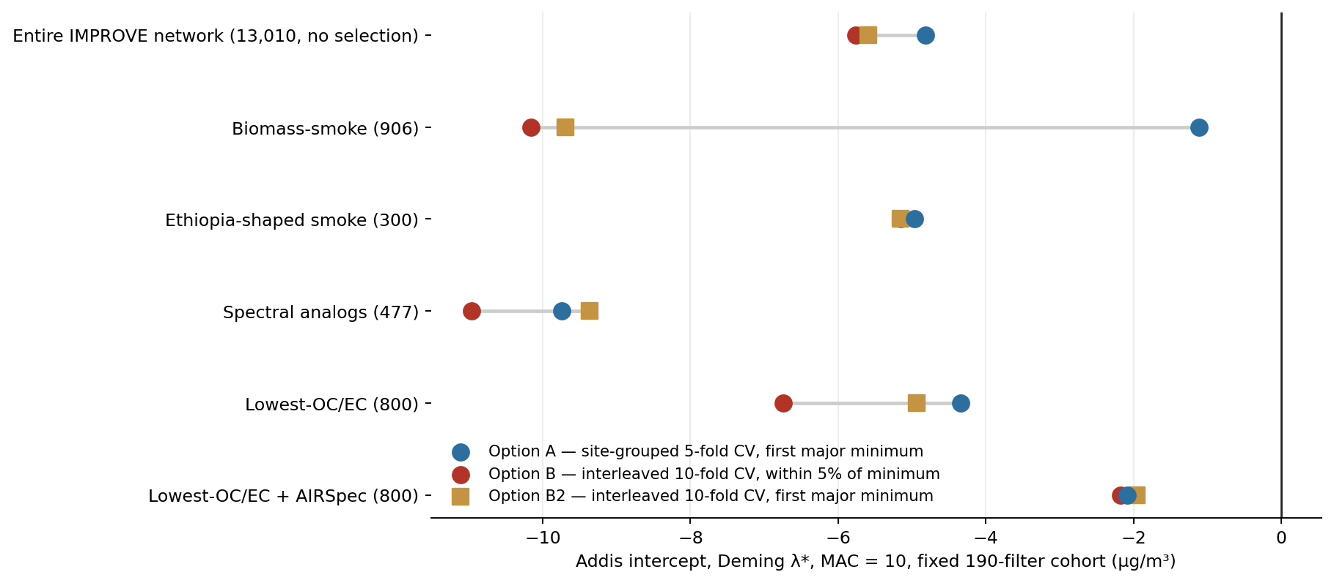
The grid under three component options — Option B reproduces last week’s numbers exactly
Notes:
SAY: Provenance first, and the naming we'll use from here on. Option A is our site-grouped 5-fold CV with the first-major-minimum rule. Option B is the current network protocol — interleaved 10-fold CV, k within 5 percent of the minimum — and it reproduces the exact intercepts from last week's slides: minus 5.76, minus 10.2, minus 6.74, minus 2.17. New today is Option B2: the same interleaved folds, but read with the first-major-minimum rule — it separates how much of the A-versus-B gap comes from the fold structure versus the k-rule. Answer: B2 mostly lands between them — the k-rule matters, but the fold structure is the bigger lever. And the AIRSpec setup barely moves under any option: minus 2.1, minus 2.2, minus 1.95.
NOTES: k by option — network A 15 / B 27 / B2 19; smoke 4/19/21; Ethiopia-shaped 10/18/18; analogs 4/19/9 (B2 lands on the meeting's 9); lowest-OC/EC 6/17/9; +AIRSpec 5/19/5. B2 needed real machinery: the pooled interleaved curve has no SE band, so the first-major-minimum rule degenerates on it — B2 uses per-fold RMSEs on the identical folds (mean ± SE), now in the shared calibration_modes code and selectable in the explorer. Caveat: network row under Option A picks k=15 vs the locked phase-3 run's 10 — unexplained, don't quote that cell as final.

Slide 4
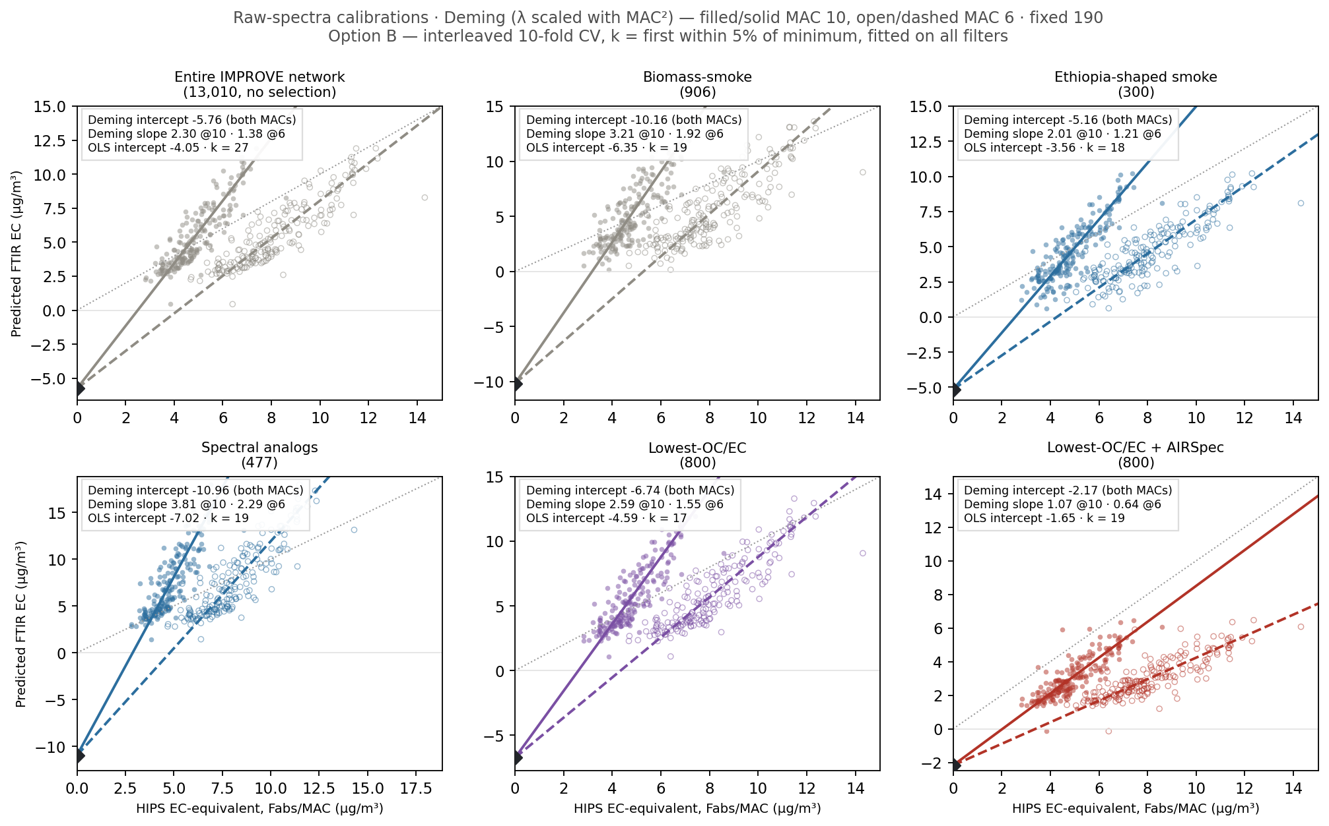
On raw spectra: every setup shares one Deming intercept across MACs — the MAC pivots only the slope
Notes:
SAY: The six-panel view we showed Satoshi, regenerated under Option B: filled points and solid lines are MAC 10, open points and dashed lines are MAC 6, Deming with lambda scaled by MAC squared. The black diamond is the shared intercept — the ftir_19 result that MAC choice cannot move any intercept, it only pivots the slope. Read the intercepts across panels: minus 5.8, minus 10.2, minus 5.2, minus 9.4, minus 6.7, and minus 2.2 for the AIRSpec setup.
NOTES: Same construction as the deck figure from last week (mac_effect grid); regenerated from the explorer so it pairs exactly with the next slide. Fixed 190-filter cohort throughout; stat boxes carry Deming both MACs + OLS intercept + k.

Slide 5
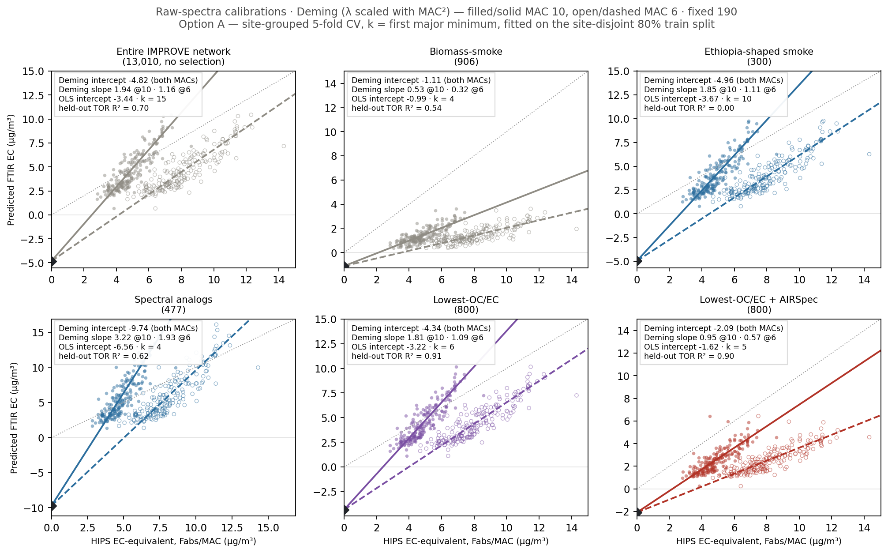
The same six setups under Option A (site-grouped 5-fold, first major minimum): fewer components, and a held-out test per panel
Notes:
SAY: The Option A variant of that grid — site-grouped 5-fold CV, first-major-minimum, fitted on the site-disjoint 80 percent train split. Two things change. First, k drops everywhere — 15, 4, 10, 4, 6, 5 instead of the twenties — the blocked CV picking the more parsimonious models, as Satoshi predicted. Second, because Option A holds sites out, every panel now carries a held-out TOR R-squared: the network tests at 0.70, lowest-OC/EC at 0.91, AIRSpec at 0.90 — and Ethiopia-shaped at 0.00, which is the asterisk we've been carrying. Biomass smoke deflates to a slope of one half at intercept minus 1.1 — small intercept, but half the EC.
NOTES: This is the grid Option B cannot draw honestly — under B there is no held-out test by construction. The k differences vs Option B are the ftir_20/21 protocol story; the intercept swings (smoke minus 10.2 to minus 1.1, analogs stay bad both ways) show which setups are protocol-fragile vs protocol-robust.

Slide 6
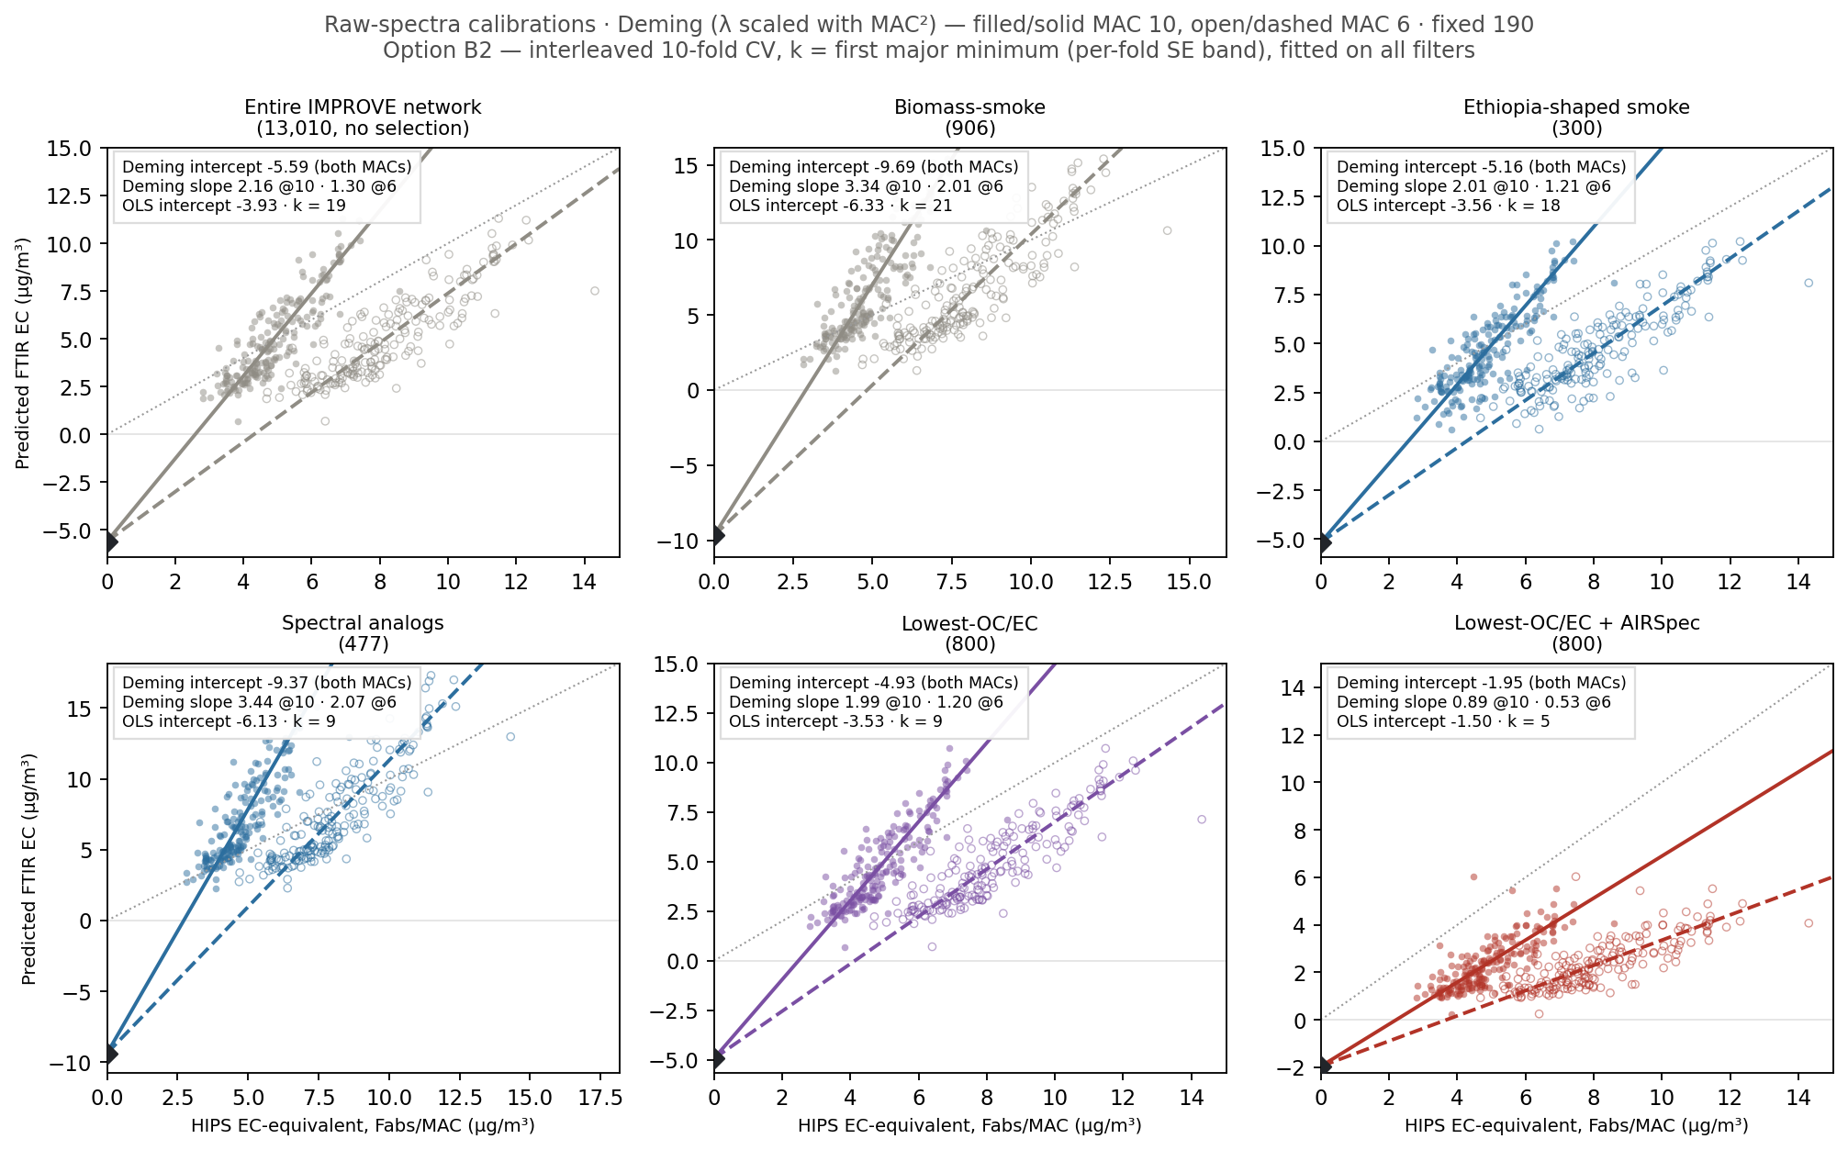
Option B2 (same interleaved folds, first-major-minimum rule): mostly lands between A and B
Notes:
SAY: And the B2 variant — identical interleaved folds to Option B, but k read by the first-major-minimum rule, which we made honest by giving the interleaved curve a per-fold SE band. The k values move to 19, 21, 18, 9, 9, 5 — and the intercepts mostly land between A and B: network minus 5.6, lowest-OC/EC minus 4.9, AIRSpec minus 1.95. Note the analogs land on exactly k equals 9 — the number from the meeting. So the A-versus-B gap decomposes: the k-rule accounts for part, the fold structure for more.
NOTES: B2 fits on all filters like B, so no held-out test. Machinery: interleaved_cv_curve_folds in calibration_modes (per-fold RMSE mean ± SE on the identical folds); needed because the pooled interleaved curve has no SE so the FMM rule degenerates on it.

Slide 7
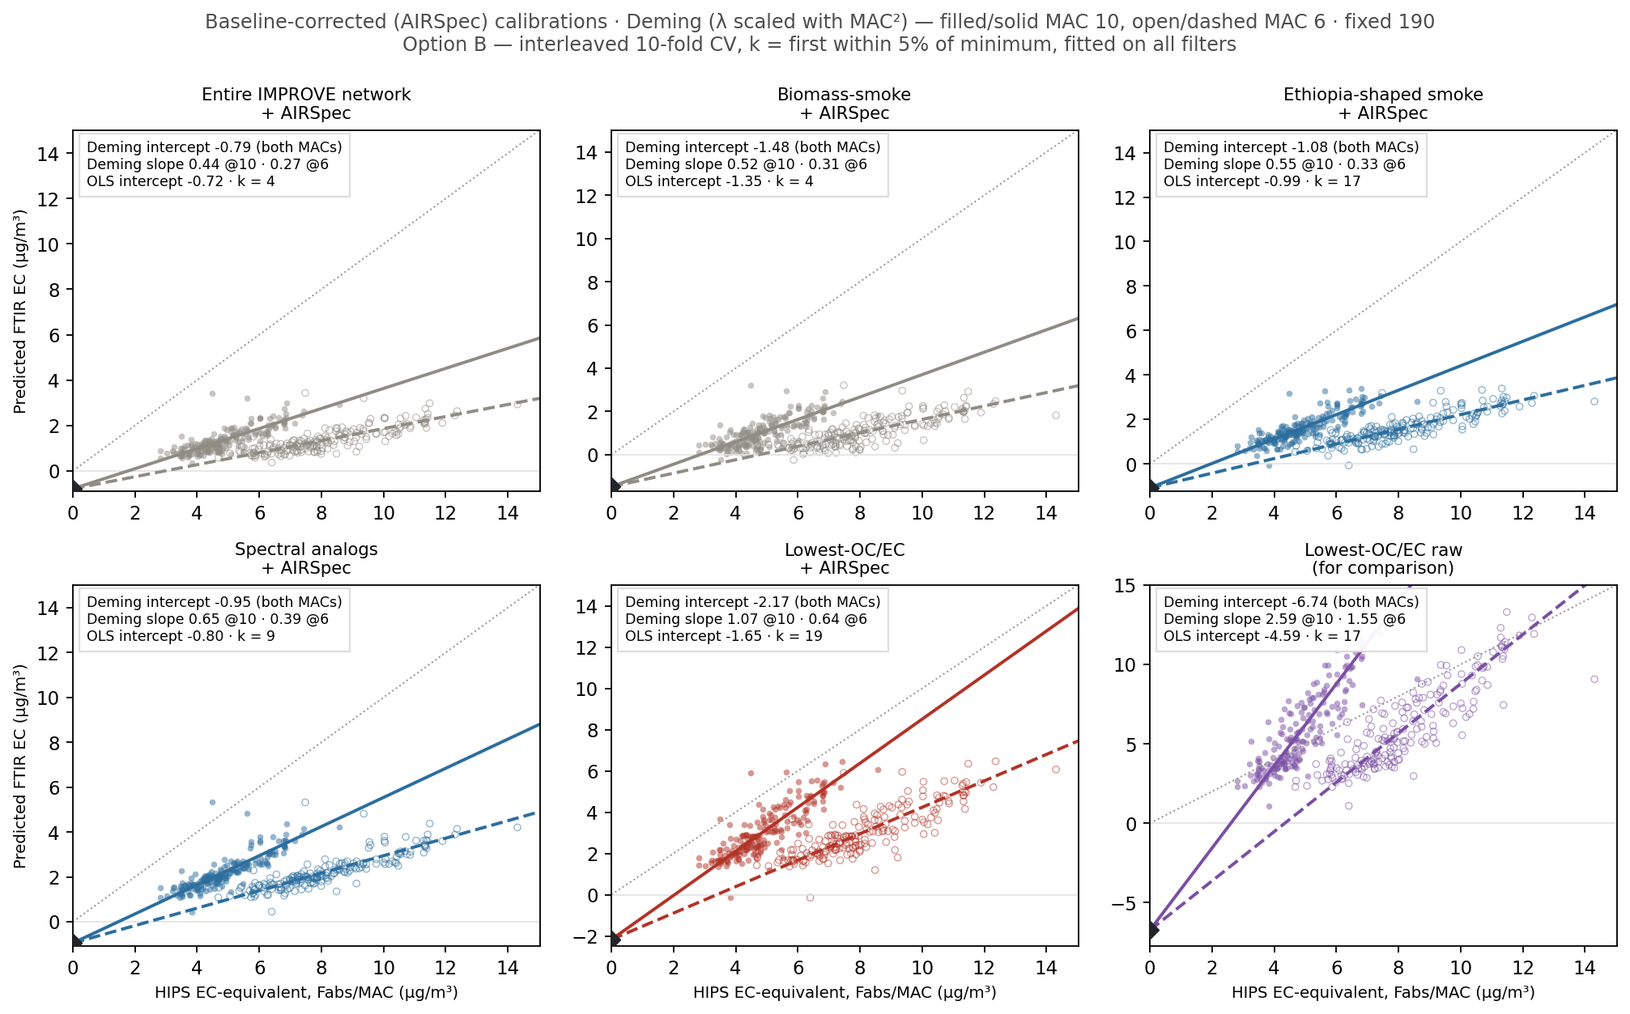
The same grid, calibrated on baseline-corrected (AIRSpec) spectra: every intercept shrinks — only Lowest-OC/EC keeps a real slope
Notes:
SAY: And here is the companion you asked about — the same six-panel grid with every calibration run on baseline-corrected AIRSpec spectra, same Option B protocol, same MAC convention. Two things to read. First, every intercept shrinks: the whole network goes to minus 0.8, smoke to minus 1.5, the analogs to minus 0.95. Second, the price: the slopes collapse to 0.3 to 0.65 everywhere — except Lowest-OC/EC plus AIRSpec, which keeps slope 1.07 at MAC 10 with intercept minus 2.17. That is the one-figure version of why that setup is the locked headline: baselining alone buys small intercepts anywhere, but only the composition cohort keeps a slope you can use. The last panel repeats raw Lowest-OC/EC for contrast.
NOTES: AIRSpec = df1=6 caches, pool side and Addis side in the same corrected space. k under Option B on corrected spectra: network 4, smoke 4, Ethiopia-shaped 17, analogs 9, OC/EC 19. The smoke-lineage slope collapse on corrected spectra is the ftir_08/ftir_13 pattern — compositional, not a baseline artifact.

Slide 8
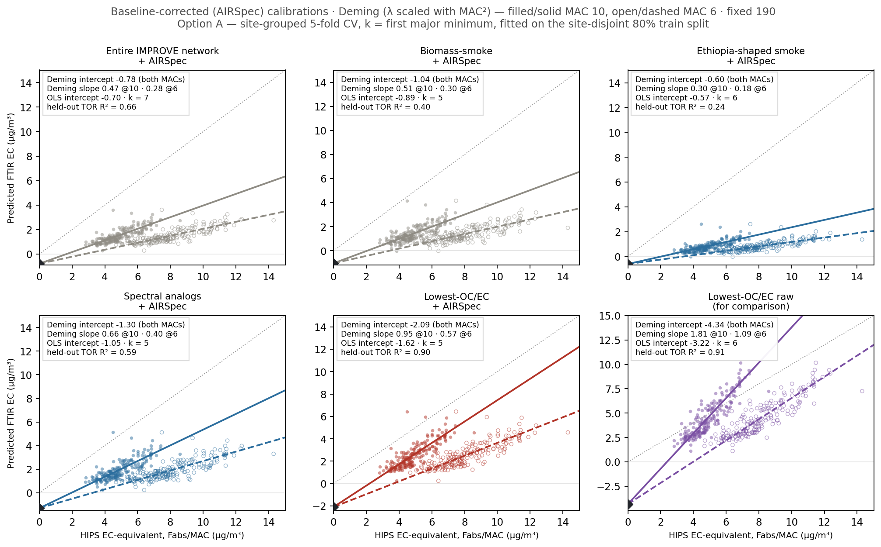
Baselined under Option A: the picture holds — small intercepts everywhere, but only Lowest-OC/EC + AIRSpec keeps TOR skill
Notes:
SAY: And the baselined grid under Option A, with the held-out tests. The intercept story is the same as under Option B — everything shrinks to minus 0.6 to minus 2.1 — and the held-out column tells you which of those small intercepts you can trust: the network at 0.66, smoke at 0.40, Ethiopia-shaped at 0.24, analogs at 0.59 — and Lowest-OC/EC plus AIRSpec at 0.90 with slope 0.95. Same conclusion from both protocols: baselining buys small intercepts anywhere, but the composition cohort is the only one that also passes the TOR test with a usable slope. That protocol-robustness is the strongest property the locked setup has.
NOTES: Lowest-OC/EC + AIRSpec across all readings: Option A minus 2.09, Option B minus 2.17, Option B2 minus 1.95 — three ways, same answer. Ethiopia-shaped + AIRSpec's minus 0.60 looks spectacular but its slope is 0.30 and TOR skill 0.24 — the trap panel to preempt if someone points at it.

Slide 9
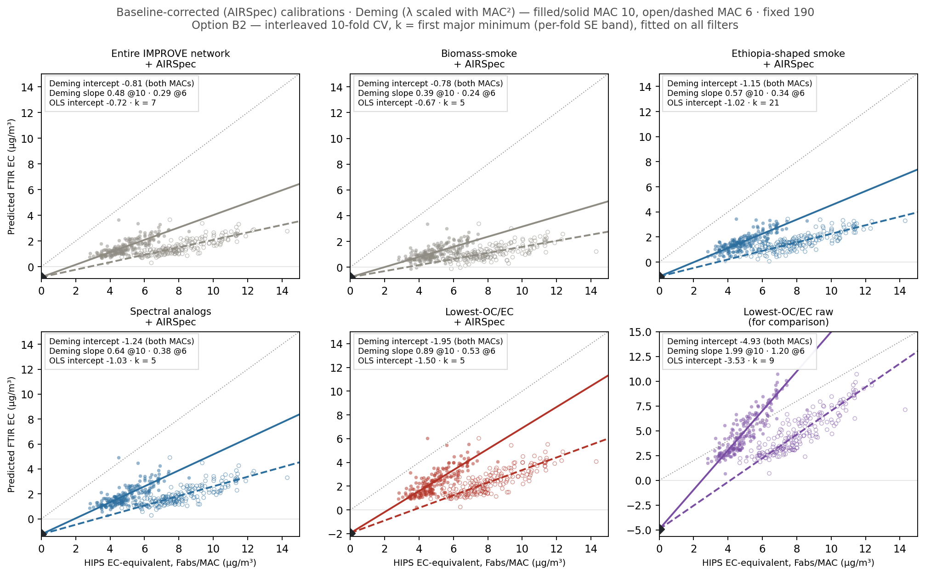
Baselined under Option B2: third protocol, same verdict — Lowest-OC/EC + AIRSpec at −1.95
Notes:
SAY: The baselined grid under B2 closes the protocol triangle. Intercepts again small everywhere — minus 0.8 to minus 1.2 — and the locked setup reads minus 1.95. So across A, B and B2 the baselined composition cohort gives minus 2.09, minus 2.17, minus 1.95: whatever we conclude about protocols, that number does not move. That protocol-invariance is the property I want on the record before we argue about anything else.
NOTES: k under B2 on corrected spectra: network 7, smoke 5, Ethiopia-shaped 21, analogs 5, OC/EC 5. Ethiopia-shaped's k=21 here is the one unstable cell — its corrected curve is flat and the FMM rule wanders; don't build anything on it.

Slide 10
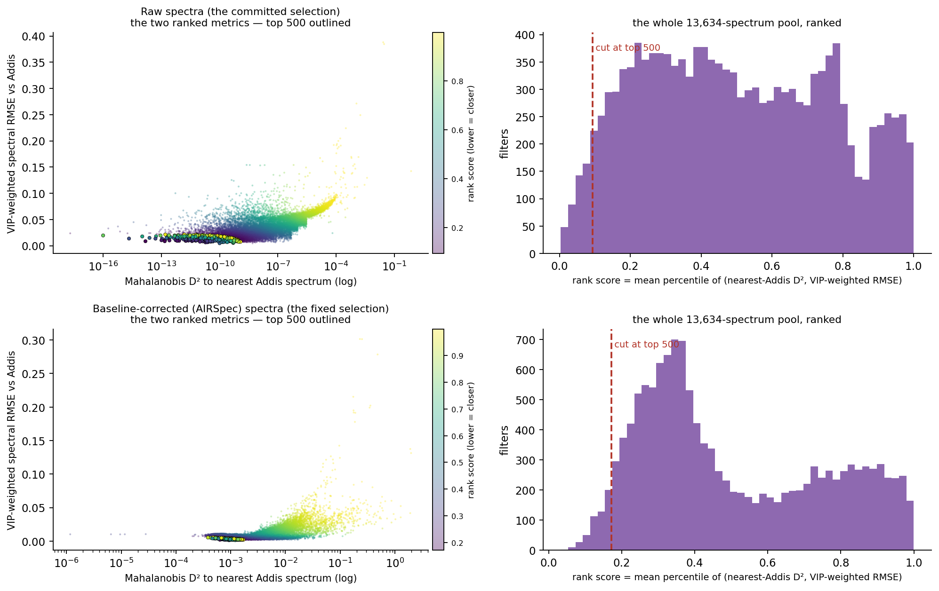
How the analogs are picked: rank the whole pool by score-space closeness to Addis — in either spectra space
Notes:
SAY: Before the fix, the mechanics, since Satoshi asked last time. Two metrics per filter: on the x-axis, the Mahalanobis distance from the filter to its nearest Addis spectrum in the score space of an IMPROVE-HIPS PLS model; on the y-axis, a spectral RMSE against the Addis median, weighted by the model's VIP — where the model looks, the mismatch counts more. Each filter's rank score is the mean of its two percentiles, and we keep the top 500 — the outlined points, with the red cut on the histograms. Top row is the committed raw-space selection; bottom row is the identical recipe on baseline-corrected spectra. Same math, and yet the two bottom panels rank an almost completely different 500 — which is the next slide.
NOTES: Corrected-space model: k=17, n=916, HIPS-tau target, site-grouped 5-fold selection, same as raw recipe except the 3900-4000 offset step is dropped (corrected spectra are already baselined). The figure's corrected row is asserted to reproduce the app's cached ranking exactly. Standing caveat: the locked raw list overlaps a pure rank-sort at 477/500 — unresolved.

Slide 11
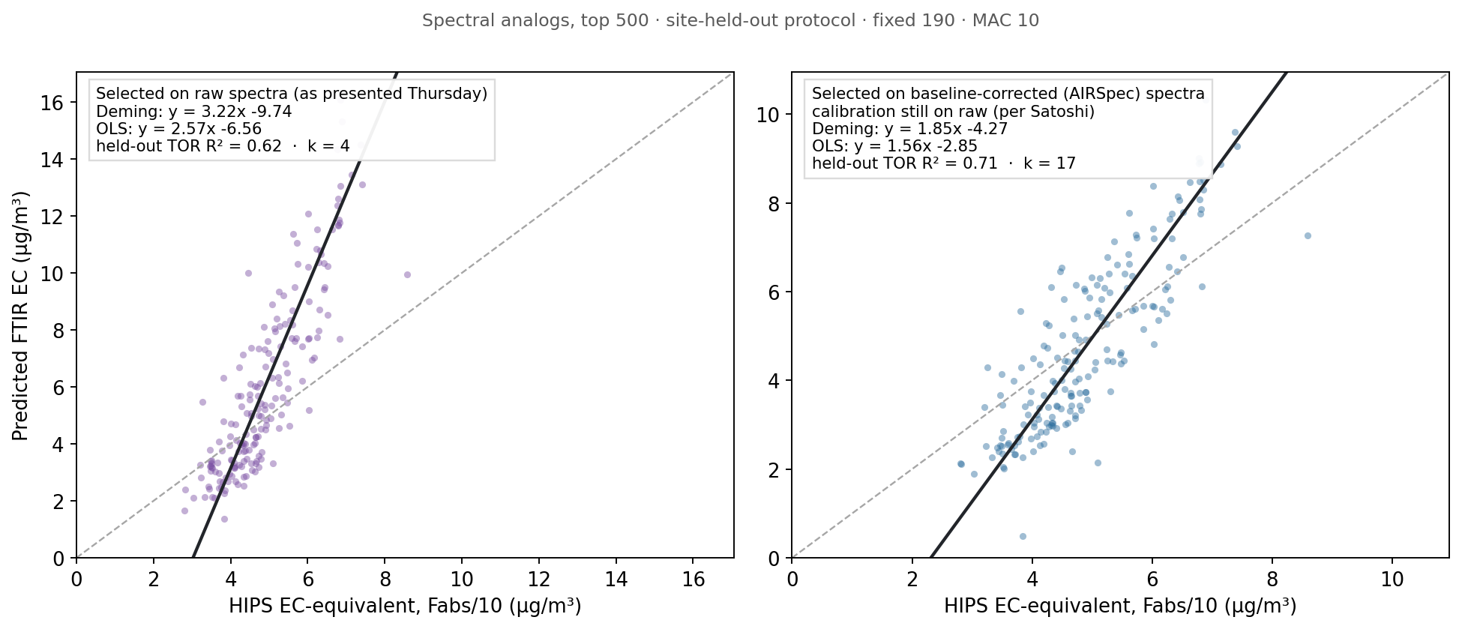
Selecting analogs on baseline-corrected (AIRSpec) spectra fixes them: −9.7 → −4.3, with real TOR skill
Notes:
SAY: The headline. Same top-500 analog selection, same calibration-on-raw-spectra per Satoshi's suggestion — the only change is that the similarity matching runs on baseline-corrected spectra instead of raw. The Deming intercept goes from minus 9.7 to minus 4.3, OLS from minus 6.6 to minus 2.9, the slope comes down from 3.2 to 1.9, and the held-out TOR test improves from 0.62 to 0.71. The corrected-selection analogs now behave like the lowest-OC/EC cohort instead of like the failure case.
NOTES: Full ftir_09 machinery refit in corrected space: IMPROVE-HIPS PLS model (k=17, n=916, HIPS-tau target), score-space nearest-Addis distance + VIP-weighted spectral RMSE, mean percentile rank; the raw recipe's 3900-4000 offset step dropped since corrected spectra are already baselined. Two caveats: (1) these are app-derived numbers through the shared validated code — the notebook write-up (ftir_34 candidate) is the next commit; (2) the raw-analog cohort resolves to 477 not 500 — the locked analog list isn't a pure sort of the committed rank score (477/500 overlap), unresolved.

Slide 12
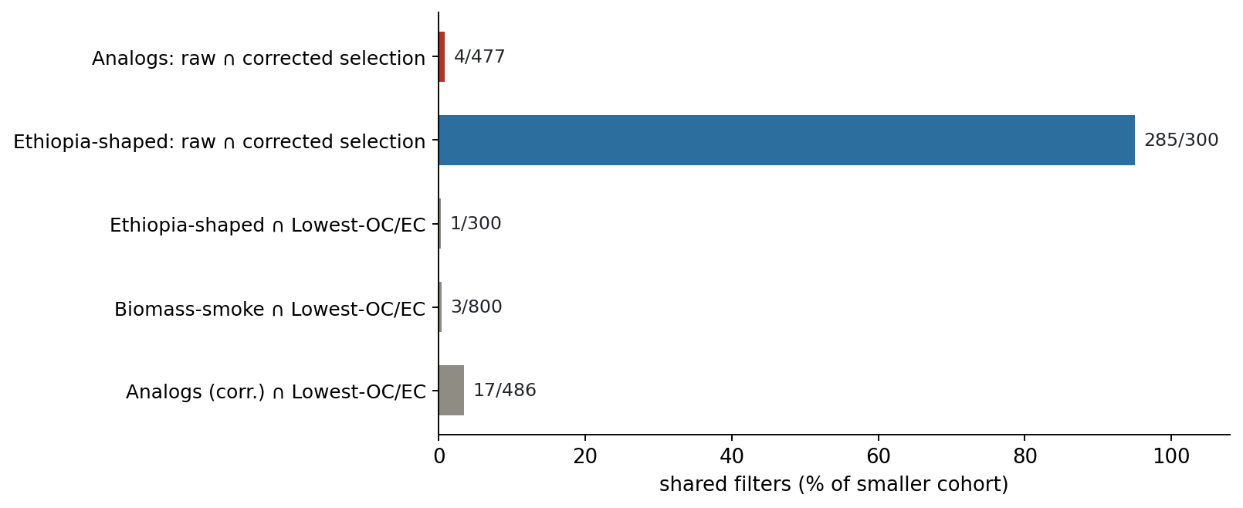
Why it works: the raw analog similarity was matching Teflon — the corrected selection keeps 4 of 477 filters
Notes:
SAY: The 'does the pool change' check answers Satoshi's Teflon point directly. For the analogs the pool changes almost completely — only 4 of 477 filters survive — so the raw-space similarity really was dominated by filter background, exactly as he suspected. Ethiopia-shaped is the opposite: 285 of 300 survive. And your overlap request from last Tuesday is in here too: Ethiopia-shaped and lowest-OC/EC share exactly 1 filter — shape-based and composition-based selection pick disjoint filters.
NOTES: The eth∩OC/EC=1 and smoke∩OC/EC=3 numbers match Ann's own committed overlap analysis exactly — good cross-validation of the tooling. Corrected-analogs∩OC/EC rises to 17, consistent with the corrected analogs drifting toward the composition cohort.

Slide 13
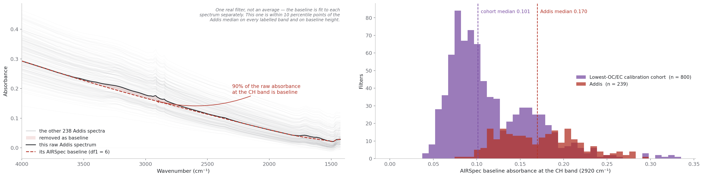
What we mean by “Teflon background”: ~90% of a raw spectrum is baseline — and Addis rides a higher one
Notes:
SAY: Since 'Teflon background' is doing a lot of work in this story, here is what it means. Left: every faint grey line is one of the 239 Addis filters; the black line is a single real filter — not an average — and the red dashed line is the baseline AIRSpec fits underneath it. Almost everything is a smooth downward slope: scattering off the PTFE filter and the deposit, not chemistry. At the CH band, about ninety percent of what we measure is baseline. Right: the size of that background at the CH band, one value per filter — Addis in red at a median of 0.17, the lowest-OC/EC IMPROVE cohort in purple at 0.10. So Addis rides a consistently higher background than the filters we calibrate on. Now connect it to the analogs: similarity computed on raw spectra is ninety percent similarity of THIS — the background — which is why the raw selection picked background-lookalikes, and why baselining before matching replaces 473 of the 477 filters.
NOTES: Caveats to have ready (from deck_notes_airspec): the two distributions overlap — a shift in the centre, not a separation; nothing here is an averaged spectrum (the representative filter is within 10 percentile points of the Addis median on all four bands AND baseline height); and baselining does not fix everything — the HIPS-transfer failure survives it, which is what tells us the remaining problem is compositional. AIRSpec = APRL smoothing-spline baseline, our Python port validated against their R to ~1e-7.

Slide 14
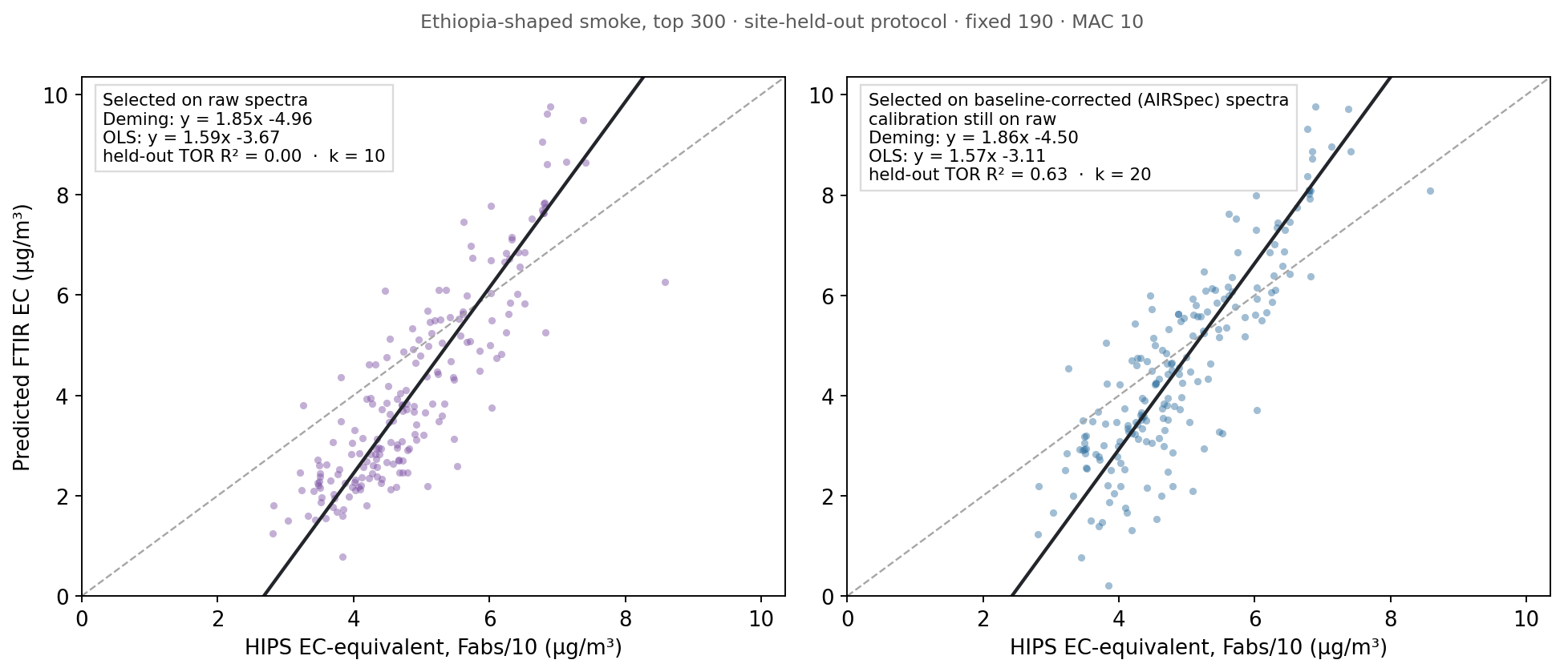
Ethiopia-shaped: nearly the same filters, but the held-out TOR test goes 0.00 → 0.63
Notes:
SAY: The mirror-image result. Ethiopia-shaped keeps 285 of its 300 filters under corrected selection — the pool barely changes — but the model changes a lot: the raw-selection version had NO held-out TOR skill at all, R-squared 0.00, which is why it carried an asterisk in the matrix. The corrected-selection version tests at 0.63 with a slightly better intercept. So the Ethiopia-shaped failure looks like a selection-space artifact, not a problem with shape-matching itself.
NOTES: The 15 swapped filters shift k from 10 to 20; k chosen by the same first-major-minimum rule both sides. Same committed band-feature metric (CH, carbonyl, 1600-shoulder peaks, IQR-scaled distance to the Addis median), just computed on corrected spectra.

Slide 15
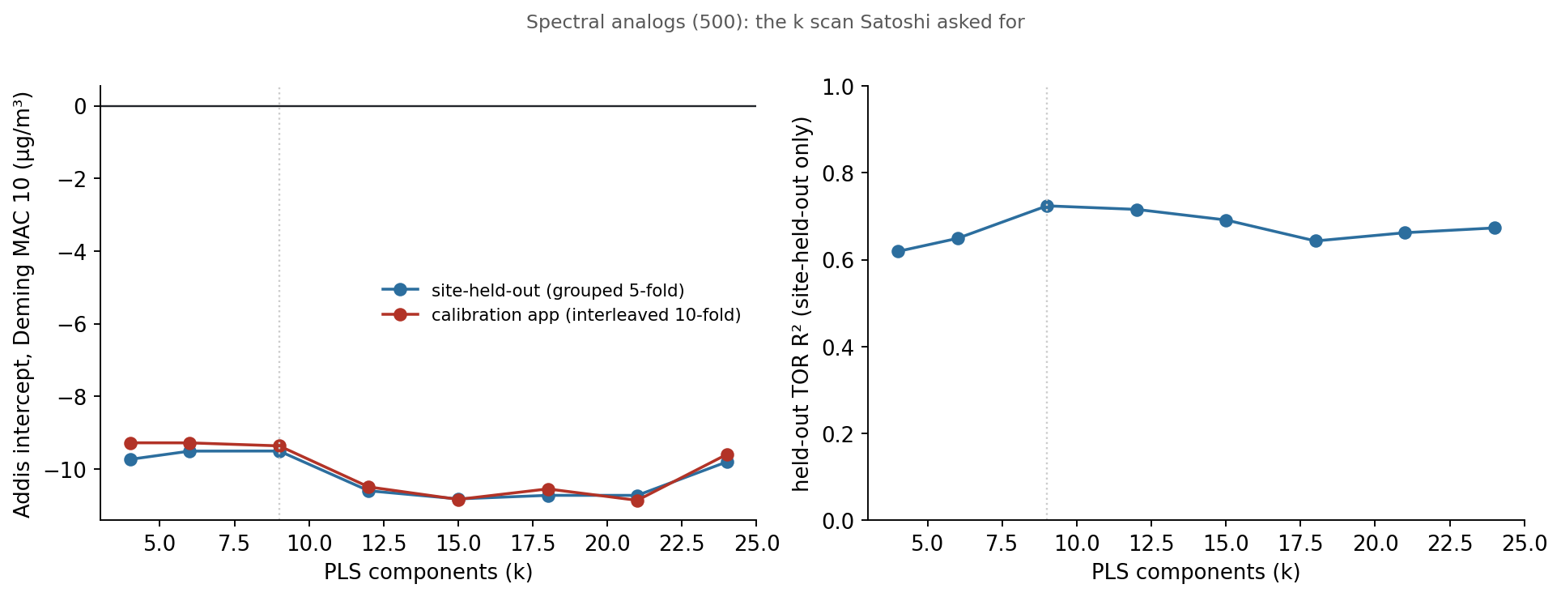
The k scan: 21 components instead of 9 does not fix the analogs
Notes:
SAY: Satoshi's direct question from the meeting — should the analogs use around 21 components instead of 9. Answer: no. Scanning k from 4 to 24 under both CV schemes, the Deming intercept never gets better than about minus 9 and drifts worse past 12; the held-out TOR skill actually peaks right at k equals 9. So it was never the component count — it was the selection space, which the previous slides fixed.
NOTES: This also covers the 'one consistent k-rule' request: rule-choices are marked, and the sweep shows the conclusion is not rule-sensitive for this cohort. Fold-count objection is separately closed by ftir_32: interleaved-5 ≈ interleaved-10 (ratios 1.00-1.04), so the app protocol's optimism is structural, not a fold-count artifact.

Slide 16
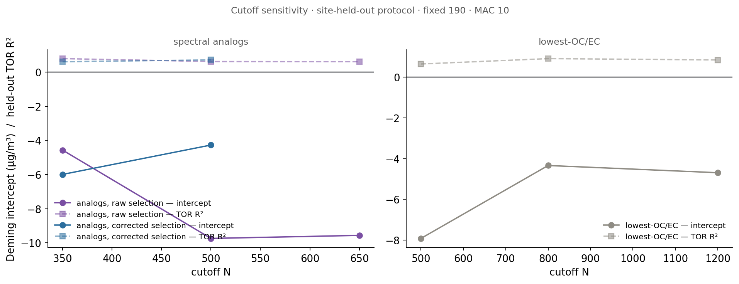
Cutoffs: the analog cutoff was a real lever (350 beats 500); OC/EC-800 is confirmed
Notes:
SAY: The 'try more and less' item. Two findings. In raw selection space the analog cutoff matters a lot — top-350 gives minus 4.6 with TOR R-squared 0.79, versus minus 9.7 at 500 — my 'technically 400' instinct in the meeting was right, the samples added past about 400 are harmful. Interesting wrinkle: under corrected selection that inverts — 500 beats 350 — consistent with the corrected ranking being trustworthy deeper into the list. And on the right, lowest-OC/EC-800 really is the sweet spot: 500 undershoots badly, 1200 is slightly worse than 800.
NOTES: Ethiopia-shaped cutoffs (200/450) both degrade the TOR test — 300 stands. All site-held-out, Deming MAC 10, fixed 190.

Slide 17
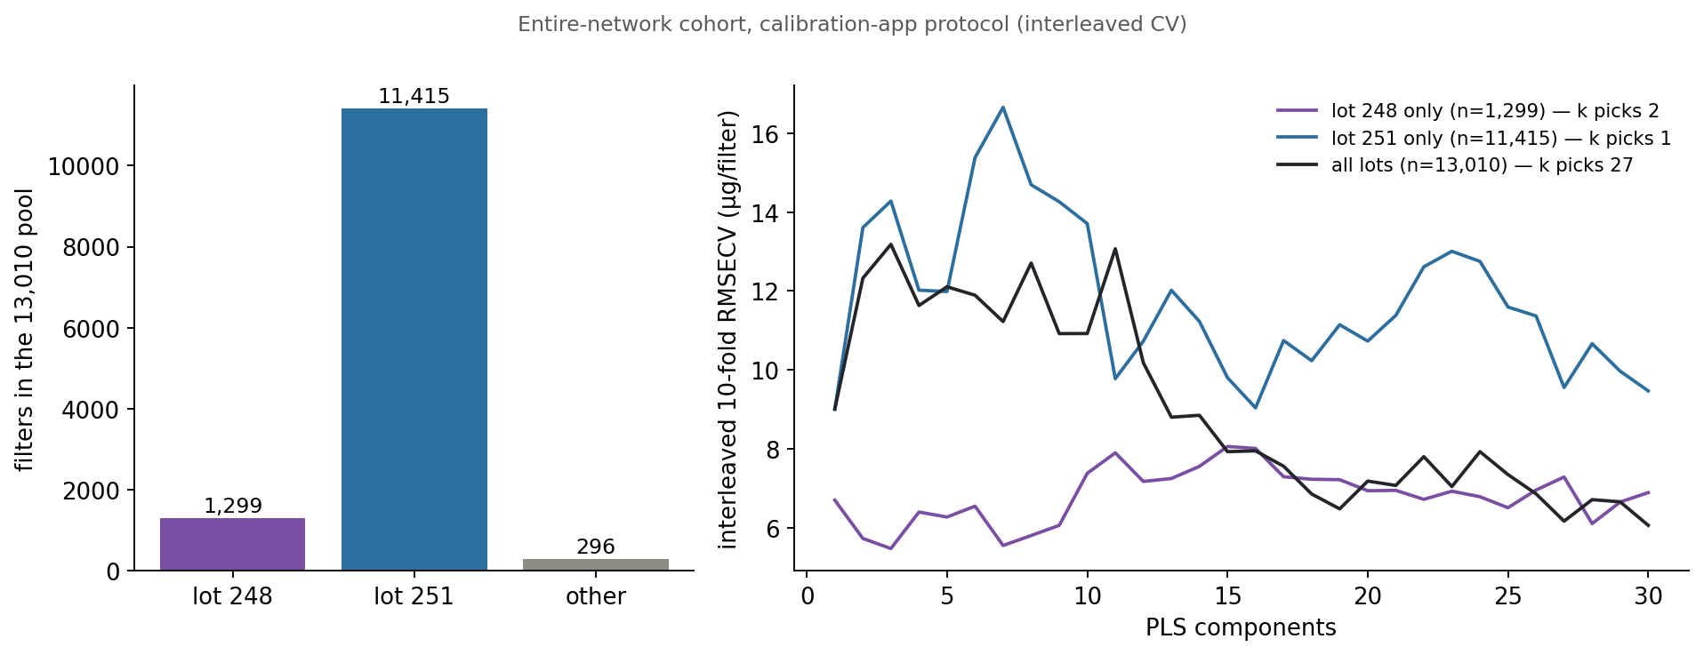
The lot check: the pool is 88% lot 251 — and the jagged CV curves survive lot isolation
Notes:
SAY: The in-hand half of the lot question, while we wait on Mona's PCA plots. First, a correction to what we said in the meeting: the 13,010-filter pool is not 'all lot 248' — it's 1,299 lot-248 and 11,415 lot-251, and the smoke-906 is 98 percent lot 251. Second, isolating either single lot does NOT smooth the erratic interleaved curves — they're jagged in both — and single-lot pools degenerate to picking one or two components, the 'average spectrum predicts best' pathology. So whatever makes those curves messy, it isn't a 248-versus-251 lot effect. Testing lots outside these two still needs Mona's PCA plus their spectra.
NOTES: Lot labels from ftir_catalog.LotNumber joined per AnalysisId; ~300 filters have other/missing lots.

Slide 18
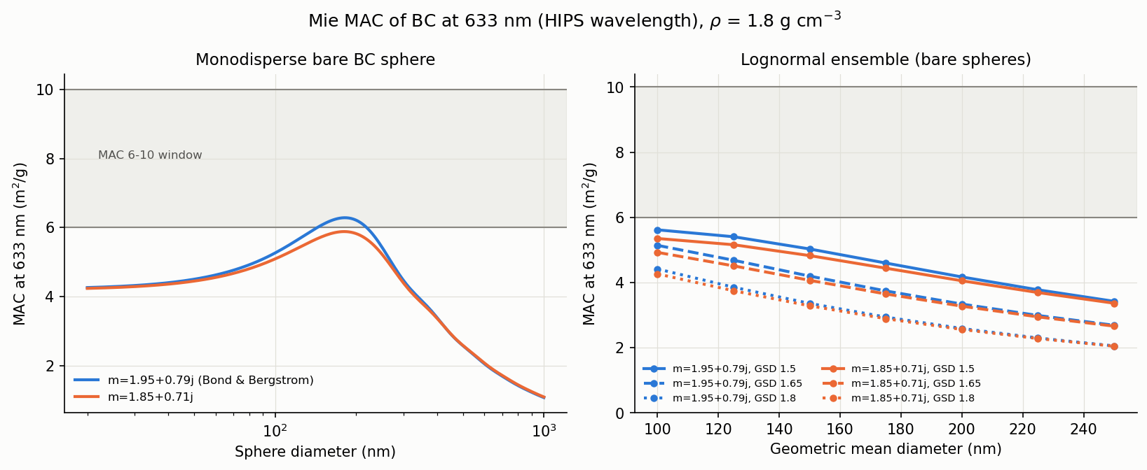
Mie theory grounds the MAC fork: bare BC tops out near 6 — MAC 10 requires aged, thickly-coated particles
Notes:
SAY: One piece of physics for the 6-versus-10 question. Mie calculations at the HIPS wavelength, 633 nanometers: bare-soot size distributions top out around 5.6 square meters per gram across the realistic parameter space — bare BC never reaches even 6 as an ensemble. Getting to 10 requires an absorption enhancement of 1.8 to 2 from thick coatings — aged, internally-mixed BC. So MAC 6 versus 10 encodes a fresh-versus-aged mixing-state assumption, not calibration noise — which is a physical frame we can put under the fork instead of treating it as a free parameter.
NOTES: PyMieScatt sweep: m = 1.95+0.79j and 1.85+0.71j, density 1.8, lognormal GMD 100-250 nm, GSD 1.5-1.8; monodisperse optimum 6.28 at D=181 nm. Consistent with the IMPROVE implied-MAC bridge (median ~10 in the Addis-like OC/EC subset). Remember ftir_19: MAC cannot move any intercept regardless — this is about the slope story.

Slide 19
Bishoftu: HIPS is in hand — the blocker is one FTIR spectra export
ETBI HIPS is already in our local SPARTAN file: 32 filters (Oct–Dec 2025).
No ETBI FTIR spectra exist anywhere in our data pull — the local database carries no SPARTAN spectra; ETAD needed a dedicated export and ETBI needs the same.
The ask: re-run the ETAD-style spectra query for ETBI (the SQL template is on hand — likely via Alex).
Once the export lands, the FTIR-EC vs HIPS crossplot is a one-click preset — the evaluation side is already built and target-generic.
Notes:
SAY: Bishoftu, per the list. The HIPS side is in hand — 32 filters. What doesn't exist anywhere in our pull is ETBI FTIR spectra; the local database has no SPARTAN spectra at all, ETAD needed its own export, and ETBI needs the same one. The SQL template from the ETAD pull is ready to reuse — I think that request goes through Alex. The moment it lands, the crossplot is literally one preset in the tooling; the readout side is already generic over evaluation sites.
NOTES: If asked about lot: ETBI's lot will show in the export metadata; flag it if it differs from 245/248/251.

Slide 20
Logistics: committee meeting + funding
Committee meeting: current scheduling status, and the plan to get it locked this week.
Funding: where things stand and what, if anything, is needed from your side.
Fall meeting moves: noted — will track the calendar (next 1:1s may shift around your travel).
Notes:
SAY: And the two items from your email. On the committee meeting: [fill in current status — who has responded, proposed dates, and commit to a concrete next step, e.g. 'doodle to the committee today, locked by Friday']. On finances: [fill in the current situation plainly — funding source, runway, any gap and by when — and the specific thing Ann could help with, if any]. And on 'something to show': the AAAR abstract is in, the provisional Addis EC series exists, and everything shown today is committed and reproducible.
NOTES: Ann flagged both items explicitly and offered to run long — don't let these get squeezed out. Bring dates, not vibes.

