Slide 1
SPARTAN EC — Weekly Update
Ahmad Jalil · 2026-06-16 · toward a SPARTAN-network EC paper (AAAR abstract due Jul 24)

Slide 2
This week — confirmation points
• Confirmed the 2003 HIPS cutoff straight from Warren White (2016): “stable calibration since 2003.”
• Confirmed SPARTAN EC = FTIR. There is NO thermal/TOR EC in SPARTAN (no quartz filters).
– The “thermal” stars on the EC/OC plot were optical BC (HIPS/SSR) — dropped them.
• Reproduced fAbs/EC by site exactly: Beijing 10.3, Pasadena 9.4, Delhi 8.5.
• Corrected lot for Addis: 251 (184 samples), not 256.
• Got the 5 Adama AMOD quartz-filter TOR samples — our first real thermal EC near Addis.

Slide 3
SPARTAN carbon is FTIR — no thermal/TOR EC
• EC PM2.5 and OC PM2.5 → methods 217 / 218 = FTIR (the functional-group method under review)
• BC PM2.5 → methods 219 / 221 = HIPS (optical); 220 = HIPS–SSR curve
• Equivalent BC PM2.5 → methods 212/214/215/216 = Smoke Stain Reflectometer
• Verified across all 4 focus sites (ETAD, CHTS, INDH, USPA).
• So the only independent check on FTIR-EC is the optical HIPS — which is why the fAbs/tau cross-plots carry the argument.

Slide 4
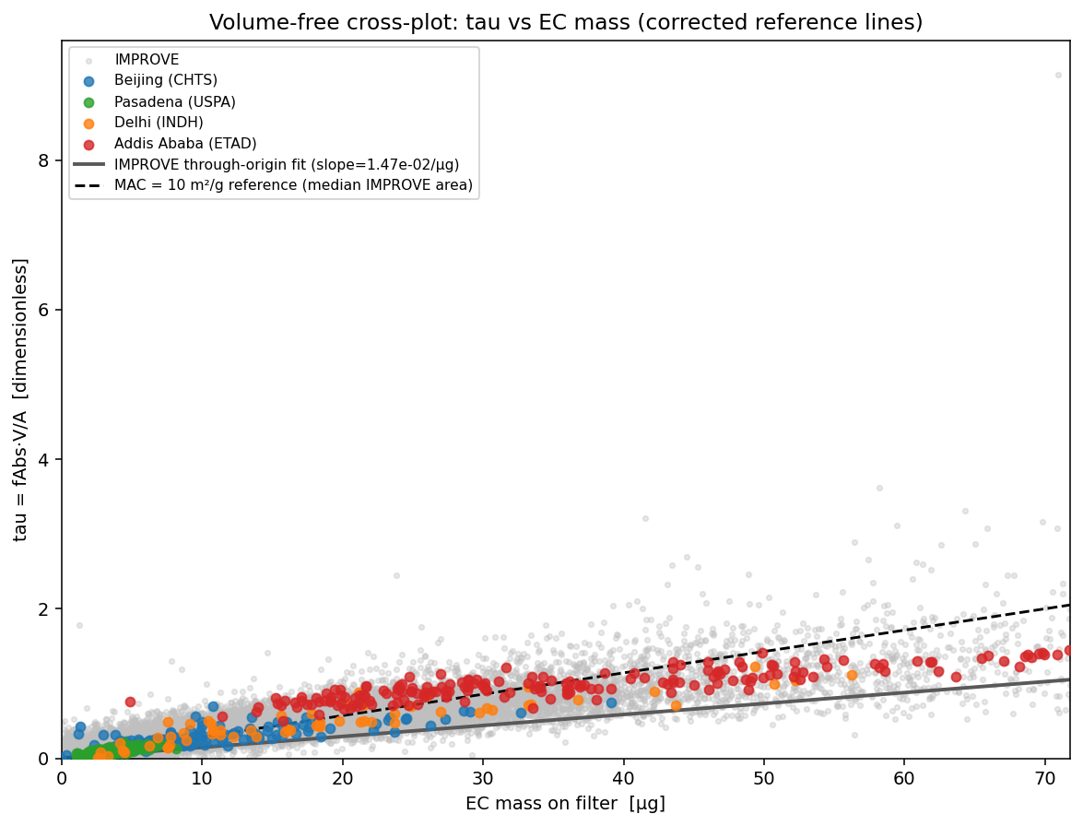
Volume-free cross-plot — reference lines fixed
• Dropped the “1:1” line — meaningless (tau is dimensionless, EC-mass is µg). tau = fAbs·V/A confirmed unitless.
• Gray = the real IMPROVE through-origin slope; black dashed = MAC=10 reference. Addis sits on a steeper line.

Slide 5
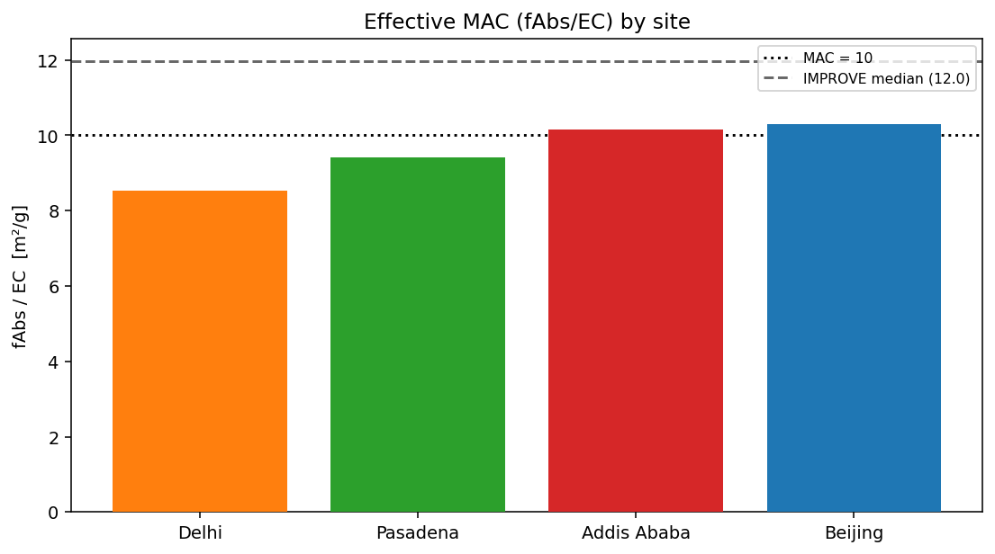
fAbs/EC by site (effective MAC)
• Reproduces the meeting values (Beijing 10.3, Pasadena 9.4, Delhi 8.5). Addis ≈ 10 — not special on this metric.
• IMPROVE median ≈ 12. Caveat: if FTIR-EC is biased low, this “MAC” is biased high.

Slide 6
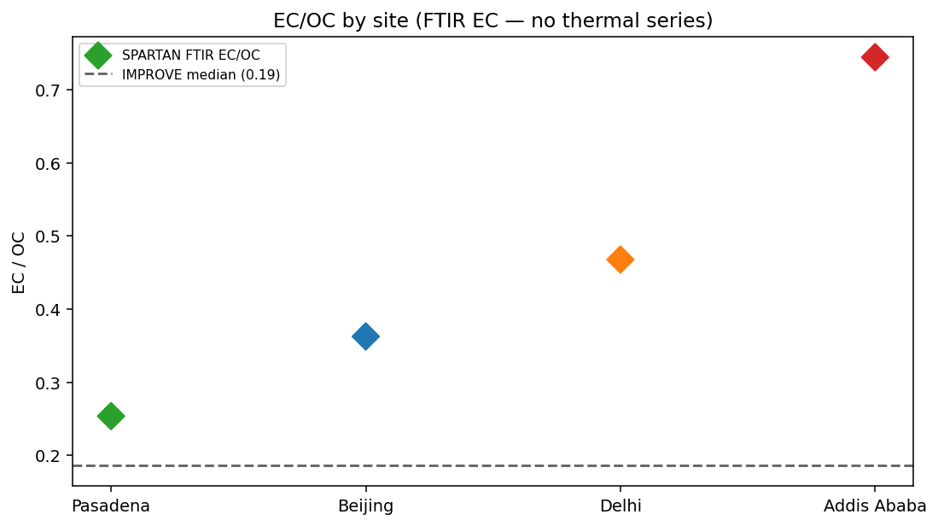
EC/OC by site (FTIR EC only)
• FTIR EC only (the “thermal” stars are gone — they weren’t thermal). Addis EC/OC highest of the four.
• IMPROVE much lower — the compositional difference behind the whole investigation.

Slide 7
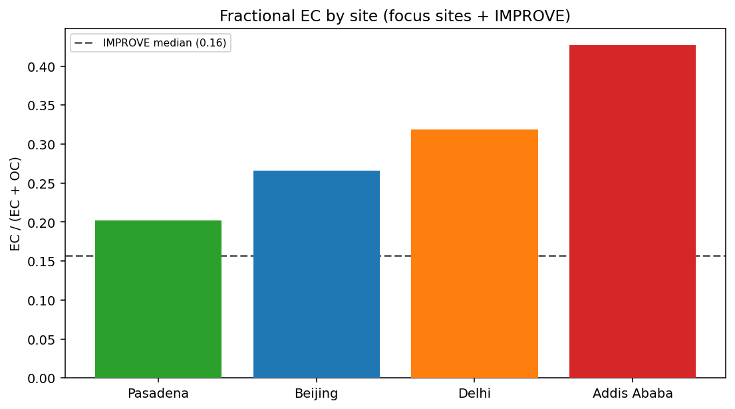
Fractional EC — focus sites vs IMPROVE
• IMPROVE fractionally much lower than every SPARTAN focus site; Addis the most extreme.
• All-sites version + ETBI need the broader public chemspec — ETBI has HIPS but no EC yet (Chris/Oxford upload).

Slide 8
Biomass-burning calibration test (top priority, with Mona)
• Plan: build a biomass-only calibration on lot 251 (Chelsea’s guidance), apply to Addis, compare EC vs the general calibration.
• Tests our original EC-paper point: smoke samples should be calibrated with smoke samples.
• Baseline is built: lot-251 Addis fit HIPS(BC-eq) = 0.43·EC + 2.65 (r = 0.89).
– That +2.65 µg/m³ ≈ 26.5 Mm⁻¹ intercept matches the ~28 Mm⁻¹ Deming intercept — the gap is in the intercept.
• Status: awaiting the biomass-only calibration + per-filter EC from the FTIR tool (Mona).

Slide 9
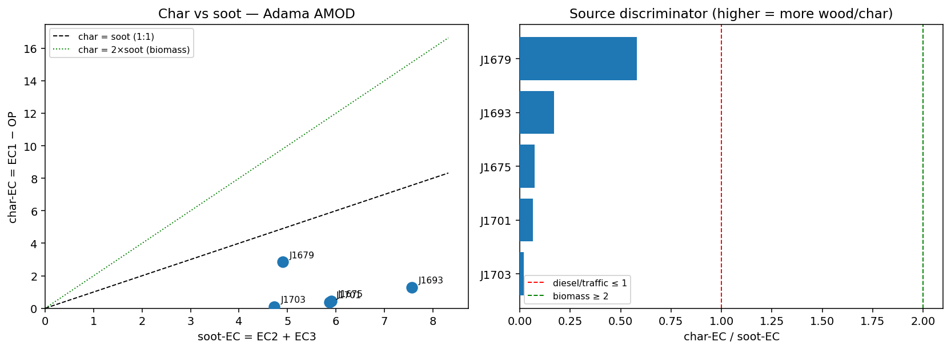
Adama TOR (5 quartz filters) — Han char vs soot
• char-EC/soot-EC is low (0.02–0.58) → the EC present is soot-leaning. But OC/EC is high (4.6–7.2) + large pyrolysis → organic-rich / biomass-influenced.
• Two metrics disagree — that’s the finding: exactly the regime where the FTIR calibration is expected to struggle.

Slide 10
Next steps
• Mona: biomass-only lot-251 calibration + per-filter EC; then Addis spectra to compare.
• Predict EC for the 5 Adama filters with general vs wood-smoke calibration; compare to TOR EC.
• Add the Han (char/soot) and KBr-pellet papers to Zotero so we can cite them.
• Charcoal KBr prep (~0.4–0.5 mg / 300 mg KBr); dry separately in the muffle furnace.
• AAAR abstract (due Jul 24): frame around SPARTAN EC.

