Slide 1
Multi-Site BC Measurement Analysis
Weekly Progress Update — April 1, 2026 New: Multi-site wavelength analysis, cross-plots, distributions, AERONET filtering

Slide 2
What Was Done This Week
1. Downloaded & processed minute-resolution aethalometer data for all 4 sites
(Beijing: 770K rows, Delhi: 561K, JPL: 1.27M, Addis: 1.56M)
2. Built QC pipeline: negative removal + IQR outlier removal + 10-min rolling median
(10-min best matches instrument smoothing — r=0.993, wins 7/11 comparisons)
3. Multi-site diurnal wavelength analysis (all 5 wavelengths, all seasons)
4. Cross-plots: HIPS BC vs FTIR EC vs Aeth for all 4 sites
5. Distribution plots: histograms + violins for all sites
6. AERONET sequential exclusion applied to Addis cross-plots
7. Comprehensive research progress document (all 10 meetings tracked)

Slide 3
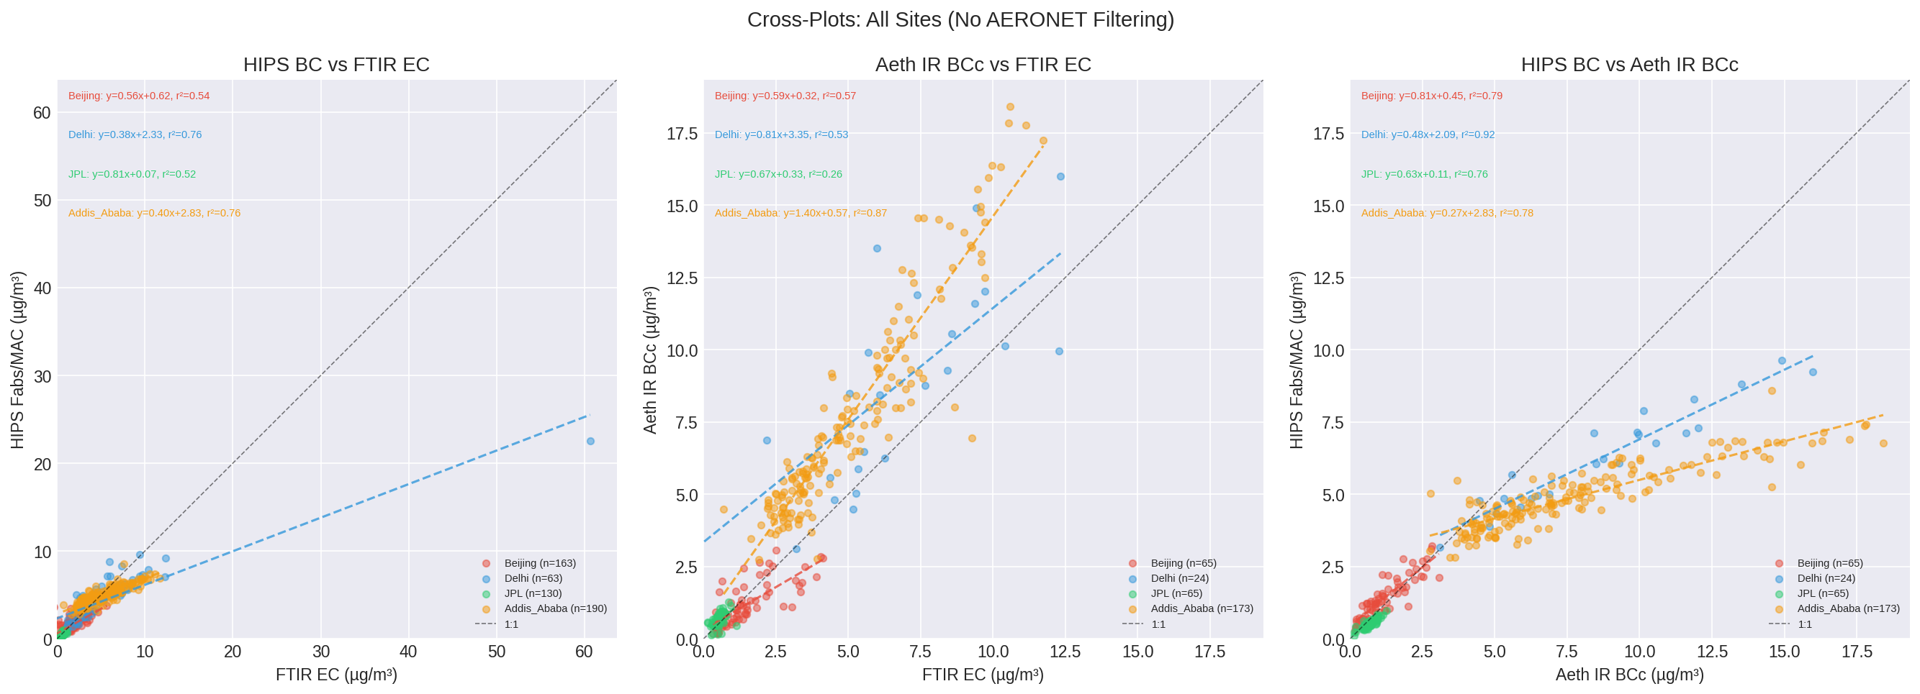
1. Cross-Plots: Addis Is the Anomalous Site
Beijing, Delhi, JPL: near-zero intercepts, slopes close to 1:1
Addis: large positive intercept (~2 ug/m3) and compressed HIPS range
Two co-occurring problems: OFFSET + COMPRESSION
Delhi has similar concentrations but works well -> anomaly is SITE-SPECIFIC, not concentration-dependent

Slide 4
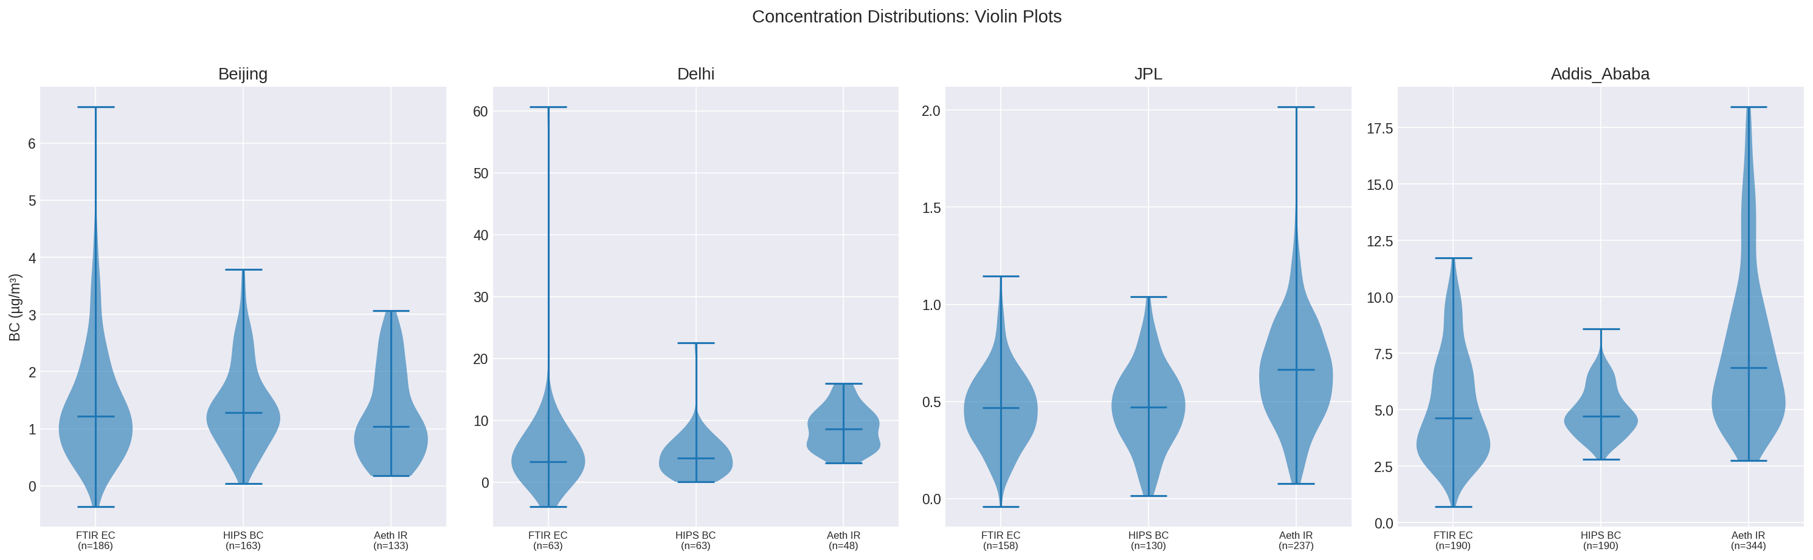
2. Distribution Comparison: HIPS Compressed at Addis
Beijing/Delhi/JPL: FTIR EC and HIPS BC have comparable distributions
Addis: HIPS BC squeezed into narrow range (~2-4 ug/m3)
FTIR EC and Aeth span much wider (~2-15 ug/m3)
This compression is unique to Addis

Slide 5
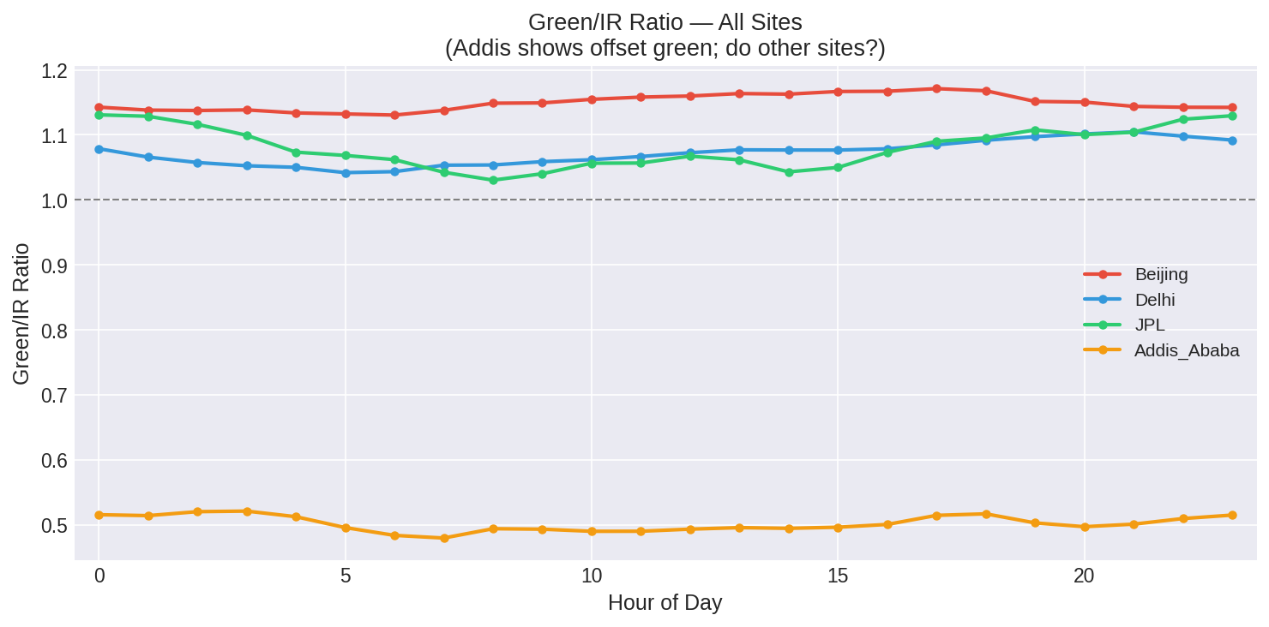
3. Green/IR Ratio: Addis Instrument Issue Confirmed
Green/IR at Addis = 0.55 (half of IR)
All other sites: 1.05-1.15 (expected)
Blue/Red/IR collapsed together at Addis
NOT aerosol physics — instrument or data processing issue on MA350-0238
Question for Cena: known issue? Correction available?

Slide 6
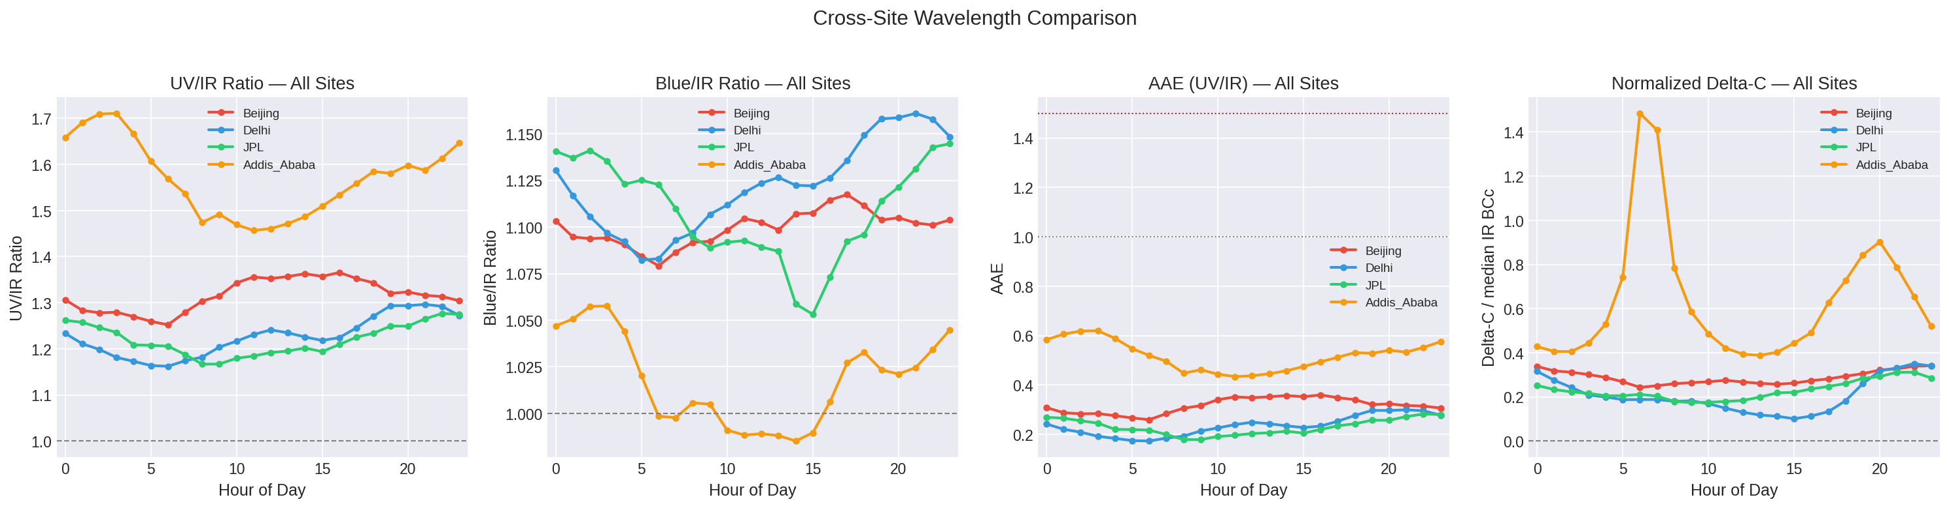
4. Cross-Site Wavelength Comparison
UV/IR ratio: Addis highest (~1.7)
Blue/IR: Addis collapsed (~1.0), others show proper separation
AAE: all sites below literature range (eBC issue)
Delta-C: Addis + Delhi show strongest biomass signatures

Slide 7
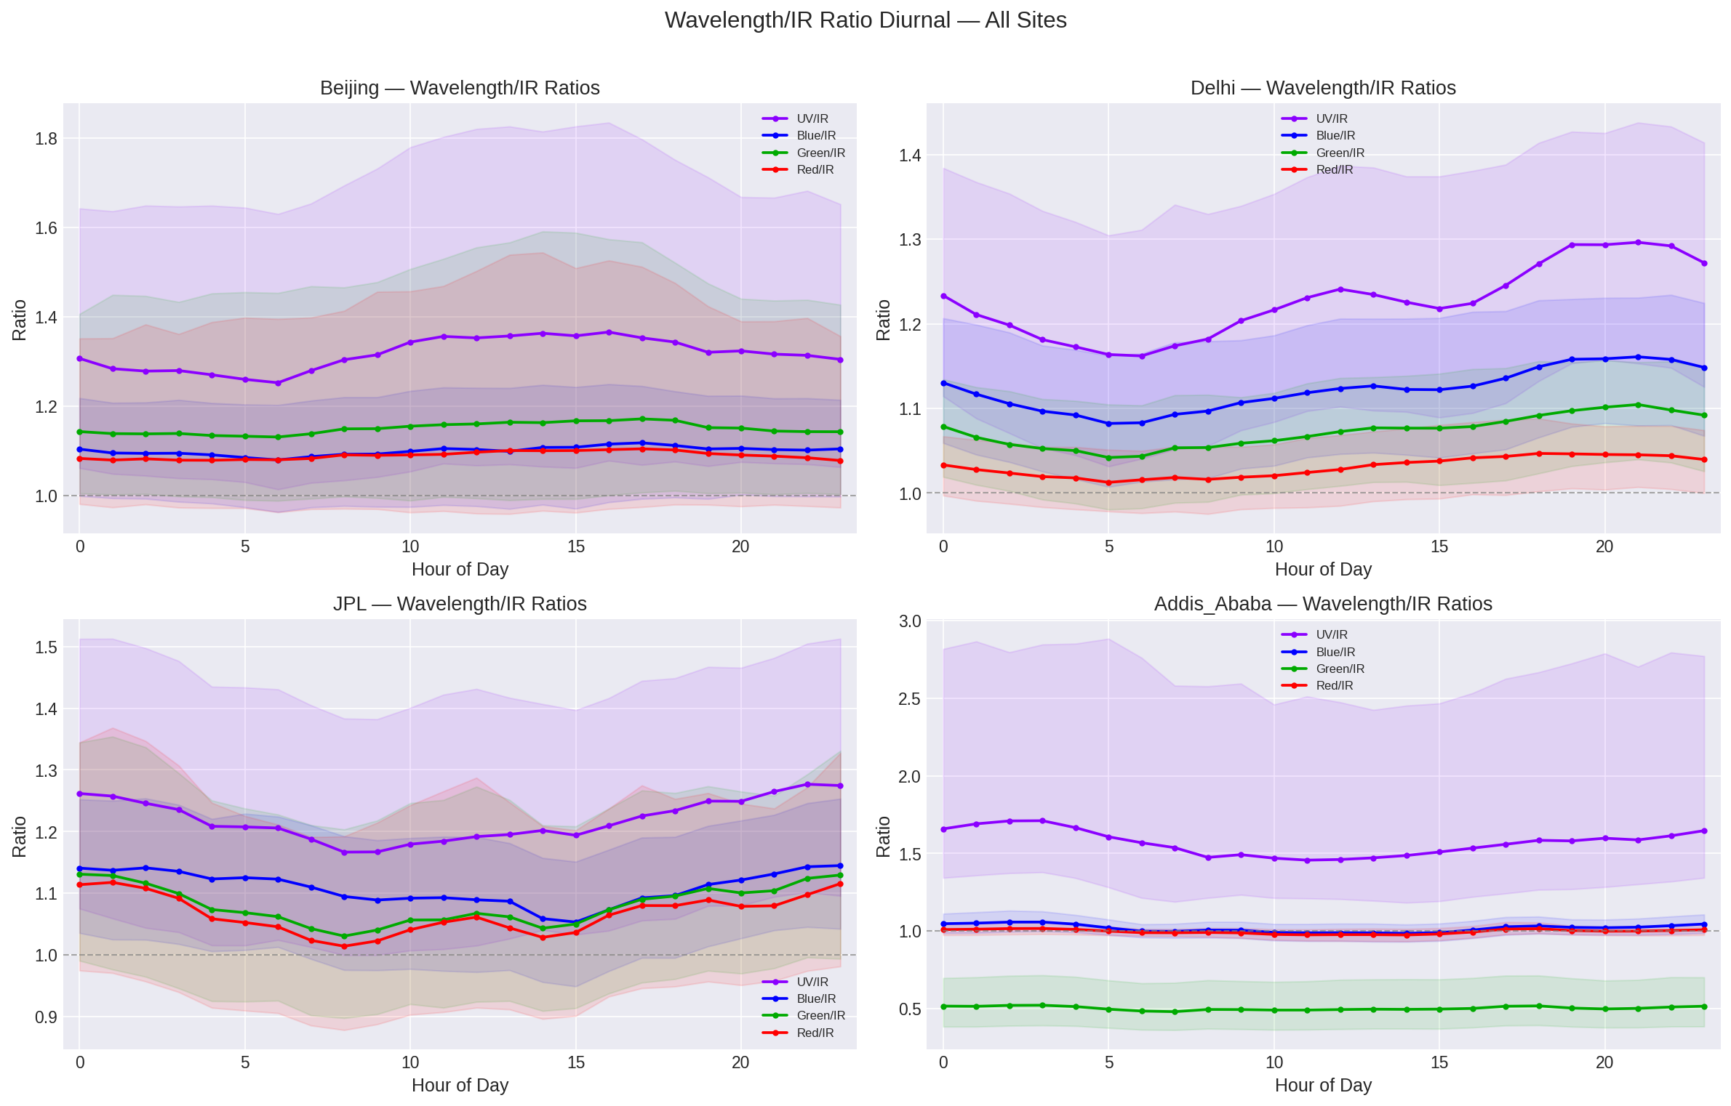
5. Wavelength/IR Ratio Diurnal — All Sites

Slide 8
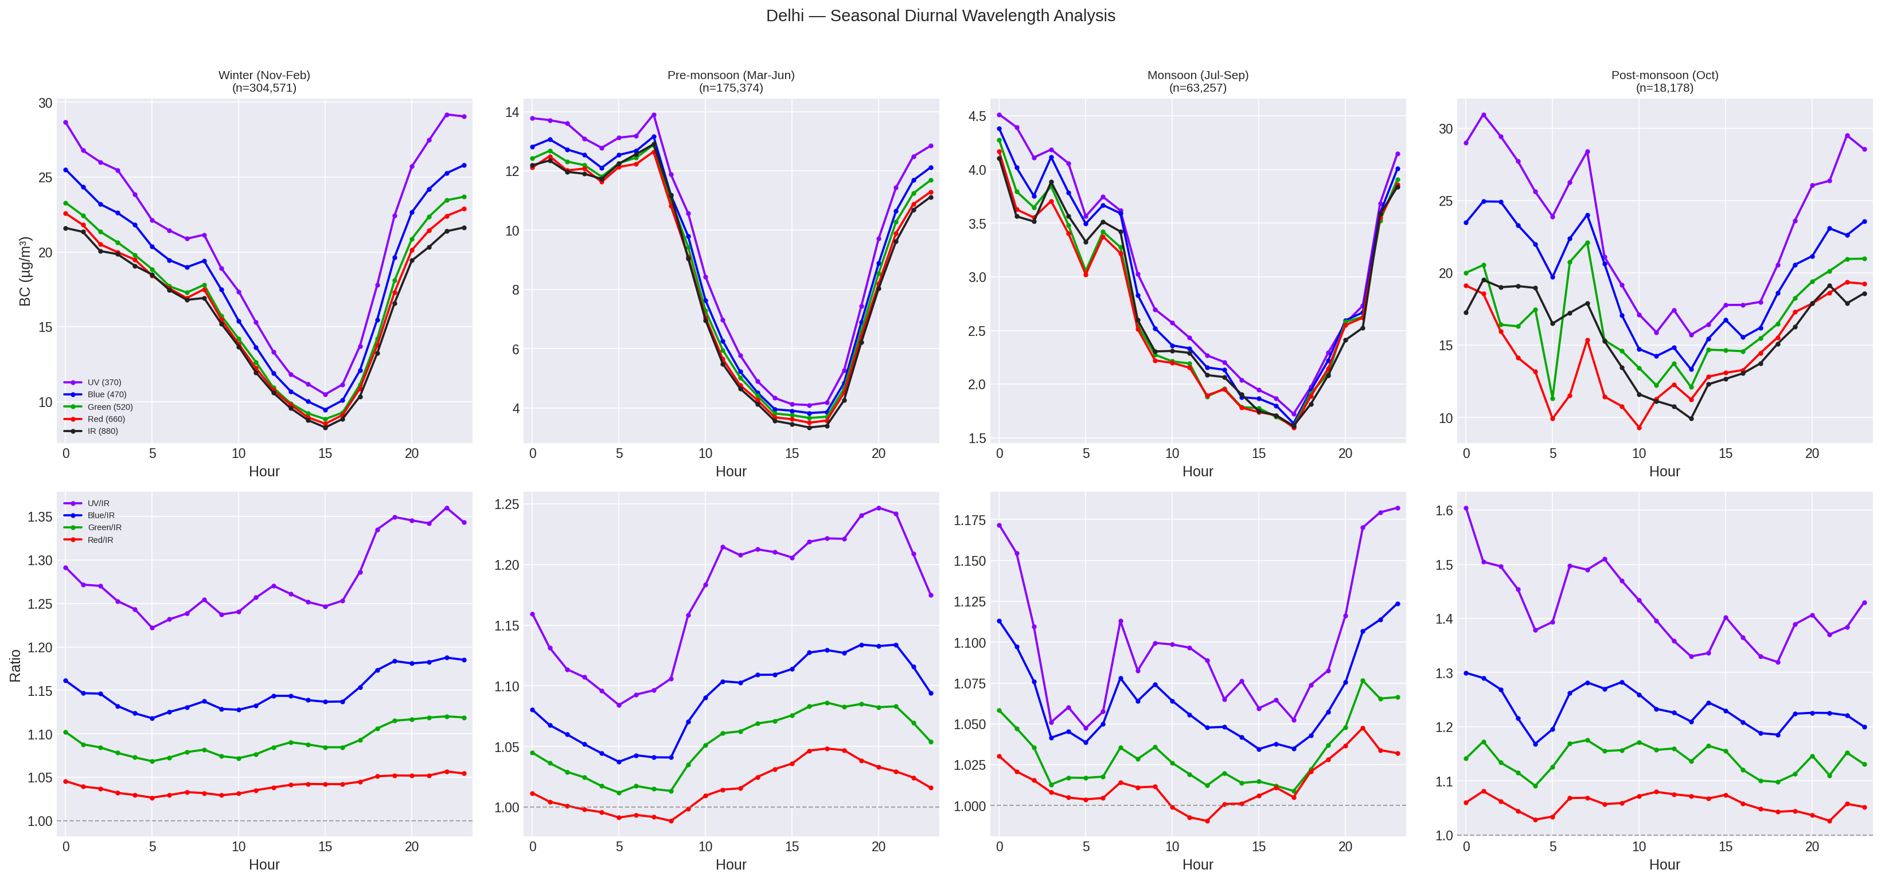
6. Seasonal Patterns: Delhi
Post-monsoon (Oct): dramatically higher AAE and UV/IR ratio
Consistent with crop-residue burning after Oct-Nov harvest
Monsoon (Jul-Sep): lowest AAE, washout effect
Seasonal definitions from Sebastian et al. (2022)

Slide 9
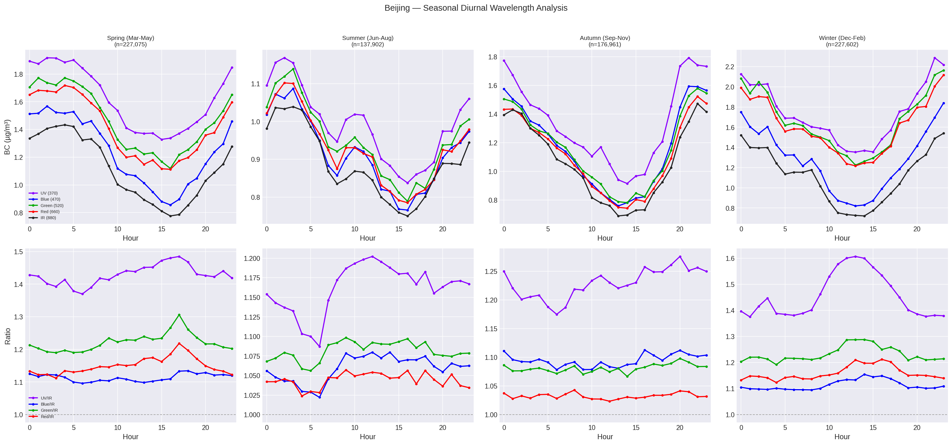
7. Seasonal Patterns: Beijing
Winter: highest AAE (~0.52 midday)
Summer: lowest AAE (~0.15)
Matches Sun et al. (2022) exactly
Proper spectral separation at all seasons (unlike Addis)

Slide 10
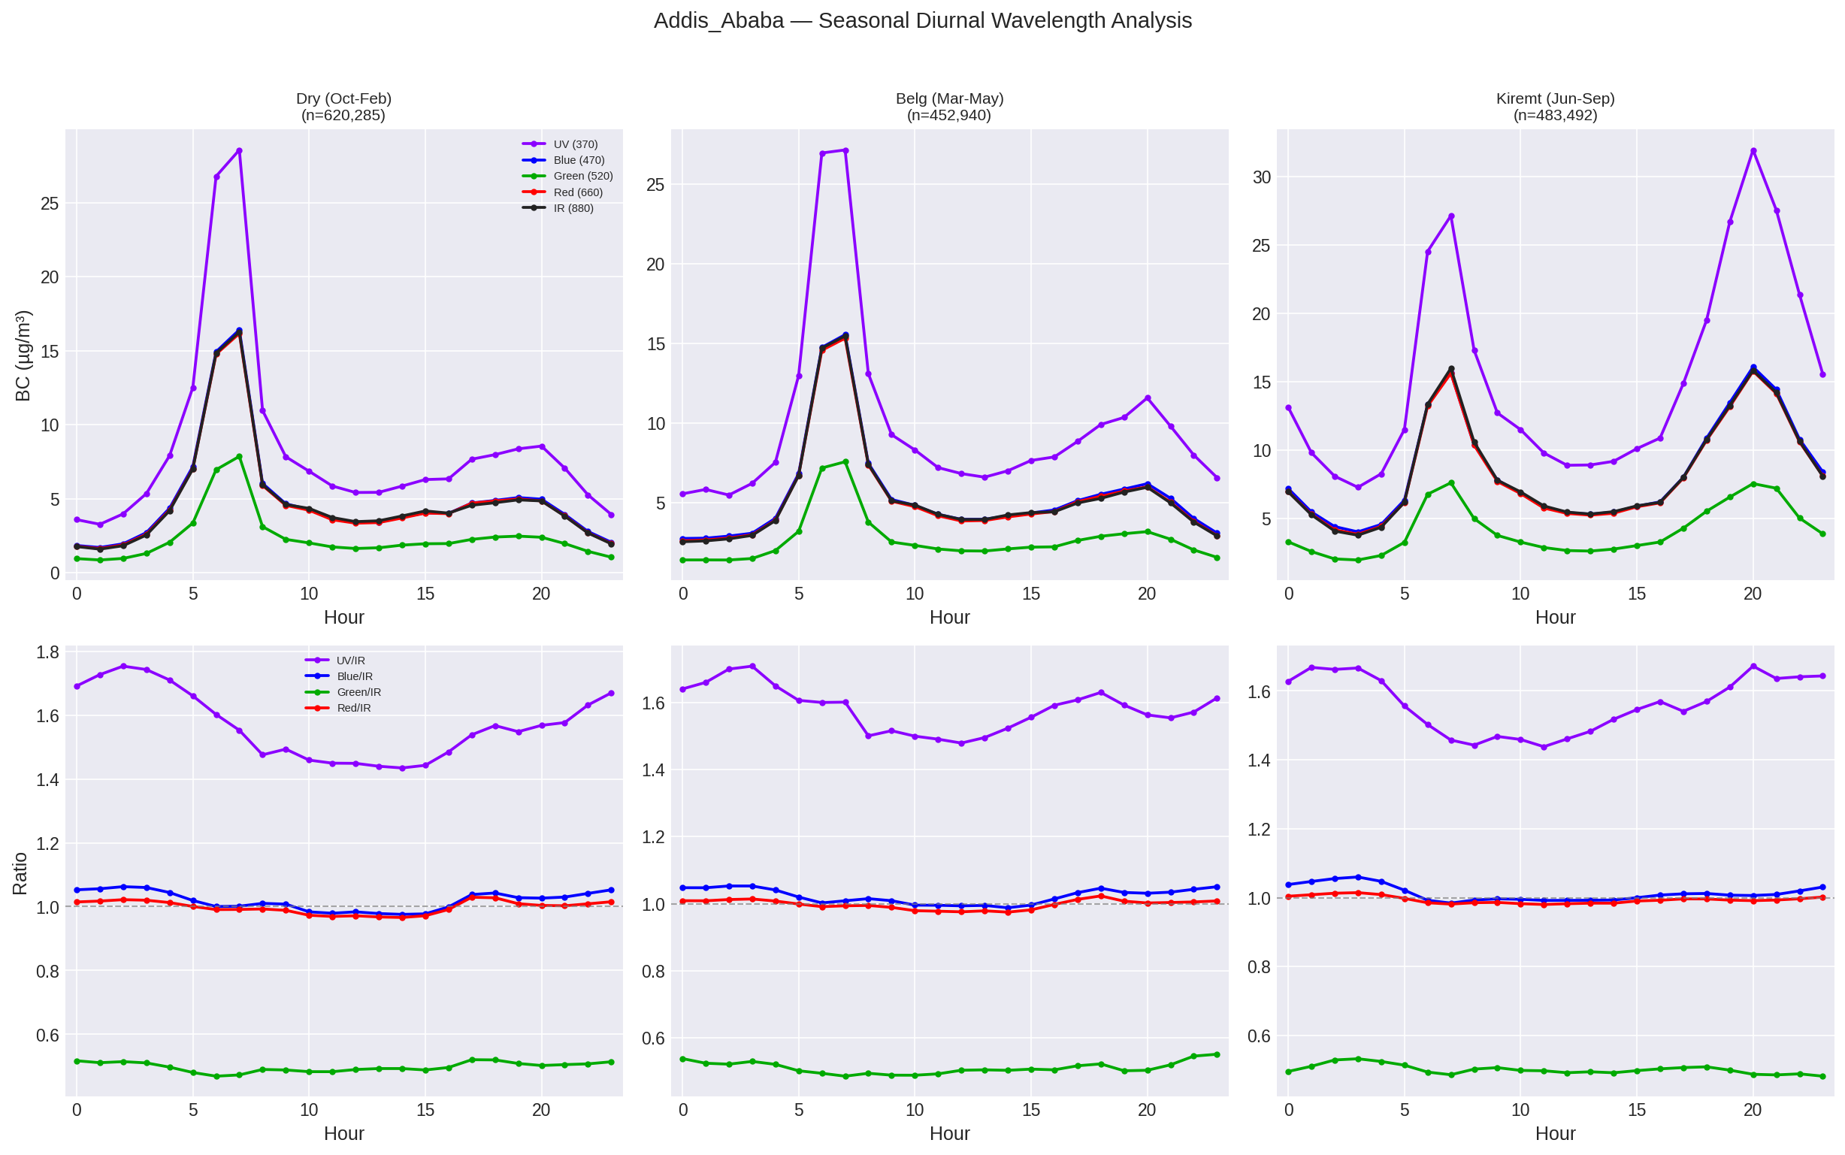
8. Seasonal Patterns: Addis Ababa
Green at 0.5x persists across ALL seasons
Kiremt evening peak distinct
Dry season morning has highest UV divergence
Divergence timing differs from concentration peaks

Slide 11
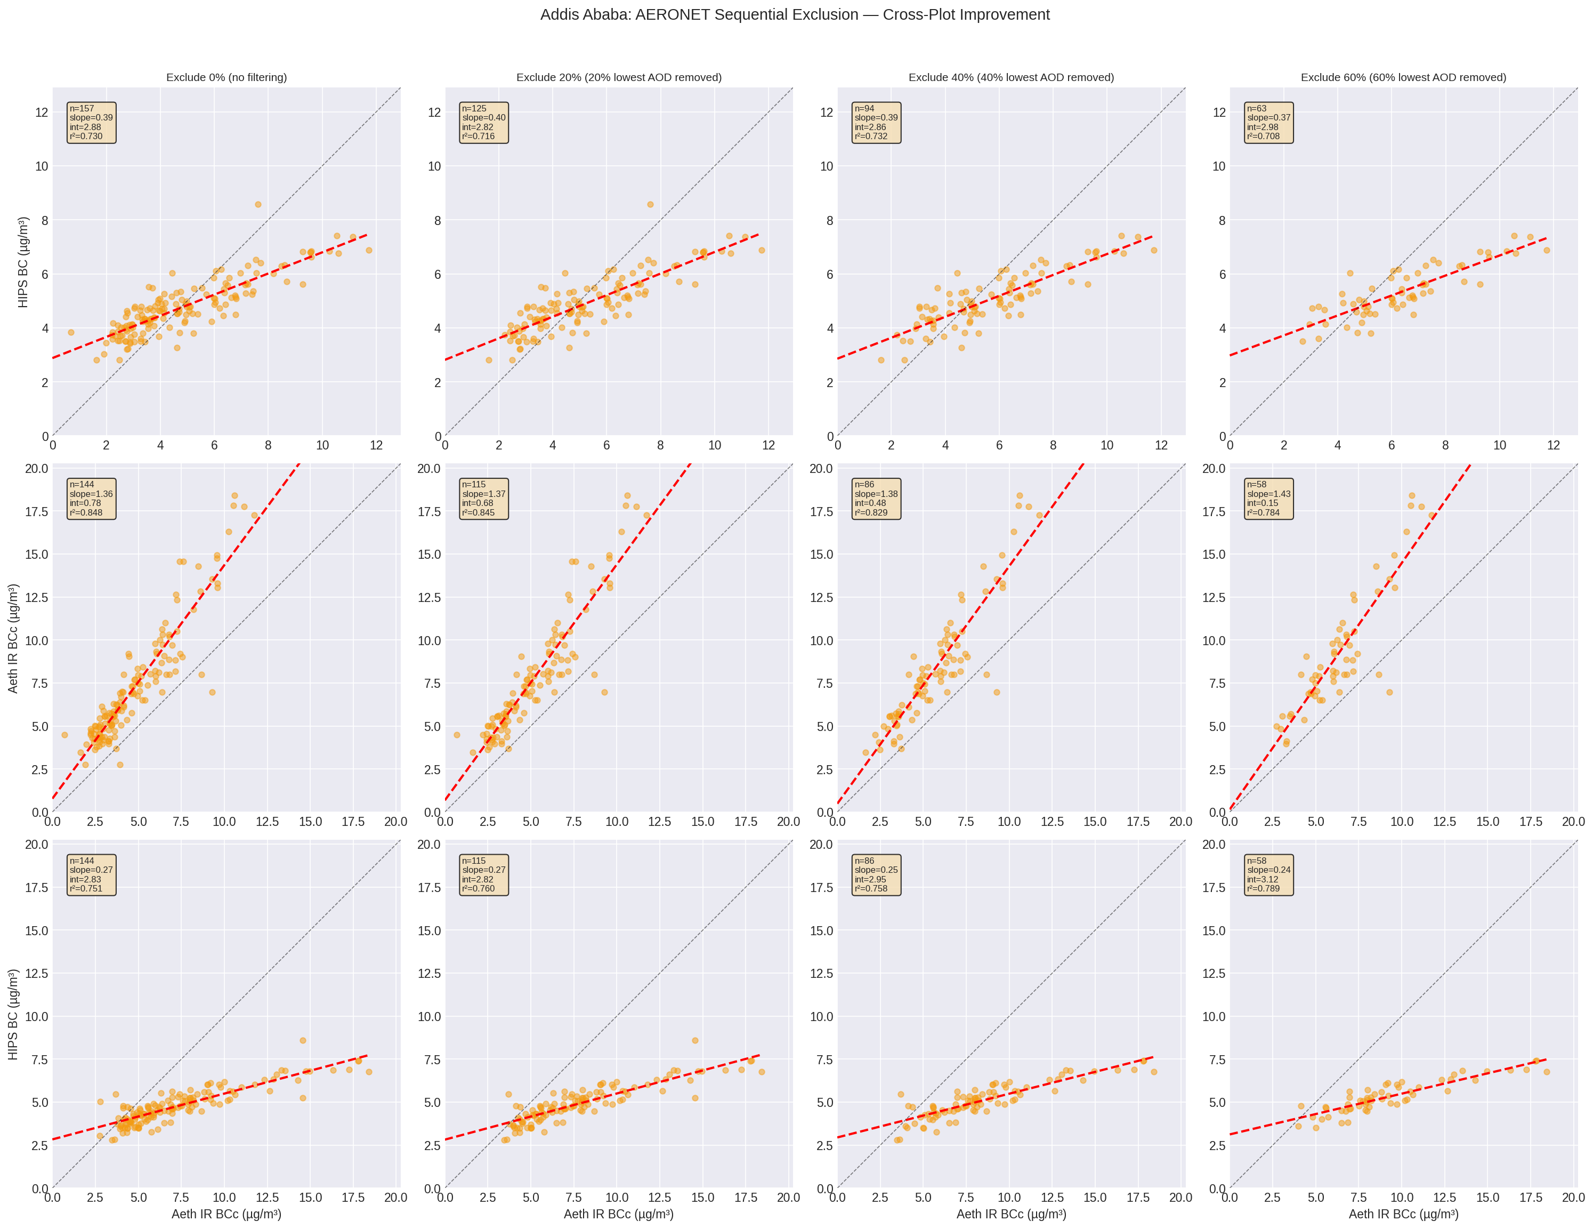
9. AERONET Filtering: Does It Improve Addis Cross-Plots?
157 filter days matched with AERONET AOD
Sequential exclusion: remove lowest 0/20/40/60% AOD days
Tests if decoupled surface-column days explain scatter
Advisor requested this analysis specifically

Slide 12
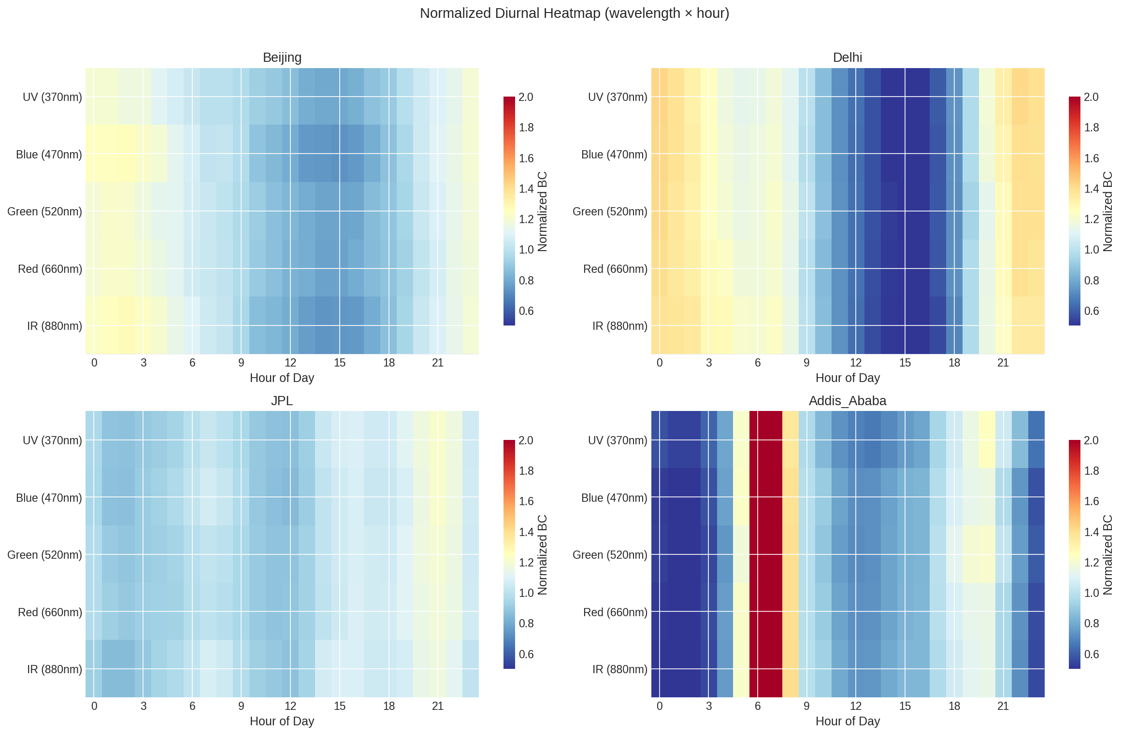
10. Normalized Diurnal Heatmaps
Addis Green channel shows deep blue stripe (near zero)
Beijing/Delhi/JPL show expected warm-cool gradient
Confirms instrument anomaly is persistent, not transient

Slide 13
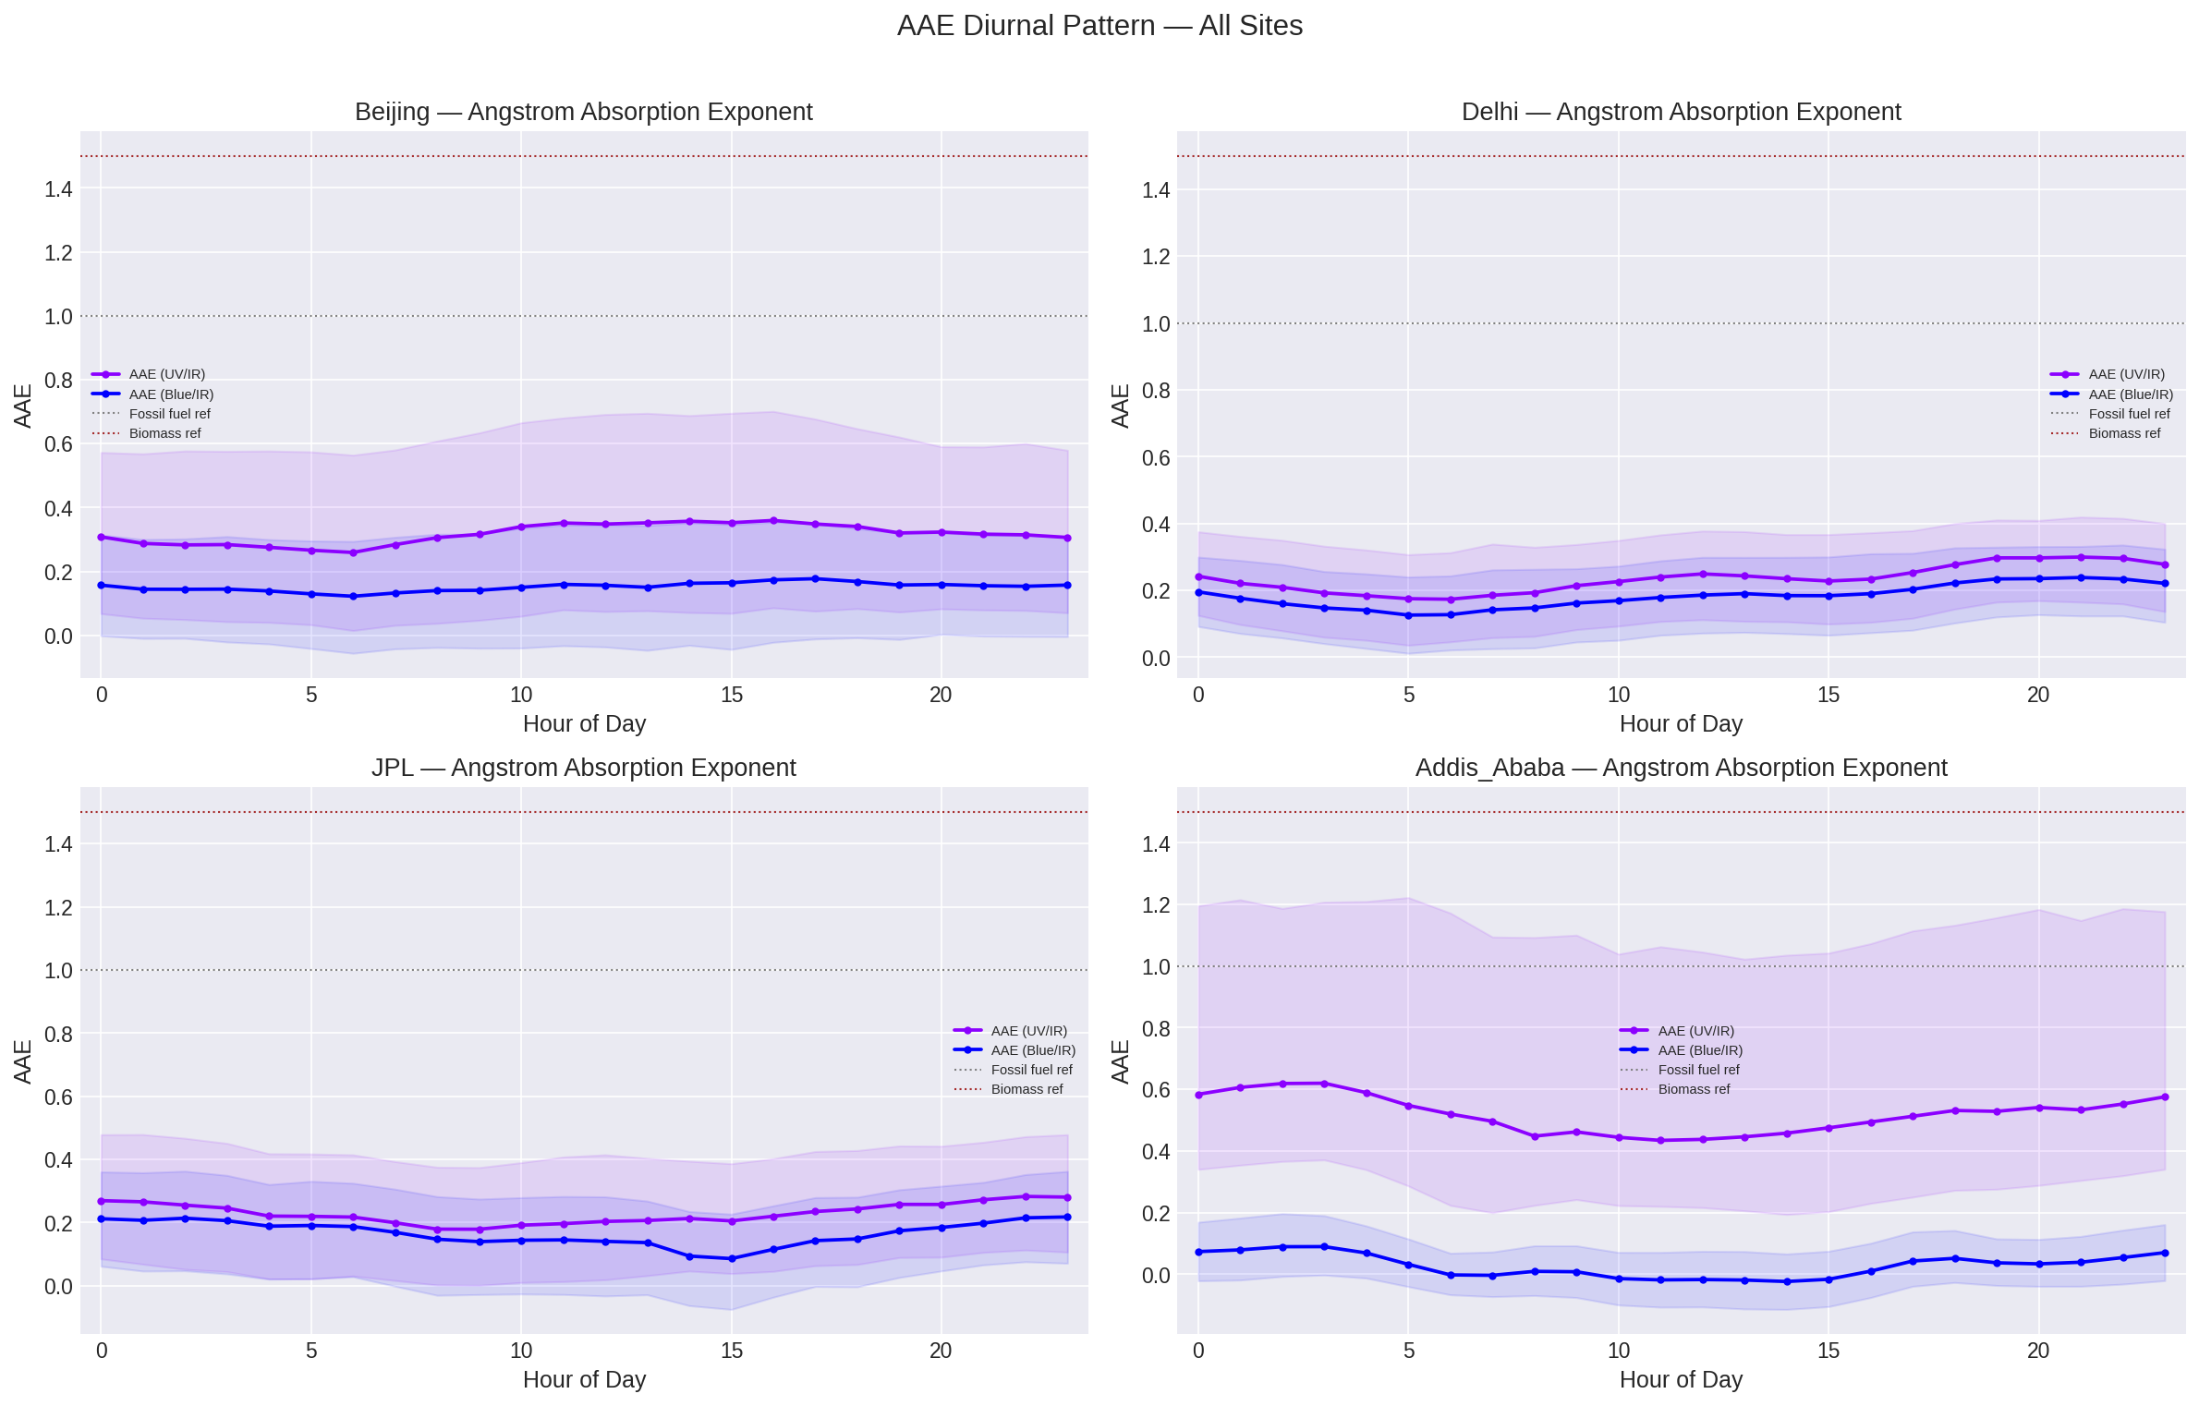
11. AAE Diurnal Pattern — All Sites
All sites: AAE_UV_IR = 0.15-0.63
Literature expects 1.0 (fossil fuel) to 2.0 (biomass)
Likely because data is eBC (MAC-corrected), not raw b_abs
Raw ATN columns exist — could recalculate from absorption coefficients
Addis Blue/IR AAE near zero — confirms wavelength correction issue

Slide 14
12. What We Tried That Didn't Explain the Anomaly
1. Relative humidity thresholds -> "Red herring" (sample sizes too small)
2. Temperature (T_min, T_max) -> Counterintuitive (burning peaks when WARMER)
3. Optical saturation -> No curvature in data (linear throughout)
4. Influential point removal -> Dataset too tight
5. OC/EC ratio -> No additional insight
6. Dust (AERONET coarse AOD) -> r = -0.33 (NEGATIVE) = RULES OUT dust
Higher dust -> HIPS UNDERESTIMATES vs FTIR (opposite of expected)
7. Iron/EC ratio thresholds -> Iron not causing slope discrepancies
8. Source apportionment (PMF) -> All combustion sources show same slopes
9. Combined source grouping -> Biomass vs fossil fuel fully overlap
10. All-season aggregation -> Masks real patterns
11. Wavelength stacking -> Unique to Addis = instrument issue

Slide 15
13. Open Questions for Cena Meeting
1. Green channel at 0.55x IR: Known issue with MA350-0238?
Correction or recalibration available?
2. AAE from eBC vs b_abs: Is data MAC-corrected?
Raw ATN exists — should we recalculate?
3. HIPS anomaly root cause: Tested humidity, temperature, saturation,
dust, iron, sources — ALL negative. What else could cause it?
4. Filter loading effects: Could high BC loading at Addis (~5 ug/m3
vs ~0.5 at JPL) affect HIPS measurement differently?
5. Seasonal wavelength data: Can we get minute-resolution for
Delhi/Beijing to extend wavelength comparison?

Slide 16
14. Next Steps
HIGH PRIORITY:
- Paper skeleton (advisor has asked multiple times)
- Contact Amina for Delhi seasonal confirmation
- Remind advisor -> schedule Cena meeting
- Queens College comparison image
MEDIUM PRIORITY:
- Data exclusion registry (formal log)
- Literature search: filter-based absorption, PSAP, MAAP
- Warren White HIPS/IMPROVE papers
- Calculate AAE from raw b_abs (ATN data)
COMPLETED THIS WEEK:
- 4 new analysis notebooks + 1 config module
- Comprehensive progress doc covering all 10 meetings
- 23 action items tracked as complete

