Slide 1
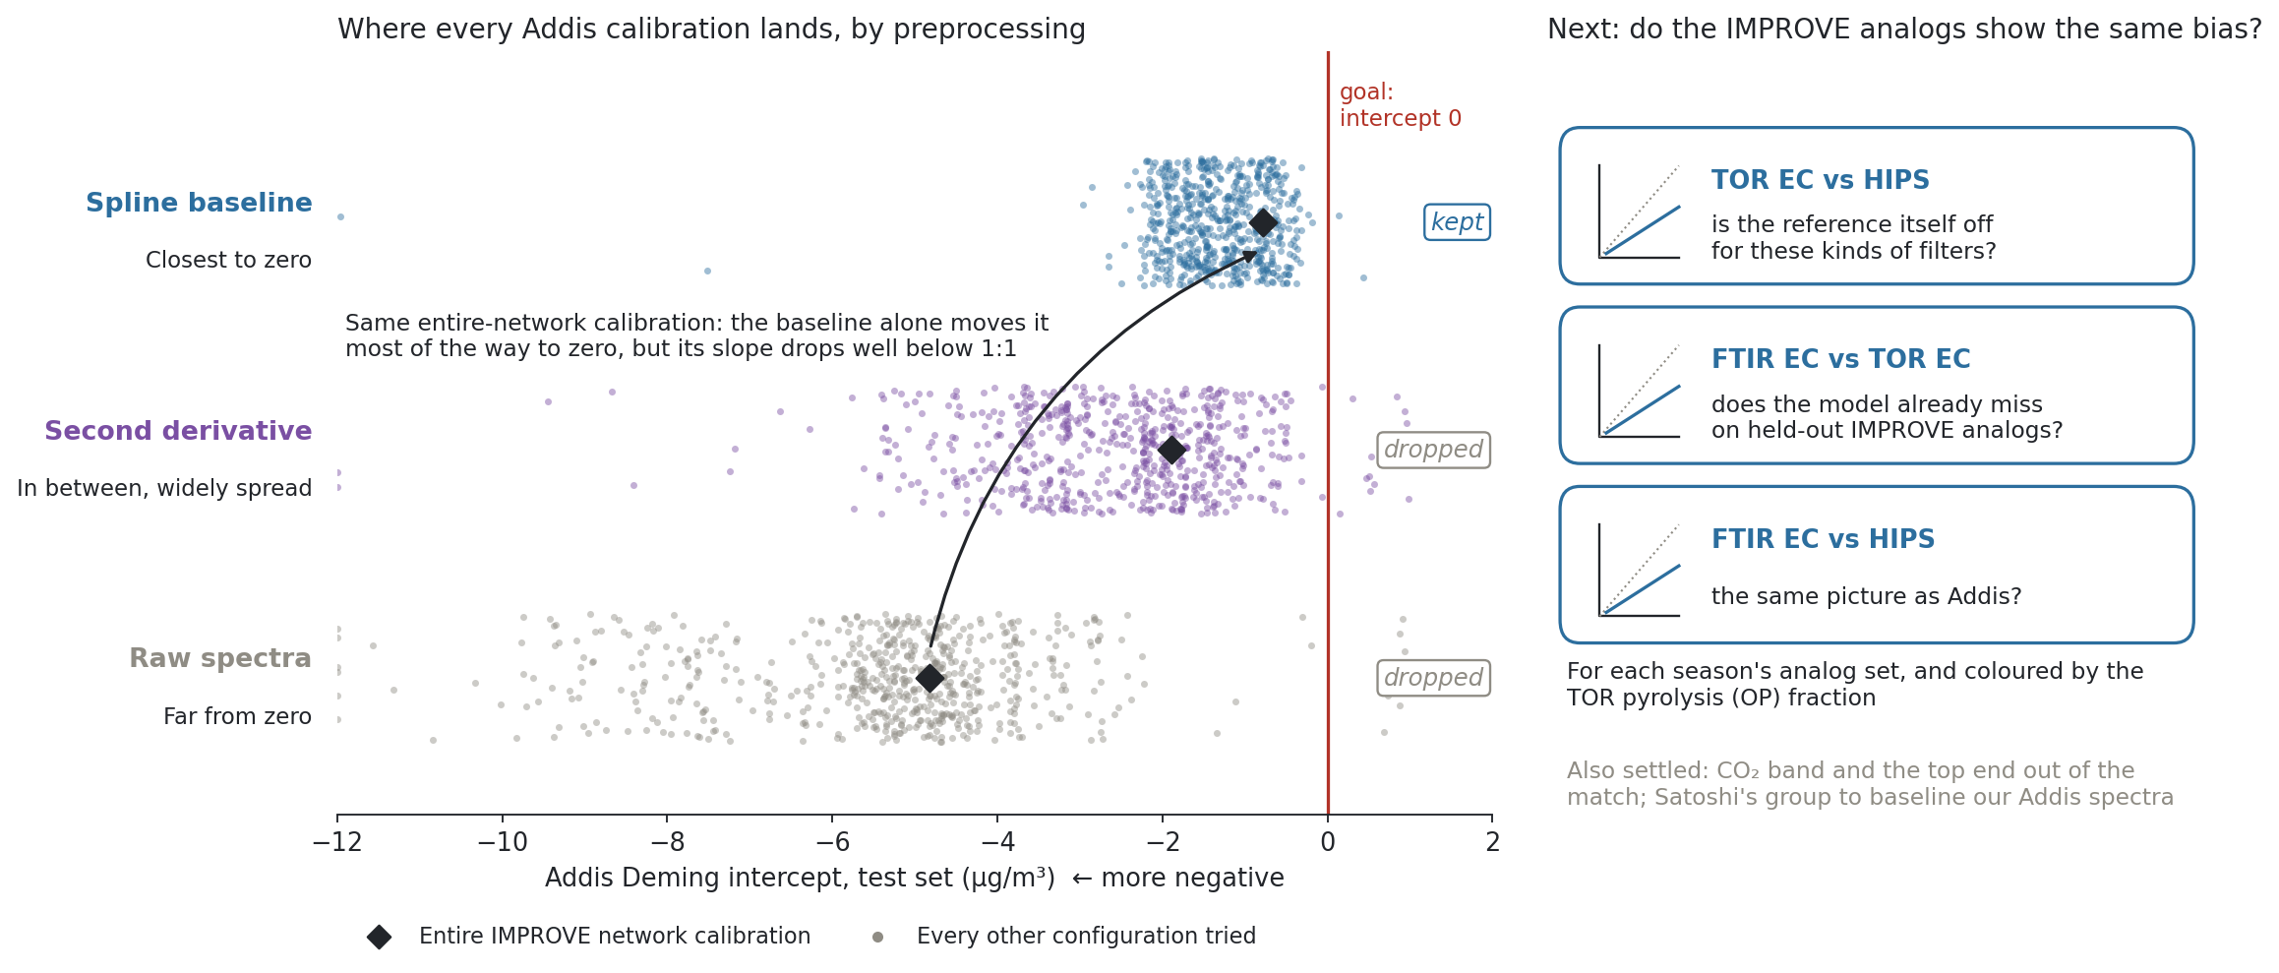
Baseline correction is the lever that moves the Addis intercept; next, check whether the IMPROVE analogs carry the same bias
Notes:
SAY: This is where the call with Satoshi landed. On the left, every dot is one Addis calibration we have tried, placed by its intercept, with zero on the red line. The rows split them by how the spectra were prepared. Raw spectra sit far to the left. Second derivative is in between and spread out. The spline baseline sits closest to zero. The black diamond is the same entire-network calibration in each row: changing only the baseline moves it most of the way to zero, but its slope falls well below one. So we decided to drop raw and second derivative and use the spline baseline from here on, which takes a big lever out of the search. On the right is Satoshi's question for next week. The analogs we pick look a lot like Addis, so do they show the same bias? For each season's analog set I will plot TOR EC against HIPS, FTIR against TOR on held-out analogs, and FTIR against HIPS, coloured by the pyrolysis fraction. If the analogs miss the same way, the problem is in the reference or the spectra, not in how we choose filters.
NOTES: Source: gallery calibration.json (calibration_explorer batch grid), Addis test set, Option A (site-grouped 5-fold CV, first major minimum, site-disjoint 80/20 fit), MAC 10, Deming. 637 configurations per row across cohorts and cutoffs; 8 beyond the plotted range are pinned to the edge. Median intercept: raw −5.13, second derivative −2.31, spline baseline −1.36; share within ±1 µg/m³: 2%, 9%, 31%. Entire IMPROVE network calibration: raw 1.94x −4.82 (k 15), spline baseline 0.47x −0.78 (k 7), second derivative 0.92x −1.89; these are the numbers quoted in the call. The biomass-smoke calibration export still showed its baseline incorrectly and is left out. Decisions in the call: spline baseline only (no raw, no second derivative); exclude the CO2 band and the top end (3500 or 3600 cm-1, nine filters apart, pick one) from matching; keep exclusions identical when the new baseline arrives. Satoshi's asks: (1) for each season's analog set, TOR EC vs HIPS Fabs/10, FTIR EC vs TOR EC on held-out analogs, FTIR EC vs Fabs/10, and where the analogs sit when predicted by the same model as Addis; (2) consider per-filter nearest analogs instead of matching the season median (less urgent, since spectra are homogeneous within a season); (3) send raw Addis spectra so Francois Kamper can baseline them with their new method, runnable code hopefully next week. Ann's asks: get TOR fractions (OPR, OPT, EC1 to EC3) and colour crossplots by OP; fix how to cross-validate so it stops being a lever. Discussion: Kiremt Addis spectra sit below most of the training range, which may explain the poor intercept there; extrapolating down from higher-loaded training filters is usually fine, extrapolating up is not. Addis is unique in the intercept; Bujumbura is unusual only in slope. Ann and Ahmad's afternoon meeting moved to next week.

