Slide 1
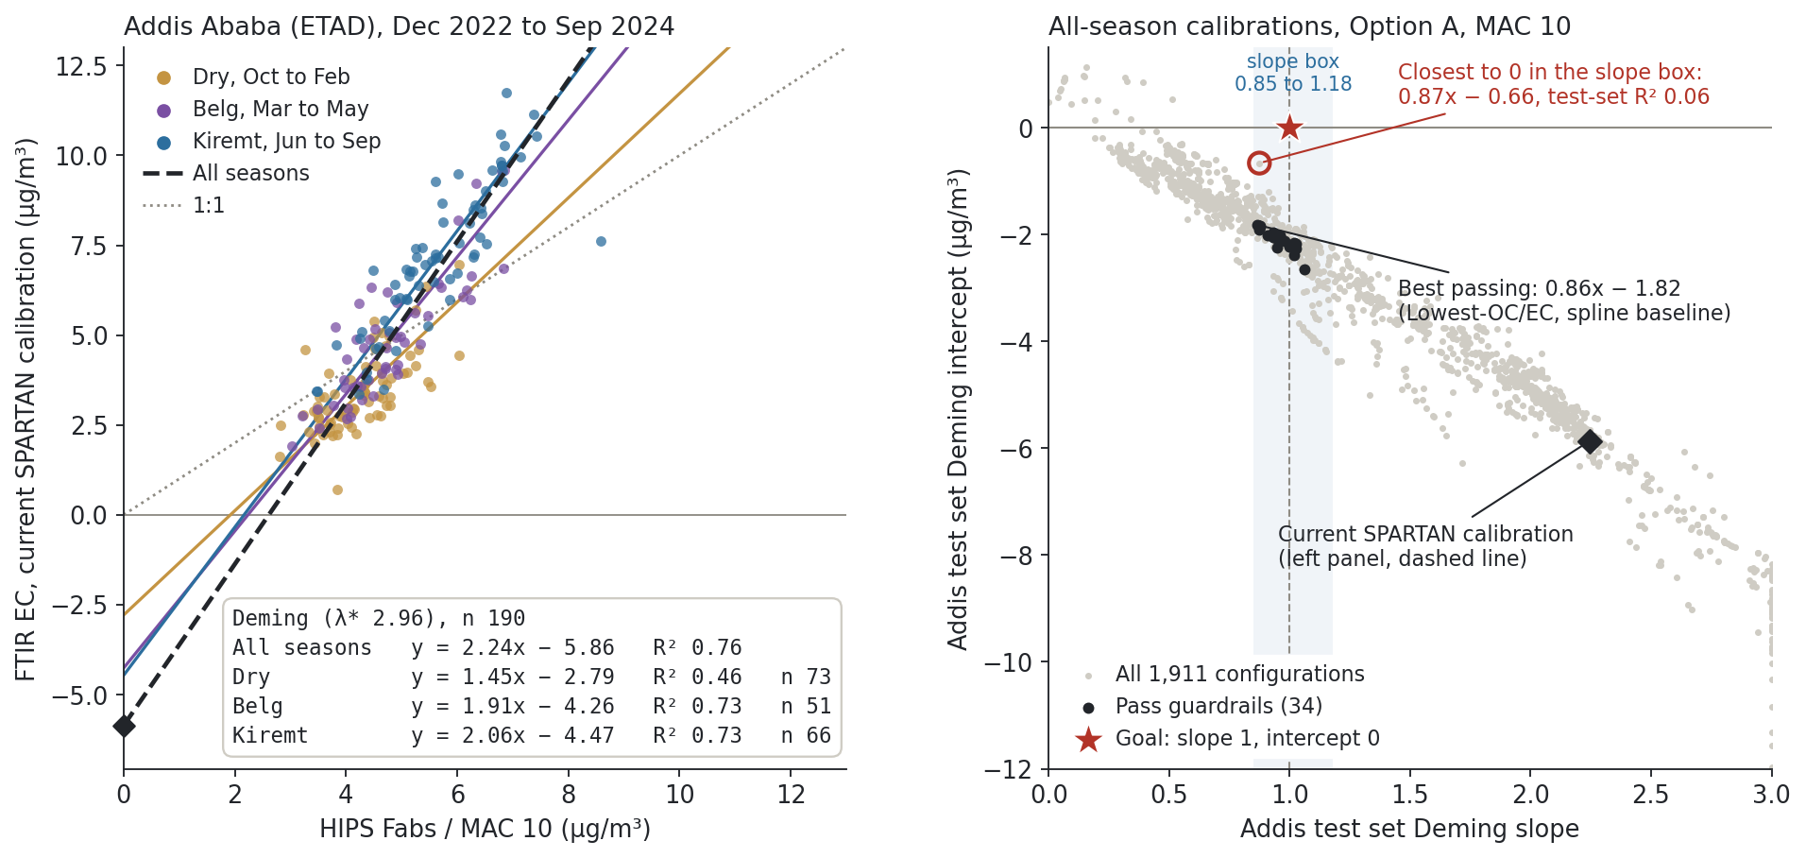
Addis FTIR EC reads high in Kiremt and low in the dry season, and no all-season calibration reaches slope 1, intercept 0
Notes:
SAY: This is the week in one slide, and it is the poster story, Addis only. On the left is Addis FTIR EC from the current SPARTAN calibration against HIPS absorption divided by MAC 10, coloured by season, Deming only. The all-season line has a slope of 2.24 and an intercept of about −6 micrograms; if FTIR and HIPS were measuring the same carbon that intercept should be near zero, and at Beijing, Delhi and JPL it is. Follow the colours: Kiremt, the wet season, has the highest loadings and FTIR sits above HIPS on average (7.2 versus 5.6); the dry season has lower loadings and FTIR sits below (3.4 versus 4.3). So the bias is not one constant offset, it moves with the season. On the right is every calibration we have fitted for Addis, about nineteen hundred of them, placed by test set Deming slope and intercept. The red star is where we want to be. The black diamond is the current network calibration. Only 34 configurations pass our guardrails, and the best of them still has an intercept of −1.8. The one in-box point that gets near zero has a test set R² of 0.06, so it is flat, not right. Takeaway: lumping all seasons together has not got us there, so the next step is a calibration per season, placed on this same plane.
NOTES: Source: gallery exports (filters.json from unified_filter_dataset.pkl; calibration.json from calibration_explorer/cache/batch_results.jsonl, exported 2026-10-01). Built by build.py. Left: 190 Addis filters with both FTIR EC and HIPS, 2022-12-07 to 2024-09-21, excluded filters dropped. Deming λ* 2.96 (HIPS uncertainty vs IMPROVE cross-validation RMSE, MAC 10); OLS is not shown, per Ann (25 Sep: data uncertain on both axes, show R² and the Deming equation). The gallery panel shown in the meeting uses λ = 1, which gives Addis 2.38x − 6.52; same λ = 1 per site: Beijing − 0.63, Delhi − 1.36, JPL + 0.096. Other sites are deliberately off the slide (poster is Addis only). Seasonal intercepts are each less negative than the all-season one because each season's line is fitted over a narrower range; the point is that the seasons sit on different lines. Right: Option A (site-grouped 5-fold CV, first major minimum, site-disjoint 80/20 fit), Addis test set, fixed 190-filter set, MAC 10, 1,911 configurations across cohorts (Lowest-OC/EC, spectral analogs, Ethiopia-shaped smoke, biomass smoke, entire IMPROVE network) and spectra (raw, spline baseline, second derivative). 53 extreme configurations are pinned to the plot edge. Guardrails = Deming slope in 0.85 to 1.18 and IMPROVE cross-validation R² at least 0.85. Best passing: ocec 1040, airspec, k 5, 0.864x − 1.818, test set R² 0.64. Closest to zero in the slope box: ocec 140, deriv2, k 3, 0.874x − 0.663, test set R² 0.062, IMPROVE cross-validation R² 0.030. Anchors reproduced before plotting: Lowest-OC/EC 800 raw k 6, OLS 1.585x − 3.221, held-out TOR R² 0.911; with spline baseline (AIRSpec) k 5, Deming 0.95x − 2.09. Caveats: analog cutoffs resolve to fewer filters than nominal (top 500 gives 477) because the cutoff is applied before TOR eligibility; second derivative configurations are still in the cloud and will be dropped; the VIBES comparison shown in the meeting cut at 1500 cm⁻¹ and is being rerun over the full range, so VIBES points are not on this slide. Agreed wording from this meeting: 'test set' (not held-out TOR), 'cross-validation protocol', 'spline baseline' and 'raw spectra'. Blocked: IMPROVE data download from the FED site has failed for four days; support emailed, Ann can chase a contact if it stays down.

