Slide 1
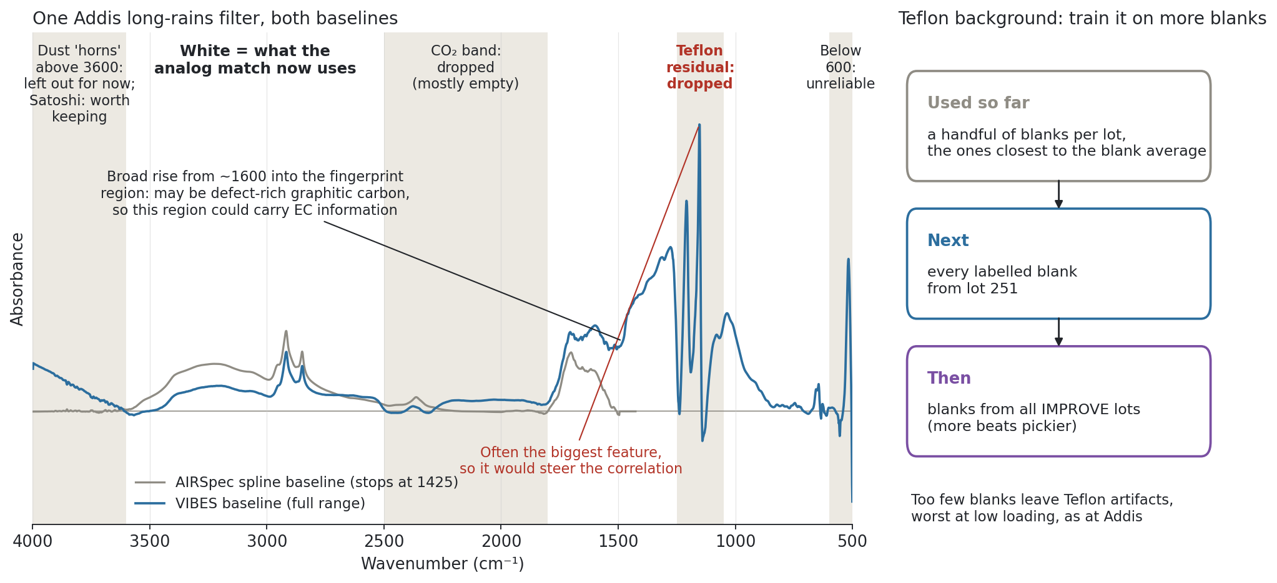
VIBES opens up the spectrum below 1500 cm⁻¹; to use it for analogs, skip the Teflon residual and train the background on many more blanks
Notes:
SAY: This is what came out of the call with Satoshi. On the left is one real Addis filter from the long rains, after two baselines. Grey is AIRSpec, which stops at 1425. Blue is VIBES, which keeps going down to 500, so for the first time we can use the fingerprint region when we pick analogs. Two things showed up. First, the Teflon residual around 1100 to 1200 is often the biggest feature in the corrected spectrum, so if we leave it in, it decides which IMPROVE filters look similar. We agreed to drop it, drop below 600 where VIBES goes negative, and keep dropping the CO2 band; the white regions are what the match uses now. Satoshi also pointed out the broad rise from about 1600 into the fingerprint region could be defect-rich graphitic carbon, which gives a reason to keep that part in. On the right is the second fix. The background model so far was trained on a handful of blanks per lot, the ones closest to the blank average. Satoshi's experience is that more is better, so next I train it on every labelled lot 251 blank, then on blanks from all IMPROVE lots, and redo the analog selection with the new window.
NOTES: Filter shown: ETAD-0105-1 (lot 251, 2023-08-16), chosen as the Kiremt (Jun to Sep) Addis target whose AIRSpec vs VIBES-full RMS difference over 1425 to 4000 cm-1 is closest to the Kiremt median (same rule as the 1 Oct methods deck, restricted to one season). One real filter, not an average. VIBES = pyvibes 1.0.0, full-range run (3998 to 500 cm-1, 12,808 cases, 0 failures), background model rank 30 from 87 blanks (IMPROVE 59, ETAD 28). For this filter the Teflon-band residual is 1.7x the largest feature elsewhere in 600 to 3600; across Kiremt Addis filters it is the largest feature in 85% of them. Agreed similarity window (mask 'oct1' in analog_transfer_checks.py): 600 to 3600 cm-1 with 1800 to 2500 and 1050 to 1250 dropped; for PLS the full spectrum can stay, since PLS down-weights it. Satoshi would keep the >3600 dust horns (dust matters for the mixture); the oct1 window still stops at 3600, so this is a sensitivity case to run. Fingerprint caveat (Satoshi): useful for dust, sulfate and levoglucosan, but organics with the same functional groups can differ there, so similarity on it may not mean similar EC; worth testing with and without. The ~1600 cm-1 broad absorption from defects in graphitic sheets was one mechanistic reason PLS can predict TOR EC (early FTIR EC papers). Also from the call, not on the slide: (1) with spline-baselined IMPROVE analogs matched to the dry season, IMPROVE FTIR vs Fabs/10 shows the same low slope as Addis, so it is not unique to Addis; Ann wants the intercept added to that view next. (2) Label the per-season panels as separate calibrations (separate analog sets), and say so in the title; the all-IMPROVE toggle views are one calibration. (3) Kiremt VIBES spectra share a 1500 to Teflon hump and sit high in the Addis HIPS range; Satoshi reads it as seasonal composition rather than a direct EC signal; Ahmad to try within-season correlation groupings past 1425. (4) Focus stays on Addis; skip Delhi and Pasadena. Follow-up questions arrived from Satoshi on 2 Oct (analog overlap, VIP, fit vs extrapolation, lower envelope).

