Slide 1
FTIR–EC at Addis: the offset, adjudicated — group update, 27 Aug 2026
Ahmad Jalil — UNBC / UC Davis AQRC
Everything in this deck reproduces from the calibration explorer;
screening numbers are labelled; quoted results are held-out or out-of-country.
Notes:
SAY: Since the last update the Addis question went from a one-city mystery to a five-city adjudication. Roadmap: I'll close out the asks from our Aug 19 meeting, show what the HIPS calibration itself turned out to be and why the Addis intercept survives it, what an exhaustive search says about Addis vs Delhi, the season-baseline interaction, and finish with the two lab measurements that would settle the rest. If Satoshi joins late: the cross-site results start at slide 7.
NOTES: Deck convention: Deming primary (lambda*=2.96 at MAC 10, scaled by MAC^2), OLS alongside; Option A = site-grouped 5-fold CV, first major minimum, site-disjoint 80/20 (the only option with a held-out TOR test); Option B = interleaved 10-fold, within-5%; B2 = interleaved, first major minimum. Units ug/m3, Mm-1 parenthetical (x10 at MAC 10).

Slide 2
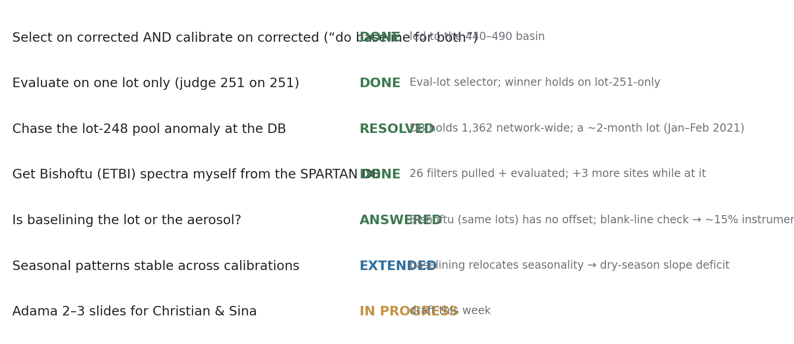
Every ask from the Aug 19 meeting is closed or in motion
Notes:
SAY: Quick score-card on what you asked for. Select-and-calibrate on corrected spectra: done, and it found something better than our locked 800. Lot-251-only evaluation: built into the app. The lot-248 mystery: solved — it was a two-month lot. Bishoftu spectra: I pulled them myself from the SPARTAN database like you suggested, and grabbed Beijing, Delhi and Pasadena while I was in there. And your big question — lot or aerosol — has an answer now.
NOTES: ETBI pull route: Networks_1_0 over SqlClient on the VPN machine (Sean's config); the same pipeline builds any SPARTAN site as an explorer target. Adama slides: in progress this week, figure already drafted (slide 13).

Slide 3
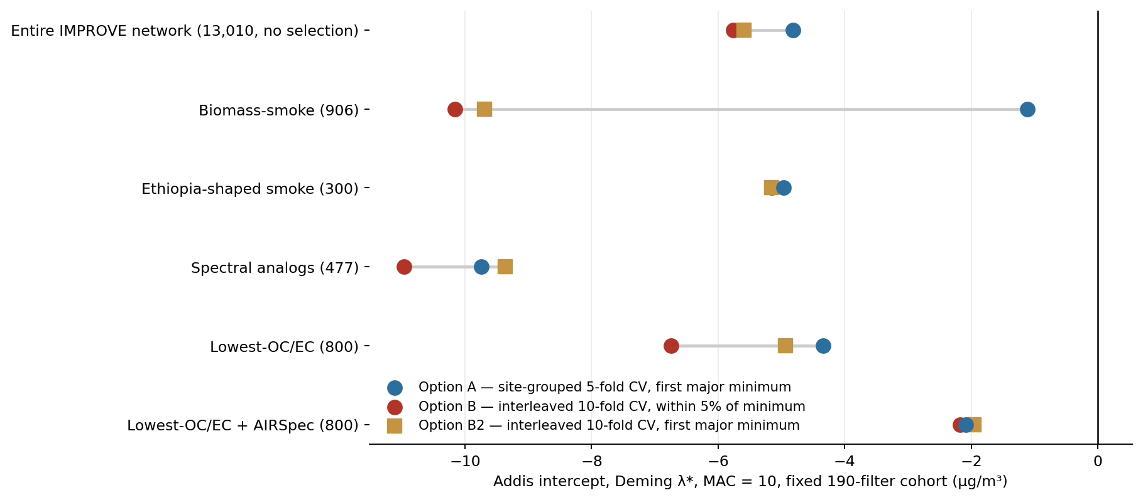
Before anything new: the locked numbers reproduce exactly
Notes:
SAY: Same anchor check as always: the six setups' Addis intercepts under all three protocols, Deming lambda-star, fixed 190. Option B reproduces the historical slide numbers, and the locked anchors reproduce to the third decimal — lowest-OC/EC Option A k=6, OLS 1.585x minus 3.221, held-out 0.911; plus AIRSpec k=5, 0.86x minus 1.615, Deming 0.95x minus 2.09. Two readings to carry forward: protocol choice moves things far less than the setup does — the comforting result from last time — and the AIRSpec row sits nearest zero under every protocol.
NOTES: Validated live against the explorer before this deck was built. Standing caveats carried: analog 'top 500' resolves to 477 after TOR eligibility; entire-network Option A picks k=15 vs the committed pool run's k=10 (unexplained — don't quote that cell); Eth-shaped+AIRSpec under B2 (k=21) is an unstable cell.

Slide 4
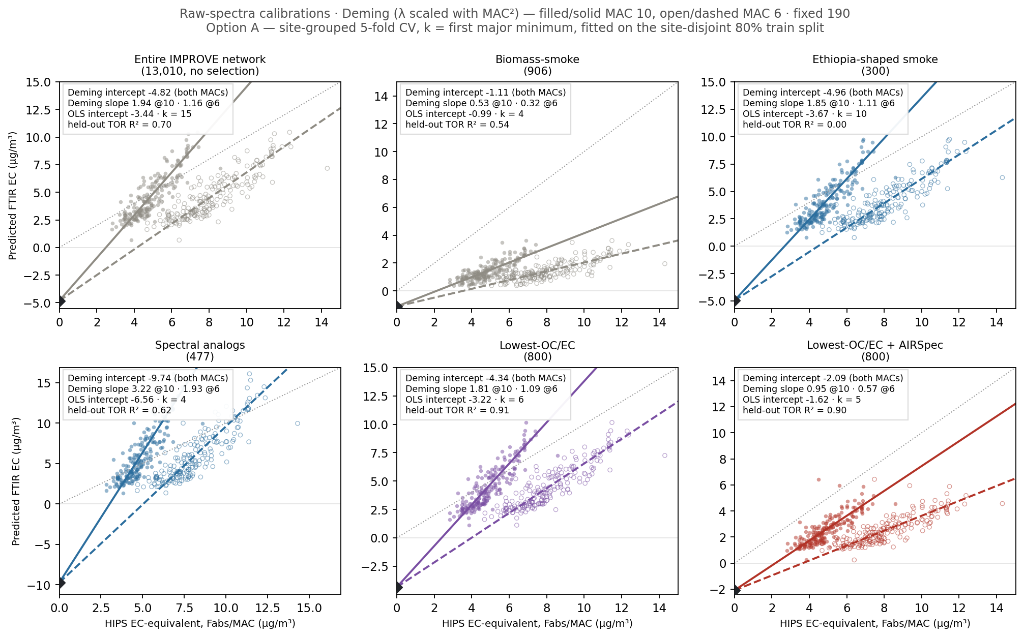
Raw spectra fail the same way across every cohort — no selection fixes it
Notes:
SAY: The six-panel view, raw spectra, Option A. Filled points and solid line are MAC 10, open and dashed are MAC 6, the black diamond is the shared Deming intercept — which is MAC-invariant, so the diamond is the number to watch. Every cohort lands a materially negative intercept on raw spectra; lowest-OC/EC raw sits at minus 4.34 despite the best held-out TOR R-squared. Selection alone does not rescue raw spectra.
NOTES: Grid grammar: dotted grey 1:1; stat box = Deming intercept (both MACs), Deming slopes @10/@6, OLS intercept, k, held-out TOR R2 (Option A only). Per-panel square-ish limits — never shared clipped axes. Fixed 190 readout.

Slide 5
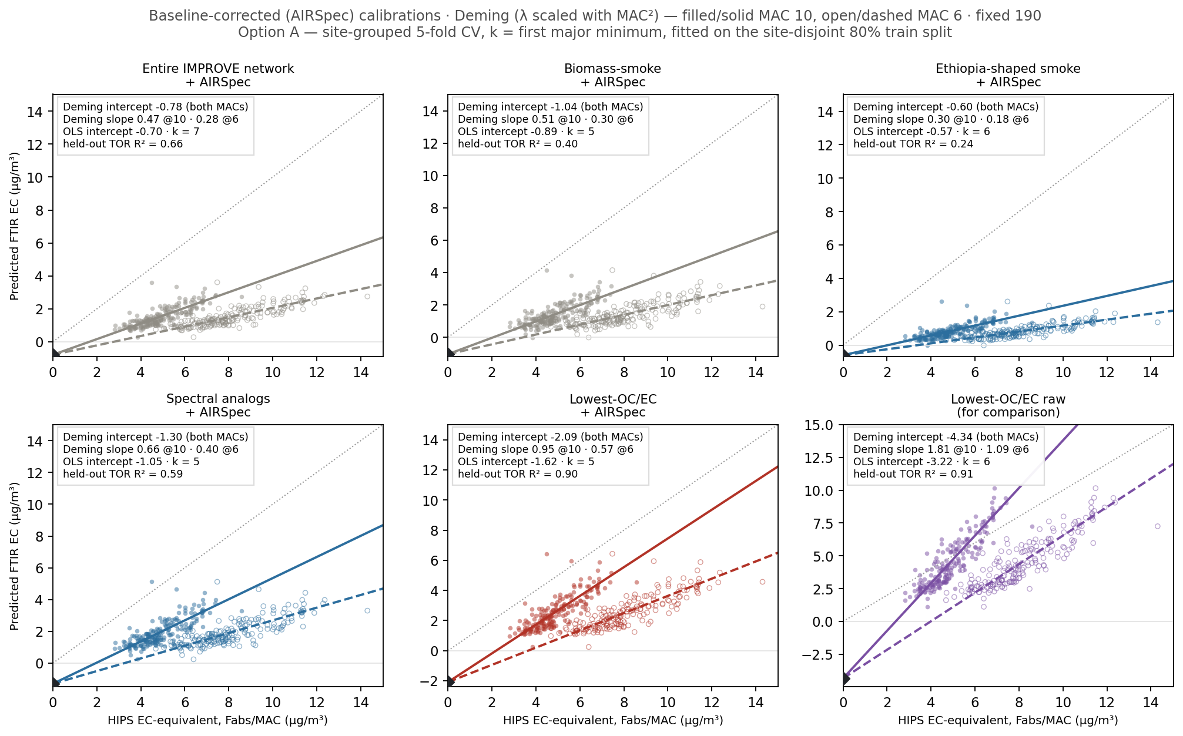
Baseline-corrected, every cohort tightens — and lowest-OC/EC + AIRSpec leads
Notes:
SAY: Same six panels, baseline-corrected. Every diamond moves toward zero, and lowest-OC/EC plus AIRSpec is the standout: Deming minus 2.09, slope 0.95 at MAC 10, held-out TOR R-squared 0.90. That pairing — composition selection plus baseline correction — is the story the rest of the deck keeps confirming: baselining is the lever, and it needs the right cohort under it.
NOTES: The shape cohorts (Ethiopia-shaped, analogs) improve cosmetically but keep weak held-out R2 (0.24 / 0.59) — shape selection does not find composition (ftir_33). 'both MACs' on the intercept: the Deming intercept is exactly MAC-invariant under lambda scaled with MAC^2 (ftir_31).

Slide 6
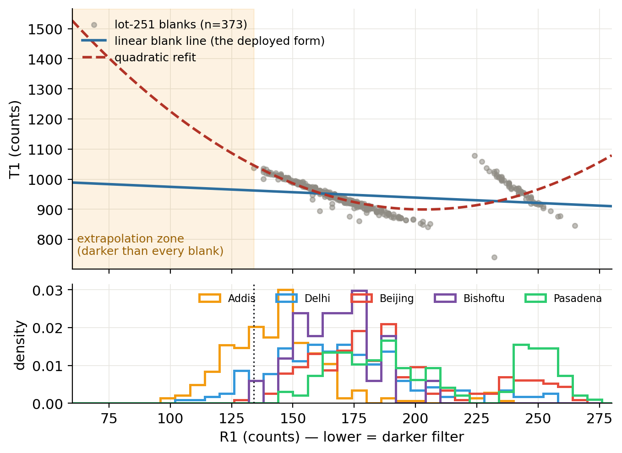
The HIPS scattering correction is a regression through blanks — heavily loaded filters sit beyond its support
Notes:
SAY: We decoded the HIPS math from the batch export: tau is ln of (intercept plus slope times R1) over T1, and that line is fitted through field blanks. Top panel: the lot-251 blank cloud with the deployed linear line and a quadratic refit. Bottom: where each site's filters sit. The shaded zone is darker than every blank — 36% of Addis filters live there. Their Fabs stands on an extrapolated calibration, so we tested what that's worth.
NOTES: Formula verified to <1e-4 against 3,859 shipped tau values. Blank-tau zero bound: +0.32 +/- 0.46 Mm-1 at Addis geometry (575 blanks) — the PTFE-zero branch is dead. Lot 253's blanks are ~10x tighter (rms 3.8 vs 31-42 counts) than the big lots — a HIPS-precision finding on its own. A lot can carry more than one deployed line; the per-line audit is in hips_lab.

Slide 7
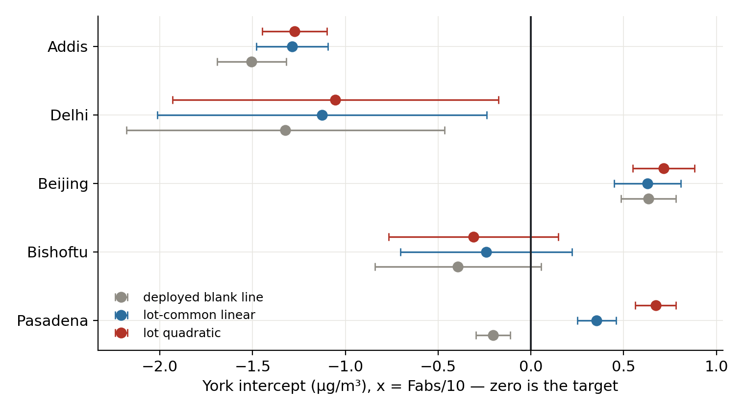
The Addis intercept survives the instrument check — the blank-line share is ~15%
Notes:
SAY: Every filter's Fabs recomputed under three blank-line variants, then refit with per-filter weighted York regression — that's errors-in-variables with the real HIPS uncertainties, replacing pooled-lambda Deming. Addis moves from minus 1.51 to minus 1.27 and stays seven sigma from zero. Delhi's point estimate matches Addis but its error bar reaches zero. Beijing, Bishoftu, Pasadena bracket zero. One certain offset: Addis.
NOTES: York et al. 2004; sigma_y inflated to MSWD=1 (absorbs lack-of-fit — conservative). Scope caveat (state if asked): blanks only sample tau~0, so high-loading response nonlinearity is unprobed by this test and still degenerate with real absorption on FTIR-EC axes — that's what quartz TOR terminates. In Mm-1: Addis offset ~13-15.

Slide 8
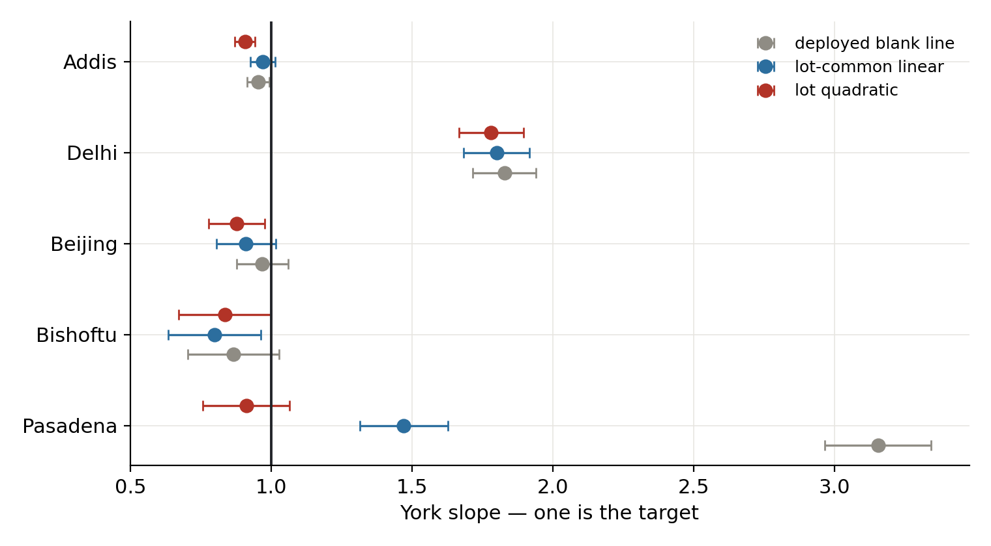
Pasadena's slope anomaly was the blank line; Delhi's 1.8x is real
Notes:
SAY: Same treatment, slopes. Pasadena read 3.15x with the deployed line — switch to a quadratic blank line and it's 0.91x. At their loadings the blank-line shape error dominates tau, so Pasadena was never an aerosol anomaly. Beijing's old 1.48x was unweighted leverage; properly weighted it's 0.98. Delhi's 1.8x barely moves under any variant — that one is real and still open: genuinely low site MAC, or the model reading oxidized organics as EC.
NOTES: Delhi correlate: within-site r(residual, carbonyl/m3) ~0.9 raw, collapsing when detrended by the site's own line — carbonyl marks WHICH sites over-read, not which filters scatter. The MA350 880-nm channel as an independent per-filter anchor at all four sites is the queued splitter (ftir_28 has only ever run at Addis).

Slide 9
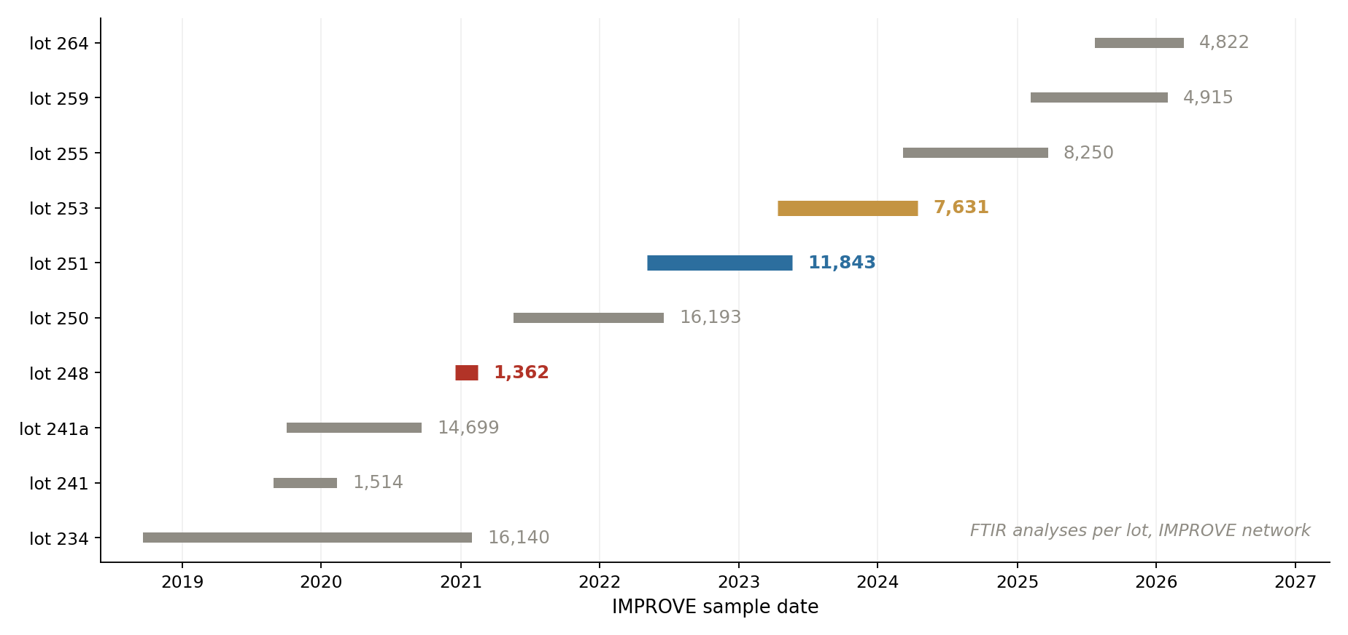
Lot 248 isn't a partial download — it's a two-month lot
Notes:
SAY: The pool mystery from our meeting. The database really does hold only about 1,400 lot-248 FTIR analyses network-wide — the lot was in service for roughly two months around January 2021. So lot-248-trained cohorts are winter-2021 cohorts; that's a season confound, not missing data. Your guess in the meeting — 'somebody decided it wasn't any good and moved on' — looks right.
NOTES: IMPROVE ftir_catalog: lot 248 = 1,362 analyses, 2020-12-17 to 2021-02-15; Ahmad's 1,299 download was essentially the whole thing. Lot 251 = 11,843 over a year. Bar labels are analysis counts; red = 248, blue = 251, amber = 253. Lots 253/255 being the recent large lots is what makes the independent-lot validation possible (backup slide).

Slide 10
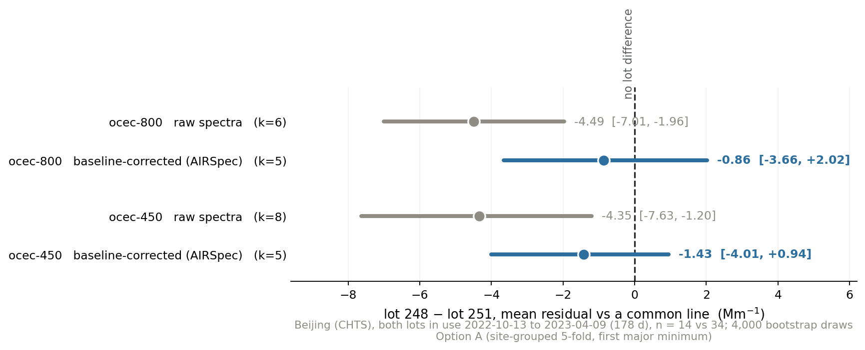
Baseline correction removes the lot-to-lot difference — the mechanism you predicted
Notes:
SAY: You suggested baselining may help partly by erasing 248-versus-251 media differences. Beijing used both lots in one 178-day window, so we can test it: on raw spectra the two lots disagree by about 4.5 inverse megameters on a common line; baseline-corrected, that collapses to about one, indistinguishable from zero. So yes — part of what AIRSpec buys is lot insensitivity. But Bishoftu shares Addis's lots and has no offset, so the lot is not the Addis story.
NOTES: Numbers (Beijing, both lots in use 2022-10-13..2023-04-09, n=14 vs 34, 4,000 bootstrap draws, Option A): ocec-800 raw -4.49 [-7.01,-1.96] significant vs airspec -0.86 [-3.66,+2.02] n.s.; ocec-450 raw -4.35 vs airspec -1.43 n.s. Caveats: n small; lot-248 filters slightly less loaded than the 251 comparators (median pred EC 1.18 vs 1.66). Does NOT explain Addis: ETBI is 100% lot 251 and ETAD ~80%, so Addis-vs-Bishoftu is a within-lot-251 contrast, and the residual post-baseline lot term (~1 Mm-1) is ~5% of the ~21.5 Mm-1 offset.

Slide 11
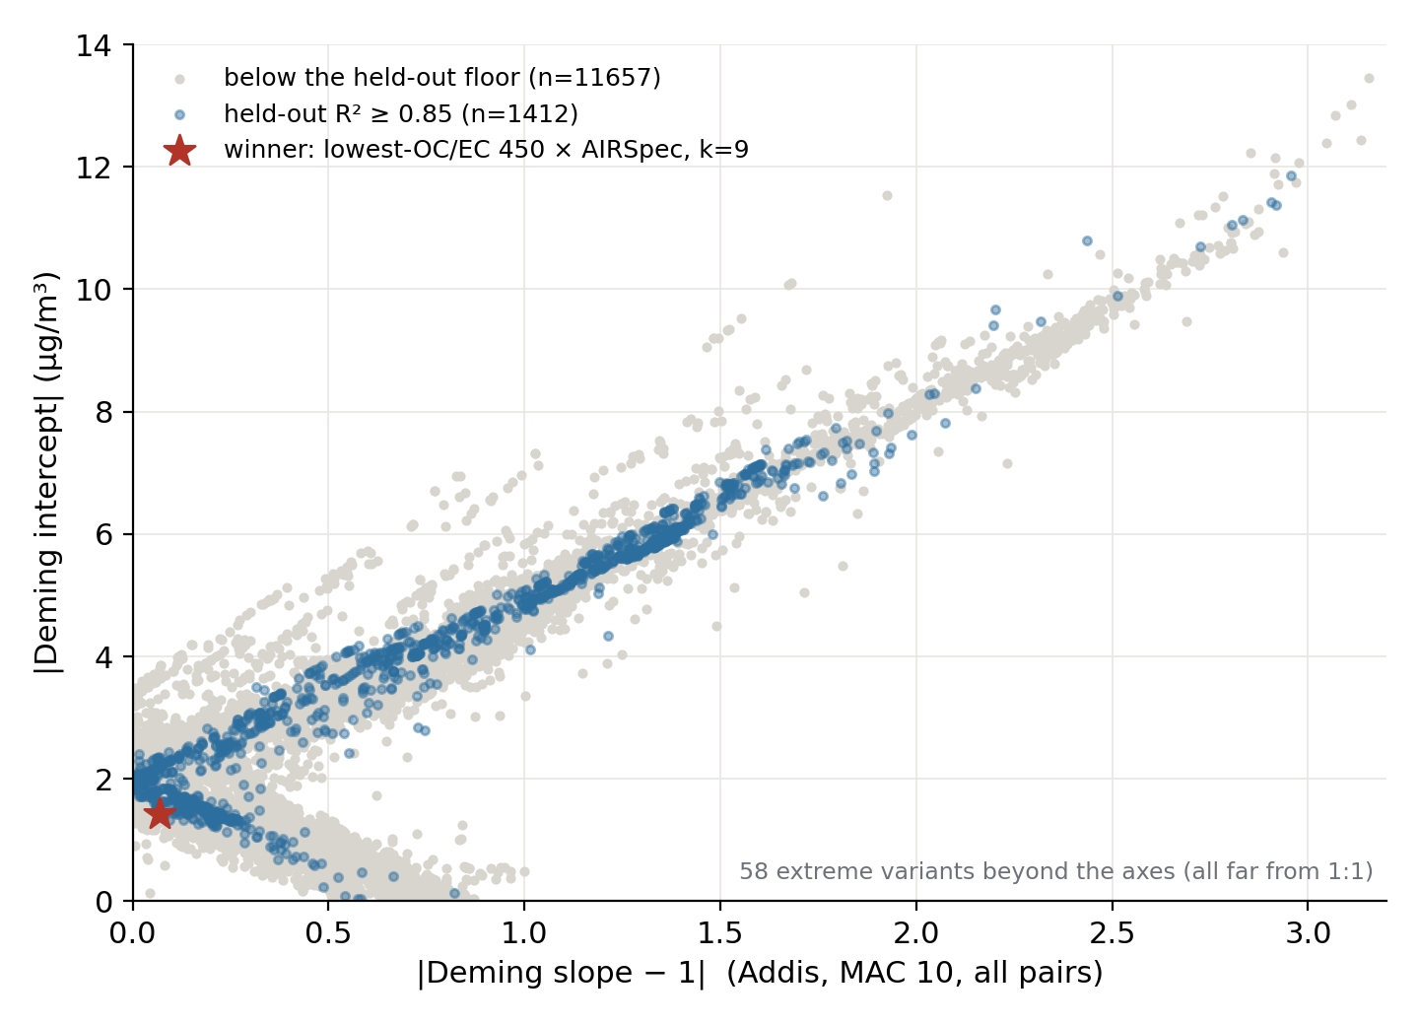
An exhaustive search: no cohort, baseline, or k reconciles Addis and Delhi
Notes:
SAY: To your 'million crossplots' worry — this is what keeping track looks like. Every variant we've identified — five cohorts, cutoffs 100 to 2000 in steps of ten, three spectral spaces, swept components — evaluated at all five sites: nine and a half thousand jobs. Grey fails the held-out floor, blue passes, the star is the winner. The punchline for Delhi: exactly one configuration lands near-1:1 at both cities, it still carries an offset at Addis, and it fails fresh holdout filters. The Addis-Delhi difference is not a knob we can turn.
NOTES: 71,263 scored rows in batch_results.jsonl, dedup-keyed, resumable. Methods lesson learned at grid scale: |intercept|+w|slope-1| is gamed by flat slopes (0.44x with ~0 intercept 'wins'); rankings are slope-boxed 0.85-1.18. Screening numbers are descriptive only — quoted results come from held-out / out-of-country sets.

Slide 12
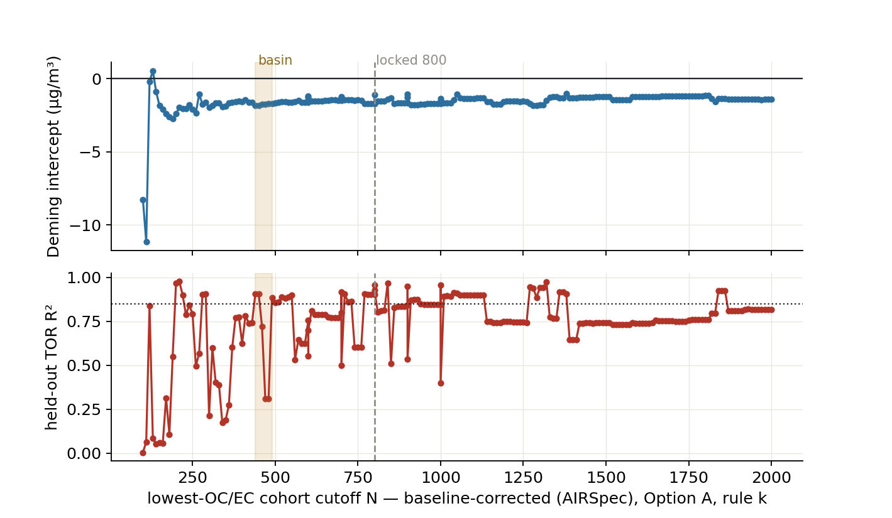
Lowest-OC/EC 440–490 × AIRSpec beats the locked 800 — and wins 62.5% of bootstraps
Notes:
SAY: The corrected-selection run you asked for, taken dense. Intercept on top, held-out TOR R-squared below, as the cohort cutoff sweeps. The shaded basin at 440 to 490 is where everything is best simultaneously — held-out 0.92 versus 0.87 at our locked 800. The honest footnote: under bootstrap reselection this winner takes 62.5% of draws, so it's the leading frozen candidate, not a final answer.
NOTES: ftir_11's '800 sweet spot' was a coarse-grid artifact (never scanned below 600). Basin needs k=8-9 — rule-k at 5 ties the 800 (connects to ftir_23's 'rules stop early'). Corrected analog-440 wins ~1/3 of draws — the runner-up family. Source-site slope interval remains wide: 1.03 [0.65, 1.50].

Slide 13
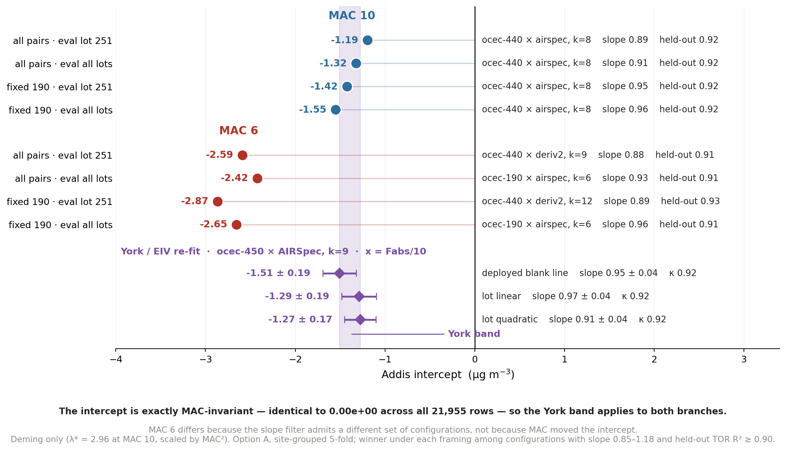
The intercept is MAC-invariant — every Deming framing lands on the independent York fit
Notes:
SAY: The stability check behind that basin. Four Deming framings — fixed 190 or all pairs, evaluated on all lots or lot 251 only — and all four select the same configuration, ocec-440 by AIRSpec at k=8, held-out TOR R-squared 0.92, intercepts minus 1.19 to minus 1.55. The purple band is the York errors-in-variables re-fit — a different estimator, per-filter HIPS uncertainties, on essentially the same configuration, ocec-450 by AIRSpec at k=9 — and it lands in the same place, minus 1.27 to minus 1.51. Now the important part about MAC. The intercept is exactly MAC-invariant: we verified it across all 21,955 rows, identical to machine zero. So MAC does not move the intercept at all. What MAC changes is which configurations survive the slope filter — at MAC 6 the raw and second-derivative models rescale into the slope window and take over, and those configurations happen to carry intercepts around minus 2.6. The MAC fork is real, but it is a selection effect, not an arithmetic one.
NOTES: Deming only, at the user's request — the OLS rows tell a different story and are deliberately excluded. MAC-INVARIANCE: verified empirically — ols/deming intercept vs their _mac6 twins are identical for 100% of 21,955 Addis rows, max |diff| 0.00e+00. This is ftir_25's algebra (C = |intercept|*MAC/slope is MAC-invariant) showing up in the grid. Consequence: the York band, fit at x = Fabs/10, applies to BOTH branches; refit at MAC 6 the same configuration would give the identical intercept and a slope of about 0.55. Two claims that hold ONLY for Deming: (a) 'rank 1 under every MAC-10 framing' — under OLS the winner moves to ocec-210 or ocec-840 x deriv2 with SMALLER intercepts, -0.26 to -1.08, which is why the previous slide's honest number is 62.5% of bootstraps; (b) 'MAC 6 is twice as bad' — MAC-6 OLS all-pairs gives -0.95, better than MAC-10 Deming's -1.19. CRITICAL METHOD NOTE: the ranking is meaningless without a held-out gate — on |intercept| + 0.5|slope-1| with only the slope box, the top config is ocec-300 x deriv2 at intercept +0.20 with held-out TOR R2 = 0.14. This figure gates at >= 0.90. York band = span of the three blank-line variants (deployed -1.51+-0.19, lot-linear -1.29+-0.19, lot-quadratic -1.27+-0.17); sigma_y inflated per site until MSWD = 1. The adjudication doc's headline -1.38+-0.18 sits mid-band.

Slide 14
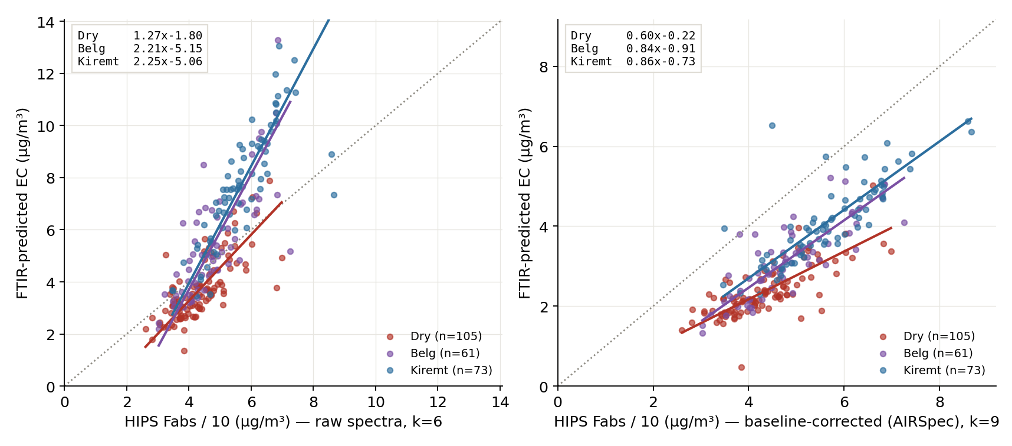
Baselining relocates seasonality: the dry season becomes the anomaly
Notes:
SAY: You flagged season-stability as hugely important, so we stratified the winner by season under both baselines. Left, raw: the whole-year 2.35x hides wet seasons at 2.2x and Dry at 1.3x — raw's failure is a wet-season phenomenon. Right, corrected: the wet seasons snap to about 0.85x with small intercepts, but Dry drops to 0.60x. Baselining doesn't remove the seasonal structure — it moves it, and the charcoal-heavy dry season becomes the anomalous regime. That's the reverse of the direction we'd guessed.
NOTES: Per-season Deming at lambda*=2.96 on restricted ranges — indicative, not final; the proper interaction fit is the ftir_24 deliverable. Consistent with char_06's dry-season spectral anomaly and ftir_22's dry-separates residuals. Season schemes differ across sites (Ethiopian vs quarters) — cross-site seasonal pooling needs a mapping decision.

Slide 15
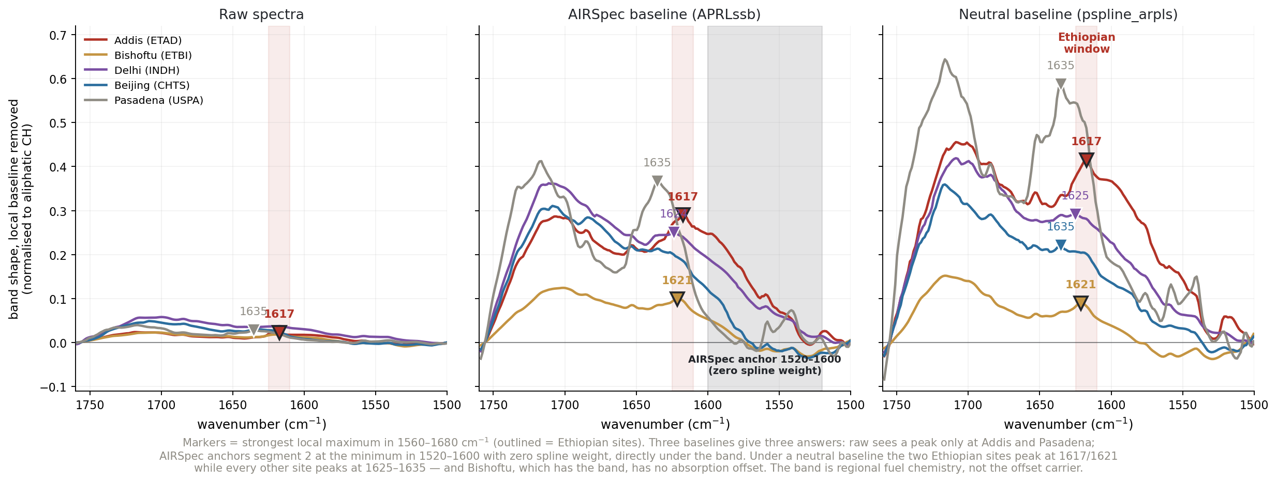
Three baselines gave three answers about the 1617 band — a methods rule, not a mechanism
Notes:
SAY: A cautionary result we're glad we caught ourselves. The 1617 band looked like it tracked the offset across five sites; on corrected spectra the match was Delhi's carbonyl flank; under a neutral baseline the band shows at Addis AND Bishoftu — an Ethiopian regional marker, decoupled from the offset, because Bishoftu has the band and no offset. The mechanism: APRLssb anchors its spline at 1520 to 1600 — directly under the band. House rule going forward: any claim in 1500-1650 needs two baselines.
NOTES: Figure shows the three baselines side by side; markers are the strongest local maximum in 1560-1680 cm-1, outlined for the Ethiopian sites. The discriminator is peak POSITION, not height — an amplitude metric puts Pasadena highest (0.59) and Bishoftu LOWEST (0.09), the exact opposite of the finding. Neutral-baseline positions: Addis 1617 (prominence 0.106), Bishoftu 1621 (0.033), Delhi 1625 (0.018), Beijing 1635 (0.014), Pasadena 1635 (0.270, the water assignment). Two details in earlier prose do NOT reproduce: Bishoftu is not stronger than Addis (Addis is 3x more prominent), and Delhi/Beijing do not peak at 1679. Neither changes the conclusion, which rests on Bishoftu having the band and no offset. Full arc with both retractions preserved in BAND1617_LEAD_2026-08-23.md. This is presentable credibility: tested, corrected in-place, rule extracted. The composition evidence for the offset now rests on the envelope-AERONET link and BC/PM2.5=23% (3x any other site), not the band.

Slide 16
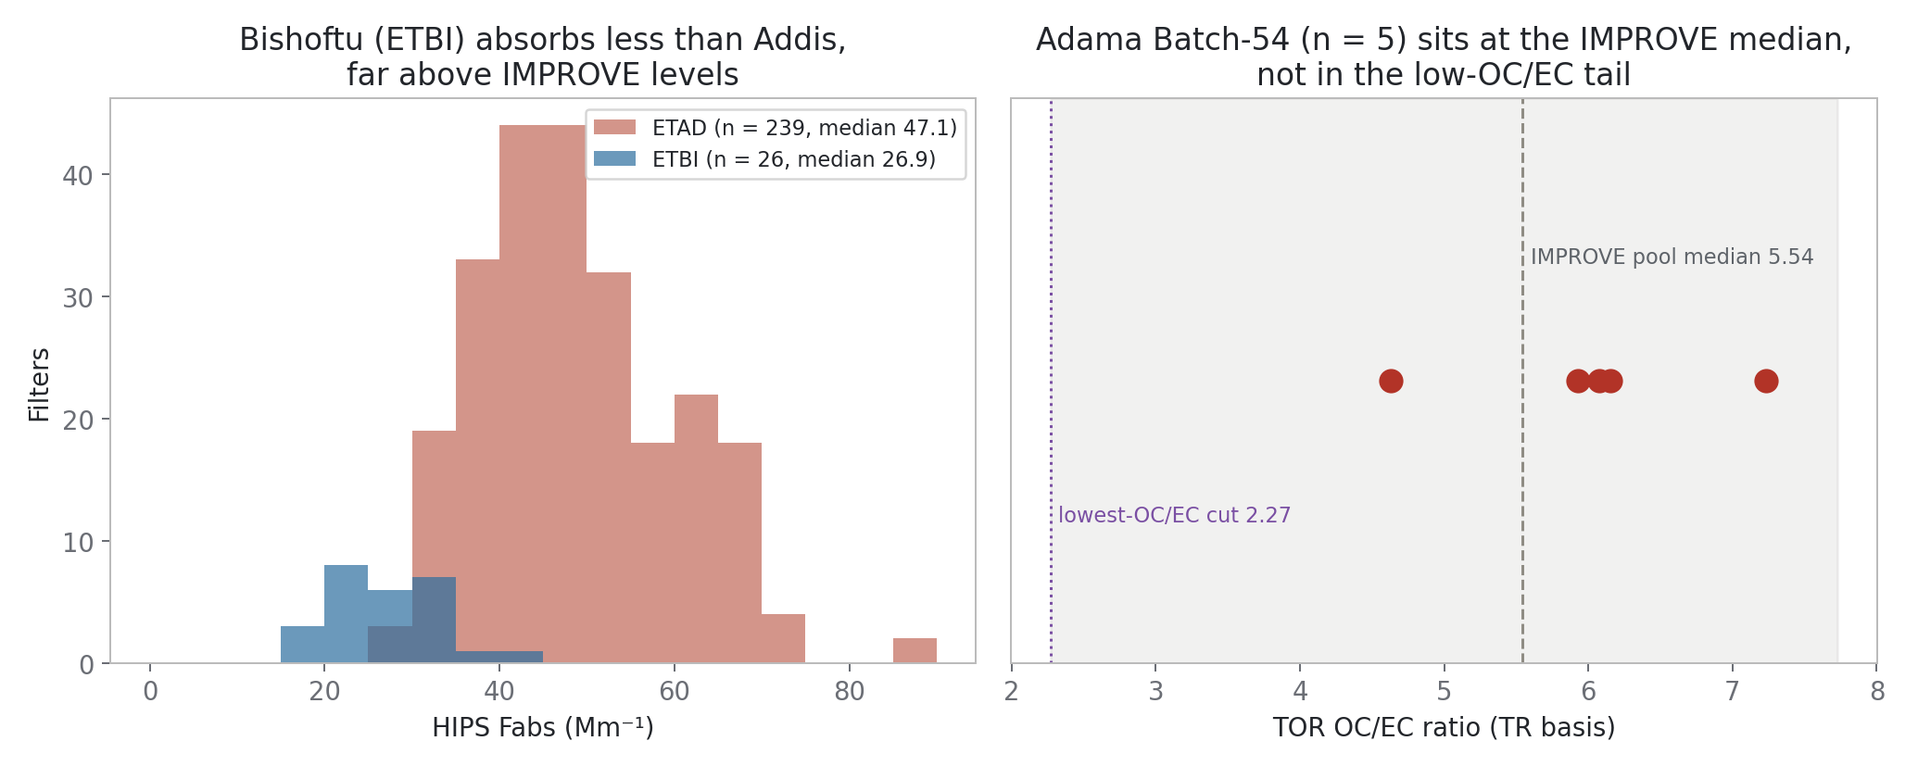
Adama is not Addis: Batch-54 sits at the IMPROVE median, with no HIPS–EC gap
Notes:
SAY: Seed of the two-pager for Christian and Sina. The five Adama TOR filters sit at OC-to-EC around six — the IMPROVE pool median, nowhere near the low-OC/EC tail that Addis calibrations need — and Bishoftu, eighty kilometres away, absorbs half of what Addis does. More Adama samples characterize a different problem than the Addis one.
NOTES: This figure is the SEED, not the full case — Ann's ask is a 2-3 slide HIPS + TOR-OC/EC vs FTIR-OC/EC comparison telling Christian & Sina that more Adama samples won't arbitrate Addis; the TOR-vs-FTIR panel still needs to be added (data: ftir16 adama_batch54 tables). Figure provenance: ftir31 figure_manifest. The decisive Adama-side contribution would be quartz filters for TOR.

Slide 17
Every variant in this deck is a click — live demo
Sites tab — the five-site table with the extrapolation flag, one click
HIPS tab — York fits under all three blank lines, plus the blank ledger
Optimize — multi-site batches, dense sweeps, slope-boxed leaderboards
New since last time: config sidebar, validation guardrails (Q-residual + score distance) on every run
Notes:
SAY: Rather than more slides — the app. [Switch to the explorer: run the Sites tab on the winner, open the HIPS tab, show the blank-line ladder live. If Satoshi asks a variant, run it now.]
NOTES: Explorer on :5058 under anaconda python; warm cache first. If the live demo dies: every figure here regenerates from build_figures.py in the deliverable folder.

Slide 18
Three lines of evidence now terminate at the same two measurements
Quartz TOR EC on collocated Addis filters — breaks the offset-vs-curvature degeneracy
(campaign one-pager written: ~36 filters across 3 seasons)
Solvent extraction + HIPS re-measurement on archived Addis + Delhi filters,
Beijing/Pasadena as controls — separates real absorbers from any residual artifact
Both use existing samples or the existing sampling plan; neither needs new field work
Notes:
SAY: The statistics have gone as far as statistics go: the MAC fork, the Bishoftu contrast, and the curvature degeneracy all end at an independent EC measurement. Quartz TOR is the decisive one; the extraction test is the cheap companion that uses filters already in the archive. These are the two asks.
NOTES: Extraction design: Kirchstetter/Novakov/Hobbs JGR 2004 — water then methanol; a drop only at Addis/Delhi = real organic absorbers; methanol-resistant dark residue = char/tar specifically. TOR sizing from ftir_16: ~3 sigma/day separation of MAC 6 vs 10 -> 11-13 days/season x 3 seasons.

Slide 19
Logistics
AAAR: poster Thursday 1–3 pm, session 9 — flights + conference hotel booked
Committee meeting: Sep 2, 3 pm — invite emails [FILL IN: confirm they arrived this time]
Adama two-pager for Christian & Sina: draft this week
Satoshi meeting: ready when scheduled — the app makes his variants runnable live
[FILL IN: lot-253 spectra pull status — needs a session on the Windows/VPN machine]
Notes:
SAY: Housekeeping: AAAR is booked, poster Thursday one to three. Committee meeting September 2 at three. The Adama two-pager lands this week. And whenever the Satoshi meeting happens, the tool is ready for it.
NOTES: The lot-253 pull script (get_improve_lot253_spectra.ps1) is staged: pilot mode first, resumable parts, lot 255 sealed as the replication set. TOR y-values for lot 253 are already local — only spectra missing.

Slide 20
Backup
Notes:
SAY: Backup material from here.
NOTES:

Slide 21
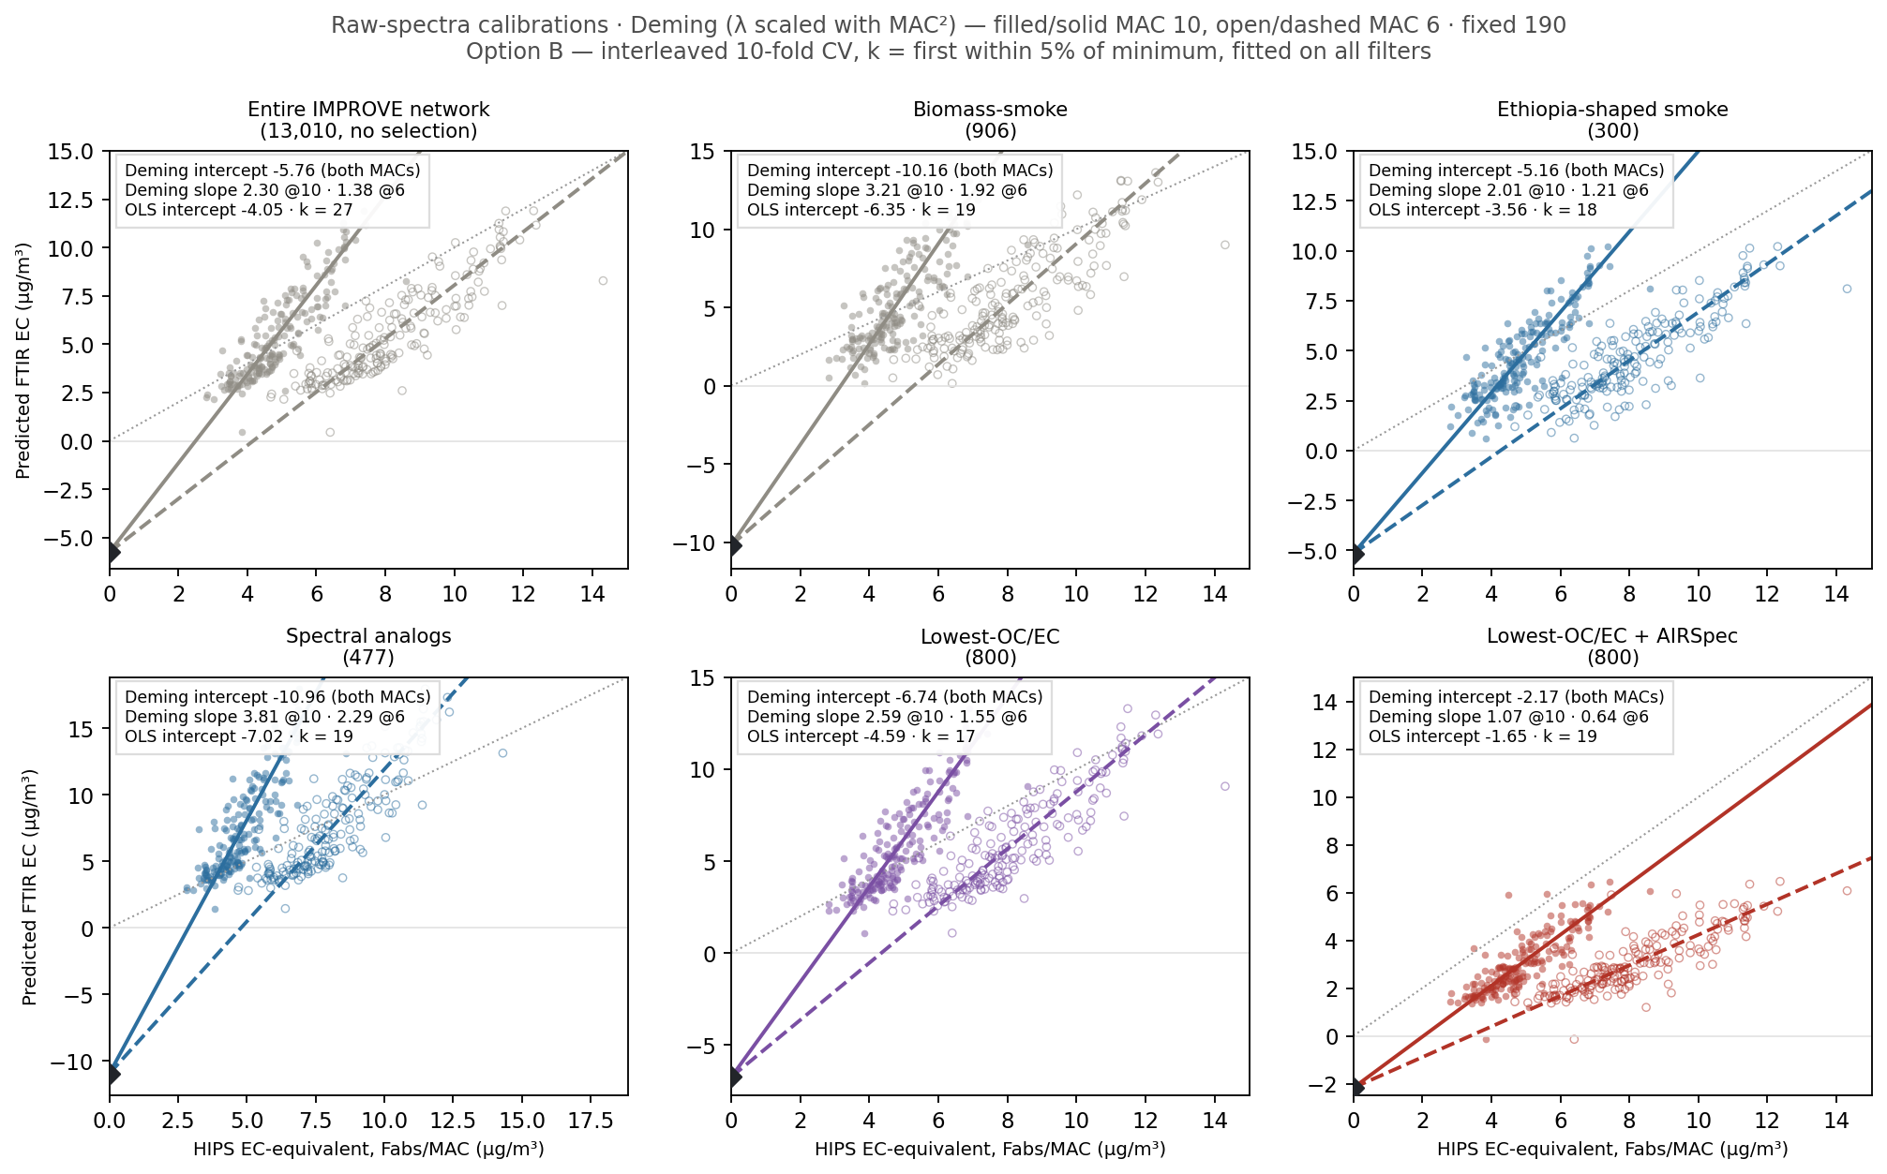
Backup — the same grids under Option B reproduce the historical slide numbers
Notes:
SAY: For reference against the network's own protocol: raw spectra under Option B — interleaved ten-fold, fitted on all filters. These reproduce the historical deck intercepts.
NOTES: Option B has no held-out TOR test (fits on all filters) — its leaderboard passes are vacuous; shown for continuity with the network's numbers, never for ranking.

Slide 22
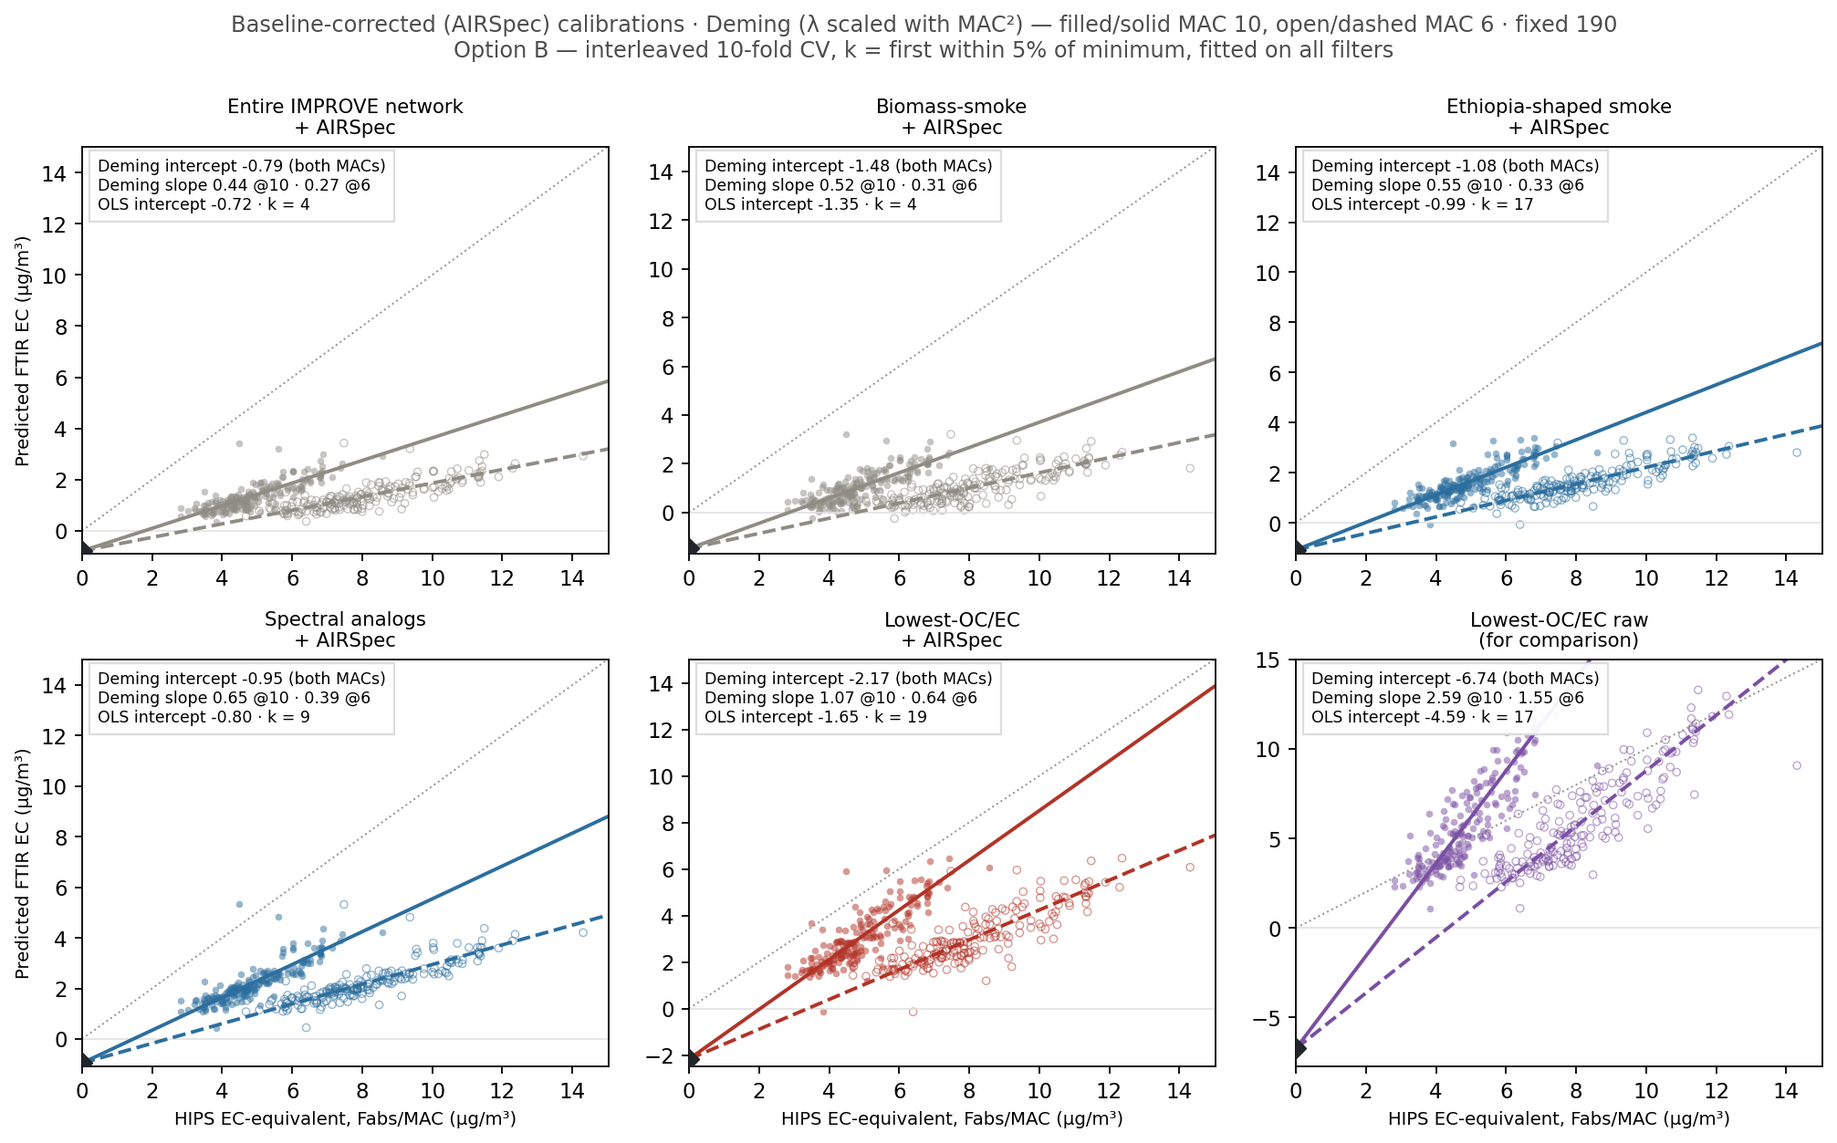
Backup — Option B, baseline-corrected: the AIRSpec conclusion is protocol-robust
Notes:
SAY: And baseline-corrected under Option B: lowest-OC/EC plus AIRSpec lands within a tenth of the Option A answer — the protocol-robustness result Ann called the good news.
NOTES: A-vs-B spread on the AIRSpec row is ~0.1 ug/m3 (-1.65 vs -1.62 OLS, ftir_21) — the strongest robustness claim in the matrix; contrast smoke-906, which swings 2.43x-6.35 to 0.50x-0.99 across protocols.

Slide 23
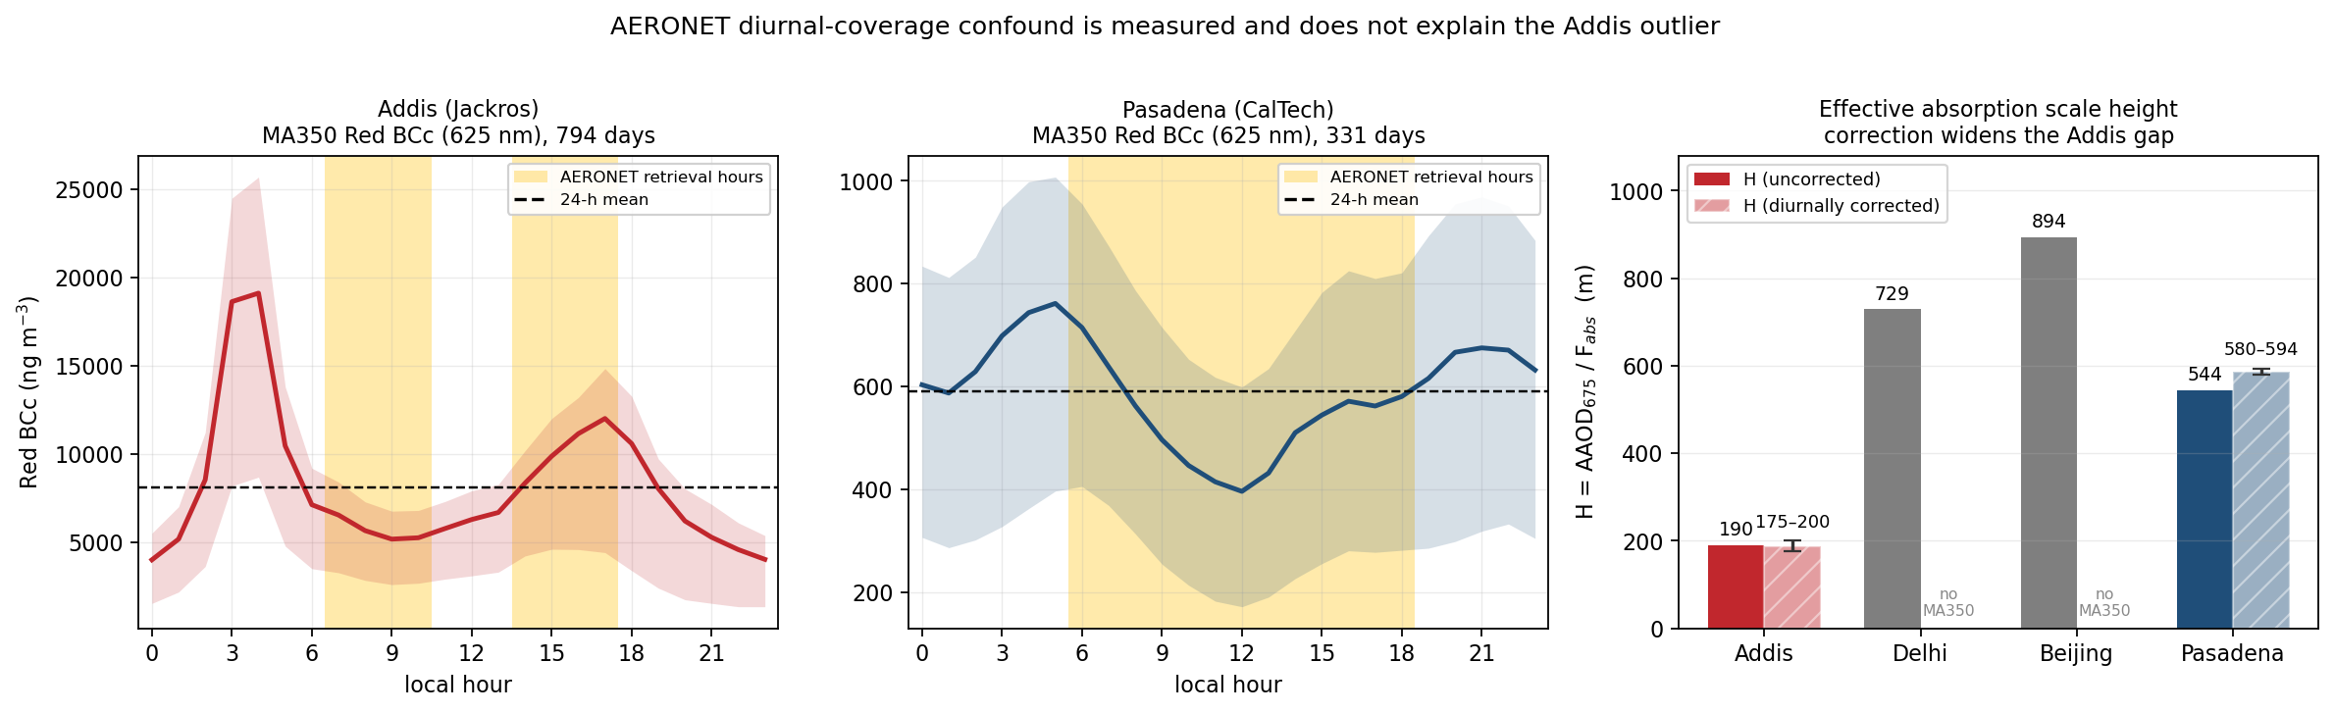
Backup — correcting for AERONET's daytime-only sampling widens the Addis gap, not closes it
Notes:
SAY: The day-night confound we flagged is now measured with the co-located MA350 minute data: correcting for AERONET's daytime-only sampling leaves Addis at ~190 metres of effective absorption scale height while Pasadena moves up — the outlier gets more anomalous, not less.
NOTES: The photometer sees ~8 of 24 hours. Addis has a 4.8x diurnal swing in Red BCc (625 nm ~ HIPS wavelength) but its two retrieval windows straddle the cycle, so the biases cancel (ratio 0.92-1.05); Pasadena's midday window sits in its own BC minimum (1.07-1.09) — correction moves the Addis/Pasadena separation from 2.9x to 3.0-3.3x. Assumes the column tracks the surface's relative diurnal shape; Delhi/Beijing have no co-located MA350 and stay uncorrected. Companion result: the corrected 1500-1700 organic envelope predicts column AAOD675 beyond loading, Fabs and month (r=+0.28, p~0.002).

Slide 24
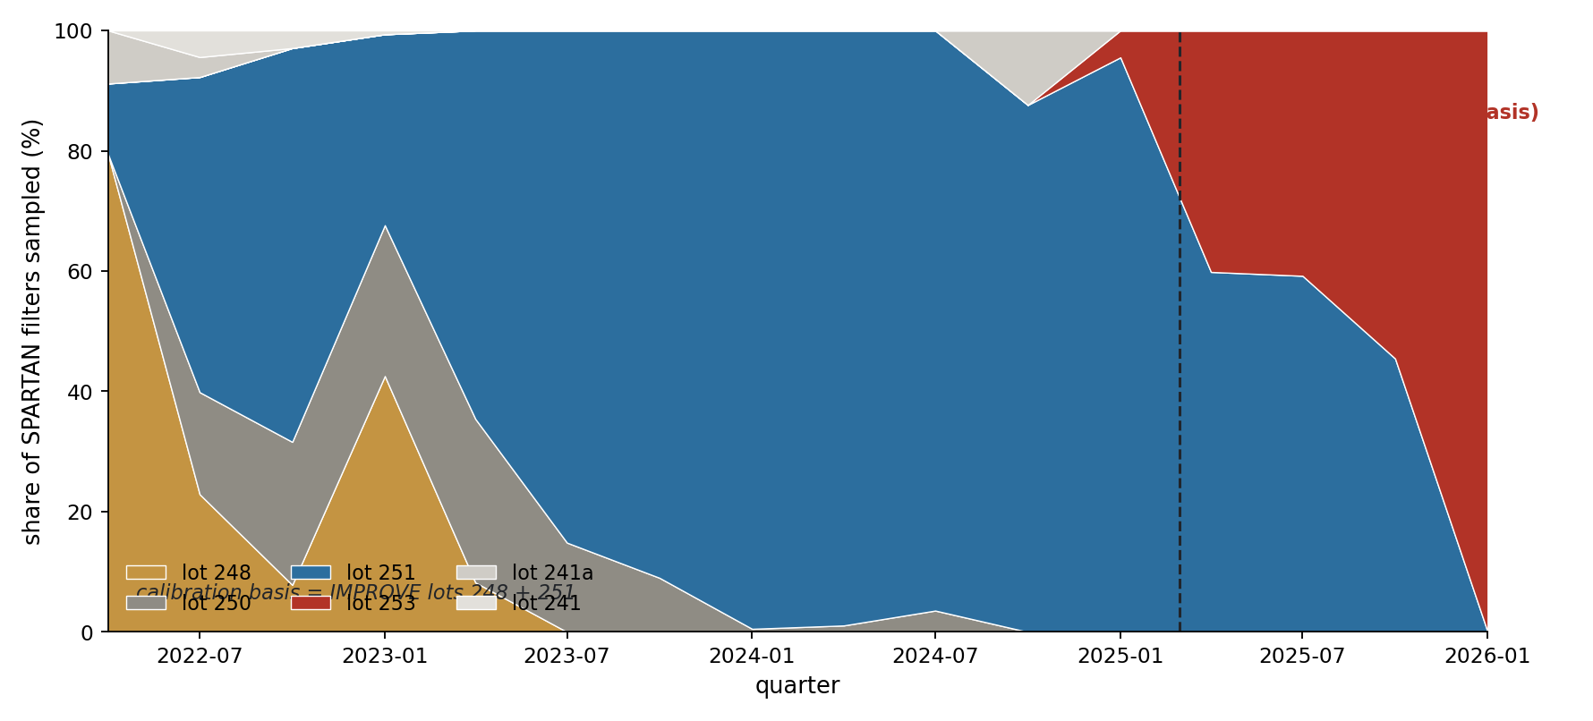
Backup — SPARTAN has moved to a lot the calibration has never seen
Notes:
SAY: Forward-looking risk and opportunity: from early 2025 the network's filters shift to lot 253 — a lot our calibration basis has never seen. That's the risk. The opportunity: IMPROVE ran 5,050 TOR-EC filters on that same lot, so a frozen protocol tested there is a true independent-lot validation — protocol frozen, lot 255 sealed for replication; only the scan spectra remain to pull.
NOTES: 433 lot-253 SPARTAN filters (stackplot uses the 340 dated), 13 sites, 58% of everything sampled since 2025-09; basis is IMPROVE 248+251 only. IMPROVE holds 5,050 lot-253 TOR-EC filters; pull manifest at output/tables/improve_pull/ftir_list_253.csv; lot 255 sealed for replication. Frozen protocol: OCEC-440 x AIRSpec, Option A, k=5 — tests lot+time transfer, not unseen-site. The direct Delhi lot-253 test is NOT identifiable (6-filter overlap, 4x loading, CI [-53,+304]).

Slide 25
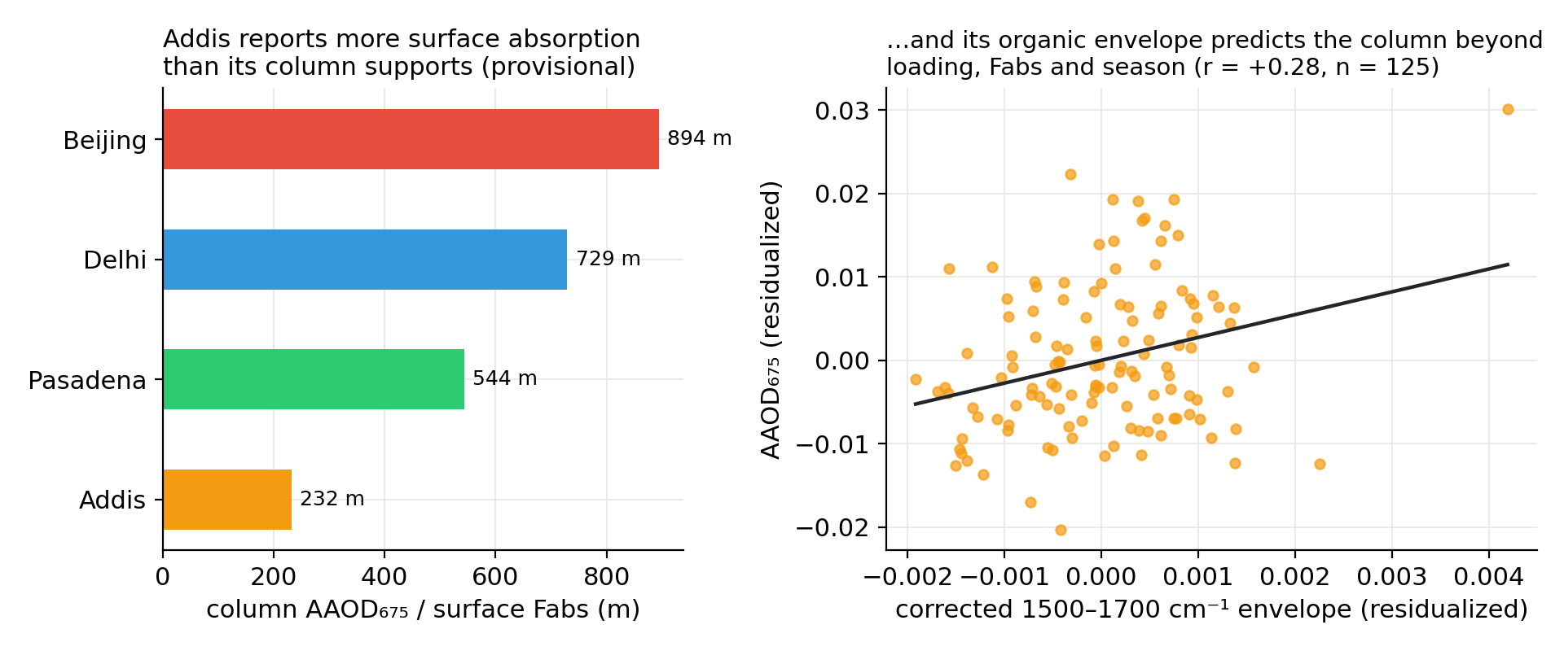
Backup — Addis reports more absorption than its own column can account for
Notes:
SAY: The column-side view: effective absorption scale height — column AAOD over surface Fabs — is 232 metres at Addis against 544 to 894 everywhere else, and the filters' organic envelope predicts the photometer's column absorption beyond loading and season.
NOTES: H is NOT a physical boundary-layer height — comparative across sites only. Sharpest contrast is Delhi: 1.6x Addis's surface Fabs but 4.3x the column. Level 1.5 retrievals (not QA'd 2.0), formally reliable only above AOD440~0.4; Gurgaon is ~30 km from the Delhi SPARTAN site.

Slide 26
Backup — per-filter LOCAL calibration: helps where the library has support
Per target filter: k most-similar library spectra -> small PLS (novel in FTIR-aerosol lit)
Delhi 1.37x (from 2.36x) and Pasadena 1.04x (from 4.22x) — real improvement
Addis 4.5x — collapses: nearest neighbors are the library's edge, local ≠ in-domain
v2: score-space similarity + refuse-to-predict gates; then CORAL / di-PLS
Notes:
SAY: First pass at per-filter local calibration: strong where the library has support, honest failure where it doesn't — which is itself the result: no selection scheme manufactures Addis support that isn't there.
NOTES: Module: calibration_explorer/local_lab.py (/api/local_cross). Survey with citations: TRANSFER_METHODS_2026-08-24.md. The decisive evaluation to run: simulated transfer at IMPROVE sites with collocated HIPS — pretend Fabs-only, run the whole pipeline, unblind TOR once.

