Slide 1
AIRSpec and VIBES both subtract a background, but they get it from different places
How pyvibes (VIBES) and AIRSpec baselining differ, step by step
VIBES shown over its full range (4000 to 500 cm⁻¹); AIRSpec over its own (4000 to 1425)
Same Addis and IMPROVE spectra, same blanks, same downstream PLS
Methods explainer, October 2026
Notes:
SAY: Today is a methods talk. I want everyone to leave knowing what each baseline method actually assumes, because that decides when we should trust each one. I will walk through AIRSpec first, then VIBES, then put the same filter through both. One thing up front: VIBES is shown over the whole measured spectrum, down to 500, because unlike AIRSpec it has no built-in window. Then a diagnostic on how far VIBES has to stretch to fit loaded filters, and finally what blanks, added peaks and EC prediction say. Short version: AIRSpec assumes the background is smooth and that some regions hold no analyte; VIBES assumes the background looks like our blanks.
NOTES: VIBES = pyvibes 1.0.0 (Kamper, Krymova, Takahama; MIT; accompanying 'Towards Universal Calibration for Infrared Spectroscopy with Probabilistic Interference Removal'). research/ftir_hips_chem/vendor/pyvibes is byte-identical to ~/Downloads/pyvibes-main. AIRSpec = segmented smoothing-spline baseline (NumPy port of FitSplineKDT.R, research/ftir_ec_phase3/scripts/airspec_baseline.py). VIBES arrays: full-range rank-30 run, 12808 of 12808 cases corrected, 0 failed, 2722 channels 3998 to 500 cm-1 (raw IMPROVE and Addis grids stop at 500, not 400). Receipt: output/tables/vibes_fullrange/rank30/ASSEMBLY.json. AIRSpec arrays: the frozen Colab run full-83dcf32e86bc0f09, same case order. Earlier results deck (VIBES cut to 1425): deliverables/airspec_vibes_2026-09-22.

Slide 2
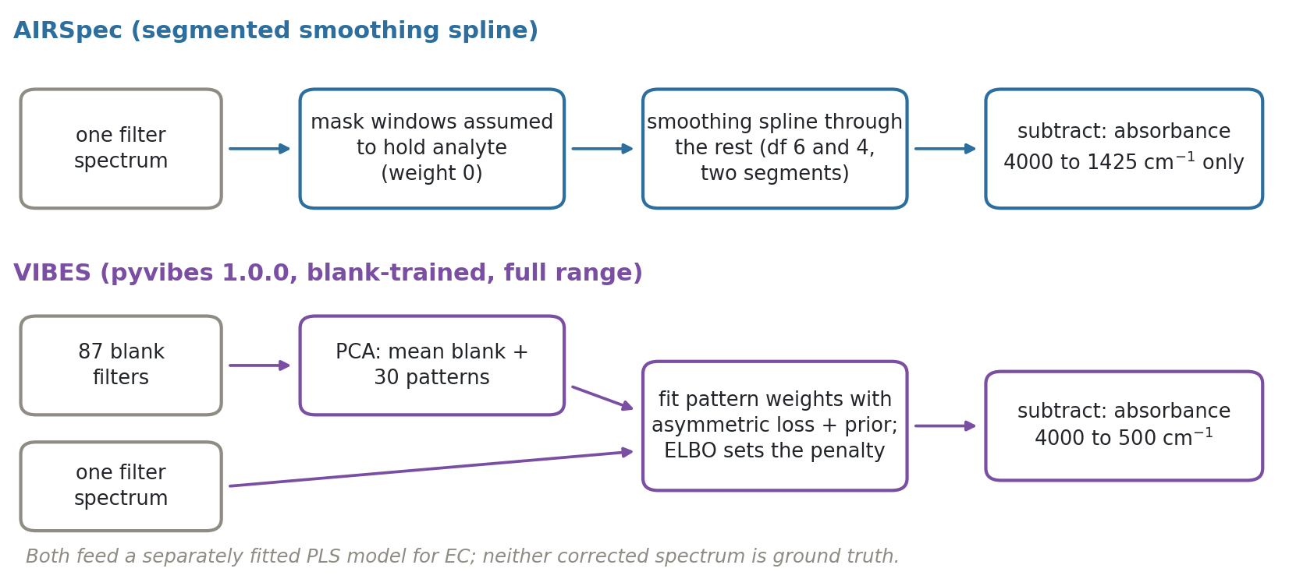
AIRSpec reads the background off each spectrum; VIBES learns it from blank filters first
Notes:
SAY: The whole difference on one page. Top row, AIRSpec: it only looks at the one spectrum in front of it. It blanks out regions where it expects analyte, draws a smooth curve through the rest, and subtracts, and it only works from 4000 down to 1425. Bottom row, VIBES: before touching a sample it studies a library of blank filters and summarises how empty filters vary. Then for each sample it asks what mix of those blank patterns sits underneath the spectrum, over the whole range the blanks cover. AIRSpec needs nothing extra but assumes smoothness; VIBES needs good blanks but assumes nothing about smoothness.
NOTES: AIRSpec: two segments, 4000 to 1820 (df 6) and 2000 to 1425 (df 4), averaged in 2000 to 1820; NaN outside 1425 to 4000 by construction. VIBES: PCA on centred blanks (pca()), rank by leave-one-blank-out one-SE rule (loo_pca) capped at 30, per-spectrum ELBO maximisation with L-BFGS-B (VibeSpec.fit), then convex MAP solve with CVXPY/Clarabel (map_pb). pyvibes also ships EBS (sigma = 0, tuned by blocked CV); not run. Cost: AIRSpec about 4 ms per spectrum locally; full-range VIBES median 4.9 s per spectrum on a Colab vCPU (different hardware, so only order of magnitude); 856 of 12808 fits used one logged optimizer restart, none failed.

Slide 3
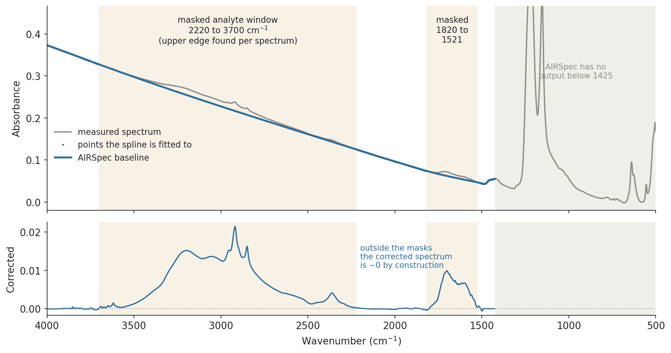
AIRSpec fits a smooth curve only where it assumes there is no analyte, and stops at 1425
Notes:
SAY: One real Addis filter, ETAD-0116-4, chosen because its AIRSpec versus VIBES difference is the median of all 253 Addis filters, so it is typical, not a showcase. Grey is the measured spectrum over the full range. The shaded bands are the windows AIRSpec treats as analyte, with zero weight. Black dots are everything the spline sees, blue is the spline. The grey block on the right is where AIRSpec does nothing at all: below 1425, including the big Teflon bands. Below, the corrected spectrum: outside the shaded windows it sits on zero, which is an assumption, not a measurement.
NOTES: Selection rule: target whose AIRSpec vs full-range VIBES RMS difference over 1425 to 4000 is closest to the median of 253 ETAD PM2.5 targets: ETAD-0116-4 (lot 251, 2023-09-15). Recomputing the AIRSpec segments on its raw spectrum reproduces the saved baseline (< 1e-5). Segment 1 window: fixed 2220 low side; high side starts at 3710 and steps down 10 cm-1 while the corrected sum just inside is negative (FindBound), here 3700. Segment 2: 1820 to the spectrum minimum in 1600 to 1520 (FindMinPos), here 1521; 20 points past that the baseline is set equal to the spectrum, so corrected absorbance is exactly zero below about 1494. y axis is clipped above the PTFE C-F bands (about 1150 and 1210) so the upper region stays readable.

Slide 4
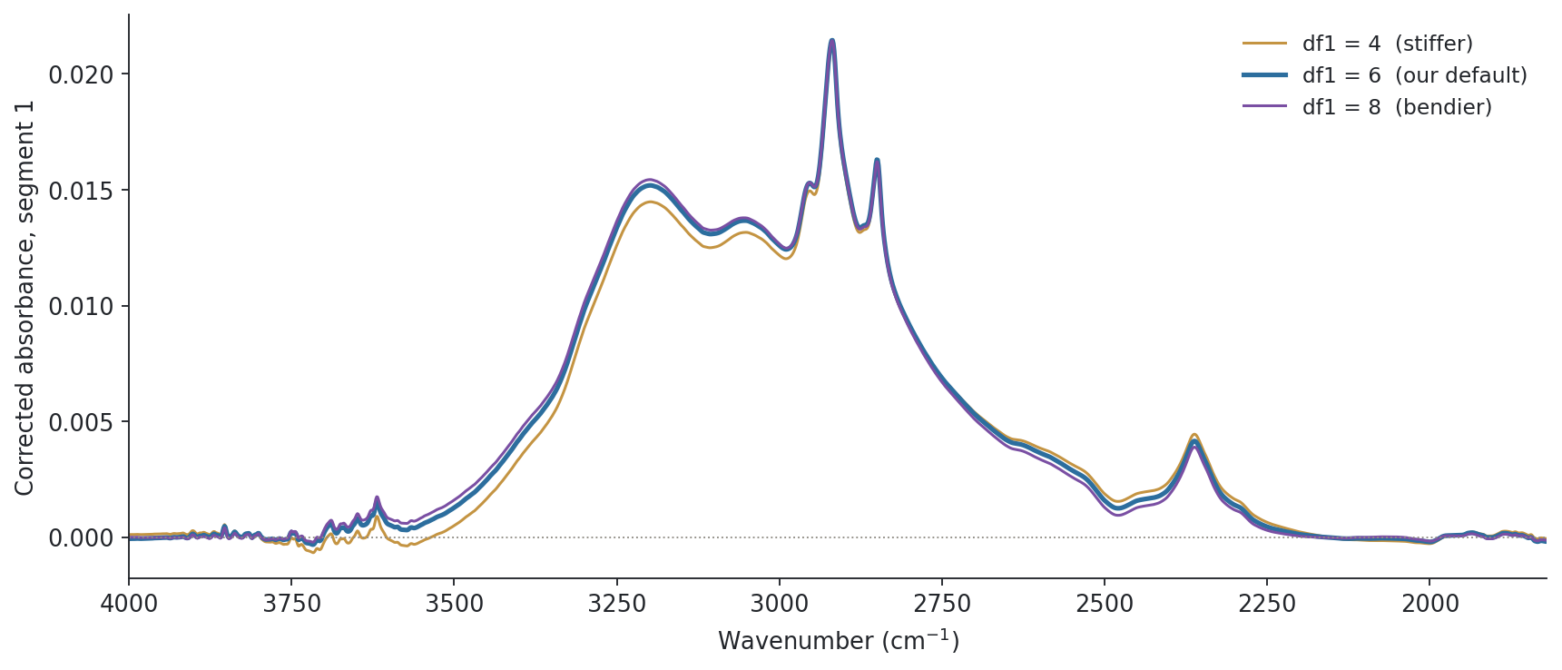
AIRSpec's main knob is spline stiffness, and it moves the broad 3000 to 3700 band
Notes:
SAY: AIRSpec has very few settings. The main one is how stiff the spline is, set as effective degrees of freedom; we use 6 for the upper segment. Here is the same filter's corrected spectrum at three settings. It changes mostly in the broad O-H and N-H region, while the sharp C-H peaks near 2900 barely move. So what AIRSpec is least sure about is broad features, because it cannot tell a broad absorption from a curving background.
NOTES: Same filter; segment 1 only (4000 to 1820), df2 fixed at 4. df 6 and 4 are the AIRSpec/APRL defaults for PTFE. The locked reproduction found DF1 = 6 and DF1 = 8 both recover PLS k = 5 on the historical calibration. The bound search reruns for each df, so the window edge can move slightly.

Slide 5
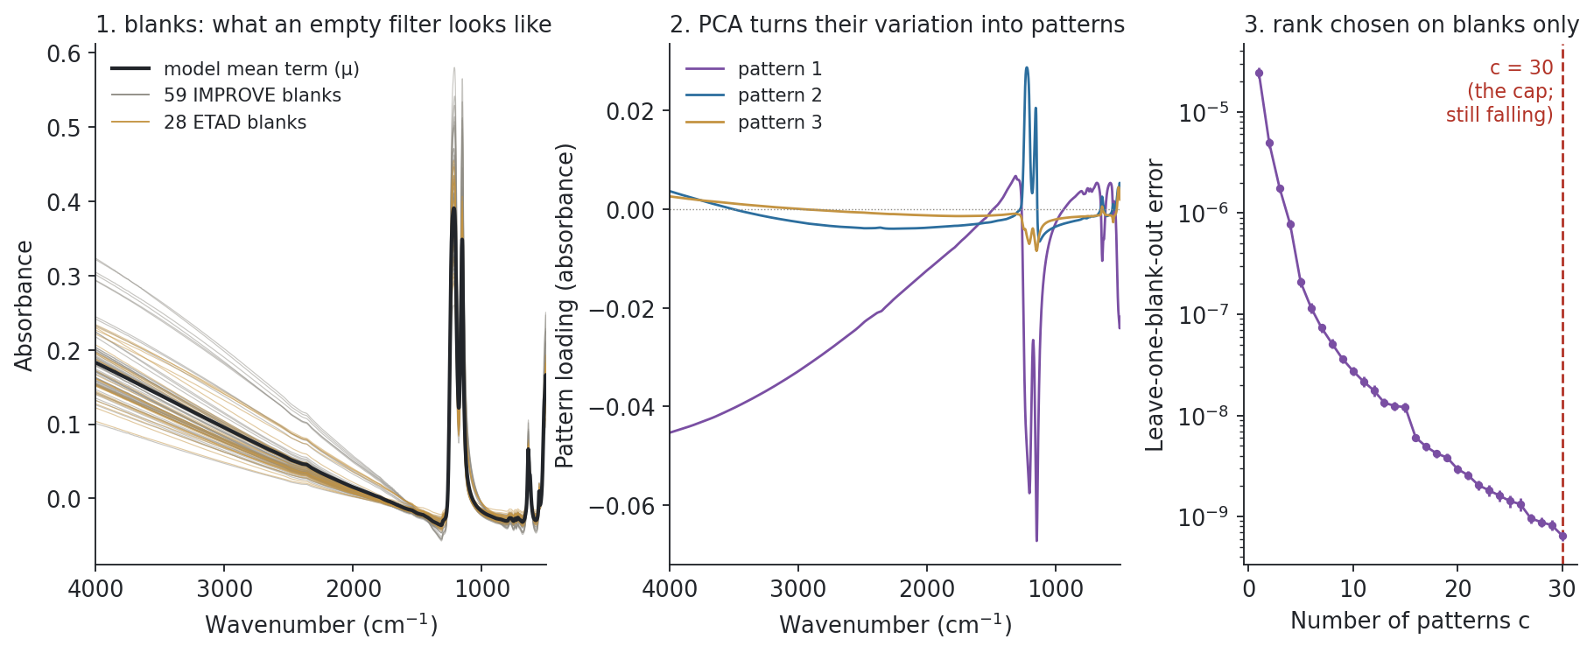
VIBES first learns what an empty filter looks like: 87 blanks become 30 patterns over 4000 to 500
Notes:
SAY: Now VIBES. Step one has nothing to do with samples. Left: 87 real blank filters, 59 from IMPROVE and 28 from Addis, one line each, over the full range; the big bumps near 1200 are the Teflon itself. Middle: PCA pulls out the main ways blanks differ; these are the first three patterns. Right: how many patterns to keep, by leaving one blank out and rebuilding it from the others. On the full range the error is still falling at our cap of 30, so the model is using as many patterns as we allowed. Everything VIBES later calls background has to be built from that mean plus those patterns.
NOTES: Background training: 87 independent physical blanks (59 IMPROVE train-site blanks across lots, 28 ETAD), from vibes_large_run.prepare_experiment (seeded; outer-test-site blanks never used). Rank cap 30 for like-for-like with the 1425-cut run; one-SE rule lands on the cap (30), i.e. the cap binds. Without the cap the full-grid one-SE rank is about 67 to 70; that uncapped rerun (rank cap 85) is only 3.5% complete (uncapped_completion_audit_20261001.json), so all results here are rank 30. Patterns are pyvibes' W: right singular vectors scaled by singular value over sqrt(n), so weight 1 = a typical blank-sized deviation. Rank selection never sees TOR or samples. The mean term is a model parameter, not a sample average.

Slide 6
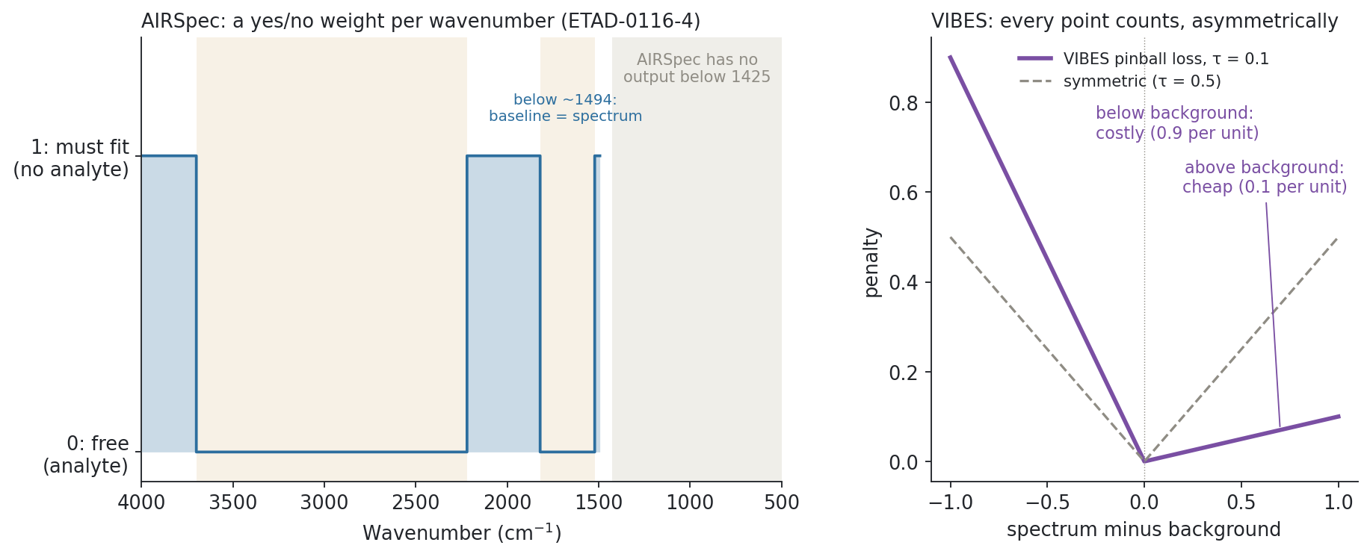
AIRSpec decides where analyte may appear; VIBES lets it appear anywhere but only above the background
Notes:
SAY: The core philosophical difference. Left: AIRSpec's rule for this filter. Each wavenumber is either 'must fit the baseline' or 'free', yes or no, and below 1425 there is no rule because there is no correction. Right: VIBES has no windows. Every point is fitted, with a lopsided penalty: spectrum above the background is cheap, because that is what absorbance looks like; background poking above the spectrum costs nine times more. So the background is pushed underneath everywhere, rather than pinned to zero in fixed places.
NOTES: pyvibes pb_loss: 0.5|a| + (τ minus 0.5)a with a = spectrum minus background; τa for a > 0, (1 minus τ)|a| for a < 0; ratio 9 at τ = 0.1. τ fixed at 0.1 (pyvibes default); pyvibes can also estimate τ from the ELBO (bounds 1e-5 to 0.5). ALS (asymmetric squared) loss also available; we used PB. The analyte term gets the Gibbs distribution of this loss and the pattern weights a standard normal prior, which makes VIBES a probabilistic model rather than a curve fit.

Slide 7
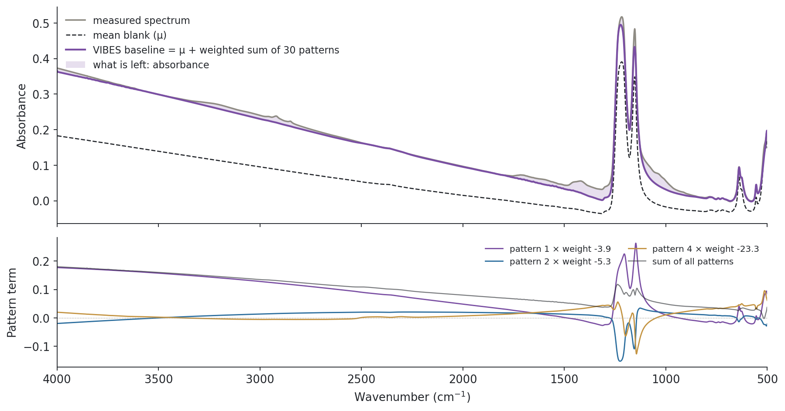
For each filter VIBES fits weights on the blank patterns, not a free-form curve
Notes:
SAY: Same typical filter. Grey is the spectrum, dashed is the mean blank, purple is the VIBES background: the mean plus a weighted sum of the 30 patterns, across the whole range including the Teflon bands. The shaded area is what VIBES calls absorbance. Bottom: the three patterns doing most of the work for this filter. Notice how far the background sits from the mean blank, and how large those weights are; I will come back to that. The key point: the background can only take shapes the blanks have shown us.
NOTES: Weights recovered by least squares from the saved full-range VIBES baseline on the saved background model (reconstruction error 1.9e-09). Per spectrum: (1) maximise the ELBO over the weights' approximate posterior and τ (fixed here), giving the penalty strength sigma (here 8.55e-04); (2) solve the convex MAP problem, pinball loss plus 0.5 sigma times squared weights. No cross-validation, no TOR. Upstream VibeSpec.fit ignores the optimizer success flag; our adapter (scripts/vibes_baseline.py) records it and allows one logged restart.

Slide 8
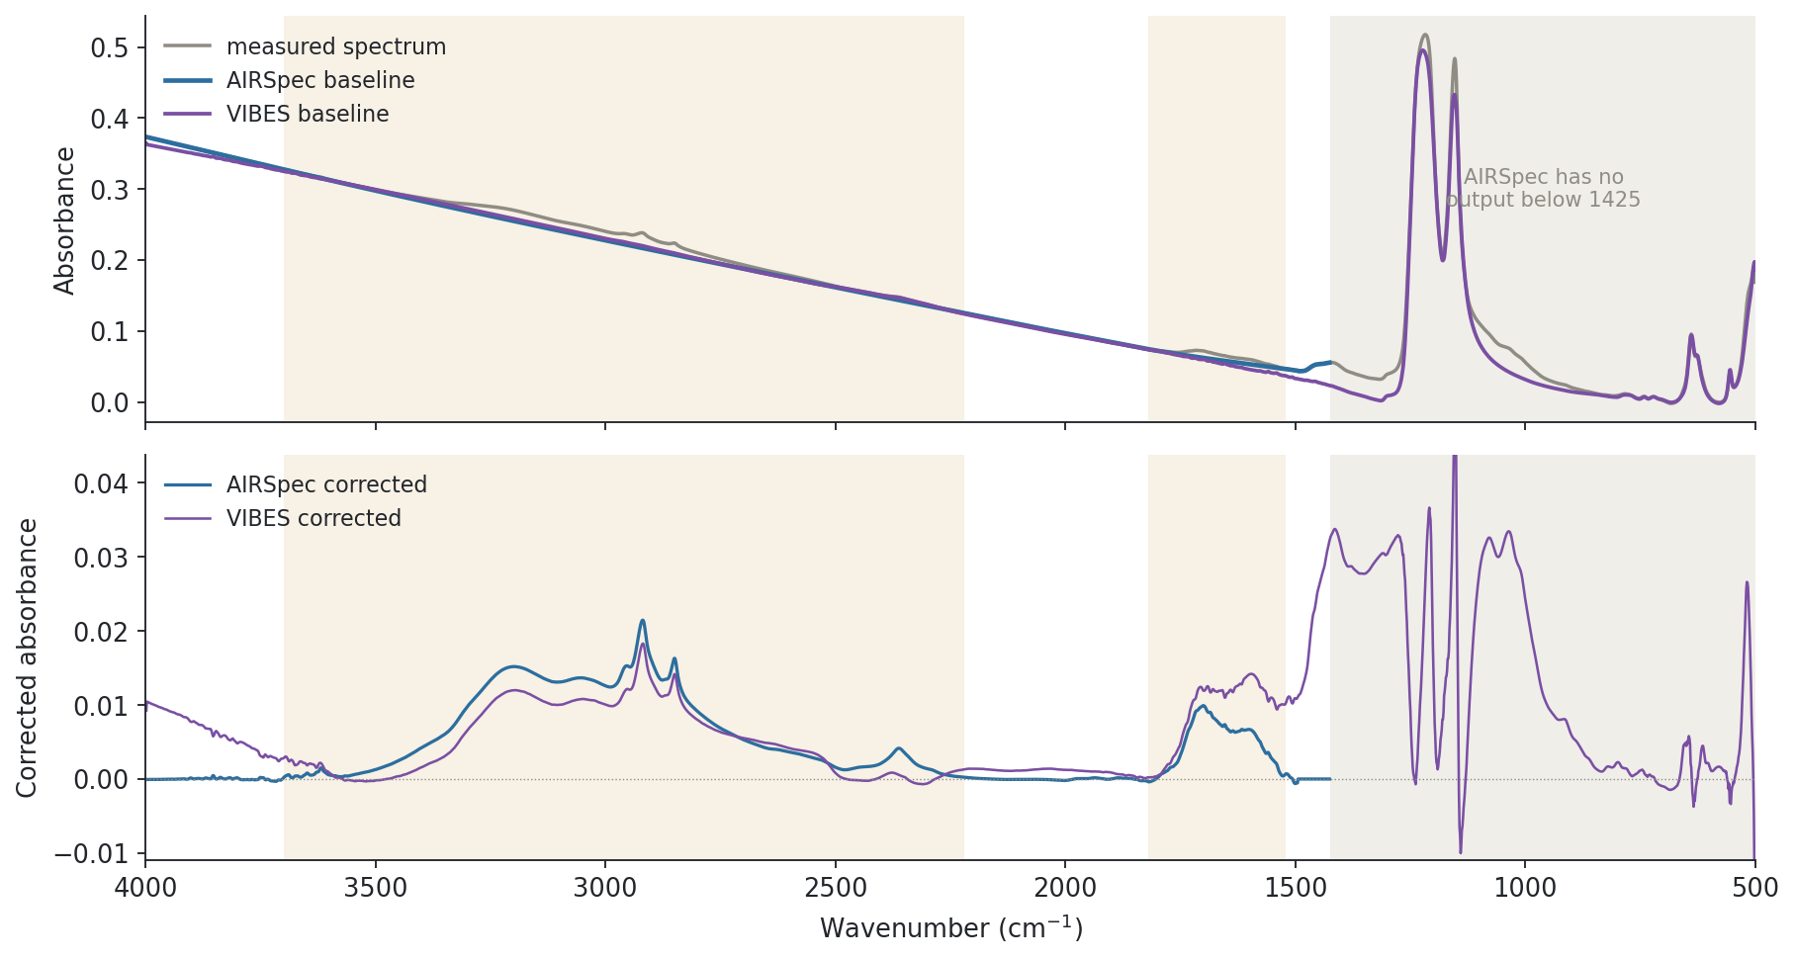
On the same filter the backgrounds part ways under the broad bands, in AIRSpec's zero zones, and below 1425
Notes:
SAY: Both on the same filter. Blue AIRSpec, purple VIBES. Three things. Under the broad O-H region, 3000 to 3700, the AIRSpec curve sits lower, so AIRSpec calls more of that hump absorbance. In the regions AIRSpec pins to zero, above 3700 and below about 1500, VIBES leaves positive absorbance. And below 1425 only VIBES says anything at all, including through the Teflon bands. Neither picture is automatically right: they are two models of the same unknown background.
NOTES: Same selected filter, ETAD-0116-4 (lot 251, 2023-09-15). No smoothing, normalisation or averaging. Lower panel y axis is clipped to the 99.5th percentile of |VIBES| for this filter. Shaded amber: AIRSpec masked windows for this filter; grey: no AIRSpec output. The corrected spectra in the C-F region (about 1100 to 1300) are a small difference between two large numbers (raw absorbance above 0.2): treat structure there with caution.

Slide 9
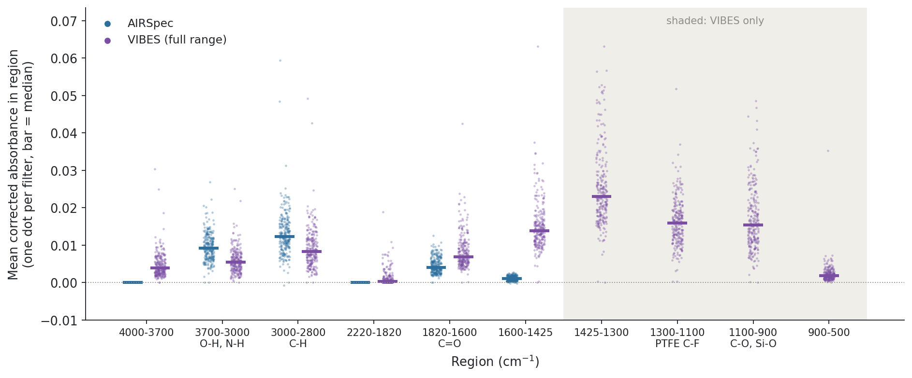
Across all 253 Addis filters: AIRSpec gives more to 2800 to 3700, VIBES more everywhere else
Notes:
SAY: Is that one filter typical? Each dot is one filter's average corrected absorbance in a region; blue AIRSpec, purple VIBES, bars are medians. In the O-H and C-H regions AIRSpec assigns more. At the ends of its window, AIRSpec is at or near zero by design while VIBES is consistently positive. And the right-hand shaded regions, below 1425, are new information only VIBES provides: carbonate and C-O, the Teflon region, dust. So the methods move signal between regions systematically, which matters for any PLS model that leans on them.
NOTES: Per-filter means of corrected absorbance within each region, 253 ETAD targets, full-range VIBES vs AIRSpec. Medians (AIRSpec vs VIBES): 4000-3700: -0.0000 vs 0.0039; 3700-3000: 0.0092 vs 0.0054; 3000-2800: 0.0122 vs 0.0083; 2220-1820: -0.0000 vs 0.0003; 1820-1600: 0.0040 vs 0.0069; 1600-1425: 0.0010 vs 0.0139; 1425-1300: VIBES 0.0230; 1300-1100: VIBES 0.0160; 1100-900: VIBES 0.0154; 900-500: VIBES 0.0018. Region edges are fixed for display; AIRSpec's own window edges vary per filter. Band labels are usual assignments, not identifications. Positive VIBES levels below 1600 could be real absorbance or background the blanks did not capture; this plot cannot say which.

Slide 10
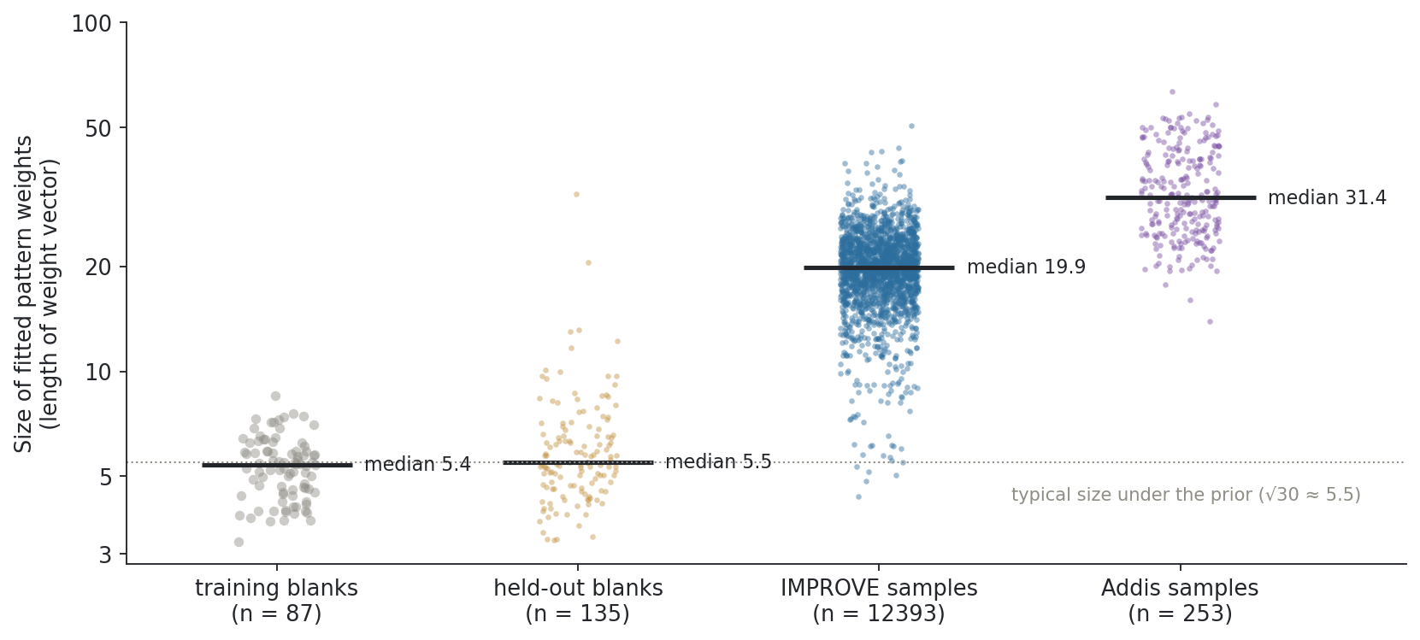
To fit loaded filters VIBES stretches its blank patterns far past any blank: about 4x for IMPROVE, 6x for Addis
Notes:
SAY: A diagnostic that explains a lot of the disagreement. Each dot is how hard VIBES had to lean on its blank patterns to fit a spectrum. For the blanks it learned from, and for blanks it never saw, the weights are about the size the model expects. For loaded IMPROVE filters they are about four times larger, and for Addis filters about six. Loaded filters have a stronger, steeper background than any blank, so VIBES is extrapolating the blank patterns rather than interpolating between real blanks, and Addis is furthest out. That is exactly where its assumption is weakest.
NOTES: New diagnostic computed for this deck (build.py), not yet in a committed notebook. Weights recovered by least squares from the saved full-range VIBES baselines on the saved 30-pattern background model (training blanks: their PCA scores). Median weight-vector length: training 5.4, held-out blanks 5.5, IMPROVE calibration samples 19.9, Addis 31.4 (90th percentiles 26.3 and 48.3). Under pyvibes' standard normal prior a blank-like spectrum has length about sqrt(30) = 5.5. The prior penalty (0.5 sigma times squared weights, sigma of order 1e-4) is too weak to stop this. Likely cause: particle loading adds scattering and slope that blanks never show. IMPROVE plot shows a random 2000 of 12393 for legibility; medians use all. Same pattern on the earlier 28-blank ETAD pilot (1425 cut): samples 31 vs blanks about 5. Not yet checked against loading or EC error.

Slide 11
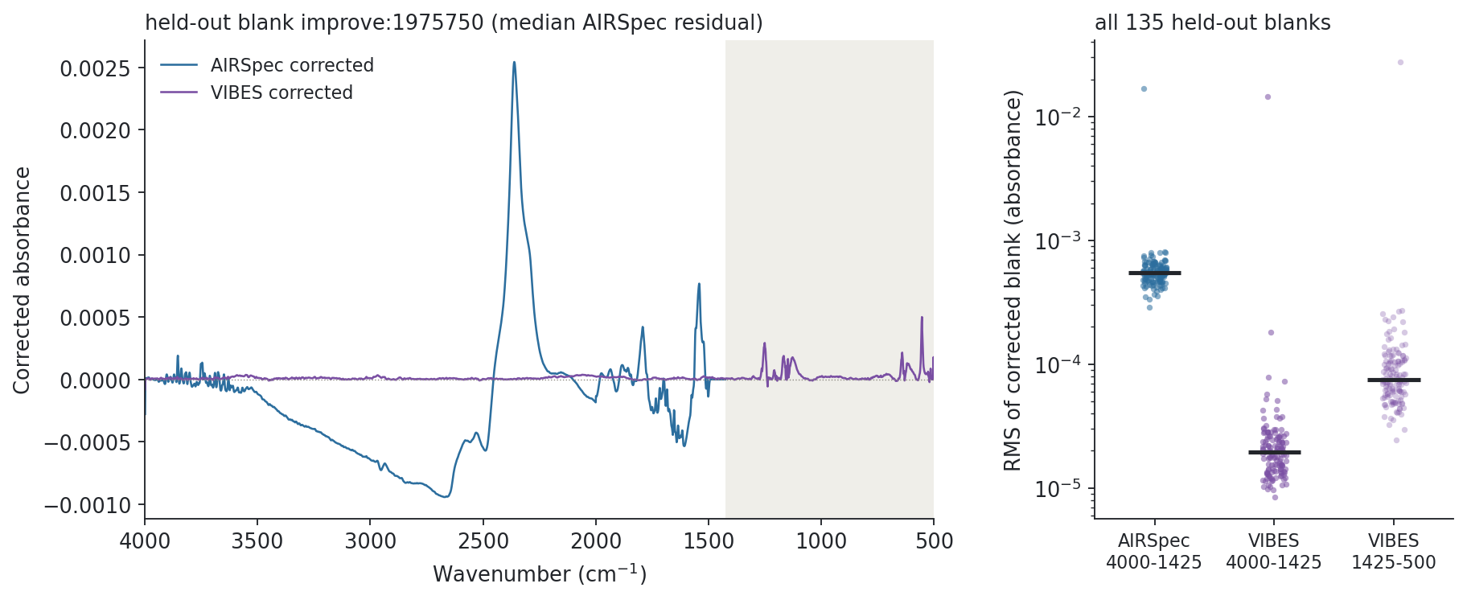
On held-out blanks VIBES leaves about 28 times less residual than AIRSpec, even over the full range
Notes:
SAY: Now evidence. The fairest test of a background method is a blank it was not trained on, where the right answer is close to zero. Left, a typical held-out blank after each correction. Right, all held-out blanks: within AIRSpec's window VIBES is far lower, and even below 1425, through the Teflon bands, the VIBES residual stays small. This is what VIBES was designed to do and it does it well.
NOTES: 135 held-out blanks (9 ETAD, 126 IMPROVE), never in the background library. Median RMS over 4000 to 1425: AIRSpec 0.000545, full-range VIBES 0.000020 (28x); ETAD 0.000577 vs 0.000020, IMPROVE 0.000541 vs 0.000019. VIBES below 1425: 0.000075. The 1425-cut VIBES run was about 80x better than AIRSpec in the window; the full-range run is less extreme because the same 30 patterns now also have to cover 1425 to 500. Caveats: blanks are what VIBES is trained to model, so this favours it by construction; field blanks can carry handling contamination; a clean blank is a spectroscopy result, not an EC result.

Slide 12
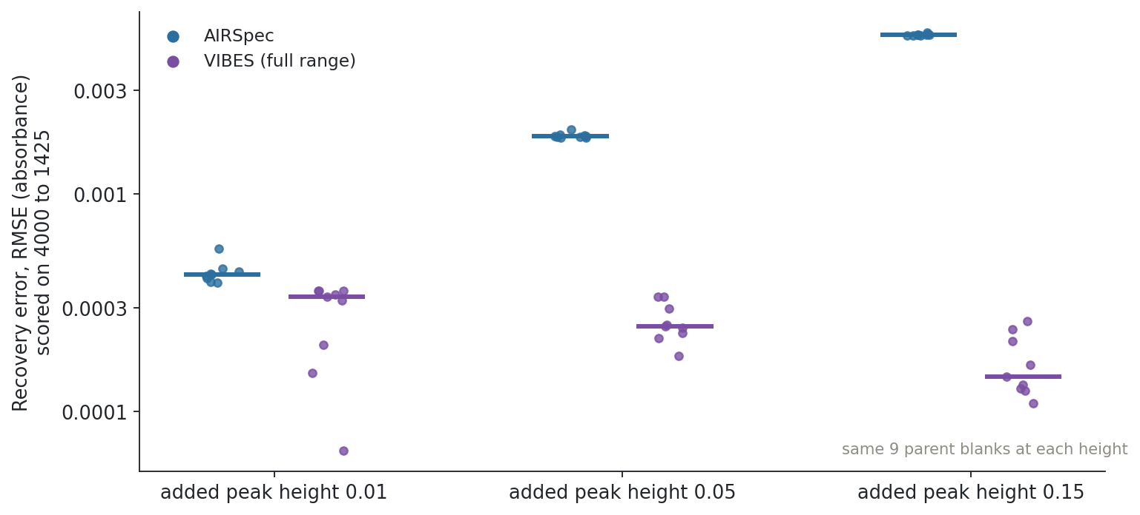
Known added peaks come back better with full-range VIBES at every height, including the weakest
Notes:
SAY: The worry with any background method is that it eats real signal. We added a known synthetic peak pattern to held-out blanks at three heights, corrected, and checked how much came back, scored over AIRSpec's window so both methods are judged on the same channels. Lower is better. VIBES recovers the added peaks better at all three heights, and AIRSpec's error grows with peak size. At the smallest height the gap is small, and in the earlier run with VIBES cut to 1425 AIRSpec actually won there, so weak signals are still where we should keep testing.
NOTES: Recovery = correct(blank + peaks) minus correct(blank), compared with the known added signal (raw injected minus raw parent), scored 4000 to 1425. Full-range VIBES vs AIRSpec medians: 0.01: 0.00043 vs 0.00034; 0.05: 0.00185 vs 0.00025; 0.15: 0.00540 vs 0.00014. The 1425-cut VIBES run lost at 0.01 (0.00059 vs 0.00043); full range wins at all three. Each height reuses the same 9 parent blanks: 9 independent units, not 27. One synthetic peak shape only; real standards still needed.

Slide 13
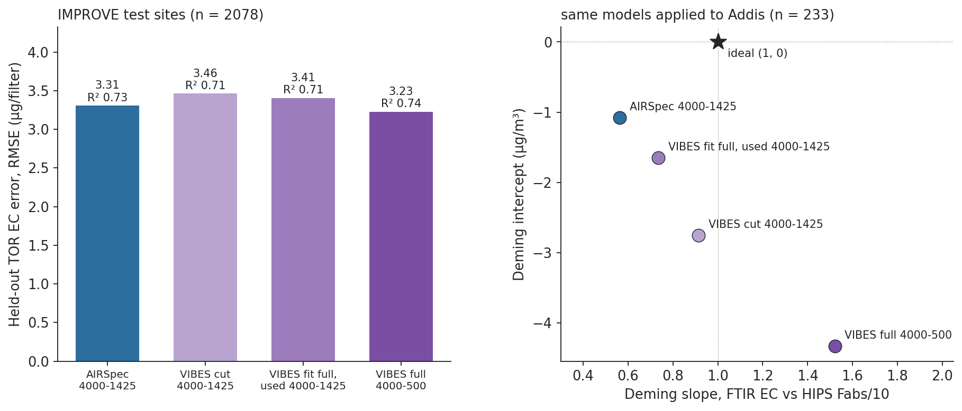
Full-range VIBES edges out AIRSpec on IMPROVE EC, but transfers to Addis worst
Notes:
SAY: The question we care about: EC. Each correction gets its own PLS model refit on the same IMPROVE training sites. Left, held-out IMPROVE error: full-range VIBES is the best of the four, slightly ahead of AIRSpec; cutting VIBES to 1425 is a bit worse. Right, the same models applied to Addis and compared with HIPS absorption: the ideal is the star at slope 1, intercept 0. AIRSpec under-predicts but is closest to zero intercept; full-range VIBES overshoots with the largest negative intercept. So the extra range helps where the samples look like the training set and hurts where they do not, which fits the extrapolation picture. AIRSpec stays the EC default.
NOTES: Source: meeting_followup_20260917 fits.csv and panel_stats.csv (all-IMPROVE lot 251 family). IMPROVE: train 9030, test 2078 filters, site-disjoint. Held-out TOR RMSE (µg/filter) / R²: AIRSpec 3.31 / 0.732 (k 8); VIBES cut 3.46 / 0.707 (k 6); VIBES fit full used to 1425 3.41 / 0.709 (k 7); VIBES full 3.23 / 0.745 (k 11). No interval on these differences. Addis (n 233): FTIR EC vs HIPS Fabs/10 (MAC 10), µg/m³, Deming with λ = 3.34 from measurement uncertainties: AIRSpec 0.56x -1.08; VIBES cut 0.91x -2.75; VIBES full-cut 0.73x -1.65; VIBES full 1.52x -4.33. HIPS/MAC is an optical equivalent, not thermal EC; no independent Addis thermal reference exists. Protocol differs from Option A/B; do not quote as those. The only in-box (slope 0.8 to 1.2, |intercept| < 1) configs ever found were VIBES full-cut seasonal analog sets, and they were fragile to analog count.

Slide 14
Side by side: a self-contained smoothness assumption versus a blank-library assumption
 | AIRSpec baseline | VIBES (pyvibes)
Information used | the one spectrum only | the spectrum plus 87 blank filters
Background shape | any smooth curve (spline, df 6 and 4) | mean blank plus weighted blank patterns (PCA, 30 here)
Where analyte goes | only inside masked windows; zero elsewhere | anywhere, as long as it sits above the background
How fit is tuned | fixed df; window edges found per spectrum | penalty set per spectrum by ELBO; τ fixed 0.1
Spectral range | 4000 to 1425 cm⁻¹ only | 4000 to 500 cm⁻¹ (all the blanks cover)
Cost | milliseconds per spectrum | seconds per spectrum (full range)
Fails when | background is not smooth, or analyte sits in a 'zero' region | sample background unlike any blank: loaded filters already need 4 to 6x
Our evidence | EC default; closest Addis intercept | far cleaner blanks and peak recovery; best IMPROVE EC; worst Addis transfer
Notes:
SAY: The one table to remember. AIRSpec is self-contained, fast, and well tested in our calibration, but it only models smooth backgrounds, forces zero absorbance in fixed places, and cannot go below 1425. VIBES uses the blanks, models the real shape of filter background including the Teflon bands, and covers the full spectrum. Its weak point is the mirror image: it is only as good as the blank library, and our loaded filters already sit well outside it.
NOTES: Range: AIRSpec output is NaN outside 1425 to 4000 by construction. pyvibes has no window; the first comparison cut VIBES to 1425 for like-for-like, the full-range run fit 4000 to 500. Timing is order of magnitude only (different hardware). 'Best IMPROVE EC' is a point estimate on one split without an interval.

Slide 15
AIRSpec stays the EC default; full-range VIBES is worth pursuing if the blanks can cover loaded filters
Different assumptions: AIRSpec = smooth background + fixed analyte windows, 4000 to 1425; VIBES = background looks like our blanks, 4000 to 500.
VIBES wins on held-out blanks and added-peak recovery; full range gives the best IMPROVE EC but the worst Addis transfer.
Loaded filters push VIBES 4 to 6x past its blank library: its key assumption is under strain, most for Addis.
Next: blanks or a loading term that span loaded backgrounds, the uncapped (rank ~70) run, and weak-signal standards.
Notes:
SAY: To wrap up. These make opposite bets about where background information comes from. VIBES does the background part better on blanks and opens up the region below 1425, and with the full range it even gives the best IMPROVE EC model. But it transfers worst to Addis, and the extrapolation diagnostic suggests why: our loaded filters, Addis most of all, look nothing like the blanks VIBES learned from. So AIRSpec stays the default for EC, and the next step for VIBES is giving it a background library that actually covers loaded filters. Happy to take questions on any step.
NOTES: Proposed next steps, not completed work. Uncapped run: rank cap 85 (one-SE about 67 to 70) is 3.5% complete; Colab VMs die when the controlling session ends, so it needs a kept-alive session. Loading coverage: e.g. add a smooth scattering term to the background model, or test weight size against filter loading and EC error. Weak-signal standards: at the 0.01 injection the margin is small and flipped between the cut and full-range runs. Units: EC errors in µg/filter, Addis comparison in µg/m³.

