Slide 1
FTIR spectral comparison: figures
Bishoftu confirmation, cross-site calibrations, comparison methods (ftir_50), network spectral map (ftir_52)
2026-09-01

Slide 2
1. Bishoftu and the five sites

Slide 3
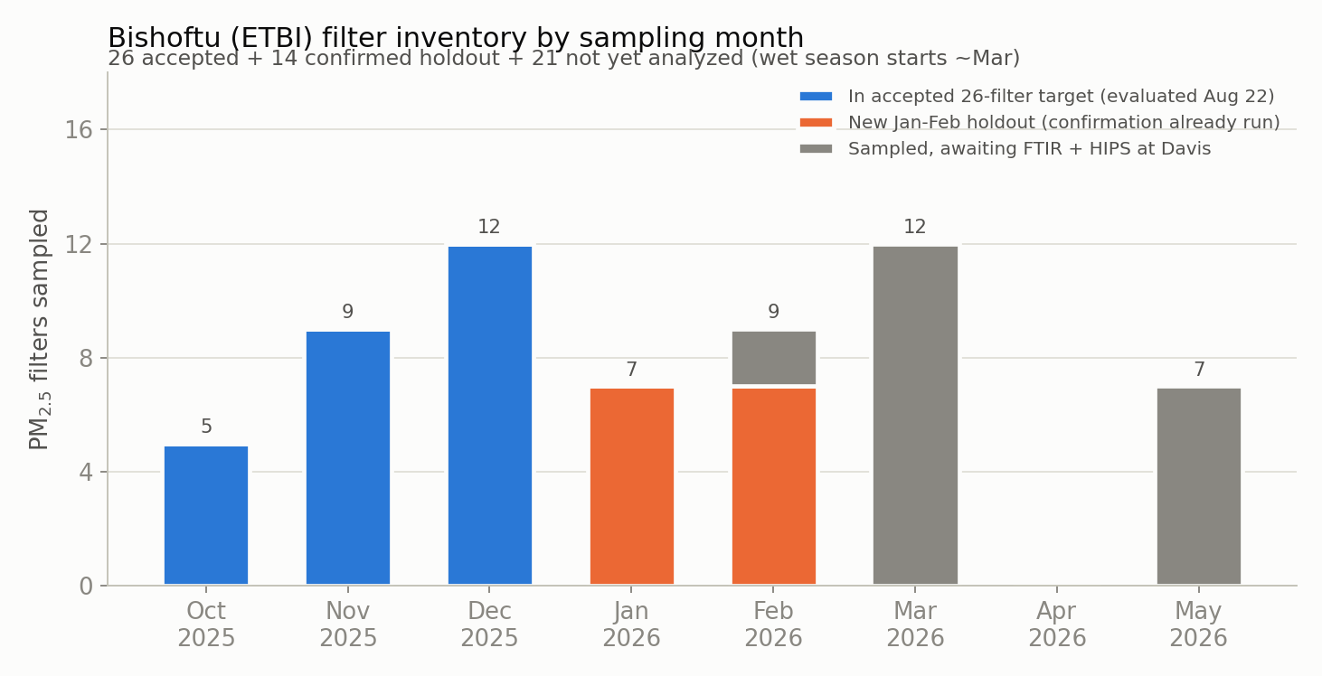
Bishoftu filter inventory by sampling month
26 accepted, 14 confirmed holdout, 21 sampled but not yet analysed

Slide 4
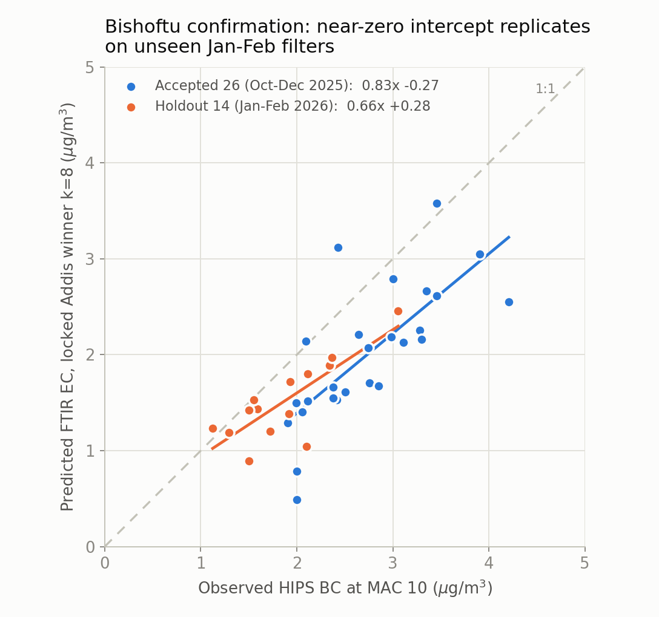
Bishoftu confirmation: the near-zero intercept replicates on unseen filters
locked Addis winner k=8, no re-selection

Slide 5
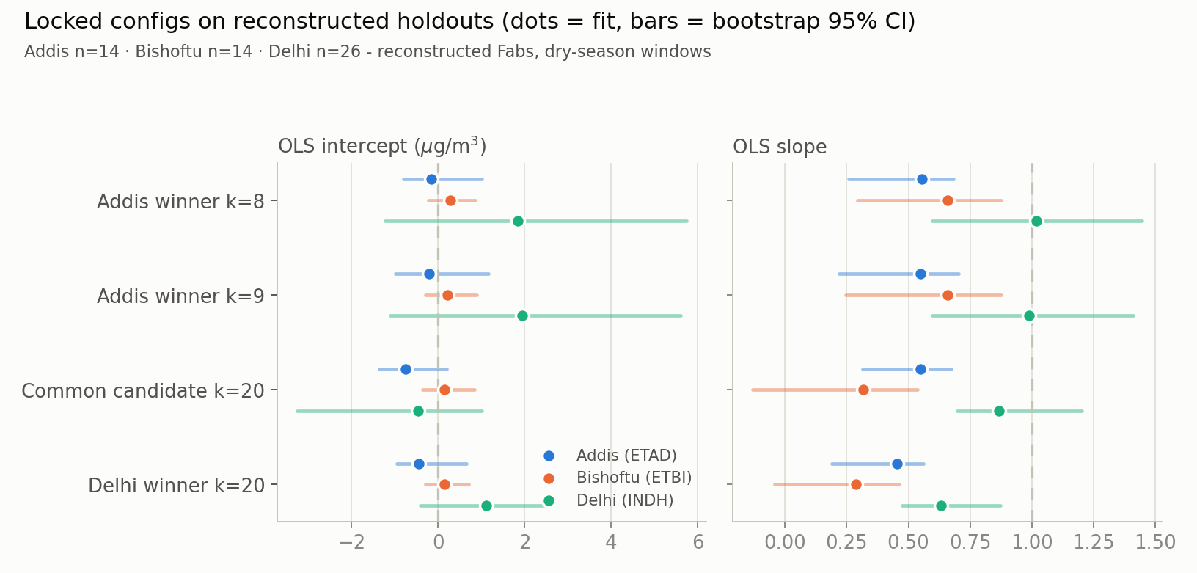
Locked configurations on the reconstructed holdouts
dots = fit, bars = bootstrap 95% CI

Slide 6
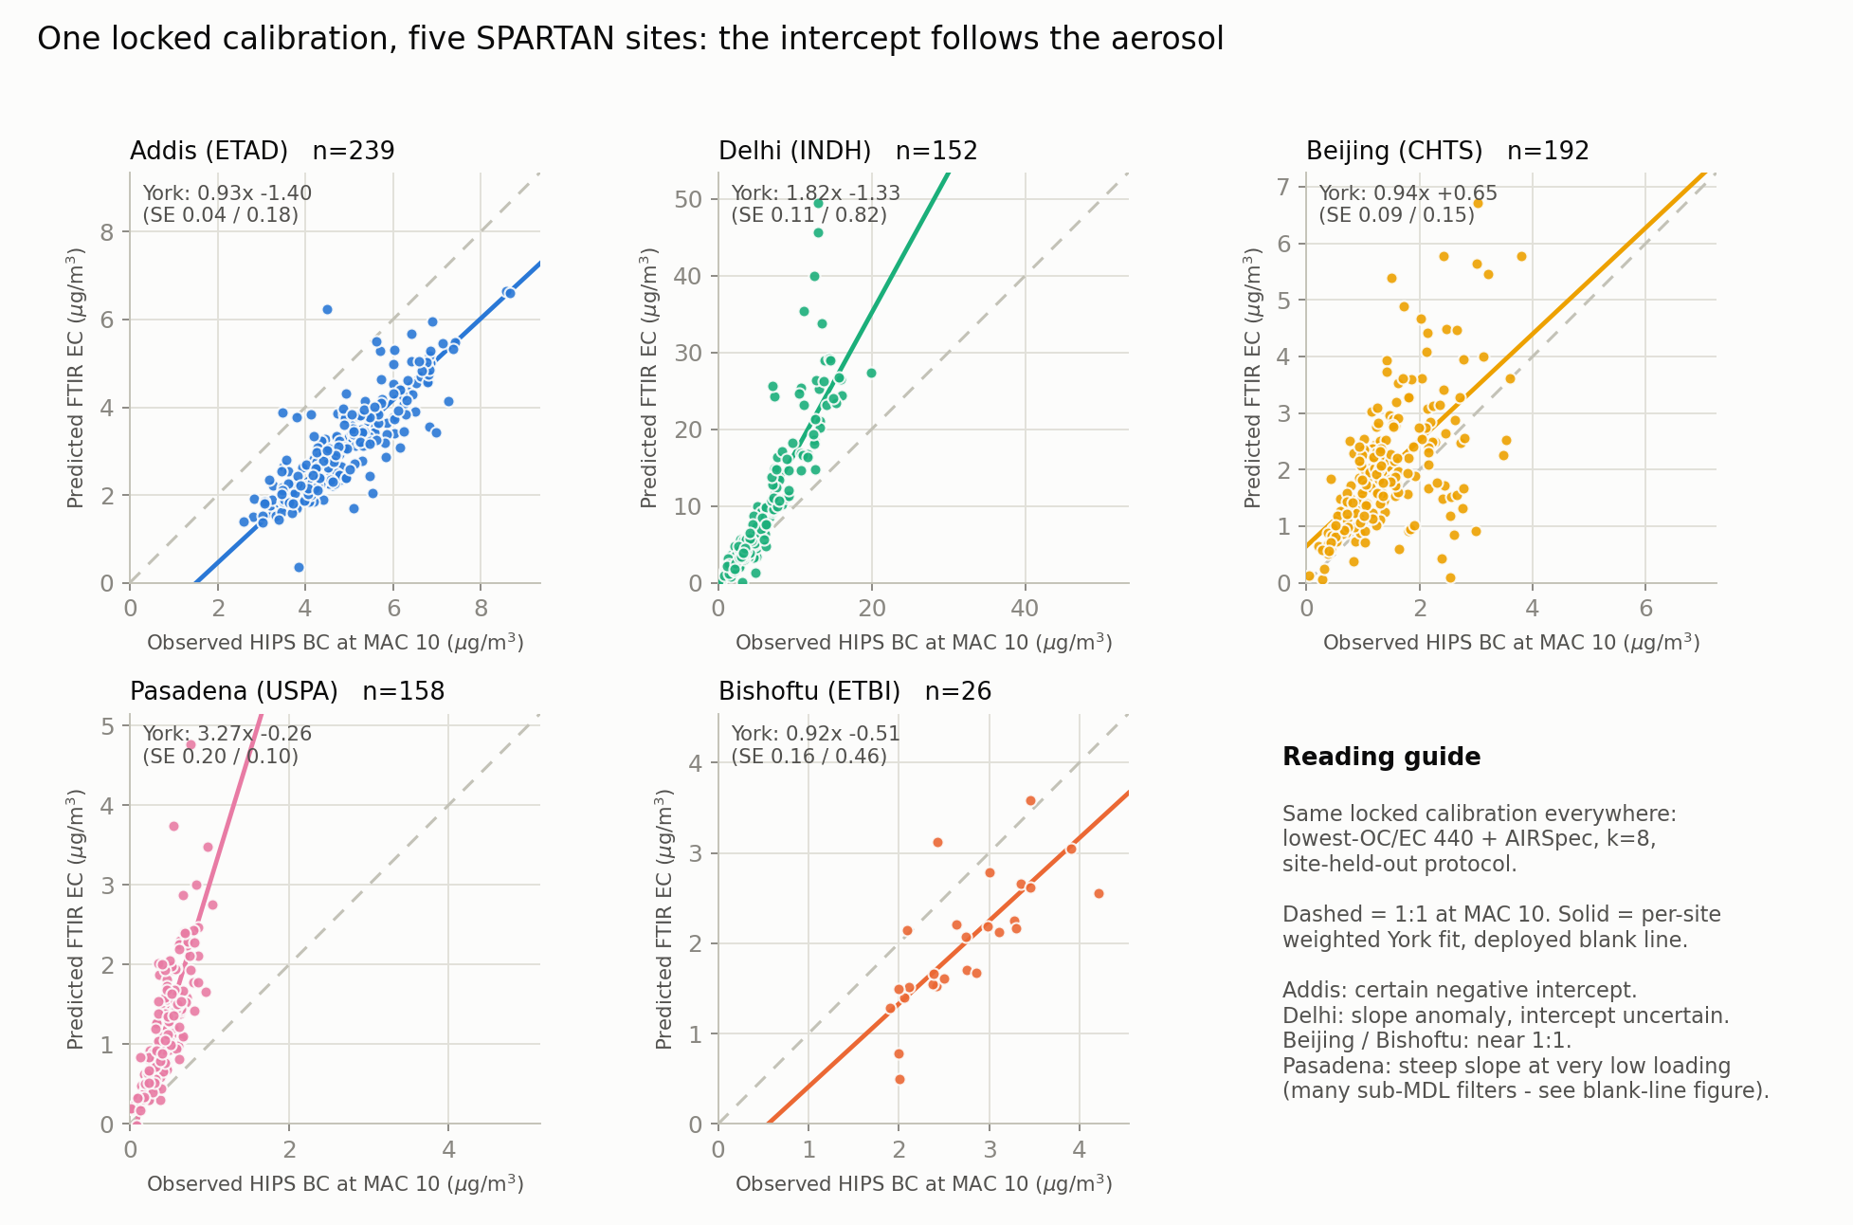
One locked calibration across five SPARTAN sites
lowest-OC/EC 440 + AIRSpec, k=8, site-held-out; York fits per site

Slide 7
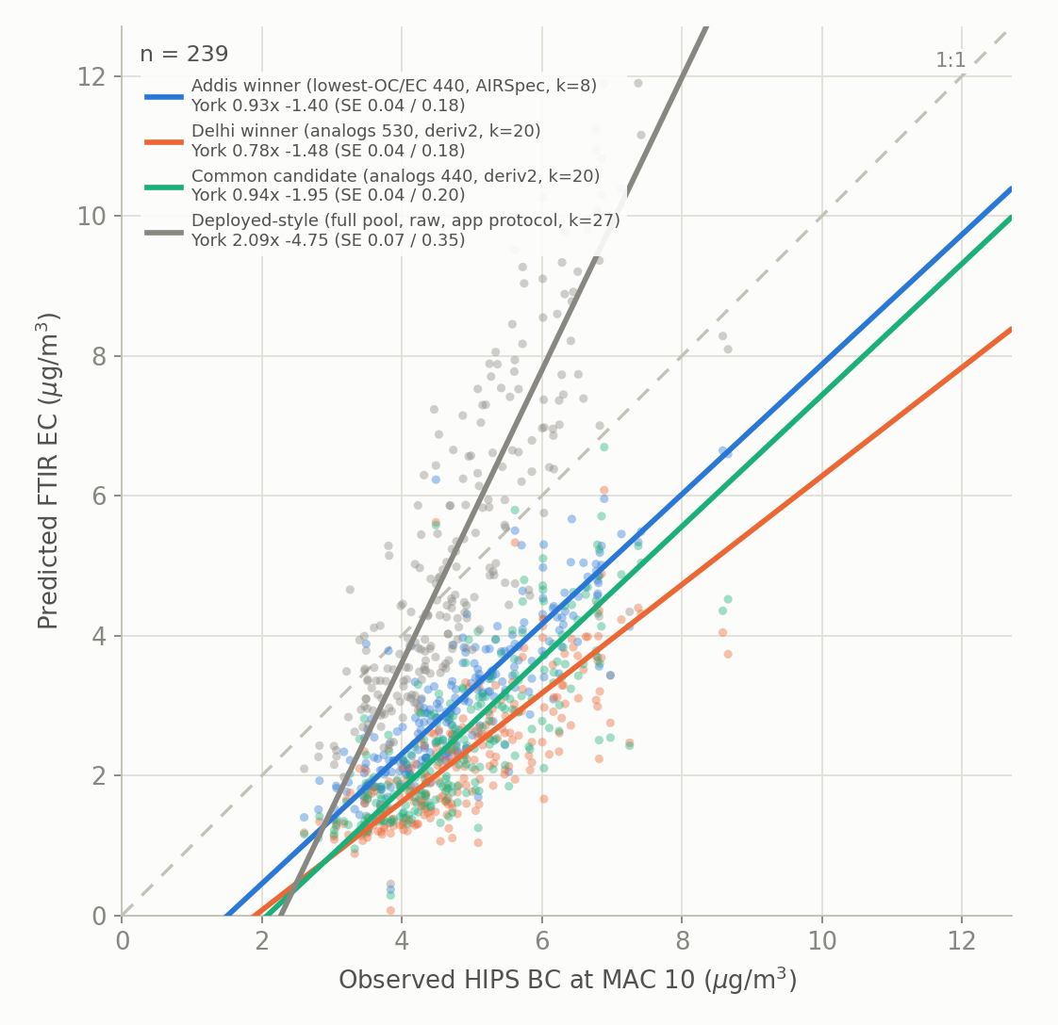
Addis under every optimised calibration
the negative intercept is present in all of them

Slide 8
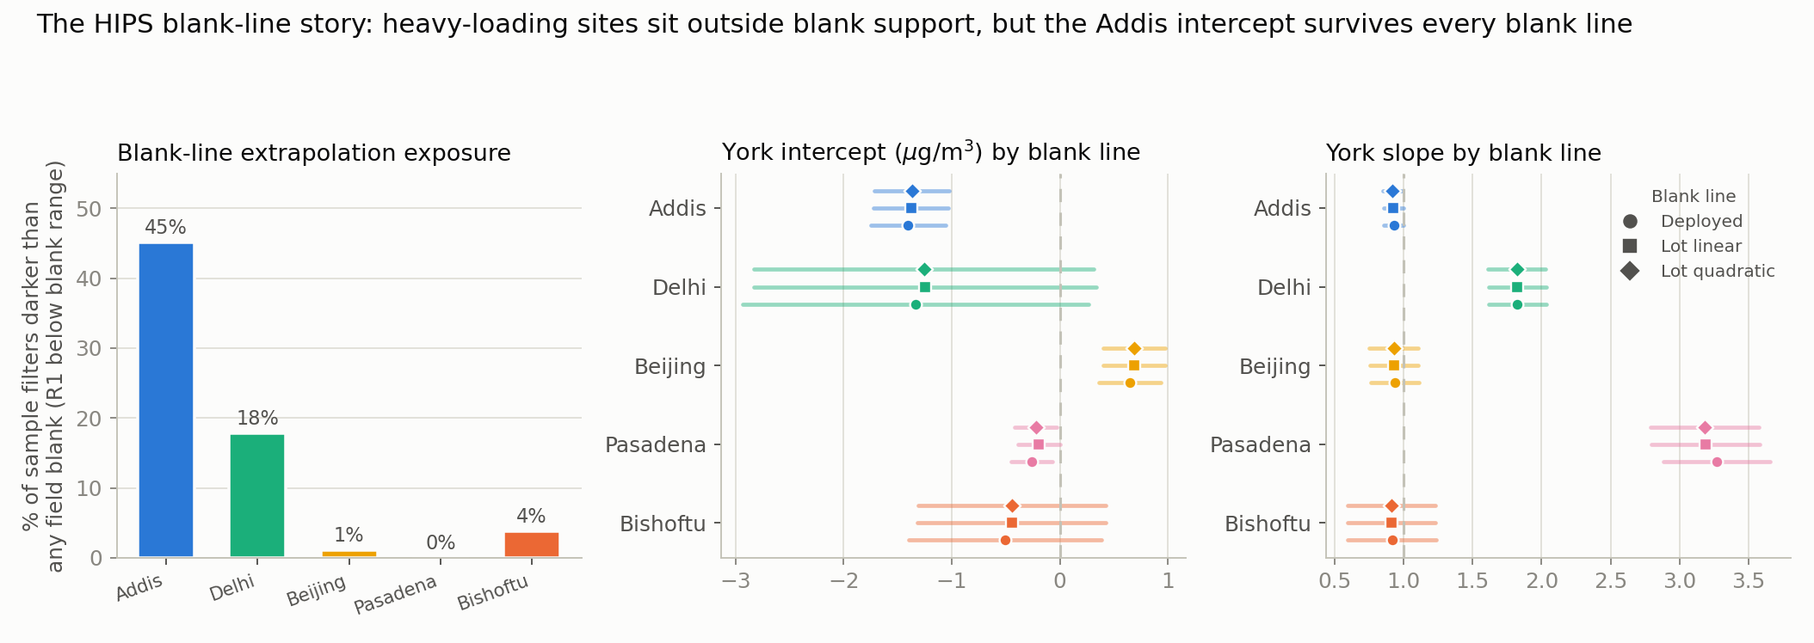
HIPS blank lines: exposure and the effect on York fits
see ftir_47 for the per-deployed-line correction

Slide 9
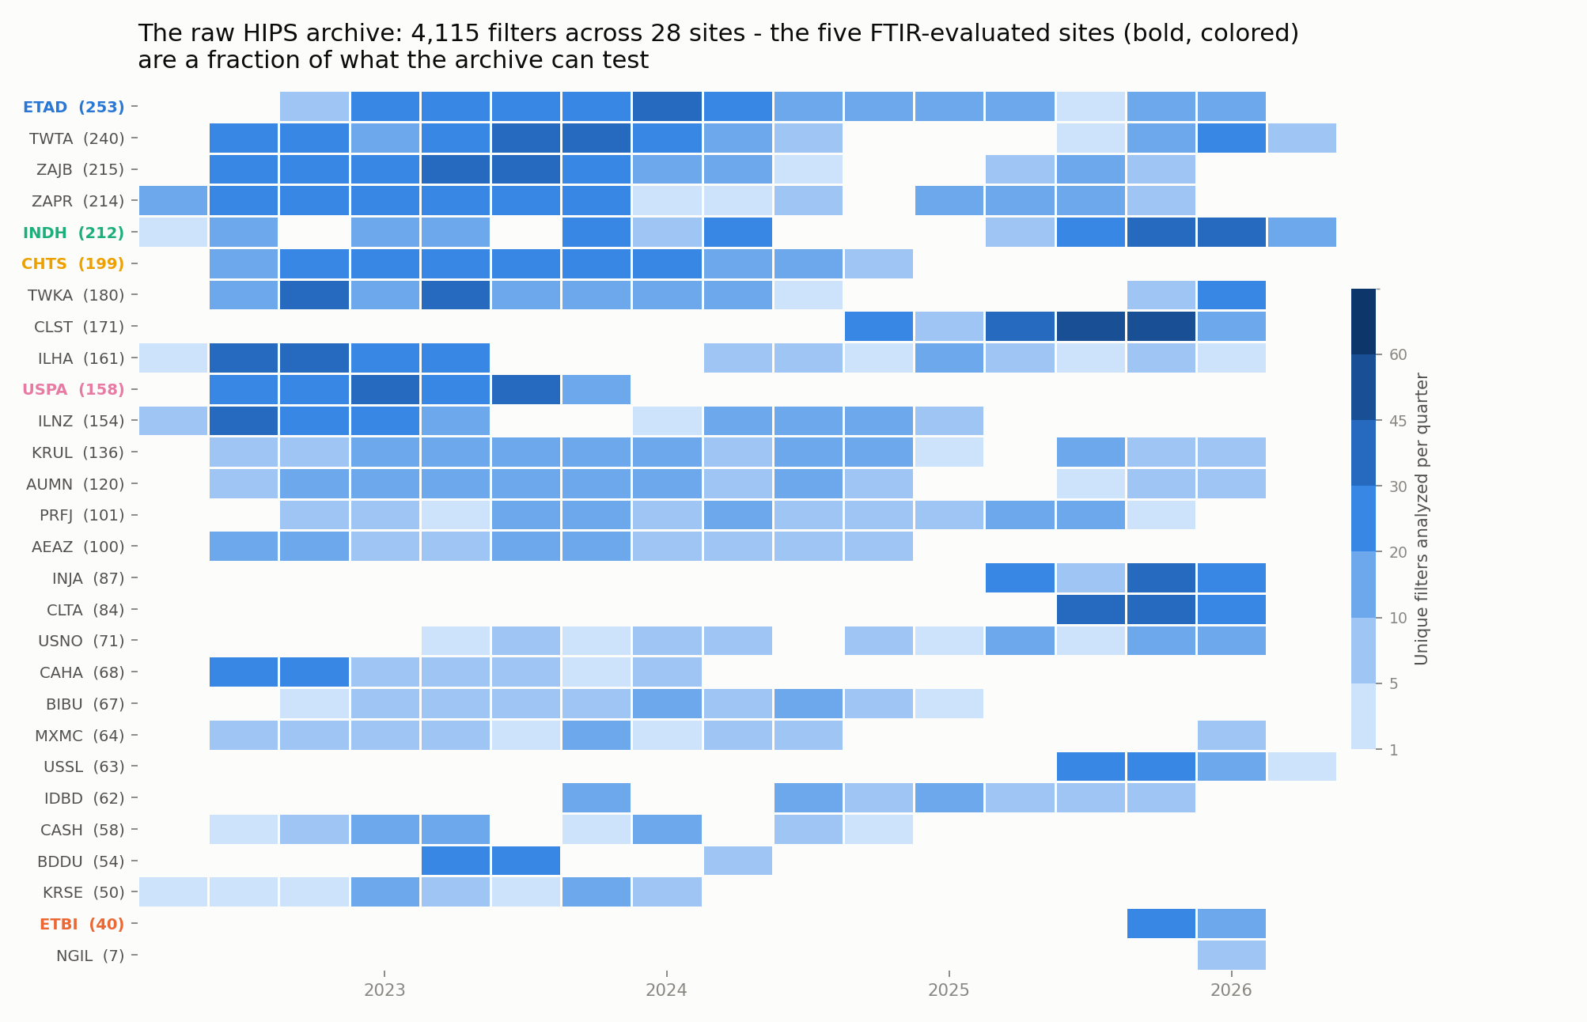
The raw HIPS archive: 4,115 filters across 28 sites

Slide 10
2. Spectral comparison methods (ftir_50)

Slide 11
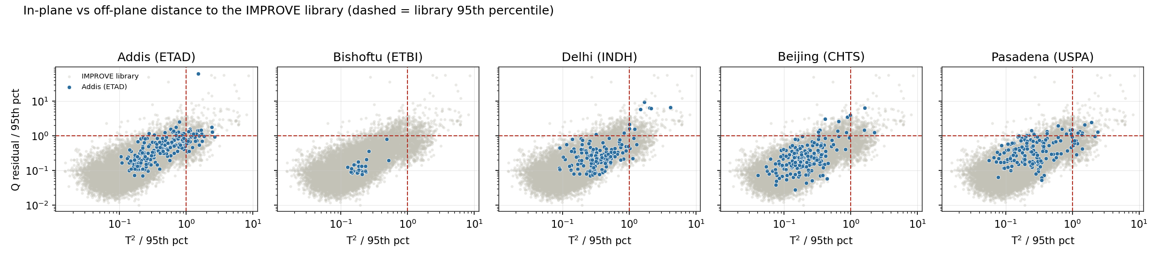
In-plane versus off-plane distance to the library
Hotelling T2 and Q residual flag different filters

Slide 12
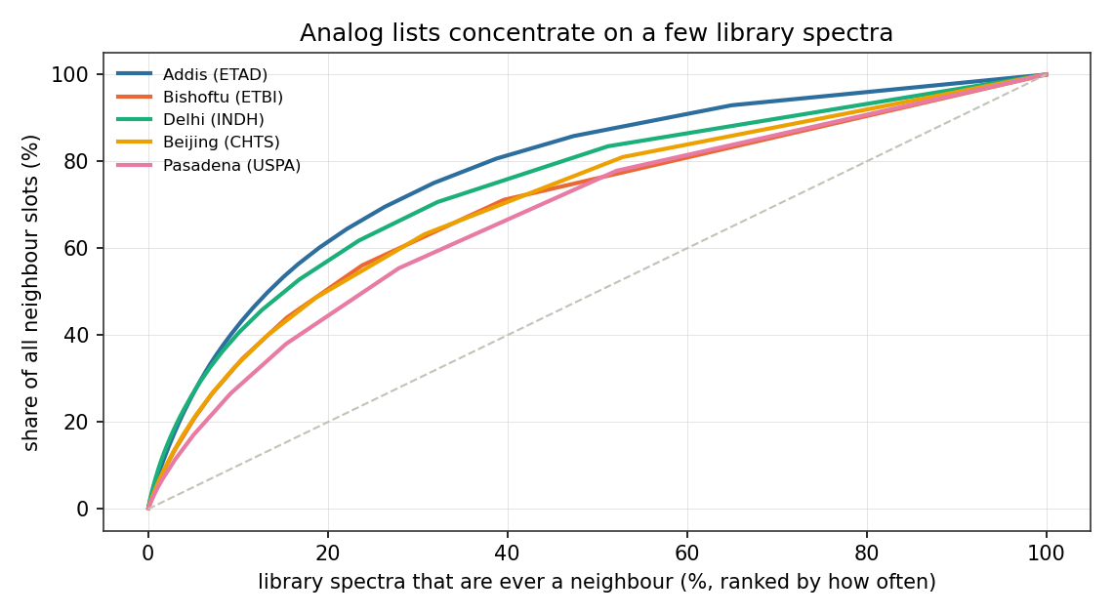
Analog lists concentrate on a few library spectra

Slide 13
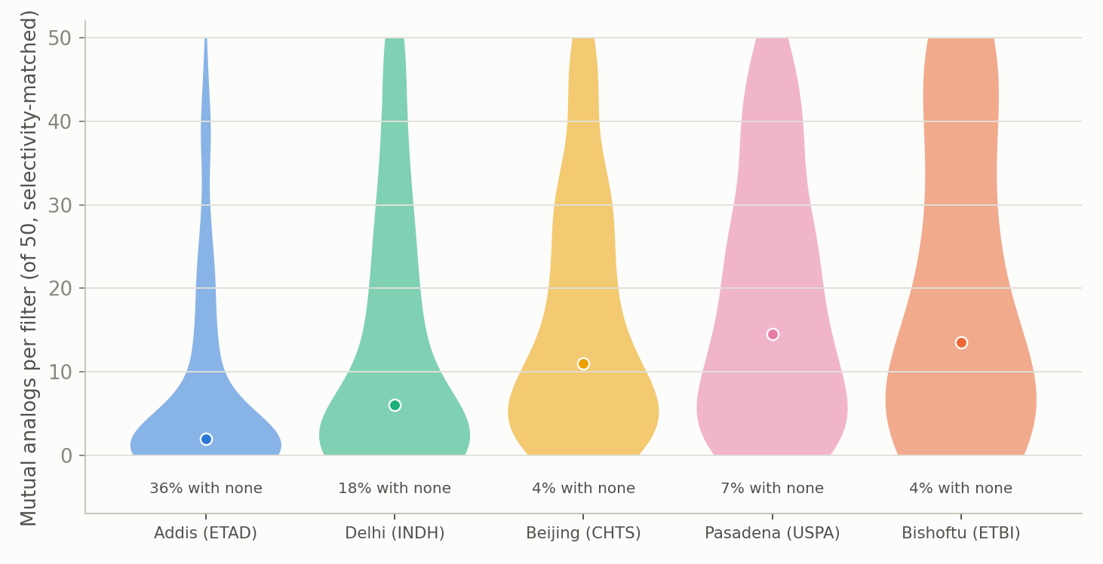
Mutual analogs per filter, selectivity-matched
36 percent of Addis filters have none

Slide 14
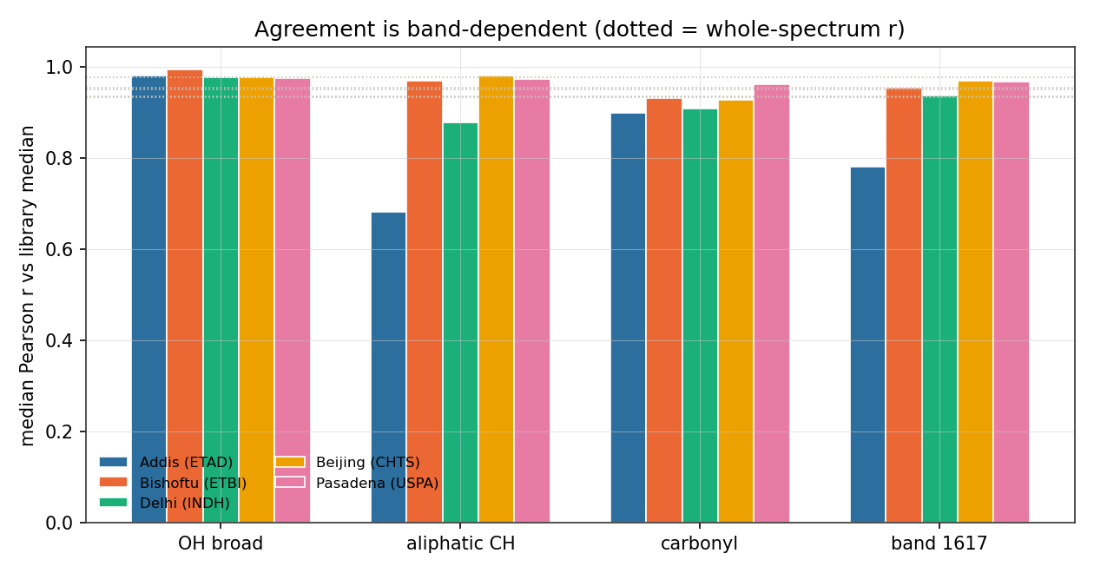
Agreement is band-dependent
dotted line = whole-spectrum r

Slide 15
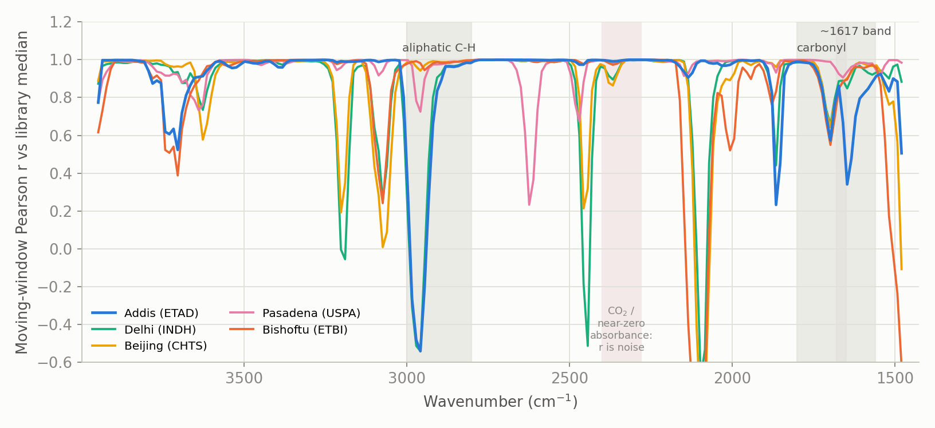
Where each site departs from the library
moving-window Pearson r against the library median

Slide 16
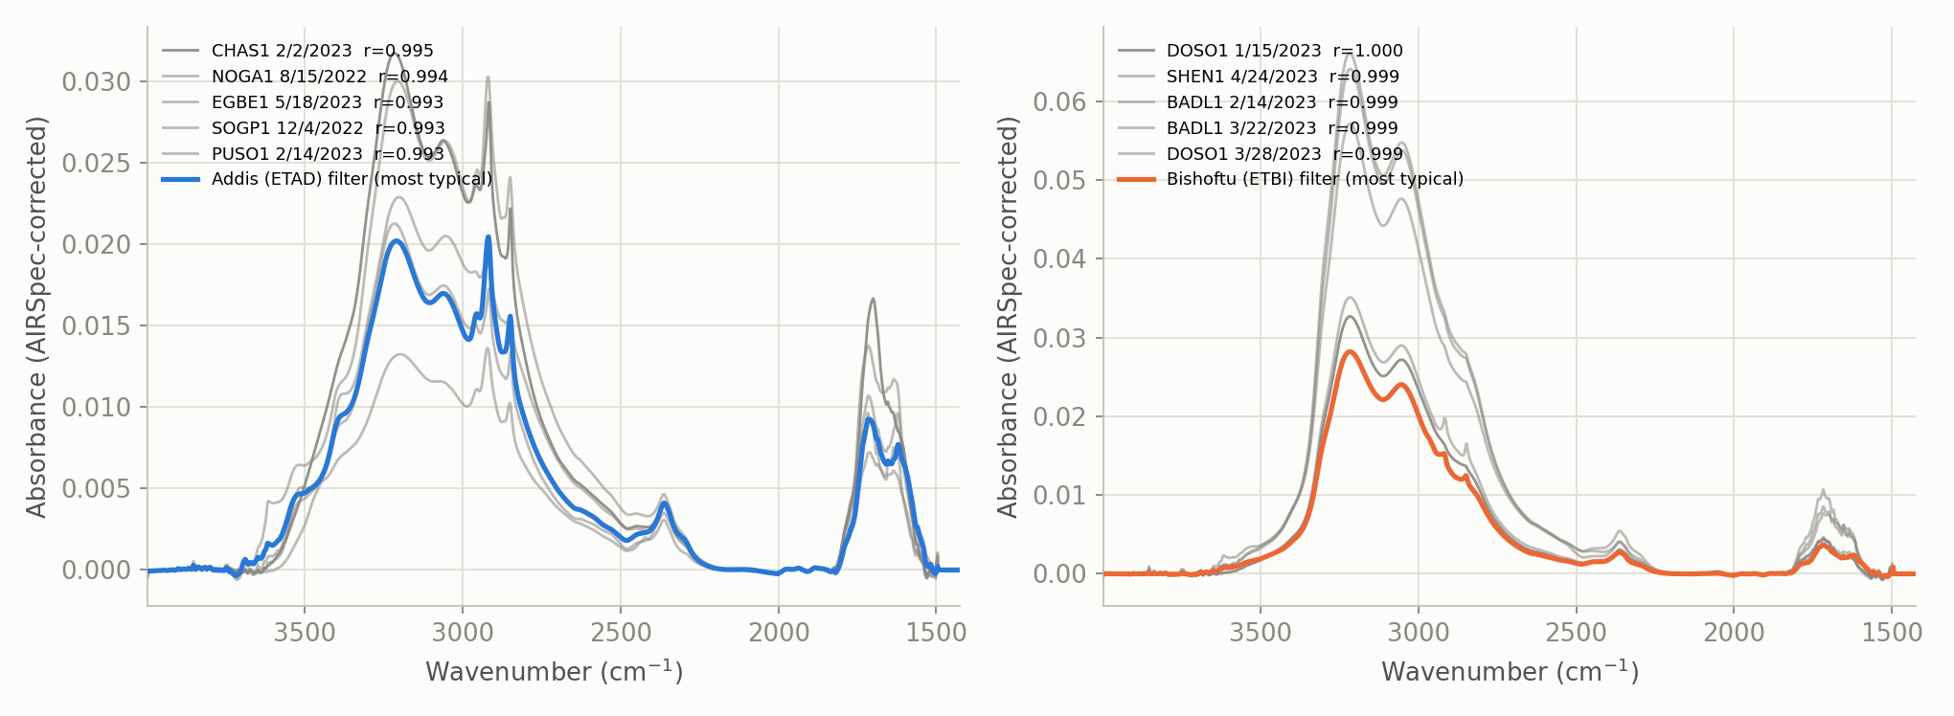
A typical Addis filter and its five nearest library spectra

Slide 17
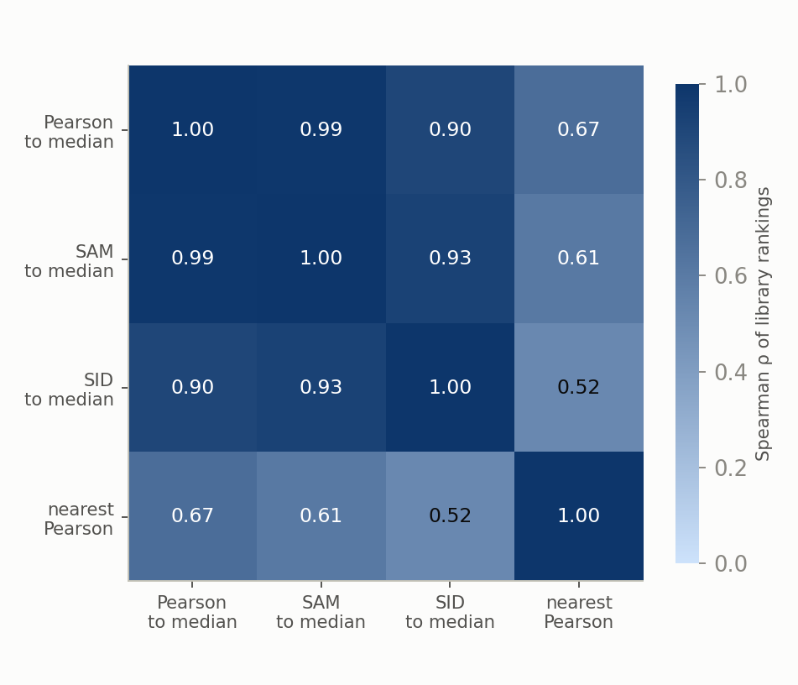
How much the similarity metrics agree
median-based and neighbour-based similarity are different measurements

Slide 18
3. The network spectral map (ftir_52)

Slide 19
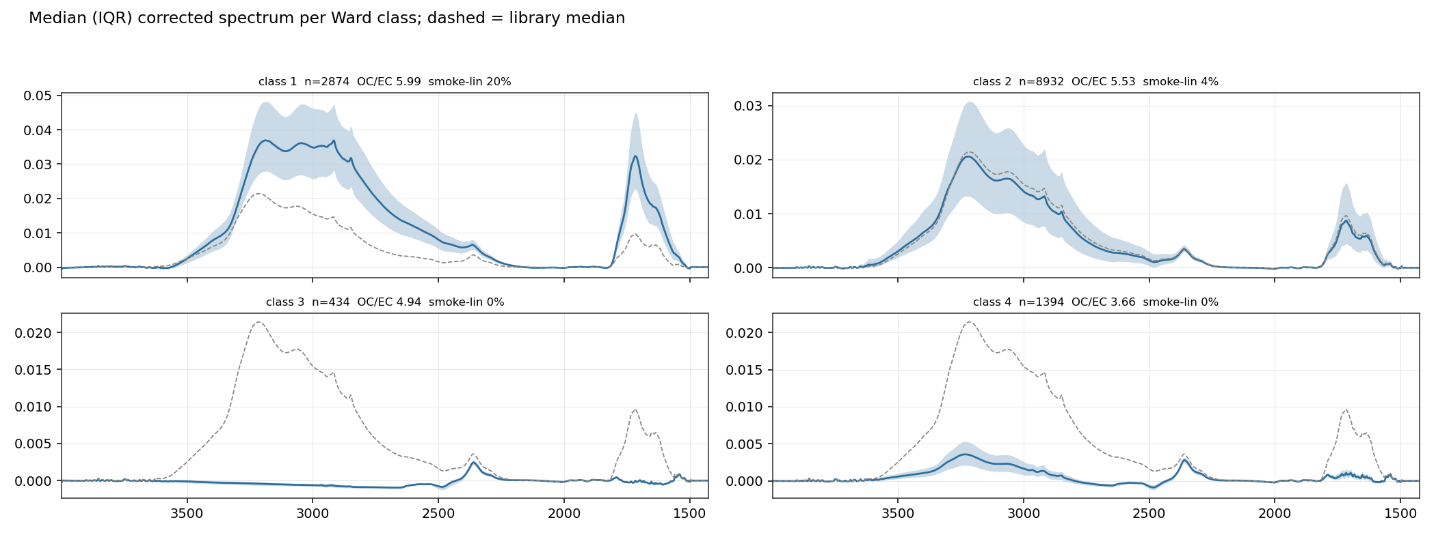
Median spectrum per Ward class
dashed = library median; two of four classes are low-deposit

Slide 20
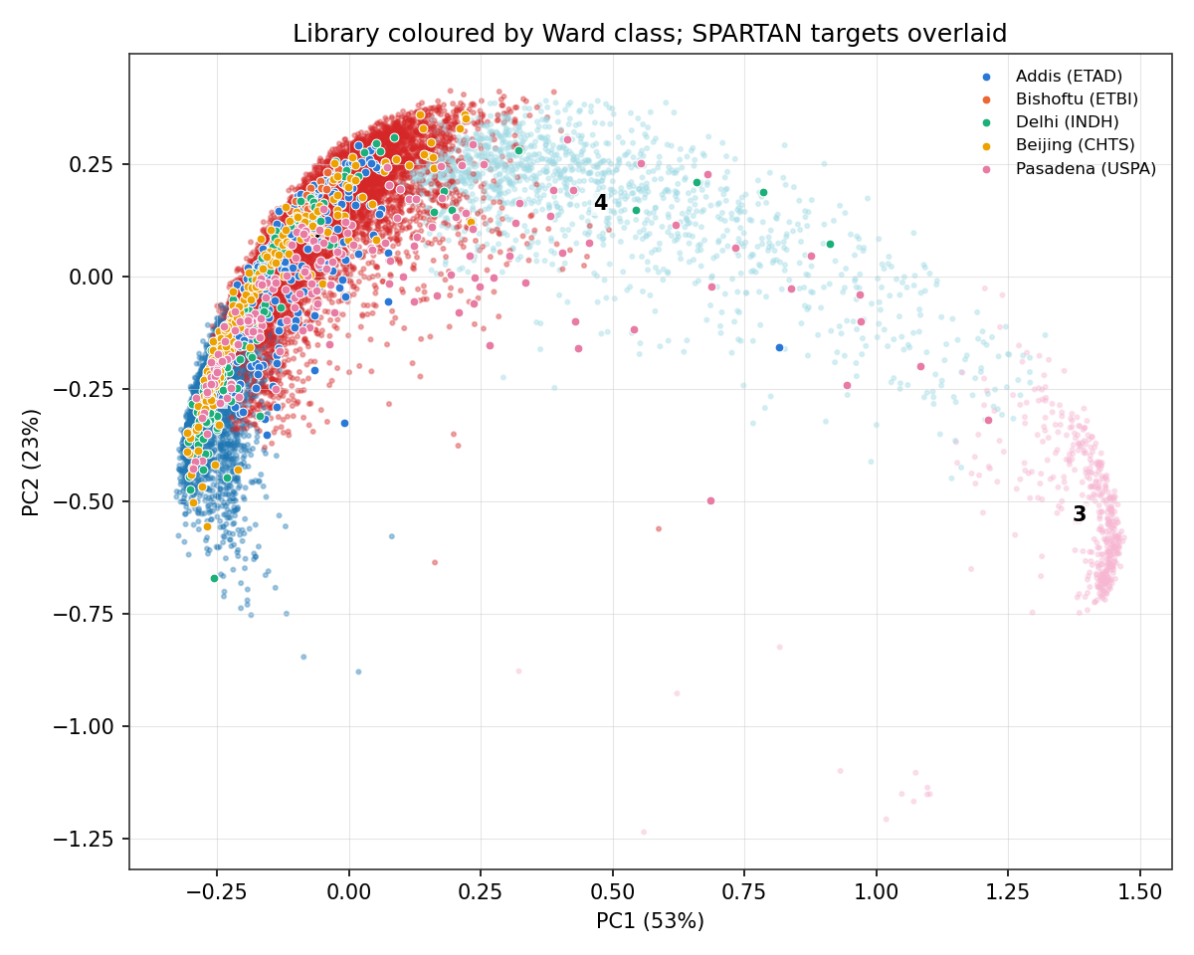
The library by Ward class, with the SPARTAN targets overlaid

Slide 21
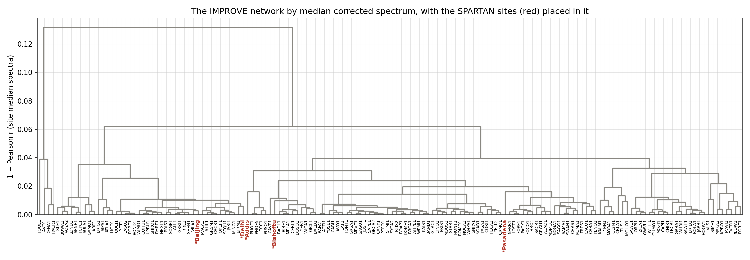
The IMPROVE network by median corrected spectrum
SPARTAN sites in red

Slide 22
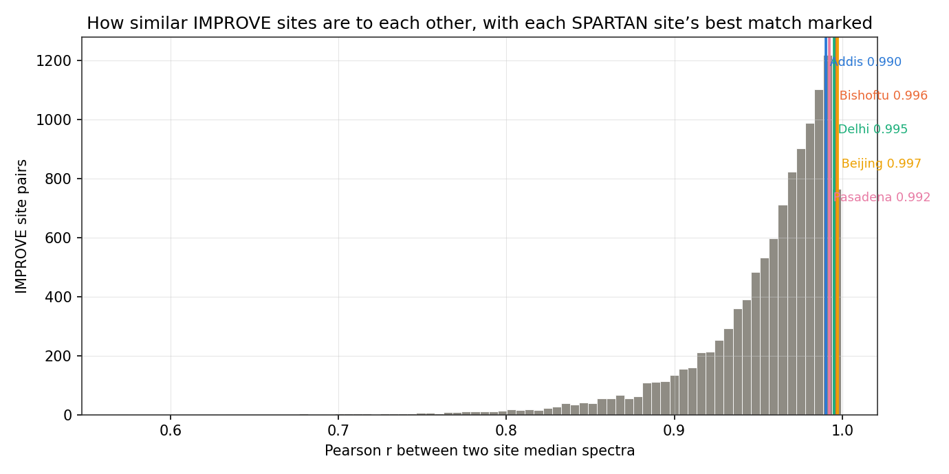
How similar IMPROVE sites are to each other
vertical lines mark each SPARTAN site's best match

Slide 23
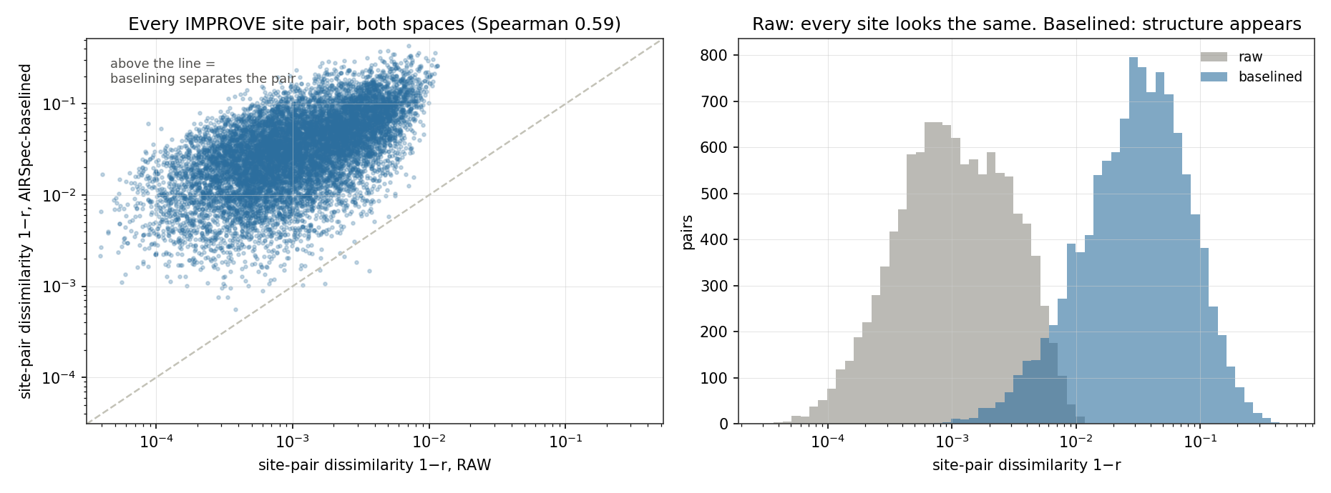
Raw versus baselined site similarity
plotted as 1 minus r on log axes; 92 percent of sites change nearest neighbour

Slide 24
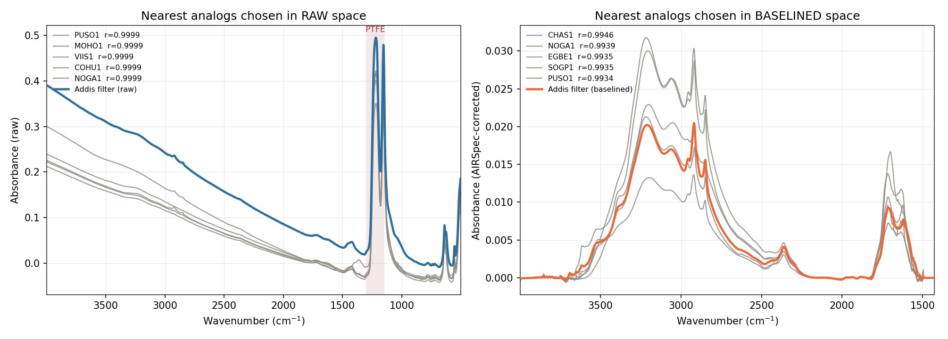
Addis analogs chosen in raw space versus baselined space
median overlap of the two top-50 sets is 12 percent

Slide 25
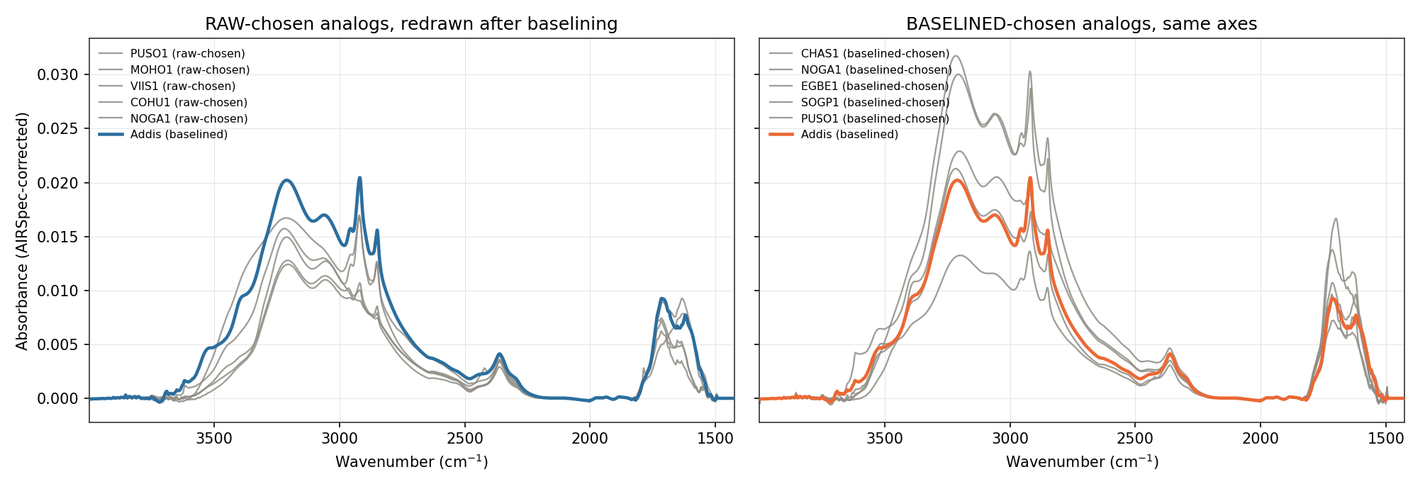
The same raw-chosen analogs, redrawn after baselining

Slide 26
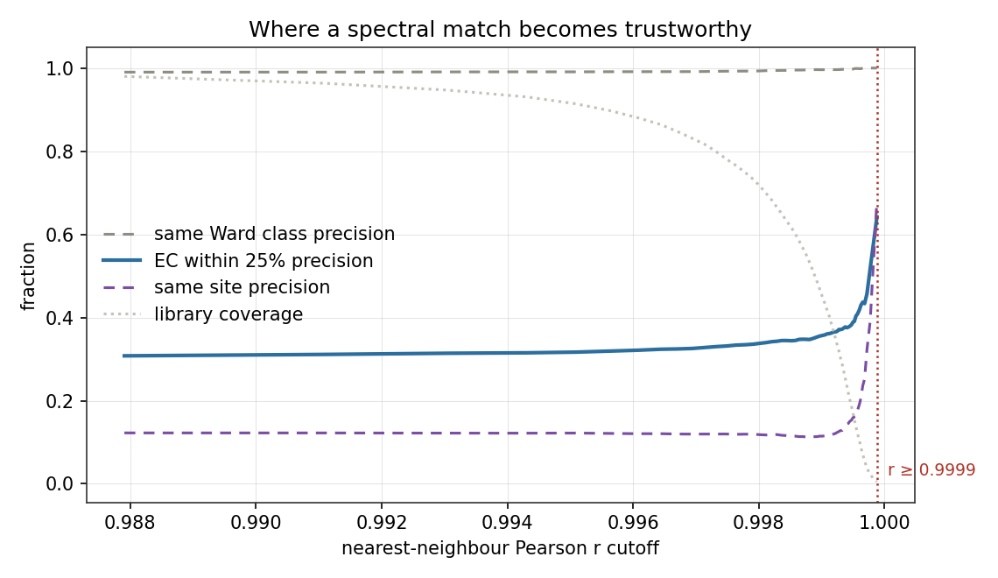
Where a spectral match becomes trustworthy
EC agreement never reaches 75 percent precision at any cutoff

Slide 27
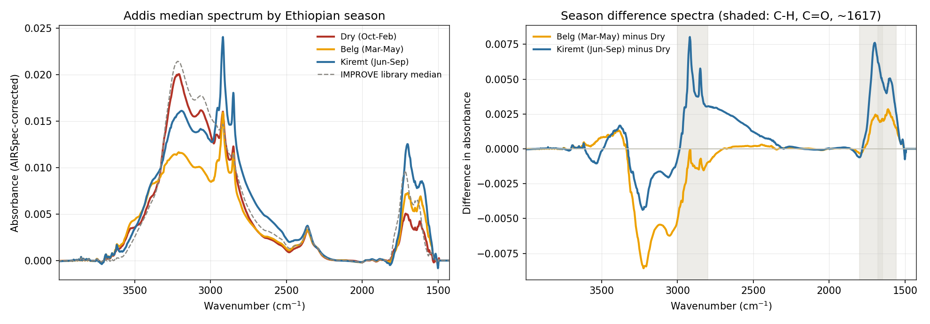
Addis median spectrum by Ethiopian season

Slide 28
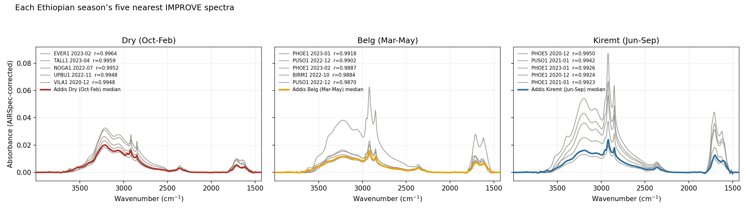
Each season's five nearest IMPROVE spectra
top-200 analog overlap is 0 percent dry versus either wet season

Slide 29
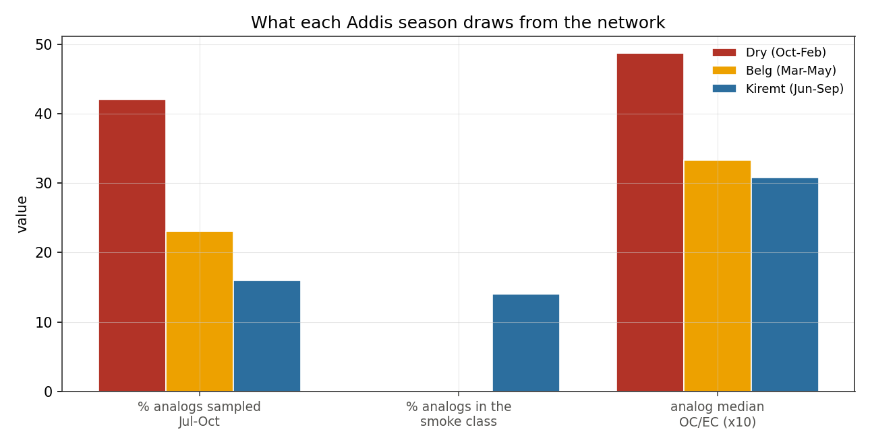
What each season draws from the network

