Slide 1
State of Knowledge
Confident Results — Multi-Site BC Measurement Comparison
"If we had to write the paper today, here is what we have."

Slide 2
The Story: Three Sites Work Well; Addis Is Anomalous
"Three sites work well; Addis Ababa is the anomalous site."
Beijing + JPL (low concentration):
HIPS and FTIR EC agree nearly perfectly (slope ~ 1.0, MAC = 10)
Delhi (high concentration):
Also works well — confirming the anomaly is SITE-SPECIFIC,
not concentration-dependent
Addis Ababa:
Two co-occurring problems with no identified physical mechanism:
1. Large positive intercept (~2 ug/m3)
2. Compressed HIPS dynamic range

Slide 3
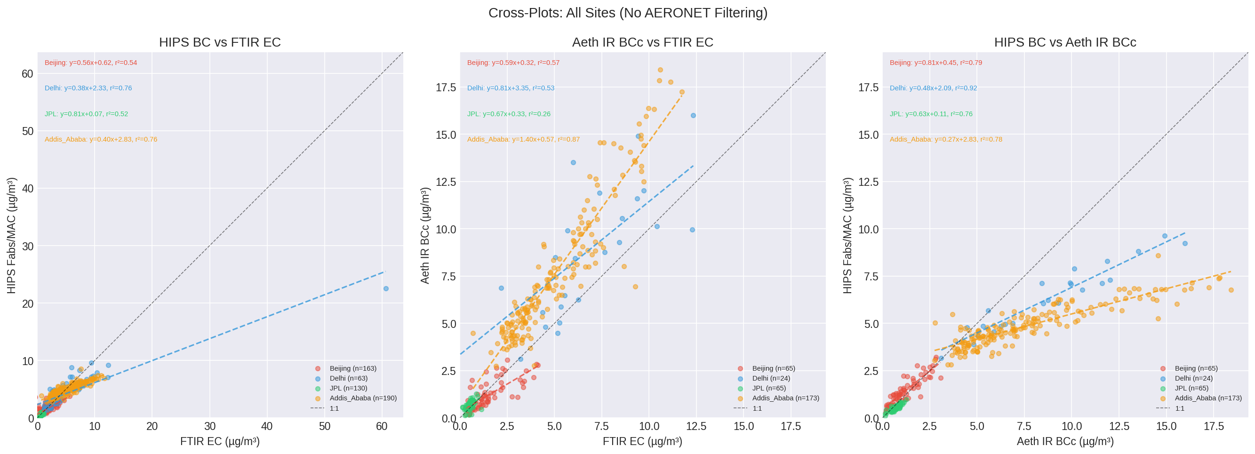
Result 1: Cross-Plots — Addis Is the Outlier

Slide 4
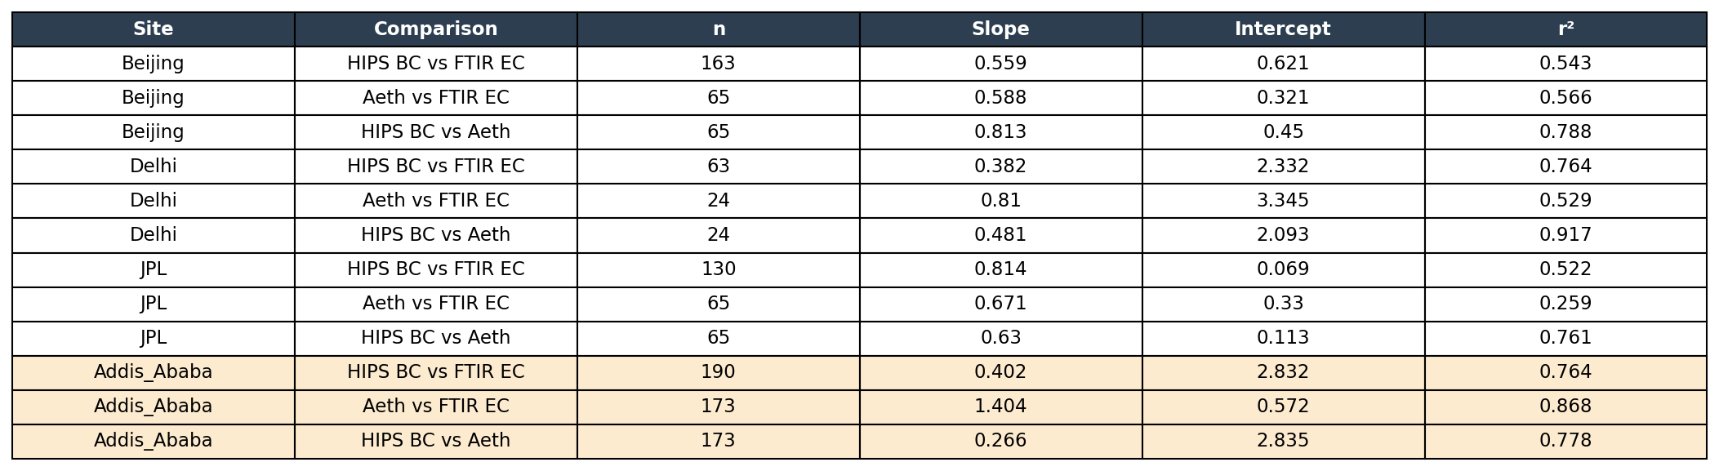
Result 1b: Cross-Plot Statistics (slope, intercept, r²)
Addis (orange rows): slope ~0.3, intercept ~2.0 for HIPS vs FTIR EC — far from 1:1
Beijing/JPL: slopes closer to 1:1, intercepts near zero
Delhi: high concentration but works well — rules out concentration as the cause

Slide 5
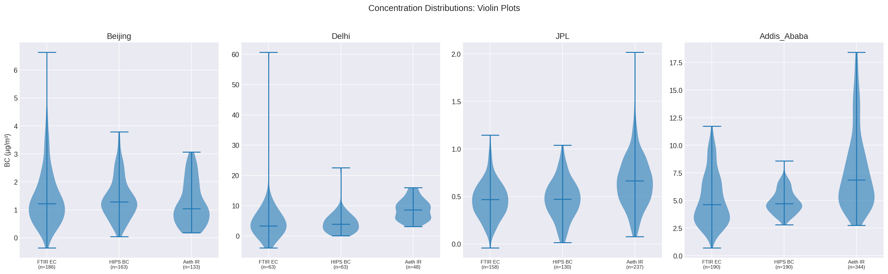
Result 2: HIPS Distribution Is Compressed at Addis
Beijing/Delhi/JPL: FTIR EC, HIPS BC, and Aeth have comparable distributions
Addis: HIPS BC squeezed into narrow range (~2-4 ug/m3) while FTIR EC and Aeth span ~2-15 ug/m3
This compression + offset cannot be fixed by changing MAC alone

Slide 6
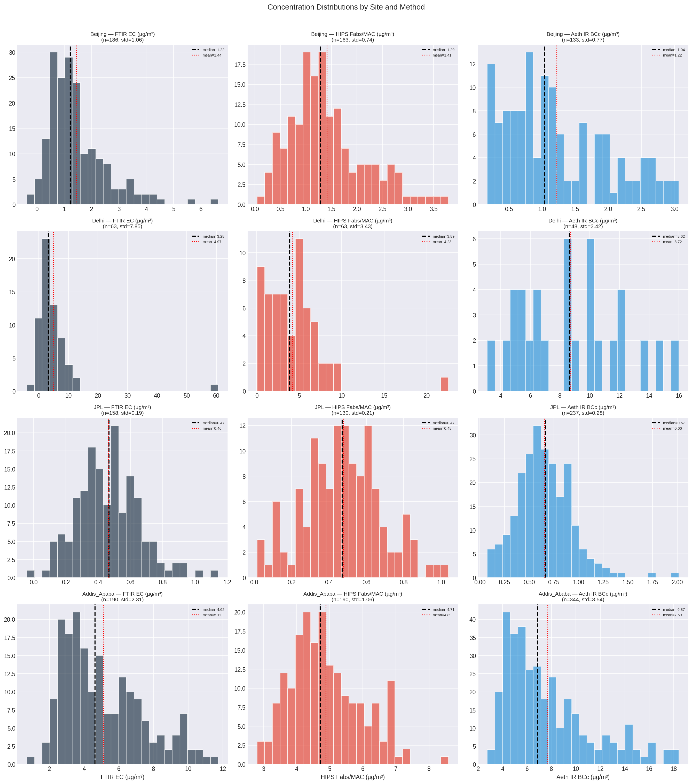
Result 2b: Detailed Histograms — EC, HIPS, Aeth by Site
Each row = one site
Each column = one method
Note the Addis row:
FTIR EC peaks ~4-5
HIPS BC peaks ~2-3
Aeth peaks ~5-7
Median (dashed black)
Mean (dotted red)
std shown in title

Slide 7
Result 3: Low-Concentration Sites — Complete
Beijing + JPL (252 paired filter samples):
1. HIPS and FTIR EC match extremely well (slope ~ 1.0 with MAC = 10)
2. Aethalometer correlation is weaker but acceptable
(measurement precision limited at low concentrations)
3. Iron (by both concentration and ratio) does NOT significantly
impact measurements at these sites
4. All three methods produce reasonably similar EC values
Practical implication:
At low-concentration sites, any of the three measurements
gives reasonable EC values.

Slide 8
Result 4: Addis Problem Is Site-Specific, Not Concentration
Delhi (63 paired samples):
Works well despite high concentrations (~11 ug/m3 median).
-> Concentration alone does NOT explain the discrepancy.
Addis Ababa (190 paired samples):
- Persistent intercept: ~2 ug/m3 (no other site shows this)
- Slope: ~0.3 in HIPS vs FTIR EC (should be ~1.0)
- Problem is year-round — not limited to one season
- Problem is across all source types — charcoal, wood, fossil fuel
all show similar slopes
The anomaly has two DISTINCT co-occurring issues:
1. OFFSET: Large positive intercept
2. COMPRESSION: HIPS has much lower variability than EC or aeth

Slide 9
Result 5: Source Apportionment Does Not Separate the Problem
PMF analysis (Naveed's data, Addis only):
5 factors: Charcoal, Wood Burning, Fossil Fuel, Polluted Marine, Sea Salt
Dominant source breakdown:
Charcoal: 40 days | Wood: 25 | Fossil Fuel: 12 | Marine: 22 | Sea Salt: 3
All combustion sources show similar slopes (~0.3-0.4) in HIPS vs FTIR EC.
Threshold filtering by dominant source % (30-60%) did not reveal
source-specific mechanisms. Slopes remained stable.
Combining charcoal+wood vs fossil fuel+marine:
Fossil fuel days fully overlap with biomass burning days.
No separation.
One exception: Polluted marine behaves differently from other sources
but in OPPOSITE directions for HIPS vs aeth comparisons.

Slide 10
Result 6: Systematic Hypothesis Testing (11 Approaches)
Tested and did NOT explain the Addis anomaly:
1. Relative humidity thresholds -> sample sizes too small to conclude
2. Temperature (T_min, T_max) -> counterintuitive (burning peaks when warmer)
3. Optical saturation -> no curvature (linear throughout)
4. Influential point removal -> dataset too tight, no leverage points
5. OC/EC ratio analysis -> no additional insight
6. Dust (AERONET coarse AOD) -> r = -0.33 (RULES OUT dust)
7. Iron/EC ratio thresholds -> iron not causing slope discrepancies
8. Source apportionment (PMF) -> all sources show same slopes
9. Combined source grouping -> biomass vs fossil fuel overlap
10. All-season aggregation -> masks patterns, doesn't explain
11. Wavelength stacking (IR=Blue=Red) -> unique to Addis = instrument issue

Slide 11
What We Can Confidently Write
1. HIPS and FTIR EC agree well at low-concentration sites
(Beijing, JPL) with MAC = 10. Iron has no measurable effect.
2. Delhi (high concentration) also shows good agreement,
confirming the anomaly is site-specific, not concentration-dependent.
3. Addis Ababa shows a persistent HIPS offset (~2 ug/m3) and
compressed dynamic range that is NOT explained by: iron, dust,
humidity, temperature, optical saturation, or source composition.
4. The Addis aethalometer has a confirmed data quality issue
(Green channel at 0.55x IR — unique across all four sites),
but this does not directly explain the HIPS-FTIR discrepancy.
5. Seasonal analysis is essential — aggregated data hides
meaningful patterns at all sites.

Slide 12
What We Still Need
TO WRITE THE PAPER:
- Paper skeleton: define the story, figure order, conclusions first
- Final figure set (cross-plots + distributions + stats table)
TO RESOLVE THE ANOMALY:
- Meet with Cena to discuss:
Green channel issue on MA350-0238
HIPS anomaly root cause
Filter loading effects at high BC concentrations
TO COMPLETE:
- Confirm Delhi seasonal definitions with Amina
- Literature: Warren White HIPS/IMPROVE papers
- Literature: filter-based absorption measurement corrections
PAPER FRAMING:
"Three sites work well + Addis is anomalous +
here is what we tried + anomaly remains open"

