Slide 1
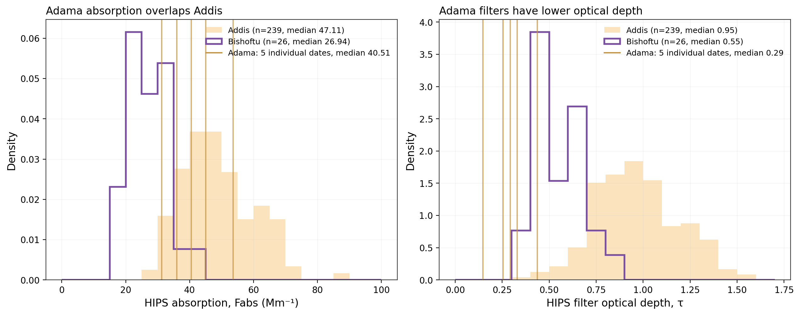
Adama absorption overlaps Addis, while filter optical depth is lower
Five July 2024 Adama filters added to the existing Addis and Bishoftu comparison
Different collection periods and samplers. Median sampled volumes: Addis 7.25 m³, Bishoftu 7.17 m³, Adama 2.88 m³.

Slide 2
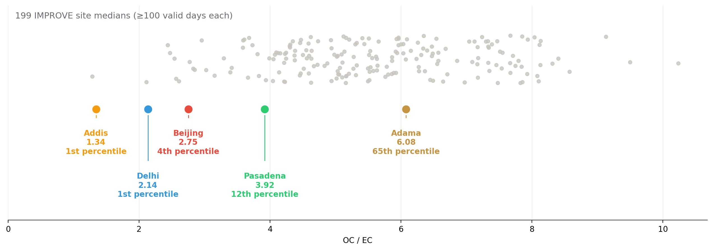
Adama TOR OC/EC falls within the IMPROVE distribution
Adama median OC/EC = 6.08 across five dates, compared with 199 IMPROVE site medians
IMPROVE and Adama use quartz TOR. The four SPARTAN city markers use deployed FTIR products, so the methods differ.

Slide 3
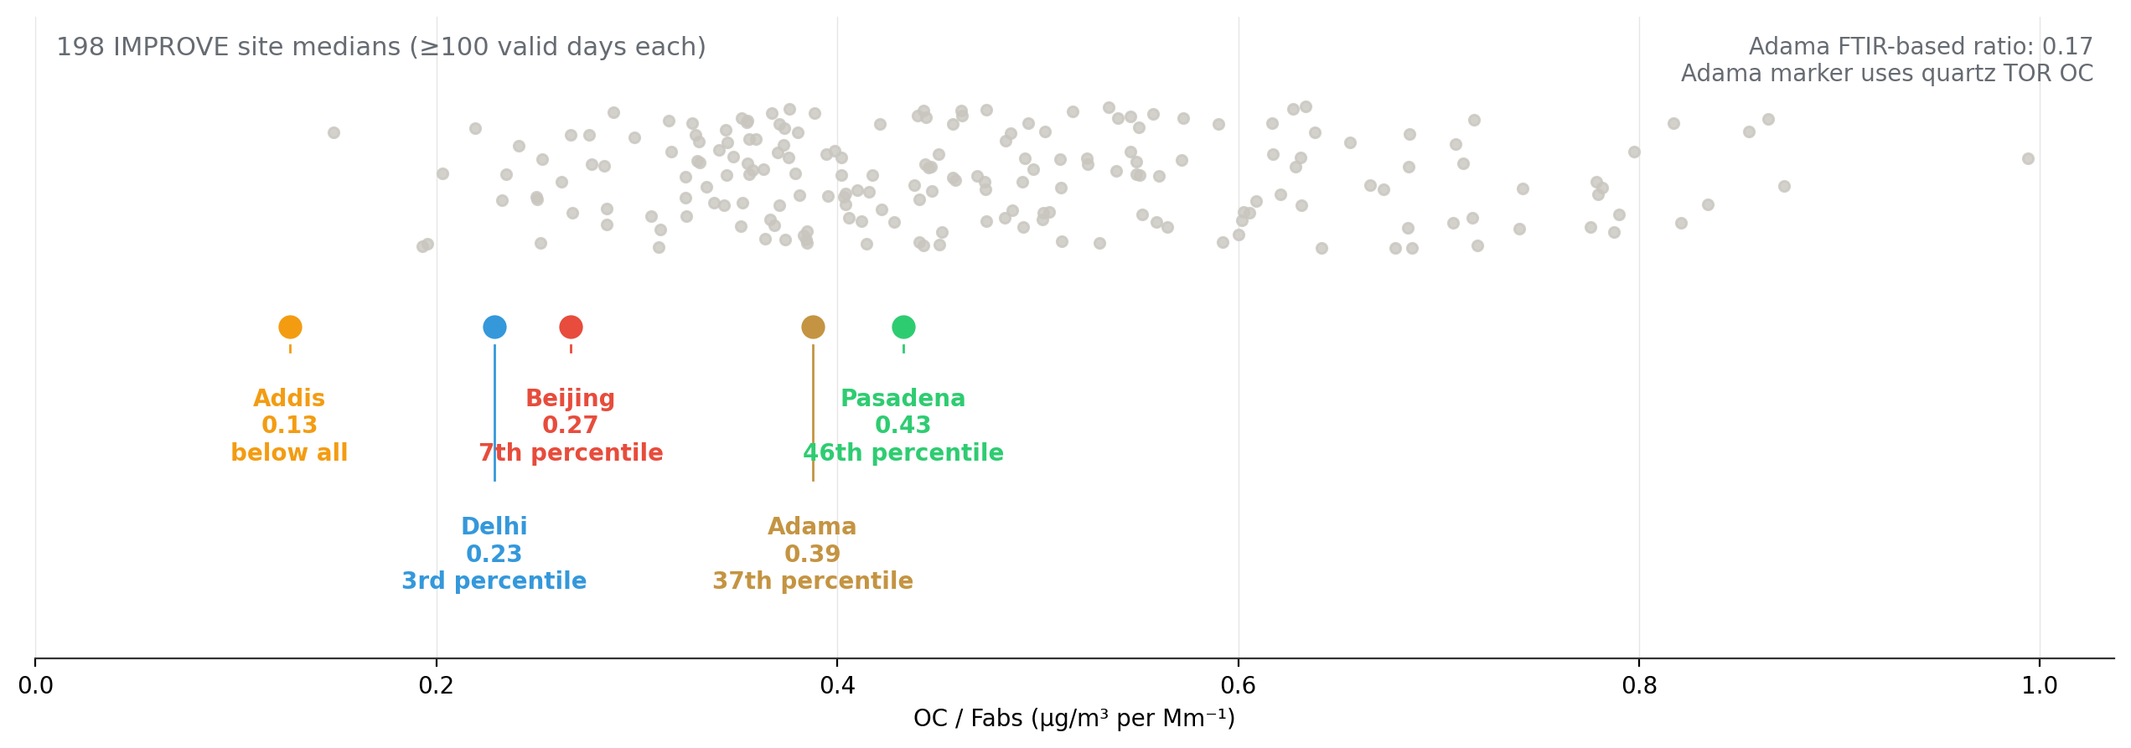
Adama can join the OC-to-absorption comparison
The Adama marker combines quartz TOR OC with HIPS on the paired PTFE filter
Adama median OC/Fabs is 0.39 using TOR OC and 0.17 using FTIR OC. The marker depends on the OC measurement method.

Slide 4
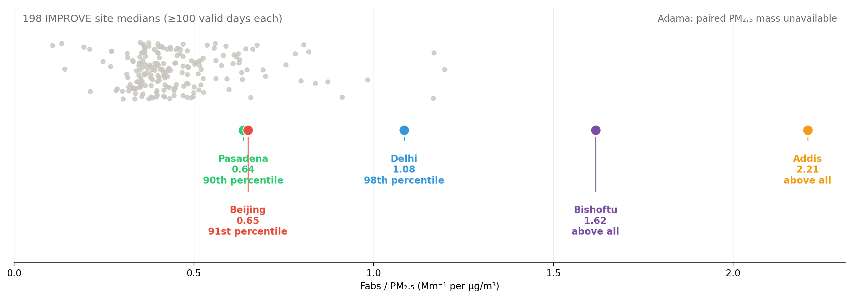
Absorption per PM₂.₅ mass still needs paired Adama gravimetry
Existing HIPS and filter-mass data provide context for Addis and Bishoftu
Adama HIPS is available. A matched PM₂.₅ mass value for each Adama PTFE filter is still missing from these source exports.

Slide 5
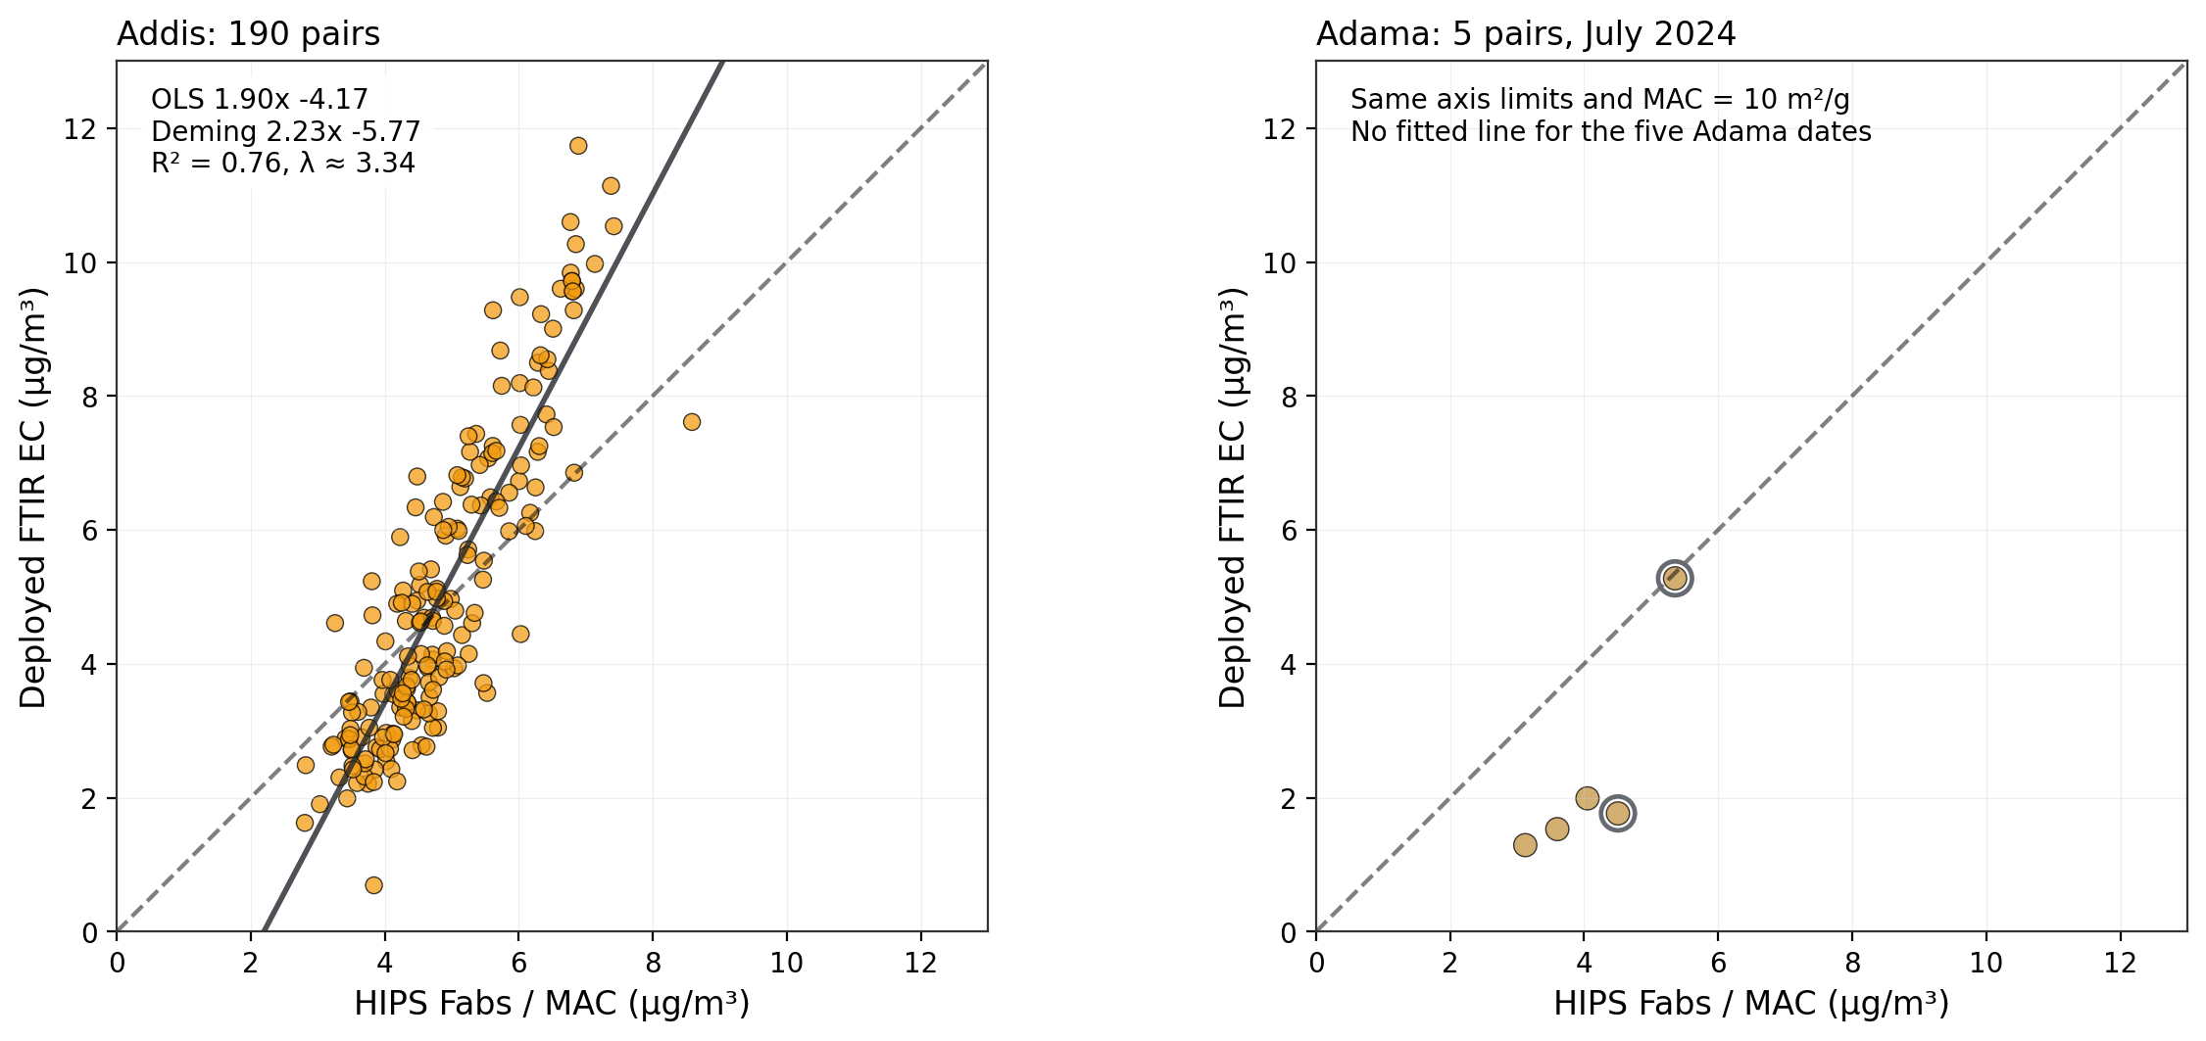
Addis and Adama against the same HIPS reference
Both panels use concentrations, identical axes and the configured MAC of 10 m²/g
Adama n = 5, with no fitted line. Open rings identify the two pairing flags. HIPS / MAC depends on the assumed MAC.

Slide 6
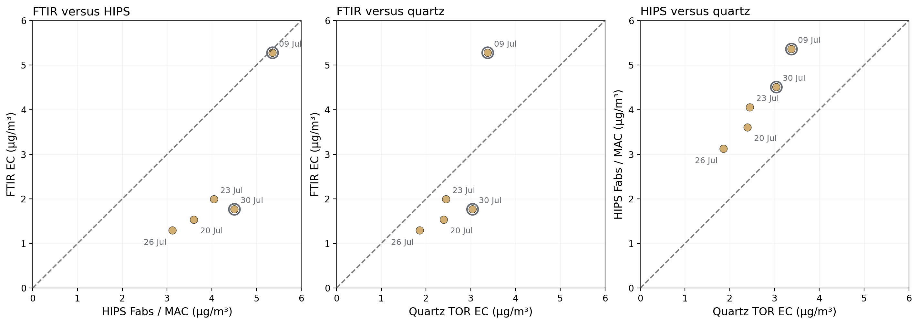
The five Adama pairs connect FTIR, HIPS and quartz TOR
All three pairwise comparisons use the same five dates and a 1:1 reference
Concentrations in µg/m³. HIPS uses MAC = 10 m²/g. Open rings flag pairing issues, with no exclusion or correction.

Slide 7
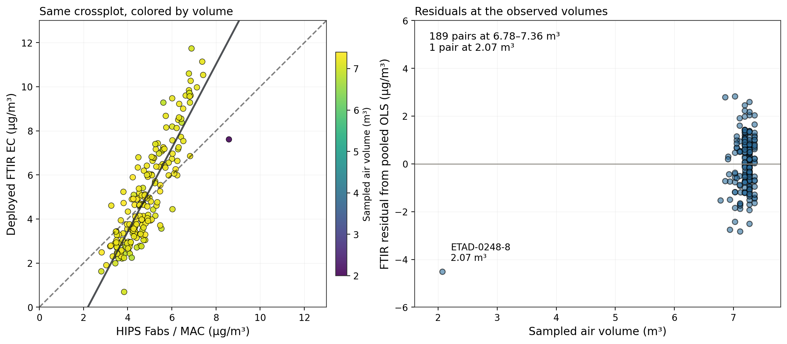
The Addis comparison mostly contains one sampled-volume range
189 of 190 pairs span 6.78–7.36 m³. One filter has a recorded volume of 2.07 m³.
Color shows recorded air volume. The solid line is pooled OLS. Residuals include every paired filter.

Slide 8
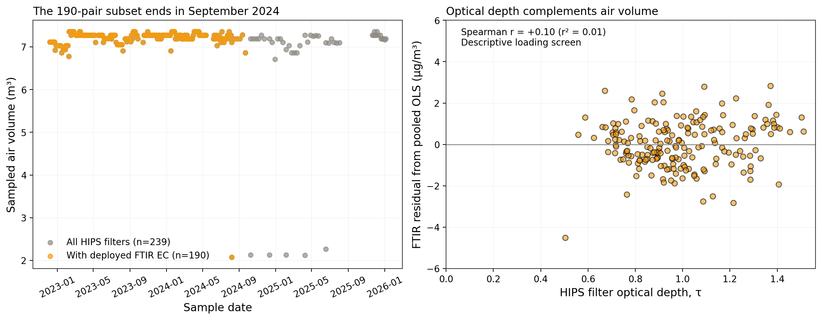
Later HIPS samples have no deployed FTIR EC in this subset
The HIPS population extends to January 2026. The 190 deployed-EC pairs end in September 2024.
The weak residual–optical-depth association is descriptive. It does not establish that loading or volume has no effect.

Slide 9
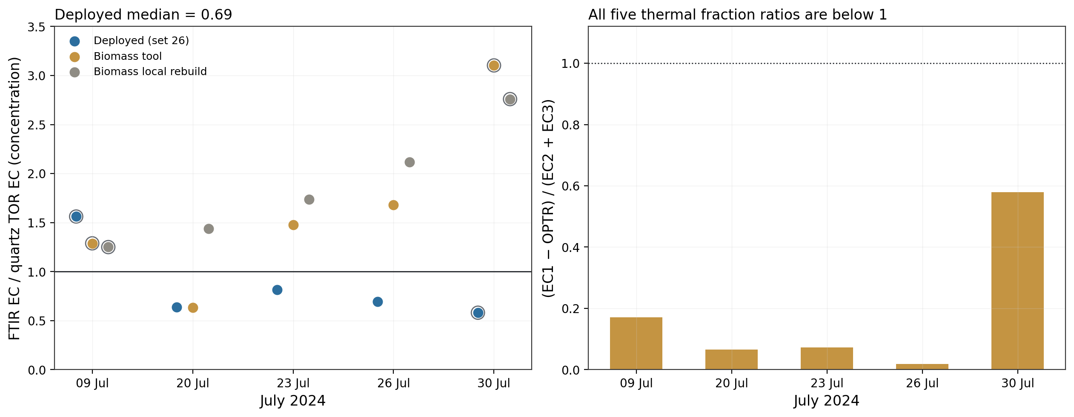
Adama FTIR/TOR ratios depend on calibration and sampled volume
Deployed FTIR/TOR median = 0.69 on a concentration basis, with a range of 0.58–1.56
The three unflagged deployed ratios span 0.64–0.81. Open rings identify the two pairing flags.

Slide 10
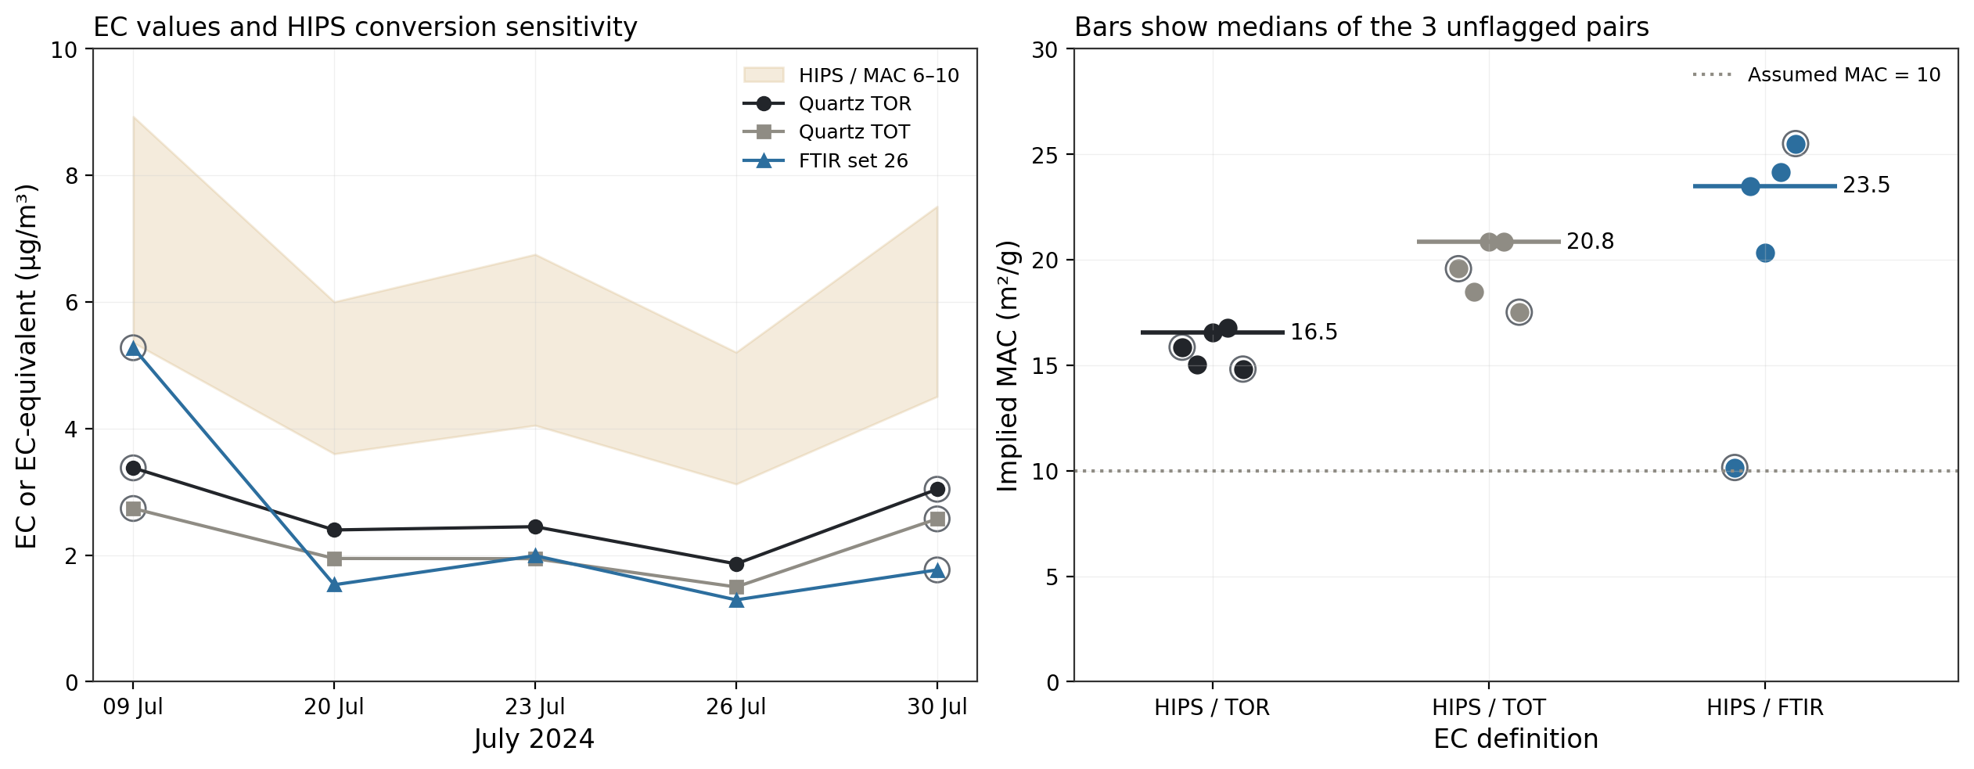
At MAC 10, HIPS EC-equivalent exceeds Adama quartz EC
For the three unflagged pairs, implied MAC medians are 16.5 versus TOR and 20.8 versus TOT
Open rings show flagged dates. The MAC 6–10 band illustrates how the assumed MAC changes the HIPS EC-equivalent.

Slide 11
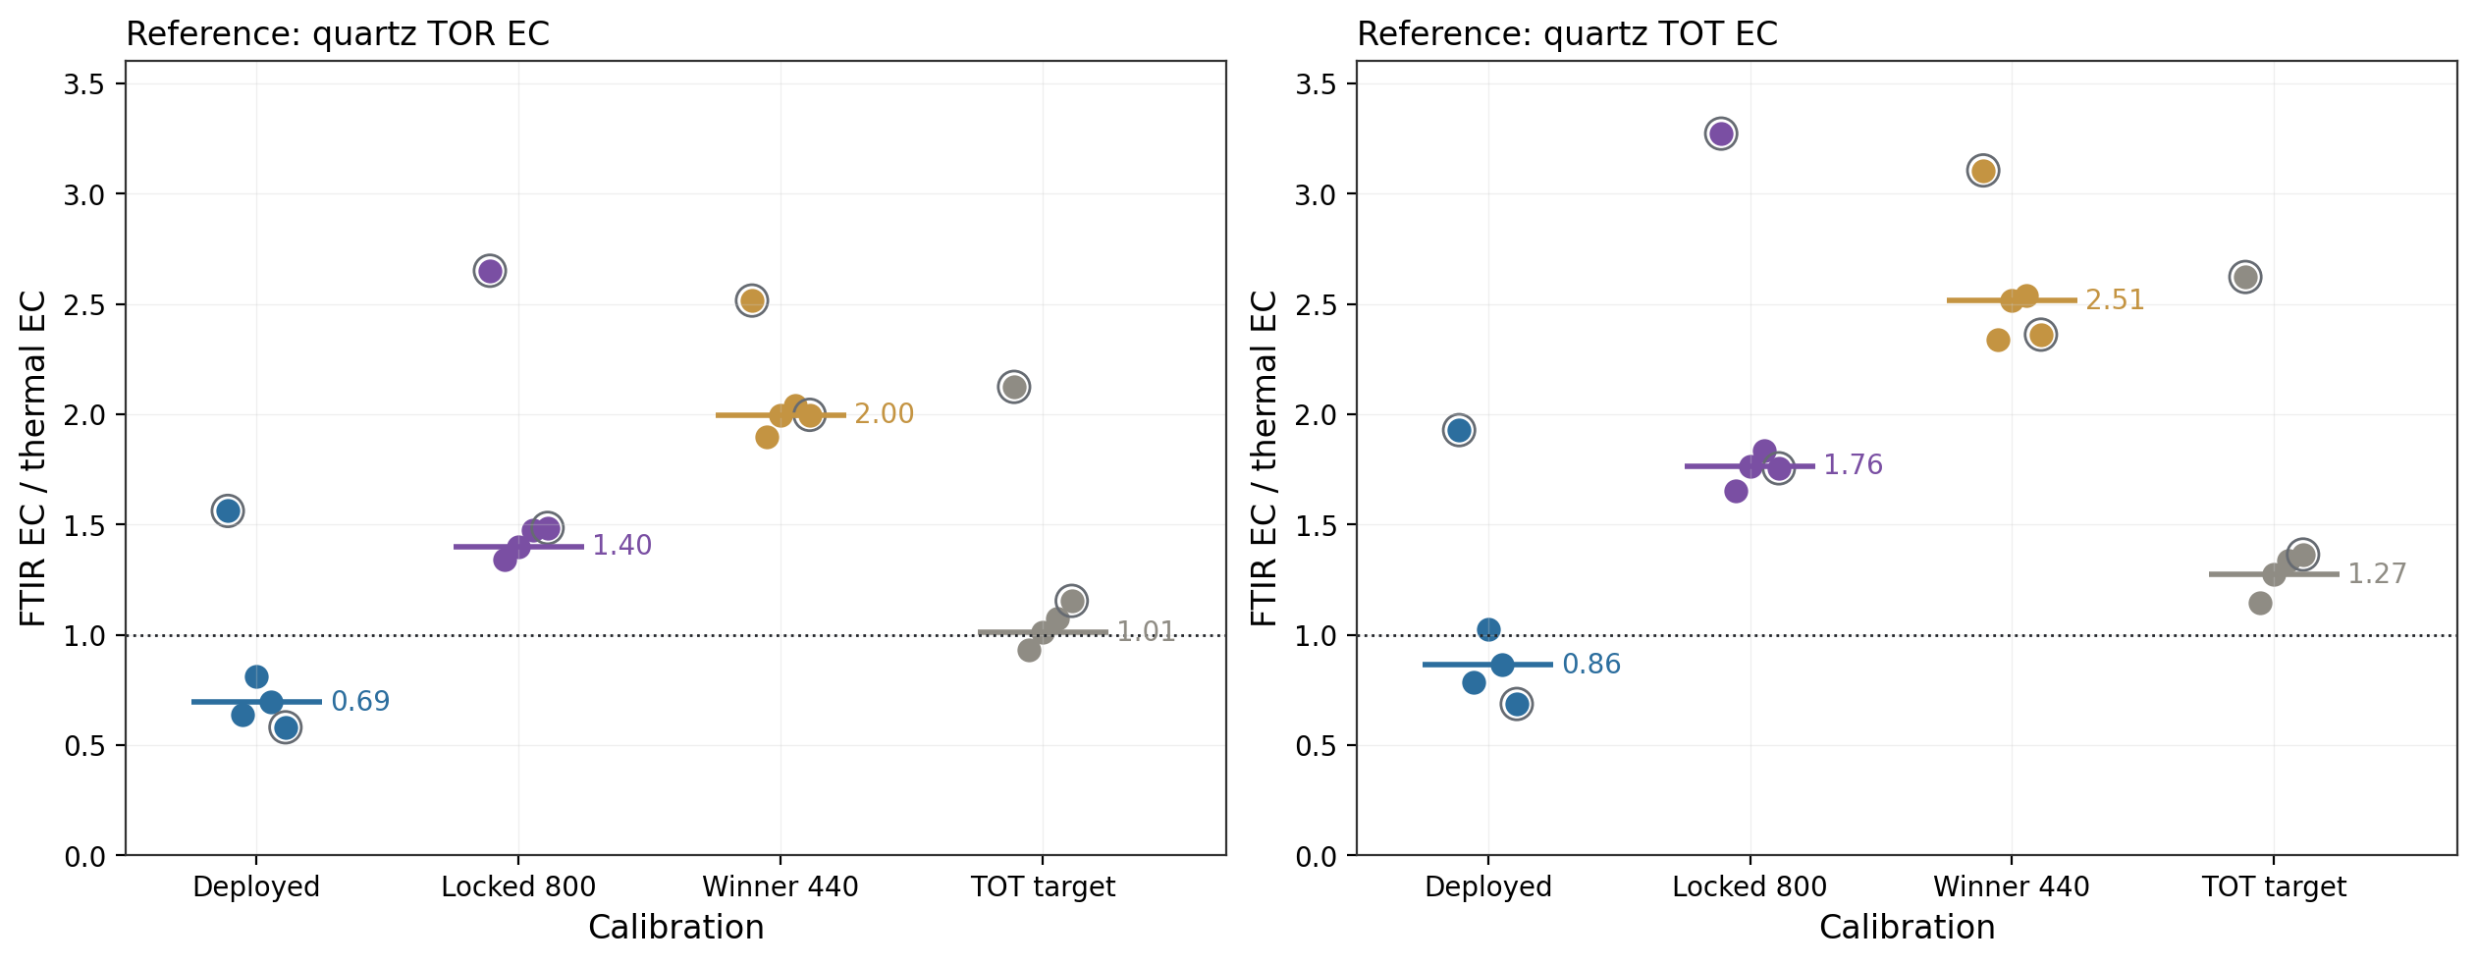
The Addis-selected models predict more EC at Adama
Median model/TOR ratios for three unflagged pairs: locked 800 = 1.40, winner 440 = 2.00
Exploratory transfer check. The spectrum-to-FilterId mapping used by these earlier model predictions remains provisional.

Slide 12
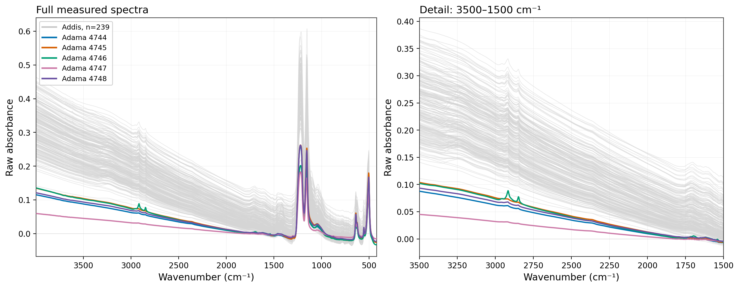
Five Adama spectra over the Addis evaluation set
Adama in color (n = 5). Addis in light gray (n = 239), December 2022–January 2026.
Raw absorbance, with no normalization or baseline correction. Legend labels 4744–4748 are Adama source spectrum IDs.

Slide 13
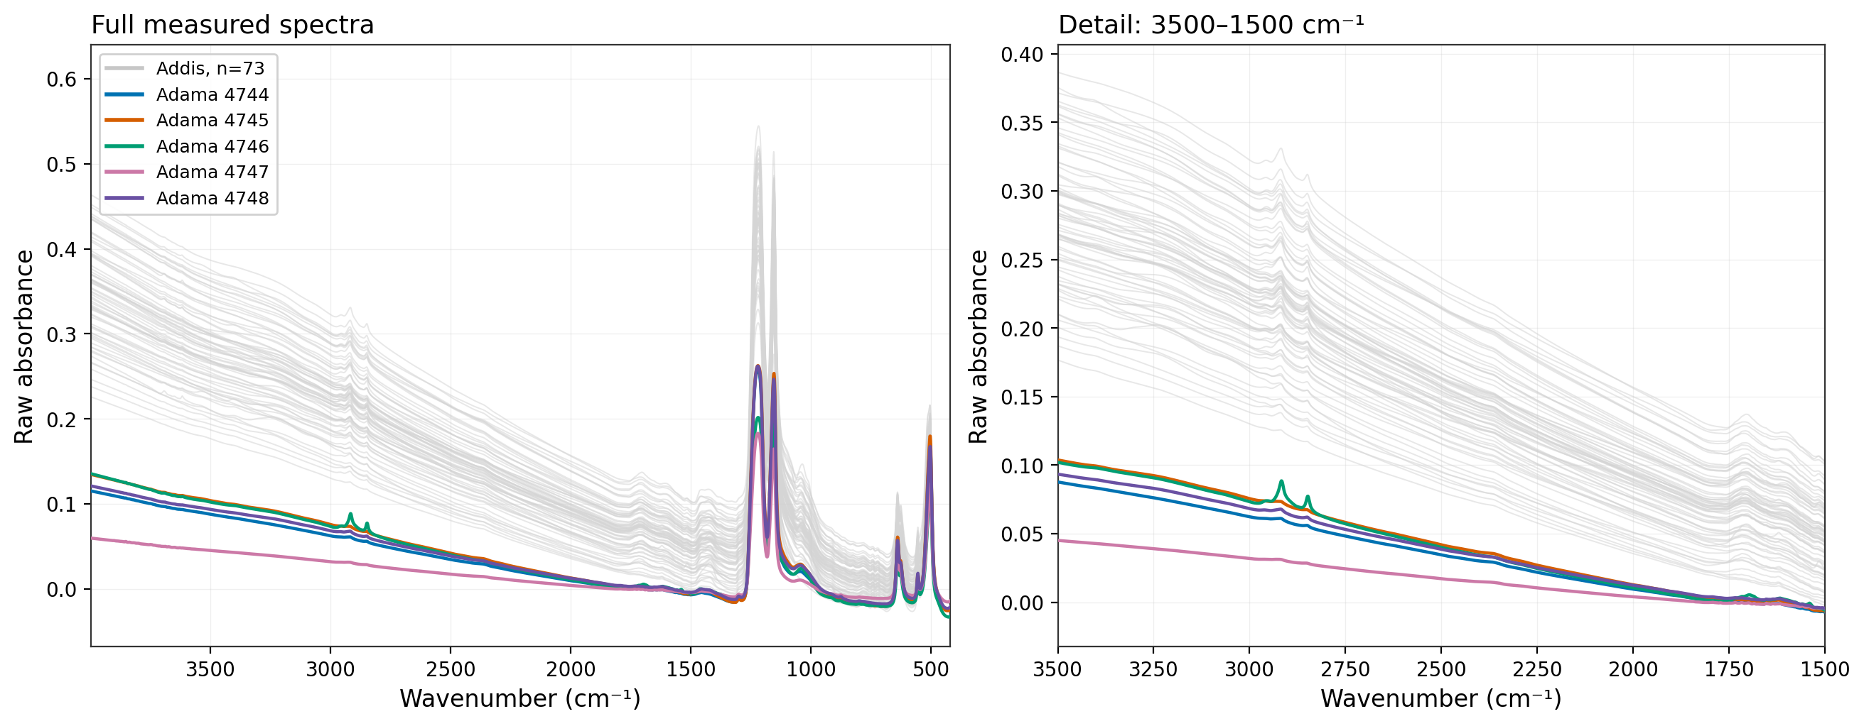
Five Adama spectra over summer Addis
Summer = Kiremt, June–September. Addis in light gray (n = 73), pooled across 2023–2025.
The same five July 2024 Adama spectra and axis limits as the previous slide. Summer selection uses the repo’s canonical calendar.

Slide 14
Two Adama pairs need sampler-log review
Paired samplers use different filters and recorded air volumes. Both flagged pairs remain in every main comparison.
July 2024 | PTFE / quartz | PTFE m³ | Quartz m³ | Volume ratio | Offset min | Review note
9 | J1269 / J1693 | 2.879 | 2.621 | 1.098 | +39.73 | Start time
20 | J1266 / J1701 | 2.880 | 2.606 | 1.105 | -0.08 | No flag
23 | J1285 / J1675 | 2.882 | 2.585 | 1.115 | -0.25 | No flag
26 | J1233 / J1703 | 2.881 | 2.583 | 1.116 | +0.15 | No flag
30 | J1270 / J1679 | 1.161 | 2.547 | 0.456 | -0.25 | Air volume
Volume ratio = PTFE / quartz. Start offset = quartz start minus PTFE start. Flags follow the existing >5 min and >20% rules.

Slide 15
Sampling priorities from the meeting
The five Adama dates inform the campaign design. They do not resolve the Addis discrepancy.
Quartz in Addis
Prioritize paired quartz and PTFE at Addis. If the SPARTAN location is infeasible, assess the existing southern Addis site and document the site differences.
Paired Delhi filters
Follow up on the quartz/PTFE material discussed with Ann. Use a known thermal reference to test whether the Addis spectral pattern appears elsewhere.
Regional PM context
Check MAIA daily BAM data for Adama, Bishoftu and Addis. Use comparable PurpleAir records if needed, with matched dates and clear method labels.
Sampler metadata
Resolve the two Adama pairing flags and obtain the Addis filter sampling protocol. Confirm the Adama spectrum-to-FilterId crosswalk with the lab.
PM context and sampler-log review remain open. Collection scope, duration and costs need agreement with the sampling team.

