Slide 1
Addis FTIR calibration
Weekly update
Spectral exclusions, seasonal analogs
and the next validation design
Ahmad Jalil
10 September 2026
Notes:
Talk track
I followed up on the spectral exclusions and reran the seasonal and PMF analog selections. The main result is that the seasons choose different IMPROVE filters, but the new seasonal calibrations still have weak TOR validation. I’ll show the spectral changes, what happens to the regressions, and the proposed Addis split for the next evaluation.
If asked
All new Addis readouts use already explored target data. They are exploratory. The three spectral comparisons at the end are backup slides. The analysis uses the September 3 task list.
Sources
/Users/ahmadjalil/github/aethmodular/research/ftir_hips_chem/output/tables/ann_weekly_20260910/calibration_fits.csv

Slide 2
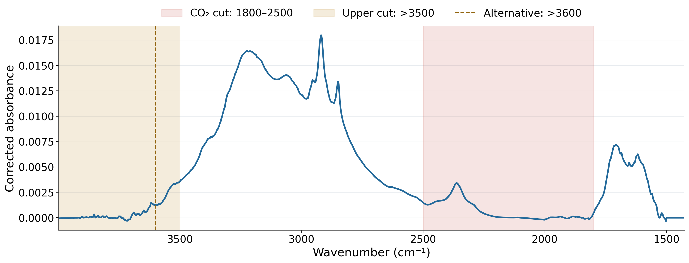
Spectral regions for analog selection
Median of all 239 Addis filters
Masks change analog selection. PLS uses the full spectrum.
2
Notes:
Talk track
This is the median baseline-corrected spectrum for all 239 Addis filters. The red section marks the CO₂ region removed from matching, from 1800 to 2500 inverse centimetres. The gold section shows the upper end where I tested cutoffs at 3500 and 3600. I applied these masks when selecting analogs. Every PLS calibration still uses the same full spectral grid, so we can isolate the effect of changing the selected filters.
If asked
Primary selection uses signed Pearson correlation to the target group’s median corrected spectrum, retaining 500 unique TOR-eligible IMPROVE filters. The gold shading starts at 3500 and encompasses both upper-cut tests. Seven masks include an 1850 lower-bound sensitivity. The full available grid has 2002 channels, about 1426–3998 cm⁻¹. Raw-spectrum selection remains closed. Mean-across-target correlation is a separate sensitivity.
Sources
/Users/ahmadjalil/github/aethmodular/research/ftir_hips_chem/output/tables/ann_weekly_20260910/mask_channels.csv
/Users/ahmadjalil/github/aethmodular/research/ftir_hips_chem/output/tables/ann_weekly_20260910/library_eligibility.csv
/Users/ahmadjalil/github/aethmodular/research/ftir_hips_chem/output/tables/ann_weekly_20260910/addis_evaluation.csv
Figure format: PNG exported from the Jupyter notebook, as requested; regenerate in the notebook to edit the graph.
/Users/ahmadjalil/github/aethmodular/research/ftir_hips_chem/notebooks/archive/executed/ann_weekly_20260910_figures.ipynb
/Users/ahmadjalil/github/aethmodular/research/ftir_hips_chem/output/plots/ann_weekly_20260910_notebook/slide_02.png

Slide 3
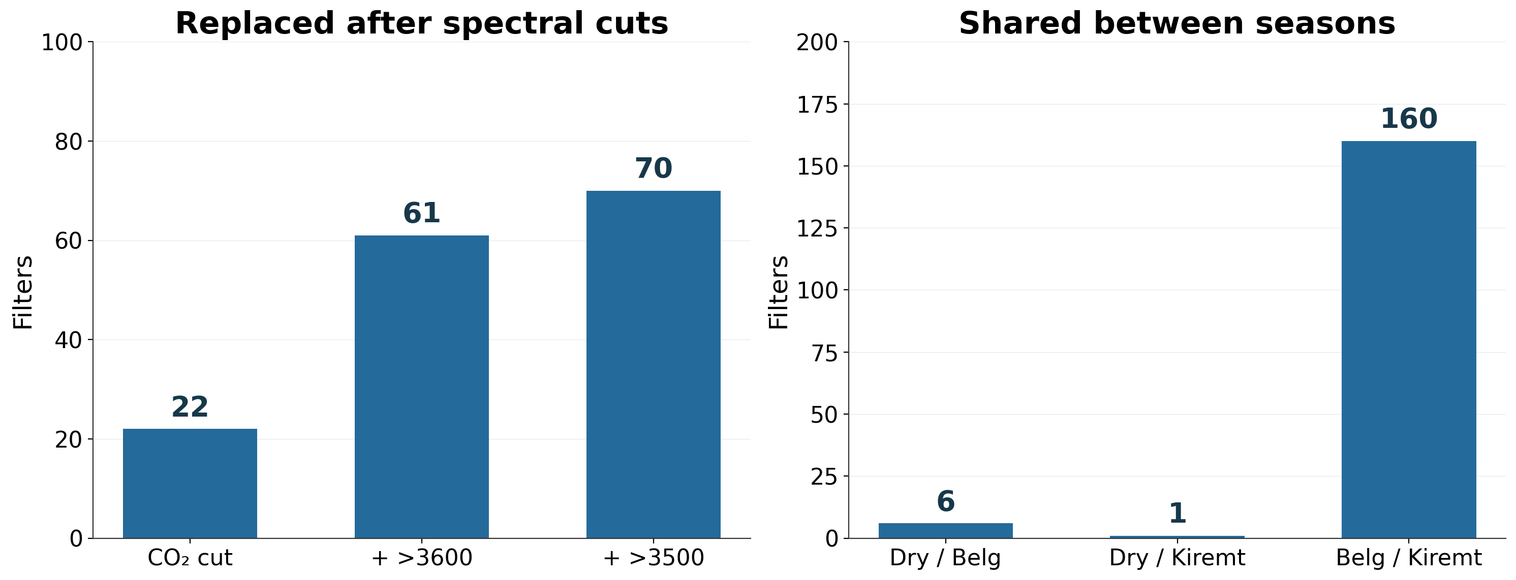
The masks and seasons select different filters
500 filters per cohort. Seasonal overlap uses the CO₂ exclusion.
3
Notes:
Talk track
On the left, the CO₂ cut replaces 22 of the pooled selection’s 500 filters. Adding the upper cut replaces 61 or 70 relative to the full-spectrum selection. On the right, the Dry selection shares only six filters with Belg and one with Kiremt. Belg and Kiremt share 160. So the seasonal spectral differences translate into quite different calibration cohorts, especially for Dry. The next question is whether those separate cohorts predict well.
If asked
Jaccard overlap is 0.6% for Dry/Belg, 0.1% for Dry/Kiremt and 19.0% for Belg/Kiremt. Jaccard uses intersection/union, unlike the shared count out of 500 shown here. The 1800 versus 1850 lower boundary changes five pooled CO₂-only analogs. All counts deduplicate physical IMPROVE filters. These are membership changes, not a causal chemical attribution.
Sources
/Users/ahmadjalil/github/aethmodular/research/ftir_hips_chem/output/tables/ann_weekly_20260910/mask_membership_changes.csv
/Users/ahmadjalil/github/aethmodular/research/ftir_hips_chem/output/tables/ann_weekly_20260910/seasonal_overlap.csv
Figure format: PNG exported from the Jupyter notebook, as requested; regenerate in the notebook to edit the graph.
/Users/ahmadjalil/github/aethmodular/research/ftir_hips_chem/notebooks/archive/executed/ann_weekly_20260910_figures.ipynb
/Users/ahmadjalil/github/aethmodular/research/ftir_hips_chem/output/plots/ann_weekly_20260910_notebook/slide_03.png

Slide 4
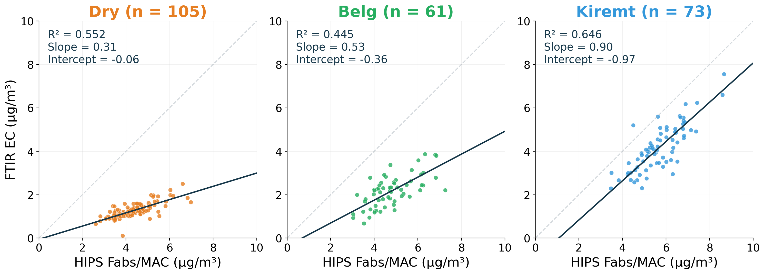
Dry’s near-zero intercept hides a shallow slope
Dark line: Deming fit. Grey line: 1:1. All Addis comparisons are exploratory.
4
Notes:
Talk track
Each panel uses a calibration selected for that season and shows all of its Addis filters. The grey diagonal is one-to-one agreement and the dark line is the Deming fit. Dry has an intercept near zero, but the slope is only about 0.31. Its predictions change far less than the HIPS comparison. Belg is also shallow. Kiremt gets closer to a slope of one, but its intercept remains negative. Looking at the intercept alone would miss these differences.
If asked
Dry (Oct-Feb): R²=0.552; Deming slope 0.305 [0.245, 0.355]; intercept -0.059 [-0.256, 0.182] µg/m³; k=7.
Belg (Mar-May): R²=0.445; Deming slope 0.528 [0.323, 0.745]; intercept -0.364 [-1.403, 0.680] µg/m³; k=17.
Kiremt (Jun-Sep): R²=0.646; Deming slope 0.904 [0.808, 1.091]; intercept -0.973 [-2.243, -0.371] µg/m³; k=18.
Axes share the 0–10 scale. MAC=10 m²/g. The target-side comparison is HIPS Fabs/MAC versus predicted FTIR EC, in µg/m³. February belongs to Dry. The same Addis spectra defined the analog selection, so these panels are exploratory. Intervals are 95% month-block bootstrap intervals at fixed λ=3.33538.
Sources
/Users/ahmadjalil/github/aethmodular/research/ftir_hips_chem/output/tables/ann_weekly_20260910/predictions.csv
/Users/ahmadjalil/github/aethmodular/research/ftir_hips_chem/output/tables/ann_weekly_20260910/regression_metrics.csv
Figure format: PNG exported from the Jupyter notebook, as requested; regenerate in the notebook to edit the graph.
/Users/ahmadjalil/github/aethmodular/research/ftir_hips_chem/notebooks/archive/executed/ann_weekly_20260910_figures.ipynb
/Users/ahmadjalil/github/aethmodular/research/ftir_hips_chem/output/plots/ann_weekly_20260910_notebook/slide_04.png

Slide 5
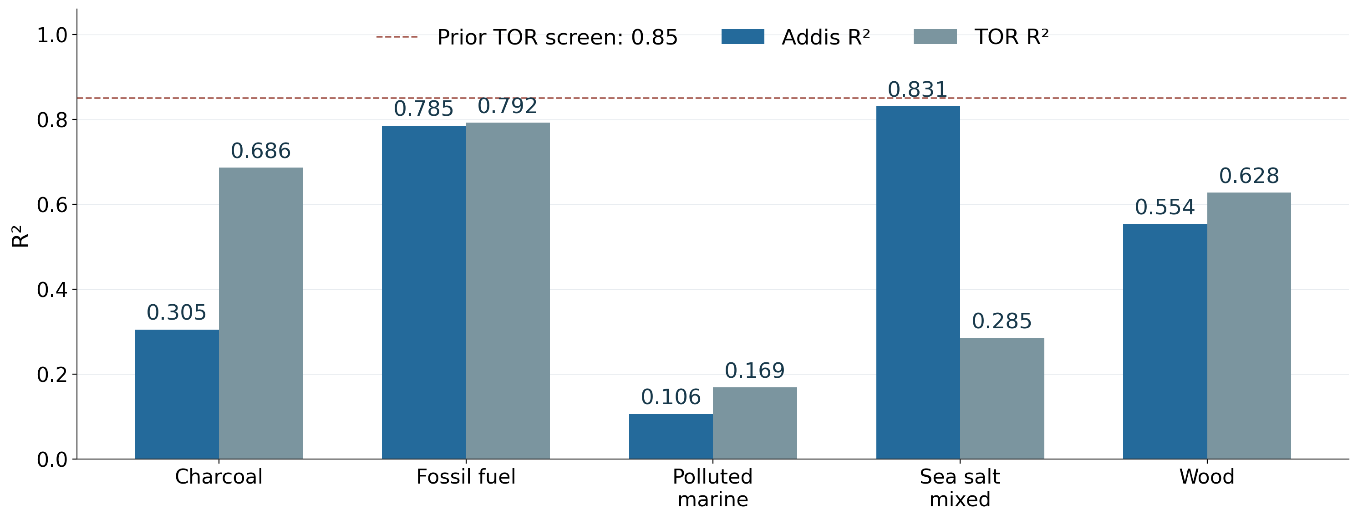
PMF correlation can hide weak TOR prediction
102 Addis filters with a PMF match
All five TOR R² values remain below the prior 0.85 screen.
5
Notes:
Talk track
Here I split Addis by its dominant PMF source and selected a calibration for each group. Blue shows correlation on the Addis comparison, and grey shows correlation with TOR on held-out IMPROVE sites. Sea Salt is the clearest warning: the Addis R² is 0.831 while TOR R² is only 0.285, and its TOR prediction Q² is negative. All five source calibrations fall below the previous TOR screen. These results don’t support adopting a PMF-specific calibration yet.
If asked
GF fractions are normalized by the canonical ETAD helper before dominant-source assignment. There are 137 unmatched Addis filters. Dominant source does not mean pure-source aerosol. TOR cohorts differ. R² is squared correlation; predictive Q² is distinct. Sea Salt TOR Q²=-0.893.
Charcoal: n=22; Deming slope=0.758; intercept=-0.696 µg/m³; Addis R²=0.305; TOR R²=0.686.
Fossil Fuel Combustion: n=25; Deming slope=0.640; intercept=-1.110 µg/m³; Addis R²=0.785; TOR R²=0.792.
Polluted Marine: n=23; Deming slope=0.063; intercept=0.249 µg/m³; Addis R²=0.106; TOR R²=0.169.
Sea Salt Mixed: n=21; Deming slope=0.811; intercept=-2.242 µg/m³; Addis R²=0.831; TOR R²=0.285.
Wood Burning: n=11; Deming slope=0.553; intercept=0.091 µg/m³; Addis R²=0.554; TOR R²=0.628.
Sources
/Users/ahmadjalil/github/aethmodular/research/ftir_hips_chem/output/tables/ann_weekly_20260910/regression_metrics.csv
/Users/ahmadjalil/github/aethmodular/research/ftir_hips_chem/output/tables/ann_weekly_20260910/pmf_overlap.csv
Figure format: PNG exported from the Jupyter notebook, as requested; regenerate in the notebook to edit the graph.
/Users/ahmadjalil/github/aethmodular/research/ftir_hips_chem/notebooks/archive/executed/ann_weekly_20260910_figures.ipynb
/Users/ahmadjalil/github/aethmodular/research/ftir_hips_chem/output/plots/ann_weekly_20260910_notebook/slide_05.png

Slide 6
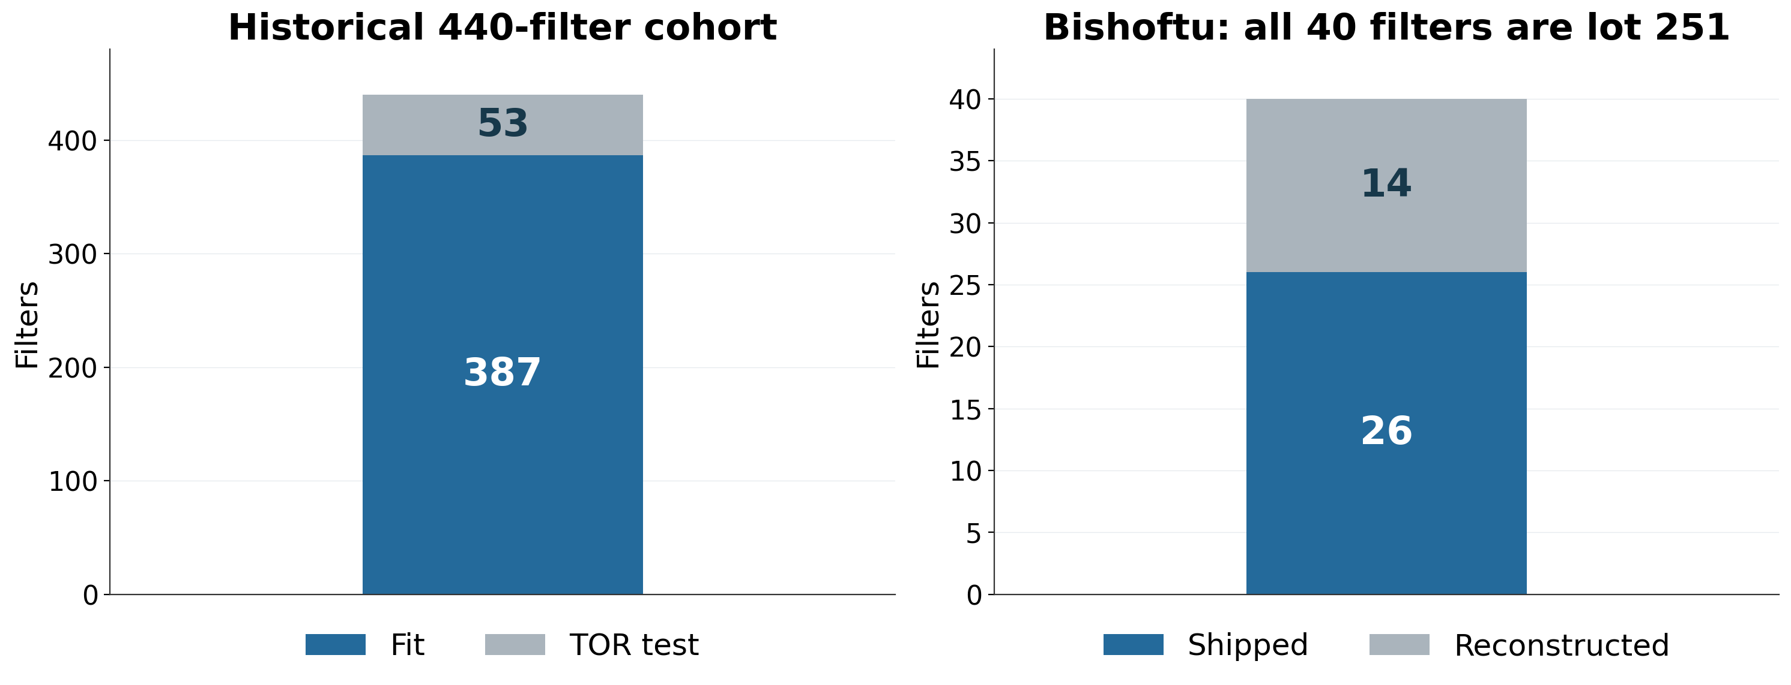
Training membership and Bishoftu lot
All 10 meeting-figure analogs fall outside the historical cohort.
6
Notes:
Talk track
I checked the actual historical calibration membership. Of its 440 filters, 387 entered the fit and 53 formed the TOR site test. All ten nearest analogs shown in the original Addis and Bishoftu figure were outside that entire cohort. I also checked the Bishoftu lot directly against raw HIPS metadata. All 40 filters are lot 251. Their HIPS values include 26 shipped values and 14 provisional reconstructions.
If asked
The historical model uses the lowest OC/EC 440-filter cohort, AIRSpec correction and k=8, with site-grouped CV and the original site split seed 20260717. The 15 earlier seasonal top-five analogs were audited separately and are also outside the cohort. Raw ExternalLotId independently confirms all 40 Bishoftu lot IDs. Lot confirmation does not make the 14 reconstructed Fabs values an official release.
Sources
/Users/ahmadjalil/github/aethmodular/research/ftir_hips_chem/output/tables/ann_weekly_20260910/historical_addis_winner_membership.csv
/Users/ahmadjalil/github/aethmodular/research/ftir_hips_chem/output/tables/ann_weekly_20260910/meeting_figure_top5_membership.csv
/Users/ahmadjalil/github/aethmodular/research/ftir_hips_chem/output/tables/ann_weekly_20260910/bishoftu_primary_lot_check.csv
Figure format: PNG exported from the Jupyter notebook, as requested; regenerate in the notebook to edit the graph.
/Users/ahmadjalil/github/aethmodular/research/ftir_hips_chem/notebooks/archive/executed/ann_weekly_20260910_figures.ipynb
/Users/ahmadjalil/github/aethmodular/research/ftir_hips_chem/output/plots/ann_weekly_20260910_notebook/slide_06.png

Slide 7
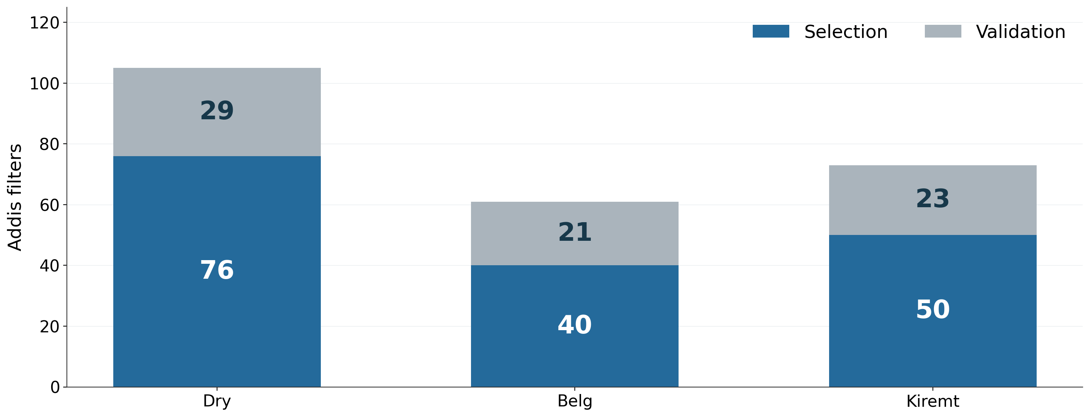
Proposed Addis split: 166 select, 73 validate
Whole-month blocks. Retrospective proposal, not yet scored.
7
Notes:
Talk track
This is the proposed split for the next Addis evaluation. Blue is the selection portion and grey is the validation portion. We would use 166 filters to choose the analog cohorts and reserve 73 for prediction. Whole calendar months stay together within each season. Before scoring, we need to lock the mask, aggregation rule, cohort size and PLS selection procedure. Because these samples have already been explored, this is a retrospective check. New samples would provide stronger confirmation.
If asked
Selection/validation counts: Dry 76/29, Belg 40/21, Kiremt 50/23. Validation blocks are 5, 3 and 4 months respectively. Seed 20260910. No month or physical filter crosses the split. It is stratified by season rather than a future-period forecast. The validation spectra and HIPS values must not choose the calibration. No split-based model has been selected or scored. Leakage reference: https://scikit-learn.org/stable/common_pitfalls.html#data-leakage
Sources
/Users/ahmadjalil/github/aethmodular/research/ftir_hips_chem/output/tables/ann_weekly_20260910/proposed_addis_split.csv
/Users/ahmadjalil/github/aethmodular/research/ftir_hips_chem/output/tables/ann_weekly_20260910/split_counts.csv
Figure format: PNG exported from the Jupyter notebook, as requested; regenerate in the notebook to edit the graph.
/Users/ahmadjalil/github/aethmodular/research/ftir_hips_chem/notebooks/archive/executed/ann_weekly_20260910_figures.ipynb
/Users/ahmadjalil/github/aethmodular/research/ftir_hips_chem/output/plots/ann_weekly_20260910_notebook/slide_07.png

Slide 8
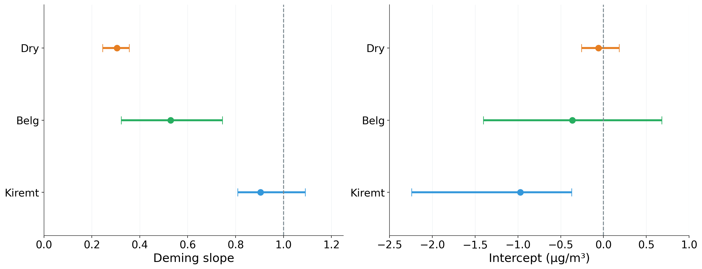
Uncertainty makes the seasonal differences clear
Dots: estimates. Bars: 95% CIs. Fixed calibration, MAC and λ = 3.34.
8
Notes:
Talk track
The dots show the seasonal Deming estimates and the horizontal error bars show their 95% confidence intervals. The left panel compares slopes with the agreement value of one. The right compares intercepts with zero. Dry’s intercept can include zero while its slope is clearly below one. Kiremt shows the opposite pattern: its slope interval includes one, but its intercept stays negative. Covering an agreement value means compatibility with that value. It does not establish practical equivalence.
If asked
The original Deming routine returned point estimates only. The added helper returns standard errors and percentile intervals from 2000 whole-month bootstrap samples. Median HIPS_Uncertainty/MAC gives sigma_x=0.290751 µg/m³. A historical FTIR held-out RMSE proxy of 0.531 gives lambda=3.335383. These conditional intervals omit uncertainty in lambda, MAC and calibration selection/fitting. No multiplicity adjustment or equivalence margin is defined. Bootstrap documentation: https://search.r-project.org/CRAN/refmans/mcr/html/mc.bootstrap.html
Dry (Oct-Feb): R²=0.552; Deming slope 0.305 [0.245, 0.355]; intercept -0.059 [-0.256, 0.182] µg/m³; k=7.
Belg (Mar-May): R²=0.445; Deming slope 0.528 [0.323, 0.745]; intercept -0.364 [-1.403, 0.680] µg/m³; k=17.
Kiremt (Jun-Sep): R²=0.646; Deming slope 0.904 [0.808, 1.091]; intercept -0.973 [-2.243, -0.371] µg/m³; k=18.
Sources
/Users/ahmadjalil/github/aethmodular/research/ftir_hips_chem/output/tables/ann_weekly_20260910/regression_metrics.csv
/Users/ahmadjalil/github/aethmodular/research/ftir_hips_chem/output/tables/ann_weekly_20260910/lambda_sensitivity.csv
Figure format: PNG exported from the Jupyter notebook, as requested; regenerate in the notebook to edit the graph.
/Users/ahmadjalil/github/aethmodular/research/ftir_hips_chem/notebooks/archive/executed/ann_weekly_20260910_figures.ipynb
/Users/ahmadjalil/github/aethmodular/research/ftir_hips_chem/output/plots/ann_weekly_20260910_notebook/slide_08.png

Slide 9
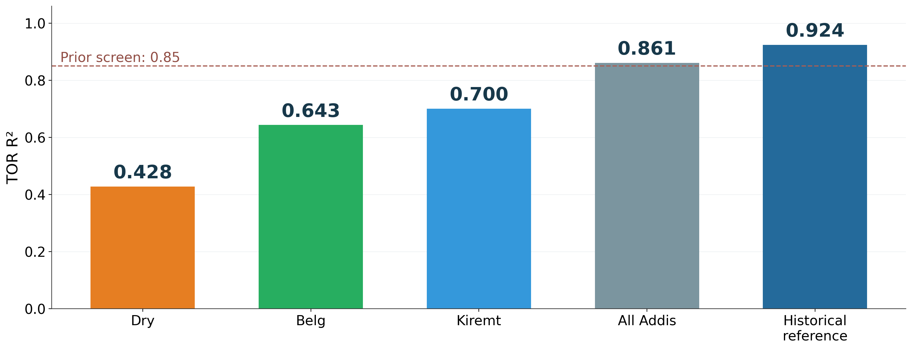
The reference calibration remains the benchmark
Prior TOR R² screen: 0.85. Each cohort uses different test filters.
9
Notes:
Talk track
This brings the calibration results together. The three seasonal TOR R² values range from about 0.43 to 0.70, below the prior 0.85 screen. The pooled CO₂-only selection reaches about 0.86. The historical OC/EC reference remains the benchmark at 0.924 on its own TOR test. These test populations differ, so this is a screening comparison rather than a paired claim of superiority. My proposed next step is to agree on the Addis split and freeze the selection rule before evaluating the reserved predictions.
If asked
The bars use the primary median-spectrum, CO₂-only selection. All new fits reserve source sites and choose components by five-fold site-grouped training CV. The historical fit retains k=8. No new model is promoted. The separate mean-correlation sensitivity also leaves all three seasonal fits below 0.85, at TOR R² 0.446, 0.569 and 0.781. R² is squared correlation, with predictive Q² available in the full fit table.
Sources
/Users/ahmadjalil/github/aethmodular/research/ftir_hips_chem/output/tables/ann_weekly_20260910/calibration_fits.csv
/Users/ahmadjalil/github/aethmodular/research/ftir_hips_chem/output/tables/ann_weekly_20260910/regression_metrics.csv
Figure format: PNG exported from the Jupyter notebook, as requested; regenerate in the notebook to edit the graph.
/Users/ahmadjalil/github/aethmodular/research/ftir_hips_chem/notebooks/archive/executed/ann_weekly_20260910_figures.ipynb
/Users/ahmadjalil/github/aethmodular/research/ftir_hips_chem/output/plots/ann_weekly_20260910_notebook/slide_09.png

Slide 10
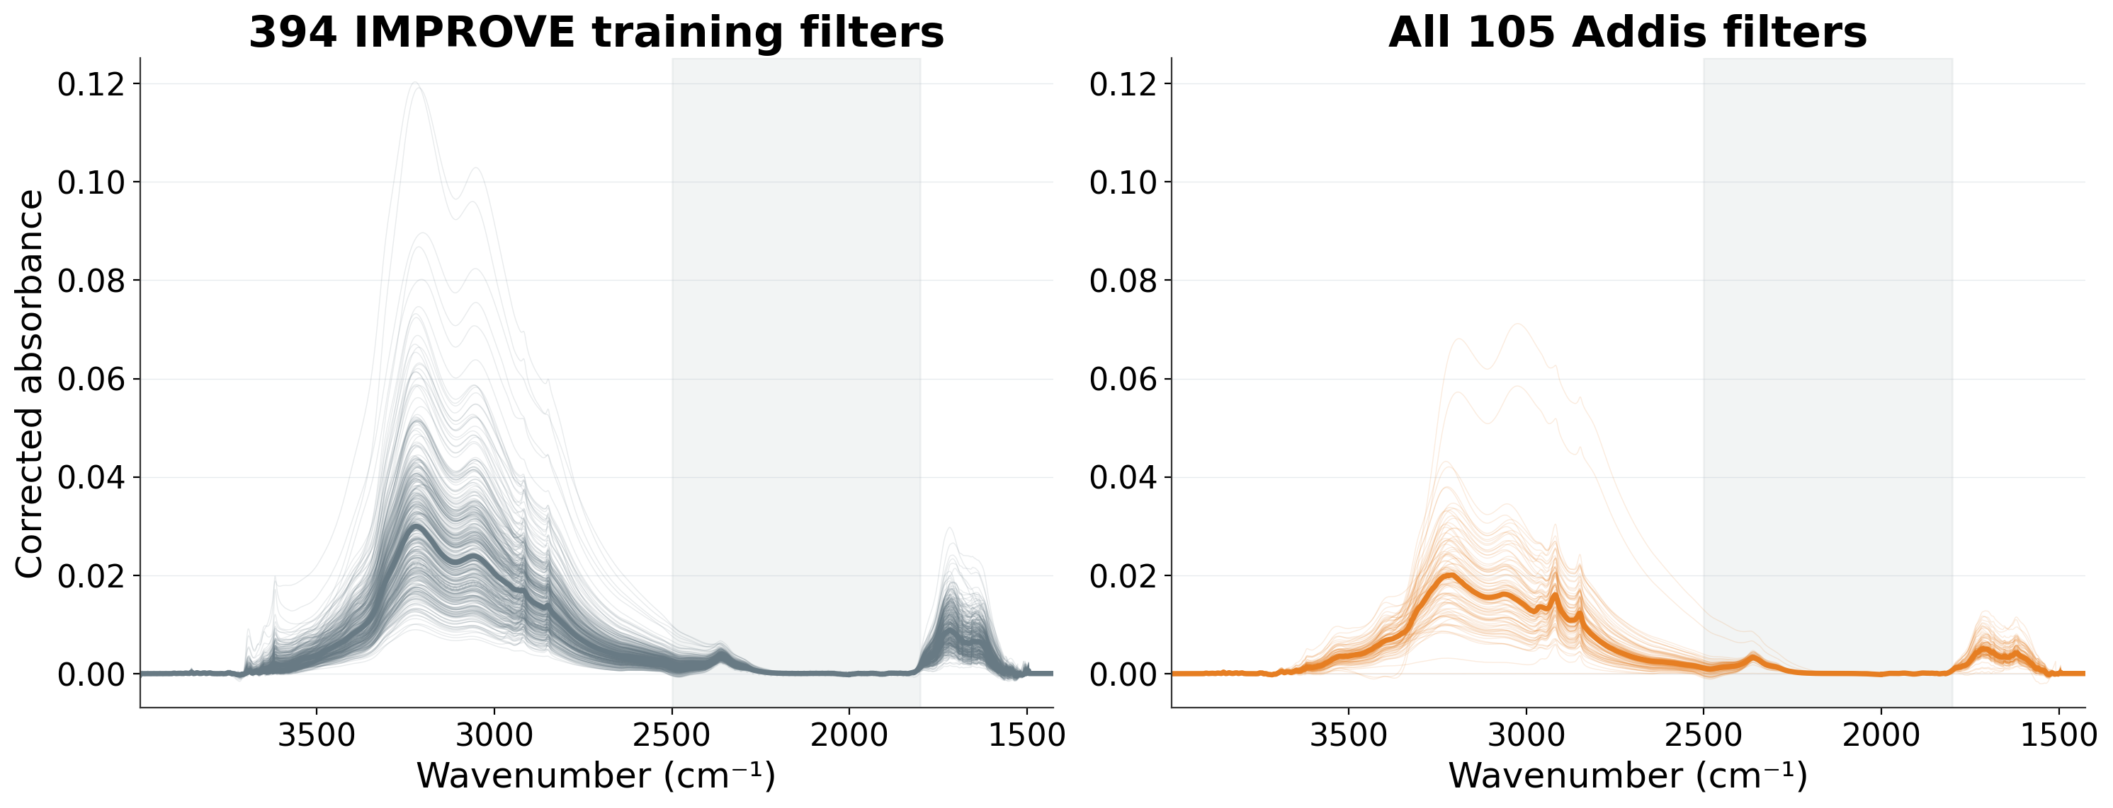
Dry: complete spectral comparison
Thin lines: individual spectra. Thick lines: medians. Shading: excluded from selection.
10
Notes:
Talk track
This backup slide summarizes every spectrum in the Dry comparison. Grey represents the 394 IMPROVE filters that actually entered the fit, and the seasonal colour represents all 105 Addis filters. Thin lines show every individual spectrum, and the thick line in each panel shows the median. This lets us compare the complete training set with the whole season, rather than selecting five examples.
If asked
The full 2002-channel grid appears here. The 500 selected analogs include a separate TOR-test subset, which does not enter these training envelopes. Every individual training and Addis trace is shown on shared axes. These are spectra, not confidence intervals. The matching mask is 1800–2500 cm⁻¹, while the model uses the full grid. No extra normalization or smoothing was applied for these comparisons.
Sources
/Users/ahmadjalil/github/aethmodular/research/ftir_hips_chem/output/tables/ann_weekly_20260910/calibration_fits.csv
/Users/ahmadjalil/github/aethmodular/research/ftir_hips_chem/output/tables/ann_weekly_20260910/summary.json
Figure format: PNG exported from the Jupyter notebook, as requested; regenerate in the notebook to edit the graph.
/Users/ahmadjalil/github/aethmodular/research/ftir_hips_chem/notebooks/archive/executed/ann_weekly_20260910_figures.ipynb
/Users/ahmadjalil/github/aethmodular/research/ftir_hips_chem/output/plots/ann_weekly_20260910_notebook/slide_10.png

Slide 11
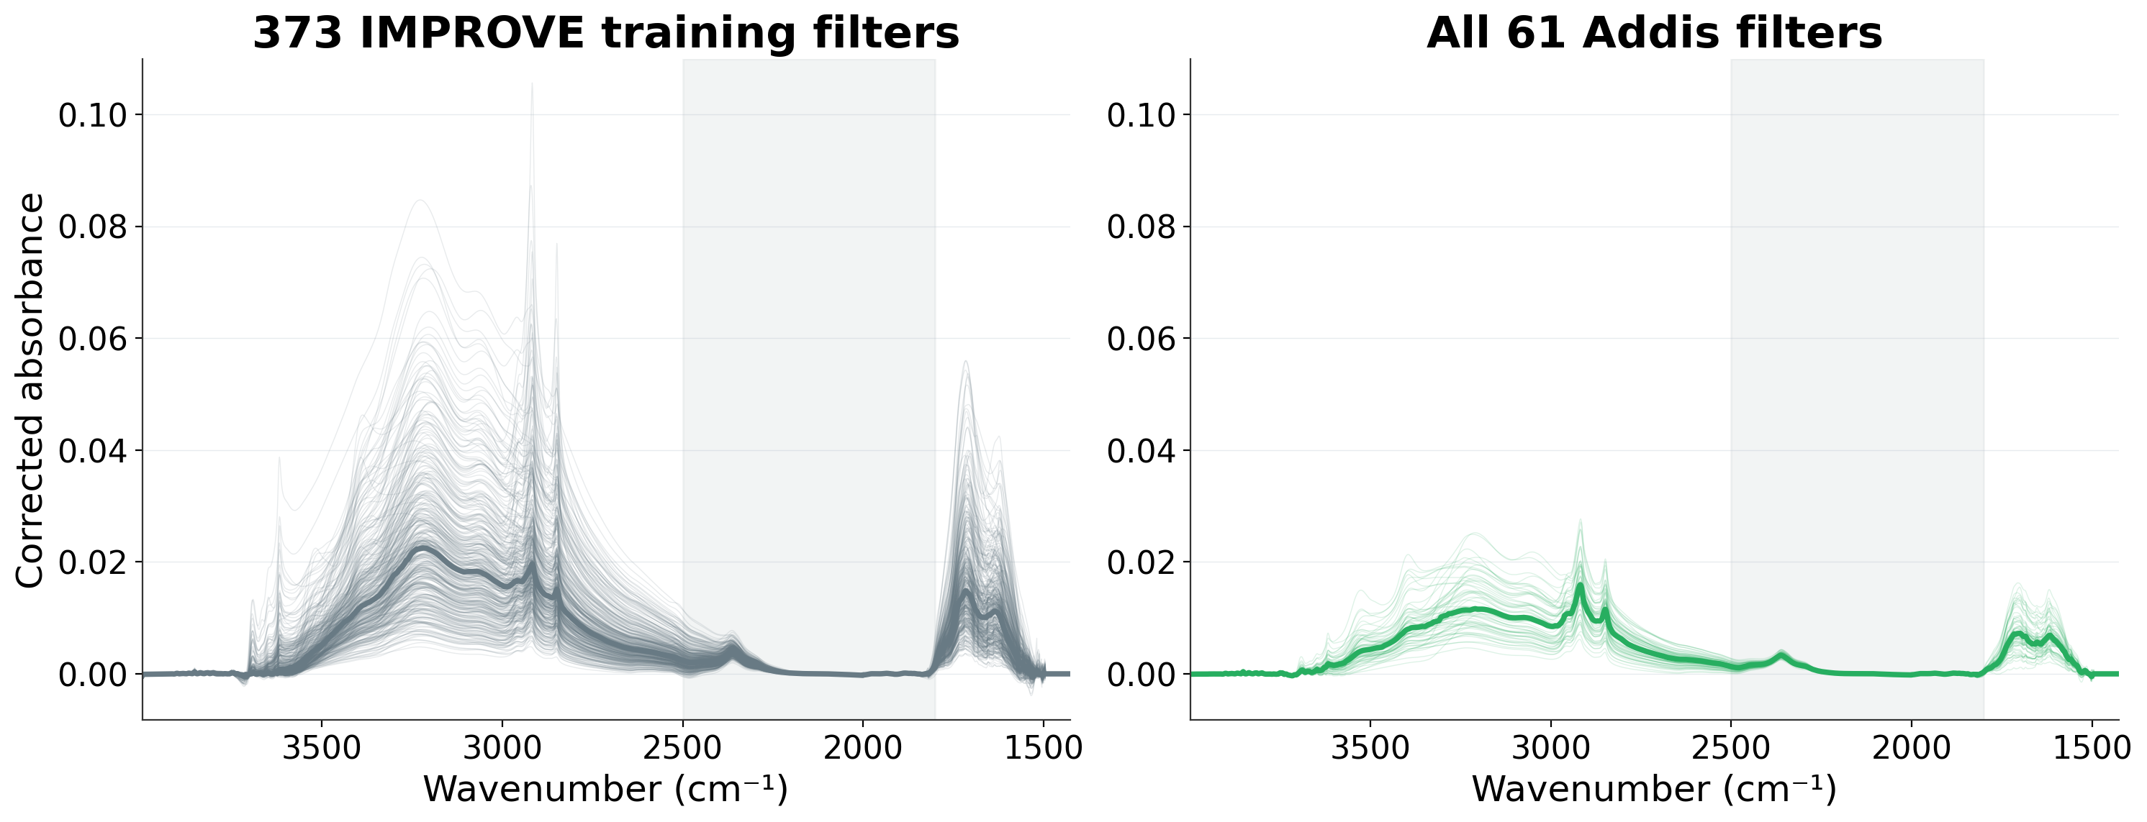
Belg: complete spectral comparison
Thin lines: individual spectra. Thick lines: medians. Shading: excluded from selection.
11
Notes:
Talk track
This backup slide summarizes every spectrum in the Belg comparison. Grey represents the 373 IMPROVE filters that actually entered the fit, and the seasonal colour represents all 61 Addis filters. Thin lines show every individual spectrum, and the thick line in each panel shows the median. This lets us compare the complete training set with the whole season, rather than selecting five examples.
If asked
The full 2002-channel grid appears here. The 500 selected analogs include a separate TOR-test subset, which does not enter these training envelopes. Every individual training and Addis trace is shown on shared axes. These are spectra, not confidence intervals. The matching mask is 1800–2500 cm⁻¹, while the model uses the full grid. No extra normalization or smoothing was applied for these comparisons.
Sources
/Users/ahmadjalil/github/aethmodular/research/ftir_hips_chem/output/tables/ann_weekly_20260910/calibration_fits.csv
/Users/ahmadjalil/github/aethmodular/research/ftir_hips_chem/output/tables/ann_weekly_20260910/summary.json
Figure format: PNG exported from the Jupyter notebook, as requested; regenerate in the notebook to edit the graph.
/Users/ahmadjalil/github/aethmodular/research/ftir_hips_chem/notebooks/archive/executed/ann_weekly_20260910_figures.ipynb
/Users/ahmadjalil/github/aethmodular/research/ftir_hips_chem/output/plots/ann_weekly_20260910_notebook/slide_11.png

Slide 12
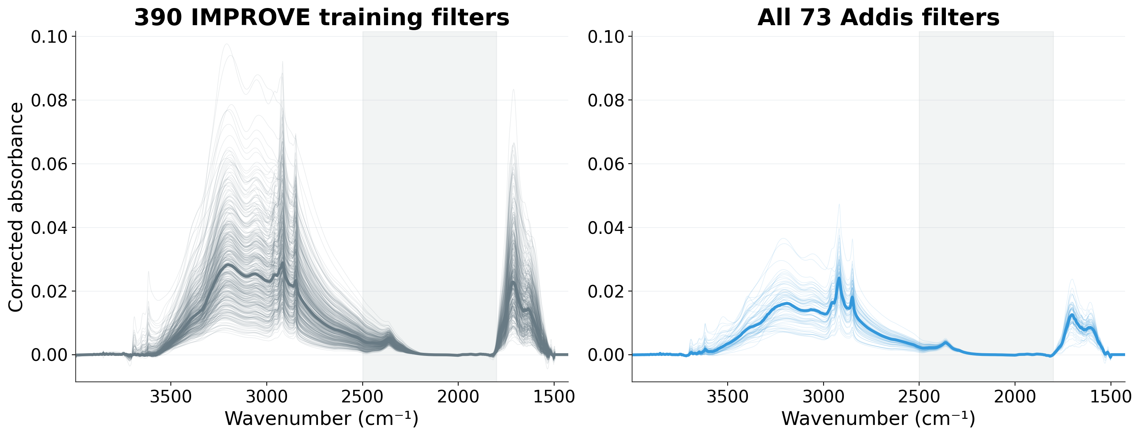
Kiremt: complete spectral comparison
Thin lines: individual spectra. Thick lines: medians. Shading: excluded from selection.
12
Notes:
Talk track
This backup slide summarizes every spectrum in the Kiremt comparison. Grey represents the 390 IMPROVE filters that actually entered the fit, and the seasonal colour represents all 73 Addis filters. Thin lines show every individual spectrum, and the thick line in each panel shows the median. This lets us compare the complete training set with the whole season, rather than selecting five examples.
If asked
The full 2002-channel grid appears here. The 500 selected analogs include a separate TOR-test subset, which does not enter these training envelopes. Every individual training and Addis trace is shown on shared axes. These are spectra, not confidence intervals. The matching mask is 1800–2500 cm⁻¹, while the model uses the full grid. No extra normalization or smoothing was applied for these comparisons.
Sources
/Users/ahmadjalil/github/aethmodular/research/ftir_hips_chem/output/tables/ann_weekly_20260910/calibration_fits.csv
/Users/ahmadjalil/github/aethmodular/research/ftir_hips_chem/output/tables/ann_weekly_20260910/summary.json
Figure format: PNG exported from the Jupyter notebook, as requested; regenerate in the notebook to edit the graph.
/Users/ahmadjalil/github/aethmodular/research/ftir_hips_chem/notebooks/archive/executed/ann_weekly_20260910_figures.ipynb
/Users/ahmadjalil/github/aethmodular/research/ftir_hips_chem/output/plots/ann_weekly_20260910_notebook/slide_12.png

Slide 13
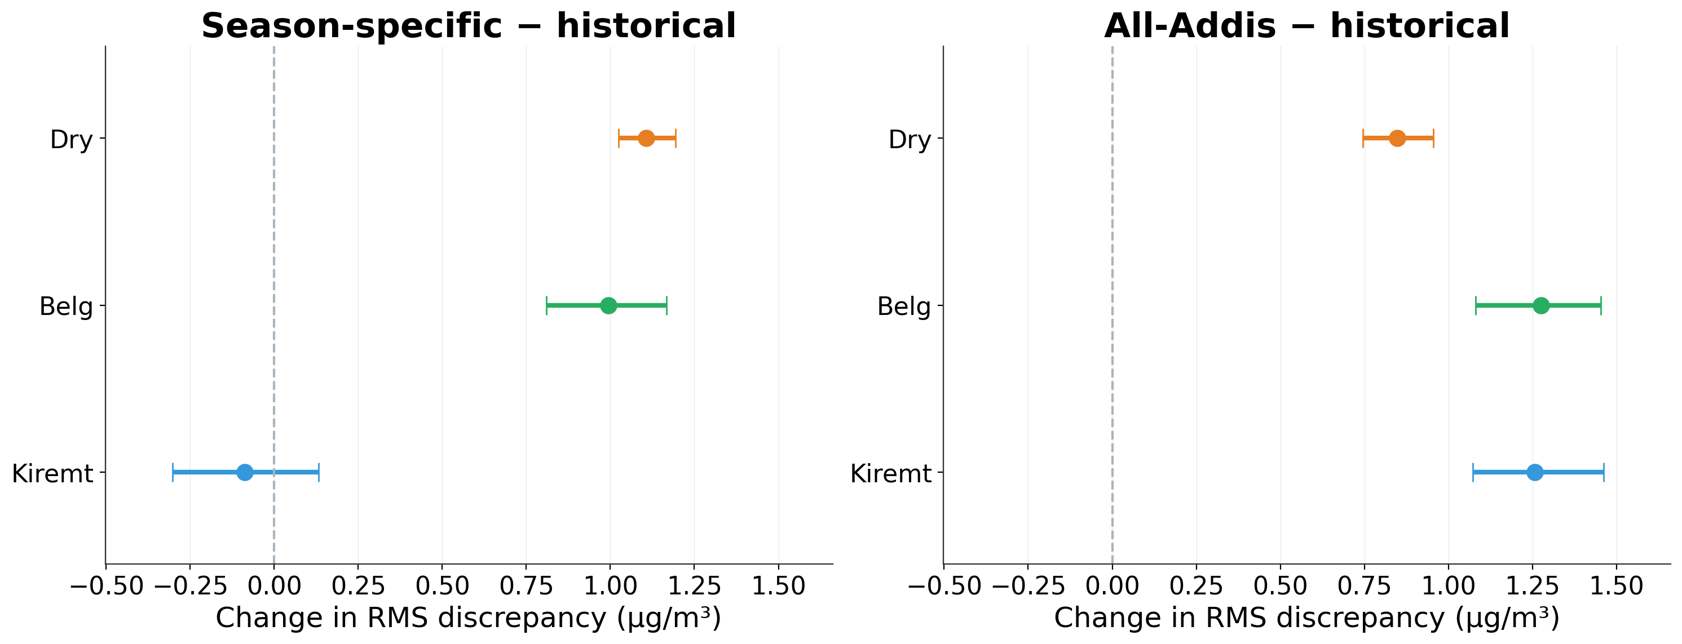
Dry and Belg increase disagreement with HIPS
Positive = greater disagreement. Same filters; 95% month-bootstrap intervals.
13
Notes:
Talk track
I compared the models on exactly the same Addis filters, with the historical calibration as the reference. The Dry and Belg seasonal models increase RMS disagreement with HIPS by about 1.11 and 1.00 micrograms per cubic metre. Kiremt improves by only 0.09, and its interval includes no improvement. The pooled analog model increases disagreement in all three seasons. This gives a more direct comparison than ranking models by correlation alone.
If asked
HIPS Fabs/MAC is a proxy, not chemical EC truth. Differences are candidate minus historical RMS discrepancy. Four thousand whole-calendar-month bootstrap draws keep all models and HIPS paired. Predictions, model choices and MAC remain fixed; intervals exclude fitting/selection uncertainty and ignore dependence between months. Existing Addis data remain exploratory.
Dry (Oct-Feb), Season-specific: RMS 2.038 → 3.145; change +1.107 [+1.024, +1.194] µg/m³.
Dry (Oct-Feb), All-Addis: RMS 2.038 → 2.887; change +0.848 [+0.746, +0.954] µg/m³.
Belg (Mar-May), Season-specific: RMS 1.729 → 2.724; change +0.995 [+0.809, +1.167] µg/m³.
Belg (Mar-May), All-Addis: RMS 1.729 → 3.005; change +1.276 [+1.081, +1.454] µg/m³.
Kiremt (Jun-Sep), Season-specific: RMS 1.745 → 1.657; change -0.088 [-0.302, +0.132] µg/m³.
Kiremt (Jun-Sep), All-Addis: RMS 1.745 → 3.001; change +1.256 [+1.072, +1.462] µg/m³.
Sources
/Users/ahmadjalil/github/aethmodular/research/ftir_hips_chem/output/tables/ann_weekly_20260910_diagnostics/paired_model_comparison.csv
/Users/ahmadjalil/github/aethmodular/research/ftir_hips_chem/output/tables/ann_weekly_20260910_diagnostics/paired_addis_predictions.csv
/Users/ahmadjalil/github/aethmodular/research/ftir_hips_chem/notebooks/archive/executed/ann_weekly_20260910_diagnostics.ipynb
/Users/ahmadjalil/github/aethmodular/research/ftir_hips_chem/output/plots/ann_weekly_20260910_diagnostics/slide_13.png
https://docs.scipy.org/doc/scipy/reference/generated/scipy.stats.bootstrap.html
Figure format: PNG exported from Jupyter, as requested.

Slide 14
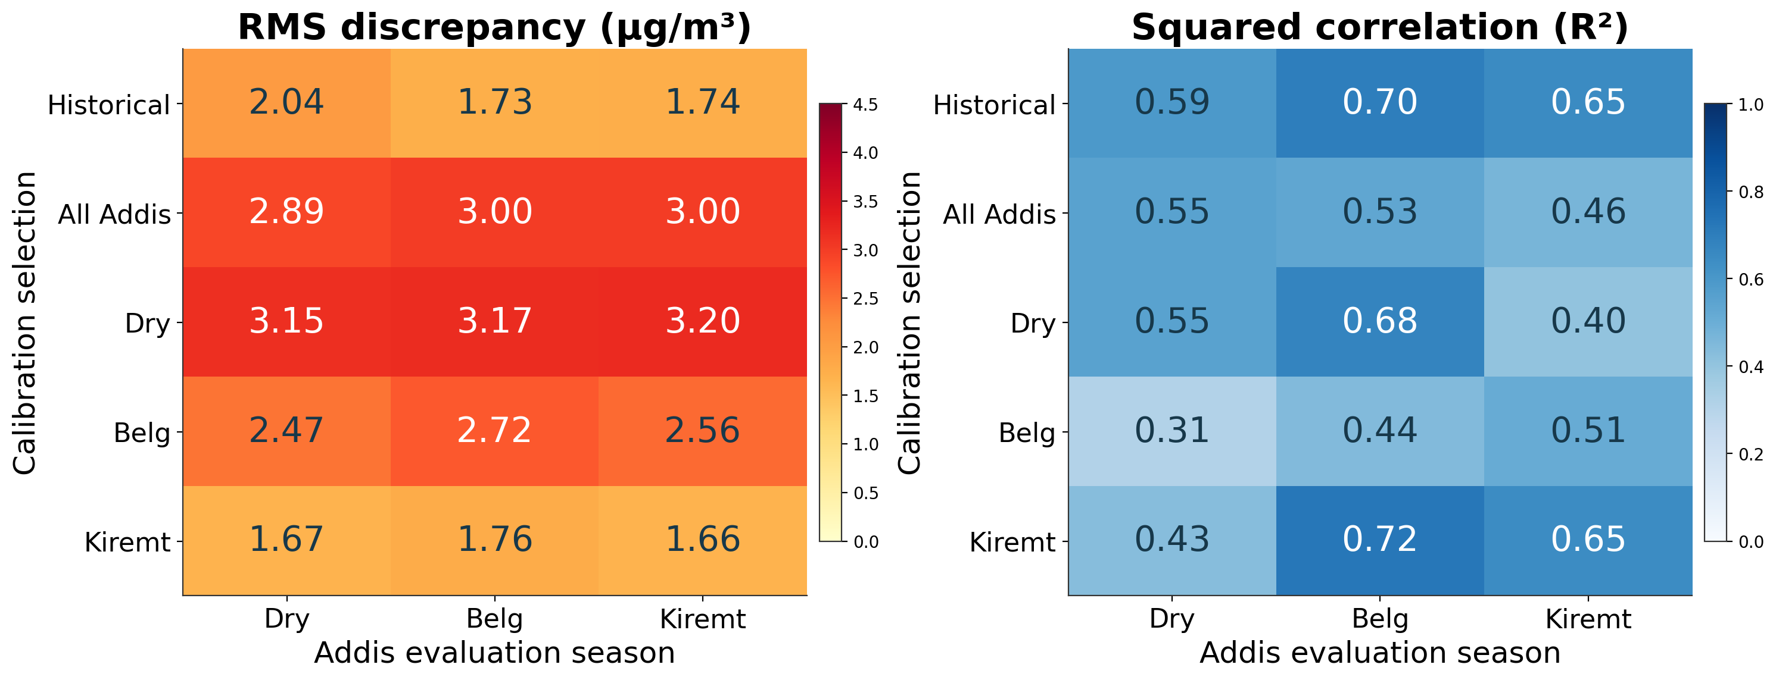
Seasonal matching does not guarantee agreement
Each column uses identical Addis filters. HIPS Fabs/MAC is the comparison proxy.
14
Notes:
Talk track
Each column holds the Addis evaluation filters constant; each row changes the calibration. The left heatmap shows RMS disagreement and the right shows correlation. The Dry-selected calibration has large disagreement in every season. The Kiremt calibration gives the smallest RMS discrepancy in Dry and Kiremt, while the historical calibration is slightly lower in Belg. This is a useful clue about transfer, but it does not make the Kiremt calibration acceptable: its source-site TOR screening was weak.
If asked
All five models were already fitted before this diagnostic. The seasonal selection masks exclude 1800–2500 cm⁻¹; PLS uses the full grid. R² means squared Pearson correlation. This heatmap provides no paired uncertainty for the cross-season Kiremt-versus-historical comparison on Dry, so the apparent ranking is descriptive. No model is selected or promoted based on this display. Fixed HIPS MAC, previously explored target data, differing source cohorts and their weak TOR validation limit inference.
Sources
/Users/ahmadjalil/github/aethmodular/research/ftir_hips_chem/output/tables/ann_weekly_20260910_diagnostics/cross_season_transfer.csv
/Users/ahmadjalil/github/aethmodular/research/ftir_hips_chem/output/tables/ann_weekly_20260910_diagnostics/paired_addis_predictions.csv
/Users/ahmadjalil/github/aethmodular/research/ftir_hips_chem/notebooks/archive/executed/ann_weekly_20260910_diagnostics.ipynb
/Users/ahmadjalil/github/aethmodular/research/ftir_hips_chem/output/plots/ann_weekly_20260910_diagnostics/slide_14.png
Figure format: PNG exported from Jupyter, as requested.

Slide 15
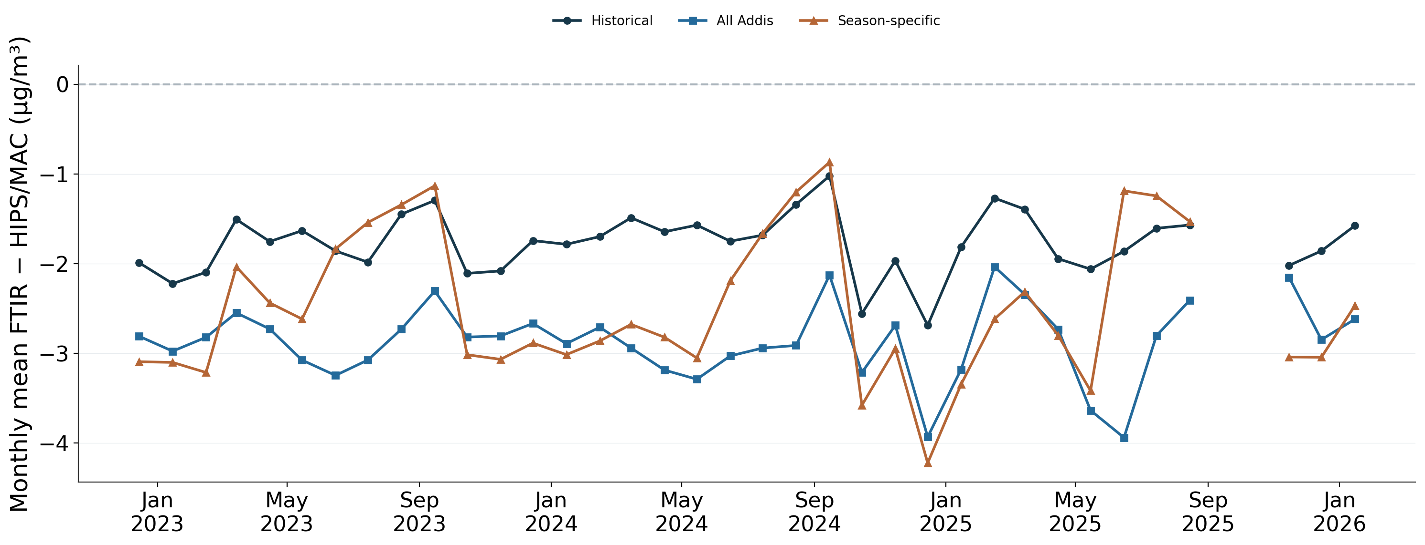
Monthly differences remain below zero
Monthly means; sample counts vary. Seasonal line switches calibration by season.
15
Notes:
Talk track
The monthly plot shows where the disagreement occurs in time. All three calibration approaches remain below the HIPS proxy in every observed monthly mean. The historical calibration is generally closer, while the seasonal approach changes sharply as its calibration switches between seasons. These jumps could arise from the modelling rule as well as changes in the aerosol, so this plot does not establish a physical cause.
If asked
There are 36 observed calendar months, with 1–11 filters per month. Means are calculated over the available filters; months with one filter are retained and do not have a meaningful within-month correlation. Missing calendar months break the lines. Month counts and per-model RMS, MAE, bias and R² are retained in the table. This is not a uniformly sampled monthly climatology. No meteorological adjustment is applied.
Sources
/Users/ahmadjalil/github/aethmodular/research/ftir_hips_chem/output/tables/ann_weekly_20260910_diagnostics/monthly_discrepancy.csv
/Users/ahmadjalil/github/aethmodular/research/ftir_hips_chem/output/tables/ann_weekly_20260910_diagnostics/paired_addis_predictions.csv
/Users/ahmadjalil/github/aethmodular/research/ftir_hips_chem/notebooks/archive/executed/ann_weekly_20260910_diagnostics.ipynb
/Users/ahmadjalil/github/aethmodular/research/ftir_hips_chem/output/plots/ann_weekly_20260910_diagnostics/slide_15.png
Figure format: PNG exported from Jupyter, as requested.

Slide 16
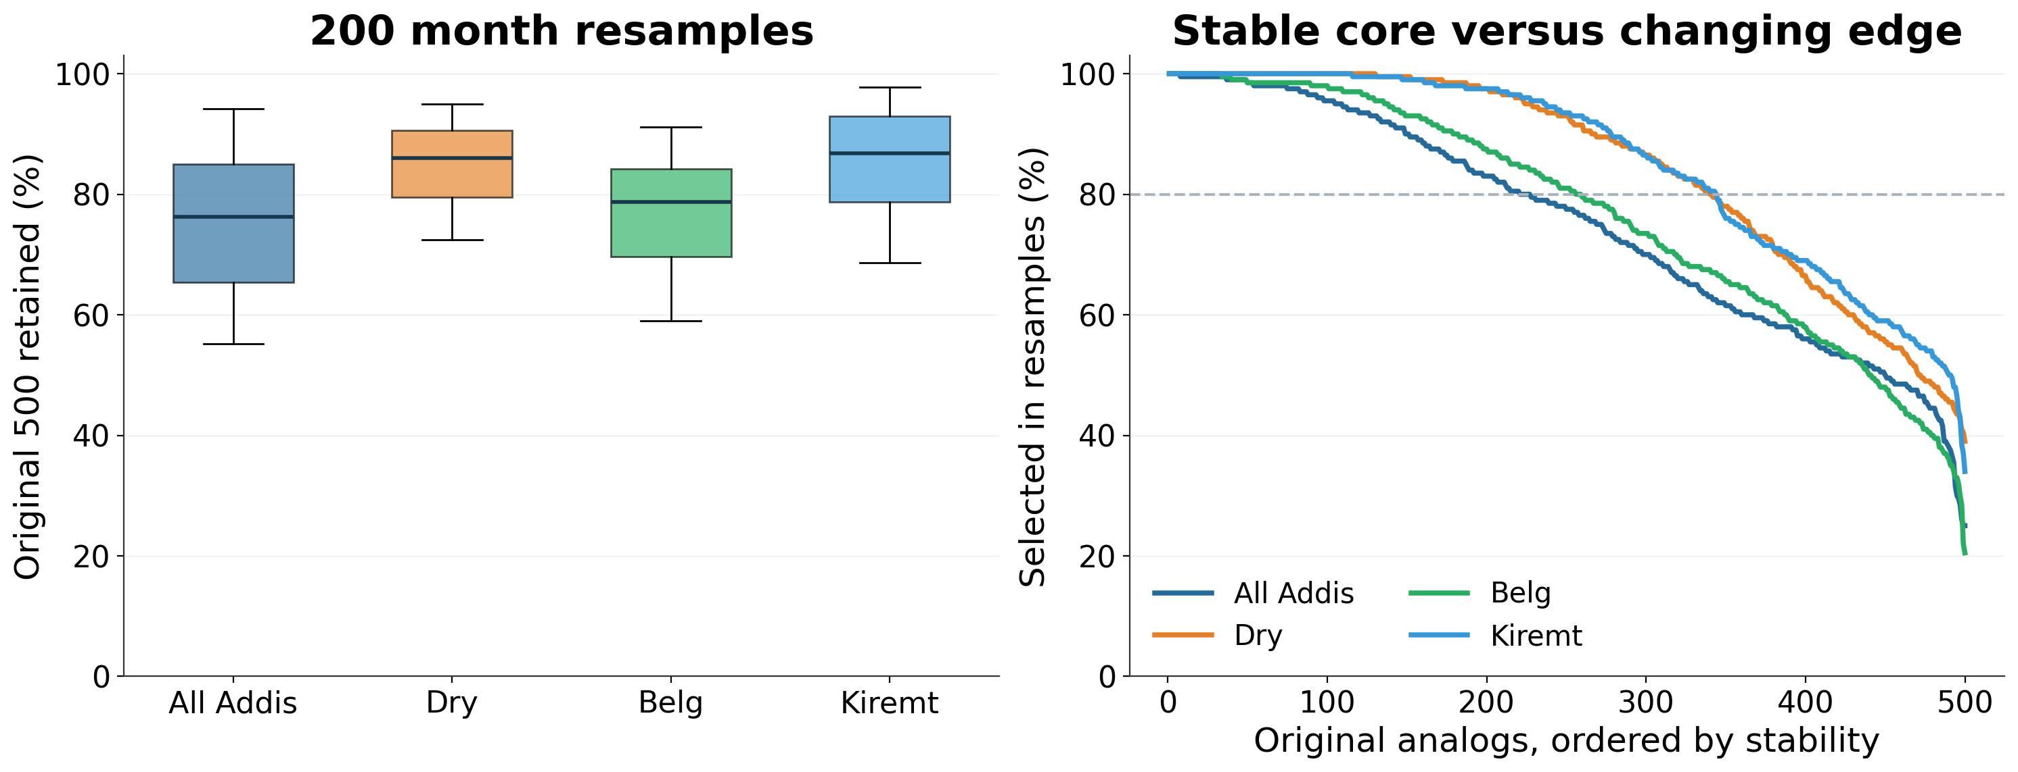
Changing sampled months changes the analog lists
Boxes: 25–75%; whiskers: 5–95% of 200 resamples. The 80% marker is descriptive.
16
Notes:
Talk track
I resampled the observed months and repeated the entire analog selection, including the median spectrum. Median overlap with the original list ranges from 76 to 87 percent. The pooled and Belg lists are less stable than Dry and Kiremt in this experiment. The curves show a stable core and a less stable edge. That suggests we should examine sensitivity to calibration-list membership before treating an exact top-500 list as definitive.
If asked
Every draw samples as many whole year-month blocks as observed, with replacement, then keeps all filters in each sampled block. The All-Addis draw is not season-stratified, so seasonal balance can vary. Correlation is signed, centred Pearson r over retained channels; duplicate scans collapse to physical filters using the same deterministic ranking helper. The baseline exactly reproduces every saved primary list. These resample distributions are conditional sampling sensitivity, not uncertainty intervals for calibration performance. No PLS model is refit.
All Addis: median retention 76.3%; 5th–95th resample percentiles 55.2–94.2%; 227/500 original filters selected in at least 80% of draws; union 1625.
Dry (Oct-Feb): median retention 86.0%; 5th–95th resample percentiles 72.4–95.0%; 341/500 original filters selected in at least 80% of draws; union 1139.
Belg (Mar-May): median retention 78.7%; 5th–95th resample percentiles 59.0–91.2%; 259/500 original filters selected in at least 80% of draws; union 1573.
Kiremt (Jun-Sep): median retention 86.8%; 5th–95th resample percentiles 68.5–97.8%; 344/500 original filters selected in at least 80% of draws; union 1152.
Sources
/Users/ahmadjalil/github/aethmodular/research/ftir_hips_chem/output/tables/ann_weekly_20260910_diagnostics/analog_stability_summary.csv
/Users/ahmadjalil/github/aethmodular/research/ftir_hips_chem/output/tables/ann_weekly_20260910_diagnostics/analog_bootstrap_draws.csv
/Users/ahmadjalil/github/aethmodular/research/ftir_hips_chem/output/tables/ann_weekly_20260910_diagnostics/analog_selection_frequencies.csv
/Users/ahmadjalil/github/aethmodular/research/ftir_hips_chem/notebooks/archive/executed/ann_weekly_20260910_diagnostics.ipynb
/Users/ahmadjalil/github/aethmodular/research/ftir_hips_chem/output/plots/ann_weekly_20260910_diagnostics/slide_16.png
Figure format: PNG exported from Jupyter, as requested.

Slide 17
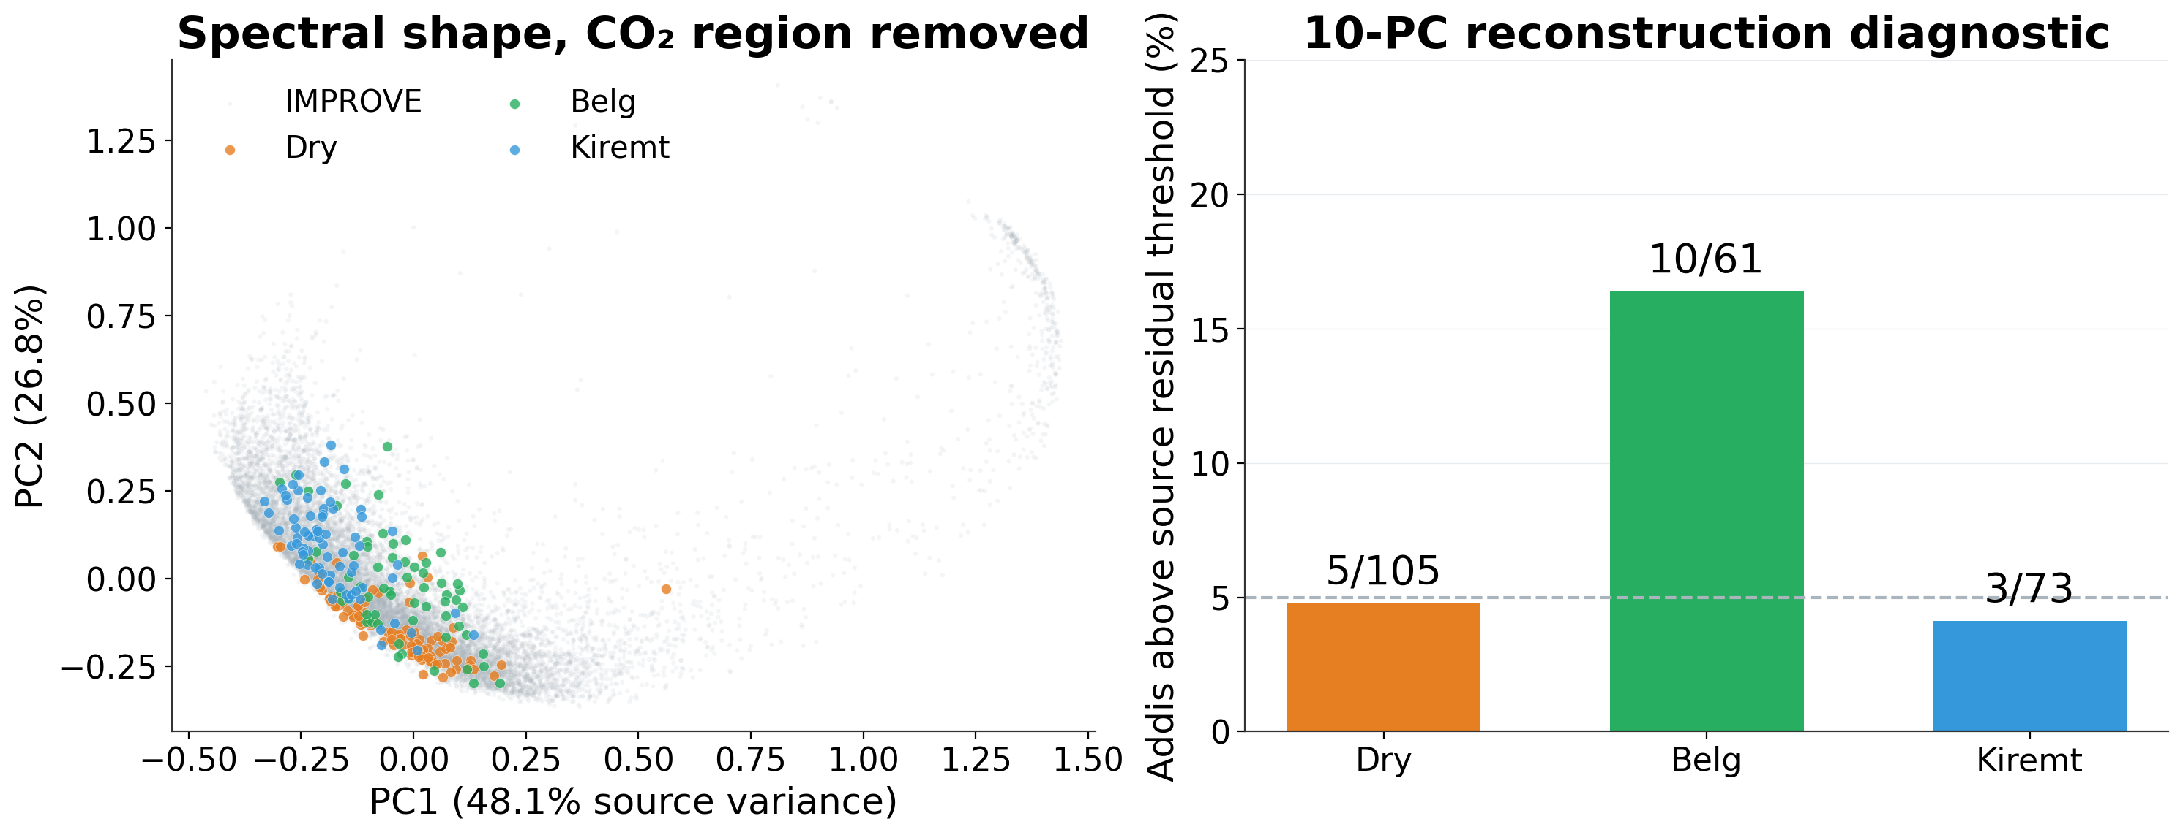
Belg more often exceeds the source residual threshold
Source-relative spectral diagnostic; it does not establish prediction accuracy.
17
Notes:
Talk track
The map summarizes spectral shape after the CO₂ region is removed. Grey points are the eligible IMPROVE library; colours show Addis seasons. The two displayed components explain about 75 percent of source shape variation. A separate ten-component reconstruction check finds 10 of 61 Belg spectra above the source residual threshold, compared with 5 of 105 Dry and 3 of 73 Kiremt spectra. Belg therefore deserves a closer inspection of the individual spectra, without automatically excluding these filters.
If asked
Each masked spectrum is centred across channels and normalized to unit length, matching Pearson geometry. PCA is fitted only to 13,010 unique eligible source filters, choosing the lowest AnalysisId for duplicate source filters. Ten fixed PCs explain 98.98% of source variance. Addis is projected using the source basis. The threshold is the in-sample source 95th percentile of squared reconstruction residual (0.00718935); it is descriptive, not a calibrated acceptance rule. The 5% dashed line is the source reference fraction. No chemical meaning is assigned to PCs, and no uncertainty or significance test is claimed for seasonal percentages.
Dry (Oct-Feb): 5/105 (4.8%) above source 95th-percentile reconstruction residual.
Belg (Mar-May): 10/61 (16.4%) above source 95th-percentile reconstruction residual.
Kiremt (Jun-Sep): 3/73 (4.1%) above source 95th-percentile reconstruction residual.
Sources
/Users/ahmadjalil/github/aethmodular/research/ftir_hips_chem/output/tables/ann_weekly_20260910_diagnostics/pca_target_scores.csv
/Users/ahmadjalil/github/aethmodular/research/ftir_hips_chem/output/tables/ann_weekly_20260910_diagnostics/pca_source_scores.csv
/Users/ahmadjalil/github/aethmodular/research/ftir_hips_chem/output/tables/ann_weekly_20260910_diagnostics/pca_season_summary.csv
/Users/ahmadjalil/github/aethmodular/research/ftir_hips_chem/output/tables/ann_weekly_20260910_diagnostics/methods.json
/Users/ahmadjalil/github/aethmodular/research/ftir_hips_chem/notebooks/archive/executed/ann_weekly_20260910_diagnostics.ipynb
/Users/ahmadjalil/github/aethmodular/research/ftir_hips_chem/output/plots/ann_weekly_20260910_diagnostics/slide_17.png
https://scikit-learn.org/stable/modules/generated/sklearn.decomposition.PCA.html
Figure format: PNG exported from Jupyter, as requested.

Slide 18
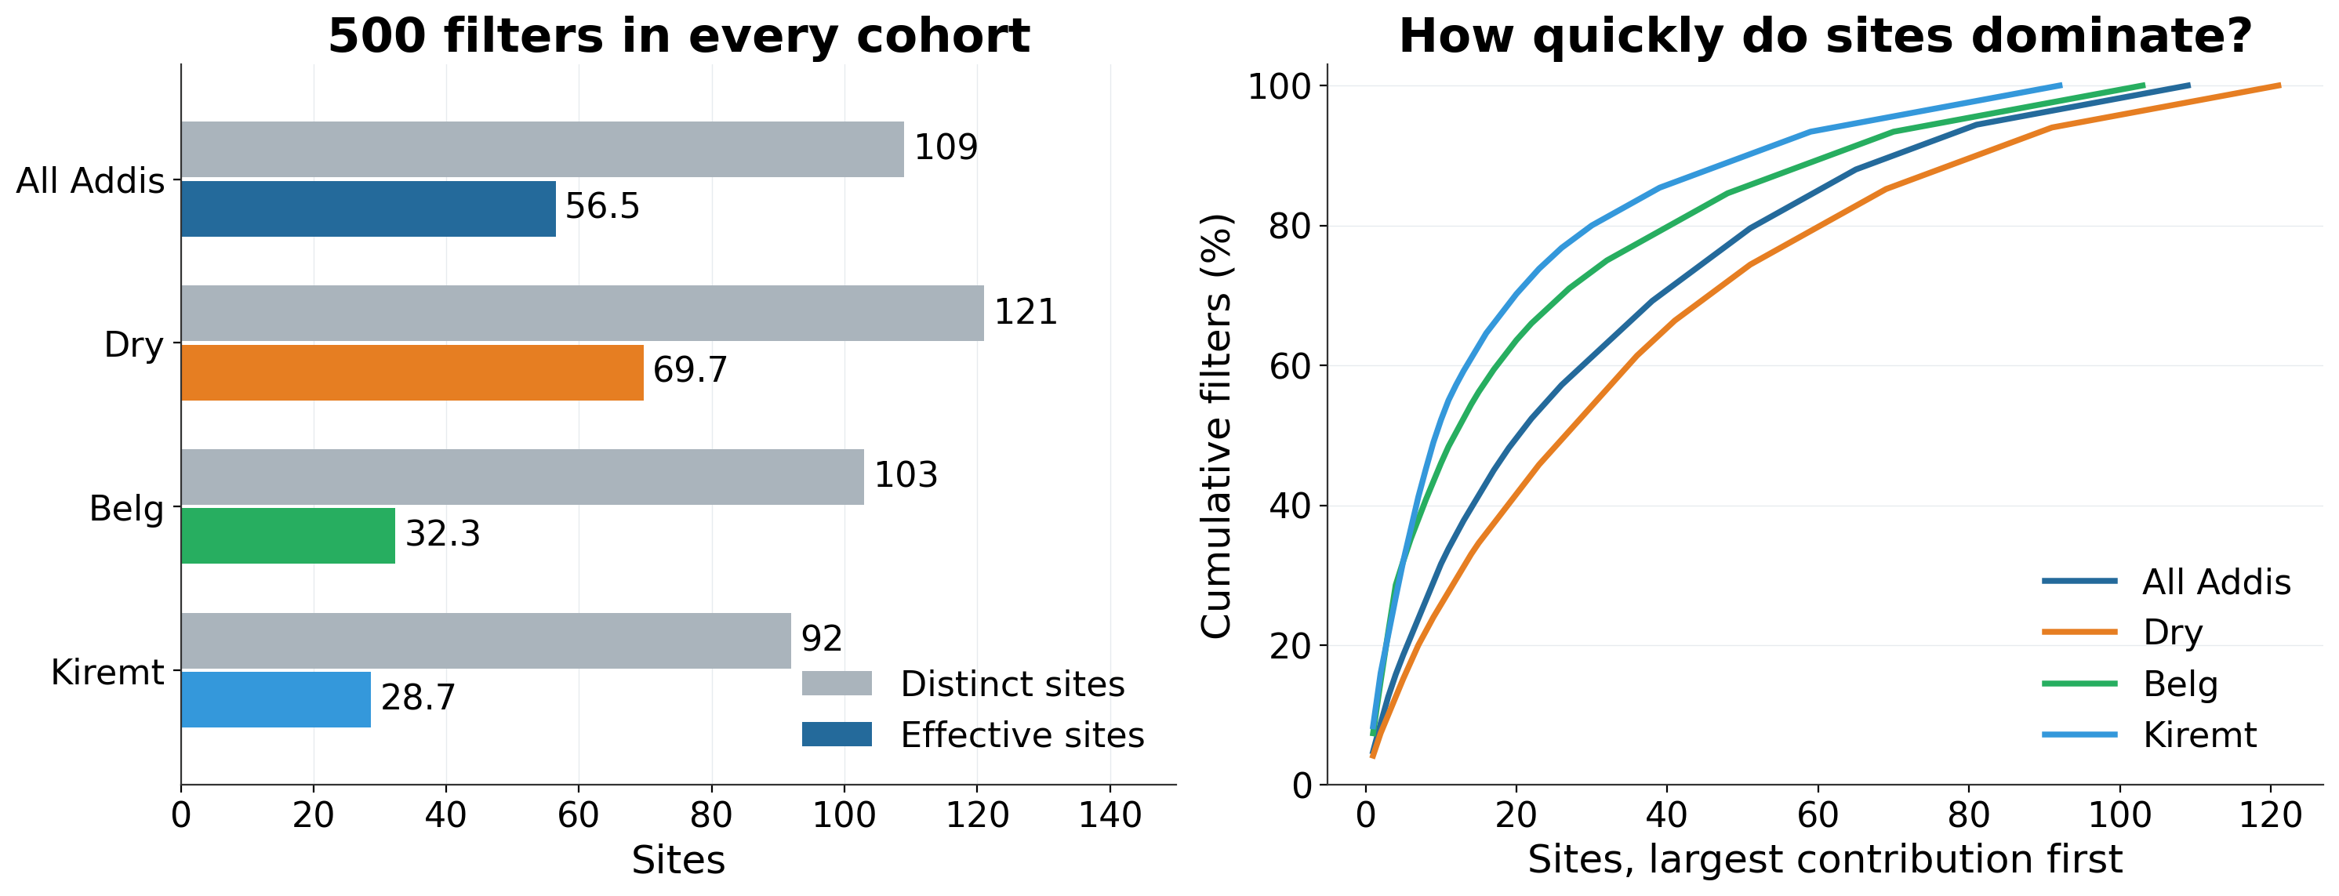
Rainy-season cohorts are more concentrated by site
Effective sites = 1/Σp². A concentration measure, not an independent sample count.
18
Notes:
Talk track
All cohorts contain 500 filters, but those filters are distributed differently across source sites. Dry has 121 distinct sites and about 70 effective sites. Belg and Kiremt have only about 32 and 29 effective sites. In each rainy-season list, five sites supply 32 percent of filters. This suggests a concrete sensitivity check: repeat calibration with source-site contributions capped, then compare models on a common source test set.
If asked
The effective site count is the inverse of the sum of squared site shares, also called inverse-Simpson concentration. Equal site contributions recover the distinct count; concentration reduces it. This is not an estimate of independent filters or a replacement for grouped validation. It is computed over the full selected 500-filter cohort, including its source training and test roles. Site identities and complete ranked contribution curves are supplied. Site capping and calibration refitting are a next experiment, not a result of this diagnostic.
All Addis: 109 distinct sites; 56.5 effective sites; top five supply 18.6% of filters.
Dry (Oct-Feb): 121 distinct sites; 69.7 effective sites; top five supply 15.2% of filters.
Belg (Mar-May): 103 distinct sites; 32.3 effective sites; top five supply 32.0% of filters.
Kiremt (Jun-Sep): 92 distinct sites; 28.7 effective sites; top five supply 32.0% of filters.
Sources
/Users/ahmadjalil/github/aethmodular/research/ftir_hips_chem/output/tables/ann_weekly_20260910_diagnostics/site_concentration.csv
/Users/ahmadjalil/github/aethmodular/research/ftir_hips_chem/output/tables/ann_weekly_20260910_diagnostics/site_concentration_curves.csv
/Users/ahmadjalil/github/aethmodular/research/ftir_hips_chem/notebooks/archive/executed/ann_weekly_20260910_diagnostics.ipynb
/Users/ahmadjalil/github/aethmodular/research/ftir_hips_chem/output/plots/ann_weekly_20260910_diagnostics/slide_18.png
Figure format: PNG exported from Jupyter, as requested.

