Slide 1
Addis FTIR calibration
Weekly update
Spectral exclusions, seasonal analogs
and the next validation design
Ahmad Jalil
10 September 2026
Notes:
Talk track
I followed up on the spectral exclusions and reran the seasonal and PMF analog selections. The main result is that the seasons choose different IMPROVE filters, but the new seasonal calibrations still have weak TOR validation. I’ll show the spectral changes, what happens to the regressions, and the proposed Addis split for the next evaluation.
If asked
All new Addis readouts use already explored target data. They are exploratory. The three spectral comparisons at the end are backup slides. The analysis uses the September 3 task list.
Sources
/Users/ahmadjalil/github/aethmodular/research/ftir_hips_chem/output/tables/ann_weekly_20260910/calibration_fits.csv

Slide 2
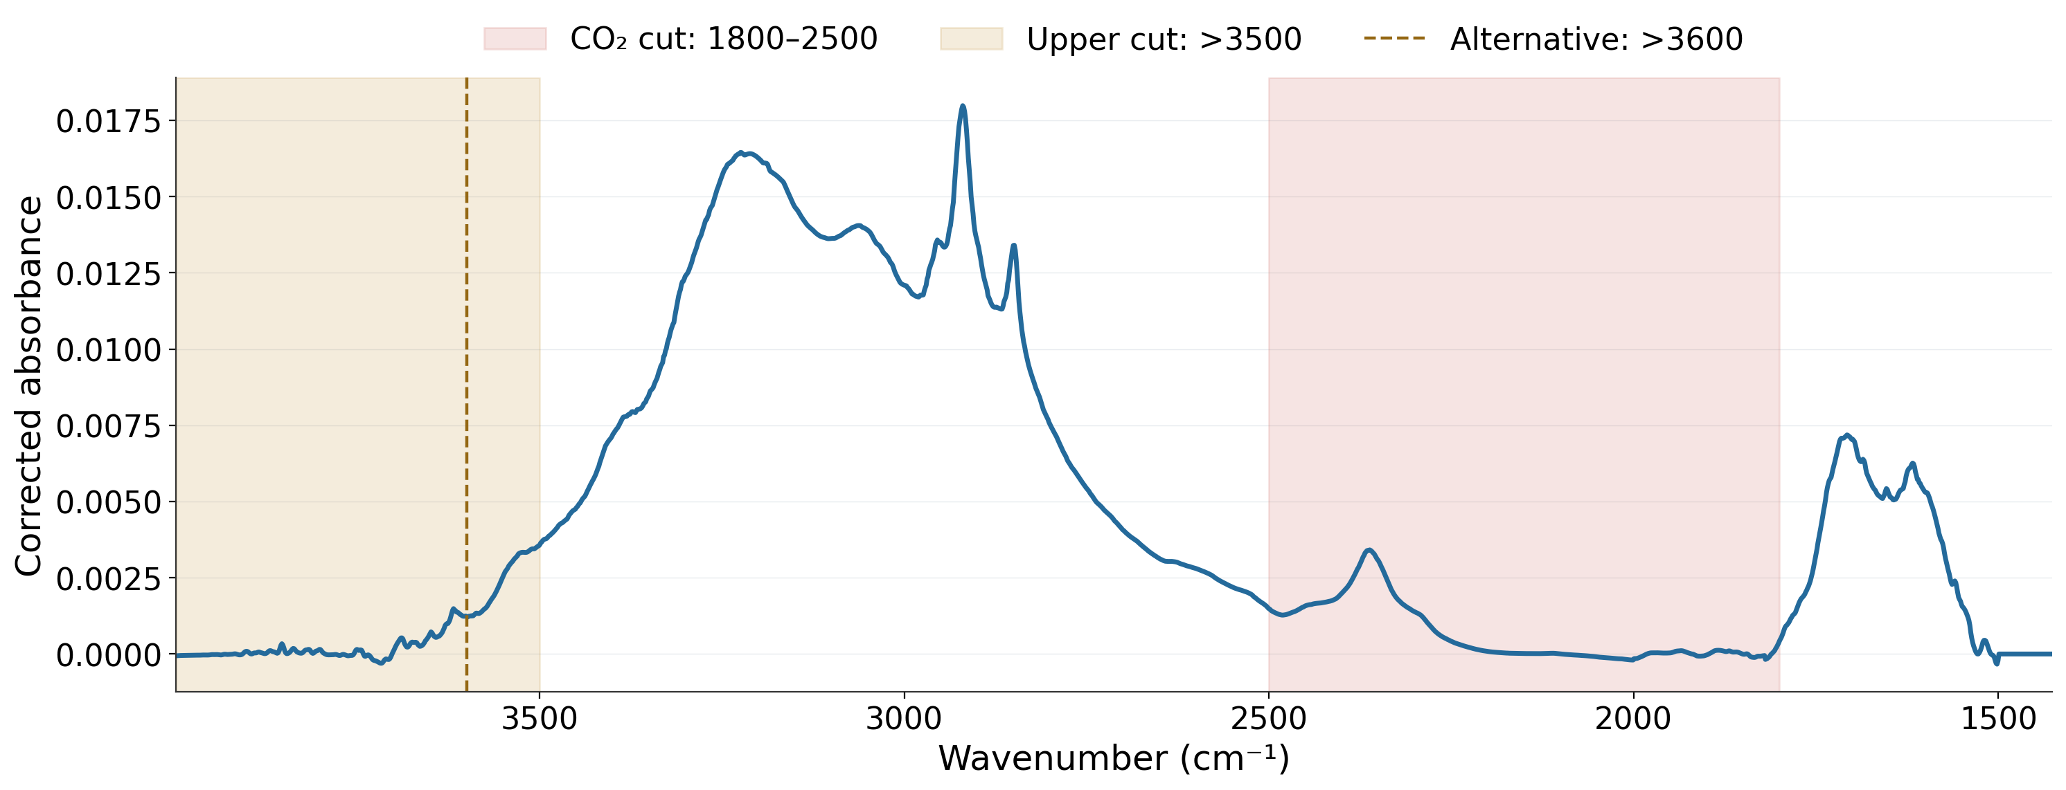
Spectral regions for analog selection
Median of all 239 Addis filters
Masks change analog selection. PLS uses the full spectrum.
2
Notes:
Talk track
This is the median baseline-corrected spectrum for all 239 Addis filters. The red section marks the CO₂ region removed from matching, from 1800 to 2500 inverse centimetres. The gold section shows the upper end where I tested cutoffs at 3500 and 3600. I applied these masks when selecting analogs. Every PLS calibration still uses the same full spectral grid, so we can isolate the effect of changing the selected filters.
If asked
Primary selection uses signed Pearson correlation to the target group’s median corrected spectrum, retaining 500 unique TOR-eligible IMPROVE filters. The gold shading starts at 3500 and encompasses both upper-cut tests. Seven masks include an 1850 lower-bound sensitivity. The full available grid has 2002 channels, about 1426–3998 cm⁻¹. Raw-spectrum selection remains closed. Mean-across-target correlation is a separate sensitivity.
Sources
/Users/ahmadjalil/github/aethmodular/research/ftir_hips_chem/output/tables/ann_weekly_20260910/mask_channels.csv
/Users/ahmadjalil/github/aethmodular/research/ftir_hips_chem/output/tables/ann_weekly_20260910/library_eligibility.csv
/Users/ahmadjalil/github/aethmodular/research/ftir_hips_chem/output/tables/ann_weekly_20260910/addis_evaluation.csv
Figure format: PNG exported from the Jupyter notebook, as requested; regenerate in the notebook to edit the graph.
/Users/ahmadjalil/github/aethmodular/research/ftir_hips_chem/notebooks/archive/executed/ann_weekly_20260910_figures.ipynb
/Users/ahmadjalil/github/aethmodular/research/ftir_hips_chem/output/plots/ann_weekly_20260910_notebook/slide_02.png

Slide 3
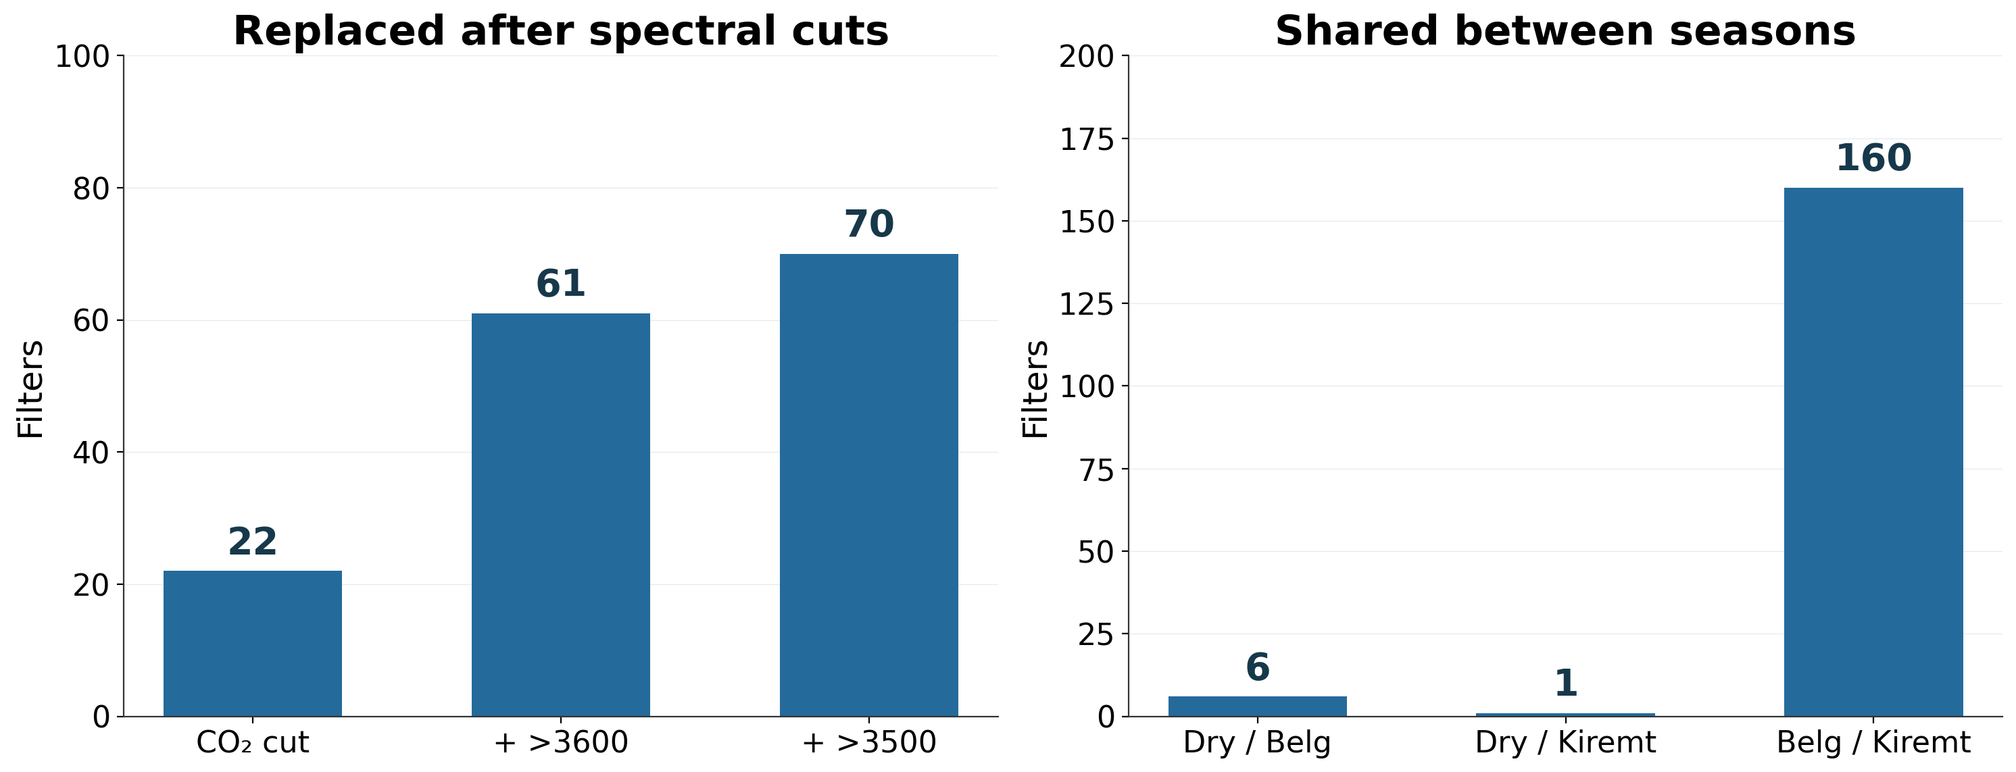
The masks and seasons select different filters
500 filters per cohort. Seasonal overlap uses the CO₂ exclusion.
3
Notes:
Talk track
On the left, the CO₂ cut replaces 22 of the pooled selection’s 500 filters. Adding the upper cut replaces 61 or 70 relative to the full-spectrum selection. On the right, the Dry selection shares only six filters with Belg and one with Kiremt. Belg and Kiremt share 160. So the seasonal spectral differences translate into quite different calibration cohorts, especially for Dry. The next question is whether those separate cohorts predict well.
If asked
Jaccard overlap is 0.6% for Dry/Belg, 0.1% for Dry/Kiremt and 19.0% for Belg/Kiremt. Jaccard uses intersection/union, unlike the shared count out of 500 shown here. The 1800 versus 1850 lower boundary changes five pooled CO₂-only analogs. All counts deduplicate physical IMPROVE filters. These are membership changes, not a causal chemical attribution.
Sources
/Users/ahmadjalil/github/aethmodular/research/ftir_hips_chem/output/tables/ann_weekly_20260910/mask_membership_changes.csv
/Users/ahmadjalil/github/aethmodular/research/ftir_hips_chem/output/tables/ann_weekly_20260910/seasonal_overlap.csv
Figure format: PNG exported from the Jupyter notebook, as requested; regenerate in the notebook to edit the graph.
/Users/ahmadjalil/github/aethmodular/research/ftir_hips_chem/notebooks/archive/executed/ann_weekly_20260910_figures.ipynb
/Users/ahmadjalil/github/aethmodular/research/ftir_hips_chem/output/plots/ann_weekly_20260910_notebook/slide_03.png

Slide 4
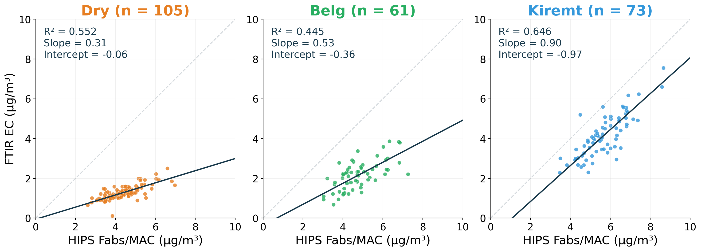
Dry’s near-zero intercept hides a shallow slope
Dark line: Deming fit. Grey line: 1:1. All Addis comparisons are exploratory.
4
Notes:
Talk track
Each panel uses a calibration selected for that season and shows all of its Addis filters. The grey diagonal is one-to-one agreement and the dark line is the Deming fit. Dry has an intercept near zero, but the slope is only about 0.31. Its predictions change far less than the HIPS comparison. Belg is also shallow. Kiremt gets closer to a slope of one, but its intercept remains negative. Looking at the intercept alone would miss these differences.
If asked
Dry (Oct-Feb): R²=0.552; Deming slope 0.305 [0.245, 0.355]; intercept -0.059 [-0.256, 0.182] µg/m³; k=7.
Belg (Mar-May): R²=0.445; Deming slope 0.528 [0.323, 0.745]; intercept -0.364 [-1.403, 0.680] µg/m³; k=17.
Kiremt (Jun-Sep): R²=0.646; Deming slope 0.904 [0.808, 1.091]; intercept -0.973 [-2.243, -0.371] µg/m³; k=18.
Axes share the 0–10 scale. MAC=10 m²/g. The target-side comparison is HIPS Fabs/MAC versus predicted FTIR EC, in µg/m³. February belongs to Dry. The same Addis spectra defined the analog selection, so these panels are exploratory. Intervals are 95% month-block bootstrap intervals at fixed λ=3.33538.
Sources
/Users/ahmadjalil/github/aethmodular/research/ftir_hips_chem/output/tables/ann_weekly_20260910/predictions.csv
/Users/ahmadjalil/github/aethmodular/research/ftir_hips_chem/output/tables/ann_weekly_20260910/regression_metrics.csv
Figure format: PNG exported from the Jupyter notebook, as requested; regenerate in the notebook to edit the graph.
/Users/ahmadjalil/github/aethmodular/research/ftir_hips_chem/notebooks/archive/executed/ann_weekly_20260910_figures.ipynb
/Users/ahmadjalil/github/aethmodular/research/ftir_hips_chem/output/plots/ann_weekly_20260910_notebook/slide_04.png

Slide 5
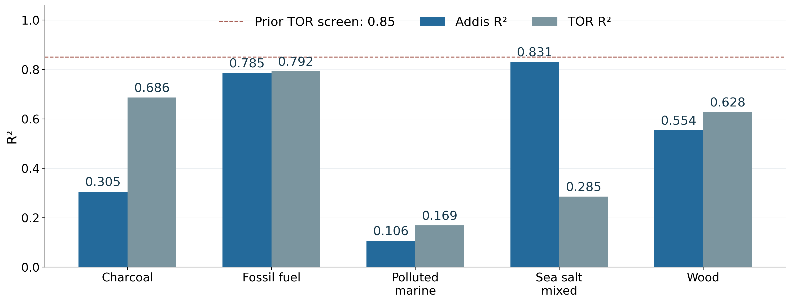
PMF correlation can hide weak TOR prediction
102 Addis filters with a PMF match
All five TOR R² values remain below the prior 0.85 screen.
5
Notes:
Talk track
Here I split Addis by its dominant PMF source and selected a calibration for each group. Blue shows correlation on the Addis comparison, and grey shows correlation with TOR on held-out IMPROVE sites. Sea Salt is the clearest warning: the Addis R² is 0.831 while TOR R² is only 0.285, and its TOR prediction Q² is negative. All five source calibrations fall below the previous TOR screen. These results don’t support adopting a PMF-specific calibration yet.
If asked
GF fractions are normalized by the canonical ETAD helper before dominant-source assignment. There are 137 unmatched Addis filters. Dominant source does not mean pure-source aerosol. TOR cohorts differ. R² is squared correlation; predictive Q² is distinct. Sea Salt TOR Q²=-0.893.
Charcoal: n=22; Deming slope=0.758; intercept=-0.696 µg/m³; Addis R²=0.305; TOR R²=0.686.
Fossil Fuel Combustion: n=25; Deming slope=0.640; intercept=-1.110 µg/m³; Addis R²=0.785; TOR R²=0.792.
Polluted Marine: n=23; Deming slope=0.063; intercept=0.249 µg/m³; Addis R²=0.106; TOR R²=0.169.
Sea Salt Mixed: n=21; Deming slope=0.811; intercept=-2.242 µg/m³; Addis R²=0.831; TOR R²=0.285.
Wood Burning: n=11; Deming slope=0.553; intercept=0.091 µg/m³; Addis R²=0.554; TOR R²=0.628.
Sources
/Users/ahmadjalil/github/aethmodular/research/ftir_hips_chem/output/tables/ann_weekly_20260910/regression_metrics.csv
/Users/ahmadjalil/github/aethmodular/research/ftir_hips_chem/output/tables/ann_weekly_20260910/pmf_overlap.csv
Figure format: PNG exported from the Jupyter notebook, as requested; regenerate in the notebook to edit the graph.
/Users/ahmadjalil/github/aethmodular/research/ftir_hips_chem/notebooks/archive/executed/ann_weekly_20260910_figures.ipynb
/Users/ahmadjalil/github/aethmodular/research/ftir_hips_chem/output/plots/ann_weekly_20260910_notebook/slide_05.png

Slide 6
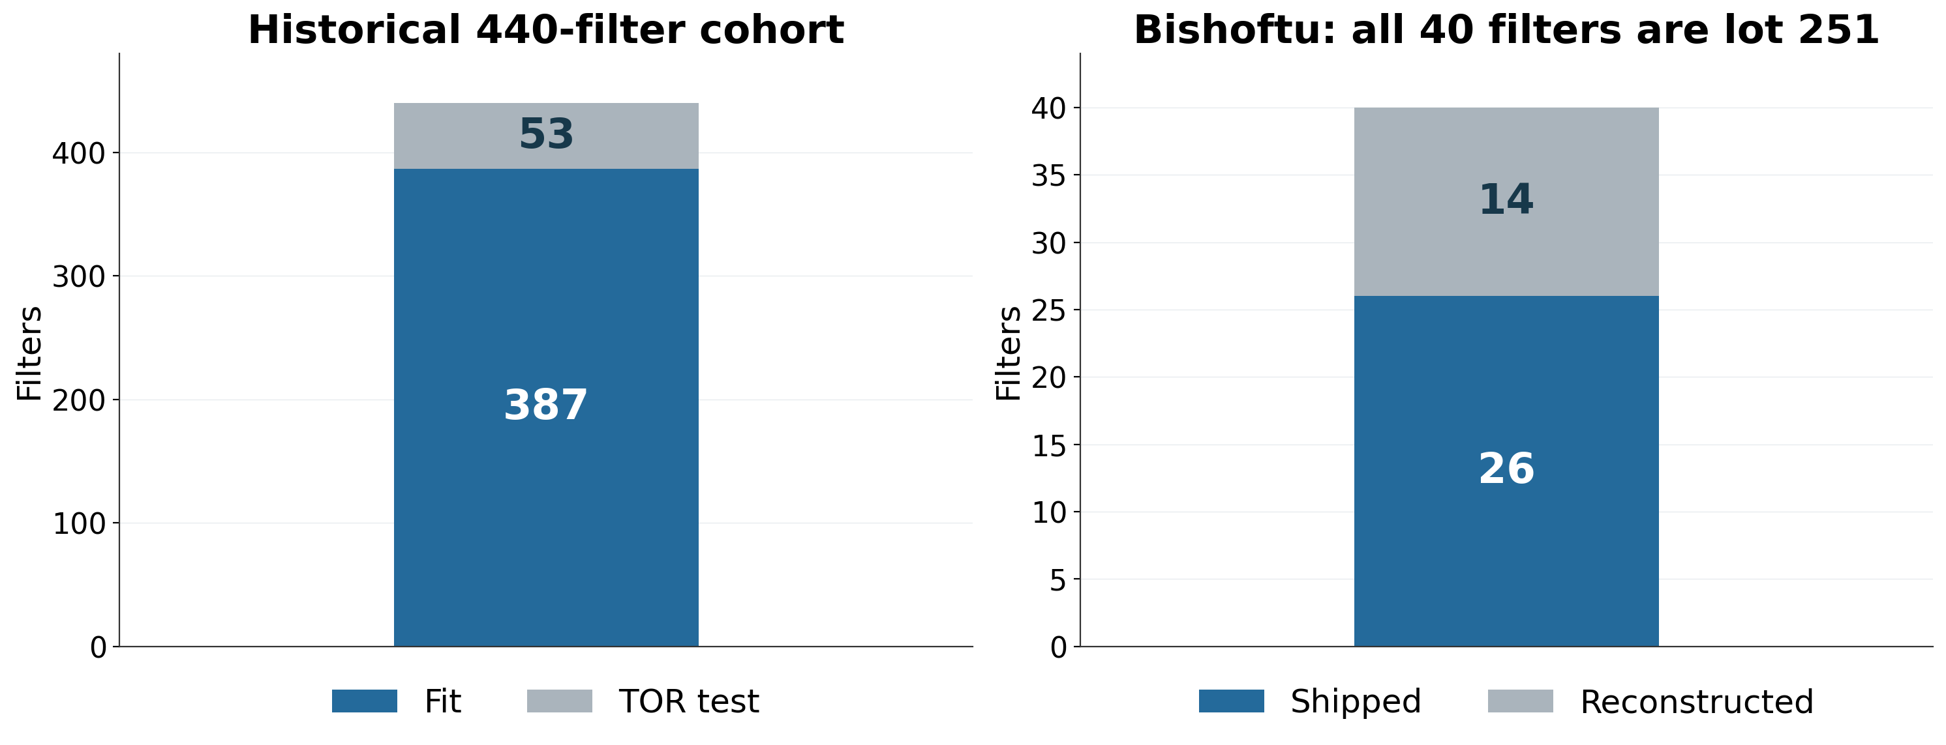
Training membership and Bishoftu lot
All 10 meeting-figure analogs fall outside the historical cohort.
6
Notes:
Talk track
I checked the actual historical calibration membership. Of its 440 filters, 387 entered the fit and 53 formed the TOR site test. All ten nearest analogs shown in the original Addis and Bishoftu figure were outside that entire cohort. I also checked the Bishoftu lot directly against raw HIPS metadata. All 40 filters are lot 251. Their HIPS values include 26 shipped values and 14 provisional reconstructions.
If asked
The historical model uses the lowest OC/EC 440-filter cohort, AIRSpec correction and k=8, with site-grouped CV and the original site split seed 20260717. The 15 earlier seasonal top-five analogs were audited separately and are also outside the cohort. Raw ExternalLotId independently confirms all 40 Bishoftu lot IDs. Lot confirmation does not make the 14 reconstructed Fabs values an official release.
Sources
/Users/ahmadjalil/github/aethmodular/research/ftir_hips_chem/output/tables/ann_weekly_20260910/historical_addis_winner_membership.csv
/Users/ahmadjalil/github/aethmodular/research/ftir_hips_chem/output/tables/ann_weekly_20260910/meeting_figure_top5_membership.csv
/Users/ahmadjalil/github/aethmodular/research/ftir_hips_chem/output/tables/ann_weekly_20260910/bishoftu_primary_lot_check.csv
Figure format: PNG exported from the Jupyter notebook, as requested; regenerate in the notebook to edit the graph.
/Users/ahmadjalil/github/aethmodular/research/ftir_hips_chem/notebooks/archive/executed/ann_weekly_20260910_figures.ipynb
/Users/ahmadjalil/github/aethmodular/research/ftir_hips_chem/output/plots/ann_weekly_20260910_notebook/slide_06.png

Slide 7
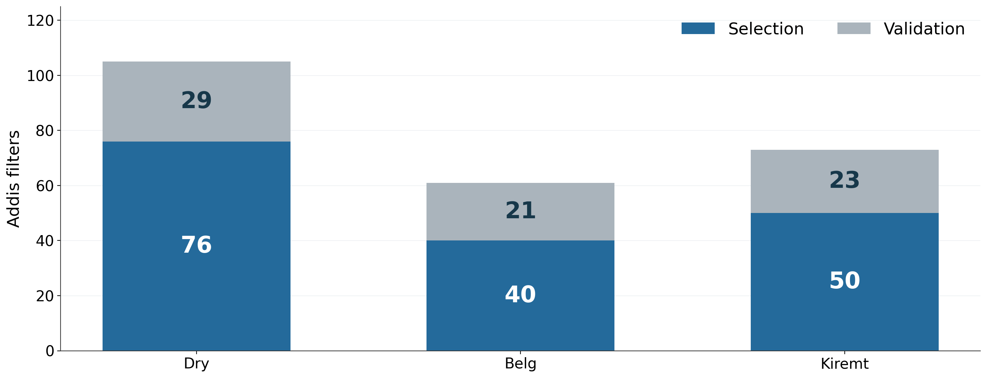
Proposed Addis split: 166 select, 73 validate
Whole-month blocks. Retrospective proposal, not yet scored.
7
Notes:
Talk track
This is the proposed split for the next Addis evaluation. Blue is the selection portion and grey is the validation portion. We would use 166 filters to choose the analog cohorts and reserve 73 for prediction. Whole calendar months stay together within each season. Before scoring, we need to lock the mask, aggregation rule, cohort size and PLS selection procedure. Because these samples have already been explored, this is a retrospective check. New samples would provide stronger confirmation.
If asked
Selection/validation counts: Dry 76/29, Belg 40/21, Kiremt 50/23. Validation blocks are 5, 3 and 4 months respectively. Seed 20260910. No month or physical filter crosses the split. It is stratified by season rather than a future-period forecast. The validation spectra and HIPS values must not choose the calibration. No split-based model has been selected or scored. Leakage reference: https://scikit-learn.org/stable/common_pitfalls.html#data-leakage
Sources
/Users/ahmadjalil/github/aethmodular/research/ftir_hips_chem/output/tables/ann_weekly_20260910/proposed_addis_split.csv
/Users/ahmadjalil/github/aethmodular/research/ftir_hips_chem/output/tables/ann_weekly_20260910/split_counts.csv
Figure format: PNG exported from the Jupyter notebook, as requested; regenerate in the notebook to edit the graph.
/Users/ahmadjalil/github/aethmodular/research/ftir_hips_chem/notebooks/archive/executed/ann_weekly_20260910_figures.ipynb
/Users/ahmadjalil/github/aethmodular/research/ftir_hips_chem/output/plots/ann_weekly_20260910_notebook/slide_07.png

Slide 8
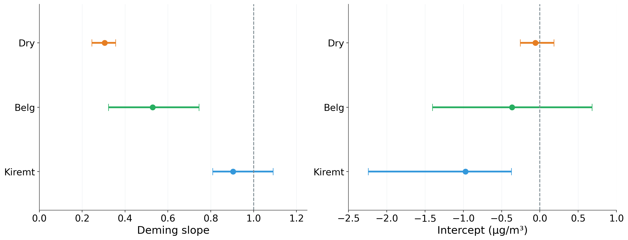
Uncertainty makes the seasonal differences clear
Dots: estimates. Bars: 95% CIs. Fixed calibration, MAC and λ = 3.34.
8
Notes:
Talk track
The dots show the seasonal Deming estimates and the horizontal error bars show their 95% confidence intervals. The left panel compares slopes with the agreement value of one. The right compares intercepts with zero. Dry’s intercept can include zero while its slope is clearly below one. Kiremt shows the opposite pattern: its slope interval includes one, but its intercept stays negative. Covering an agreement value means compatibility with that value. It does not establish practical equivalence.
If asked
The original Deming routine returned point estimates only. The added helper returns standard errors and percentile intervals from 2000 whole-month bootstrap samples. Median HIPS_Uncertainty/MAC gives sigma_x=0.290751 µg/m³. A historical FTIR held-out RMSE proxy of 0.531 gives lambda=3.335383. These conditional intervals omit uncertainty in lambda, MAC and calibration selection/fitting. No multiplicity adjustment or equivalence margin is defined. Bootstrap documentation: https://search.r-project.org/CRAN/refmans/mcr/html/mc.bootstrap.html
Dry (Oct-Feb): R²=0.552; Deming slope 0.305 [0.245, 0.355]; intercept -0.059 [-0.256, 0.182] µg/m³; k=7.
Belg (Mar-May): R²=0.445; Deming slope 0.528 [0.323, 0.745]; intercept -0.364 [-1.403, 0.680] µg/m³; k=17.
Kiremt (Jun-Sep): R²=0.646; Deming slope 0.904 [0.808, 1.091]; intercept -0.973 [-2.243, -0.371] µg/m³; k=18.
Sources
/Users/ahmadjalil/github/aethmodular/research/ftir_hips_chem/output/tables/ann_weekly_20260910/regression_metrics.csv
/Users/ahmadjalil/github/aethmodular/research/ftir_hips_chem/output/tables/ann_weekly_20260910/lambda_sensitivity.csv
Figure format: PNG exported from the Jupyter notebook, as requested; regenerate in the notebook to edit the graph.
/Users/ahmadjalil/github/aethmodular/research/ftir_hips_chem/notebooks/archive/executed/ann_weekly_20260910_figures.ipynb
/Users/ahmadjalil/github/aethmodular/research/ftir_hips_chem/output/plots/ann_weekly_20260910_notebook/slide_08.png

Slide 9
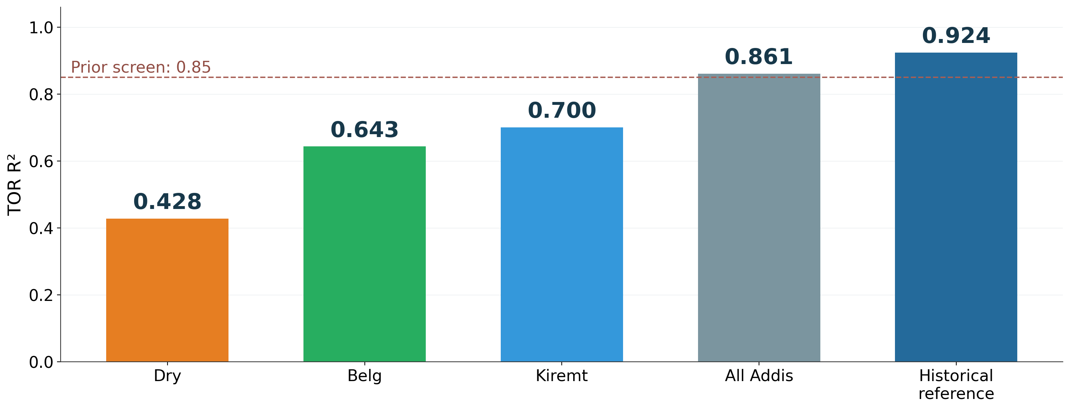
The reference calibration remains the benchmark
Prior TOR R² screen: 0.85. Each cohort uses different test filters.
9
Notes:
Talk track
This brings the calibration results together. The three seasonal TOR R² values range from about 0.43 to 0.70, below the prior 0.85 screen. The pooled CO₂-only selection reaches about 0.86. The historical OC/EC reference remains the benchmark at 0.924 on its own TOR test. These test populations differ, so this is a screening comparison rather than a paired claim of superiority. My proposed next step is to agree on the Addis split and freeze the selection rule before evaluating the reserved predictions.
If asked
The bars use the primary median-spectrum, CO₂-only selection. All new fits reserve source sites and choose components by five-fold site-grouped training CV. The historical fit retains k=8. No new model is promoted. The separate mean-correlation sensitivity also leaves all three seasonal fits below 0.85, at TOR R² 0.446, 0.569 and 0.781. R² is squared correlation, with predictive Q² available in the full fit table.
Sources
/Users/ahmadjalil/github/aethmodular/research/ftir_hips_chem/output/tables/ann_weekly_20260910/calibration_fits.csv
/Users/ahmadjalil/github/aethmodular/research/ftir_hips_chem/output/tables/ann_weekly_20260910/regression_metrics.csv
Figure format: PNG exported from the Jupyter notebook, as requested; regenerate in the notebook to edit the graph.
/Users/ahmadjalil/github/aethmodular/research/ftir_hips_chem/notebooks/archive/executed/ann_weekly_20260910_figures.ipynb
/Users/ahmadjalil/github/aethmodular/research/ftir_hips_chem/output/plots/ann_weekly_20260910_notebook/slide_09.png

Slide 10
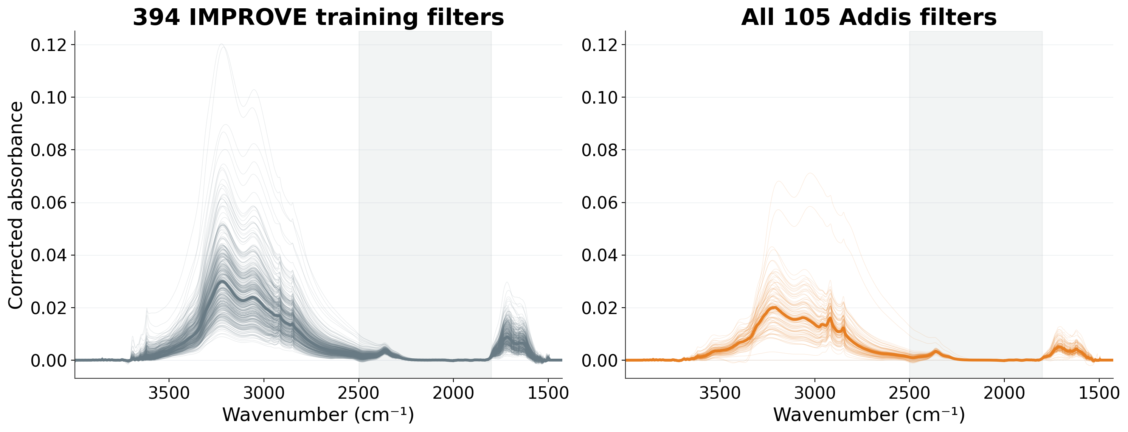
Dry: complete spectral comparison
Thin lines: individual spectra. Thick lines: medians. Shading: excluded from selection.
10
Notes:
Talk track
This backup slide summarizes every spectrum in the Dry comparison. Grey represents the 394 IMPROVE filters that actually entered the fit, and the seasonal colour represents all 105 Addis filters. Thin lines show every individual spectrum, and the thick line in each panel shows the median. This lets us compare the complete training set with the whole season, rather than selecting five examples.
If asked
The full 2002-channel grid appears here. The 500 selected analogs include a separate TOR-test subset, which does not enter these training envelopes. Every individual training and Addis trace is shown on shared axes. These are spectra, not confidence intervals. The matching mask is 1800–2500 cm⁻¹, while the model uses the full grid. No extra normalization or smoothing was applied for these comparisons.
Sources
/Users/ahmadjalil/github/aethmodular/research/ftir_hips_chem/output/tables/ann_weekly_20260910/calibration_fits.csv
/Users/ahmadjalil/github/aethmodular/research/ftir_hips_chem/output/tables/ann_weekly_20260910/summary.json
Figure format: PNG exported from the Jupyter notebook, as requested; regenerate in the notebook to edit the graph.
/Users/ahmadjalil/github/aethmodular/research/ftir_hips_chem/notebooks/archive/executed/ann_weekly_20260910_figures.ipynb
/Users/ahmadjalil/github/aethmodular/research/ftir_hips_chem/output/plots/ann_weekly_20260910_notebook/slide_10.png

Slide 11
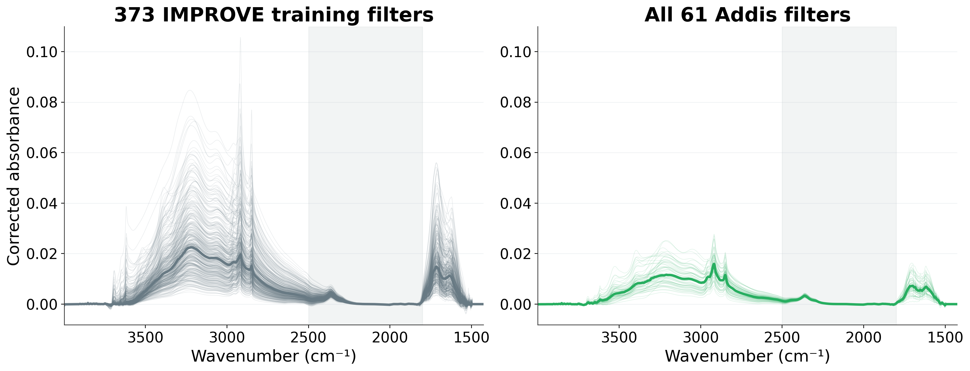
Belg: complete spectral comparison
Thin lines: individual spectra. Thick lines: medians. Shading: excluded from selection.
11
Notes:
Talk track
This backup slide summarizes every spectrum in the Belg comparison. Grey represents the 373 IMPROVE filters that actually entered the fit, and the seasonal colour represents all 61 Addis filters. Thin lines show every individual spectrum, and the thick line in each panel shows the median. This lets us compare the complete training set with the whole season, rather than selecting five examples.
If asked
The full 2002-channel grid appears here. The 500 selected analogs include a separate TOR-test subset, which does not enter these training envelopes. Every individual training and Addis trace is shown on shared axes. These are spectra, not confidence intervals. The matching mask is 1800–2500 cm⁻¹, while the model uses the full grid. No extra normalization or smoothing was applied for these comparisons.
Sources
/Users/ahmadjalil/github/aethmodular/research/ftir_hips_chem/output/tables/ann_weekly_20260910/calibration_fits.csv
/Users/ahmadjalil/github/aethmodular/research/ftir_hips_chem/output/tables/ann_weekly_20260910/summary.json
Figure format: PNG exported from the Jupyter notebook, as requested; regenerate in the notebook to edit the graph.
/Users/ahmadjalil/github/aethmodular/research/ftir_hips_chem/notebooks/archive/executed/ann_weekly_20260910_figures.ipynb
/Users/ahmadjalil/github/aethmodular/research/ftir_hips_chem/output/plots/ann_weekly_20260910_notebook/slide_11.png

Slide 12
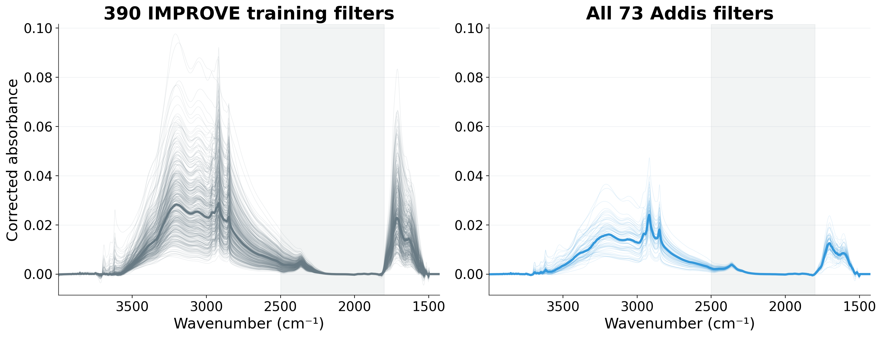
Kiremt: complete spectral comparison
Thin lines: individual spectra. Thick lines: medians. Shading: excluded from selection.
12
Notes:
Talk track
This backup slide summarizes every spectrum in the Kiremt comparison. Grey represents the 390 IMPROVE filters that actually entered the fit, and the seasonal colour represents all 73 Addis filters. Thin lines show every individual spectrum, and the thick line in each panel shows the median. This lets us compare the complete training set with the whole season, rather than selecting five examples.
If asked
The full 2002-channel grid appears here. The 500 selected analogs include a separate TOR-test subset, which does not enter these training envelopes. Every individual training and Addis trace is shown on shared axes. These are spectra, not confidence intervals. The matching mask is 1800–2500 cm⁻¹, while the model uses the full grid. No extra normalization or smoothing was applied for these comparisons.
Sources
/Users/ahmadjalil/github/aethmodular/research/ftir_hips_chem/output/tables/ann_weekly_20260910/calibration_fits.csv
/Users/ahmadjalil/github/aethmodular/research/ftir_hips_chem/output/tables/ann_weekly_20260910/summary.json
Figure format: PNG exported from the Jupyter notebook, as requested; regenerate in the notebook to edit the graph.
/Users/ahmadjalil/github/aethmodular/research/ftir_hips_chem/notebooks/archive/executed/ann_weekly_20260910_figures.ipynb
/Users/ahmadjalil/github/aethmodular/research/ftir_hips_chem/output/plots/ann_weekly_20260910_notebook/slide_12.png

