Slide 1
Addis FTIR calibration
Weekly update
Spectral exclusions, seasonal analogs
and the next validation design
Ahmad Jalil
10 September 2026
Notes:
Follow-up to the September 3 meeting and Ann’s approved task email. Baseline-corrected spectra throughout. All new Addis readouts in this deck are exploratory.

Slide 2
Spectral regions for analog selection
Rank IMPROVE spectra by Pearson correlation to each group’s median Addis spectrum.
Selection space | Channels used
Full AIRSpec control | 1426–3998 cm⁻¹
Primary exclusion | Remove 1800–2500 cm⁻¹
Upper-end tests | Also remove >3600 or >3500 cm⁻¹
500 unique, TOR-eligible filters per selection
All PLS fits retain the same full AIRSpec grid.
1850 cm⁻¹ lower-bound sensitivity also checked. Raw-spectra selection stays closed.
2
Notes:
/Users/ahmadjalil/github/aethmodular/research/ftir_hips_chem/output/tables/ann_weekly_20260910/mask_channels.csv
/Users/ahmadjalil/github/aethmodular/research/ftir_hips_chem/output/tables/ann_weekly_20260910/library_eligibility.csv
Available grid: 2002 channels. Only correlation selection is masked. Signed r avoids rewarding inverted spectra. The group median preserves the earlier seasonal selection definition. Physical IMPROVE FilterIds are deduplicated after ranking. Mean-across-filter correlation is retained as a separate sensitivity run.

Slide 3
Region exclusions change the analog sets
Number of filters replaced relative to the full-spectrum selection, out of 500.
Season pair | Shared filters / 500 | Jaccard overlap
Dry / Belg | 6 | 0.6%
Dry / Kiremt | 1 | 0.1%
Belg / Kiremt | 160 | 19.0%
Seasonal overlap uses the primary CO₂ exclusion. Jaccard = shared filters / combined unique filters.
3
Notes:
/Users/ahmadjalil/github/aethmodular/research/ftir_hips_chem/output/tables/ann_weekly_20260910/mask_membership_changes.csv
/Users/ahmadjalil/github/aethmodular/research/ftir_hips_chem/output/tables/ann_weekly_20260910/seasonal_overlap.csv

Slide 4
A near-zero Dry intercept hides a shallow slope
All three seasonal models fall below the previous TOR R² screening threshold of 0.85.
Season | n | Addis R² | Deming slope [95% CI] | Intercept [95% CI]
Dry | 105 | 0.552 | 0.31 [0.24, 0.36] | -0.06 [-0.26, 0.18]
Belg | 61 | 0.445 | 0.53 [0.32, 0.74] | -0.36 [-1.40, 0.68]
Kiremt | 73 | 0.646 | 0.90 [0.81, 1.09] | -0.97 [-2.24, -0.37]
Site-held-out TOR R²: 0.428–0.700
TOR tests differ between cohorts, so these are not paired model comparisons.
x = HIPS Fabs/MAC, y = FTIR EC, both µg/m³. February belongs to Dry (dry_feb).
4
Notes:
/Users/ahmadjalil/github/aethmodular/research/ftir_hips_chem/output/tables/ann_weekly_20260910/regression_metrics.csv
/Users/ahmadjalil/github/aethmodular/research/ftir_hips_chem/output/tables/ann_weekly_20260910/calibration_fits.csv
MAC=10. 95% percentile intervals from 2000 month-block bootstrap draws. PLS k comes from site-grouped CV on training sites only, first-major-minimum rule. Readouts use all seasonal Addis filters that also defined spectral selection. They are exploratory, not an independent Addis holdout. TOR R² is squared Pearson correlation, Q² prediction accuracy is separately saved in calibration_fits.csv. Error ratio lambda=3.3354.

Slide 5
PMF models remain exploratory
102 matched Addis filters support five separate source selections.
PMF dominant source | n | Addis R² | TOR R² | Slope | Intercept
Charcoal | 22 | 0.305 | 0.686 | 0.76 | -0.70
Fossil Fuel Combustion | 25 | 0.785 | 0.792 | 0.64 | -1.11
Polluted Marine | 23 | 0.106 | 0.169 | 0.06 | 0.25
Sea Salt Mixed | 21 | 0.831 | 0.285 | 0.81 | -2.24
Wood Burning | 11 | 0.554 | 0.628 | 0.55 | 0.09
Slope and intercept use Deming (intercept in µg/m³). 137 filters have no PMF match.
5
Notes:
/Users/ahmadjalil/github/aethmodular/research/ftir_hips_chem/output/tables/ann_weekly_20260910/pmf_overlap.csv
/Users/ahmadjalil/github/aethmodular/research/ftir_hips_chem/output/tables/ann_weekly_20260910/regression_metrics.csv
GF fractions normalized with the canonical ETAD helper before dominant-source assignment. Exact calendar-date join. Dominant source does not mean pure-source aerosol. Each row uses its own selected calibration and only its own PMF target group. All 95% uncertainty intervals, common-model group readouts and TOR tests are in the analysis report.

Slide 6
Training membership and Bishoftu lot
The historical Addis calibration used site-grouped CV and a separate TOR site test.
Historical model: lowest OC/EC 440, AIRSpec, k = 8
387 filters in the fit, 53 in the TOR test.
All 10 IMPROVE filters in the meeting’s Addis / Bishoftu figure
were outside the historical 440-filter calibration cohort.
Bishoftu: all 40 filters confirmed as lot 251 in raw metadata.
HIPS values: 26 shipped + 14 reconstructed.
6
Notes:
/Users/ahmadjalil/github/aethmodular/research/ftir_hips_chem/output/tables/ann_weekly_20260910/historical_addis_winner_membership.csv
/Users/ahmadjalil/github/aethmodular/research/ftir_hips_chem/output/tables/ann_weekly_20260910/meeting_figure_top5_membership.csv
/Users/ahmadjalil/github/aethmodular/research/ftir_hips_chem/output/tables/ann_weekly_20260910/old_deck_top5_membership.csv
/Users/ahmadjalil/github/aethmodular/research/ftir_hips_chem/output/tables/ann_weekly_20260910/representative_top5_membership.csv
/Users/ahmadjalil/github/aethmodular/research/ftir_hips_chem/output/tables/ann_weekly_20260910/bishoftu_lot_audit.csv
/Users/ahmadjalil/github/aethmodular/research/ftir_hips_chem/output/tables/ann_weekly_20260910/bishoftu_primary_lot_check.csv
New representative top-five lists use each site median, so do not claim they reproduce the old medoid display. Historical training membership is reconstructed from exact original OC/EC ordering and the locked site split seed 20260717. Distinguish membership in the 440-filter cohort from the subset actually used to fit.

Slide 7
A separate Addis selection and validation set
Proposed design: hold out whole calendar months within each season.
Season | Selection filters | Validation filters | Validation months
Dry | 76 | 29 | 5
Belg | 40 | 21 | 3
Kiremt | 50 | 23 | 4
166 filters select the analog cohorts.
73 filters are reserved for a later prediction check.
Retrospective proposal, not yet scored. Earlier Addis exploration prevents a pristine holdout claim.
7
Notes:
/Users/ahmadjalil/github/aethmodular/research/ftir_hips_chem/output/tables/ann_weekly_20260910/proposed_addis_split.csv
/Users/ahmadjalil/github/aethmodular/research/ftir_hips_chem/output/tables/ann_weekly_20260910/split_counts.csv
Seed 20260910. Approximately one-third of each season’s observed calendar-month blocks are reserved. Lock masks, aggregation, N and k-selection before scoring. Select using only selection-side spectra, then fit using IMPROVE TOR. Neither validation spectra nor HIPS values may choose a calibration. For a stronger confirmatory test collect new samples or use a previously unexamined cohort. https://scikit-learn.org/stable/common_pitfalls.html#data-leakage https://scikit-learn.org/stable/modules/cross_validation.html

Slide 8
What the uncertainty intervals establish
The existing Deming functions returned point estimates only. Bootstrap intervals are now available.
Intervals use whole-month resampling to keep nearby filters together.
HIPS uncertainty: 0.291 µg/m³ after MAC conversion.
The FTIR error proxy gives λ = 3.34.
An interval covering slope 1 or intercept 0 means compatibility.
It does not prove agreement or acceptable practical error.
Intervals condition on the chosen calibration and fixed MAC and λ. They exclude model-selection uncertainty.
8
Notes:
/Users/ahmadjalil/github/aethmodular/research/ftir_hips_chem/output/tables/ann_weekly_20260910/regression_metrics.csv
Median HIPS_Uncertainty / MAC read from parameter rows. sigma_y=0.531 µg/m³ is the historical held-out TOR RMSE proxy, not a measured per-filter uncertainty. It is approximate and shared across models; sensitivity to lambda belongs in interpretation. References: https://search.r-project.org/CRAN/refmans/mcr/html/mc.bootstrap.html and https://stat.ethz.ch/CRAN/web/packages/deming/refman/deming.html. No equivalence test or practical margin has been established.

Slide 9
The reference calibration remains the benchmark
Distinct spectral analog sets have not yet produced a stronger seasonal calibration.
Dry shares only 1–6 filters with the rainy-season analog sets.
Seasonal TOR R² ranges from 0.43 to 0.70.
The historical OC/EC reference gives 0.924 on its own TOR test.
Next: agree on the Addis split and freeze the selection rule
before assessing the reserved predictions.
Cohort-specific TOR tests differ. The mean-correlation sensitivity reaches the same screening conclusion.
9
Notes:
/Users/ahmadjalil/github/aethmodular/research/ftir_hips_chem/output/tables/ann_weekly_20260910/calibration_fits.csv
/Users/ahmadjalil/github/aethmodular/research/ftir_hips_chem/output/tables/ann_weekly_20260910/seasonal_overlap.csv
The primary results preserve the prior median-spectrum selection. The first pass using mean-across-filter correlation is retained under output/tables/ann_weekly_20260910_mean_sensitivity. Both approaches fail the 0.85 screening floor for each of the three season-specific fits. Do not claim statistical superiority from different TOR test populations or adopt a calibration selected on already explored Addis outcomes.

Slide 10
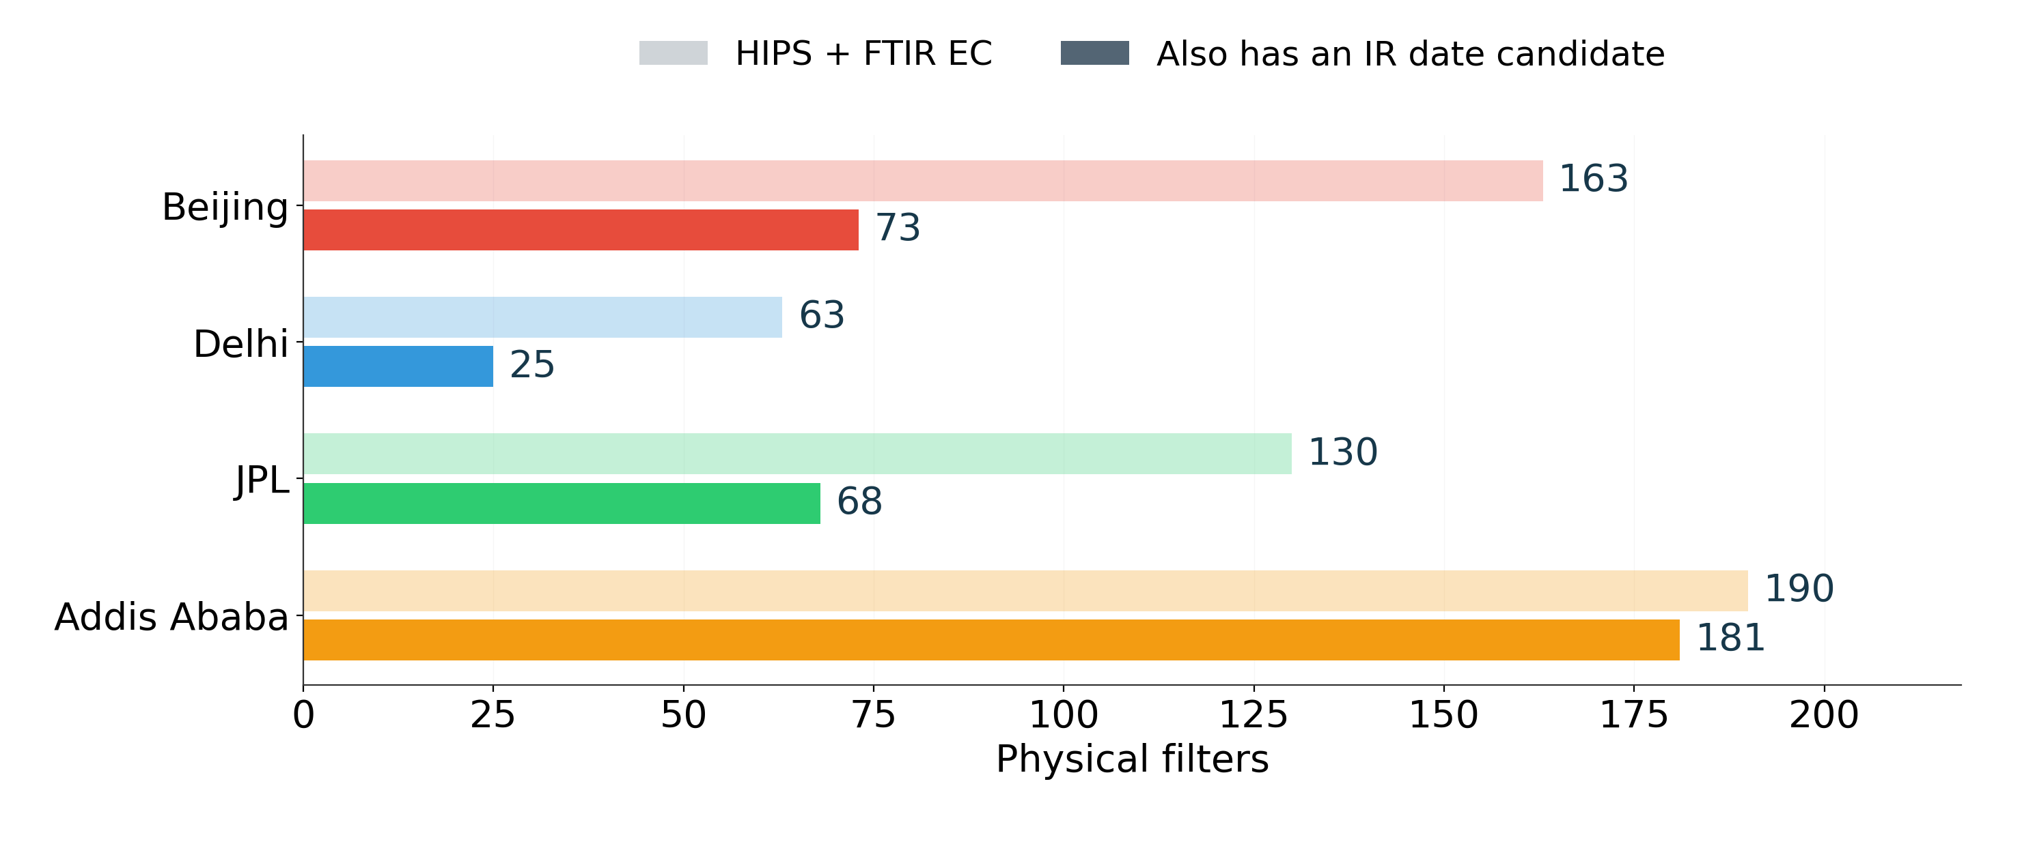
546 filter pairs, 347 IR date candidates
Date candidates still need verified sampling intervals. Counts precede registry exclusions.
10
Notes:
All finite HIPS/FTIR pairs appear here, including the registered Delhi exclusion. The darker bars are a subset with finite raw IR within the legacy ±1-calendar-day search. These 347 candidates do not establish a shared sampling interval or observed coverage. This catalog is separate from the 239-filter seasonal calibration cohort in the weekly presentation. One registered Delhi exclusion leaves 545 eligible HIPS/FTIR diagnostic pairs.
Sources:
/Users/ahmadjalil/github/aethmodular/docs/matched-sample-audit-2026-09-10.md
/Users/ahmadjalil/github/aethmodular/research/ftir_hips_chem/notebooks/archive/executed/matched_sample_audit_figures.ipynb
/Users/ahmadjalil/github/aethmodular/research/ftir_hips_chem/output/plots/matched_sample_audit/01_pair_availability.png
/Users/ahmadjalil/github/aethmodular/research/ftir_hips_chem/output/tables/matched_sample_audit_figures

Slide 11
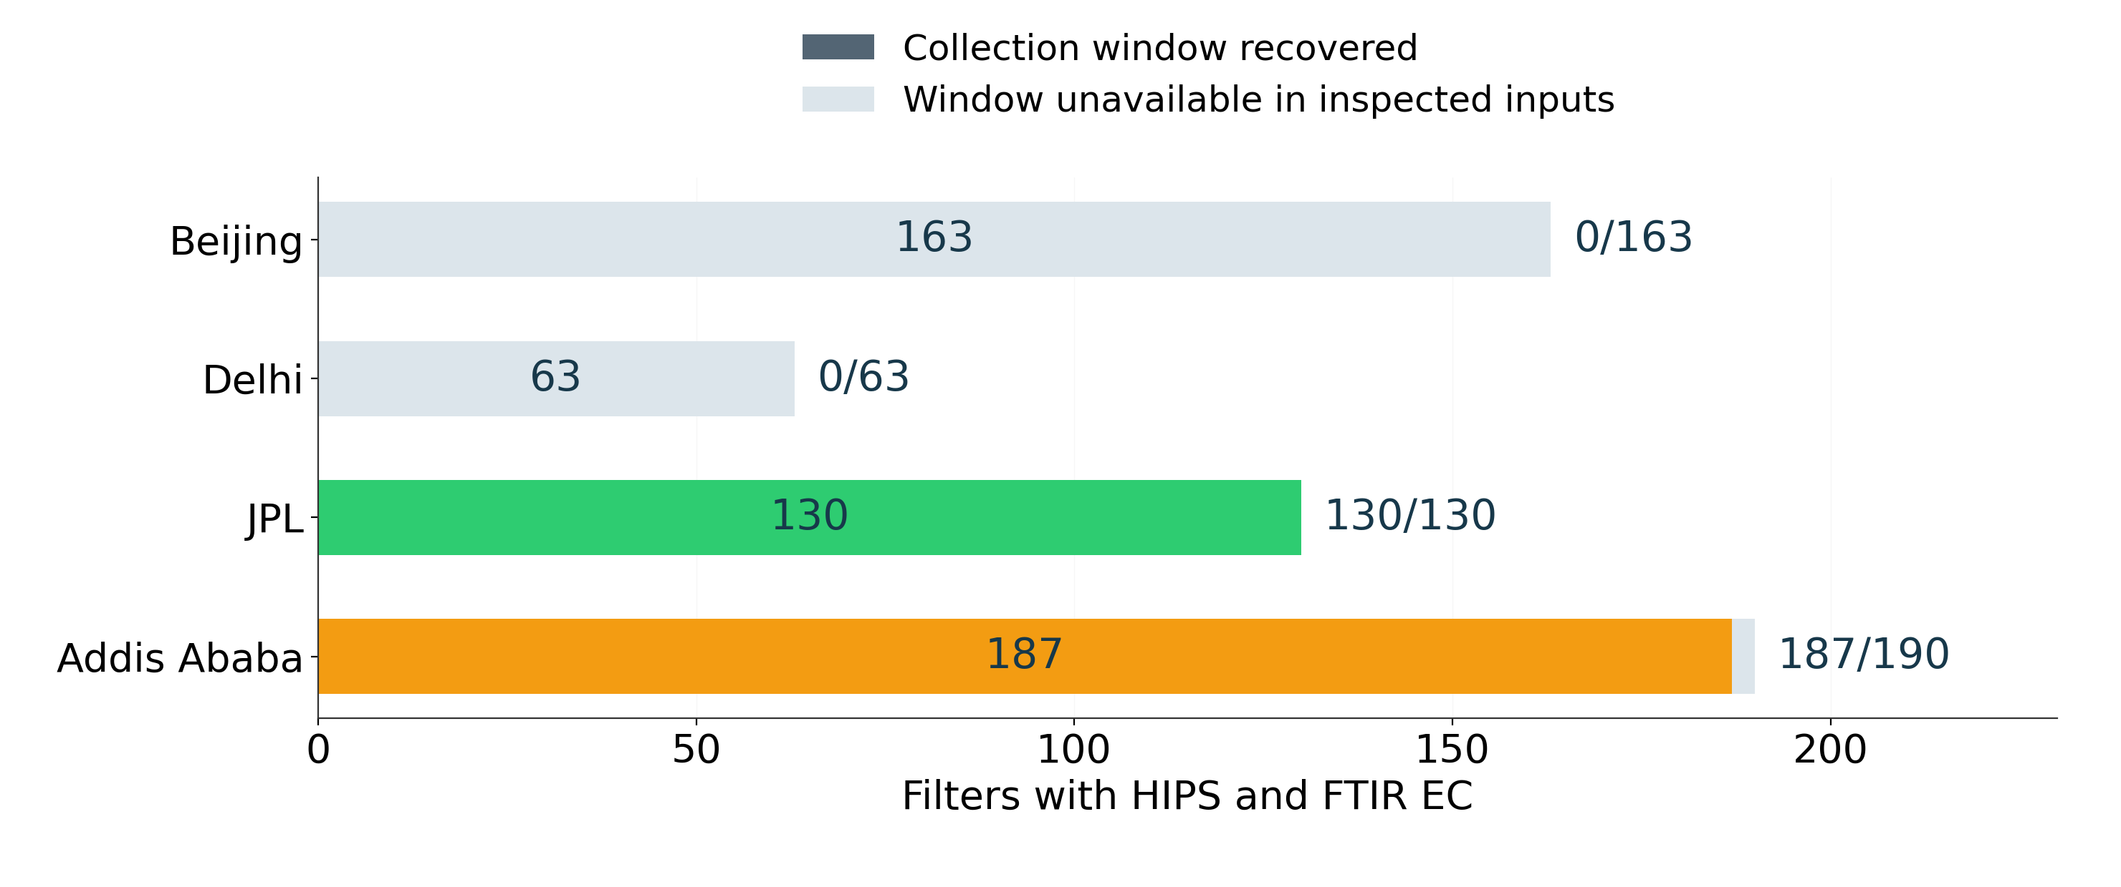
317 HIPS filters have collection windows
Window availability reflects the inspected sources. Active sampling periods remain unverified.
11
Notes:
Each complete bar contains the HIPS/FTIR pairs from the previous figure. Colored portions have positive-duration collection bounds recovered from portal records. Grey portions have no usable window in the inspected inputs. The current source directory supplied Addis and JPL exports only. Zeros for Beijing/Delhi describe that source coverage, not whether such metadata exist elsewhere. Recovered bounds still require active-period verification for intermittent collection.
Sources:
/Users/ahmadjalil/github/aethmodular/docs/matched-sample-audit-2026-09-10.md
/Users/ahmadjalil/github/aethmodular/research/ftir_hips_chem/notebooks/archive/executed/matched_sample_audit_figures.ipynb
/Users/ahmadjalil/github/aethmodular/research/ftir_hips_chem/output/plots/matched_sample_audit/02_metadata_availability.png
/Users/ahmadjalil/github/aethmodular/research/ftir_hips_chem/output/tables/matched_sample_audit_figures

Slide 12
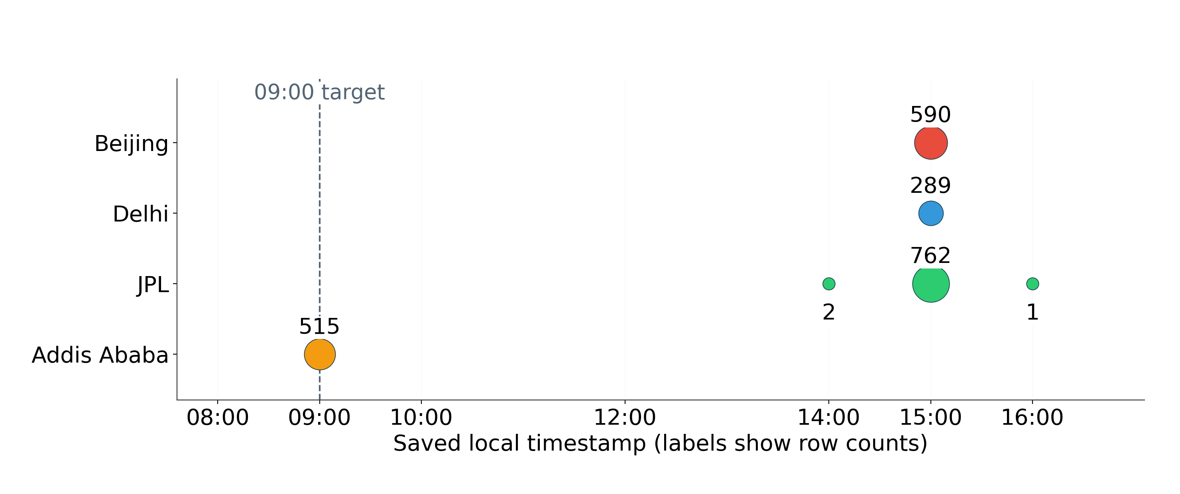
Saved timestamps cluster at 15:00
The source code is corrected. Existing saved averages still need rebuilding.
12
Notes:
Labels give the complete saved row counts at each local hour. Marker area increases with count but every nonempty hour remains visible. The old builder shifted by 15 hours despite its 9 AM label. The corrected code now defines local [09:00, next 09:00) intervals and accounts for elapsed DST minutes. Existing saved files have not been rebuilt. Relabeling their timestamps would not repair their averages.
Sources:
/Users/ahmadjalil/github/aethmodular/docs/matched-sample-audit-2026-09-10.md
/Users/ahmadjalil/github/aethmodular/research/ftir_hips_chem/notebooks/archive/executed/matched_sample_audit_figures.ipynb
/Users/ahmadjalil/github/aethmodular/research/ftir_hips_chem/output/plots/matched_sample_audit/03_timestamp_hours.png
/Users/ahmadjalil/github/aethmodular/research/ftir_hips_chem/output/tables/matched_sample_audit_figures

Slide 13
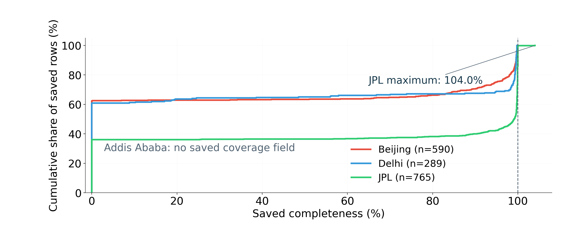
Saved completeness needs an observation audit
This saved field describes input availability. Observed IR coverage remains unverified.
13
Notes:
Empirical cumulative distributions include all finite saved completeness values, including zeros and the value above 100%. Denominators are all saved rows for each represented site. Addis has no such field and does not receive an invented zero. The original field counted first-channel non-null records relative to 1,440 minutes. It does not verify observed IR minutes, duplicate handling, DST duration, or interpolation history. The corrected pipeline requires explicit observation provenance to distinguish observed minutes from mere input availability.
Sources:
/Users/ahmadjalil/github/aethmodular/docs/matched-sample-audit-2026-09-10.md
/Users/ahmadjalil/github/aethmodular/research/ftir_hips_chem/notebooks/archive/executed/matched_sample_audit_figures.ipynb
/Users/ahmadjalil/github/aethmodular/research/ftir_hips_chem/output/plots/matched_sample_audit/04_completeness.png
/Users/ahmadjalil/github/aethmodular/research/ftir_hips_chem/output/tables/matched_sample_audit_figures

Slide 14
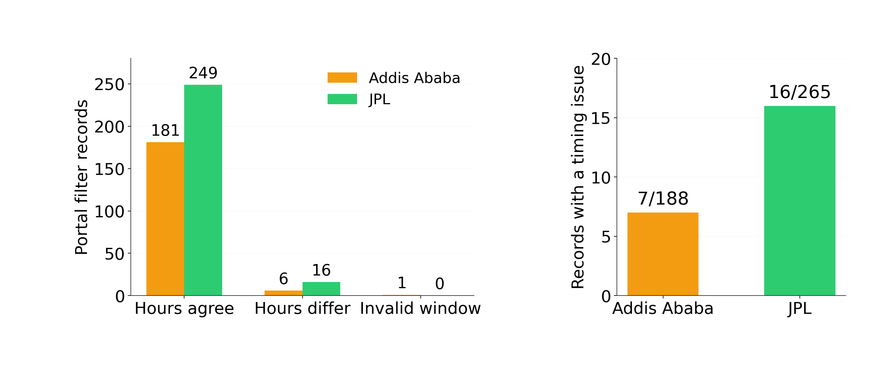
23 timing issues in 453 portal records
Agreement within 0.05 h checks metadata consistency. It does not establish continuous operation.
14
Notes:
Hours agree means a positive-duration window and reported sampled hours agreeing within 0.05 hours. It is a metadata consistency check, not proof of continuous operation. All 453 portal filter records remain in the count: Addis 181 consistent, 6 differing, 1 invalid; JPL 249 consistent, 16 differing. The right panel enlarges the issue counts using the same denominators. The separate one-day SampleDate disagreement for ETAD-0243 is not counted as an additional record.
Sources:
/Users/ahmadjalil/github/aethmodular/docs/matched-sample-audit-2026-09-10.md
/Users/ahmadjalil/github/aethmodular/research/ftir_hips_chem/notebooks/archive/executed/matched_sample_audit_figures.ipynb
/Users/ahmadjalil/github/aethmodular/research/ftir_hips_chem/output/plots/matched_sample_audit/05_timing_status.png
/Users/ahmadjalil/github/aethmodular/research/ftir_hips_chem/output/tables/matched_sample_audit_figures

Slide 15
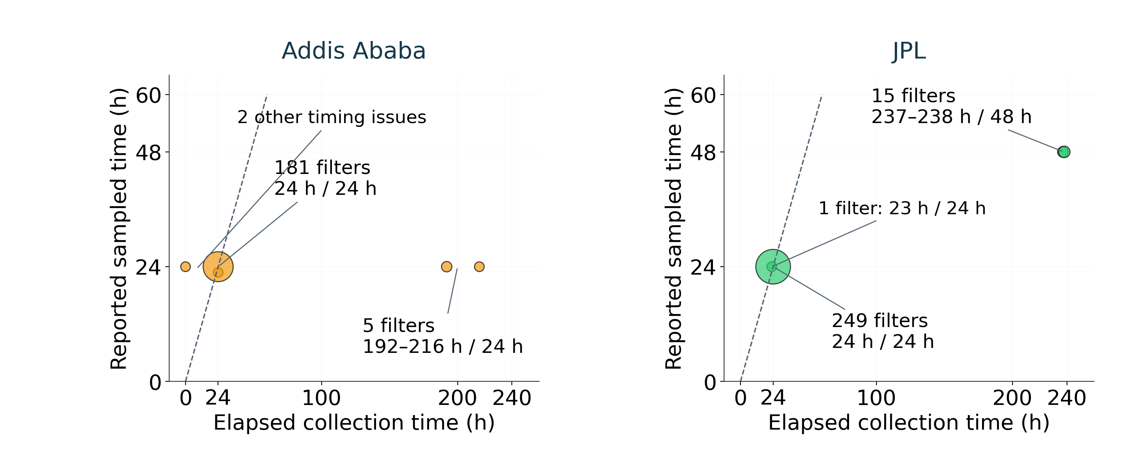
20 filters span several days of collection
Points group identical durations. Dashed line: equal hours. All 453 records contribute.
15
Notes:
Every portal filter contributes to a duration group. Coincident points are grouped by site, elapsed hours and sampled hours, with marker area increasing with group count. The dashed segment denotes equal hours; no regression or validation statistic is fitted. The horizontal axis has a wider range than the vertical axis. Five Addis filters report 24 sampled hours across 192–216 elapsed hours; 15 JPL filters report 48 sampled hours across 237–238 elapsed hours. The other three timing issues are ETAD-0163 (24 vs 22.8 h), ETAD-0178 (0 vs 24 h), and USPA-0243 (23 vs 24 h). UTC differences account for the local JPL daylight-saving change.
Sources:
/Users/ahmadjalil/github/aethmodular/docs/matched-sample-audit-2026-09-10.md
/Users/ahmadjalil/github/aethmodular/research/ftir_hips_chem/notebooks/archive/executed/matched_sample_audit_figures.ipynb
/Users/ahmadjalil/github/aethmodular/research/ftir_hips_chem/output/plots/matched_sample_audit/06_collection_durations.png
/Users/ahmadjalil/github/aethmodular/research/ftir_hips_chem/output/tables/matched_sample_audit_figures

Slide 16
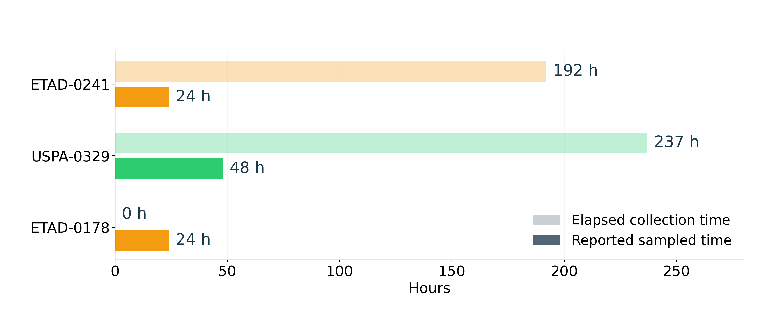
24 sampled hours within a 192-hour window
These bars compare totals. The actual on/off periods remain unknown.
16
Notes:
Examples are selected explicitly to show the two intermittent patterns and an invalid record, not to estimate their prevalence. ETAD-0241 spans 7–15 August 2024 locally: 192 elapsed hours, 24 reported sampled hours. USPA-0329 spans 6–16 March 2024 locally: 237 elapsed hours, 48 sampled hours. ETAD-0178 reports identical local start/end on 24 February 2024 despite 24 sampled hours. The bars compare totals only. They do not place sampled hours at the beginning of the window or identify any active interval. Active on/off records are needed before computing a matched aethalometer mean.
Sources:
/Users/ahmadjalil/github/aethmodular/docs/matched-sample-audit-2026-09-10.md
/Users/ahmadjalil/github/aethmodular/research/ftir_hips_chem/notebooks/archive/executed/matched_sample_audit_figures.ipynb
/Users/ahmadjalil/github/aethmodular/research/ftir_hips_chem/output/plots/matched_sample_audit/07_duration_examples.png
/Users/ahmadjalil/github/aethmodular/research/ftir_hips_chem/output/tables/matched_sample_audit_figures

Slide 17
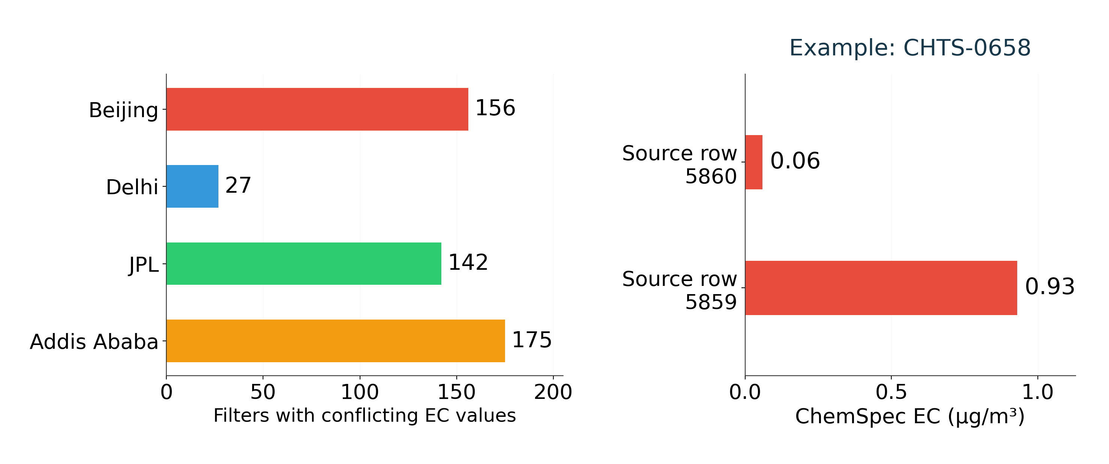
500 filters contain conflicting EC values
Original values remain separate. Independent EC validation needs a separate reference.
17
Notes:
The left chart counts physical-filter groups whose ChemSpec_EC_PM2.5 concentrations conflict in the unified table. This is a count of inconsistent groups, not a count of independent EC references or chemically invalid filters. CHTS-0658 illustrates the issue: source rows 5859 and 5860 carry 0.93 and 0.06 µg/m³ under the same parameter name and calibration label. Source-row positions are zero-based iloc offsets in the hashed input. The audit retains both and does not average or choose the first value. Existing repository provenance work identifies the concentration product as FTIR EC and ChemSpec BC as HIPS/10, subject to rounding. Independent EC validation requires a separate reference. The next comparison needs resolved parameter definitions, active sampling intervals, observed coverage and optical conversions before evaluating adjustments in withheld calendar periods.
Sources:
/Users/ahmadjalil/github/aethmodular/docs/matched-sample-audit-2026-09-10.md
/Users/ahmadjalil/github/aethmodular/docs/open-items.md
/Users/ahmadjalil/github/aethmodular/research/ftir_hips_chem/notebooks/archive/executed/matched_sample_audit_figures.ipynb
/Users/ahmadjalil/github/aethmodular/research/ftir_hips_chem/output/plots/matched_sample_audit/08_ec_conflicts.png
/Users/ahmadjalil/github/aethmodular/research/ftir_hips_chem/output/tables/matched_sample_audit_figures

Slide 18
Dry: full spectral range of both sets
394 IMPROVE filters in the actual fit and all 105 Addis filters. Grey = IMPROVE. Colour = Addis.
Thin lines show the full minimum–maximum envelope. Thick lines show the median. All individual traces are supplied separately.
18
Notes:
/Users/ahmadjalil/github/aethmodular/research/ftir_hips_chem/output/plots/ann_weekly_20260910/full_calibration_vs_addis_Dry__Oct_Feb.png
Complete 2002-channel data in the editable chart. Full-range envelope represents all actual training spectra and every seasonal Addis spectrum. The 500 selected filters include the TOR test subset, which does not enter the fit; the chart uses only actual training filters. This display summarizes the full set rather than choosing five examples. The downloadable PNG shows every individual trace. No extra smoothing or area normalization applied.

Slide 19
Belg: full spectral range of both sets
373 IMPROVE filters in the actual fit and all 61 Addis filters. Grey = IMPROVE. Colour = Addis.
Thin lines show the full minimum–maximum envelope. Thick lines show the median. All individual traces are supplied separately.
19
Notes:
/Users/ahmadjalil/github/aethmodular/research/ftir_hips_chem/output/plots/ann_weekly_20260910/full_calibration_vs_addis_Belg__Mar_May.png
Complete 2002-channel data in the editable chart. Full-range envelope represents all actual training spectra and every seasonal Addis spectrum. The 500 selected filters include the TOR test subset, which does not enter the fit; the chart uses only actual training filters. This display summarizes the full set rather than choosing five examples. The downloadable PNG shows every individual trace. No extra smoothing or area normalization applied.

Slide 20
Kiremt: full spectral range of both sets
390 IMPROVE filters in the actual fit and all 73 Addis filters. Grey = IMPROVE. Colour = Addis.
Thin lines show the full minimum–maximum envelope. Thick lines show the median. All individual traces are supplied separately.
20
Notes:
/Users/ahmadjalil/github/aethmodular/research/ftir_hips_chem/output/plots/ann_weekly_20260910/full_calibration_vs_addis_Kiremt__Jun_Sep.png
Complete 2002-channel data in the editable chart. Full-range envelope represents all actual training spectra and every seasonal Addis spectrum. The 500 selected filters include the TOR test subset, which does not enter the fit; the chart uses only actual training filters. This display summarizes the full set rather than choosing five examples. The downloadable PNG shows every individual trace. No extra smoothing or area normalization applied.

