Slide 1
FTIR elemental carbon calibrated on IMPROVE filters transfers poorly to heavily loaded samples like those in Addis Ababa, and to similar samples within IMPROVE
Ahmad Jalil¹,⁴, Sina Hasheminassab², Kyan Shlipak⁵,², Tesfaye Mamo Mekonnen³, Araya Asfaw³, Hossein Kazemian¹, Ann M. Dillner⁴
¹ Materials Technology & Environmental Research (MATTER) lab, University of Northern British Columbia, Prince George, BC, Canada
² NASA Jet Propulsion Laboratory, Pasadena, CA, USA
³ Addis Ababa University, Addis Ababa, Ethiopia
⁴ University of California Davis, Air Quality Research Center, Davis, CA, USA
⁵ Northwestern University, Evanston, IL, USA

Slide 2
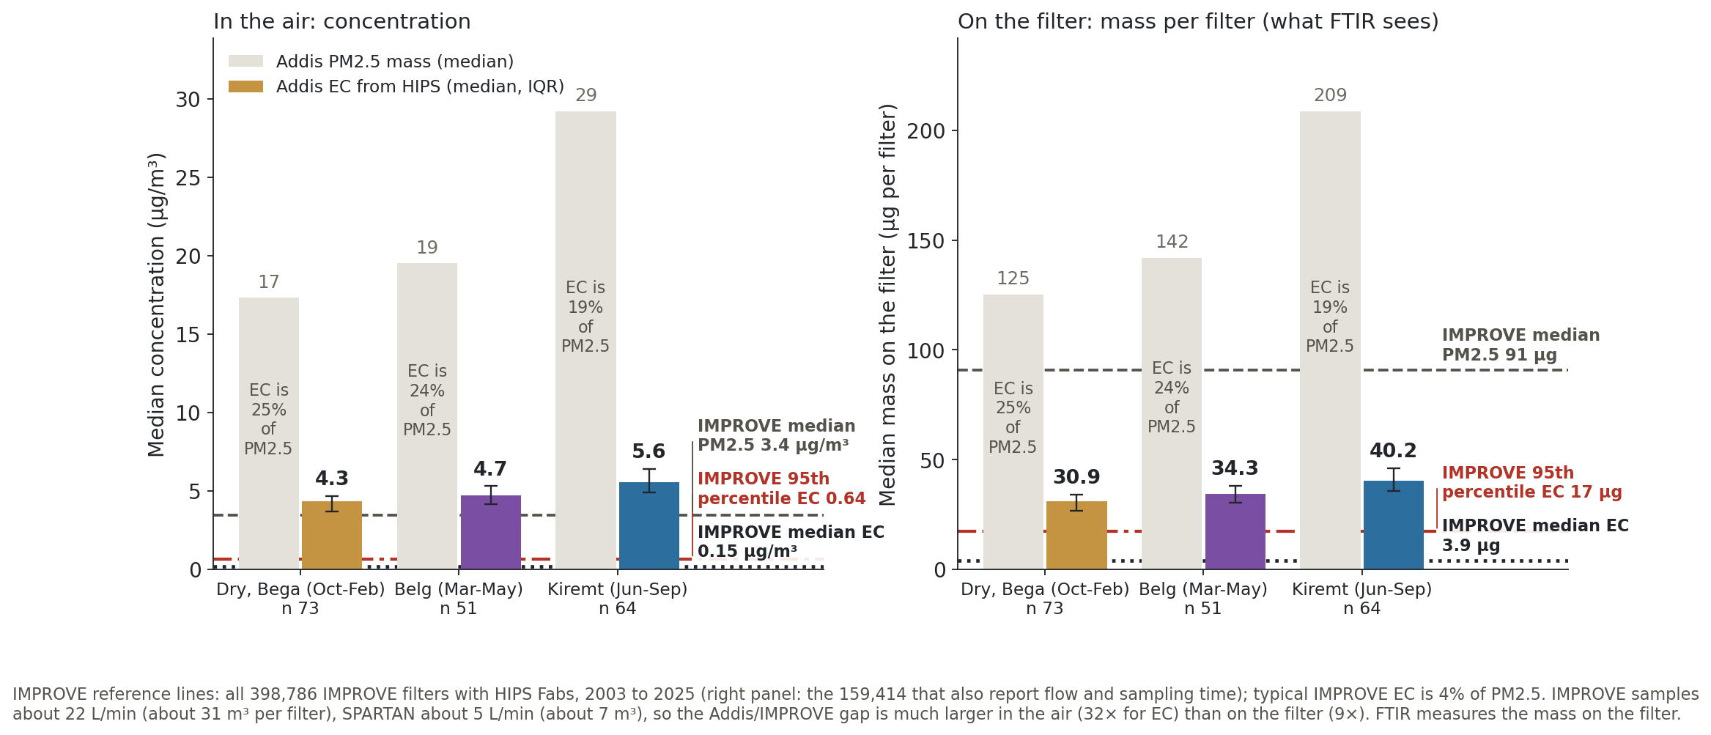
Elemental carbon in Addis Ababa is very high in every season, about 32× the typical IMPROVE level

Slide 3
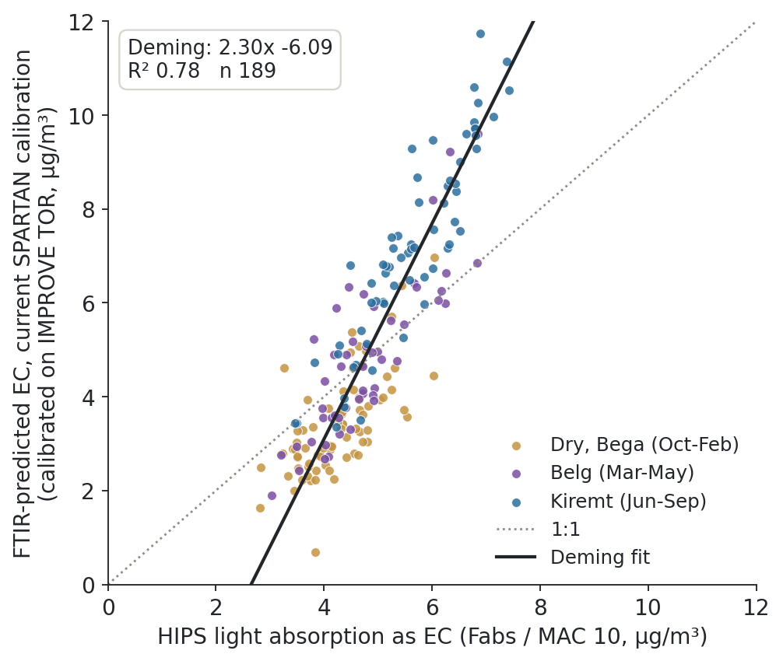
In Addis Ababa, current SPARTAN FTIR EC is well correlated with HIPS EC but on the wrong scale

Slide 4
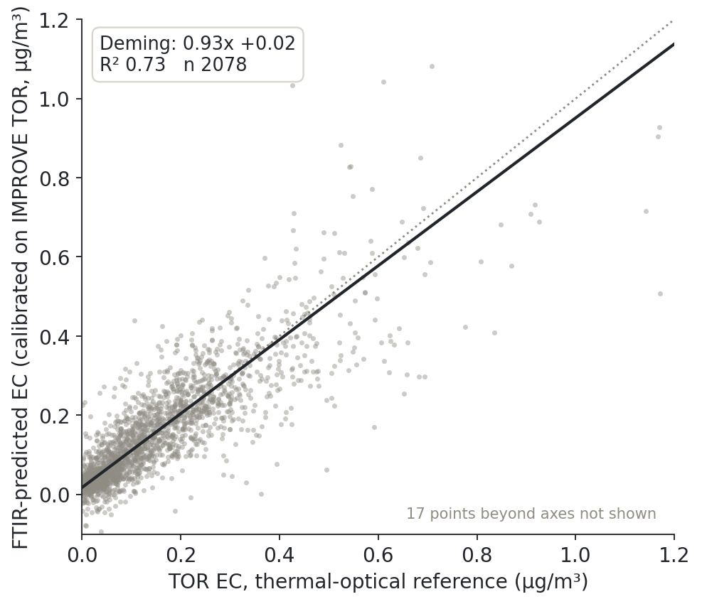
On typical IMPROVE filters, the same FTIR method predicts EC well

Slide 5
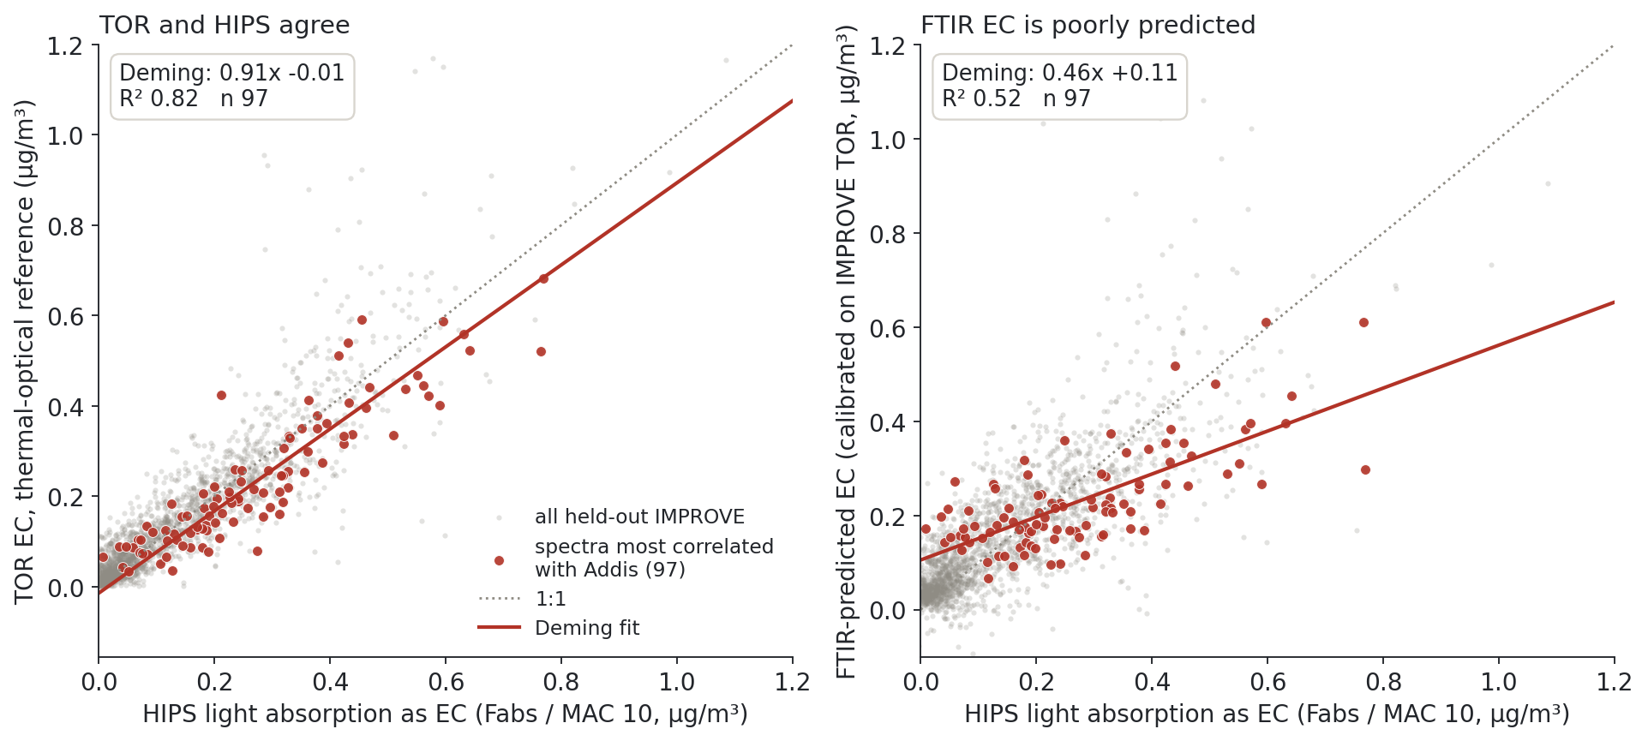
Current calibrations poorly predict IMPROVE FTIR EC for spectra similar to Addis Ababa spectra

Slide 6
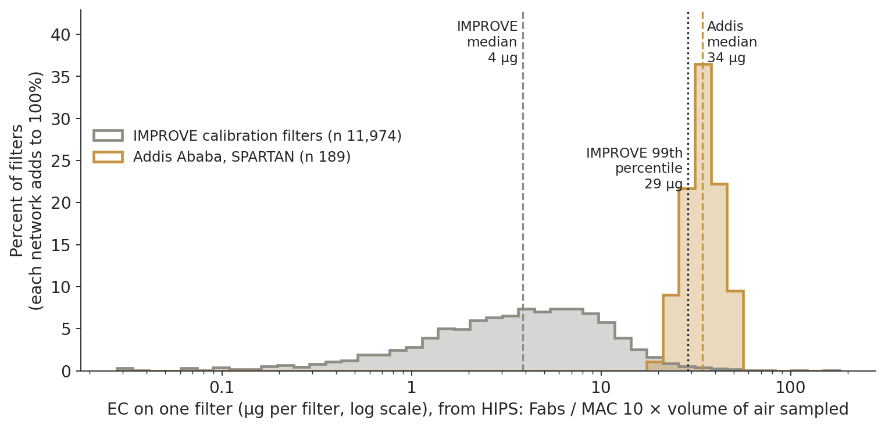
Addis filters carry about 9 times more EC per filter than a typical IMPROVE filter

Slide 7
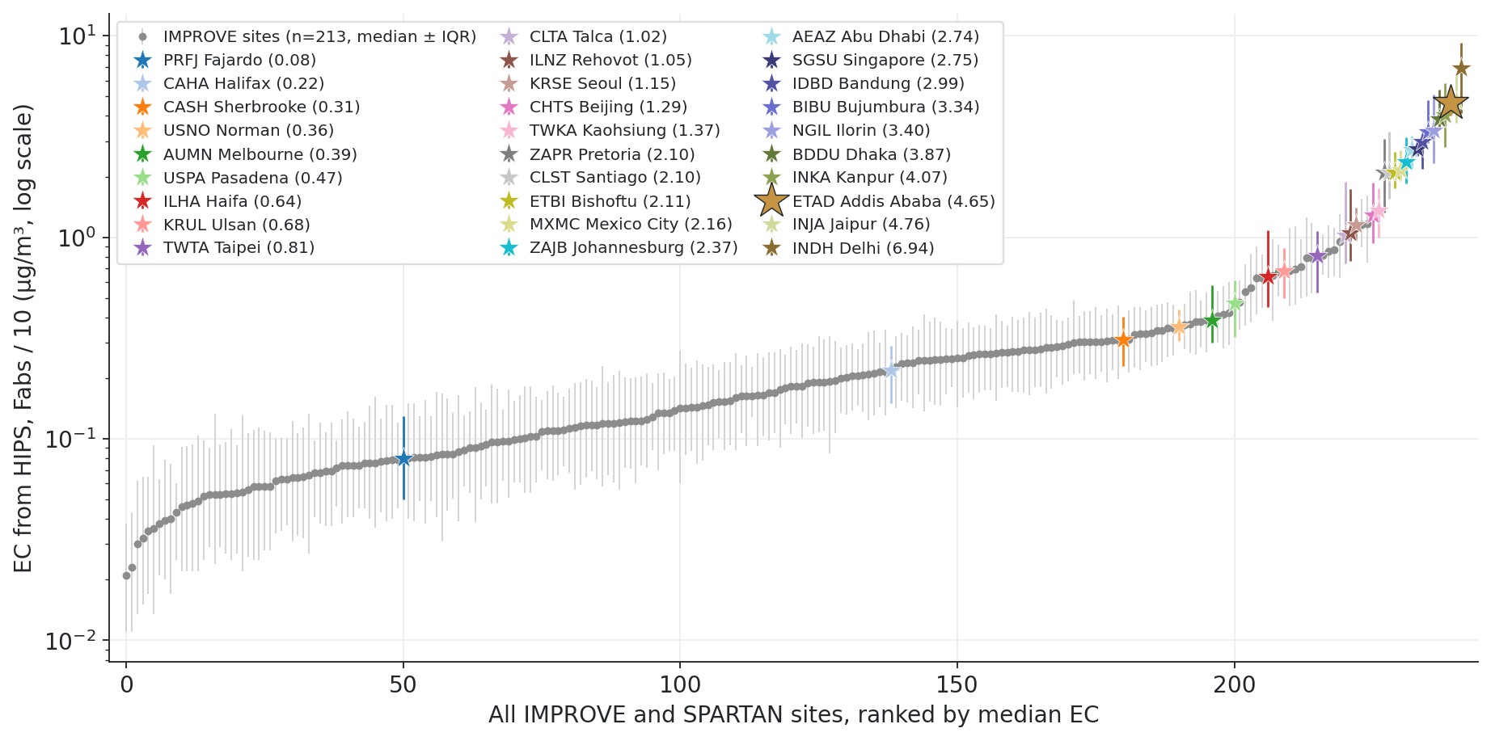
Addis Ababa EC is higher than at any IMPROVE site, and 28 of 29 SPARTAN sites sit above the typical IMPROVE site

Slide 8
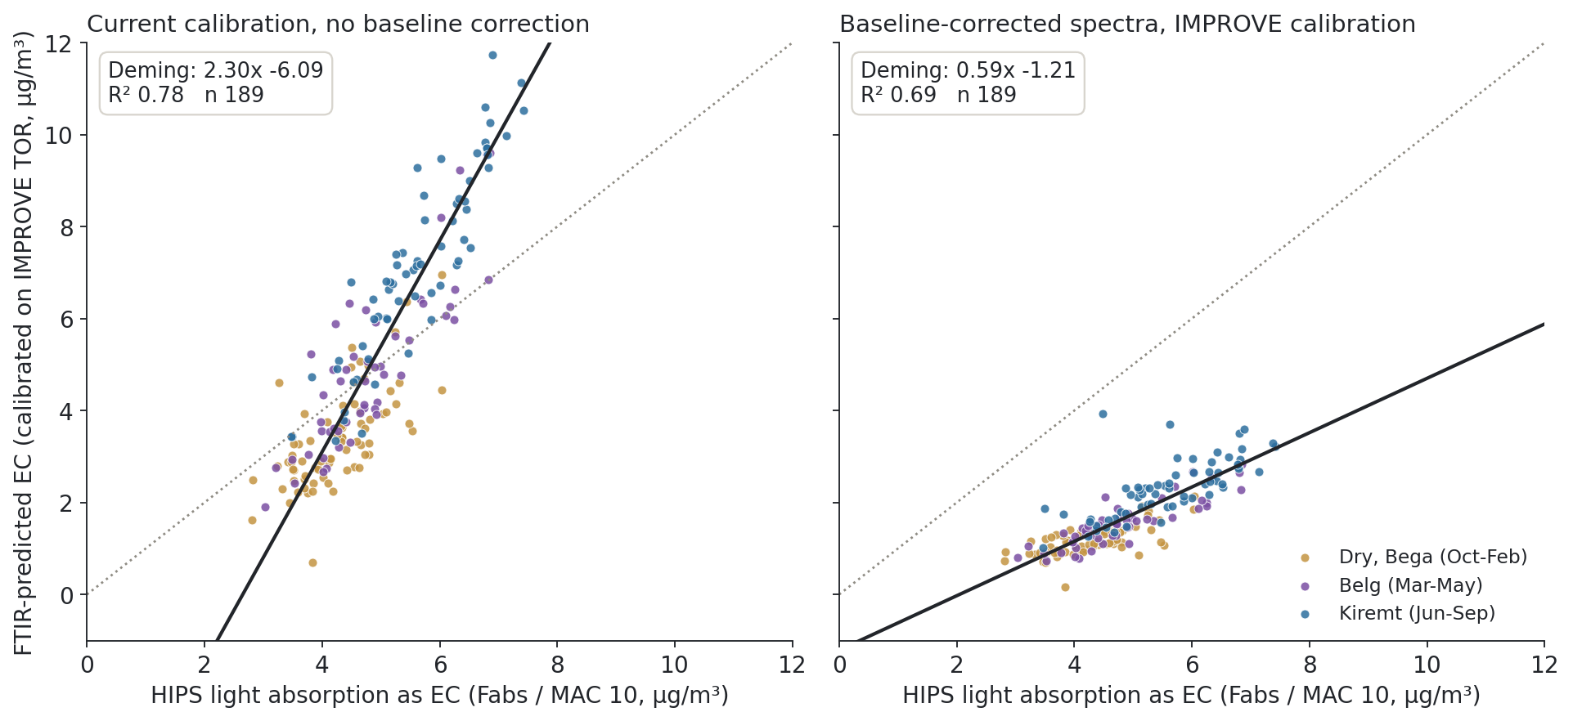
Baseline-correcting the spectra shrinks the Addis intercept from -6.1 to -1.2 µg/m³

Slide 9
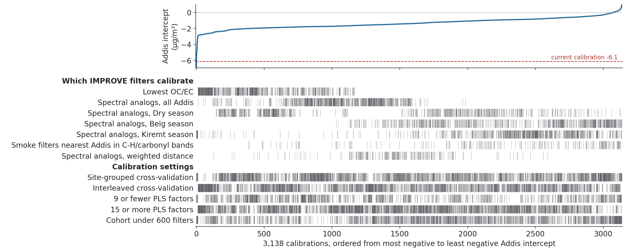
A calibration explorer lets us evaluate thousands of calibrations to improve EC predictions

Slide 10
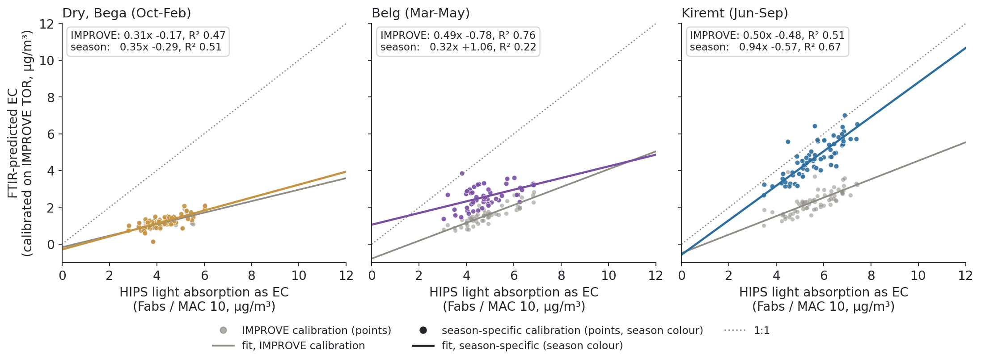
Season-specific calibrations help in Kiremt, but not yet in the Dry or Belg seasons

Slide 11
Conclusions
EC in Addis Ababa is very high, about 32× typical IMPROVE, and highest in the Kiremt rainy season.
Current FTIR calibrations poorly predict Addis EC, and also the IMPROVE filters whose spectra most resemble Addis.
Addis filters carry ~9× more EC than typical IMPROVE filters; most SPARTAN sites are also beyond IMPROVE.
Baseline correction helps: the Addis intercept goes from -6.1 to -1.2 µg/m³.
Season-specific calibrations help in Kiremt; a calibration explorer is helping us search for better ones.

