Slide 1
FTIR elemental carbon calibrated on IMPROVE filters transfers poorly to heavily loaded samples like those in Addis Ababa, and to similar samples within IMPROVE
Ahmad Jalil, Ann M. Dillner, Satoshi Takahama [FILL IN: affiliations, co-authors]
Notes:
SAY: This talk is about measuring elemental carbon, EC, in Addis Ababa, Ethiopia. First why we care: EC there is very high. Then the problem: the current FTIR calibration predicts Addis EC on the wrong scale, and the same calibration also struggles on the IMPROVE filters that look most like Addis. Then why: Addis filters carry far more EC than almost anything the calibration learned from. Then what we are doing about it: baseline correction, a calibration explorer to test thousands of calibrations, and season-specific calibrations.
NOTES: Practice run of the AAAR poster, laid out as slides first. Work in progress by design: the goal is feedback. Leave at least 20 minutes for questions; keep the first part of the discussion general.

Slide 2
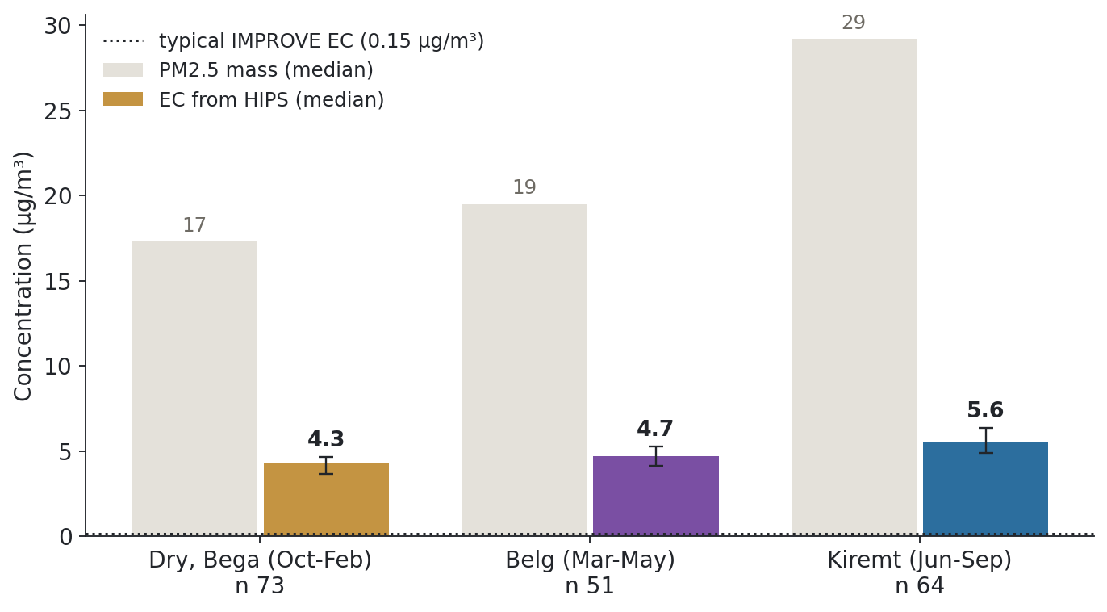
Elemental carbon in Addis Ababa is very high in every season, about 32× the typical IMPROVE level
Notes:
SAY: Addis Ababa has three seasons: a long dry season, the short Belg rains, and the main Kiremt rainy season. The grey bars are total PM2.5 and the coloured bars are elemental carbon, EC. Two things: the rainy Kiremt season has the worst air, and EC is very high in every season, around 4 to 6 µg/m³, against about 0.1 at a typical IMPROVE site, the dotted line. That is why we care about measuring EC well in Addis.
NOTES: EC = SPARTAN 'BC PM2.5', which is HIPS absorption / 10 (checked on Addis: median ratio 10.00), the same definition as IMPROVE fAbs / 10 for the dotted line (median over all IMPROVE filters in the FED export). Medians with IQR over the same 189 Addis filters used on every Addis slide; SPARTAN public release v3.1.4 (Aug 2026). Kiremt is partly worse because the boundary layer is shallow (ERA5 median ~370-410 m vs 650-800 m in Dry). Season names: Dry is also called Bega.

Slide 3
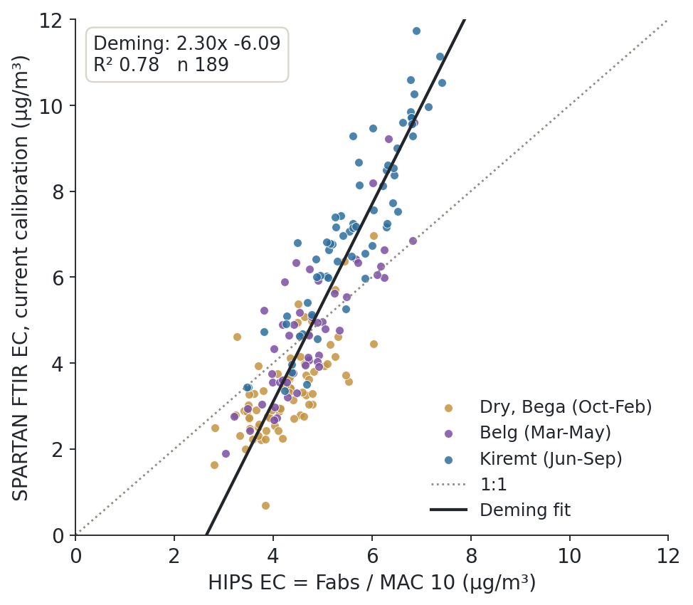
In Addis Ababa, current SPARTAN FTIR EC is well correlated with HIPS EC but on the wrong scale
Notes:
SAY: Here is the problem. Each point is one Addis filter. Along the bottom is EC from HIPS, an optical absorption measurement. Up the side is EC from FTIR with the current SPARTAN calibration. They are well correlated, R² 0.78, but the line has a slope of 2.3 and an intercept of -6 µg/m³: lower-EC filters, mostly dry season, come out too low, and the high Kiremt filters too high.
NOTES: Deming regression, HIPS EC = Fabs / MAC 10 on x. SPARTAN filters have no thermal-optical (TOR) analysis, so HIPS is the independent reference at Addis. n 189. The current calibration uses spectra without baseline correction (slide 8). Colours are the three seasons from slide 2.

Slide 4
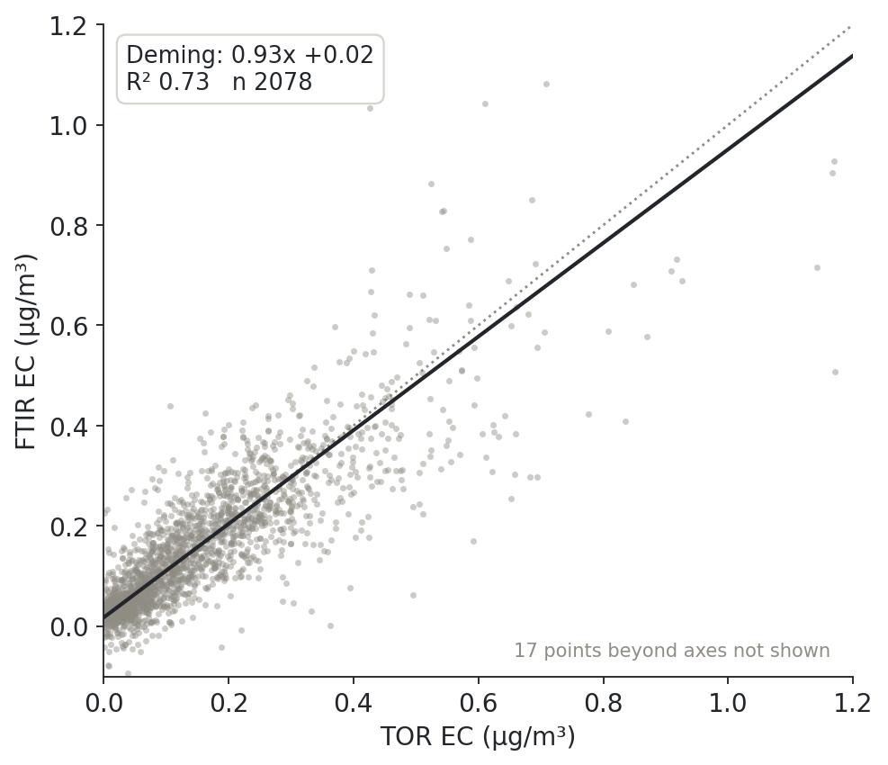
On typical IMPROVE filters, the same FTIR method predicts EC well
Notes:
SAY: Now IMPROVE, where filters have both FTIR and the thermal method, TOR. The calibration is built on IMPROVE filters and tested on filters from sites it never saw. On these 2,078 held-out filters, FTIR matches TOR well: slope 0.93, intercept close to zero, R² 0.73.
NOTES: Baseline-corrected (spline, AIRSpec) spectra, all-IMPROVE calibration on lot 251, held-out sites. TOR vs HIPS on the same filters: 1.19x -0.02, R² 0.72. FTIR vs HIPS on the same filters: 0.88x +0.04, R² 0.47. Axis clipped at 1.2 µg/m³.

Slide 5
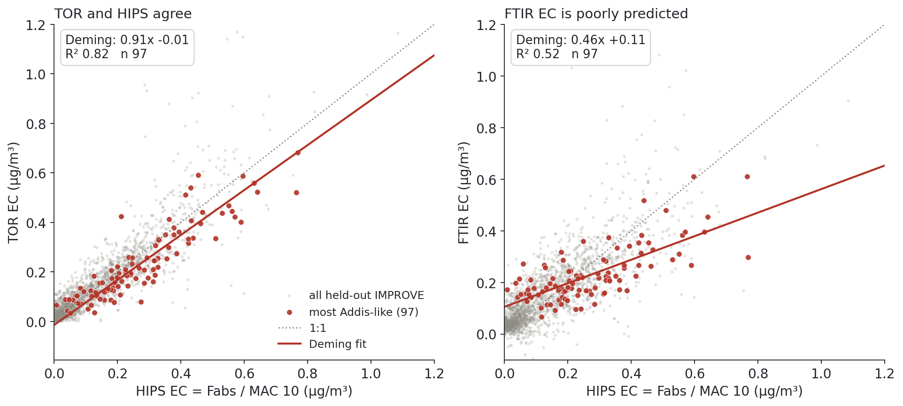
Current calibrations poorly predict IMPROVE FTIR EC for spectra similar to Addis Ababa spectra
Notes:
SAY: Out of the held-out IMPROVE filters, we picked the 97 whose infrared spectra look most like Addis Ababa, in red; grey is all held-out IMPROVE. On the left, TOR and HIPS agree on them: slope 0.91, R² 0.82. On the right, FTIR EC against HIPS: slope 0.46 and R² 0.52. FTIR is too high at the low end and too low at the high end. Same calibration as the last slide; only the samples changed. So the Addis problem also shows up inside IMPROVE, for its most Addis-like filters.
NOTES: Analogs: the 500 IMPROVE filters whose spectra correlate best with Addis; 97 are from held-out sites (88 lot 251, 9 lot 248) and none trained the calibration. Against TOR instead of HIPS: 0.48x +0.12, R² 0.46. Self-prediction: IMPROVE predicts IMPROVE well (slide 4), and the analogs fit well when they are themselves the calibration set (CV R² 0.5-0.9); the failure is transfer.

Slide 6
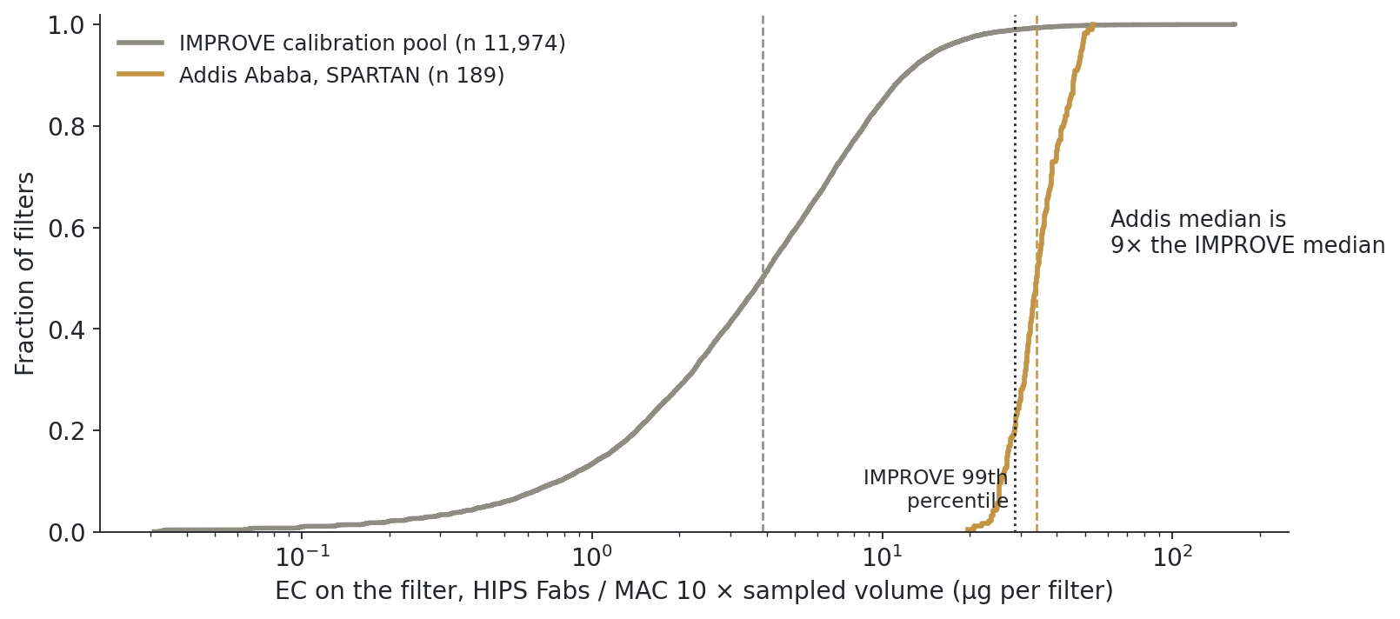
Addis filters carry about 9 times more EC per filter than a typical IMPROVE filter
Notes:
SAY: Why? This is how much EC sits on each filter, on a log scale: grey is the IMPROVE calibration pool, gold is Addis. The typical Addis filter has about 9 times more EC on it, and 79 percent of Addis filters are above IMPROVE's 99th percentile. The calibration has almost never seen filters like these.
NOTES: Per filter = HIPS Fabs / MAC 10 × sampled volume, so both networks are on the same footing (IMPROVE ~33 m³ per filter at 22 L/min, SPARTAN ~7 m³ at 5 L/min). Addis: the same 189 filters as slides 3, 8 and 10.

Slide 7
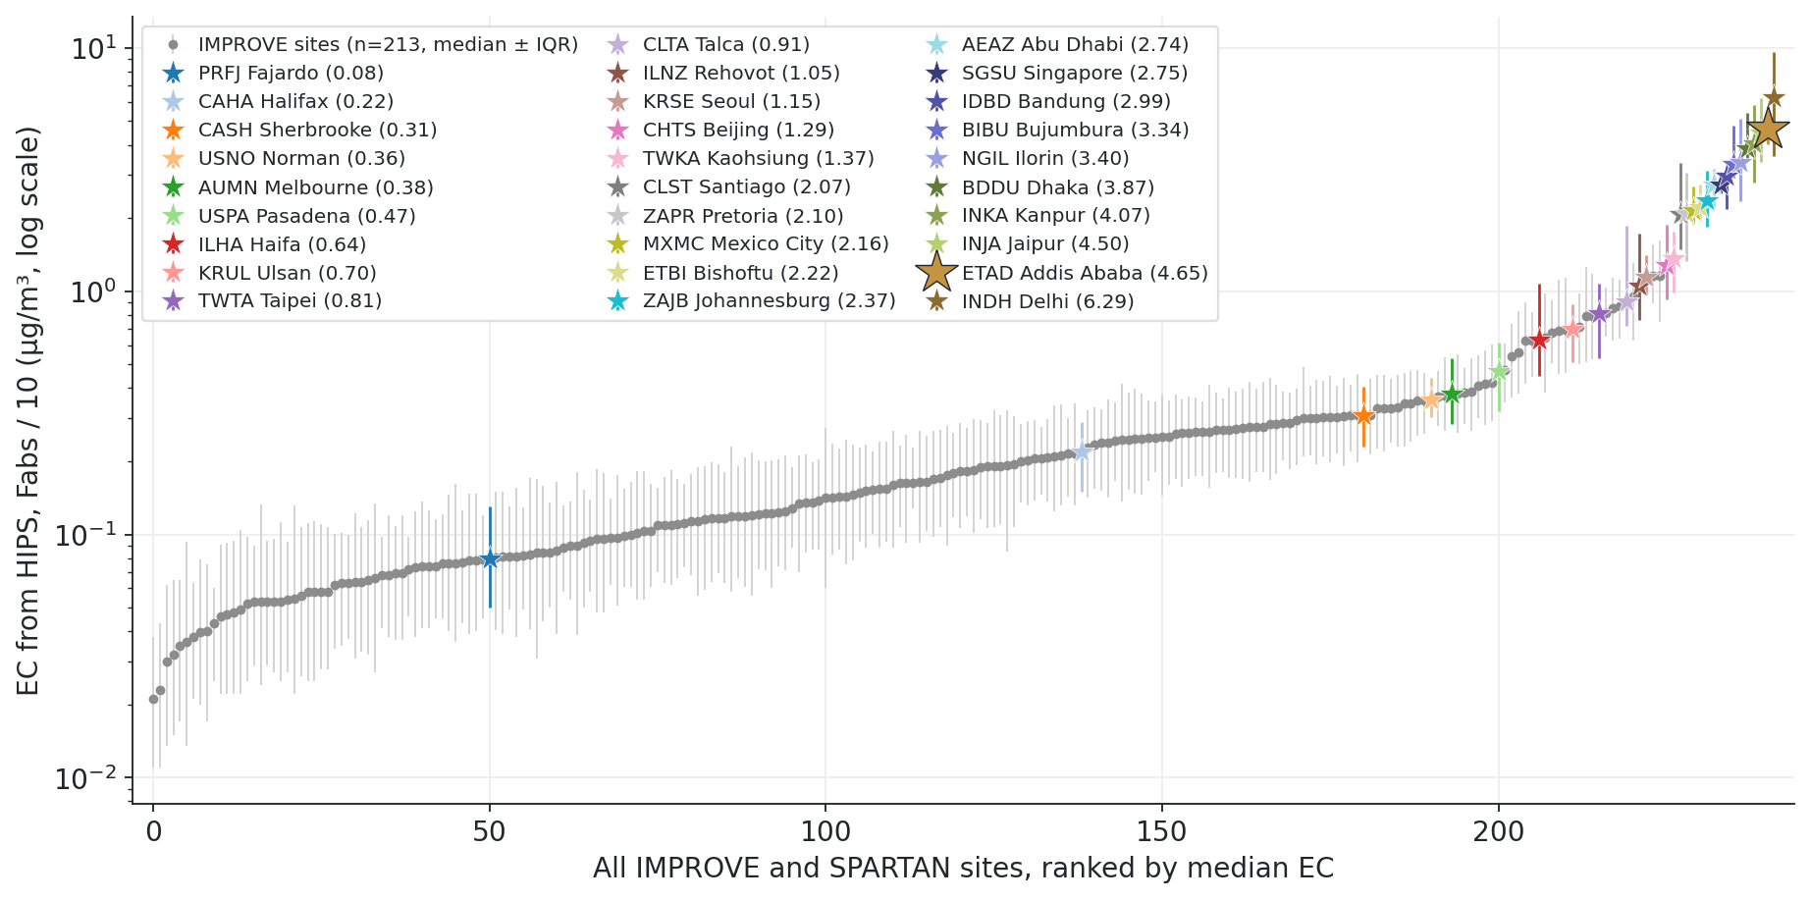
Addis Ababa EC is higher than at any IMPROVE site, and 28 of 29 SPARTAN sites sit above the typical IMPROVE site
Notes:
SAY: Every site in both networks, ranked by its typical EC. Grey dots are the 213 IMPROVE sites; each coloured star is one of the 29 SPARTAN sites around the world. Addis, the big gold star, is at about 4.7 µg/m³, above every IMPROVE site, and most SPARTAN sites sit at the high end. So this is not only Addis: the IMPROVE calibration network barely covers the EC levels much of the world lives with.
NOTES: EC from HIPS for both networks (IMPROVE fAbs / 10, SPARTAN 'BC PM2.5' = fAbs / 10), so no FTIR EC is used. SPARTAN BC values estimated from the HIPS-SSR curve (method 220) are left out; only HIPS measurements count. Site medians with IQR, log scale; every site, Addis included, uses all its public filters (Addis n 246), so the comparison is like for like across sites. IMPROVE sites with >= 50 filters (FED export, 1988-2025); SPARTAN >= 10 (public release v3.1.4). Addis is number 2 of 242 sites from the top; 17 SPARTAN sites are above the highest IMPROVE site (1.16 µg/m³). Concentration, not per-filter loading: per filter the SPARTAN values would be ~4.6x lower relative to IMPROVE. Table: figures/f5_ec_site_continuum.csv.

Slide 8
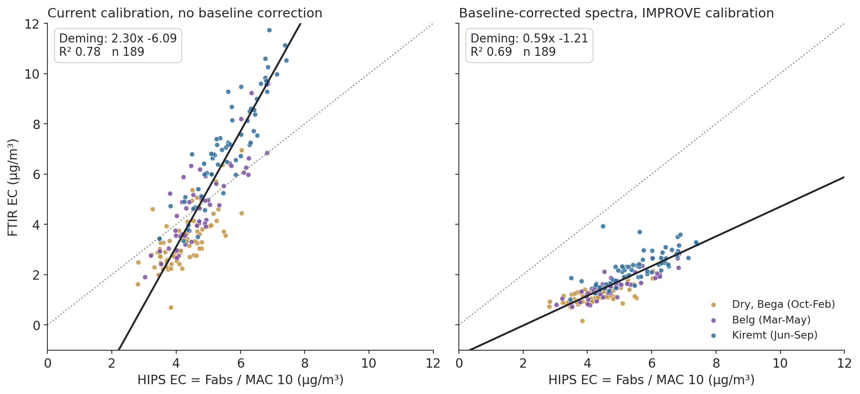
Baseline-correcting the spectra shrinks the Addis intercept from -6.1 to -1.2 µg/m³
Notes:
SAY: What are we doing about it? The first thing we learned is that the spectra need baseline correction. On the left is the current calibration, without it. On the right, the same Addis filters predicted by a calibration built on baseline-corrected IMPROVE spectra. The intercept moves from -6.1 to -1.2 µg/m³. The slope drops to 0.59, so FTIR now reads low at high EC: better, but not solved.
NOTES: Both panels: the same 189 Addis filters (those with a current SPARTAN FTIR EC value). Right: spline (AIRSpec) baseline, all-IMPROVE lot-251 calibration, R² 0.69; on all 233 filters it is 0.56x -1.08. The two calibrations differ in more than the baseline (training set and protocol too), so this is before/after for the approach, not a single-variable test. A second baseline method (VIBES) is being tested as well; it gives a more negative Addis intercept so far.

Slide 9
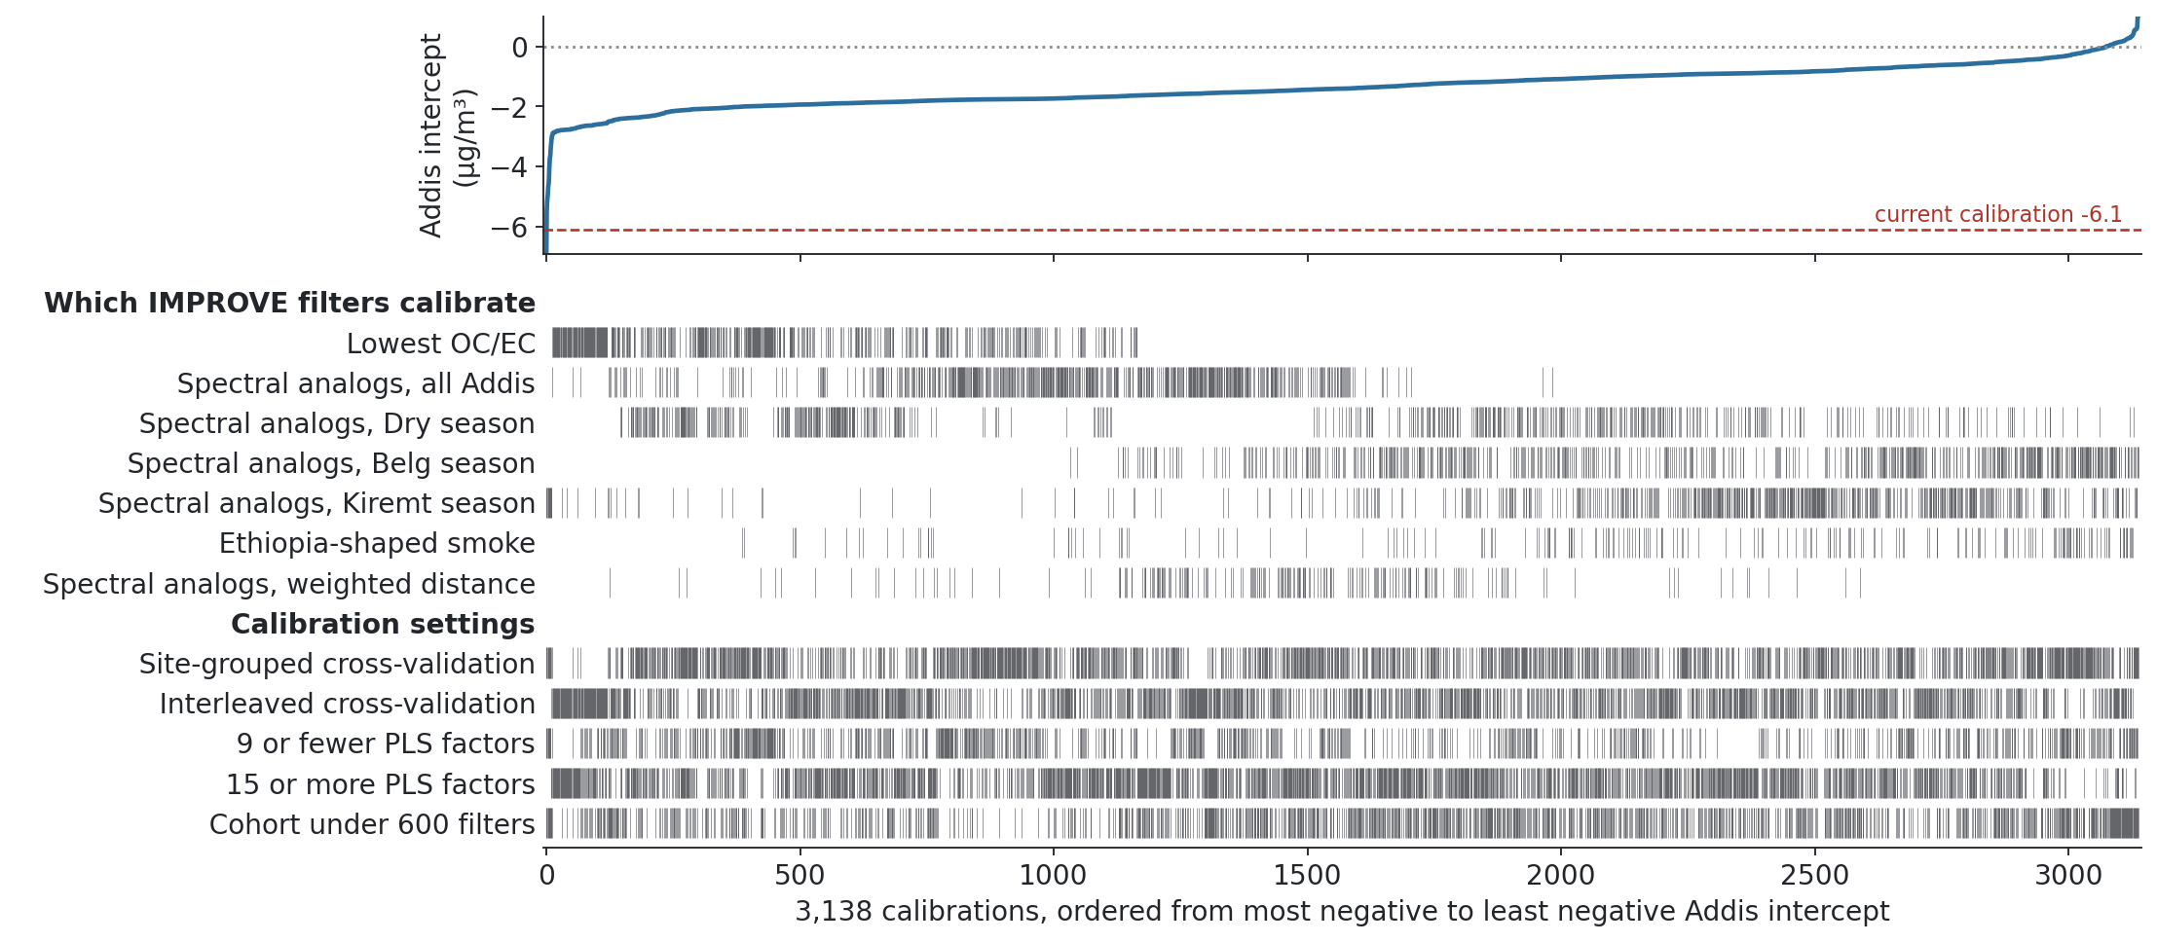
A calibration explorer lets us evaluate thousands of calibrations to improve EC predictions
Notes:
SAY: Next, we built a tool that runs and compares many calibrations. Here are 3,138 of them, all on baseline-corrected spectra, ordered by how far off their Addis intercept is, from worst on the left to best on the right. The top line is that intercept; the current calibration is the red dashed line. Underneath, each row shows which calibrations used a choice: first, which IMPROVE filters to calibrate with, for example filters with the lowest OC/EC, or filters whose spectra look like each Addis season; second, the calibration settings. 3,137 of the 3,138 do better than the current calibration, and 254 get the intercept within half a microgram of zero, though not always with a good slope. We have not found a calibration that gets Addis right yet, but this is how we are searching.
NOTES: Spline baseline only (the VIBES baseline and no-baseline runs have their own versions of this plot). Deming intercept at MAC 10, median -1.4 µg/m³. Settings rows: cross-validation scheme, number of PLS factors and cohort size; name them if asked, but don't go into them. The explorer scores all 233 Addis filters with HIPS (its stored grid has no per-filter predictions to re-score), while slides 3, 8 and 10 use the 189 that also have a current SPARTAN value. From the gallery export gallery/app/public/data/meeting-r70/spec_curve_20260917.json (rank-70 run).

Slide 10
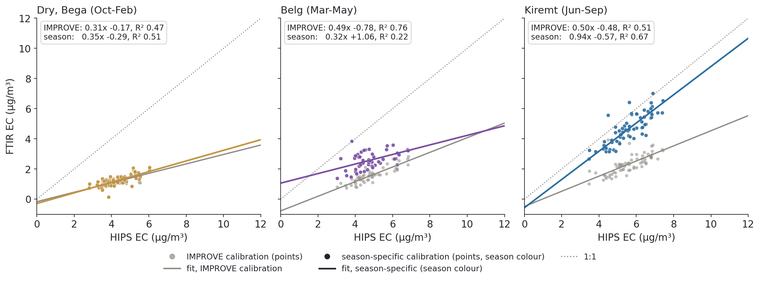
Season-specific calibrations help in Kiremt, but not yet in the Dry or Belg seasons
Notes:
SAY: One option we tried: a separate calibration for each Addis season, built from the IMPROVE filters whose spectra look most like that season. Grey points and the grey line are the single IMPROVE calibration from slide 8; coloured points and line are the season-specific one; the dotted line is 1:1. In Kiremt the slope improves from 0.50 to 0.94 and R² from 0.51 to 0.67. In the dry season it barely changes, and in Belg it gets worse. So seasonality matters, and it is one of the levers we are exploring.
NOTES: Each season: 500 IMPROVE spectral analogs (correlation, spectral region 600-3600 cm⁻¹ without CO₂ and the Teflon band), spline baseline, site-grouped calibration. Dry 0.31x -0.17 -> 0.35x -0.29; Belg 0.49x -0.78 -> 0.32x +1.06; Kiremt 0.50x -0.48 -> 0.94x -0.57. Putting the three seasonal predictions together gives 1.51x -4.59 overall, because each season lands at a different offset. Same 189 Addis filters as slides 3 and 8.

Slide 11
Conclusions
EC in Addis Ababa is very high, about 32× typical IMPROVE, and highest in the Kiremt rainy season.
Current FTIR calibrations poorly predict Addis EC, and also IMPROVE filters with Addis-like spectra.
Addis filters carry ~9× more EC than typical IMPROVE filters; most SPARTAN sites are also beyond IMPROVE.
Baseline correction helps: the Addis intercept goes from -6.1 to -1.2 µg/m³.
Season-specific calibrations help in Kiremt; a calibration explorer is helping us search for better ones.
Notes:
SAY: To sum up. Addis has very high EC, and the calibrations built on IMPROVE do not predict it well, for Addis and for the IMPROVE filters that look like Addis. Addis filters are far heavier than what the calibration has seen. Baseline correction is a real improvement, season-specific calibrations help in one season, and we have a tool to test many more options. I would love your ideas on what to try next.
NOTES: Open for discussion: VIBES baseline; the 14 Oct k-sweep (Addis intercept gets more negative with more PLS factors: spline -0.1 to -1.6, VIBES -0.3 to -7.0 µg/m³ at k 2 to 20); OC/fAbs by site (Addis lowest of the IMPROVE sites, a possible reason; not on a slide); boundary-layer normalisation; Chile sites after AAAR.

