Slide 1
FTIR EC at Addis Ababa: one intercept problem, a huge space of choices
Ahmad Jalil
UNBC / UC Davis AQRC
FTIR group, 27 Aug 2026
Notes:
SAY: Four parts today. One: Addis is different, and you can see it in the spectra themselves. Two: depending on which samples we use as the calibration set, whether we baseline-correct, and how we pick the model, we get a huge array of possible answers; I will show a few illustrative ones, then the full search. Three: what the filters and lots contribute. Four, and this is the part I want your input on: what constraints and what validation would make a choice defensible. Discussion questions are at the end.
NOTES: Conventions: Deming regression (errors in both variables) at MAC 10, intercepts in ug/m3 everywhere; 'baseline-corrected (using AIRSpec)' on first mention, then 'baseline-corrected'. Every result slide names its calibration set and its prediction target.

Slide 2
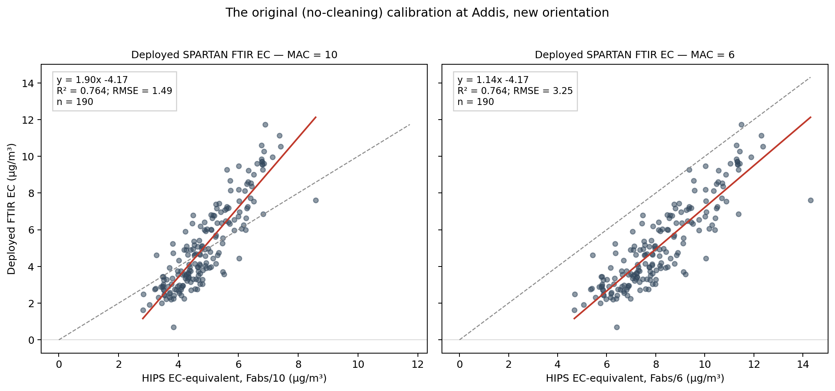
The problem: the deployed calibration predicts Addis at 1.90x with a -4.2 µg/m³ intercept
Notes:
SAY: Where this starts. Using the network's deployed calibration to predict the Addis samples, against HIPS: slope 1.9, intercept minus 4.2 micrograms per cubic meter. Something reads absorption at Addis that the predicted EC cannot explain, at a site where the satellite work needs ground truth. Everything today is the anatomy of that line.
NOTES: Deployed EC exists only for the fixed 190 filters. At MAC 6 the same predictions read 1.14x-4.17: the Deming intercept is MAC-invariant, MAC only pivots the slope. x-axis is Fabs/MAC in ug/m3.

Slide 3
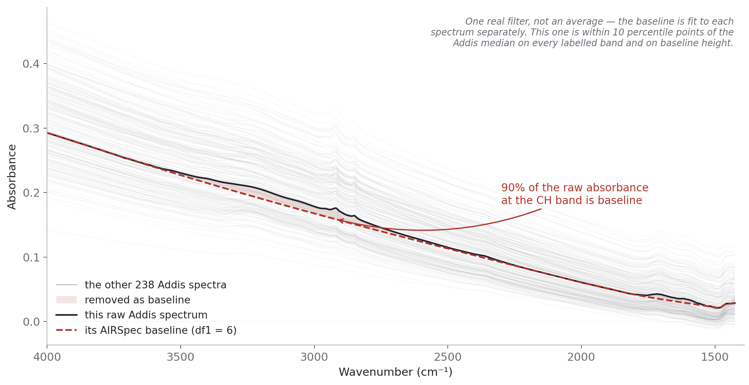
A raw FTIR spectrum is mostly filter background, not chemistry
Notes:
SAY: Before any calibration: what the instrument hands us. Every faint grey line is one of the 239 Addis filters; the black line is a single real filter, not an average; the red dashed line is the background fitted underneath it. Nearly everything is a smooth scattering slope from the PTFE filter and the deposit. At the CH band, about ninety percent of what we measure is background.
NOTES: Representative filter picked within 10 percentile points of the Addis median on four bands AND background height; picking on the CH band alone is a trap (that filter sits at the 92nd percentile of O-H). Split from the old two-panel figure at full resolution per the run-through (the pasted pair rendered blurry).

Slide 4
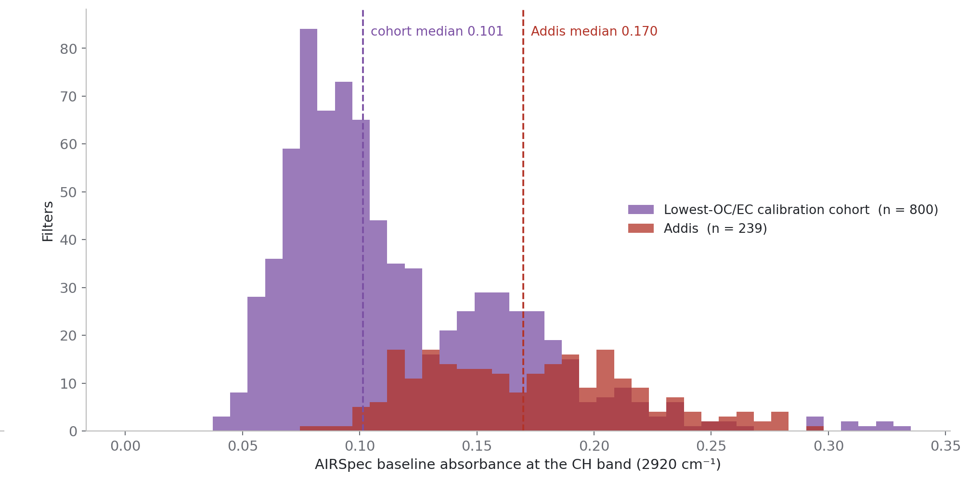
and Addis rides a higher background than the calibration samples
Notes:
SAY: The size of that background, one value per filter: Addis in red at a median of 0.17, the low-OC/EC IMPROVE calibration samples at 0.10. A model trained on raw spectra can learn background that does not transfer from the calibration set to Addis. That is the mechanism behind most of what follows.
NOTES: Background = fitted baseline height at 2920 cm-1. Companion half of the previous figure, full resolution.

Slide 5
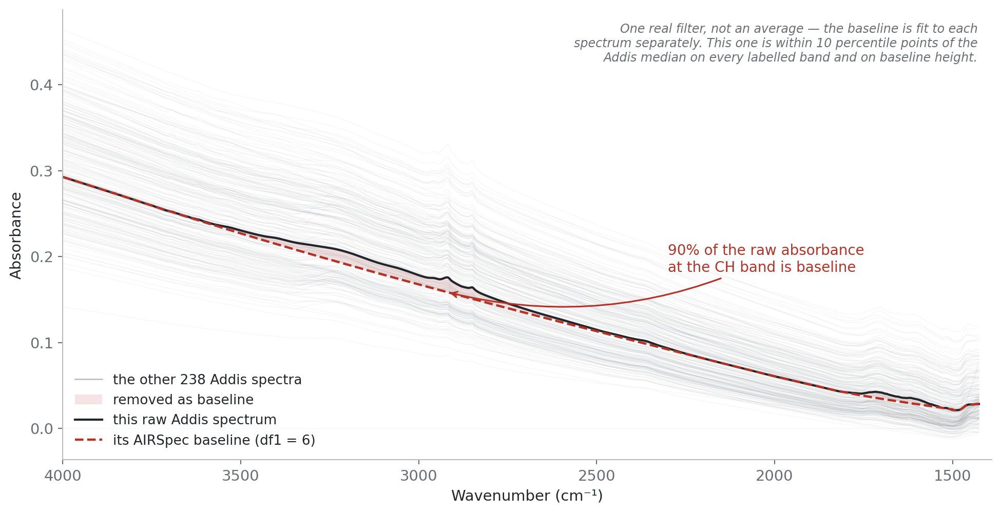
Baseline correction (using AIRSpec): fit the background and remove it
Notes:
SAY: What baseline-correcting means operationally: fit a smooth baseline under the analyzed segments of each spectrum and subtract it, so the calibration sees chemistry instead of background. We use the baseline-correction step of AIRSpec for this; from here on I will just say baseline-corrected.
NOTES: AIRSpec also computes functional groups; we use ONLY its baseline-correction step (Ann's language rule). Validated Python port of APRLssb, matches R to ~1e-7. Nagendra, Mona and Naveed know AIRSpec, so the name lands with this group.

Slide 6
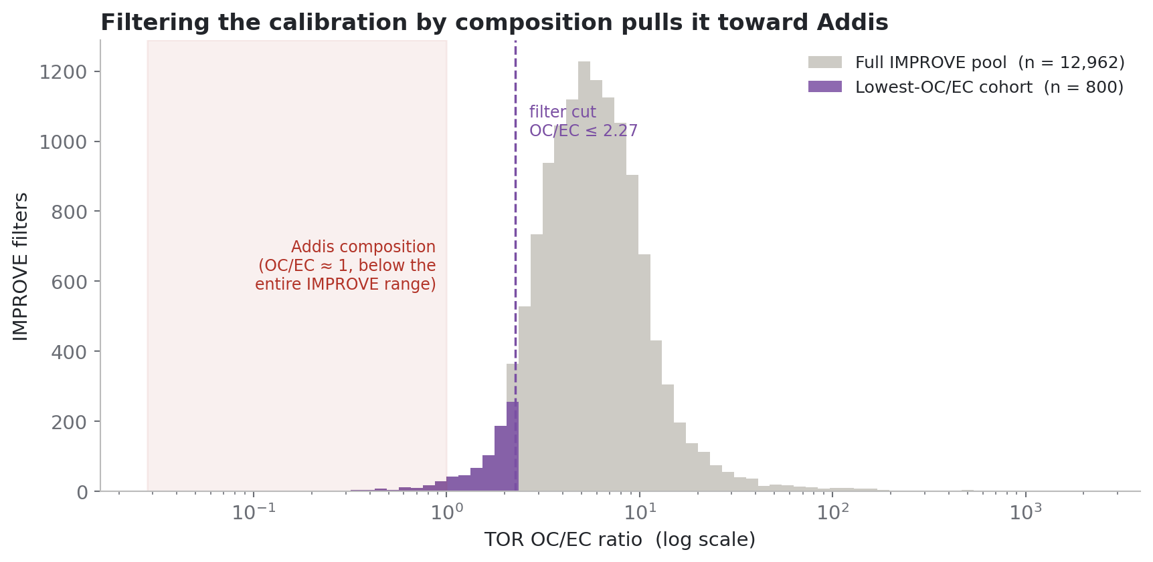
Choosing calibration samples by composition: keep the lowest-OC/EC IMPROVE samples
Notes:
SAY: First way of choosing a calibration set. Addis sits at the extreme low end of the OC-to-EC ratio, in the red range, where the IMPROVE pool has very few samples. So: rank every IMPROVE sample by OC/EC and keep the lowest N as the calibration set, to predict the Addis samples. We started with N of 800 as a compromise between being composition-like and having enough samples; how arbitrary that was comes up in a few slides.
NOTES: Cut at 800 = OC/EC <= 2.27. Addis barely overlaps the pool at all, which seeds discussion question 4 (is spectral similarity more defensible than OC/EC similarity, given the non-overlap?).

Slide 7
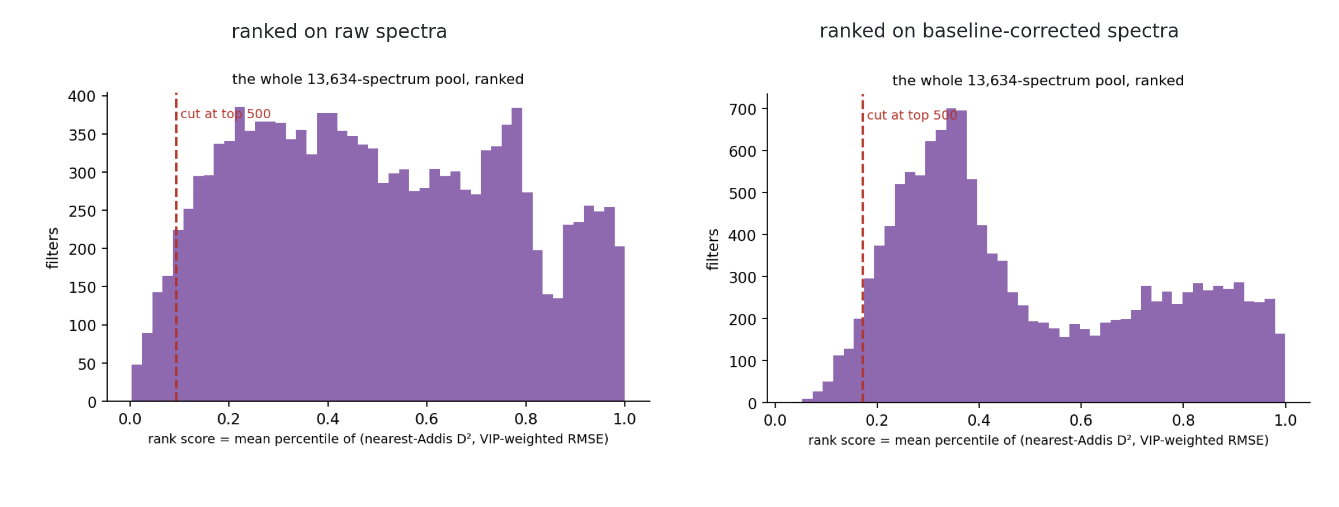
Choosing by spectral shape, and baselining changes which samples get picked
Notes:
SAY: Second way: rank the whole pool by how close each spectrum is to the Addis spectra, and keep the closest 500 as the calibration set. Top: ranking computed on raw spectra. Bottom: the identical recipe on baseline-corrected spectra. The shape of the ranking changes completely; left, ranked on raw spectra; right, the identical recipe on baseline-corrected spectra, where a clear near-Addis population emerges; the two rankings share almost no filters. So even the choice of similarity space is a choice that matters.
NOTES: Left diagnostic scatter panels removed per the run-through (not intuitive). Under corrected selection only 4 of 477 raw-selected filters survive: the raw similarity was matching filter background, exactly Satoshi's suspicion. 'Top 500' resolves to 477 after TOR eligibility.

Slide 8
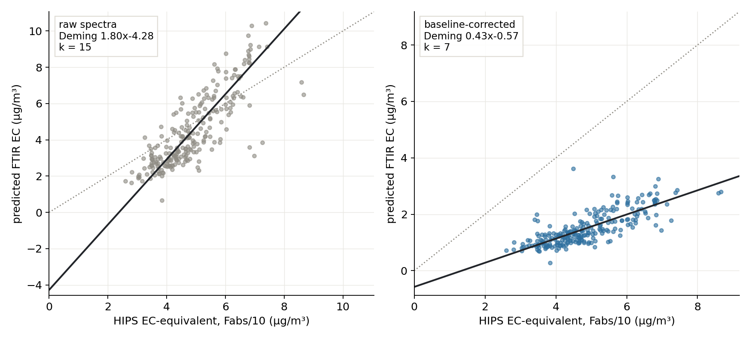
Baselining transforms the answer: the intercept moves from -4.3 to -0.6 µg/m³, but the slope collapses
Notes:
SAY: The one before-and-after graph. Same calibration set, the entire IMPROVE network; same Addis prediction target; the only change is baseline correction. The intercept goes from minus 4.3 to minus 0.6. But look at the slope: 0.43. Baselining alone buys a small intercept almost anywhere, at the price of a collapsed slope; which samples you calibrate on decides whether you keep both. That is the next slide.
NOTES: Site-grouped model selection (the held-out variant); network raw k=15, corrected k=7. This replaces the two full six-panel grids (raw and corrected) from the earlier cut, per the run-through: one before/after, then the six baselined crossplots only.

Slide 9
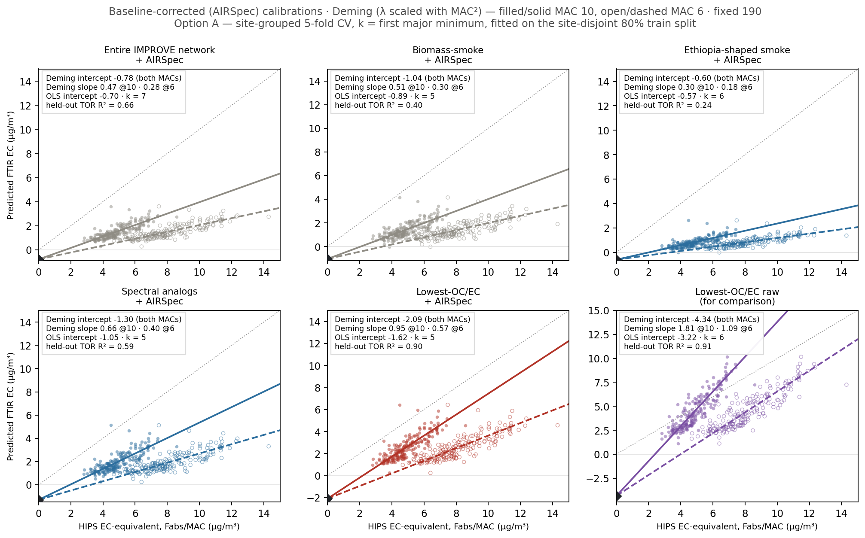
Notes:
SAY: The six candidate calibration sets, all baseline-corrected, all predicting Addis. Filled points are MAC 10, open are MAC 6, and the black diamond is the shared Deming intercept, which MAC cannot move. Every intercept is now small. The held-out test in each box tells you which small intercepts to trust: the network at 0.66, smoke 0.40, Ethiopia-shaped 0.24, analogs 0.59, and lowest-OC/EC at 0.90 with slope 0.95 and intercept minus 2.09. Composition selection plus baselining is the pairing that keeps everything.
NOTES: Held-out here = TOR test on held-out IMPROVE sites (calibration quality), not an Addis holdout; the Addis-side validation gap is discussion question 2. Suptitle on the figure says 'baseline-corrected (AIRSpec)' which matches the language rule.

Slide 10
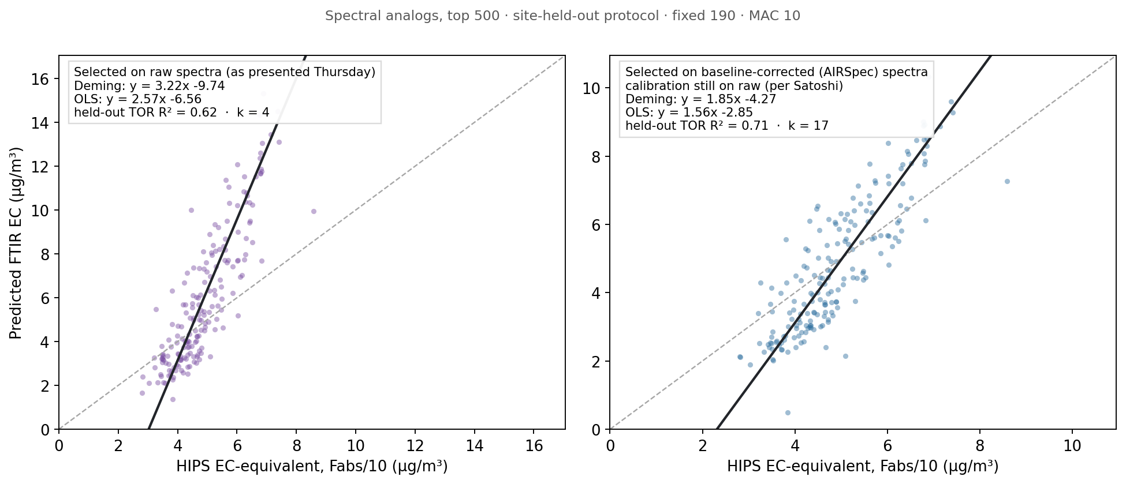
One illustrative outcome: selecting analogs on baseline-corrected spectra fixes them, -9.7 to -4.3 µg/m³
Notes:
SAY: One concrete example of how much these choices move the answer. Same spectral-analog recipe, same calibration on raw spectra; the only change is that the similarity matching runs on baseline-corrected spectra instead of raw. The intercept goes from minus 9.7 to minus 4.3, the slope from 3.2 toward 1.9, and the held-out quality from 0.62 to 0.71. The selection space alone is worth five micrograms per cubic meter; that is the scale of choice we are dealing with.
NOTES: Satoshi's suggestion (select corrected, calibrate raw). Kept per the run-through as an illustrative outcome; the Ethiopia-shaped rescue and the k-scan moved to backup. Under corrected selection only 4/477 raw-selected filters survive (previous slide's point).

Slide 11
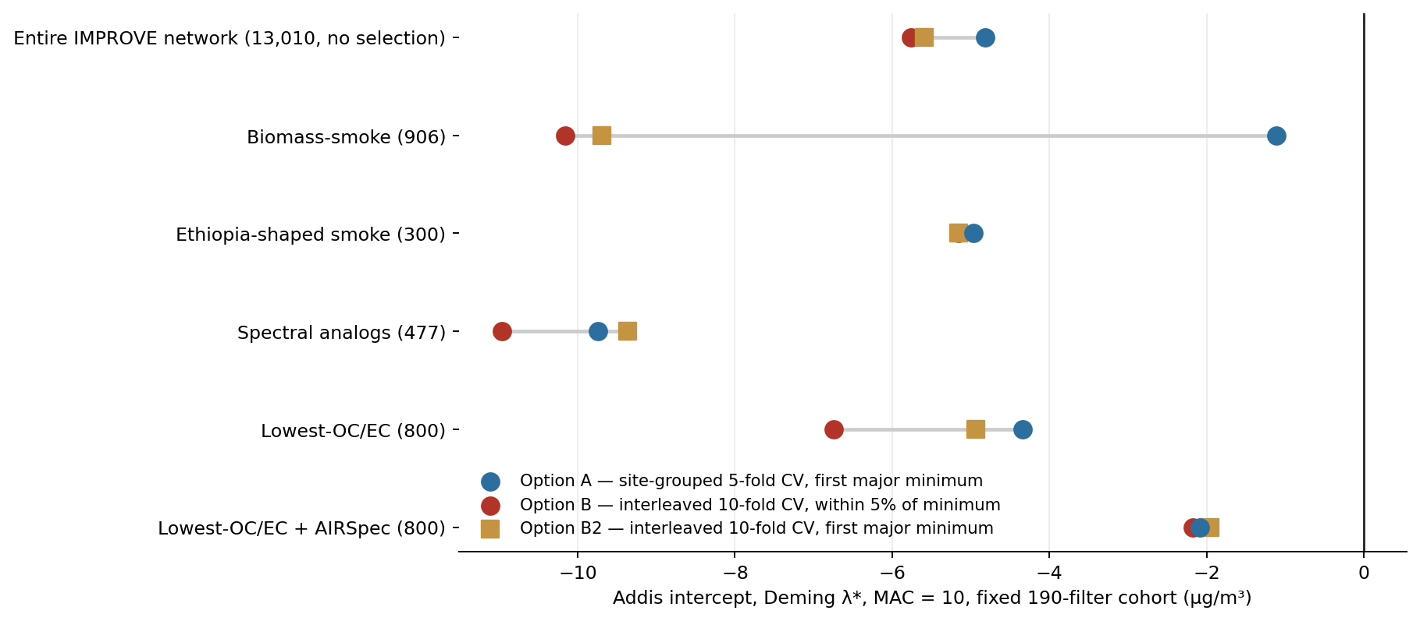
Three ways of selecting the model; the red circles are how all deployed SPARTAN calibrations are made
Notes:
SAY: One more choice: how the model itself is selected. There are three reasonable recipes; I will not walk through their internals. The red circles are the way the current calibration app, the Shiny app, does it, which is how every deployed SPARTAN calibration was made; the blue and gold are two other defensible ways stacked on top. Two things to see: the choice of calibration set moves the answer far more than the choice of recipe, which is comforting; and the baseline-corrected composition row sits nearest zero under all three.
NOTES: Jargon stripped per the run-through (no interleaved/site-grouped / within-5% language without an RMSE-vs-components CV curve, which the group agreed not to show). If pressed: red = interleaved 10-fold CV, k within 5% of minimum, fit on all filters; blue = site-grouped 5-fold, first major minimum, site-disjoint 80/20; gold = interleaved folds with the first-major-minimum rule. Historical deployed intercepts reproduce exactly on the red circles: -5.76/-10.16/-6.74/-2.17.

Slide 12
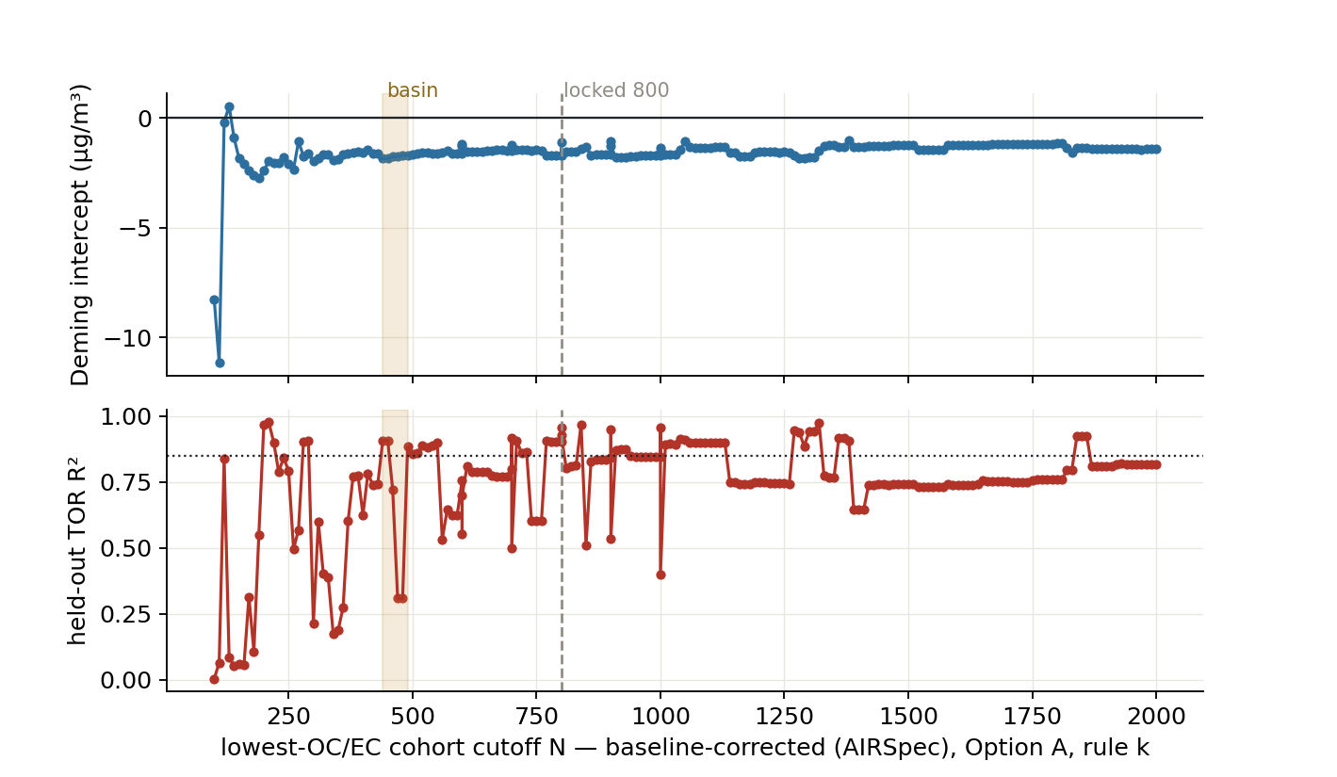
Cohort size: the intercept barely cares, the held-out R² does; 800 was somewhat arbitrary
Notes:
SAY: How many calibration samples should the cut keep? Sweeping the cutoff every ten filters: the intercept, top panel, is remarkably stable across the whole range. The held-out R-squared, bottom, is not: it bounces around at small N and only settles once the calibration set gets large. So our 800 was somewhat arbitrary; the shaded 440-to-490 basin is where both are best simultaneously, and the number of filters is a genuine decision, not a detail. That is one of the questions at the end.
NOTES: This sweep is under the site-grouped selection recipe; the Shiny-style recipe's version would differ (flagged in the run-through). Intercept stability + R2 instability was Ann's own reading. Basin held-out 0.92 vs 0.87 at 800; under re-selection the basin winner takes 62.5% of draws (stability slide later).

Slide 13
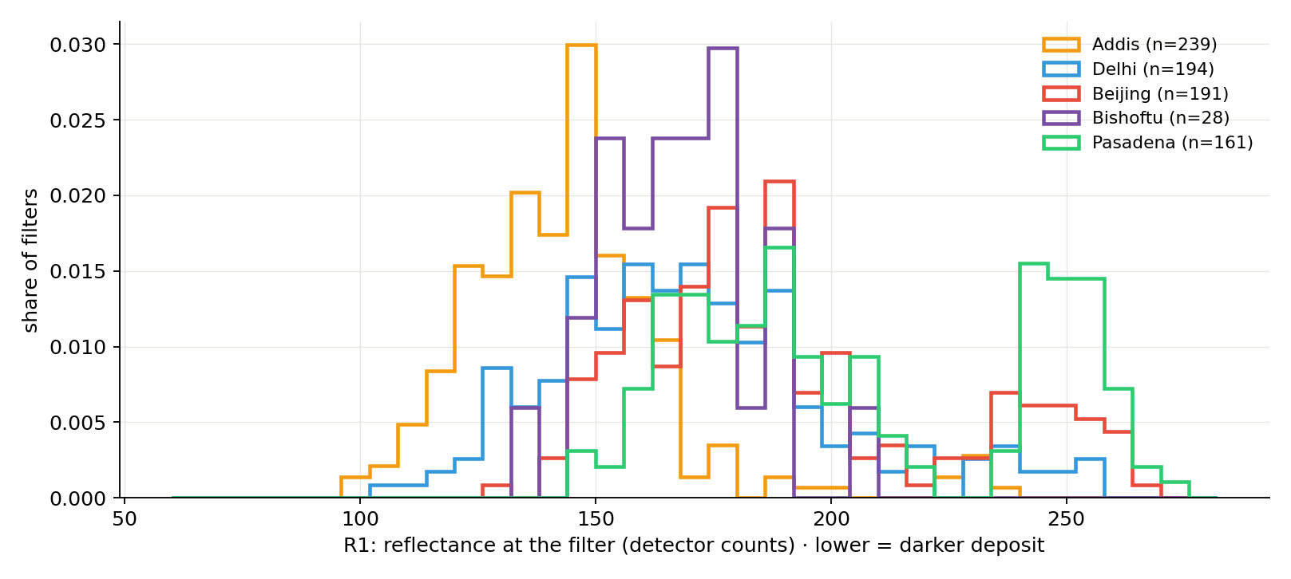
The filters themselves differ by site: what's on the filter, not what's in the air
Notes:
SAY: Now the filter side. R1 is the reflectance measured at the filter, in detector counts; lower means a darker deposit. The sites separate: Addis filters are the darkest population, Pasadena the lightest, and Delhi sits in the middle despite Delhi's air, because sampled volume differs by site; Delhi collects less volume per filter. So this is a statement about deposits, not about the atmosphere, and it means the calibration meets filter-darkness regimes it has rarely seen.
NOTES: Rebuilt per the run-through: axes defined in words, fit lines and blank cloud removed, and the mislabeled blank count dropped (a lot can carry more than one calibration set; the old 'lot-251 blanks n=373' conflated two). T1 = transmittance counts if asked. The blank-line extrapolation analysis lives in backup.

Slide 14
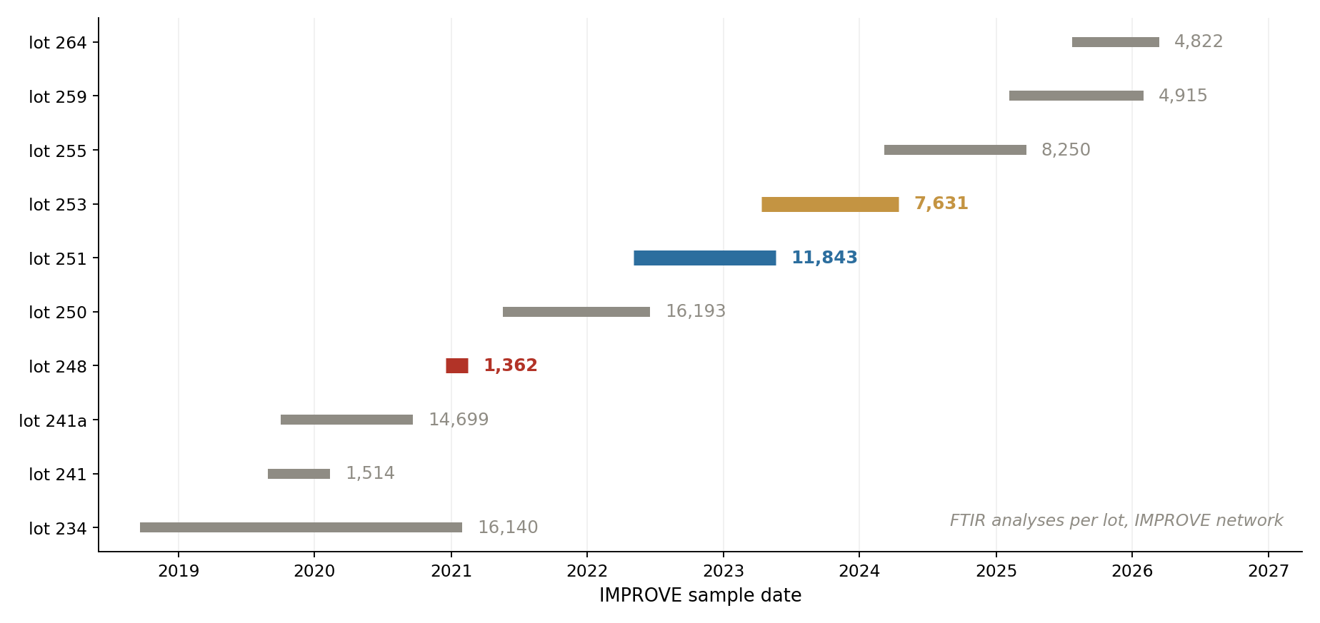
Lot 248 isn't a partial download; it's a genuine two-month lot
Notes:
SAY: The lot timeline, which also shows when filters were analyzed. Lot 248 really does hold only about fourteen hundred analyses, December 2020 to February 2021; my 1,299-filter pull was essentially all of it. Lot 251 is the year-long workhorse with nearly twelve thousand. So lot-248-trained calibrations are winter-2021 calibrations; a season note, not missing data. And the older lots were analyzed years ago, on instruments that have changed since.
NOTES: Ann liked this slide as-is. Red = 248, blue = 251, amber = 253. IMPROVE is done with 253/255; SPARTAN's 253 is being analyzed now. 253/255 being large recent lots is what enables an independent-lot validation later.

Slide 15
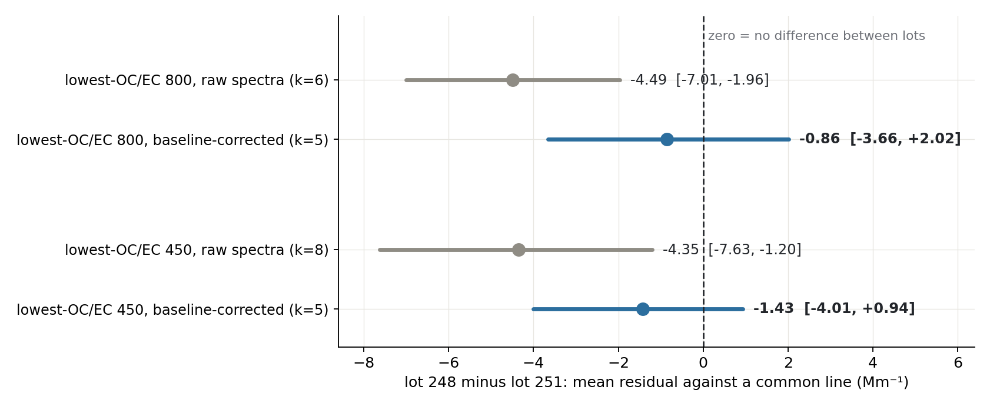
Baseline correction removes the lot-to-lot difference between filter lots
Notes:
SAY: Do the lots behave differently? Beijing used lots 248 and 251 side by side for 178 days, so we can test it. On raw spectra the two lots disagree by about four and a half inverse megameters against a common line; baseline-corrected, the difference collapses to about one and is indistinguishable from zero. So part of what baselining buys is lot insensitivity. And the lot is not the Addis story: Bishoftu shares Addis's lots and has no offset.
NOTES: n = 14 vs 34, bootstrapped; loadings not perfectly matched (median predicted EC 1.18 vs 1.66 ug/m3). Residual post-baseline lot term ~1 Mm-1, about 5% of the Addis offset.

Slide 16
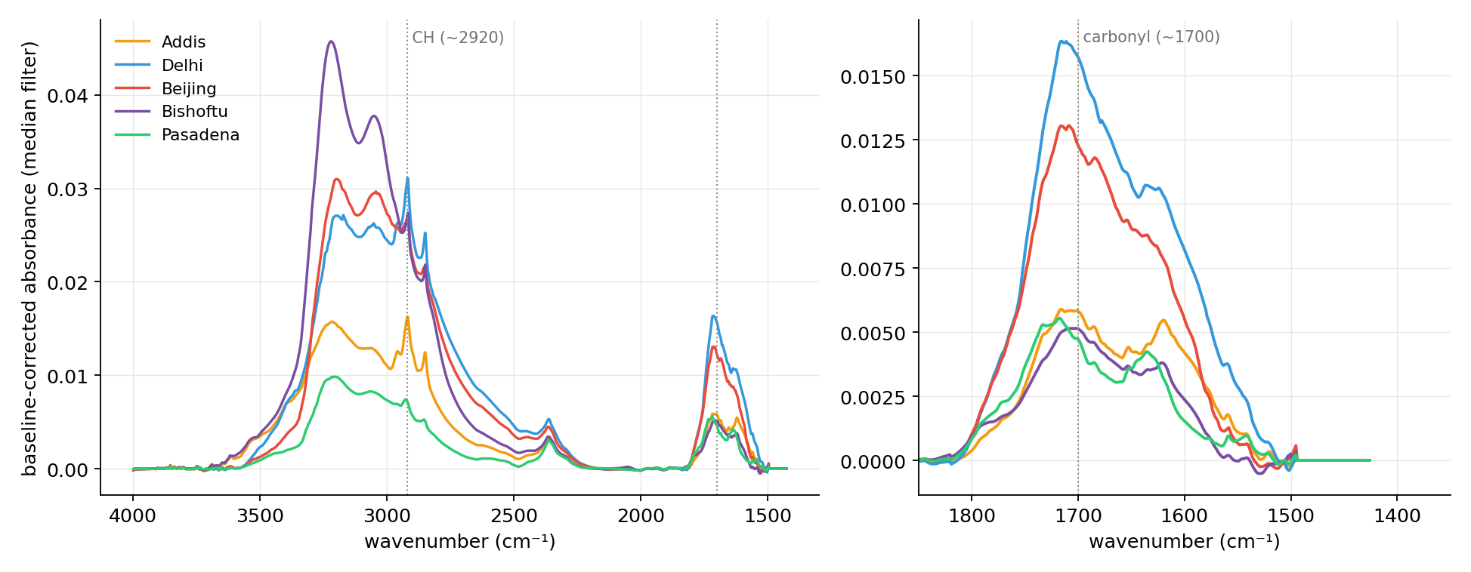
Median baseline-corrected spectra, five cities: Addis has the least organic signal
Notes:
SAY: The new data this month: spectra for four more SPARTAN cities, pulled from the database and evaluated alongside Addis. Median baseline-corrected spectrum per city. Left: the O-H and N-H region and the sharp CH peaks near 2920. Right: the carbonyl region around 1700. Delhi and Beijing carry the biggest organic signals; Bishoftu is surprisingly high in O-H; and Addis, the most polluted-feeling site, has close to the least organic absorbance. Which is actually consistent: Addis's OC-to-EC is the lowest we have; most of its carbon is black carbon, and these bands are organic functional groups. The spectra are partly telling us what OC/EC already said.
NOTES: Ann's talking point from the run-through folded in (low organics at Addis consistent with very low OC/EC). The 1617 band panel was cut per the run-through (its rationale needs the other deck's material); the carbonyl-vs-intercept scatter in ug/m3 is in backup if it comes up. Bands labeled: CH ~2920, carbonyl ~1700.

Slide 17
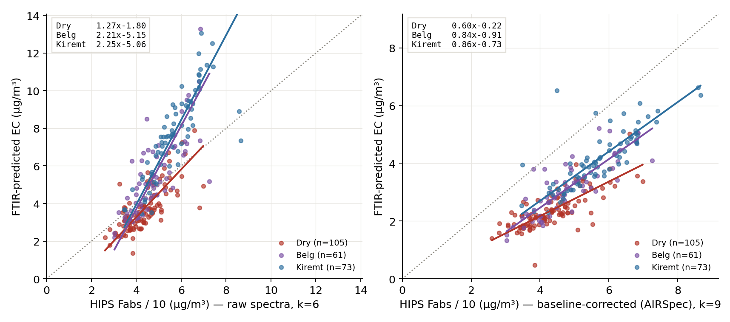
Baselining shifts Addis seasonality but does not remove it; the dry season becomes the anomaly
Notes:
SAY: Seasonality, which we have tracked all along. Left, raw: the wet seasons are the outliers. Right, baseline-corrected: the wet seasons snap to about 0.85x and the dry season drops to 0.60x. So baselining does not remove the seasonal structure; it moves it onto the charcoal-heavy dry season, while improving the intercept a lot. Seasonality is shifted, not solved.
NOTES: Per-season Deming on restricted ranges; indicative, the formal interaction fit is the ftir_24 deliverable. The overall seasonal ordering of concentrations stays stable across calibrations, which remains the good news.

Slide 18
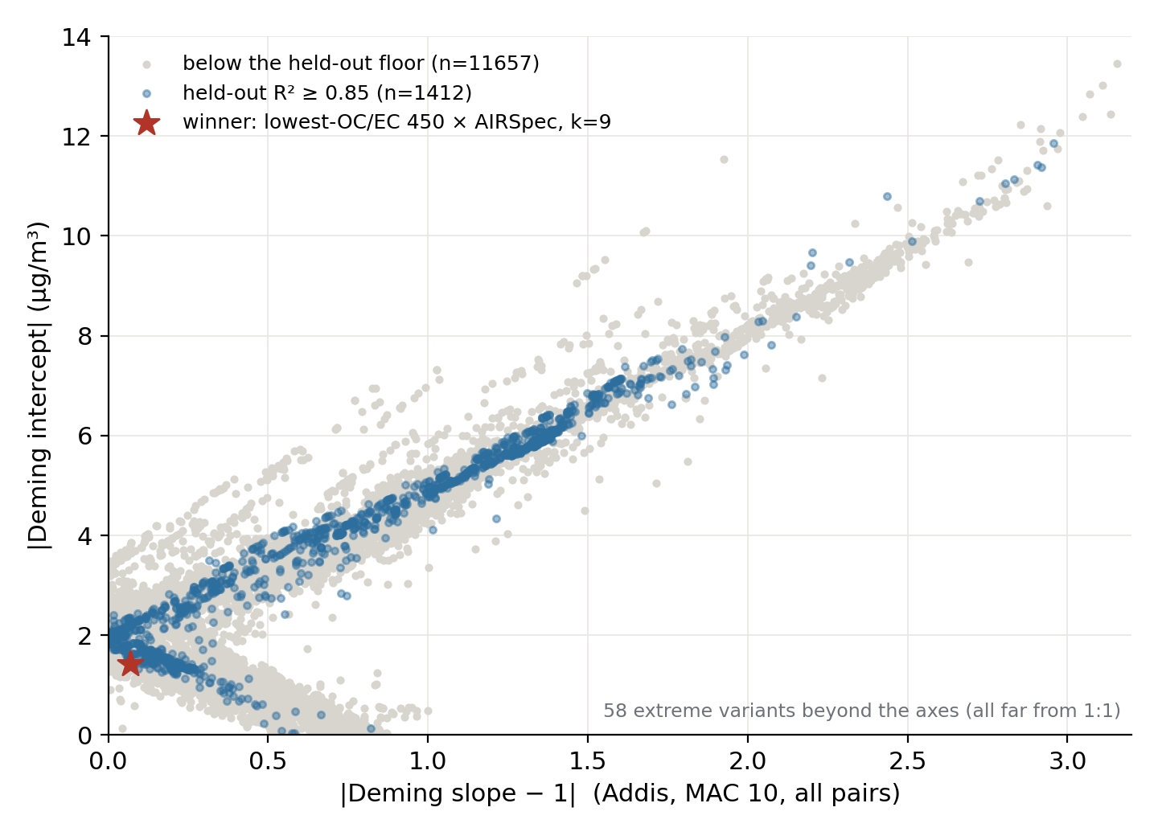
So we tried everything at Addis: 12,000+ configurations, scored on the same two numbers
Notes:
SAY: Instead of graph after graph, we let the computer run the whole space: every calibration-set family, cutoffs from 100 to 2000 in steps of ten, raw and two baseline treatments, swept components; each dot is one configuration predicting the Addis samples. Horizontal axis: how far the slope is from one. Vertical: the intercept size in micrograms per cubic meter. You want the bottom-left corner. Grey fails a held-out quality floor; blue passes; the star is the best passing configuration. Notice the V: you can buy a zero intercept with a terrible slope, so we always constrain both. And hold this thought: in two slides we run the identical search for Delhi and the other cities, and that is where it gets interesting.
NOTES: 58 extreme variants beyond the capped axes, counted on-figure. This slide is Addis only (13,069 scored rows shown); the same grid ran at all five cities (71k rows total), which feeds the per-city and Delhi slides. The scoring lesson: |intercept| alone is gamed by flat slopes; rankings are slope-boxed 0.85-1.18.

Slide 19
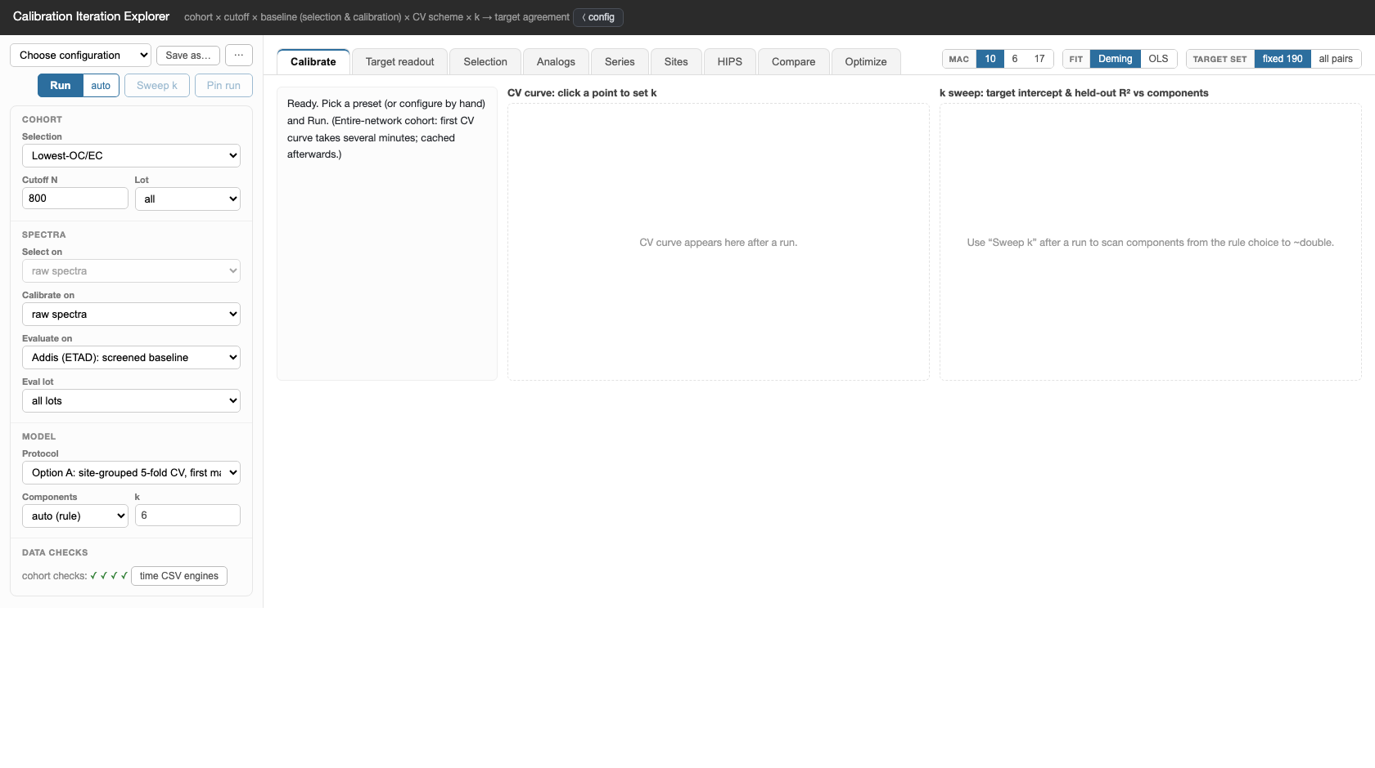
How the search runs: the calibration explorer (live, if we have time)
Notes:
SAY: How those thousands of runs happen: a Flask app in the spirit of the Shiny calibration app, but built for research; every choice in this talk is a control, every run is cached, and any variant this room proposes we can run before the meeting ends. I will demo it live if time allows; the search results on the next slides all come out of it.
NOTES: On-screen config is the demo default (network raw 800), not the winner; say so if asked. Batches run server-side and survive closing the page; results land in a shared results file the leaderboard reads.

Slide 20
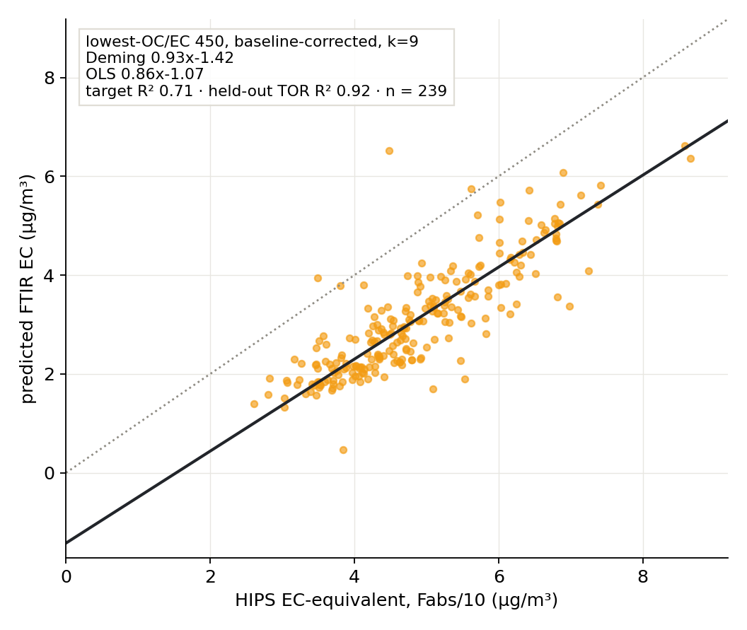
The winner, as a crossplot; because the crossplot is what we look at
Notes:
SAY: The starred configuration, drawn the way we actually judge calibrations. Lowest-OC/EC 450 as the calibration set, baseline-corrected, predicting all 239 Addis samples: 0.93x minus 1.4, held-out quality 0.90. Better than anything we had, and it is exactly our locked family with a smaller cohort. Two honesty notes: minus 1.4 is not zero, and under re-selection this winner is chosen 62.5 percent of the time, not always.
NOTES: Added per the run-through ('you want to show the crossplot... that's what we look at'). All-pairs readout at MAC 10, Deming lambda*. The k=9 is above the rule choice of 5 (the basin needs k=8-9; rules stop early).

Slide 21
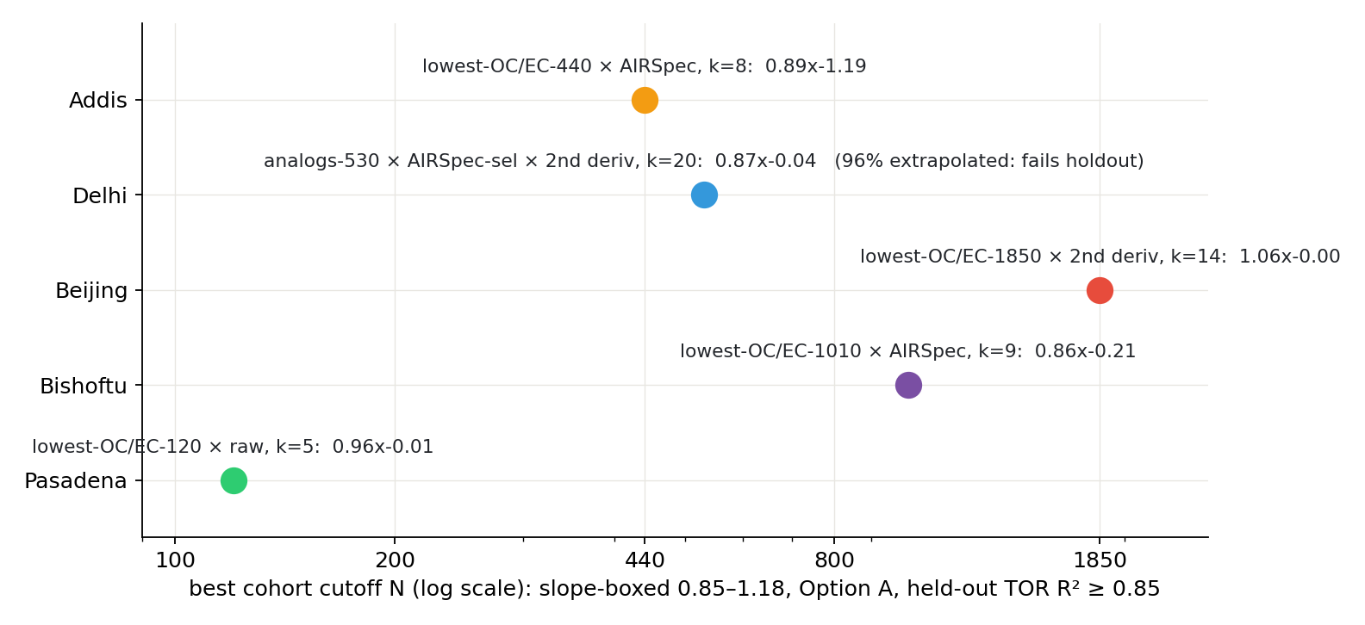
Ask each city for its own best and no two agree; cohort size is doing per-site work
Notes:
SAY: Now run the same search for each city separately. Each row is a city's best configuration under the same constraints: Pasadena wants 120 calibration samples, Addis 440, Bishoftu about a thousand, Beijing eighteen hundred and fifty. And Delhi's apparent best is the cautionary tale: it looks lovely and it is 96 percent extrapolation, and it fails fresh holdout filters. Per-city optimization is doing real work that one global calibration cannot.
NOTES: Slope-boxed 0.85-1.18, held-out floor 0.85, score = |intercept| plus half the slope error. Screening numbers: per-site winners are candidates, not conclusions.

Slide 22
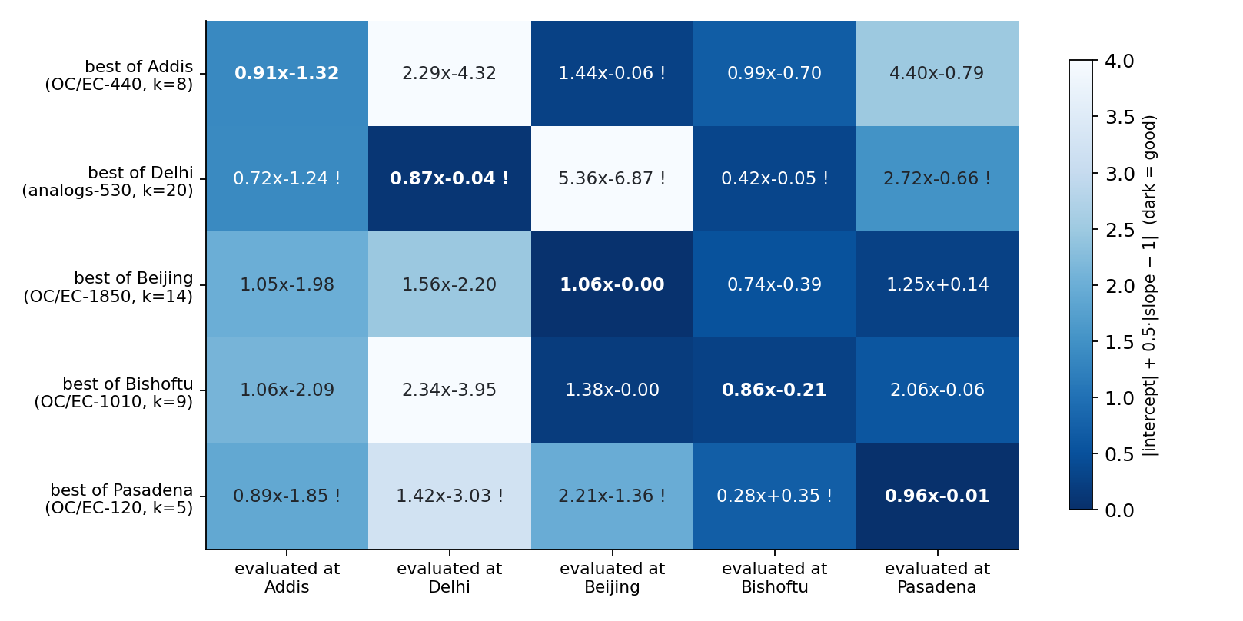
Cross-applied, every city's best fails abroad; only the Ethiopian pair transfers
Notes:
SAY: Then take each city's best and apply it to the other four. Rows are calibrations, columns are prediction targets. The color is simply how far the fit is from ideal, combining the intercept size in micrograms per cubic meter with the slope error; darker is better. Bold is the home fit; an exclamation mark means the model is extrapolating for most of that city's filters. The diagonal is dark: every best works at home. The off-diagonal mostly is not: Delhi's best collapses everywhere else, Pasadena's tiny cohort is unusable abroad. The one genuine transfer: Addis's best lands at 0.99x at Bishoftu. The two Ethiopian sites cohere, which is exactly what you would want a regional calibration to do.
NOTES: Metric in words per the run-through: color = |intercept in ug/m3| + 0.5 x |slope - 1|, capped at 4. Delhi's row inherits its extrapolated screening artifact (every cell flagged). Beijing's 1850-sample best is the most tolerable abroad but still misses Delhi.

Slide 23
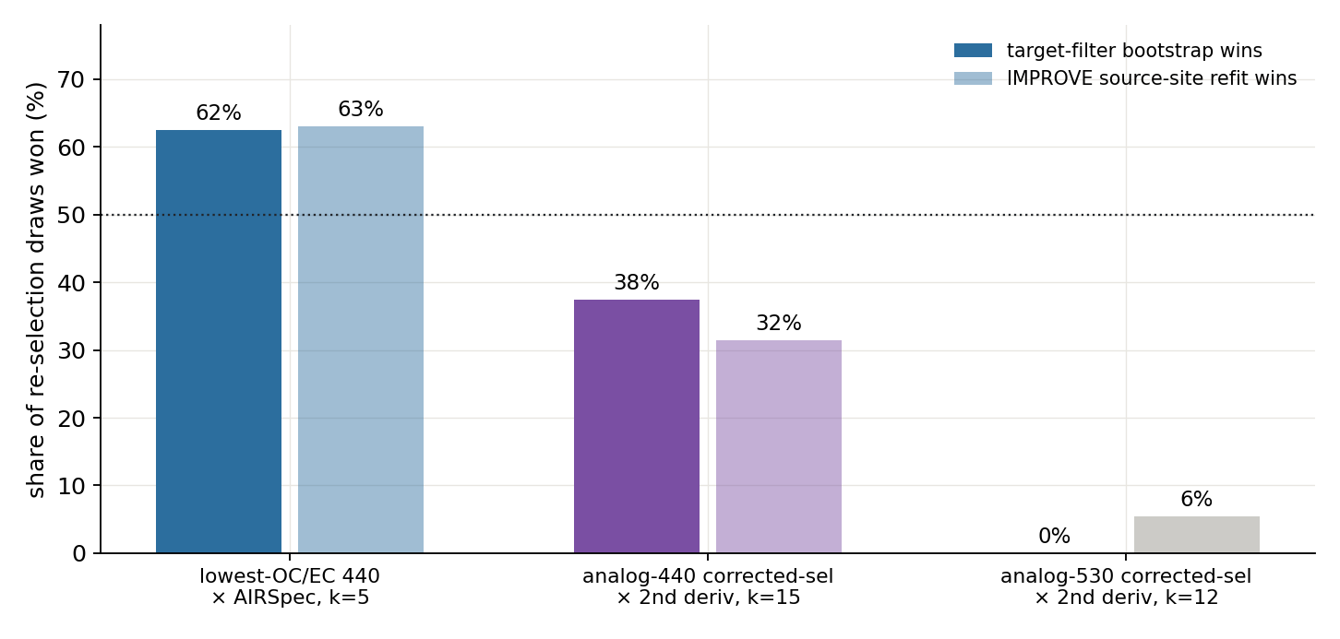
How stable is the winner? Chosen in 62.5% of re-selection draws, not all of them
Notes:
SAY: The 'add twenty filters and the winner changes' worry, quantified. Re-run the entire selection under resampling of the Addis filters, and again under re-draws of the IMPROVE calibration sites: the winner is re-chosen about 63 percent of the time both ways, and the corrected-selection spectral-analog family takes about a third. So lowest-OC/EC 440 is the leading candidate, not a settled answer, and the runner-up is the spectral-similarity family; which connects directly to the question of which selection principle is more defensible.
NOTES: From the validation layer: target-filter wins 62.5/37.5/0%; source-site wins 63.0/31.5/5.5%. Source-site slope interval for the winner is wide: 1.03 [0.65, 1.50].

Slide 24
Question 1: what is good enough?
Is an intercept of -1 µg/m³ acceptable? (deployed today: -4.2)
What slope range counts as usable: 0.9 to 1.1? 0.85 to 1.18?
Is held-out R² of at least 0.85 the right quality floor?
Should the number of calibration samples itself be a constraint
(no cohorts under ~400, whatever the score says)?
Notes:
SAY: The search gives us thousands of candidates and a ranking, but the ranking needs a definition of good enough that the group owns. Concretely: is minus one acceptable for the intercept, given we are at minus four today? What slope range is usable? Is the 0.85 quality floor right? And should cohort size be a constraint on its own?
NOTES: Anchor numbers if asked: winner reads 0.93x-1.4 at Addis with held-out 0.90; deployed reads 1.90x-4.2. The tuned-on-both two-city compromise sits near -1 at both cities.

Slide 25
Question 2: how should we validate the choice? (the current gap)
Today, ALL Addis samples are used both to pick the winning
configuration and to judge it; the win is partly self-graded.
Proposed validation: split the Addis set into equal halves
(first year vs second year), pick the calibration on one half,
predict the blind other half; equal test sizes keep R² comparable.
Also available: a never-screened IMPROVE lot (253, ~5,000 TOR
filters) as a true independent check.
Notes:
SAY: The honest gap in everything I showed: the same Addis samples pick the winner and grade it. The fix we discussed Tuesday: split the Addis samples into equal halves by time; select the calibration using only the first half; predict the untouched second half blind. Equal test sizes so the R-squared numbers are comparable. And beyond Addis, IMPROVE lot 253 gives a five-thousand-filter never-screened set for a true independent test. Does the group agree this is the standard the choice has to pass?
NOTES: The IMPROVE-side held-out TOR test already exists (that is the 0.85 floor); the gap is on the TARGET side. Lot-253 protocol is frozen (winner family, k=5) with lot 255 sealed for replication; only the scan spectra remain to pull.

Slide 26
Question 3: one calibration, or per-site calibrations, and on what grounds?
The cross-application matrix: every city's best fails abroad;
only Addis-to-Bishoftu transfers (0.99x).
A per-site calibration helps exactly where it is hardest to defend:
among 19,000 configurations there is always a flattering one.
Middle ground: one calibration per REGION or aerosol regime
(the Ethiopian pair coheres), chosen under pre-agreed constraints?
Notes:
SAY: The transfer matrix says one global calibration does not exist in the space we searched, and per-city tuning works at home while failing abroad. But a per-site calibration is also the easiest thing to fool ourselves with: among nineteen thousand configurations there is always a flattering one. The Ethiopian pair cohering suggests a middle ground: regional calibrations, chosen under constraints we write down in advance. Is that defensible, and what would the grounds be?
NOTES: A tuned-on-both compromise exists: near-1 slopes at Addis AND Delhi with intercepts near -1; is one compromise calibration better than two tuned ones? Connects to Q1's 'is -1 acceptable'.

Slide 27
Question 4: is spectral similarity more defensible than OC/EC similarity?
Addis OC/EC barely overlaps the IMPROVE pool; selecting on OC/EC
means selecting the pool's thin extreme tail.
Selecting on baseline-corrected spectral shape selects on what the
model actually sees; and it is the re-selection runner-up (~1/3).
The common thread, pre-computed: the top 20 configurations at Addis
are ALL lowest-OC/EC (17 baseline-corrected, 3 second-derivative;
cutoffs 440-800, k mostly 6-9); not unrelated calibrations.
External constraints not yet used: the co-located sun photometer
(AERONET) as an independent absorption check.
Notes:
SAY: Last one, conceptual, from Ann. Lowest-OC/EC wins our re-selection test, but Addis's OC/EC barely overlaps IMPROVE at all, so selecting on it means living in the pool's thin tail. Selecting on baseline-corrected spectral shape selects on what the calibration actually sees, and it is the consistent runner-up. Is it more defensible in principle? And the common-thread question has an answer: the top twenty configurations at Addis are all lowest-OC/EC, mostly baseline-corrected, cutoffs 440 to 800. So composition dominates the top of the board, and the debate is principle versus performance, not confusion. And there are external constraints we have not used, like the co-located sun photometer, if we want an independent check.
NOTES: Ann's common-thread question, ANSWERED from the grid: the top 20 slope-boxed, held-out-passing configurations at Addis are ALL lowest-OC/EC cohorts (17 baseline-corrected + 3 second-derivative), cutoffs 440-800, k mostly 6-9; not eight unrelated calibrations. So composition selection dominates the top of the board, while the spectral-analog family is the runner-up under RE-SELECTION stability (~1/3 of draws), which is the precise sense in which Q4 stays open. AERONET detail in backup: the diurnal-corrected column check hardens the Addis anomaly.

Slide 28
Backup
Notes:
SAY: Backup material from here.
NOTES:

Slide 29
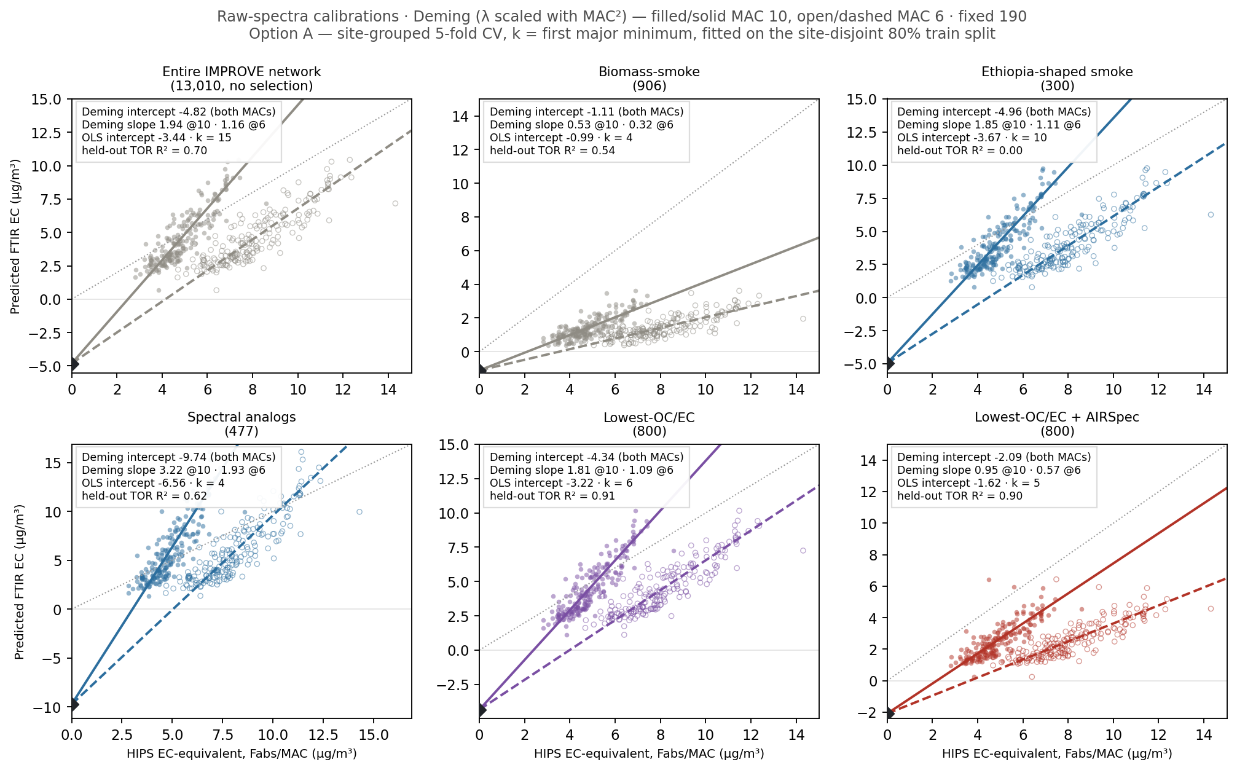
Backup: the six calibration sets on raw spectra; no selection fixes raw
Notes:
SAY: The raw-spectra companion grid: every calibration set lands a materially negative intercept on raw spectra.
NOTES: Main deck shows one before/after + the corrected grid per the run-through; this is the full raw grid if someone asks.

Slide 30
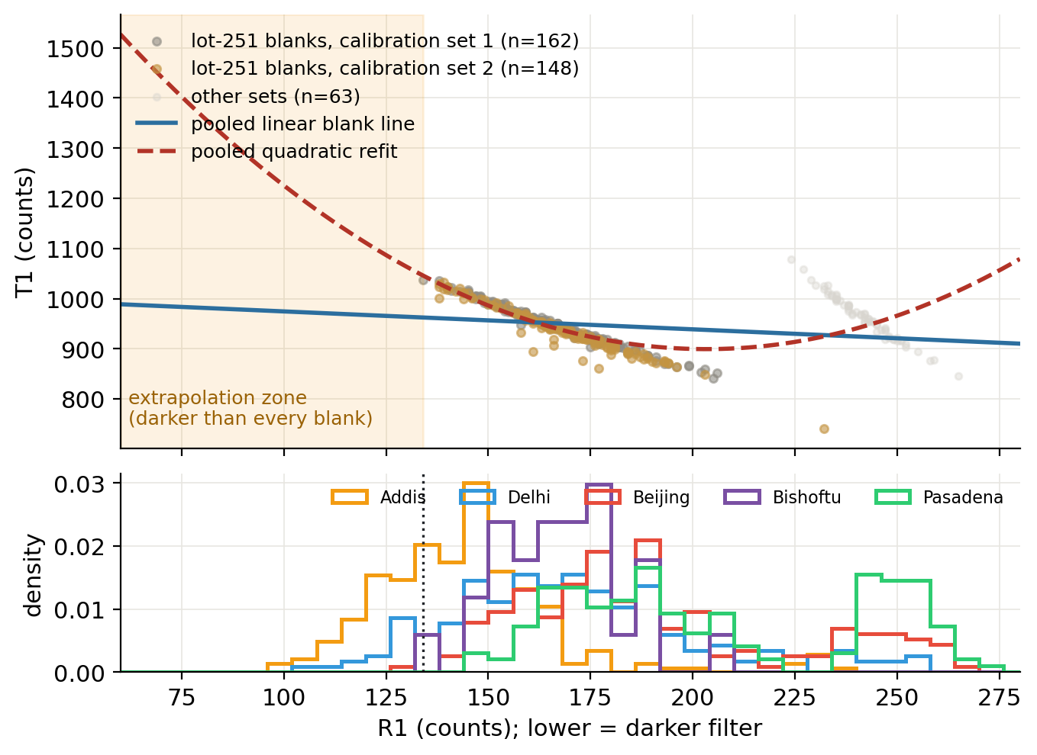
Backup: the HIPS correction is a regression through blanks; heavy filters sit beyond it
Notes:
SAY: The instrument-side analysis behind the darkness slide: the scattering correction is a line fitted through blanks, and 36 percent of Addis filters are darker than every blank that defines it.
NOTES: Blank clusters now labeled by calibration set (162 + 148 in the two largest lot-251 sets, 63 in other sets; the right-hand cluster belongs to the other sets), resolving the run-through flag about one pooled n. Fit lines shown are the POOLED linear/quadratic used in the sensitivity test; the per-line audit exists in the app's HIPS tab.

Slide 31
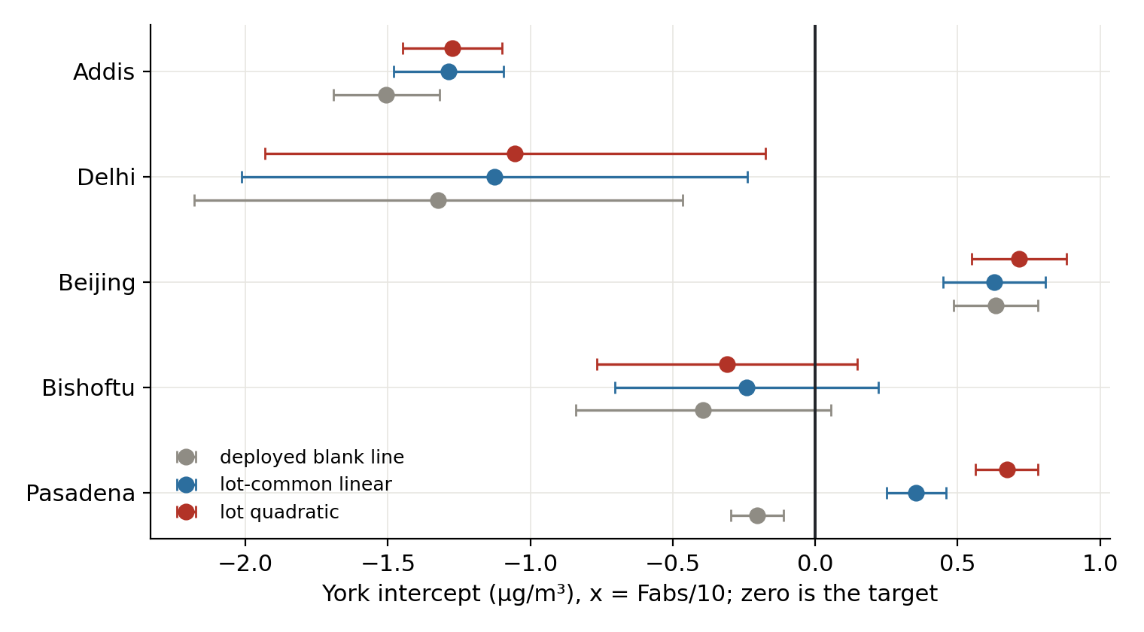
Backup: an errors-in-both-variables refit with per-filter uncertainties (York) confirms the intercepts
Notes:
SAY: York regression is an errors-in-both-variables fit, like Deming but with each point's own uncertainty. Refitting every city with real per-filter HIPS uncertainties, under three versions of the blank line: the Addis intercept survives everything, minus 1.3 to minus 1.5 micrograms per cubic meter; Delhi matches in size but its error bar reaches zero; the rest bracket zero.
NOTES: Plain-language definition added per the run-through (group unfamiliar with York). Instrument share of the Addis intercept ~15% (blank-line mechanism only).

Slide 32
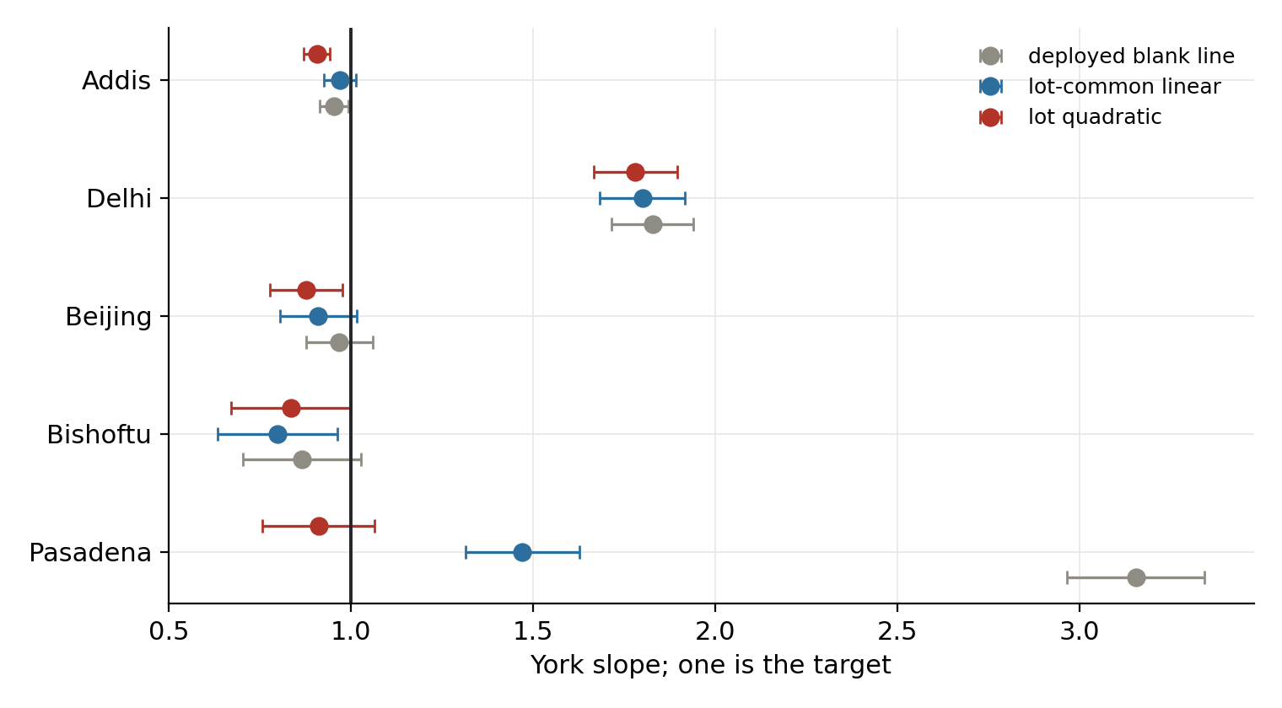
Backup: the same refit for slopes; Pasadena's anomaly was the blank line, Delhi's is real
Notes:
SAY: Slopes under the same treatment: Pasadena's wild 3.15x dissolves to 0.91 under a quadratic blank line; Delhi's 1.8x survives every variant.
NOTES: Pasadena's loadings are so light that blank-line shape error dominates; never an aerosol anomaly.

Slide 33
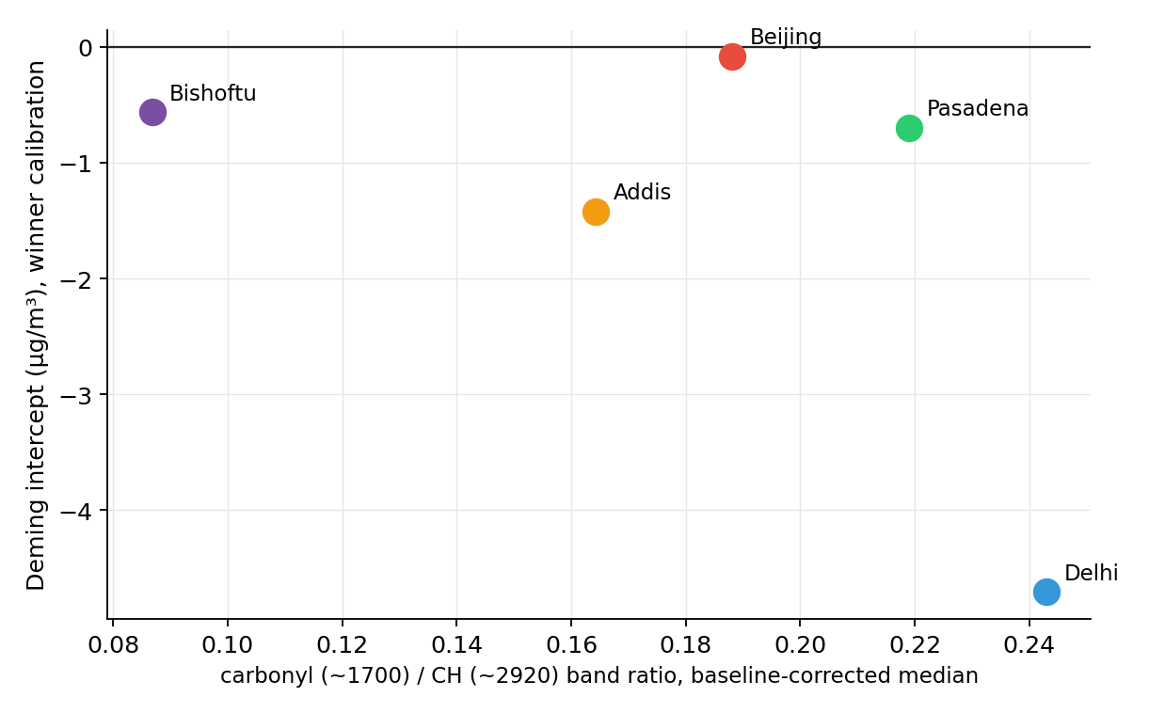
Backup: carbonyl band strength vs each city's intercept (µg/m³)
Notes:
SAY: The band-versus-offset view, rebuilt on the carbonyl band at 1700 and with the intercept in micrograms per cubic meter: no clean five-city relationship; the offset is not simply organic-band-driven.
NOTES: Replaces the earlier 1617-band panel (its rationale lives in the working deck, where it was also retired: the band is an Ethiopian regional marker, decoupled from the offset).

Slide 34
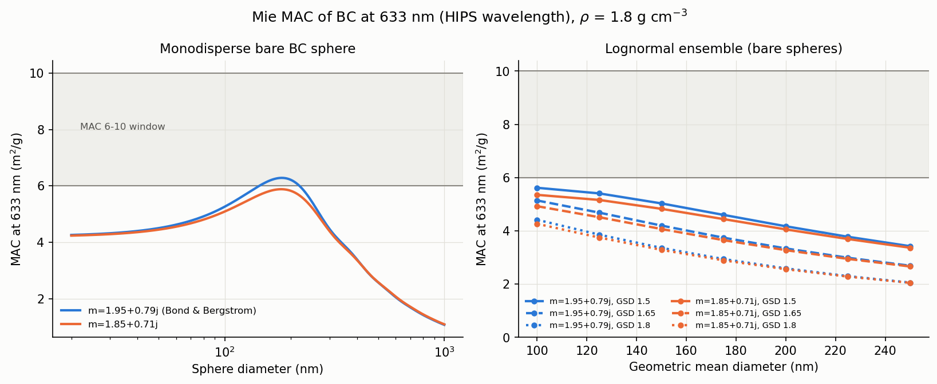
Backup: Mie theory grounds the MAC fork; bare BC tops out near 6
Notes:
SAY: Physics context for MAC 6 versus 10: bare soot ensembles top out near 5.6; reaching 10 requires aged, thickly coated particles. The fork encodes a mixing-state assumption.
NOTES: PyMieScatt at 633 nm; enhancement 1.8-2.0 for the coated branch. IMPROVE implied-MAC bridge centers Addis-like filters at 10.

Slide 35
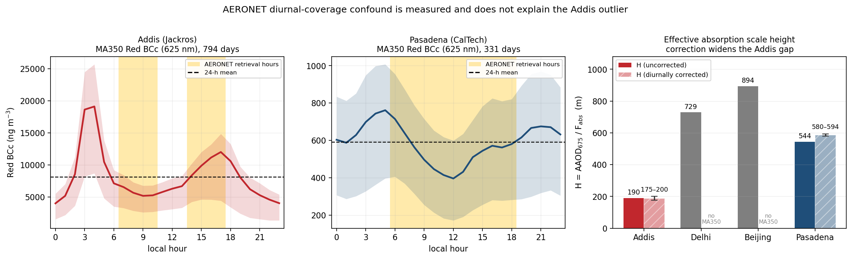
Backup: the sun-photometer cross-check; the Addis anomaly widens after the diurnal correction
Notes:
SAY: The AERONET check mentioned on question 4: correcting for the photometer's daytime-only sampling with co-located minute aethalometer data widens the Addis column-versus-surface anomaly rather than closing it.
NOTES: Level 1.5 retrievals; Delhi/Beijing lack minute-resolution MA350 and stay uncorrected. Companion: the filters' organic envelope predicts column absorption beyond loading and season (r=+0.28, p~0.002).

Slide 36
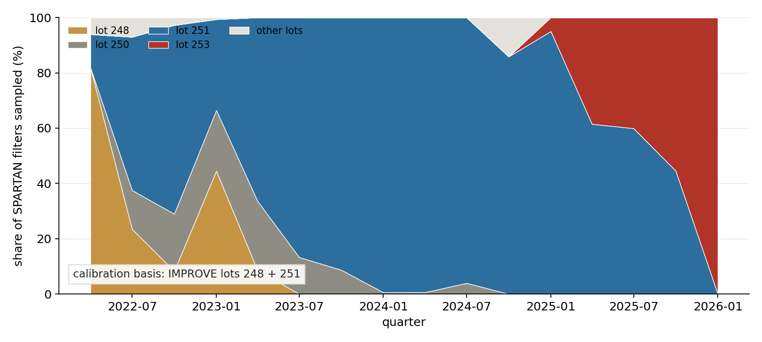
Backup: SPARTAN has moved to a lot the calibration has never seen
Notes:
SAY: From early 2025 SPARTAN filters shift to lot 253, outside the 248-plus-251 calibration basis; the same lot has five thousand IMPROVE TOR filters, which is what makes the independent-lot validation in question 2 possible.
NOTES: Rebuilt with black in-plot text per the run-through (old version had a clipped red annotation). Addis today: 34 x 248, 191 x 251, 14 x 253; Delhi leans newer.

Slide 37
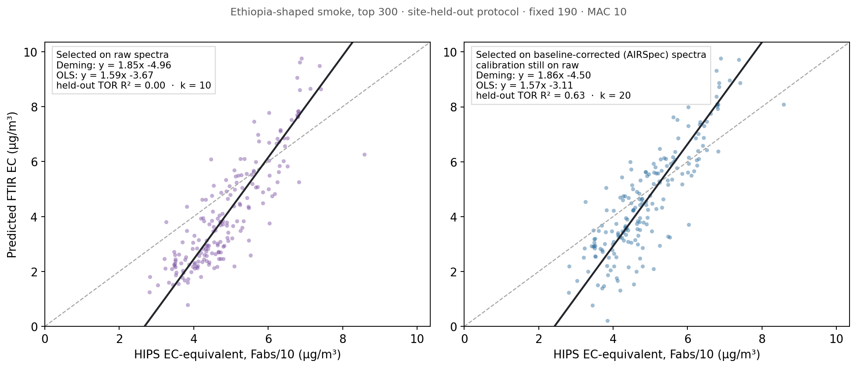
Backup: the Ethiopia-shaped rescue: nearly the same filters, held-out TOR 0.00 to 0.63
Notes:
SAY: The mirror-image of the analog fix: Ethiopia-shaped keeps 285 of 300 filters under corrected selection, but the model goes from zero held-out skill to 0.63; fifteen filters were enough to poison the calibration.
NOTES: The raw-selection failure was a selection-space artifact, not a failure of shape-matching itself. Shape cohorts still fail the held-out floor at essentially every cutoff in the wide grid.

Slide 38
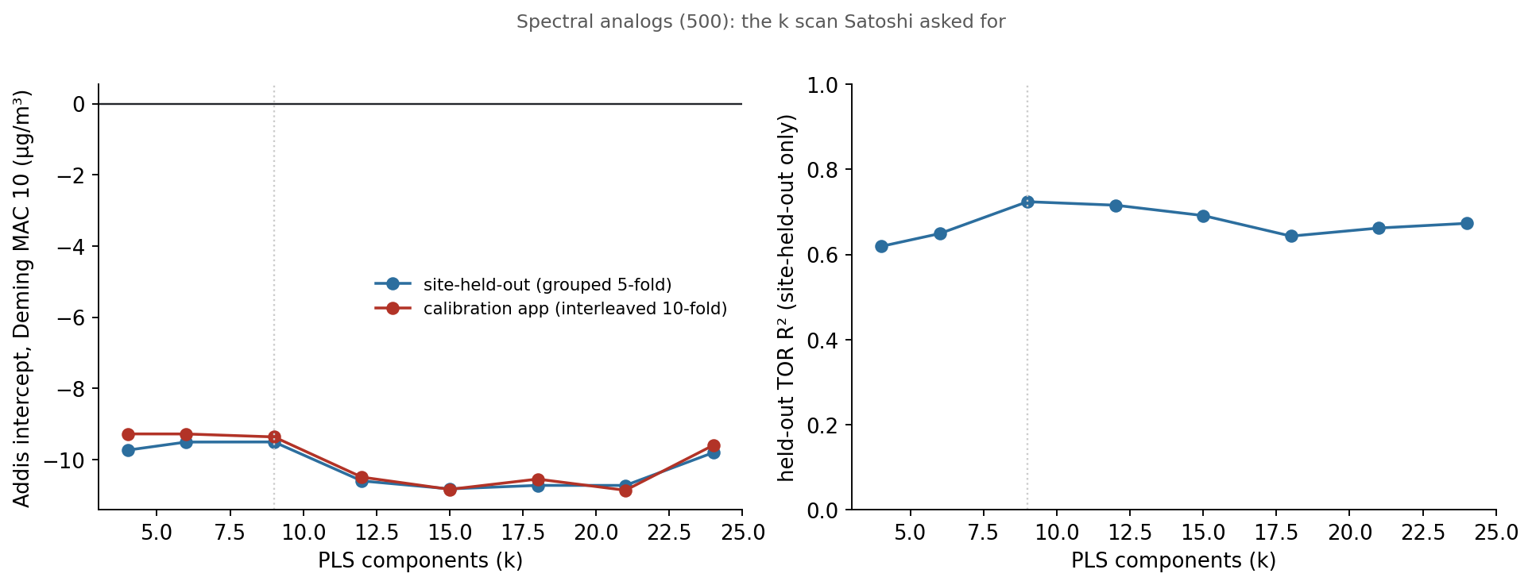
Backup: using 21 components instead of 9 does not fix the analogs
Notes:
SAY: Scanning components 4 to 24 under both selection recipes: the intercept never beats about minus 9 and held-out skill peaks at k equals 9. It was never the component count; it was the selection space.
NOTES: Also covers the one-consistent-k-rule request; conclusion is not rule-sensitive for this cohort.

Slide 39
Backup: the two lab measurements that settle the remainder
Quartz TOR EC on collocated Addis filters: the only measurement that
is a function of neither axis (campaign one-pager written)
Solvent extraction + HIPS re-measurement on archived Addis and Delhi
filters, Beijing/Pasadena as controls: separates real absorbers
from any residual filter artifact
Notes:
SAY: If the discussion reaches 'what would settle this': quartz TOR on collocated filters, and the extraction re-measurement on archived filters.
NOTES: Three lines of evidence (MAC fork, Bishoftu contrast, offset-vs-curvature degeneracy) terminate at an independent EC measurement.

