Slide 1
FTIR EC at Addis Ababa: one intercept problem, a huge space of choices
Ahmad Jalil
UNBC / UC Davis AQRC
FTIR group, 27 Aug 2026

Slide 2
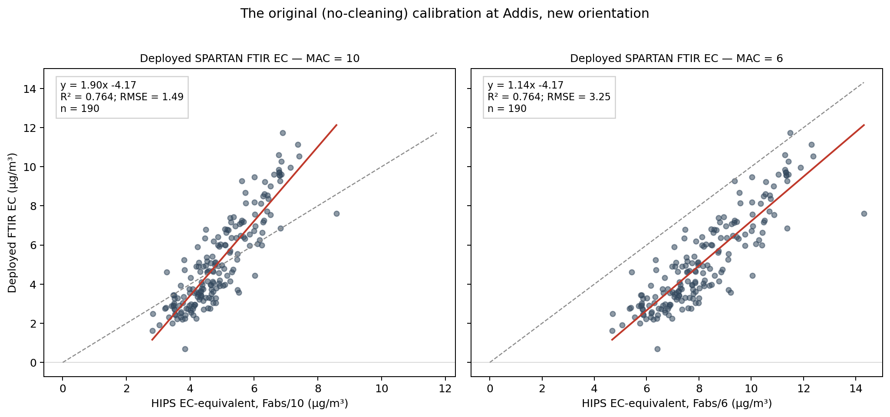
The problem: the deployed calibration predicts Addis at 1.90x with a -4.2 µg/m³ intercept

Slide 3
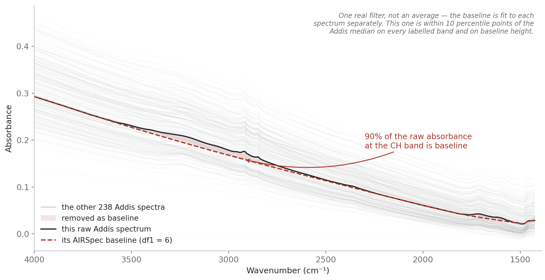
A raw FTIR spectrum is mostly filter background, not chemistry

Slide 4
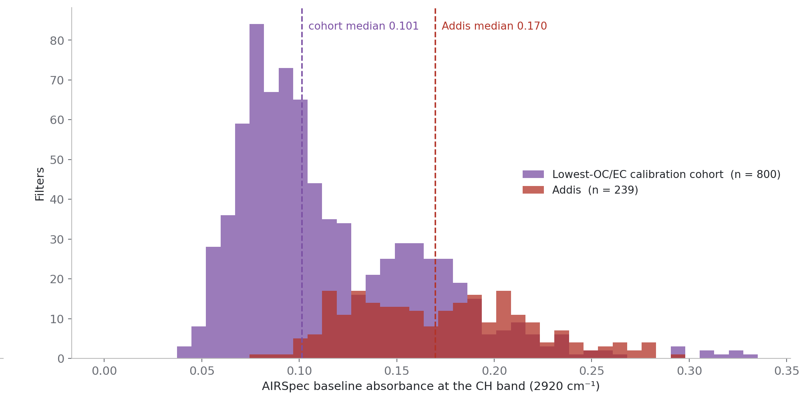
and Addis rides a higher background than the calibration samples

Slide 5
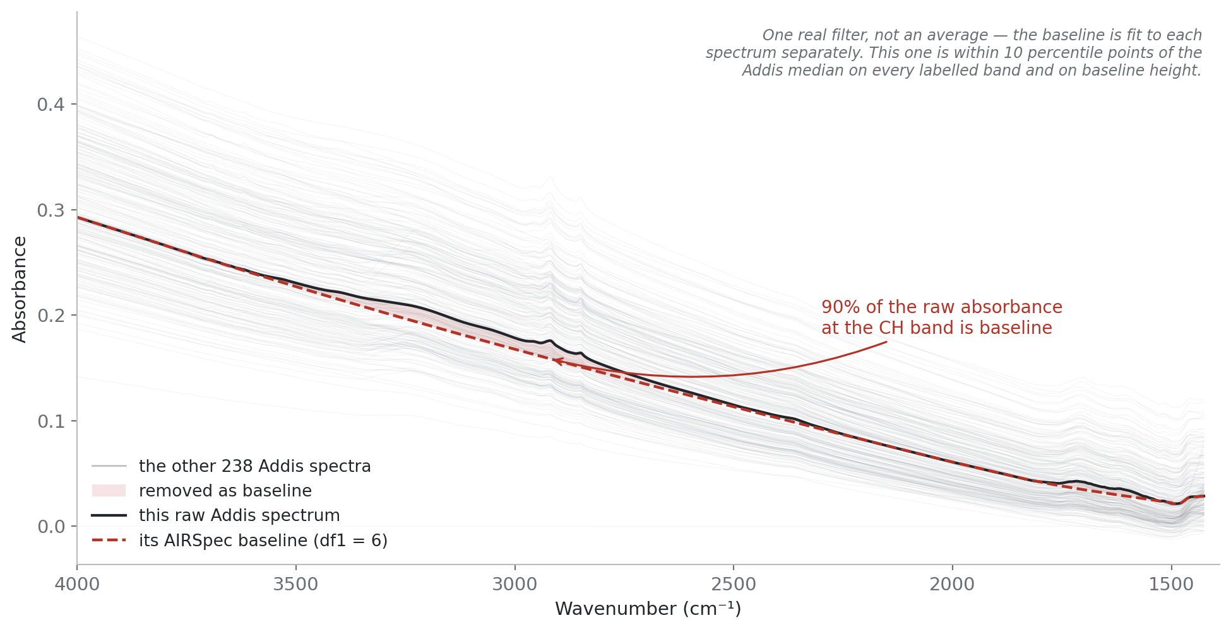
Baseline correction (using AIRSpec): fit the background and remove it

Slide 6
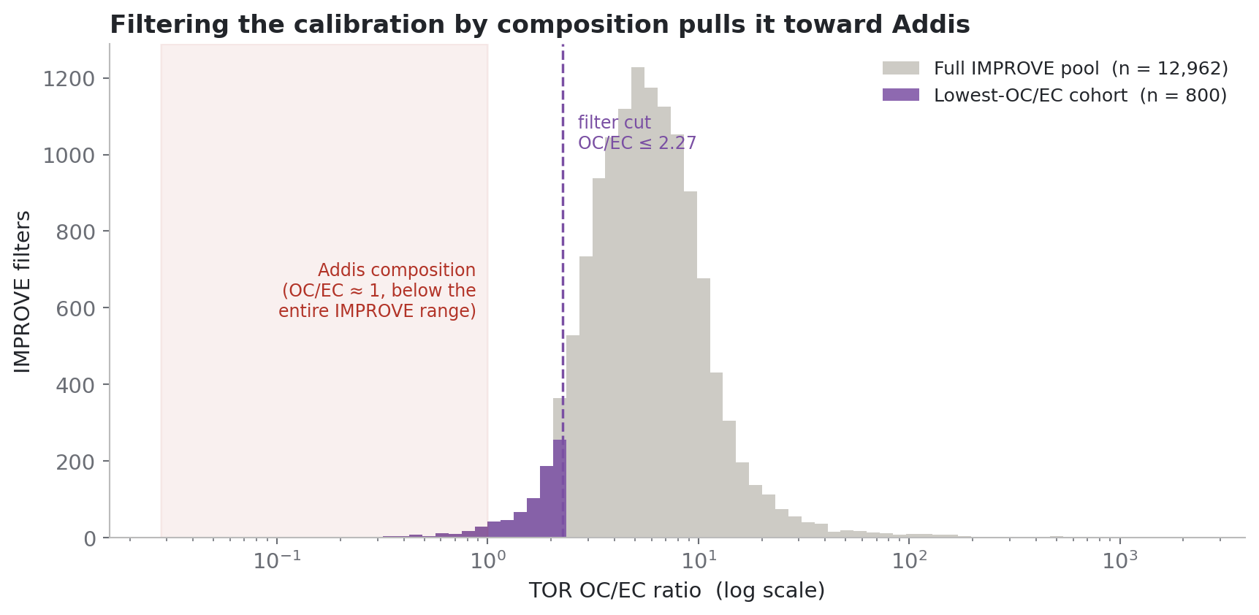
Choosing calibration samples by composition: keep the lowest-OC/EC IMPROVE samples

Slide 7
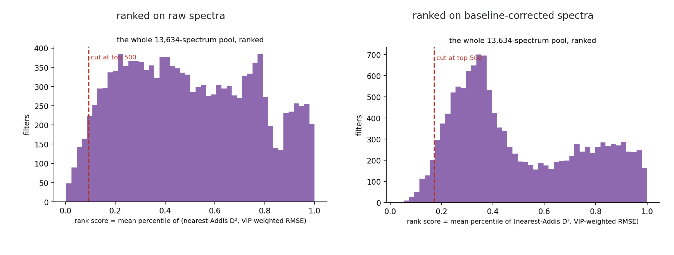
Choosing by spectral shape, and baselining changes which samples get picked

Slide 8
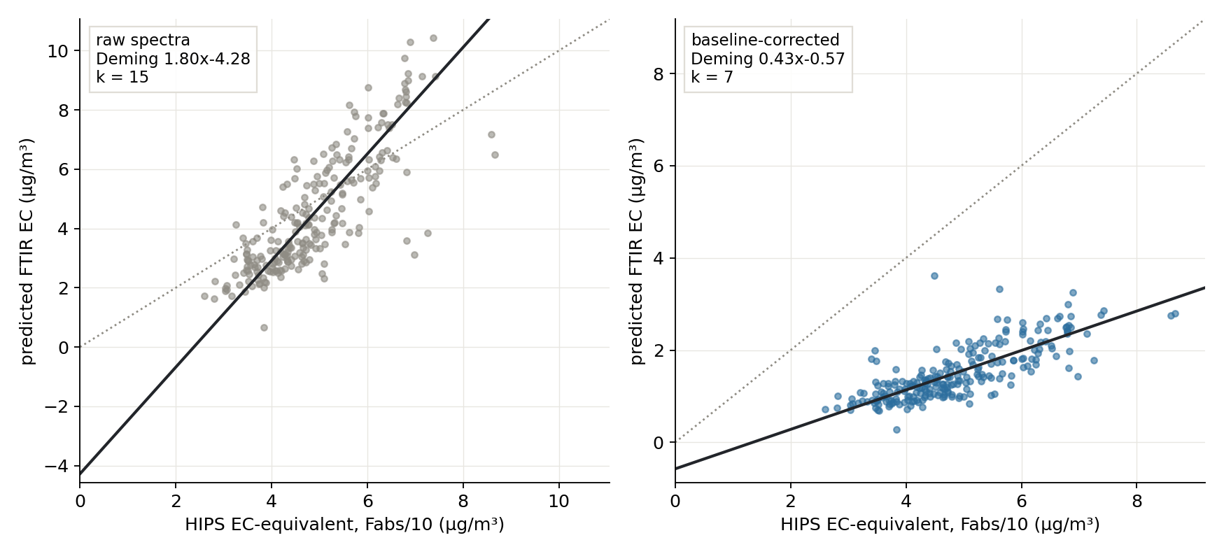
Baselining transforms the answer: the intercept moves from -4.3 to -0.6 µg/m³, but the slope collapses

Slide 9
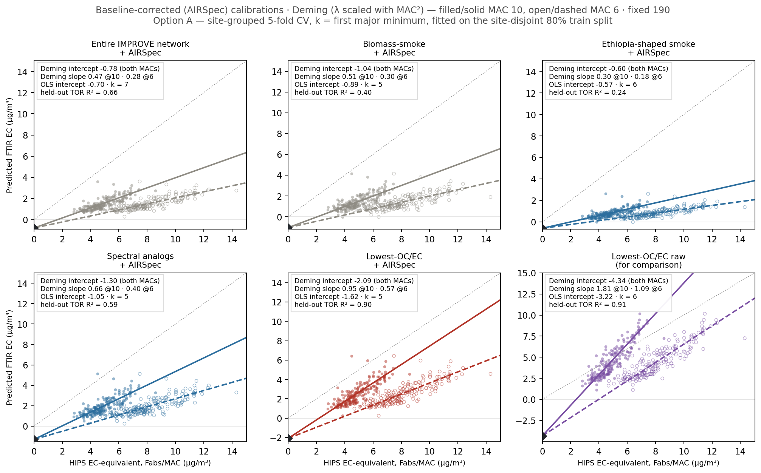

Slide 10
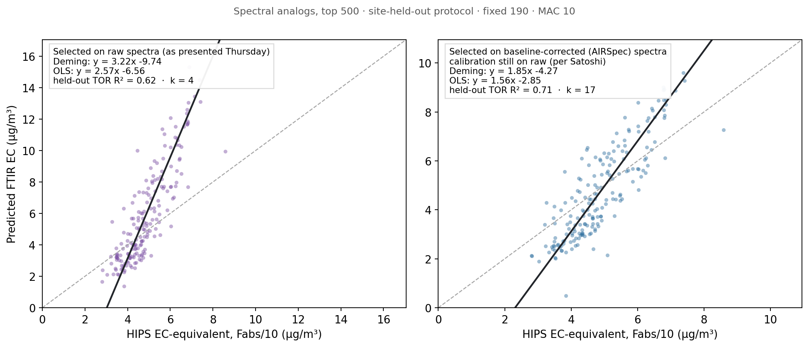
One illustrative outcome: selecting analogs on baseline-corrected spectra fixes them, -9.7 to -4.3 µg/m³

Slide 11
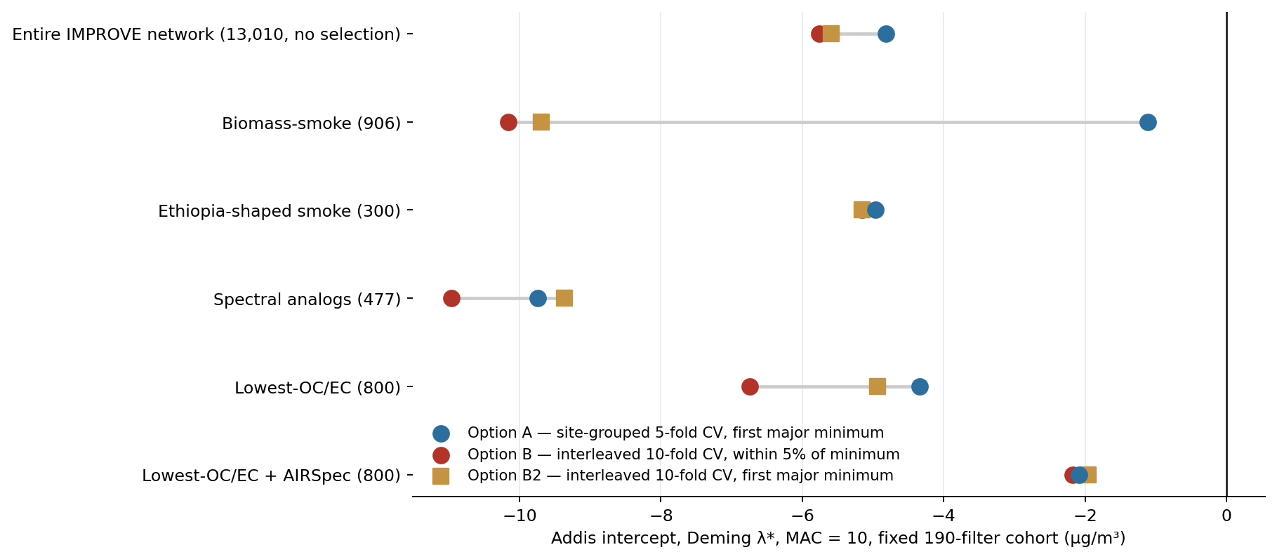
Three ways of selecting the model; the red circles are how all deployed SPARTAN calibrations are made

Slide 12
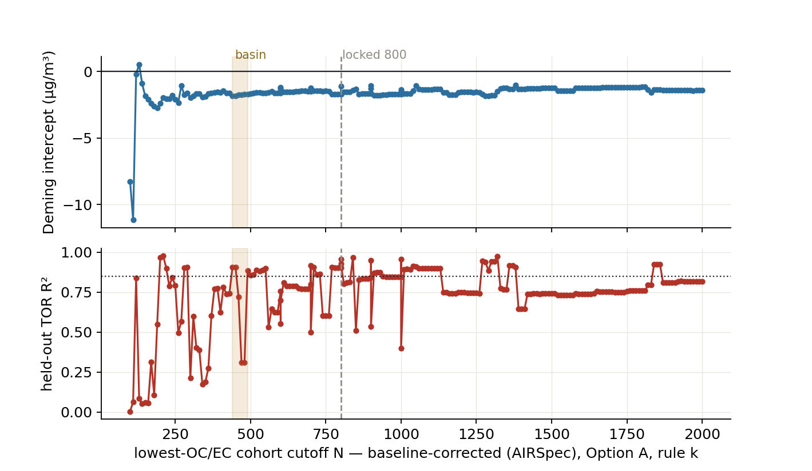
Cohort size: the intercept barely cares, the held-out R² does; 800 was somewhat arbitrary

Slide 13
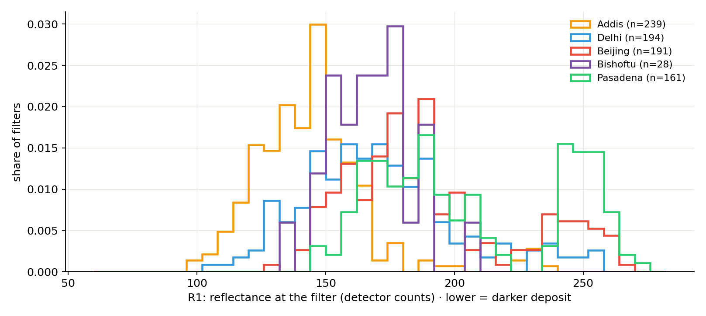
The filters themselves differ by site: what's on the filter, not what's in the air

Slide 14
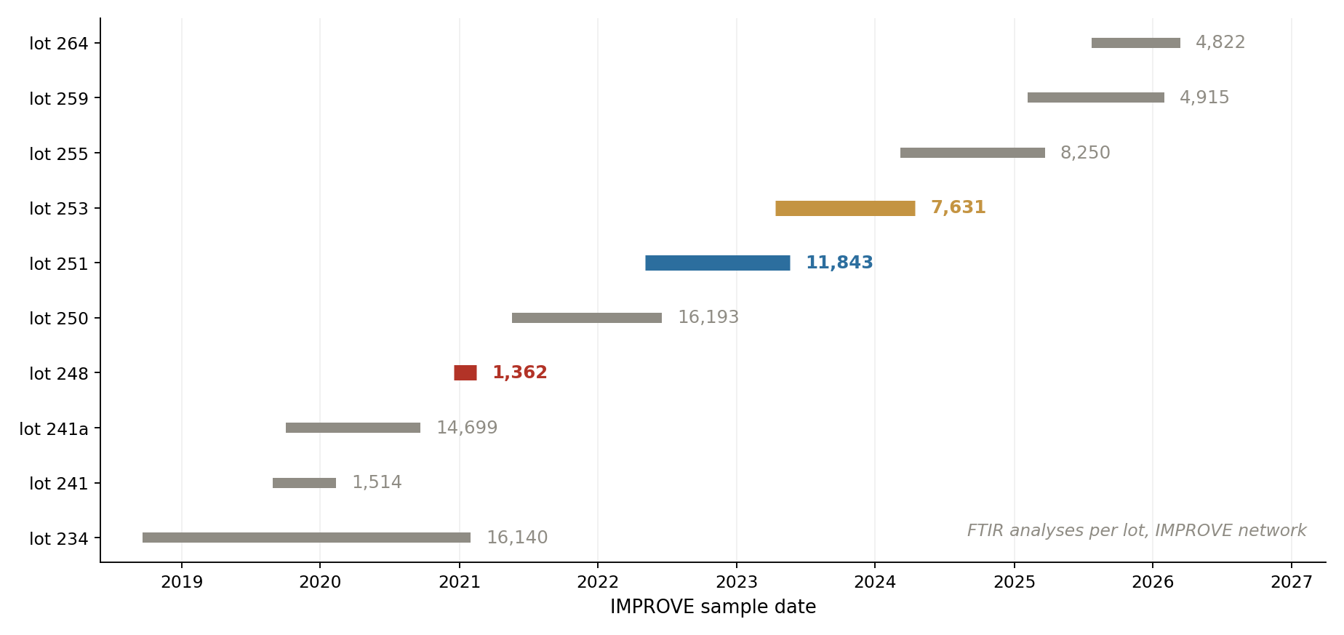
Lot 248 isn't a partial download; it's a genuine two-month lot

Slide 15
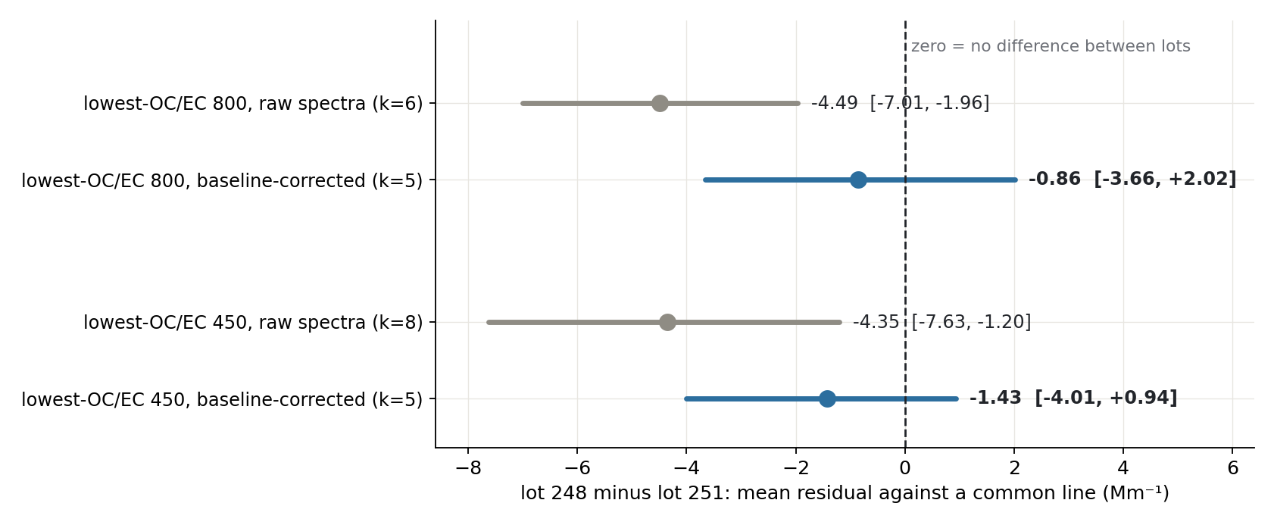
Baseline correction removes the lot-to-lot difference between filter lots

Slide 16
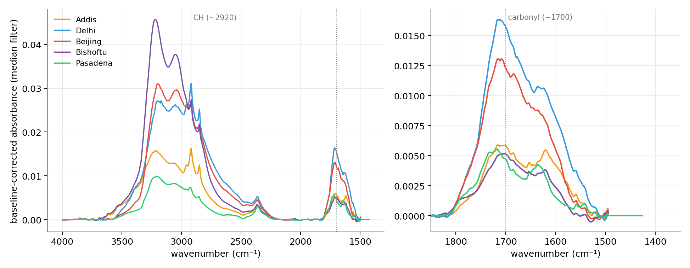
Median baseline-corrected spectra, five cities: Addis has the least organic signal

Slide 17
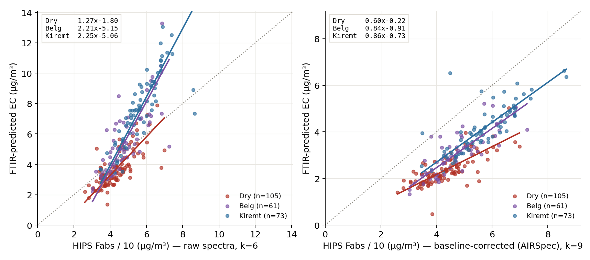
Baselining shifts Addis seasonality but does not remove it; the dry season becomes the anomaly

Slide 18
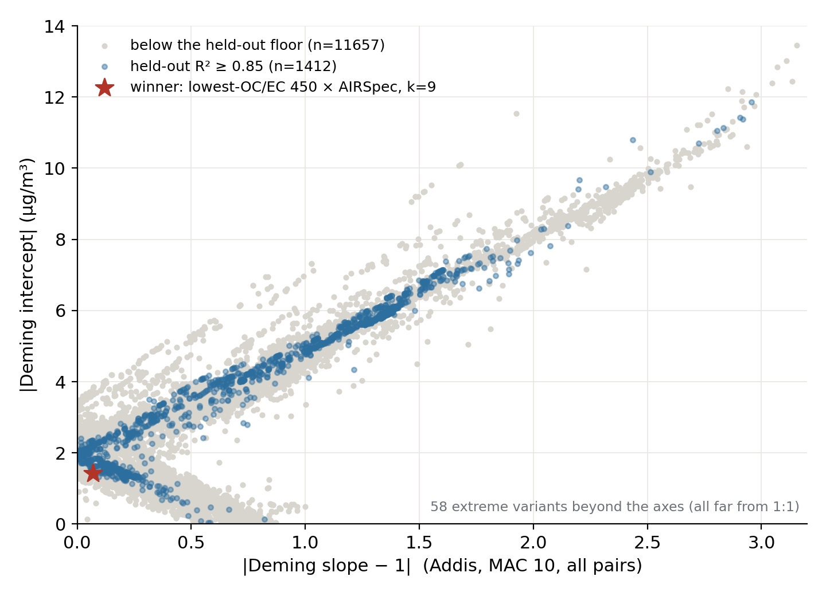
So we tried everything at Addis: 12,000+ configurations, scored on the same two numbers

Slide 19
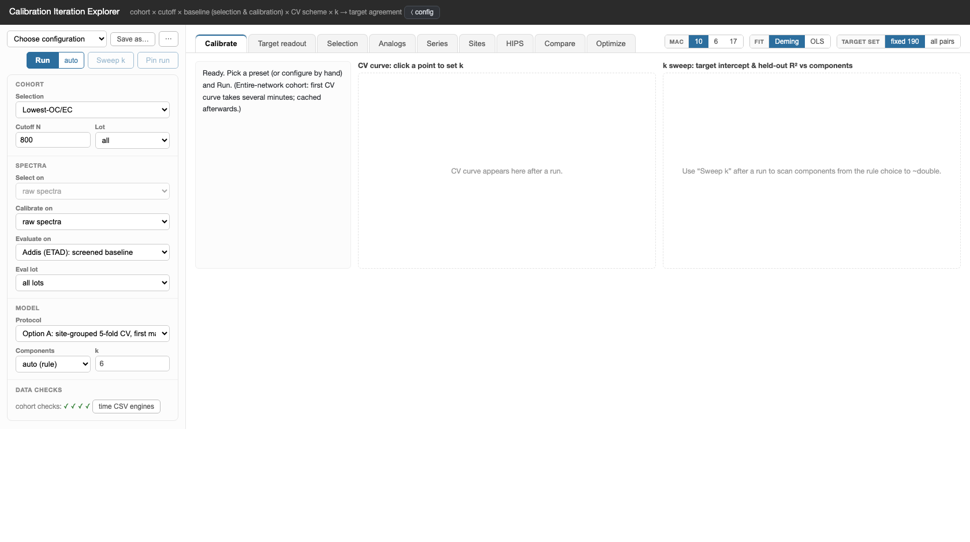
How the search runs: the calibration explorer (live, if we have time)

Slide 20
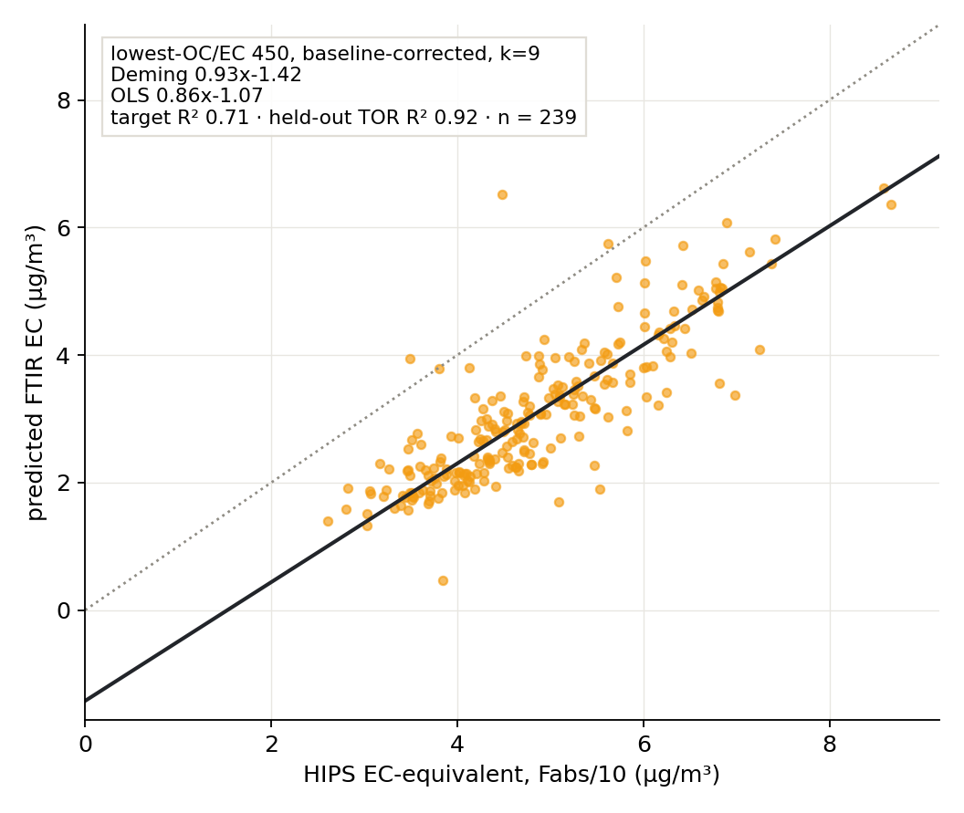
The winner, as a crossplot; because the crossplot is what we look at

Slide 21
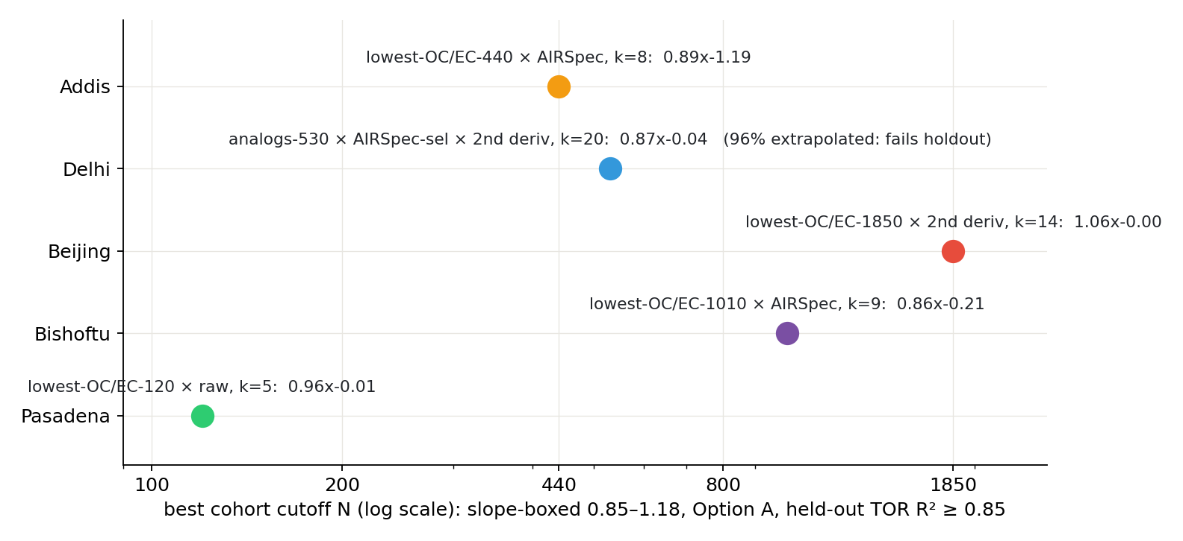
Ask each city for its own best and no two agree; cohort size is doing per-site work

Slide 22
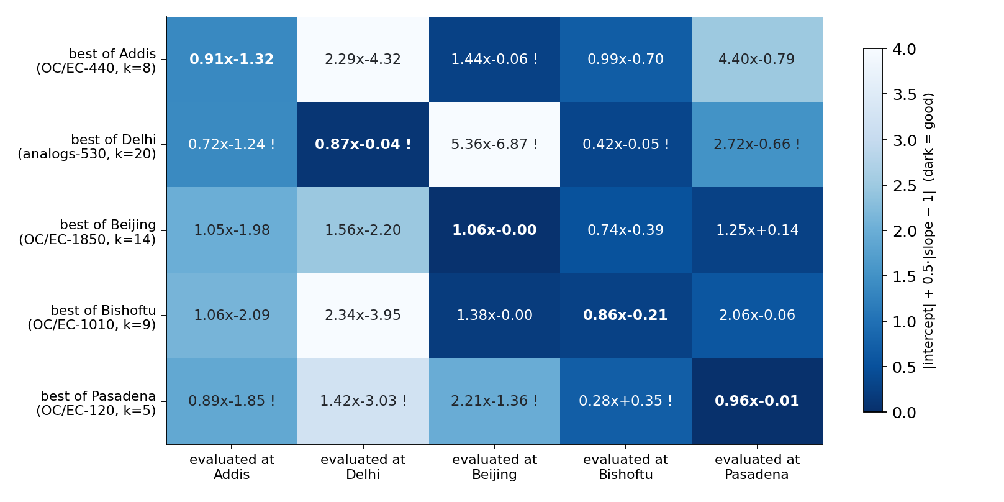
Cross-applied, every city's best fails abroad; only the Ethiopian pair transfers

Slide 23
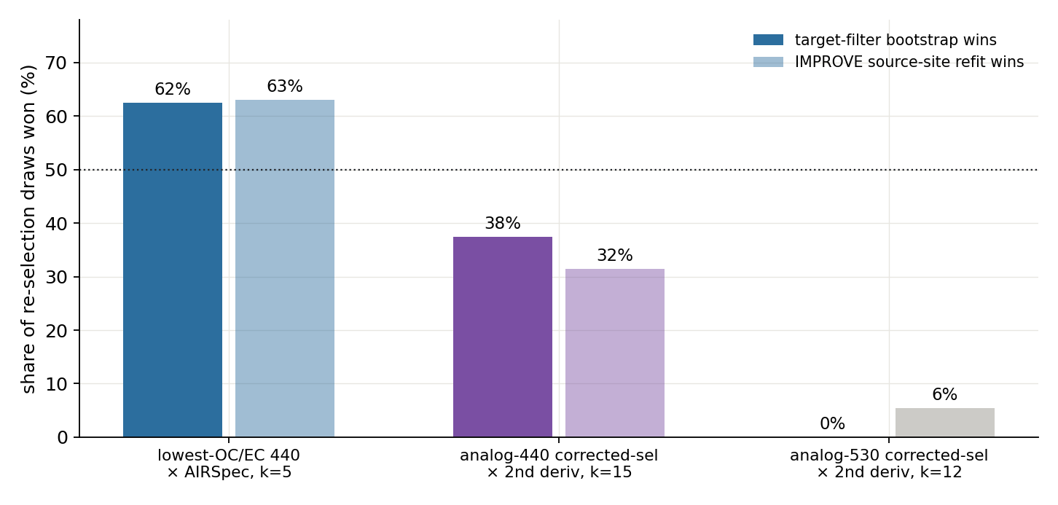
How stable is the winner? Chosen in 62.5% of re-selection draws, not all of them

Slide 24
Question 1: what is good enough?
Is an intercept of -1 µg/m³ acceptable? (deployed today: -4.2)
What slope range counts as usable: 0.9 to 1.1? 0.85 to 1.18?
Is held-out R² of at least 0.85 the right quality floor?
Should the number of calibration samples itself be a constraint
(no cohorts under ~400, whatever the score says)?

Slide 25
Question 2: how should we validate the choice? (the current gap)
Today, ALL Addis samples are used both to pick the winning
configuration and to judge it; the win is partly self-graded.
Proposed validation: split the Addis set into equal halves
(first year vs second year), pick the calibration on one half,
predict the blind other half; equal test sizes keep R² comparable.
Also available: a never-screened IMPROVE lot (253, ~5,000 TOR
filters) as a true independent check.

Slide 26
Question 3: one calibration, or per-site calibrations, and on what grounds?
The cross-application matrix: every city's best fails abroad;
only Addis-to-Bishoftu transfers (0.99x).
A per-site calibration helps exactly where it is hardest to defend:
among 19,000 configurations there is always a flattering one.
Middle ground: one calibration per REGION or aerosol regime
(the Ethiopian pair coheres), chosen under pre-agreed constraints?

Slide 27
Question 4: is spectral similarity more defensible than OC/EC similarity?
Addis OC/EC barely overlaps the IMPROVE pool; selecting on OC/EC
means selecting the pool's thin extreme tail.
Selecting on baseline-corrected spectral shape selects on what the
model actually sees; and it is the re-selection runner-up (~1/3).
The common thread, pre-computed: the top 20 configurations at Addis
are ALL lowest-OC/EC (17 baseline-corrected, 3 second-derivative;
cutoffs 440-800, k mostly 6-9); not unrelated calibrations.
External constraints not yet used: the co-located sun photometer
(AERONET) as an independent absorption check.

Slide 28
Backup

Slide 29
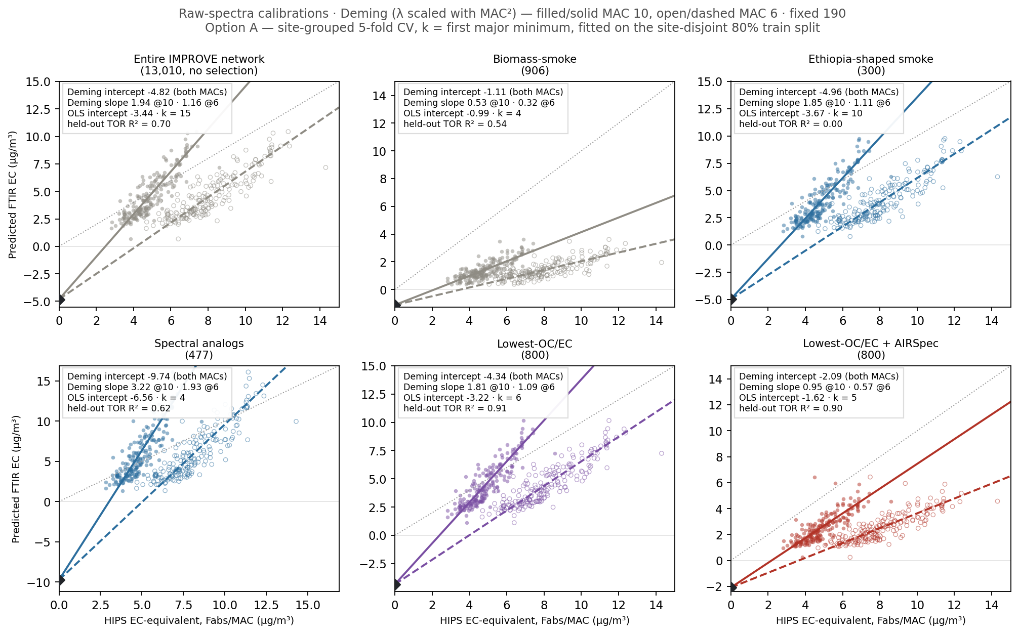
Backup: the six calibration sets on raw spectra; no selection fixes raw

Slide 30
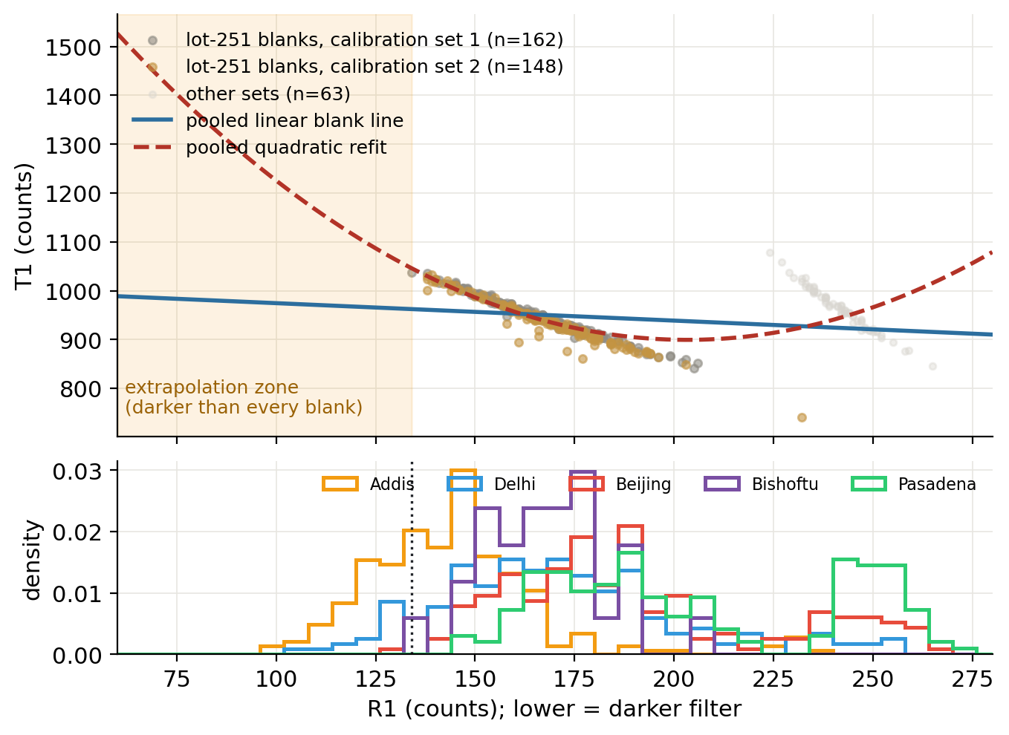
Backup: the HIPS correction is a regression through blanks; heavy filters sit beyond it

Slide 31
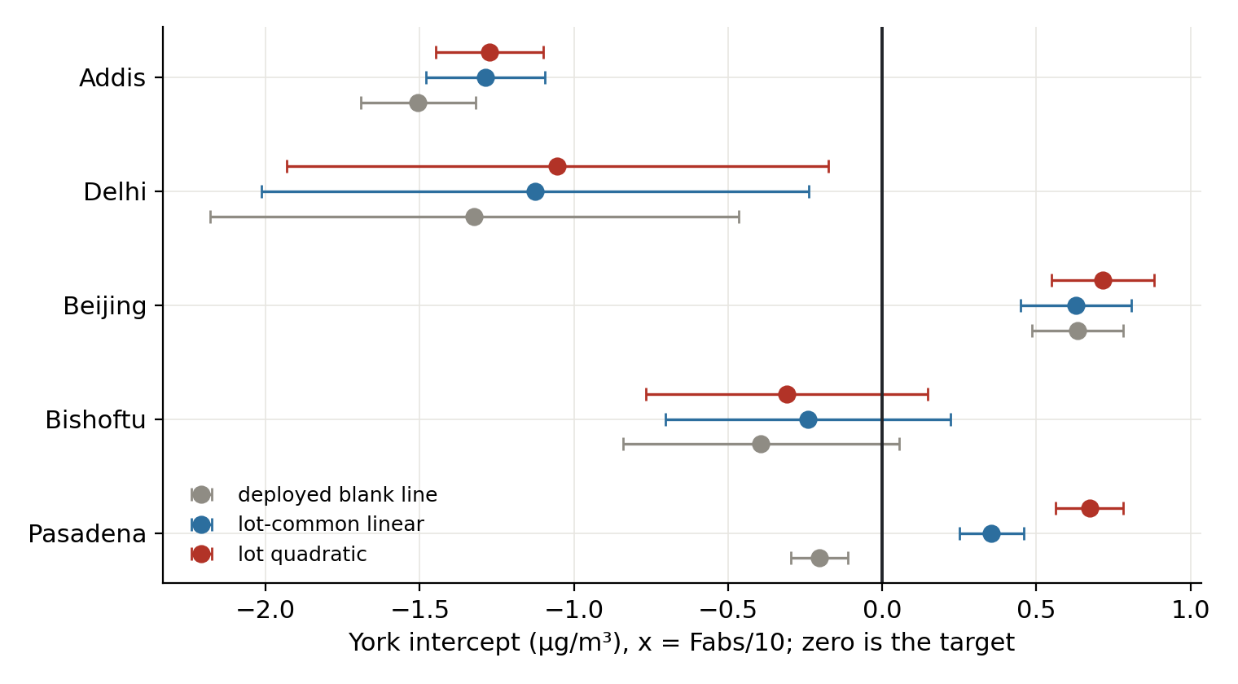
Backup: an errors-in-both-variables refit with per-filter uncertainties (York) confirms the intercepts

Slide 32
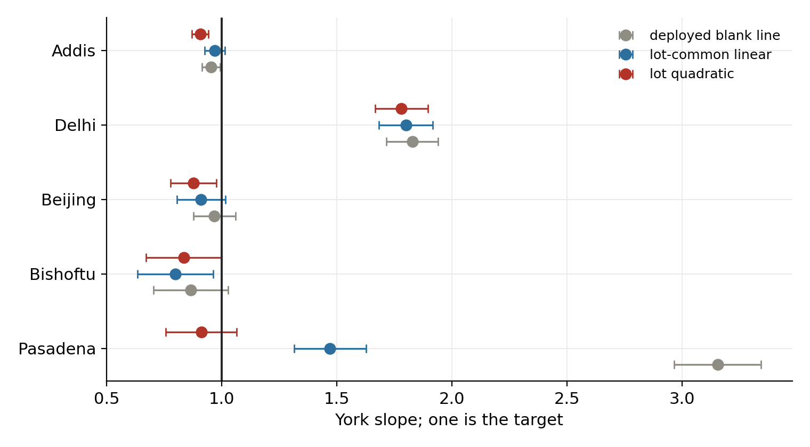
Backup: the same refit for slopes; Pasadena's anomaly was the blank line, Delhi's is real

Slide 33
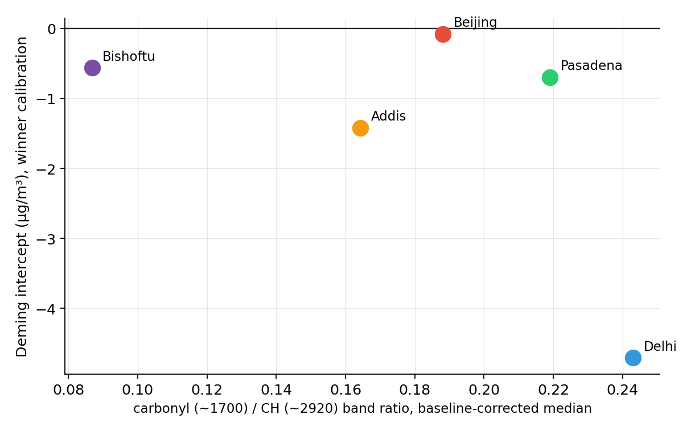
Backup: carbonyl band strength vs each city's intercept (µg/m³)

Slide 34
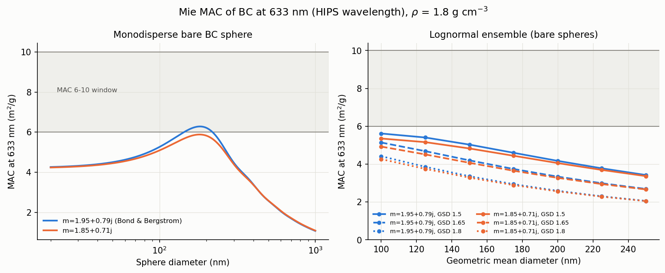
Backup: Mie theory grounds the MAC fork; bare BC tops out near 6

Slide 35
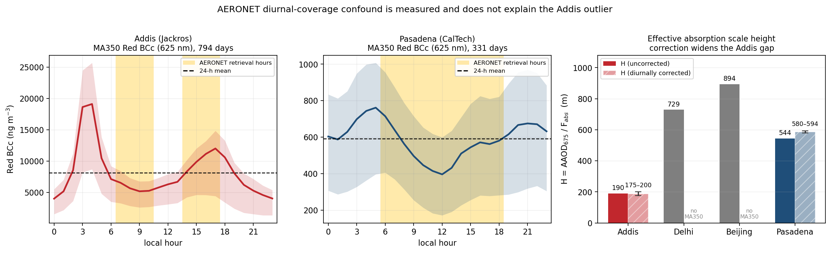
Backup: the sun-photometer cross-check; the Addis anomaly widens after the diurnal correction

Slide 36
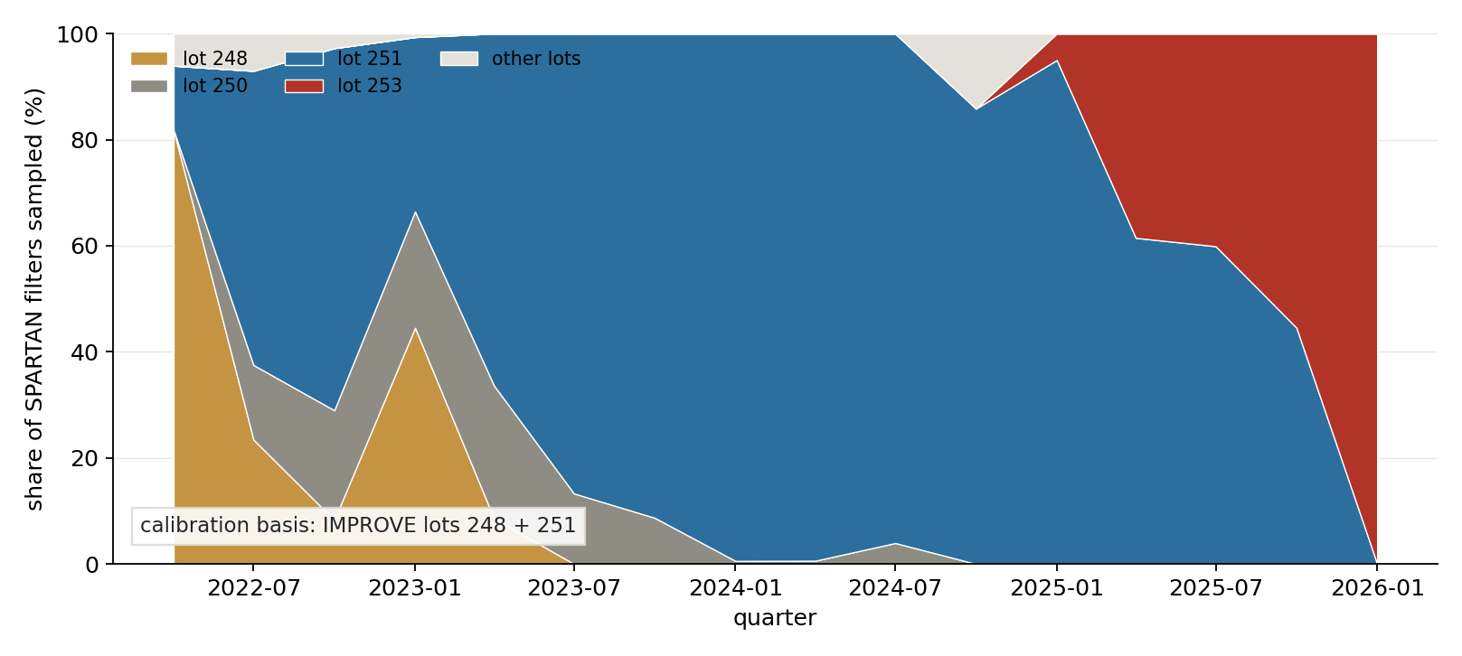
Backup: SPARTAN has moved to a lot the calibration has never seen

Slide 37
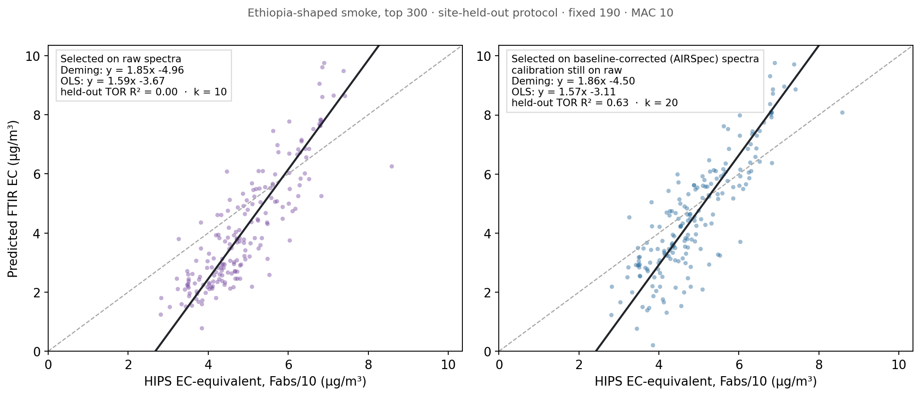
Backup: the Ethiopia-shaped rescue: nearly the same filters, held-out TOR 0.00 to 0.63

Slide 38
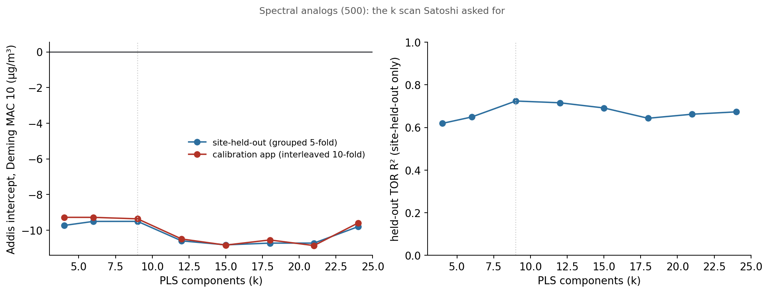
Backup: using 21 components instead of 9 does not fix the analogs

Slide 39
Backup: the two lab measurements that settle the remainder
Quartz TOR EC on collocated Addis filters: the only measurement that
is a function of neither axis (campaign one-pager written)
Solvent extraction + HIPS re-measurement on archived Addis and Delhi
filters, Beijing/Pasadena as controls: separates real absorbers
from any residual filter artifact

